Slide 1
1-Year Outcomes Following Real- world Transcatheter Aortic Valve Implantation with a Self- Expanding Repositionable Valve: Results from the FORWARD Study
Eberhard Grube, MD, FACC, FSCAI for the FORWARD Study Investigators

Slide 2
Potential conflicts of interest
I do not have any potential conflict of interest
X I have the following potential conflicts of interest to report:
Consultant: Medtronic, Boston Scientific, Liva Nova, Abbott ,
Millipede,
Stockholder of a healthcare company: Valve Medical, Valtech, Claret, Shockwave
Other(s): Paid proctor for Medtronic and Boston Scientific
6

Slide 3
Evolut R FORWARD Study
Background
Patients with symptomatic aortic stenosis at elevated surgical risk are referred for transcatheter aortic valve implantation (TAVI) instead of surgical replacement.
Multidisciplinary Heart Teams use the latest guideline recommendations for
centralized decision making on patient eligibility for TAVI.
TAVI technologies vary and clinical evaluation in real-world practice provides important information.
The Evolut R FORWARD Study included over 1000 patients, selected based on advanced age and Heart Team assessment, undergoing non- urgent TAVI at 53 investigational sites in 20 countries.
We previously reported low 30-day mortality of 1.9% and a low incidence of disabling stroke (1.7%). Here we report continued follow-up at 1 year.
6

Slide 4
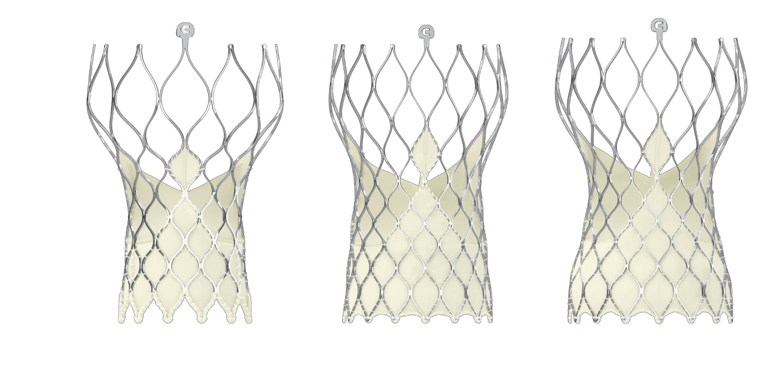
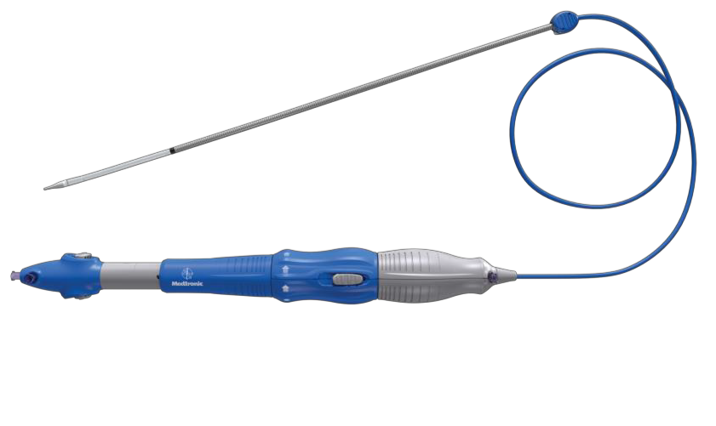
Evolut R FORWARD Study
Study devices
Catheter Delivery System
14Fr-equivalent profile
Transcatheter Valve (23, 26, 29 mm)
Supra-annular design, excellent
hemodynamics
The Evolut R TAV is a supra-annular porcine valve in a self-expanding Nitinol frame that can be resheathed or fully recaptured to assist with accurate valve positioning.
6

Slide 5
Evolut R FORWARD Study
Patients
EXCLUSION
INCLUSION
Symptomatic native aortic valve stenosis or surgical bioprosthetic valve failure
Acceptable candidate for elective treatment with the Evolut R System in conformity with the local regulatory context
Age ≥80 years OR considered to be at high or greater risk for surgical aortic valve replacement (AVR) where high risk is defined as:
  STS predicted risk of mortality ≥8%
  OR
  Heart team agreement of risk for AVR due to frailty or comorbidities.
Contraindication to aspirin, heparin, bivalirudin, ticlopidine, clopidogrel, Nitinol, contrast media
Mechanical heart valve in aortic position
Sepsis, including active endocarditis
Anatomically unsuitable for the
Evolut R system
Estimated life expectancy <1 year
Participating in another trial that may
influence the outcome of this trial
Need for emergency surgery for any reason
6

Slide 6
Evolut R FORWARD Study
Study methods
FORWARD is a post-market approval study of the Evolut R
transcatheter aortic valve in routine practice.
Multi-slice computed tomography of the peripheral vasculature and aortic annulus was required.
100% monitoring of patient consent and endpoint-related events
Standard hospital practice techniques at implant and during follow-up (discharge, 30 days, and annually through 3 years).
Modified Rankin Score at baseline and at each follow-up by certified assessor
– Performed at 90 days after suspected neurological event
Independent Clinical Events Committee adjudicated safety endpoints per VARC-2*.
Independent Echocardiographic Core Laboratory (Mayo Clinic,
Rochester, MN, USA)
*Kappetein AP, et al. Eur Heart J 2012; 33, 2403–18.
6

Slide 7






Evolut R FORWARD Study
Patient flow
Enrolled N=1060
Inclusion/Exclusion criteria not met: 6
Death: 1
Withdrew: 4
Other: 9
Attempted Implant N=1040*
Death: 25
Withdrew: 2
Other: 0
30-Day Follow-up
N= 1002/1011 (98.9%)
Death: 72
Withdrew: 14 Other:19
1-Year Follow-up N= 876/908 (96.5%)
*Since our initial report in 1038 patients, consent was lost for 1 patient and in 3 patients, consent was validated, therefore we are now reporting on 1040 patients.
7

Slide 8
Evolut R FORWARD Study
Baseline characteristics
Mean ± standard deviation or % | N=1040
Age, years | 81.8 ± 6.2
Female sex | 64.8
STS-PROM, % | 5.5 ± 4.5
EuroSCORE II, % | 5.7 ± 5.0
New York Heart Association class III/IV | 72.0
Diabetes mellitus | 29.6
Serum creatinine >2 mg/dL | 5.6
Chronic lung disease/chronic obstructive pulmonary disease | 26.3
Frailty | 34.2
Assisted living | 15.3
Pacemaker or implanted cardioverter defibrillator | 12.2
8

Slide 9
Evolut R FORWARD Study
Procedural characteristics
% | Evolut R N=1040
Local anaesthesia | 65.1
Iliofemoral access route | 98.0
Implanted valve size
23 mm | 6.0
26 mm | 36.5
29 mm | 57.4
Pre-TAVI balloon dilation performed | 45.8
Post-implant dilation performed | 33.4
Patients with resheathing or recapture performed | 25.8
EnVeo R InLine sheath used | 88.6
Multiple valves (≥ 2 implanted) | 1.0
Failed bioprosthetic valve | 4.8
8

Slide 10
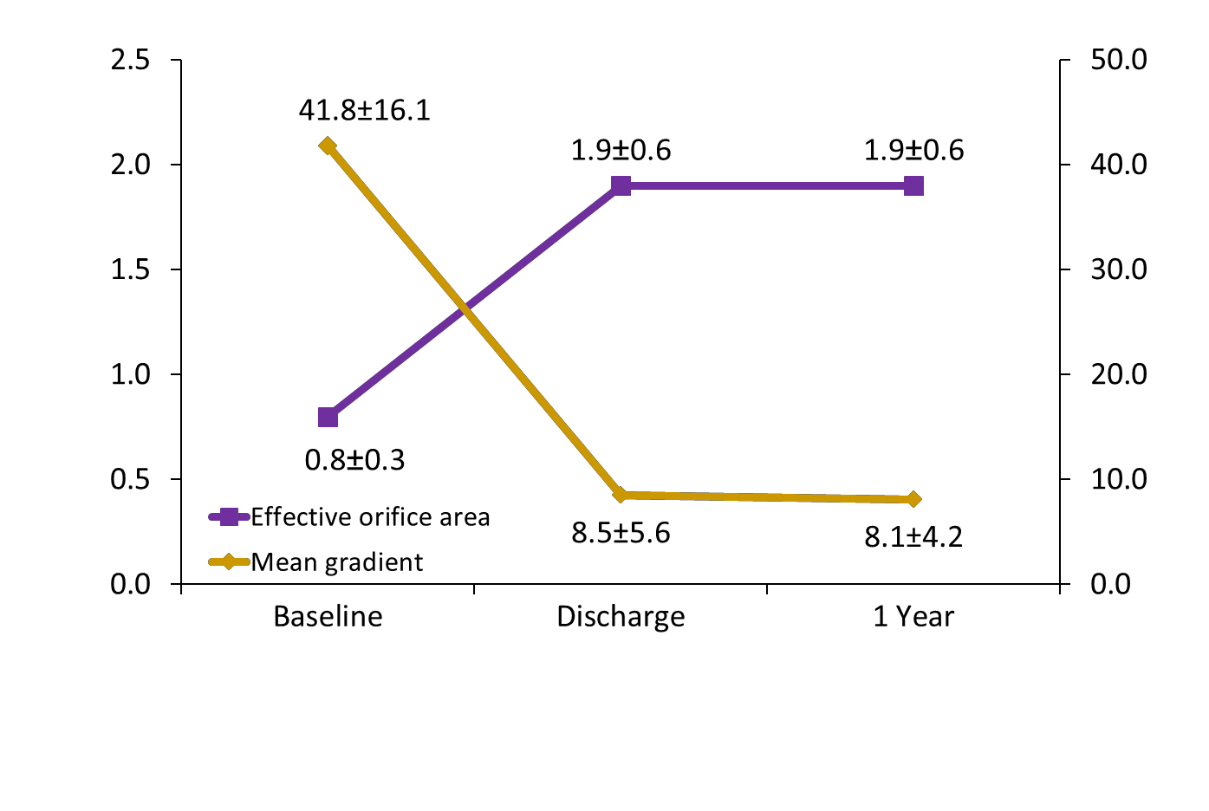
Evolut R FORWARD Study
Hemodynamics to 1 year for all patients
Effective orifice area (cm²)
Mean AV gradient (mm Hg)
Gradient | 915 | 868 | 635
Effective orifice area | 631 | 541 | 454
Per independent core laboratory assessment.

Slide 11
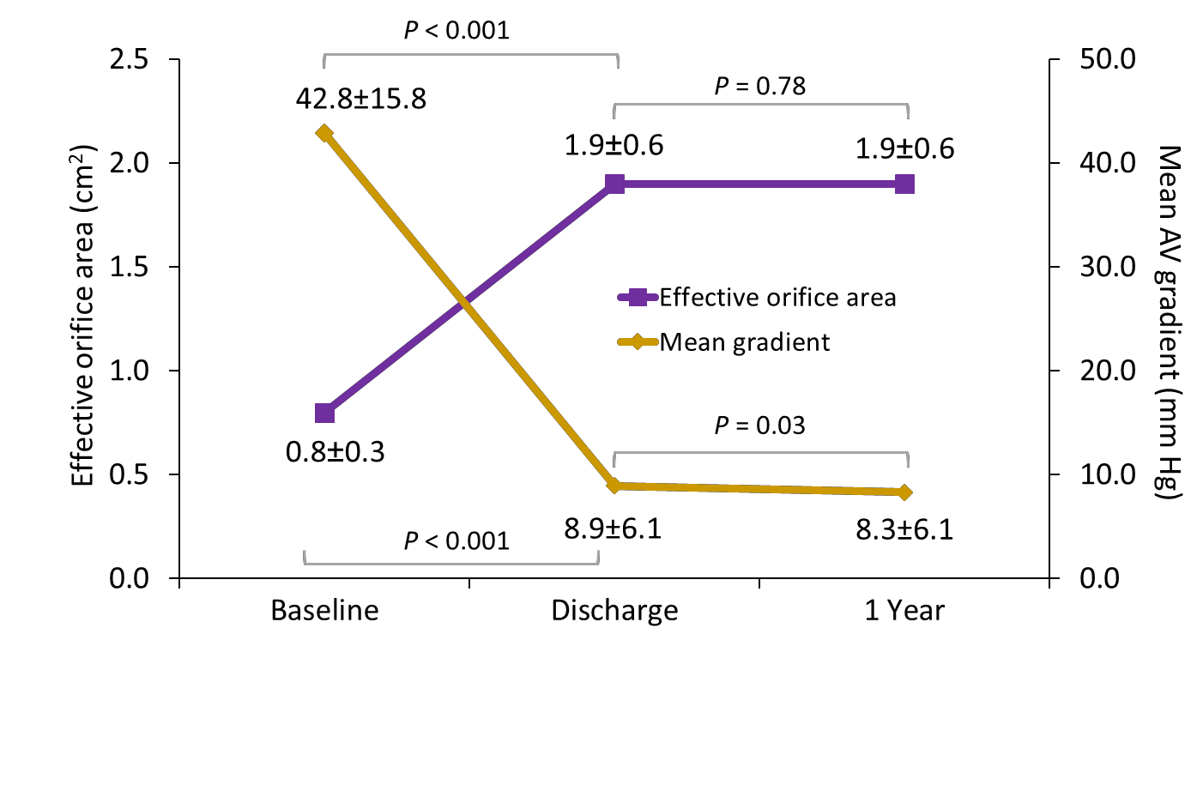
Evolut R FORWARD Study
Hemodynamics to 1 year for paired data
Gradient | 521 | 521 | 521
Effective orifice area | 238 | 238 | 238
Per independent core laboratory assessment.

Slide 12
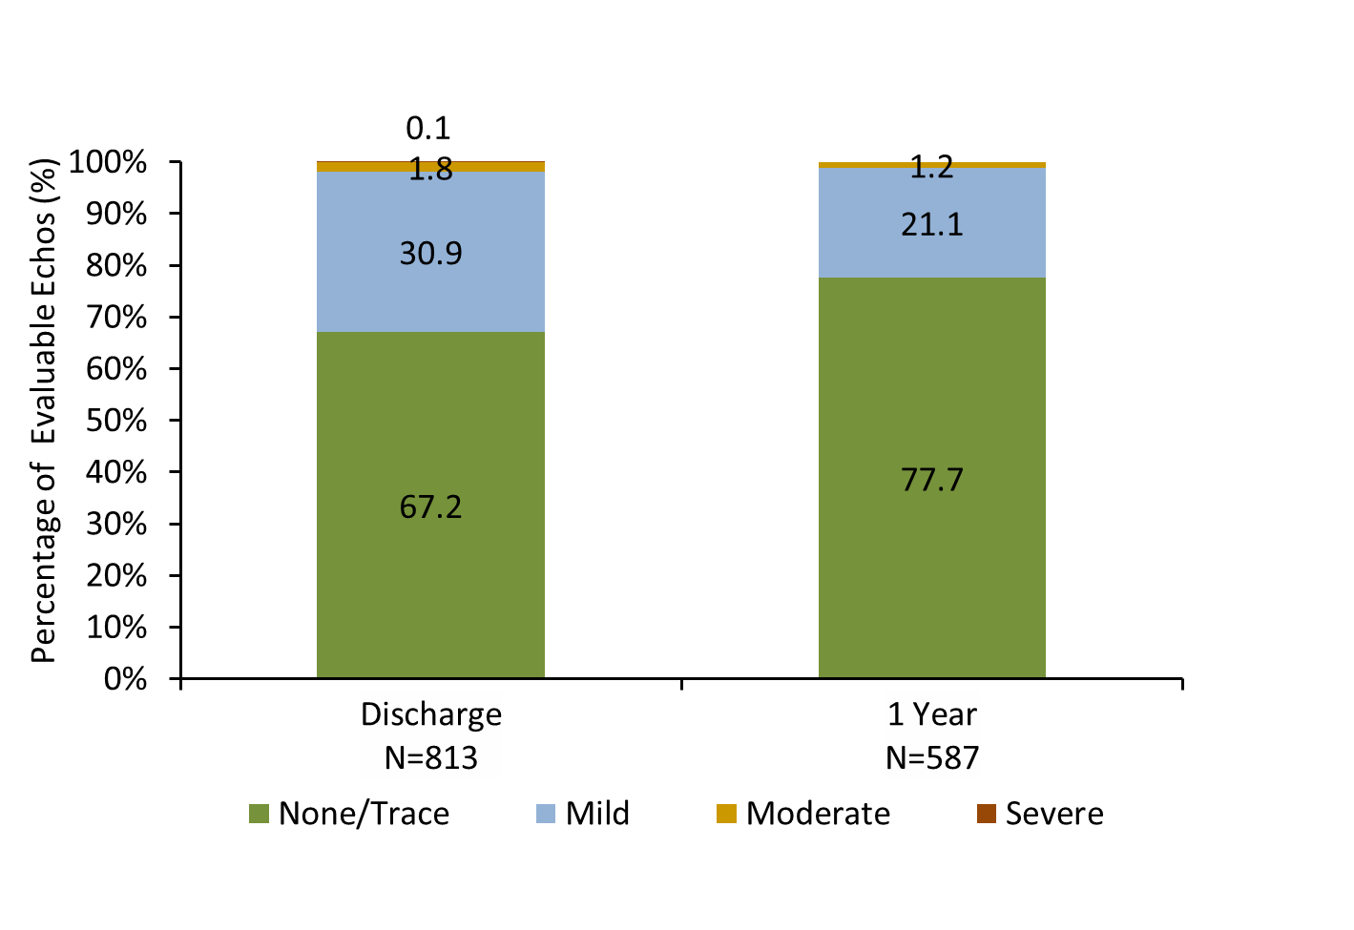
Evolut R FORWARD Study
Paravalvular leak at 1 year for all
patients
Per independent core laboratory assessment.

Slide 13
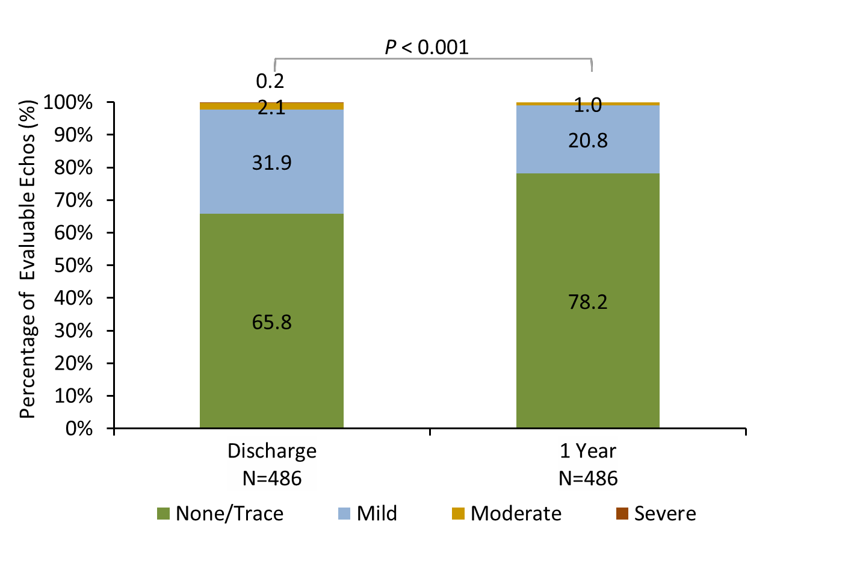
Evolut R FORWARD Study
Paravalvular leak at 1 year for paired data
Per independent core laboratory assessment.

Slide 14
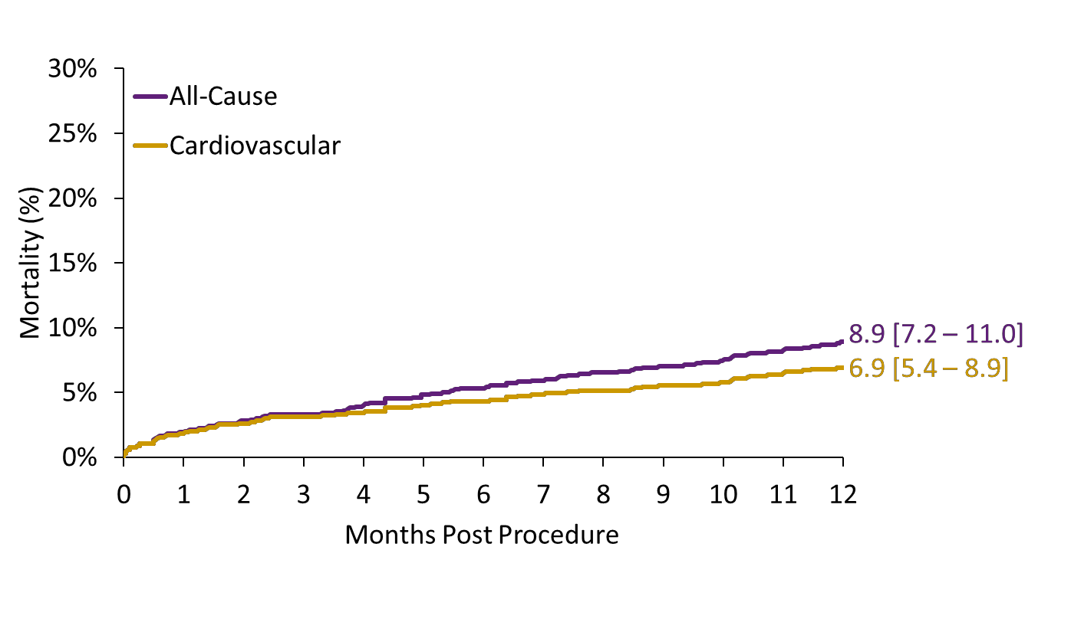
Evolut R FORWARD Study
All-cause and cardiovascular mortality to 1 year
No. at Risk | 1040 | 1012 | 787

Slide 15
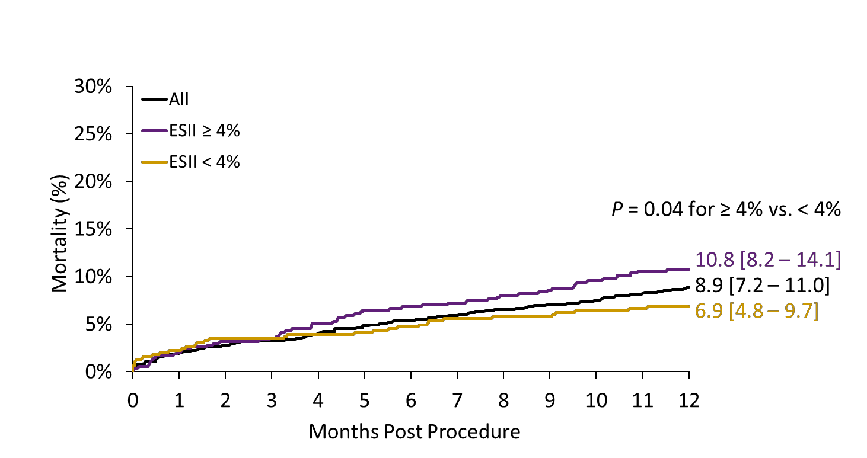
Evolut R FORWARD Study
Mortality stratified by EuroSCORE II to 1 year
No. at Risk
All | 1040 | 1012 | 787
ESII ≥ 4% | 545 | 530 | 392
ESII <4% | 495 | 482 | 395

Slide 16
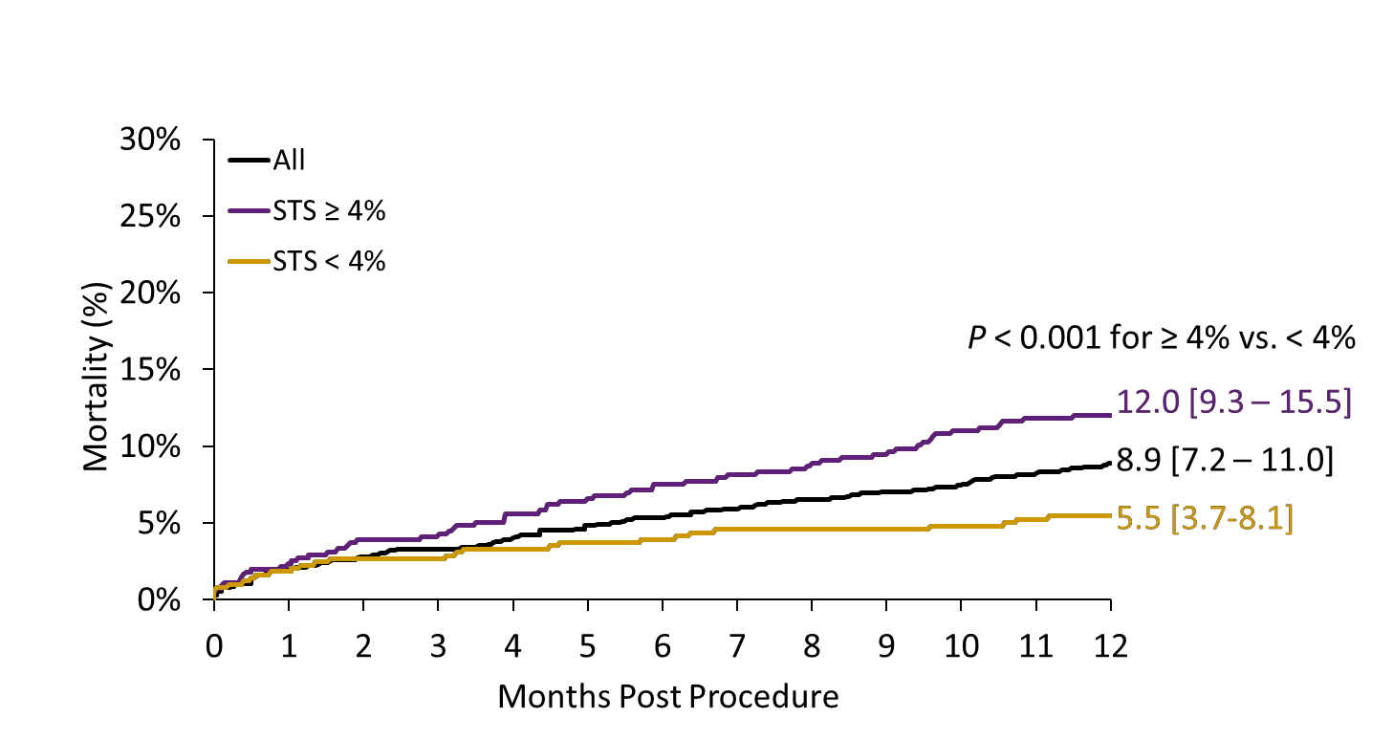
Evolut R FORWARD Study
Mortality stratified by STS score to 1 year
No. at Risk
All | 1040 | 1012 | 787
STS ≥ 4% | 548 | 531 | 382
STS <4% | 492 | 481 | 405

Slide 17
Evolut R FORWARD Study Safety outcomes to 1 year
Kaplan-Meier rate (no.) | 30 Days N=1040 | 1 Year N=1040
All-cause mortality | 1.9 (20) | 8.9 (89)
Cardiovascular mortality | 1.8 (19) | 6.9 (69)
All stroke | 2.8 (29) | 3.4 (35)
Disabling stroke | 1.7 (18) | 2.1 (21)
Valve thrombosis | 0.0 (0) | 0.0 (0.0)
Valve endocarditis | 0.1 (1) | 0.5 (5)
Embolization or migration | 1.0 (10) | 1.0 (10)
Coronary artery obstruction | 0.0 (0) | 0.1 (1)
Pacemaker implanted | 17.8 (184) | 19.7 (202)

Slide 18
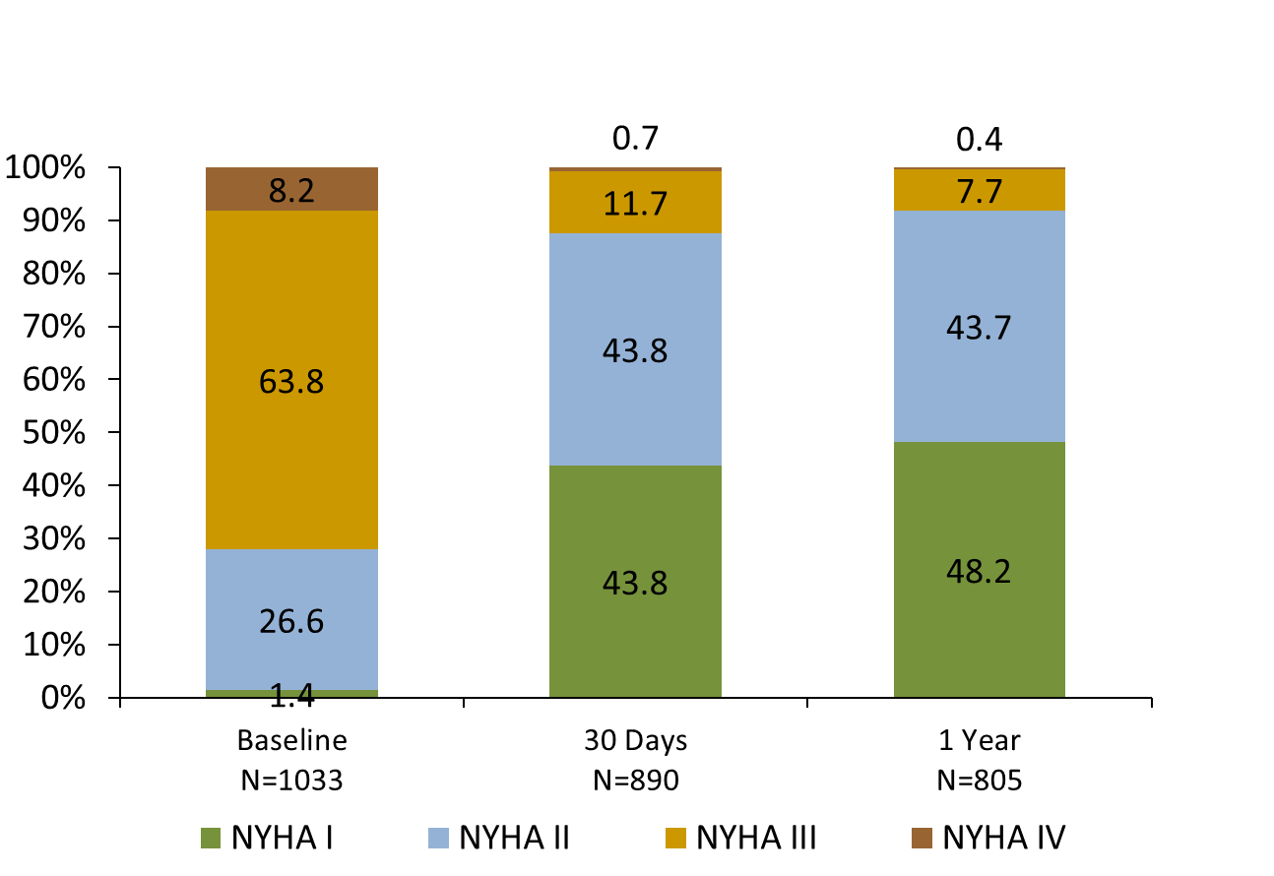
Evolut R FORWARD Study
New York Heart Association class to 1 year
80.5% of patients had improvement in NYHA from baseline to 1
year
Percentage of Patients (%)

Slide 19
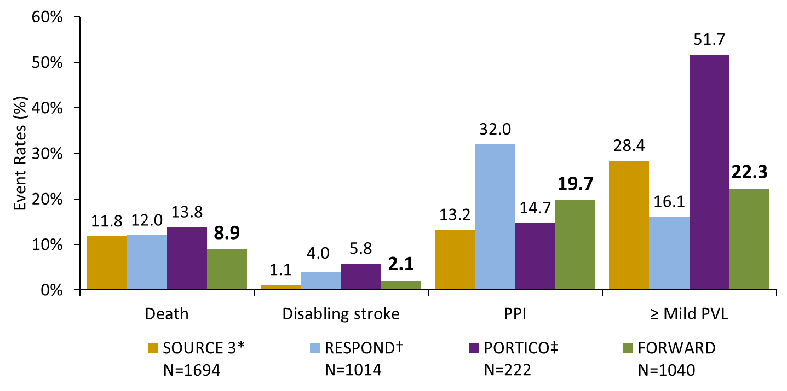
Evolut R FORWARD Study
1-Year outcomes in contemporary valves
*SAPIEN 3 TF patients. Wendler O, et al. Eur Heart J 2017; 38: 2717-26. †Lotus valve. Van Mieghem
NM. Presented at EuroPCR 2017; ‡Linke A, et al. Circ Cardiovasc Interv 2018; 11: e005206.
19

Slide 20
Evolut R FORWARD Study
Summary
At 1 year, the Evolut R R FORWARD Study showed:
  Overall low all-cause mortality of 8.9%
  Stratifying patients by an STS score or EuroSCORE II
≥ 4% resulted in significantly higher mortality
  Low disabling stroke of 2.1%
  98.8% of patients with ≤ mild regurgitation and significant improvement in paired analysis
  Excellent haemodynamics
20

