Slide 1
Acute PE Management: How to Choose your Lytic Strategy
Jay Giri, MD MPH
Assistant Professor of Medicine
Director, Pulmonary Embolism Response Team
Associate Director, Penn Cardiovascular Quality, Outcomes & Evaluative Research Center
Hospital of the University of Pennsylvania

Slide 2
Disclosure
Nothing to Disclose

Slide 3
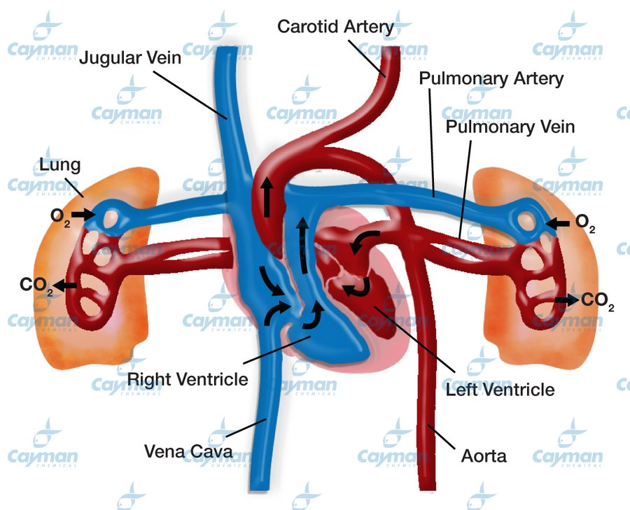
Lungs Receive 100% of Circulation

Slide 4
CDT Claims
Increased Efficacy
Better Safety

Slide 5
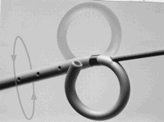
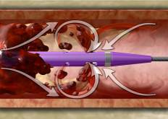
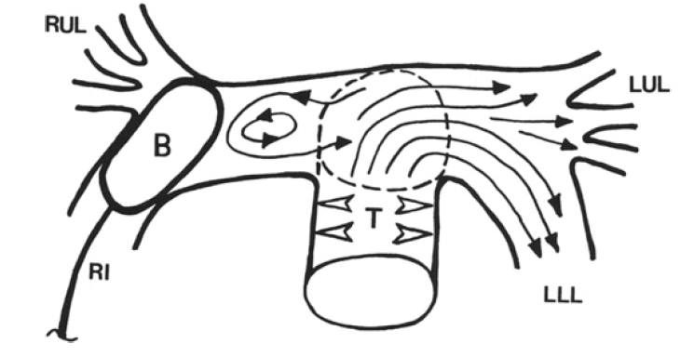
Theoretical Advantages for Local Lytic
Higher local concentration
Lower overall dose
Ability to fragment clot if desired
PA pressure monitoring
Blinc, et al. Thromb Haemost. 1991 May 6;65(5):549-52.
Scmitz-Rode CVIR 1998;21:199-204

Slide 6
Who Knows?
Reduced Dose
Longer Infusion

Slide 7
Increased Efficacy?

Slide 8
CDT Reduces PA Systolic Pressure
p < 0.0001
51.4
p < 0.0001
37.5
36.9
Mean PA Systolic Pressure (mmHg)
Piazza, JACC Intvn, 2015.
Notes:
3/5/14- clean

Slide 9
So Does Systemic Lysis
Jaff MR. et al. Circulation. 2011; 123: 1788-1830

Slide 10
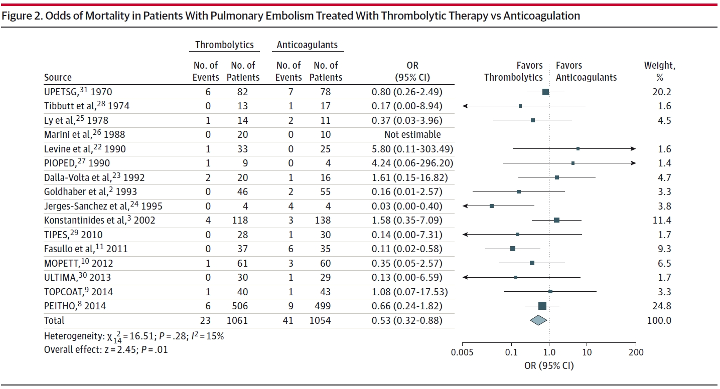
Systemic Lysis a/w Lower Mortality
Chatterjee, et al. JAMA 2014

Slide 11
Catheter-Directed Lysis
No Data

Slide 12
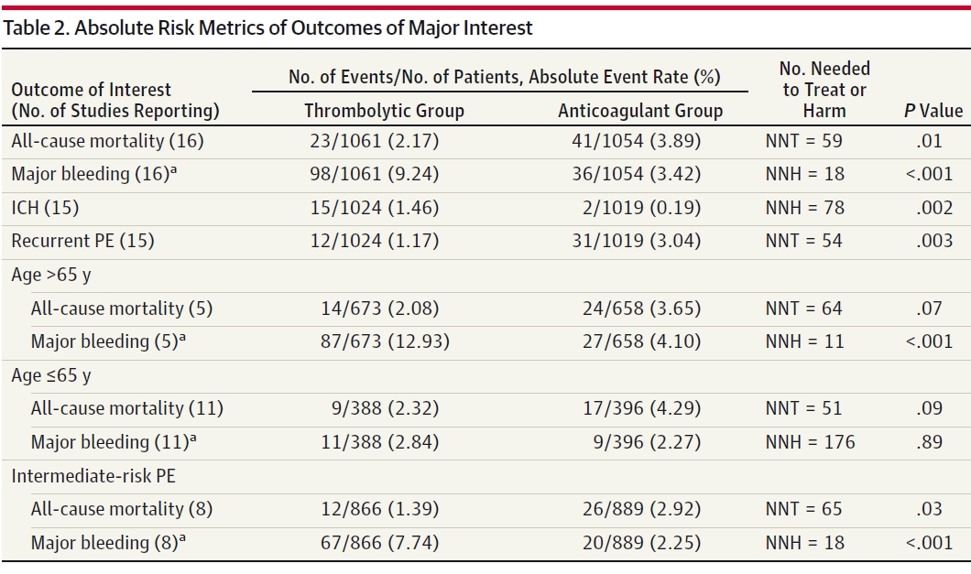
Chatterjee, et al. JAMA 2014

Slide 13
Better Safety?
Decrease Overall Bleeding Complications?
Decrease ICH rates?

Slide 14
All Studies – Major Bleeding Comparison
 | Non-ICH Major Bleed | No Bleeding
Catheter-Directed Lysis | 16 | 164
Systemic Lysis | 83 | 948
P = 0.66
Chatterjee, et al. JAMA 2014.
Kucher, et al. Circulation 2014.
Piazza, et al. JACC Intvn. 2015.

Slide 15
Is this news for intracranial hemorrhage?
Study | Intracranial Hemorrhage (Fibrinolysis Group)
ICOPER (Goldhaber SZ, et al. 1999) | 9/304 (3%)
PEITHO (Meyer G, et al. 2014) | 10/506 (2%)
JAMA SRMA (Chatterjee, et al. 2014) | 15/1024 (1.46%)
SEATTLE II (Piazza G, et al. 2014) | 0/150 (0%)
Notes:
Study limitations include lack of control arm, lack of clinical outcomes, unclear use of CT size (instead of echo derived and the 1.55 RV/LV ratio seems very high), mixture of echo and CT outcomes

Slide 16
All Studies – ICH Comparison
 | ICH | No ICH
Catheter-Directed Lysis | 0 | 180
Systemic Lysis | 15 | 1009
P = 0.15
Chatterjee, et al. JAMA 2014.
Kucher, et al. Circulation 2014.
Piazza, et al. JACC Intvn. 2015.

Slide 17
Incentives
EKOS catheter = $3,000 list price
Most cases – 2 catheters = $6,000
Estimated 300,000 PE hospitalizations
40% intermediate/high-risk
120,000 potential cases
US market: $720M

Slide 18
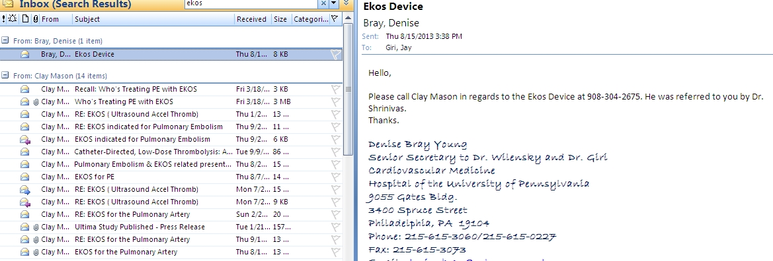
Marketing

Slide 19
Interventional Physician Incentives
Procedure | CPT code | Work RVU - Unilateral | Work RVU - Bilateral
US guided access | 76937 | 0.3 | 0.6
Main PA cath placement | 36013 | 2.52 | 2.52
PA gram | 75743 | 1.33 | 1.66
Selective PA Placement | 36015 | 3.5 | 5.25
Infusion | 37211 | 8 | 12
Cessation | 37214 | 2.74 | 4.11
Total |  | 18.39 | 26.14
Bilateral PE CDT : 26.14 RVU
LHC + PCI : 15.96 RVU
TF TAVR : 15.7 RVU (per operator)
1 hour critical care time: 4.5 RVU

Slide 20
CDT Trade-Offs
Pros
Cons
Lower Dose
Can halt infusion in response to complication or hemodyamic improvement
Less off-target exposure (theoretical)
Better Clot Penetration (theoretical)¹
Longer Infusion
Technical Expertise
Resource Intensive
Deep Vein Access (not absolutely required)
¹Blinc, et al. Thromb Haemost. 1991 May 6;65(5):549-52.

Slide 21
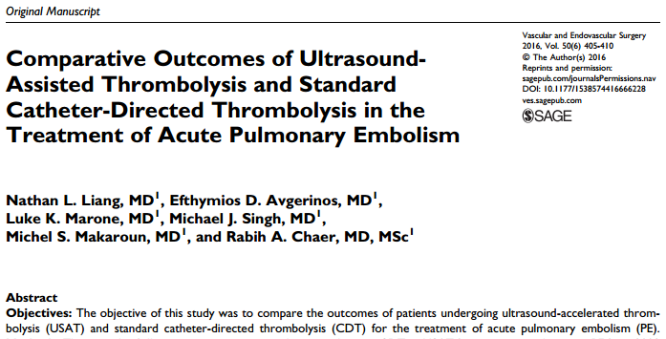
CDT vs. USAT

Slide 22
CDT
I consider this in patients with both multiple features of poor prognosis (intermediate-high risk) and relative bleeding risks
Age > 65
Recent trauma
Recent surgery
History of stroke
Hematologic Abnormalities

Slide 23
BP less than 90 or on pressors?
No
Signs of submassive PE?
- + Troponin
- RV dysfxn
Yes
Yes
No
Submassive PE
Minor PE
Thrombus in transit?
Massive PE
Yes
No
Anticoagulation
Assess bleeding risk
Percutaneous
thrombectomy
and anticoagulation
Risk stratify submassive PE
PESI
- RV (TAPSE)
- Overall cardiopulmonary reserve
- HR/BP
- Objective vitals with exertion
Low
Elevated
High
Systemic Lytics
Assess surgical risk
Assess Surgical Risk
High
Lower
Low-Intermediate
Higher
Prohibitive
Elevated
Low
Anticoag +/- perc thrombectomy
Open Ebolectomy
Assess bleeding risk
Anticoagulation
Catheter Directed
Lytics
Open Embolectomy vs. CDT
Open Ebolectomy
Low
Elevated
Prohibitive
Age
Anticoagulation
< 65
> 65
Consider perc thrombectomy
if clot-in-transit
Systemic lytics
Catheter directed lytics
Notes:
Given high NNT and high bleeding risk, our approach is a conservative one. How to prevent submassive PE from progressing to massive PE cuasing hemodynamic collapse and death.
PE severity index

Slide 24
Thank You
Penn Pulmonary Embolism Response Team
Akaya Smith
Jeremy Mazurek
Barry Fuchs
Prashanth Vallabhajosyula
Nimesh Desai
Deepak Sudheendra
PE Research Collaborators
Saurav Chatterjee
Ido Weinberg
Geoffrey Barnes,
Chris Kabhrel
Bram Geller
Srinath Adusumalli

Slide 25
Who to Lyse?
If under 65 with multiple high-risk features, lytics will:
Improve hemodynamics/echo findings faster
Improve symptoms faster
Possibly decrease acute mortality modestly
? Decrease chance of CTEPH

Slide 26
How to Decide?
If any risks of bleeding, be conservative
Recent surgery/trauma
Any history of stroke/ICH
Recent bleeds or hematologic abnormalities
If no significant risks of bleeding, assess the following:
RV (TAPSE)
Overall cardiopulmonary reserve
HR/BP
Objective vitals with exertion

