Slide 1
Edoxaban for 3 months versus 12 months in cancer patients with isolated distal deep vein thrombosis: ONCO DVT Study
Yugo Yamashita
Department of Cardiovascular Medicine, Graduate School of Medicine, Kyoto University
HOT LINE 9; 28 August 2023; 16:50-

Slide 2
Declaration of interest
Research contracts : Funding was provided by Daiichi Sankyo Company, Limited, which had no role in the study design, data collection, analysis, interpretation, or writing of the report.
Others : Dr. Yamashita received lecture fees from Bayer Healthcare, Bristol-Myers Squibb, Pfizer, and Daiichi Sankyo, and grant support from Bayer Healthcare and Daiichi Sankyo.
• •
ESC Congress 2023
Amsterdam & Online

Slide 3
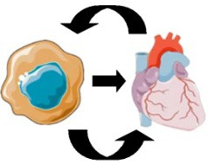
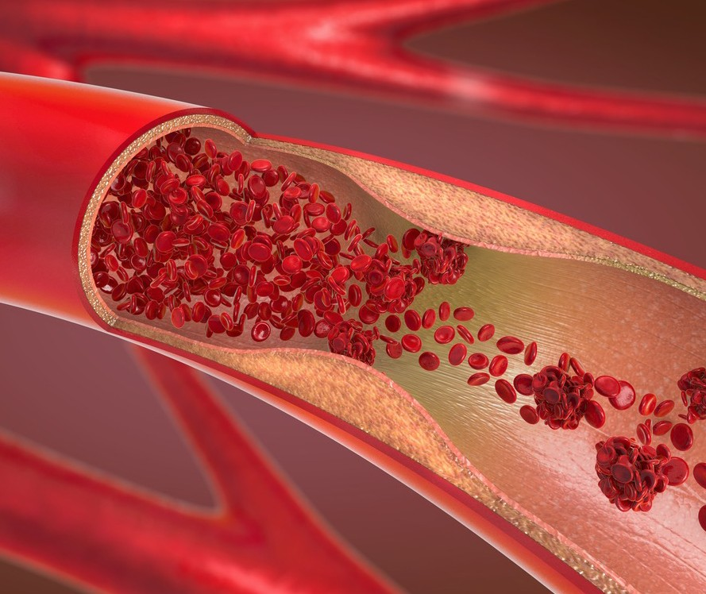
Background
Cancer patients: Surviving longer
---> Cardiovascular complications ↑↑: cardio-oncology.
(Eur Heart J. 2022;43:4229-4361.)
Venous thromboembolism (VTE): Risk of recurrence.
---> Can be prevented by anticoagulation therapy.
(Lancet. 2010;376:2032-9.)
Isolated distal deep vein thrombosis (DVT): Common
---> More benign or not than a proximal DVT?
(Thromb Res. 2014;134:36-40. J Vasc Surg. 2012;55:550-61.)

Slide 4
Background
Guidelines recommendations for isolated distal DVT (ACCP/CHEST )
---> Anticoagulation of prolonged duration for cancer patients
(Weak recommendation, Low-certainty evidence)
(Chest. 2021;160:e545-e608.)
Previous RCTs for distal DVT (CACTUS [2016], RIDTS [2022])
---> Excluded patients with active cancer
(Lancet Haematol. 2016;3:e556-e562. BMJ. 2022;379:e072623.)
No RCT for optimal duration of anticoagulation therapy for cancer patients

Slide 5
Purpose of the ONCO DVT study
To compare 12-month edoxaban treatment with 3-month edoxaban treatment in cancer patients with isolated distal DVT in a randomized clinical trial.
ONCO DVT Study: NCT03895502
(Optimal duration of anticoagulation therapy for isolated distal deep vein thrombosis in patients with cancer study)

Slide 6
Study design: ONCO DVT study
(A multicenter, open-label, adjudicator-blinded, randomized clinical trial)
Patients with active cancer who were newly diagnosed with isolated distal DVT confirmed by ultrasonography were eligible for inclusion.
3 months
(61-119 days)
12 months
12-month edoxaban
Diagnosis
Edoxaban
R
(Administered orally at 60 mg/day and at 30 mg/day based on reduced dose criteria)
Primary endpoint intention-to-treat analysis
(Symptomatic recurrent VTE/VTE-related death)
Edoxaban
3-month edoxaban

Slide 7
Inclusion and Exclusion Criteria
Key Inclusion Criteria
A new diagnosis of DVT objectively confirmed by ultrasonography
With active cancer at randomization
Scheduled for DVT treatment with anticoagulation therapy
Key Exclusion Criteria
Already on anticoagulation therapy at the time of the diagnosis
With pulmonary embolism
Expected to have a life prognosis of 3 months or less

Slide 8
Endpoints
Primary endpoint (ITT analysis)
Symptomatic recurrent VTE or VTE-related death at 12 months
Major secondary endpoint (ITT analysis)
A major bleeding event (ISTH criteria definition) at 12 months

Slide 9
Sample Size Calculation
Hypothesis: Superiority of 12-month to 3-month edoxaban for the primary endpoint at 12 months
Assumption: Event rate at 12-month: 6% (12-month group)
13% (3-month group)
Randomization ratio: 1:1
Power: 80%
Two-sided alpha: 0.05
Sample size: 550 patients (275 in each arm)
Considering the potential dropouts: 600 patients

Slide 10
60 participating centers
Kyoto University Hospital
Osaka International Cancer Institute Saiseikai Noe Hospital
Osaka Red Cross Hospital Japanese Red Cross Otsu Hospital
Kakogawa Central City Clinics Cancer Institute Hospital
Kansai Medical University Medical Center
Kyoto Prefectural University of Medicine Kyorin University Faculty of Medicine Kindai University Hospital
Kumamoto University Hospital
Kurashiki Central Hospital Kurume University Hospital Kuwana City Medical Center Gunma University
Kobe City Medical Center General Hospital Kobe University Hospital
Kohka Public Hospital
Fukushima Medical University Hospital Kokura Memorial Hospital
National Cancer Center Hospital NHO Okayama Medical Center NHO Kyoto Medical Center
Saiseikai Yokohamashi Nanbu Hospital Saiseikai Wakayama Hospital
Saku Central Hospital Advanced Care Center Shiga General Hospital
Shizuoka Cancer Center
Shizuoka City Shizuoka Hospital Shimane University Hospital Shimada General Medical Center
St. Marianna University School of Medicine Medical Research Institute Kitano Hospital
University of Tsukuba Hospital Tenri Hospital
Tokyo Women’s Medical University Hospital Tokyo Metropolitan Tama Medical Center Toho University Ohashi Medical Center Toho University Omori Medical Center
Tohoku University Hospital Nagasaki University Hospital Nara Medical University Hospital Nippon Medical School Hospital
Japanese Red Cross Wakayama Medical Center Hyogo Prefectural Amagasaki General Medical Center
Hirakata Kohsai Hospital
Fukui Prefectural Hospital Saiseikai Yahata General Hospital Fujisawa City Hospital Makiminato Central Hospital
Mie University Hospital Mitsubishi Kyoto Hospital
Japanese Red Cross Musashino Hospital Yokohama Minami Kyousai Hospital Yokohama Rosai Hospital
Rakuwakai Otowa Hospital
Niigata University Graduate School of Medicine and Dentistry Niigata Cancer Center Niigata Hospital
Hyogo College of Medicine
with collaboration of
cardiologists and oncologists

Slide 11
Study Flow
605 patients with active cancer who were newly diagnosed with isolated distal DVT
between April 2019 and June 2022 at 60 institutions in Japan
1 withdrew consent
604 underwent randomization
12-month edoxaban group
298 patients
3-month edoxaban group
306 patients
2 withdrew consent
1 withdrew consent
296 were included in the intention-to-treat analysis
ITT population
601 patients
305 were included in the intention-to-treat analysis
At 12 months
7 loss to follow-up (2.4%)
4 loss to follow-up (1.3%)

Slide 12
Clinical characteristics at baseline
Variables, No. (%) | 12-month edoxaban (N=296) | 3-month edoxaban (N=305)
Age, years (Mean±SD) | 71.6±9.4 | 70.1±10.3
Male sex | 94 (32) | 73 (24)
Body weight, kg | 56.3±12.1 | 54.8±11.6
Symptoms at baseline | 53 (18) | 69 (23)
Lower dose of edoxaban (30 mg/day) | 216 (73) | 234 (77)
Cancer status
Metastatic disease | 67 (23) | 80 (26)
ECOG performance status
0 | 161 (54) | 150 (49)
1 | 78 (26) | 103 (34)
≥2 | 57 (19) | 52 (17)
History of venous thromboembolism | 20 (6.8) | 13 (4.3)
Creatinine clearance ≤50 mL/min | 69 (23) | 62 (20)
Anemia (Hb <13 g/dL for men and <12 g/dL for women) | 199 (67) | 203 (67)
Platelet count <100,000 per μL | 12 (4.1) | 19 (6.2)

Slide 13
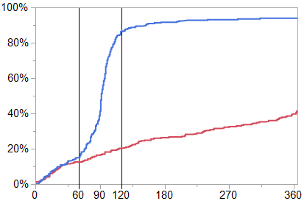
Persistent edoxaban discontinuation
93.9%
86.3%
12-month edoxaban 3-month edoxaban
41.3%
Cumulative incidence
20.6%
Persistent edoxaban discontinuation was defined as a discontinuation of edoxaban according to the study protocol or lasting for more than 14 days for any reason.
Days after diagnosis
N of patients on edoxaban | 0-day | 60-day | 90-day | 120-day | 180-day | 365-day
12-month edoxaban | 296 | 253 | 240 | 224 | 202 | 151
3-month edoxaban | 305 | 255 | 173 | 40 | 23 | 15

Slide 14
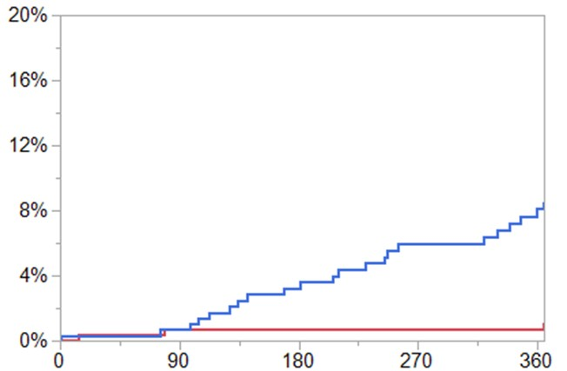
Primary endpoint
(Symptomatic recurrent VTE or VTE-related death)
12-month edoxaban 3-month edoxaban
Cumulative incidence
Log-rank P<0.001
Days after diagnosis
N of patients at risk | 0-day | 60-day | 90-day
12-month edoxaban | 296 | 283 | 274
3-month edoxaban | 305 | 289 | 280
120-day 180-day 365-day
269 253 222
275 256 210

Slide 15
Primary endpoint
(Symptomatic recurrent VTE or VTE-related death)
12-month edoxaban 3-month edoxaban
Log-rank P<0.001
Cumulative incidence
Odds ratio: 0.13 (95%CI: 0.03-0.44)
8.5%
1.2%
Days after diagnosis
N of patients at risk | 0-day | 60-day | 90-day | 120-day | 180-day | 365-day
12-month edoxaban | 296 | 283 | 274 | 269 | 253 | 222
3-month edoxaban | 305 | 289 | 280 | 275 | 256 | 210

Slide 16
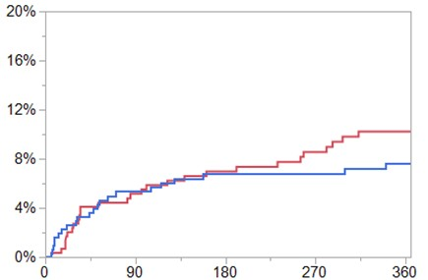
Major secondary endpoint (Major bleeding)
12-month edoxaban 3-month edoxaban
Odds ratio: 1.34 (95% CI: 0.75-2.41)
10.2%
7.6%
Cumulative incidence
Days after diagnosis
N of patients at risk | 0-day | 60-day | 90-day | 120-day | 180-day | 365-day
12-month edoxaban | 296 | 273 | 267 | 261 | 245 | 210
3-month edoxaban | 305 | 279 | 271 | 264 | 250 | 217

Slide 17
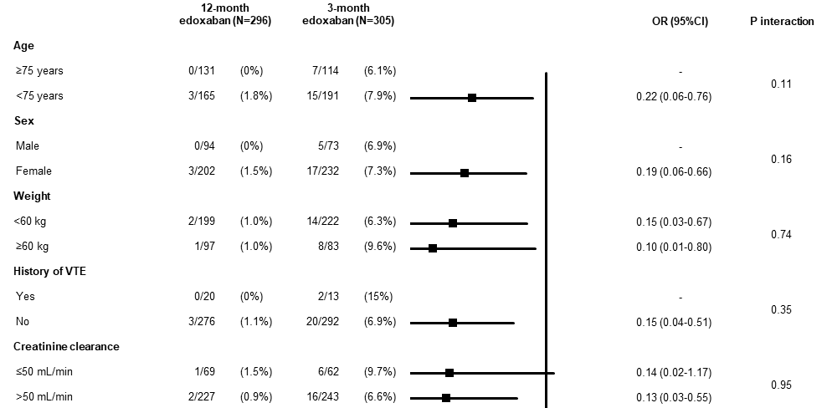
Subgroup analyses for the primary endpoint

Slide 18
Platelet count
<100,000/µI | 0/12 | (0%) | 1/19 | (5.3%)
100,000/µI | 3/284 | (1.1%) | 21/286 | (7.3%)
■
0.68
0.13 (0.04-0.46)
Anemia Yes | 3/199 | (1.5%) | 17/203 | (8.4%) |  | 0.17 (0.05-0.58)
No | 0/97 | (0%) | 5/102 | (4.9%)
Edoxaban dose adjustment
Normal dose (60 mg/day) | 1/80 | (1.3%) | 7/71 | (9.9%) |  | 0.12 (0.01-0.97)
Low dose (30 mg/day) | 2/216 | (0.9%) | 15/234 | (6.4%) |  | 0.14 (0.03-0.60)
History of major bleeding
Yes | 017 | (0%) | 2/16 | (13%)
No Cancer metastasis | 3/289 | (1.0%) | 20/289 | (6.9%) | ■ | 0.14 (0.04-0.48)
Yes | 2/67 | (3.0%) | 12/80 | (15%) |  | 0.17 (0.04-0.81)
No | 1/229 | (0.4%) | 10/225 | (4.4%) |  | 0.09 (0.01-0.74)
Overall 3/296 (1.0%) 221305 (7.2%) ■ |  |  |  |  |  | 0.13 (0.03-0.44)
0.24
0.90
0.61
0.63
0.0625
0.25
◄
12-month edoxban better
4
►
3-month edoxban better
• •
ESC Congress 2023
Amsterdam & Online

Slide 19
Study limitations
Open-label design (although blinded endpoint adjudication)
Lower event rates of the primary endpoints than expected
Not-high adherence to the study protocol as to edoxaban treatment
Differences of races and a variety of cancer types (generalizability)

Slide 20
Conclusions
In cancer patients with isolated distal DVT, edoxaban treatment for 12 months was superior to 3 months with respect to the composite outcome of a symptomatic recurrent VTE or VTE-related death.

Slide 21
Edoxaban for 12 Months versus 3 Months in Cancer Patients with Isolated Distal Deep Vein Thrombosis (ONCO DVT study): An Open-label, Multicenter, Randomized Clinical Trial
Yugo Yamashita, Takeshi Morimoto, Nao Muraoka, Takuya Oyakawa, Michihisa Umetsu, Daijirou Akamatsu, Yuji Nishimoto, Yukihito Sato, Takuma Takada, Kentaro Jujo, Yuichiro Minami, Yoshito Ogihara, Kaoru Dohi, Masashi Fujita, Tatsuya Nishikawa, Nobutaka Ikeda, Go Hashimoto, Kazunori Otsui, Kenta Mori, Daisuke Sueta, Yukari Tsubata, Masaaki Shoji, Ayumi Shikama, Yutaka Hosoi, Yasuhiro Tanabe, Ryuki Chatani, Kengo Tsukahara, Naohiko Nakanishi, Kitae Kim, Satoshi Ikeda, Makoto Mo, Yusuke Yoshikawa, Takeshi Kimura;
On behalf of the ONCO DVT Study Investigators.
Circulation. 2023; DOI: 10.1161/CIRCULATIONAHA.123.066360
https://www.ahajournals.org/doi/10.1161/CIRCULATIONAHA.123.066360
21

