Slide 1
STeroids to REduce Systemic Inflammation after infant heart Surgery (STRESS) Trial
Embargoed for 8:13am CT/9:13am ET, Sunday, Nov. 6, 2022
Kevin D. Hill MD MSCI, Prince J. Kannankeril MD MSCI, Jeffrey P. Jacobs MD, H. Scott Baldwin MD, Marshall L. Jacobs MD, Sean M. O’Brien PhD, David P. Bichel MD, Eric M. Graham MD, Brian Blasiole MD, Ashraf Resheidat MD, Adil Husain MD, S. Ram Kumar MD PhD, Soju Chang MD MPH, Jerry L. Kirchner BS CRRP, Dianne S. Gallup MS, Joseph P. Turek, MD PhD, Mark Bleiweis MD, Bret Mettler MD, Alexis Benscoter MD, Eric Wald MD, Tara Karamlou MD, Andrew Vanbergen MD, David Overman MD, Pirooz Eghtesady MD, Ryan Butts MD, John Kim MD, John Scott MD, Brett Anderson MD, Michael Swartz PhD, Patrick McConnell MD, Jennifer S. Li MD MHS
and the STRESS Network Investigators

Slide 2
DISCLOSURES
STRESS Network and STRESS Trial (NCT03229538) were supported by grants from the National Centers For Advancing Translational Sciences (NCATS 1U01 TR001803-01, U24TR-001608-03) and from the Eunice Kennedy Shriver National Institute of Child Health and Human Development (U18FD-006298-02).

Slide 3
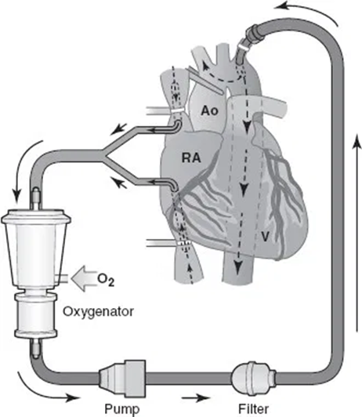
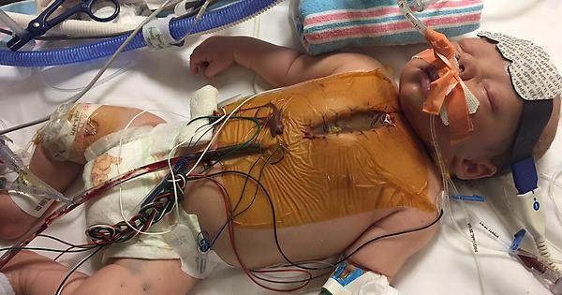
BACKGROUND: PERIOPERATIVE CORTICOSTEROIDS
Used to treat CPB-related systemic inflammatory response
Safety and efficacy not established in children
Registry Data (2011-’16)
52% of neonatal surgeries used pre/perioperative steroids
Surgical injury
Ischemia-
reperfusion
Adult trials (DECS¹, SIRS²)
>12,000 randomized
Meta-analysis³:
No difference in mortality, stroke, renal failure, afib
Reduced respiratory failure, infection, LOS
Pediatric trials⁴
Meta-analysis: 10 RCTs conducted over 4 decades, 768 children enrolled
Improved fluid balance at 24, 36 hrs
No difference in any other endpoints
But underpowered
Exposure to artificial surfaces
Hypothermia
Shear forces
Dieleman et al. JAMA 2012 Nov 7;308(17):1761-7
Whitlock et al. Lancet 2015 Sep 26;386(10000):1243-53
3. Dvirnik et al. BRJ Anaesth 2018 Apr;120(4):657-67
4. Bronicki et al. Ann Thorac Surg 2021 Oct;112(4):1363-70

Slide 4
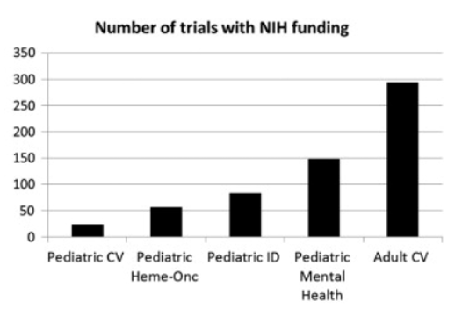
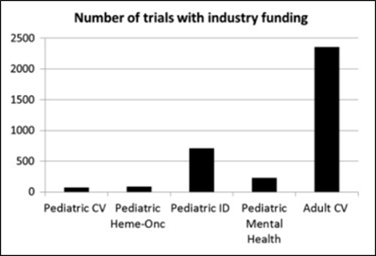
BACKGROUND: TRIAL CHALLENGES
Historically very few trials in children with heart disease¹
Why?
Rare, heterogeneous patient cohort
Difficult to consent and enroll
High costs, limited funding
Hill et al. Am Heart J 2014 Jun;167(6):921-9

Slide 5
TRIAL DESIGN
Solution: Pragmatic “trial within a registry”
Society of Thoracic Surgeons Congenital Heart Surgery Database (STS-CHSD)
Mature registry in existence since 1998¹
Demographic, surgical and outcomes data
98% accuracy in prior audits²
Randomized, placebo controlled trial
Participants randomized 1:1 to methylprednisolone (30mg/kg) vs placebo at 24 STS-CHSD Centers
Final Study
Database
Link
+
Ancillary
database
Kumar et al. Ann Thorac Surg 2021 Dec;112(6):1753-1762
Nathan et al. Ann Thorac Surg. 2017 Feb;103(2):629-636

Slide 6
ENDPOINTS
Primary endpoint: Ranked composite
Participants assigned worst outcome experienced during hospitalization
Ranking commensurate with clinical impact
Covariate adjusted primary analysis
1200 participants: > 90% power
Secondary endpoints
Unadjusted analysis and “Win Ratio”
Composite mortality/major morbidity (>91)
Post-op LOS, Prolonged ventilation (> 7 days)
Post-op Low Cardiac Output Syndrome
Safety Endpoints
Composite infection, Hyperglycemia, Insulin administration
Rank | Description
97 | Operative mortality
96 | Heart transplant (during hospitalization)
95 | Renal failure with permanent dialysis
 | Neurologic deficit persistent at discharge
 | Respiratory failure requiring tracheostomy
94 | Post-operative mechanical circulatory support
 | Unplanned cardiac reoperation
93 | Reoperation for bleeding
 | Unplanned delayed sternal closure
 | Post-op unplanned interventional catheterization
92 | Post-op cardiac arrest
 | Multi-system organ failure
 | Renal failure with temporary dialysis
 | Prolonged ventilator support (> 7 days)
91 | Post-operative length of stay > 90 days
1-90 | Post-operative length of stay
Notes:
Comment on how we chose these

Slide 7
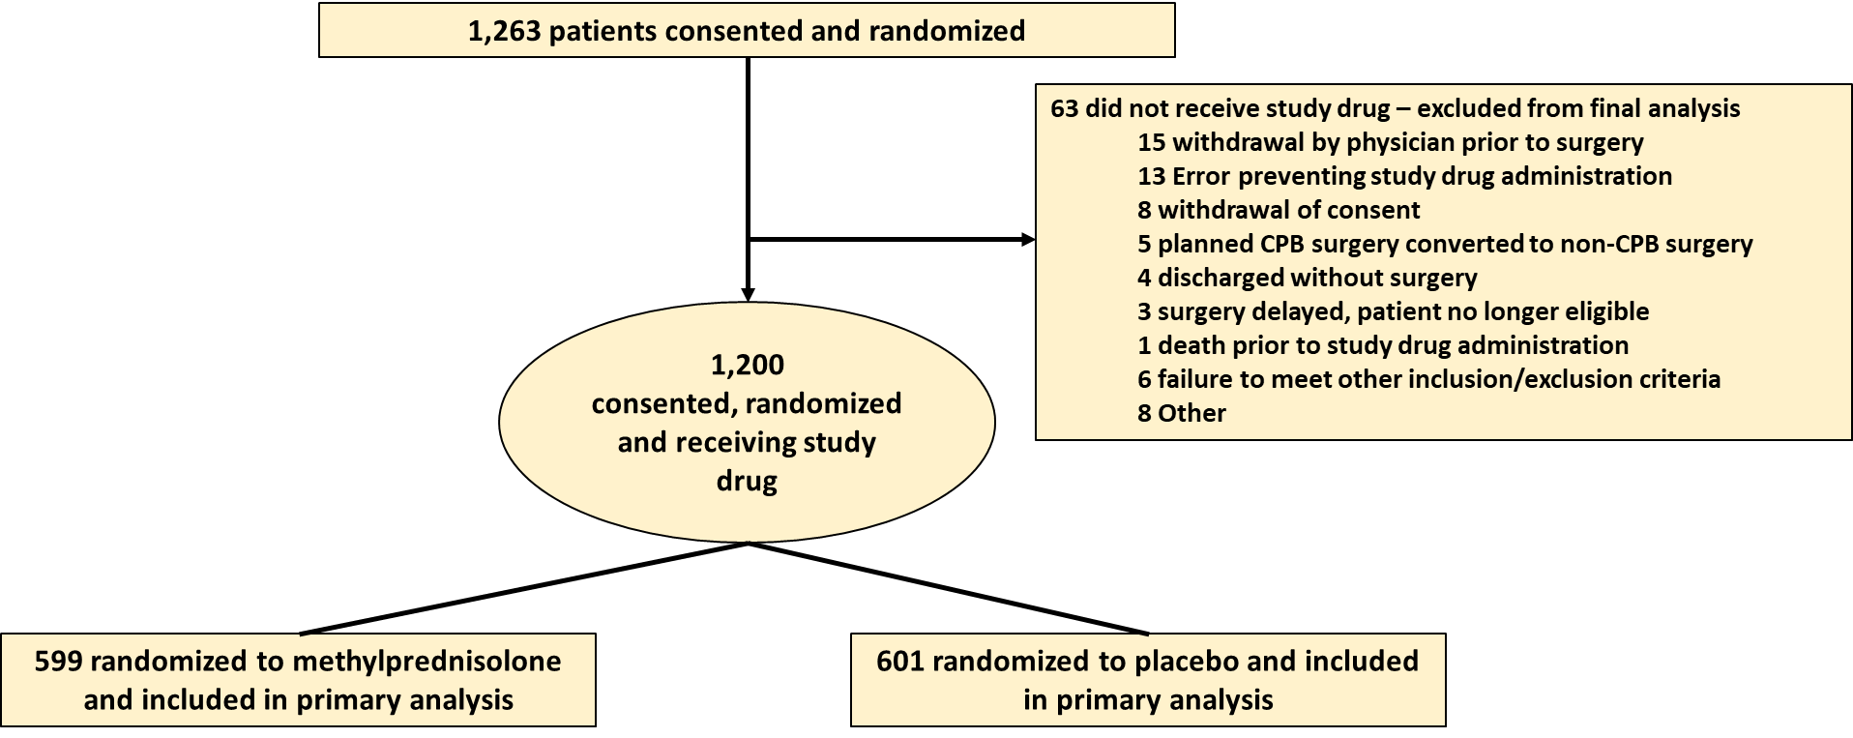
RESULTS: TRIAL COHORT

Slide 8
RESULTS: BASELINE CHARACTERISTICS
Similar distribution of baseline characteristics
Diverse participant cohort
Characteristic | MP N=599 | Placebo N=601
Median age at surgery, days (Q1, Q3) | 126 (14, 191) | 124 (14, 182)
Age Category
≤30 days | 177/599 (29.5%) | 187/601 (31.1%)
Median wt at surgery, kg (Q1, Q3) | 5.2 (3.7, 6.4) | 5.0 (3.6, 6.3)
Male sex | 320/599 (53.4%) | 334/600 (55.7%)
Premature | 100/598 (16.7%) | 93/599 (15.5%)
Non-cardiac congenital anatomic abn. | 26/599 (4.3%) | 15/600 (2.5%)
Chromosomal abnormality or syndrome | 200/599 (33.4%) | 183/600 (30.5%)
Prior cardiothoracic operation | 81/599 (13.5%) | 110/600 (18.3%)
Any preoperative risk factor | 223/594 (37.5%) | 212/594 (35.7%)
Median CPB time, min (Q1, Q3) | 122.0 (88, 161) | 121.0 (90, 160)
Characteristics | MP N=599 | Placebo N=601
Ethnicity²
Hispanic or Latino | 80/580 (13.8%) | 63/584 (10.8%)
Not Hispanic or Latino | 500/580 (86.2%) | 521/584 (89.2%)
Race³
Caucasian | 428/585 (73.2%) | 425/583 (72.9%)
Black/African American | 90/585 (15.4%) | 102/583 (17.5%)
Asian | 15/585 (2.6%) | 12/583 (2.1%)
American Indian/Alaska Native | 5/585 (0.9%) | 4/583 (0.7%)
Native Hawaiian/Pacific Islander | 4/585 (0.7%) | 0
Multiracial | 13/585 (2.2%) | 15/583 (2.6%)
Other | 30/585 (5.1%) | 25/583 (4.3%)

Slide 9
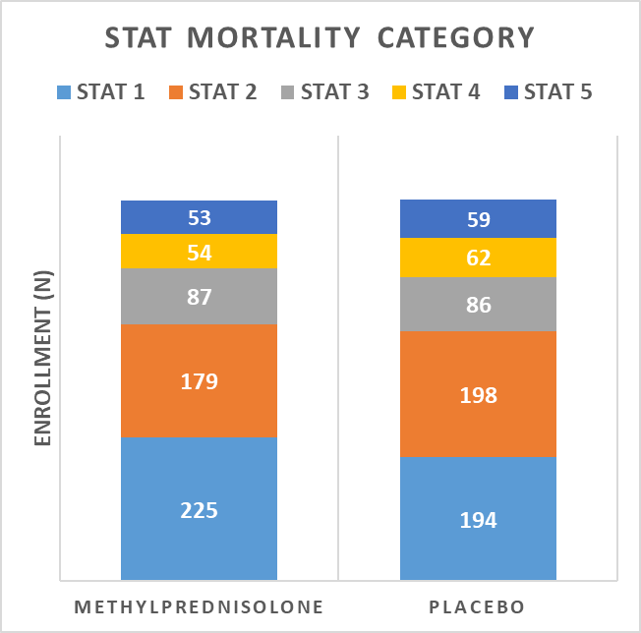
RESULTS CASE COMPLEXITY AND PROCEDURAL DISTRIBUTION

Slide 10
RESULTS: PRIMARY OUTCOME
Adjusted OR = 0.86, 95% CI 0.71 to 1.05; p=0.14

Slide 11
RESULTS: SECONDARY OUTCOMES
Component | Steroids N=599 | Placebo N=601 | OR | 95% CI | P-value
Unadjusted analysis of primary outcome | NA | NA | 0.82 | 0.67, 1.00 | 0.047
Win ratio analysis of primary outcome | NA | NA | 1.15 | 1.00, 1.32 | 0.046
Operative mortality | 12/599 (2.0%) | 17/601 (2.8%) | 0.74 | 0.34, 1.57 | 0.428
Composite morbidity/mortality (Rank > 91) | 103/599 (17.2%) | 122/601 (20.3%) | 0.83 | 0.61, 1.13 | 0.228
Prolonged (> 7 days) post-operative mechanical ventilation | 41/599 (6.8%) | 51/601 (8.5%) | 0.79 | 0.50, 1.25 | 0.309
Post-op low cardiac output syndrome | 31/599 (5.2%) | 37/601 (6.2%) | 0.91 | 0.52, 1.57 | 0.723
Post-operative infectious complication | 31/599 (5.2%) | 24/601 (4.0%) | 1.39 | 0.80, 2.42 | 0.242
Bleeding requiring reoperation | 7/599 | 21/601 | 0.34 | 0.14, 0.81 | 0.016
Post-operative hospital LOS, median (IQR) | 10 (6, 20) | 11 (6, 23) | 1.11 | 0.99, 1.25 | 0.066
Favors Methylprednisolone

Slide 12
RESULTS: SAFETY AND OTHER OUTCOMES
Methylprednisolone with higher post-operative blood glucose
Methylprednisolone more likely to receive post-op insulin
Methylprednisolone less likely to receive post-op hydrocortisone
P<0.001
P<0.001
P=0.004
No differences in rates of any other complications

Slide 13
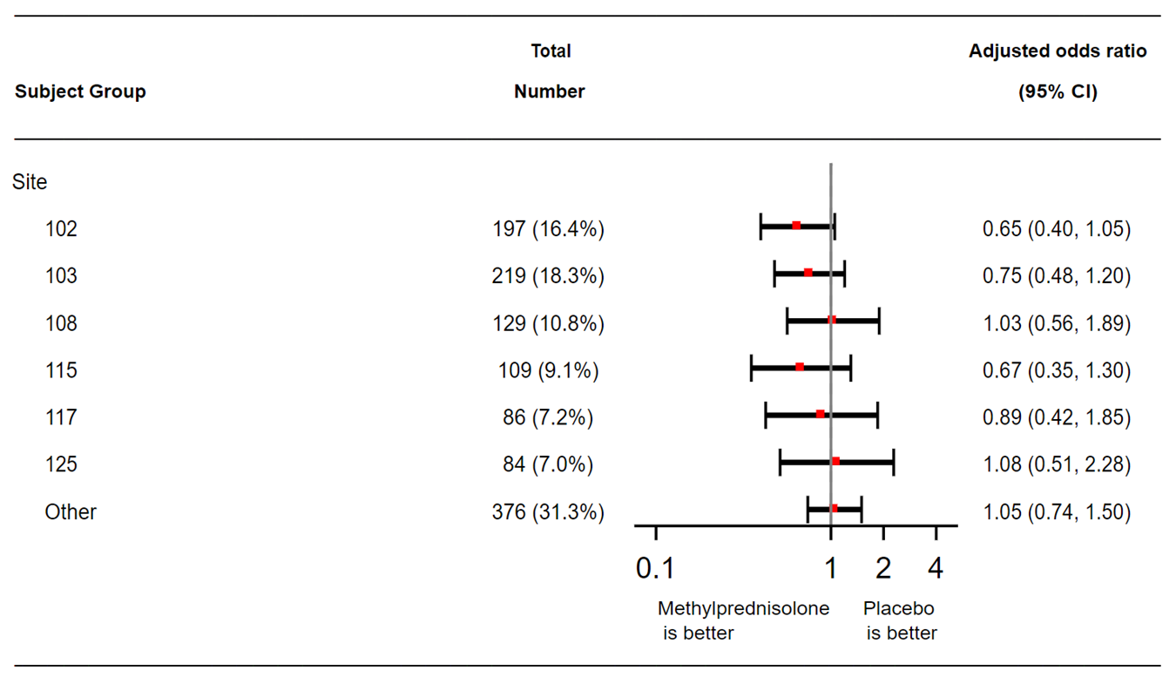
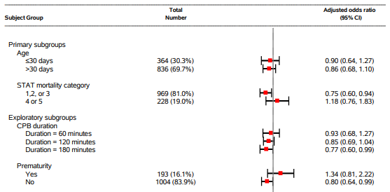
RESULTS: SUBGROUP ANALYSES
Potential benefit in STAT 1,2,3 cases, longer bypass duration and non-premature infants
No site-dependent treatment effect
No differences by race, ethnicity, gender, presence of other preop-risk factors, non-cardiac anatomic abnormalities or syndromes/chromosomal anomalies

Slide 14
CONCLUSIONS
Methylprednisolone did not decrease the likelihood of the risk adjusted composite primary endpoint…but did reduce the likelihood of the primary endpoint when analyzed without risk adjustment and using the “Win Ratio”
Methylprednisolone increased the likelihood of hyperglycemia requiring insulin therapy
In subgroup analysis, there was evidence of benefit for infants undergoing lower complexity operations (STAT 1,2,3), those with longer CPB times and those without prematurity
Future studies should evaluate mechanisms for risk-stratification to elucidate whether a more targeted approach might offer benefit in select sub-populations
Notes:
Note small numbers

Slide 15
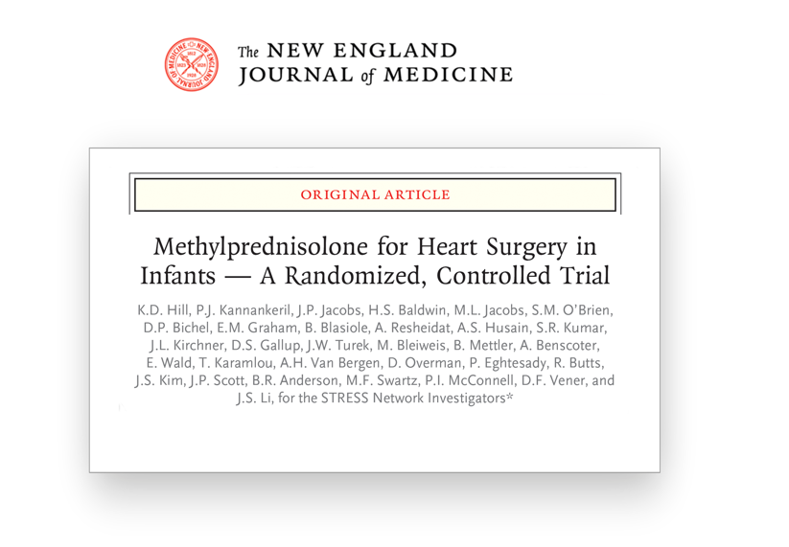

Slide 16
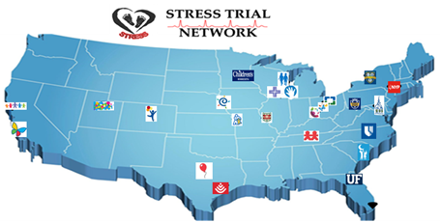
THANK YOU TO OUR STRESS NETWORK
Executive committee: Kevin D. Hill MD MSCI, Prince J. Kannankeril MD MSCI, Jeffrey P. Jacobs MD, H. Scott Baldwin MD, Marshall L. Jacobs MD, Sean M. O’Brien PhD, David P. Bichel MD, Jennifer S. Li MD MHS
NCATS Program Officer: Soju Chang MD MPH
Steering committee: Eric M. Graham MD, Jane Newburger MD, James Tweddel MD, Lori Smoot (Parent)
Site PIs/Co-Is: Brian Blasiole MD PhD, Ashraf Resheidat MD, Adil S. Husain MD, S. Ram Kumar MD PhD, Joseph W. Turek, MD PhD, Mark Bleiweis MD, Bret Mettler MD, Alexis Benscoter MD, Eric Wald MD, Tara Karamlou MD MSc, Andrew H Van Bergen MD, David Overman MD, Pirooz Eghtesady MD, Ryan Butts MD, John S. Kim MD, John P. Scott MD, Brett R. Anderson MD MBA MS, Michael F. Swartz PhD, Patrick I. McConnell MD, David F. Vener MD, Venugopal Amula, MD, Nick Andersen, MD, Jean Ballweg, MD, Scott M. Bradley, MD, Jason R. Buckley, MD, Reid C. Chamberlain, MD, Karla G. Christian, MD, John D. Cleveland, MD, Nhue Do, MD, Will Gibson, MD, Christoph P. Hornik, MD MS PhD, James Jaggers, MD, Minoo N. Kavarana, MD, William Ravekes, M.D., Jennifer Schuette, MD, MS, Sarah Tabutt, MD PhD, Richard V. Williams, MD, Sinai C. Zyblewski, MD
Data Safety and Monitoring Board: Tim Feltes MD, Matt Laughon MD MHS, Kimberly Gauvreau, ScD,
Site Personnel: Sarita Madell, Kimberly Crum, Laura Sullivan, Kate Galligy, Kathleen Van’tHof, Laura Burgardt, Michelle Otto, Chantal Sanchez, Layla Al Sarraf, Lucey Boyle, Shalayna Woodly, Taylor Swann, Kathleen Molony, William Anguiano, Maria Martinez, Bianca Mobley, Parvin Mohazabnia Molly Brown, Amy Taylor, Brandi Scott, Mike Gawad, Jennifer Nelson, Jennifer Marshall, Amy Monroe, Reality Price, Susan Richey, Dalia Lopez-Colon, Leah Breault, Linda Lambert, Disha Goel, Pawel Kwiatkowski, Chelsea Mannie, Annie Pourney, Gabriel Hansen, Carolyn Chamberlain, Luke Murphy, Jennifer Harman, Melissa Challman, Andrew Lee, Martine Malivers, Elizabeth Menard, Bonnie Hughes, Katrin O’Grady, Mark LoGalbo, Deborah Bizjak, Fejeania Hunter, Sidney Koepp, Lukas Kost, Kimberly Teknipp
STRESS Trial Coordinating Center (DCRI): Sergei Avdiushko, Susan Bartone, Gail Beaulieu, Darwin Chavez, Stephanie Decker, Deborah Drosdick, Laura Edwards, Carrie Elliott, Alicia Ellis, Claire Evans, Julie Fly, Dianne Gallup, Cindy Green, Jesse Hickerson, Valerie Jackson, Theresa Jasion, David Jensen, Jerry Kirchner, Cheryl Mayton, Annette McDaniel, Rania Metry, Carol Pereira, Thomas Phillips, Gudaye Tasissa, Tinisha Turner, Kadie Wells, Vanderbilt University Darlene Fountain, Central IRB coordination
Duke University Pediatric and Congenital Heart Center, Vanderbilt University Medical Center, University of Florida Congenital Heart Center, Johns Hopkins University School of Medicine, Medical University of South Carolina, UPMC Children’s Hospital of Pittsburgh, Texas Children’s Hospital, Baylor College of Medicine, University of Utah/Primary Children’s Hospital, University of Southern California; Heart Institute, Children's Hospital of Los Angeles, University of Cincinnati, Cincinnati Children's Hospital Medical Center, Ann & Robert H. Lurie Children's Hospital of Chicago, Northwestern University Feinberg School of Medicine, Cleveland Clinic Children’s, Advocate Children’s Hospital, Children's Minnesota, Washington University School of Medicine, University of Texas Southwestern, Children's Hospital Colorado, University of Colorado School of Medicine, Children's Wisconsin, Medical College of Wisconsin, NewYork-Presbyterian/Columbia University Irving Medical Center, University of Rochester Medical Center, Nationwide Children's Hospital; The Ohio State University, Children’s Mercy Kansas City, University of California San Francisco Benioff Children’s Hospital.
Notes:
Note small numbers

