Slide 1
ORION
A pooled analysis of Phase III studies of inclisiran
RS Wright Rochester
D Kallend | Zurich | LA Leiter | Toronto | CA Meanwell | Parsippany
KK Ray | London | U Landmesser | Berlin | PL Wijngaard | Parsippany
FJ Raal | Johannesburg | G Schwartz | Denver | JP Kastelein | Amsterdam
W Koenig | Munich | A Friedman | Parsippany
On behalf of the ORION Phase III investigators
1

Slide 2
ORION Phase III pooled analysis: Background and rationale
Challenges remain with regard to LDL-C lowering
LDL-C lowering is the most effective intervention to change the course of ASCVD and FH yet substantial residual risk remains despite aggressive treatment with statins and other agents¹.
Lifestyle modification and statin treatment are foundational for ASCVD prevention^{2,3}
Ezetimibe and monoclonal antibodies to PCSK9 are adjunctive strategies to reduce LDL- C and clinical events by multiple treatment guidelines⁴⁻⁶
Benjamin et al. Circulation 2019;139:e56-e528.
Grundy et al. Circulation 2019;139:e1082-e143.
Mach F et al. European Heart Journal 2019 doi:10.1093/eurheartj/ehz455
Cannon et al. N Engl J Med 2015;372:2387-97.
Sabatine et al. N Engl J Med 2017;376:1713-22.
Schwartz et al. N Engl J Med 2018;379:2097-107
2

Slide 3
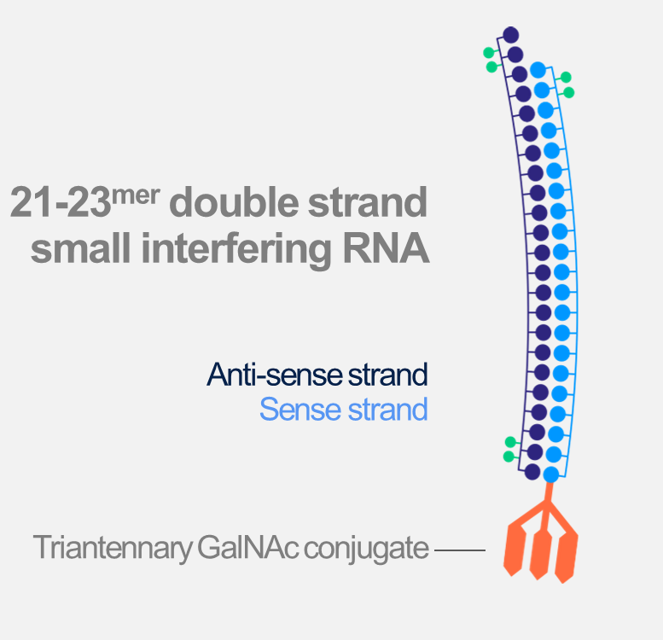
ORION Phase III pooled analysis: Background and rationale
Harnessing the natural process of RNAi
Inclisiran
Small interfering double-stranded RNA¹
Harnesses the natural process of RNAi
Nucleotides modified for durability and low immunogenicity
Distributed to liver due to GalNAc conjugation
Inhibits production of PCSK9 in hepatocytes
Fitzgerald et al. N Engl J Med. 2017;376:41-51.
3

Slide 4
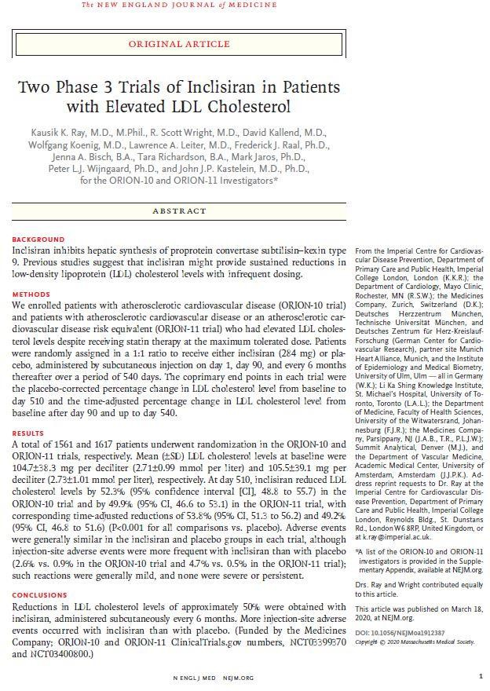
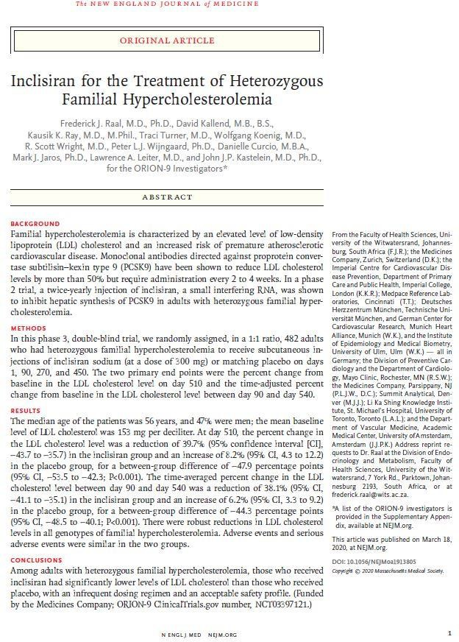
ORION Phase III pooled analysis
Online e-publications of ESC and AHA Individual Study presentations
1. DOI: 10.1056/NEJMoa1912387
2. DOI: 10.1056/NEJMoa1913805
4

Slide 5
ORION Phase III pooled analysis
Purpose
To assess efficacy and safety of inclisiran 284 mg compared to placebo in a pooled analysis of all Phase III trials
Inclisiran 284 mg is equivalent to Inclisiran sodium 300 mg.
8

Slide 6
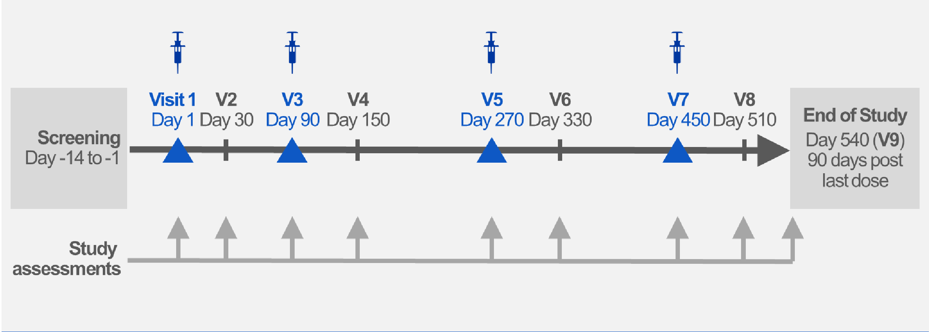
ORION Phase III pooled analysis: Common study design
18 months treatment & observation
Randomized 1:1 inclisiran 284 mg vs. placebo – with maximally tolerated statins
8

Slide 7
ORION Phase III pooled analysis: Entry criteria
General study inclusions and exclusions
Inclusion criteria | Exclusion criteria
Age ≥18 years | Prior or planned use of PCSK9 mAbs
Statin treatment | MACE within 3 months of randomization
Maximal y tolerated doses, or documented intolerance | NYHA class IV HF ─ or LVEF 25%
Ezetimibe alowed | Uncontrol ed severe hypertension
Informed consent required | Severe concomitant non CV disease
 | Prior/planned other investigational drug
 | Fasting TG >400 mg/mL (4.52mmol/L)
8

Slide 8
ORION Phase III pooled analysis: Entry criteria
Specific study inclusions
ORION-9 |  | ORION-10 |  | ORION-11
HeFH¹ |  | ASCVD (CHD, CVD, PAD) |  | ASCVD (CHD, CVD, PAD)
Stable on a low-fat diet |  |  |  | ASCVD risk equivalents Type 2 diabetes 10-year risk ≥20% HeFH¹
LDL-C ≥100 mg/dL |  | LDL-C ≥70 mg/dL |  | LDL-C ≥70 mg/dL / ≥100 mg/dL in risk-equivalent
1. Diagnosed by genetic testing and/or Simon Broome criteria
8

Slide 9
ORION Phase III pooled analysis: Objectives
To confirm inclisiran efficacy and safety over 18 months
Study endpoints
1. Effectiveness | 2. Safety and tolerability
Primary | Treatment emergent adverse events
Percent LDL-C change vs. placebo | Laboratory parameters
— At day 510
— Average over days 90 – 540
Secondary | 3. Exploratory
LDL-C change over time | Cardiovascular events¹
Changes in PCSK9 and other lipids
1. MedDRA-defined cardiovascular non-adjudicated terms including cardiac death, and any signs or symptoms of cardiac arrest, non-fatal MI and/or stroke

Slide 10
ORION Phase III pooled analysis: Statistical plan
Large sample enrolled to enable reliable inference
Pre-specified pooling strategy and methods - agreed with regulatory agencies
Primary endpoints
Family-wise type I error rate control ed using a sequential testing procedure
Sensitivity analysis for primary efficacy endpoints
Pre-specified imputation and analysis methods used to account for missing data
Safety observation of ~7000 inclisiran injections and >2700 years patient exposure

Slide 11
ORION Phase III pooled analysis: Patient disposition
High proportion of patients completed the studies
Abbreviated consort diagram
Died
Withdrew consent Lost to folow-up Adverse event PCSK9 mAb initiation Other
27
55
29
5
10
6
Placebo
ITT 1827
Safety 1822
Completed 92.8%
Screened 5327
Randomized 3660
Inclisiran
ITT 1833
Safety 1833
Completed 94.3%
Screen failures Entry criteria miss Withdrew consent Other
1667
1485
148
34
Died
Withdrew consent Lost to folow-up Adverse event PCSK9 mAb initiation Other
27
37
17
12
0
12
Safety population comprises any subject given any study medication

Slide 12
ORION Phase III pooled analysis: Patients
Representative high risk cohort balanced by randomization
Patient characteristic | Placebo |  | Inclisiran
ITT population¹ | N = 1827 |  | N = 1833
Age median (range) - years | 65 | (21-89) | 65 | (20-90)
United States | 812 | (44%) | 814 | (44%)
Male gender | 1244 | (68%) | 1226 | (67%)
Diabetes | 631 | (35%) | 687 | (38%)
Lipid management treatment | 1737 | (95%) | 1761 | (96%)
Statins | 1675 | (92%) | 1686 | (92%)
Of which high intensity statins given | 1345 | (74%) | 1356 | (74%)
Ezetimibe² | 246 | (14%) | 231 | (13%)
Baseline LDL-C mg/dL (SD) | 111 | (44) | 112 | (45)
1. Al patients who were randomized, analyzed according to randomization
2. Does not include statin-ezetimibe combination tablets

Slide 13
ORION Phase III pooled analysis
Efficacy results

Slide 14
ORION Phase III pooled analysis: Efficacy
Highly significant lowering of LDL-C relative to placebo
Treatment group | N (ITT¹) |  | Percent change LDL-C
 |  | Mean at day 510 |  | Time-averaged day 90 - 540
 |  | Observed | Imputed² | Observed | Imputed³
Placebo | 1827 | + 4 | + 6 | + 4 | + 5
Inclisiran | 1833 | - 51 | - 45 | - 48 | - 45
Difference (1º endpoint) |  | - 55 | - 51 | - 52 | - 51
P-value |  | <0.0001 |  | <0.0001
1. Al patients who were randomized, analyzed according to randomization
2: Multiple imputation washout model
3: Control-based patern mixed model

Slide 15
ORION Phase III pooled analysis: Efficacy
Durable and potent with consistent effect over 18 months
Percent change in LDL-C over time – observed values in ITT patients
Mean % change from baseline
0
-20
-40
-60
-80
-100
Time-averaged Δ 52%
Δ 55%
Inclisiran
Placebo
0 3 6
9
Months
12
15
18
P-value for placebo – inclisiran comparison at each time point <0.0001
1. Al 95% confidence intervals are less than ±2% and therefore are not visible outside data points

Slide 16
ORION Phase III pooled analysis: Efficacy
Likelihood of achieving specific LDL-C thresholds
LDL-C threshold
100 patients on statin
100 patients on statin + inclisiran
Odds ratio
<100 mg/dL
⓪⓪①⓪①⓪①①⓪①⓪⓪①①⓪①①
⓪①①⓪⓪①⓪①①⓪①⓪①①⓪①①
①⓪⓪①⓪①⓪①⓪①①⓪①①①⓪① 51
⓪⓪①⓪①⓪①①⓪①⓪⓪①①⓪①⓪①①⓪⓪①⓪①①⓪①⓪①①⓪⓪①
⓪①⓪①①⓪①⓪⓪①①⓪①⓪①①⓪⓪①⓪①①⓪①⓪①①⓪①⓪①⓪①
①⓪①⓪①⓪①⓪①①⓪①⓪⓪①⓪①⓪①①⓪①⓪ 89
8
<70 mg/dL | ⓪⓪①⓪⓪ ①⓪①①⓪ ⓪①⓪⓪14 |  |  | ⓪⓪①⓪①⓪①①⓪①⓪⓪①①⓪①⓪①①⓪⓪①⓪①①① ⓪⓪①①⓪⓪①⓪①⓪①①⓪①⓪⓪①①⓪①⓪①①⓪⓪ ①⓪①①①⓪①⓪①⓪①⓪①①⓪①⓪①①⓪①①⓪①⓪ 76 |  |  | 19
<50 mg/dL | ⓪⓪ | 2 |  | ⓪⓪①⓪①⓪①①⓪①⓪⓪①①⓪①⓪①①⓪①⓪① ①⓪①⓪①①⓪⓪①⓪①⓪①①⓪①⓪⓪①①⓪①⓪ ①①⓪⓪①①⓪①①⓪⓪① 58 |  | 54
<25 mg/dL | 0.3 |  |  | ⓪⓪①①⓪① ①①⓪⓪⓪ ①①⓪①① 16 | 60
⓪
Likelihood of reaching LDL-C thresholds at Day 510 among patients with available data

Slide 17
ORION Phase III pooled analysis: Efficacy
Effects on other lipid parameters
Percent Change from baseline to day 510 |  | Placebo | Inclisiran | p-value
ITT population¹ Imputed values² |  | N = 1827 | N = 1833
PCSK9 | Mean % | + 14.8 -83 | % - 68.2 | <0.0001
Total cholesterol | Mean % | + 2.9 -32 | % - 29.5 | <0.0001
Non HDL-C | Mean % | + 3.6 -46 | % - 42.8 | <0.0001
ApoB | Mean % | + 1.7 -42 | % - 40.2 | <0.0001
Lp (a) (day 540) | Median % | + 0.7 -20 | % - 19.5 | <0.0001³
1. Al patients who were randomized
2: Imputed using a mixed model for repeated measures
3: Non-parametric test; not imputed

Slide 18
ORION Phase III pooled analysis: Efficacy
Robust LDL-C across pre-specified sub-populations
Subgroup
Inclisiran
N
Placebo LS Mean Percent Difference in LDL-C N
Overall
Overall | 1833 | 1827 | -54.1
Sex
Male | 1226 | 1244 | -53.8
Female | 607 | 583 | -54.8
Age <65 yr or ≥65 yr
<65 yr | 853 | 884 | -54.3
≥65 yr | 980 | 943 | -53.7
Age <75 yr or ≥75 yr
<75 yr | 1593 | 1575 | -54.0
≥75 yr | 240 | 252 | -55.0
Body mass index
≤29.7 | 942 | 888 | -51.6
>29.7 | 891 | 937 | -56.8
Race
White | 1670 | 1708 | -54.2
Black | 130 | 102 | -53.6
Other | 33 | 17 | -49.8
Baseline statin treatment
On statin | 1686 | 1675 | -54.5
Not on statin | 147 | 152 | -48.8
Intensity of statin treatment
High intensity statin | 1356 | 1345 | -54.6
Not on high intensity statin | 477 | 482 | -52.7
Lipid management treatment (LMT)
Any statin | 1686 | 1675 | -54.5
Other LMT but no statin | 75 | 62 | -53.9
No LMT | 72 | 90 | -45.6
Metabolic disease
Diabetes | 687 | 631 | -56.1
Metabolic syndrome | 499 | 526 | -56.2
Neither | 647 | 670 | -50.6
-100.0
-75.0
-50.0 -25.0
Inclisiran better
0.0
25.0
Placebo better
18

Slide 19
ORION Phase III pooled analysis: Efficacy
Robust LDL-C across pre-specified sub-populations
Subgroup | Inclisiran N | Placebo N | LS Mean Percent Difference in LDL-C
Risk category
ASCVD | 1552 | 1555 |  | -55.3
ASCVD equivalent | 281 | 272 |  | -47.1
Renal function (eGFR - Cockcroft Gault)
Normal
Mild impairment Moderate impairment
996
637
196
1020
600
202
-54.1
-53.3
-56.9
Baseline triglycerides in mg/dL
≤130
>130
918
915
914
913
-52.2
-55.9
Baseline LDL-C in mg/dL
Baseline LDL-C quartiles in mg/dL
≤100 | 927 | 925 |  | -61.1
>100 | 906 | 902 |  | -46.9
≤82
>82 - ≤100
>100 - ≤129
>129
455
472
434
472
482
443
465
437
-65.2
-56.9
-50.7
-43.1
Ethnicity
Hispanic or latino Not hispanic or latino
120
1713
116
1711
-43.6
-54.8
Geographic region
North America Europe
South Africa
826
859
148
823
854
150
-56.4
-51.1
-57.6
-100.0
-75.0
-50.0 -25.0
Inclisiran better
0.0
25.0
Placebo better

Slide 20
ORION Phase III pooled analysis
Safety results

Slide 21
ORION Phase III pooled analysis: Safety and tolerability
Adverse event profile similar to placebo
Treatment emergent adverse event (TEAE) | Placebo |  | Inclisiran
Safety population¹ – AEs in ≥5% patients² | N = 1822 |  | N = 1833
Patients with at least one TEAE | 1409 | (77.3%) | 1430 | (78.0%)
Diabetes melitus adverse events | 207 | (11.4%) | 212 | (11.6%)
Nasopharyngitis | 134 | (7.4%) | 140 | (7.6%)
Upper respiratory tract infection | 103 | (5.7%) | 105 | (5.7%)
Hypertension | 104 | (5.7%) | 104 | (5.7%)
Arthralgia | 72 | (4.0%) | 91 | (5.0%)
Protocol-defined injection site TEAE | 12 | (0.7%) | 91 | (5.0%)
Safety population includes al patients who received at least 1 dose of study medication
Other TEAEs reported with lower frequencies than 5% in any group had no clinicaly meaningful differences
21

Slide 22
ORION Phase III pooled analysis: Safety and tolerability
No evidence of liver, kidney, muscle or platelet toxicity
Laboratory tests |  | Placebo |  | Inclisiran
Safety population^{1,2} |  | N = 1822 |  | N = 1833
Liver function | ALT >3x ULN | 7 | (0.4%) | 9 | (0.5%)
 | AST >3x ULN | 10 | (0.5%) | 8 | (0.4%)
 | ALP >2x ULN | 5 | (0.3%) | 8 | (0.4%)
 | Bilirubin >2x ULN³ | 14 | (0.8%) | 14 | (0.8%)
Kidney function | Creatinine >2 mg/dL | 39 | (2.1%) | 36 | (2.0%)
Muscle | CK >5x ULN | 22 | (1.2%) | 24 | (1.3%)
 | CK >10x ULN | 6 | (0.3%) | 4 | (0.2%)
Hematology | Platelet count ≤75x10⁹/L | 2 | (0.1%) | 1 | (0.1%)
1. Safety population includes al patients who received at least 1 dose of study medication
3. No cases met Hy’s Law
2. Patients may be counted in more than one category
22

Slide 23
ORION Phase III pooled analysis: Exploratory endpoint
Serious adverse events and CV endpoint
Serious treatment emergent adverse events | Placebo |  | Inclisiran
Safety population^{1,2} | N = 1822 |  | N = 1833
Patients with at least one serious TEAE | 419 | (23.0%) | 374 | (20.4%)
All cause death | 27 | (1.5%) | 27 | (1.5%)
Cancer | 6 | (0.3%) | 4 | (0.2%)
New, worsening or recurrent malignancy | 49 | (2.7%) | 44 | (2.4%)
TEAEs leading to drug discontinuation | 35 | (1.9%) | 45 | (2.5%)
Pre-specified exploratory CV endpoint³ | 172 | (9.4%) | 131 | (7.1%)
Cardiovascular death | 14 | (0.8%) | 17 | (0.9%)
Resuscitated cardiac arrest | 1 | (0.1%) | 4 | (0.2%)
Non-fatal MI | 142 | (7.8%) | 96 | (5.2%)
Stroke (Ischemic or Hemorrhagic) | 18 | (1.0%) | 16 | (0.9%)
1. Safety population includes al patients who received at least 1 dose of study medication 2. Patients may be counted in more than one category
3. MedDRA-defined CV basket of non-adjudicated terms cardiac death, and any signs or symptoms of cardiac arrest, non-fatal MI and/or stroke
23

Slide 24
ORION Phase III pooled analysis: Summary
Twice-a-year inclisiran lowered LDL-C by ≥50% safely
Efficacy
Primary and secondary endpoints were met
Co-Primary endpoints:
55% (observed values) and 51% (imputed) reduction at 17 months (Day 510)
52% (observed) and 51% (imputed) reduction 3-18 months (Days 90-540)
Reductions were consistent across sub-populations
Accompanied by substantial lowering of PCSK9, non-HDL-C, apoB and Lp(a)
Safety and tolerability
Inclisiran safety profile was similar to placebo
No adverse changes in laboratory markers
Exploratory basket of CV events less frequent on inclisiran than placebo

Slide 25
ORION Phase III pooled analysis: Conclusions and implications
Conclusions and implications
Inclisiran is a novel approach to reduce the level of LDL-C
With twice yearly administration, it provides robust and durable LDL-C reduction over 18 months on top of maximal y tolerated oral therapies.
Effects were consistent in patients with HeFH, ASCVD, or ASCVD risk-equivalence.
The safety profile was similar to placebo in a high risk population.
Twice yearly administration will coincide with typical twice yearly patient visits with health care providers, thereby assuring treatment adherence.

Slide 26
Thank you

