Slide 1
Initial experience of a novel intra-annular self-expanding transcatheter aortic valve in Japan
Kentaro Hayashida, MD, PhD, FESC, FACC, FJCS Tokyo, Japan
on behalf of the OCEAN-TAVI investigators

Slide 2
Potential conflicts of interest
Speaker's name : Kentaro Hayashida
☑ I have conflict of interest to declare
A clinical proctor of Edwards Lifesciences, Medtronic, and Abbott.

Slide 3
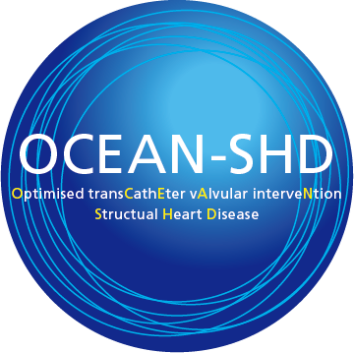
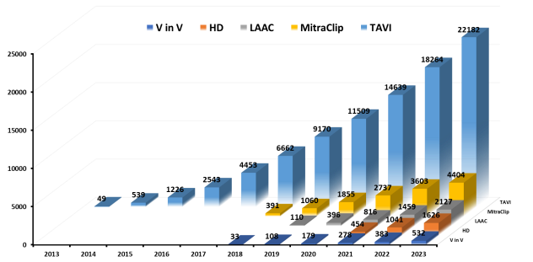
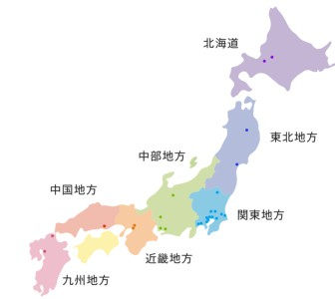
OCEAN-SHD family
Japanese multicenter registry (29 centers, >300 members)
TAVI, MTEER, Tricuspid, LAAC etc…
>22K TAVIs in our OCEAN-TAVI registry (2013-2023)

Slide 4
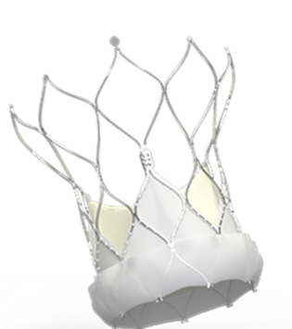
Navitor: Abbott
The latest generation of intra-annular self-expandable valve
NaviSeal: reduce PVL
FlexNav: a highly flexible delivery system to improve accessibility
Large cell: preserve better coronary access
Good hemodynamic performance
Launched in Japan from May 2022

Slide 5
The study protocol
OCEAN-TAVI Registry database May 2022 to April 2024
862 who underwent TAVI with Navitor
5 missing clinical data after TAVI
857 included in this analysis

Slide 6
Baseline characteristics
Baseline characteristics | %
Male | 29.9
Clinical Frailty Scale ≧4 | 51.7
NYHA 3 or 4 | 28.4
Smoking | 23.6
Dyslipidemia | 54.7
Diabetes mellitus | 29.4
HTN | 81.2
Atrial fibrillation | 18.9
CAD | 32.4
PAD | 14.2
Carotid stenosis | 5.4
COPD | 6.3
CKD | 68.5
Age 85.7±5.2
BMI 22.1±3.6 kg/m²
STS score 5.8 [3.9-9.4] %
>> Older, more frail, and higher-risk patients were included than Western cohorts

Slide 7
Preoperative data with TTE and MDCT
Echocardiography
index aortic valve area, cm²/m² | 0.46±0.13
peak flow velocity, m/s | 4.38±0.68
mean pressure gradient, mmHg | 45.7±15.8
LVEF, % | 63.0±11.3
AR ≧mild, % | 56.0
MR ≧mild, % | 55.9
MDCT
annulus area, mm² | 396±70
perimeter, mm | 71.5±6.4
right MLD, mm | 6.2±1.9
left MLD, mm | 5.9±1.7
Navitor was frequently used for patients with
Small annulus
Small vascular access
*MLD, minimal lumen diameter

Slide 8
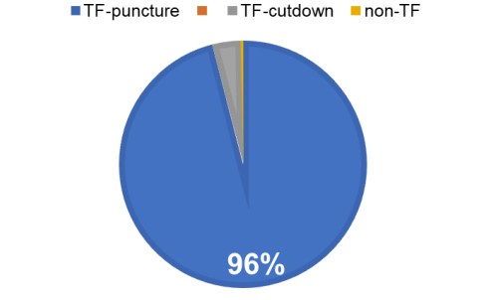
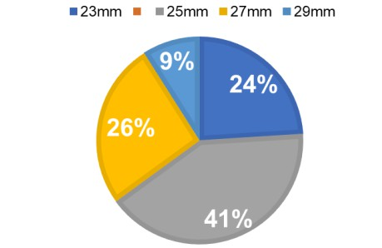
Procedure characteristics
Predilatation: 95.9%
Postdilatation: 7.3%
The smaller size accounted for two-third of the total
3.7%
0.3%

Slide 9
Postprocedural clinical outcomes
Clinical outcomes | (%)
All cause death | 2.1
Coronary obstruction | 0.4
Disabling stroke | 1.2
Major bleeding | 3.9
New PMI | 11.7
Valve embolization | 0.4
Echocardiography
index EOA, cm²/m² | 1.29±0.35
THV Vmax, m/s | 1.92±0.43
mean pressure gradient, mmHg | 8.0±4.0
PVL ≧mild, % | 37.5
MR ≧mild, % | 49.1
VARC-3 defined technical success was achieved 98.2%
2 cases required surgical conversion, 3 cases were changed to another type of valve, 7 cases required repair of vascular access

Slide 10
Postprocedural clinical outcomes
Paravalvular leakage; PVL
Prosthesis-patient mismatch; PPM
91,6
39,8
34,3
22,7
3,1
6,5
0,1
1,8
none
trivial
mild
moderate
severe
none
moderate
severe

Slide 11
The essential results of this study
VARC-3 defined technical success: 98%
TF approach was used in 96% despite of narrow vascular access
Excellent hemodynamic performance (8.0±4.0mmHg) despite of
small annulus (396±70mm²)
Severe PPM: 1.8%
Moderate-severe PVL: 3.4%

Slide 12
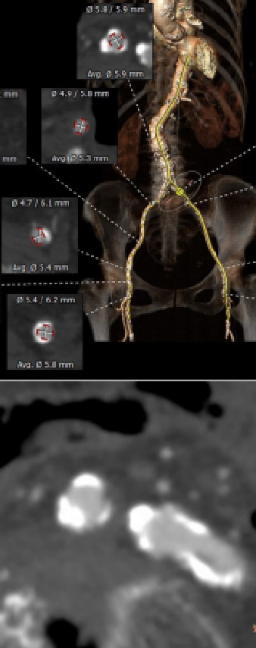
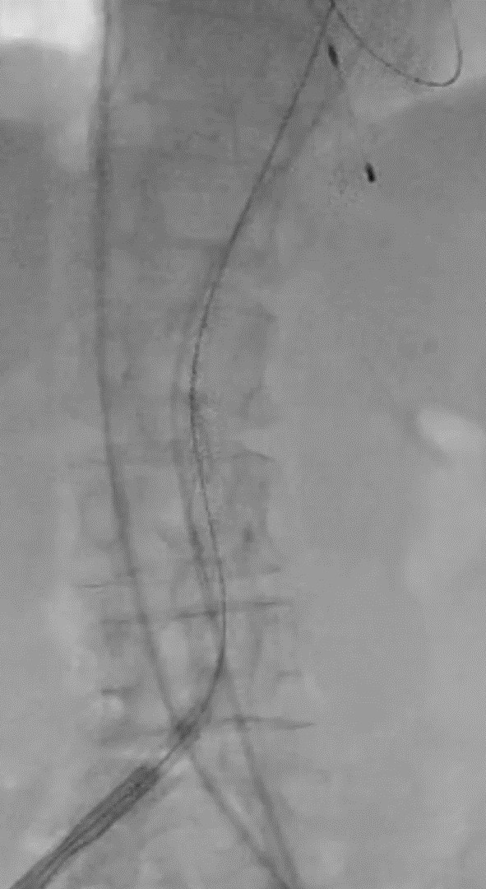
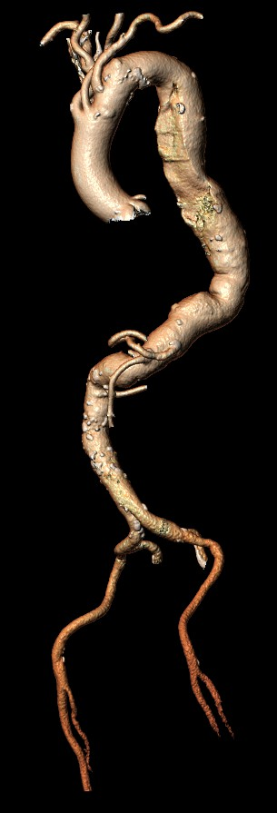
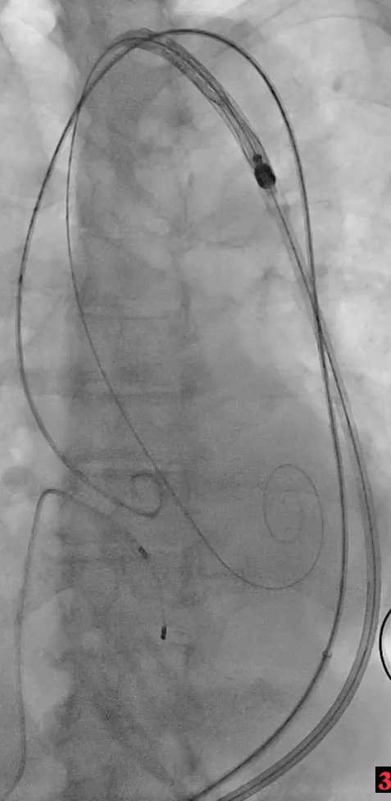
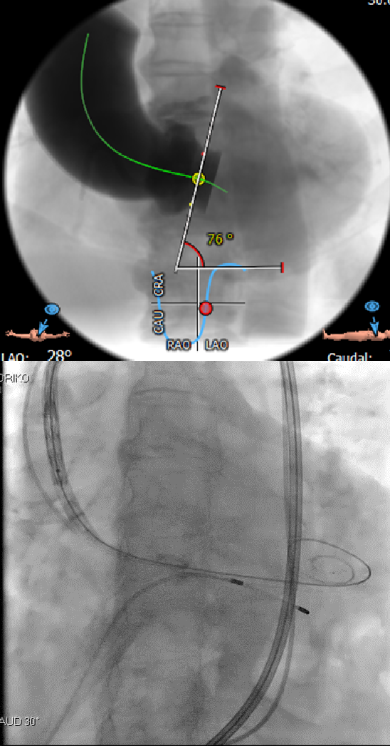
Heavily calcified vascular access: Navitor

Slide 13
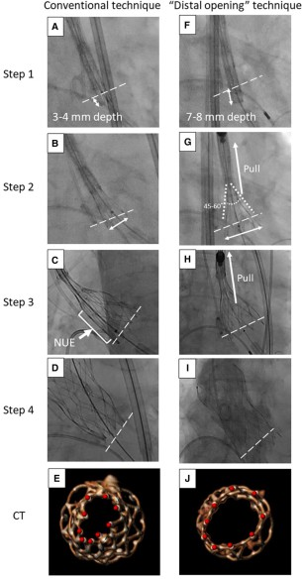
To achieve stable valve deployment
Avoiding non-uniform expansion (NUE) is important
“Distal opening technique”
Much stabler valve deployment
This technique is leading to lower pacemaker requirement
Kobari et al. EHJ Case Rep 2023

Slide 14
Conclusion
Navitor demonstrated excellent short-term clinical outcomes as high technical success, low incidence of significant PVL and PPM, despite small annulus or narrow vascular access
Long-term follow-up in a larger cohort are awaited in the future

Slide 15
The OCEAN-SHD family
The 10-year anniversary: The 21st January 2024
Thank you!!
Slide preparation: Dr. Juri Iwata

Slide 16
PCRonline.com

