Slide 1



EPA Levels and Cardiovascular Outcomes in the Reduction of Cardiovascular Events with Icosapent Ethyl–Intervention Trial
Deepak L. Bhatt, MD, MPH, Michael Miller, MD, Ph. Gabriel Steg, MD, Eliot A. Brinton, MD, Terry A. Jacobson, MD, Steven B. Ketchum, PhD,
Rebecca A. Juliano, PhD, Lixia Jiao, PhD, Ralph T. Doyle, Jr., BA, Christina Copland, PhD, Richard L. Dunbar, MD, Craig Granowitz, MD, PhD, Fabrice MAC Martens, MD, PhD, Matthew Budoff, MD, John R. Nelson, MD, R. Preston Mason, PhD, Peter Libby, MD,
Paul Ridker, MD, Jean-Claude Tardif, MD, Christie M. Ballantyne, MD, on Behalf of the REDUCE-IT Investigators

Slide 2

Disclosures
Dr. Deepak L. Bhatt discloses the following relationships - Advisory Board: Cardax, Cereno Scientific, Elsevier Practice Update Cardiology, Medscape Cardiology, PhaseBio, PLx Pharma, Regado Biosciences; Board of Directors: Boston VA Research Institute, Society of Cardiovascular Patient Care, TobeSoft; Chair: American Heart Association Quality Oversight Committee; Data Monitoring Committees: Baim Institute for Clinical Research (formerly Harvard Clinical Research Institute, for the PORTICO trial, funded by St. Jude Medical, now Abbott), Cleveland Clinic (including for the ExCEED trial, funded by Edwards), Duke Clinical Research Institute, Mayo Clinic, Mount Sinai School of Medicine (for the ENVISAGE trial, funded by Daiichi Sankyo), Population Health Research Institute; Honoraria: American College of Cardiology (Senior Associate Editor, Clinical Trials and News, ACC.org; Vice-Chair, ACC Accreditation Committee), Baim Institute for Clinical Research (formerly Harvard Clinical Research Institute; RE- DUAL PCI clinical trial steering committee funded by Boehringer Ingelheim; AEGIS-II executive committee funded by CSL Behring), Belvoir Publications (Editor in Chief, Harvard Heart Letter), Duke Clinical Research Institute (clinical trial steering committees, including for the PRONOUNCE trial, funded by Ferring Pharmaceuticals), HMP Global (Editor in Chief, Journal of Invasive Cardiology), Journal of the American College of Cardiology (Guest Editor; Associate Editor), Medtelligence/ReachMD (CME steering committees), MJH Life Sciences, Population Health Research Institute (for the COMPASS operations committee, publications committee, steering committee, and USA national co-leader, funded by Bayer), Slack Publications (Chief Medical Editor, Cardiology Today’s Intervention), Society of Cardiovascular Patient Care (Secretary/Treasurer), WebMD (CME steering committees); Other: Clinical Cardiology (Deputy Editor), NCDR-ACTION Registry Steering Committee (Chair), VA CART Research and Publications Committee (Chair); Research Funding: Abbott, Afimmune, Amarin, Amgen, AstraZeneca, Bayer, Boehringer Ingelheim, Bristol-Myers Squibb, Cardax, Chiesi, CSL Behring, Eisai, Ethicon, Ferring Pharmaceuticals, Forest Laboratories, Fractyl, Idorsia, Ironwood, Ischemix, Lexicon, Lilly, Medtronic, Pfizer, PhaseBio, PLx Pharma, Regeneron, Roche, Sanofi Aventis, Synaptic, The Medicines Company; Royalties: Elsevier (Editor, Cardiovascular Intervention: A Companion to Braunwald’s Heart Disease); Site Co-Investigator: Biotronik, Boston Scientific, CSI, St. Jude Medical (now Abbott), Svelte; Trustee: American College of Cardiology; Unfunded Research: FlowCo, Merck, Novo Nordisk, Takeda. This presentation includes off-label and/or investigational uses of drugs.
REDUCE-IT was sponsored by Amarin Pharma, Inc.

Slide 3
REDUCE-IT Design
Key Inclusion Criteria
Statin-treated men and women ≥45 yrs
Established CVD (~70% of patients) or DM + ≥1 risk factor
TG ≥150 mg/dL and
<500 mg/dL*
LDL-C >40 mg/dL and ≤100 mg/dL
Icosapent Ethyl
4 g/day (n=4089)
Primary Endpoint
Time from randomization to the first occurrence of composite of CV death, nonfatal MI, nonfatal stroke, coronary revascularization, unstable angina requiring hospitalization
Lead-in
Statin stabilization
Medication washout
Lipid qualification
1:1
Randomization
with
continuation of stable statin therapy (N=8179)
4 months,
12 months, annually
End-of-study follow-up visit
Placebo
(n=4090)
4 months,
12 months, annually
End-of-study follow-up visit
Screening Period
Double-Blind Treatment/Follow-up Period
Randomization
End of Study
Year Months Visit
Lab values
0
0 4
2 3
Up to 6.2 years†
-1 Month
1
Screening
12
4
Every 12 months
5 6
7
8
9
Final Visit
Baseline
* Due to the variability of triglycerides, a 10% allowance existed in the initial protocol, which permitted patients to be enrolled with qualifying triglycerides ≥135 mg/dL. Protocol amendment 1 (May 2013) changed the lower limit of acceptable triglycerides from 150 mg/dL to 200 mg/dL, with no variability allowance.
† Median trial follow-up duration was 4.9 years (minimum 0.0, maximum 6.2 years).
Adapted with permission^{ǂ} from Bhatt DL, Steg PG, Brinton EA, et al; on behalf of the REDUCE-IT Investigators. Rationale and design of REDUCE-IT: Reduction of Cardiovascular Events with Icosapent Ethyl–Intervention Trial. Clin Cardiol. 2017;40:138-148. REDUCE-IT ClinicalTrials.gov number, NCT01492361. [^{ǂ}https://creativecommons.org/licenses/by-nc/4.0/]

Slide 4
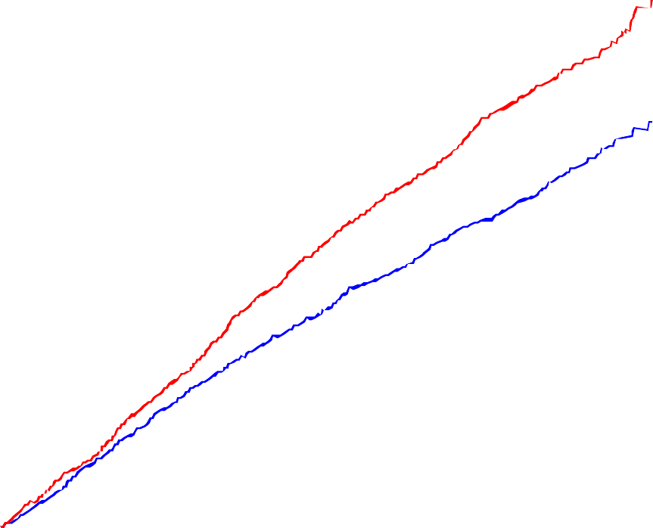
Primary and Key Secondary Composite Endpoints
Primary Composite Endpoint:
CV Death, MI, Stroke, Coronary Revasc, Unstable Angina
Key Secondary Composite Endpoint:
CV Death, MI, Stroke
30 | Hazard Ratio, 0.75 (95% CI, 0.68–0.83) | 28.3% | 30 | Hazard Ratio, 0.74 (95% CI, 0.65–0.83)
20 | RRR = 24.8% _{Placebo} ARR = 4.8% NNT = 21 (95% CI, 15–33) P=0.00000001 | 23.0% | 20 | RRR = 26.5% ARR = 3.6% NNT = 28 (95% CI, 20–47) P=0.0000006 | 20.0% Placebo
Patients with an Event (%)
Patients with an Event (%)
Icosapent Ethyl
16.2%
10
10
Icosapent Ethyl
0
0
0
1
2 3 4
Years since Randomization
5
0
1
2 3 4
Years since Randomization
5
Bhatt DL, Steg PG, Miller M, et al. N Engl J Med. 2019; 380:11-22. Bhatt DL. AHA 2018, Chicago.

Slide 5

First and Subsequent Events – Full Data
RR 0.69
(95% CI, 0.61-0.77)
P=0.0000000004
31% Reduction in Total Events
Number of Primary Composite Endpoint Events
2,000
1,724
≥4 Events
RR 0.46
(95% CI, 0.36-0.60)
3rd Events
HR 0.70
No. of Fewer Cases
-539
-99
-80
-164
-196
184
1,500
176
1,185
85
463
(95% CI, 0.59-0.83)
2nd Events
HR 0.68
(95% CI, 0.60-0.77)
1,000
96
299
500
901
1st Events
HR 0.75
(95% CI, 0.68-0.83) P=0.00000002
705
0
Placebo [N=4090]
Full Dataset Event No.
Icosapent Ethyl [N=4089]
₁st ₂nd ₃rd
≥4
Note: WLW method for the 1st events, 2nd events, and 3rd events categories; Negative binomial model for ≥4th events and overall treatment comparison.
Bhatt DL, Steg PG, Miller M, et al. J Am Coll Cardiol. 2019;73:2791-2802. Bhatt DL. ACC 2019, New Orleans.

Slide 7
Primary and Key Secondary Composite Endpoints by Baseline Serum EPA Tertiles
Interaction P-value
Endpoint
Icosapent Ethyl
Placebo
Hazard Ratio (95% CI)
n/N (%)
n/N (%)
Primary Composite Endpoint (ITT) |  | 705/4089 (17.2%) | 901/4090 (22.0%) |  | 0.75 (0.68-0.83)
Baseline EPA Tertiles (median) µg/mL |  |  |  |  | 0.91
≤20 µg/mL | 14 | 230/1199 (19.2%) | 283/1161 (24.4%) |  | 0.75 (0.63-0.90)
>20–34 µg/mL | 26 | 203/1135 (17.9%) | 263/1217 (21.6%) |  | 0.79 (0.66-0.95)
>34 µg/mL | 48 | 203/1195 (17.0%) | 255/1155 (22.1%) |  | 0.75 (0.63-0.91)
0.1
0.5
1.0
2.0
Icosapent Ethyl Better
Placebo Better
Bhatt DL. ACC/WCC 2020, Chicago (virtual).

Slide 8
Primary and Key Secondary Composite Endpoints by Baseline Serum EPA Tertiles
Interaction P-value
Endpoint
Icosapent Ethyl
Placebo
Hazard Ratio (95% CI)
n/N (%)
n/N (%)
Primary Composite Endpoint (ITT)
705/4089 (17.2%)
901/4090 (22.0%)
0.75 (0.68-0.83)
Baseline EPA Tertiles (median) µg/mL
≤20 µg/mL 14
0.91
230/1199 (19.2%)
283/1161 (24.4%)
0.75 (0.63-0.90)
>20–34 µg/mL 26
>34 µg/mL 48
203/1135 (17.9%)
263/1217 (21.6%)
0.79 (0.66-0.95)
203/1195 (17.0%)
255/1155 (22.1%)
0.75 (0.63-0.91)
Key Secondary Composite Endpoint (ITT)
459/4089 (11.2%)
606/4090 (14.8%)
0.74 (0.65-0.83)
Baseline EPA Tertiles (median) µg/mL
≤20 µg/mL 14
0.90
157/1199 (13.1%)
195/1161 (16.8%)
0.76 (0.61-0.93)
>20–34 µg/mL 26
>34 µg/mL 48
125/1135 (11.0%)
174/1217 (14.3%)
0.74 (0.59-0.94)
132/1195 (11.0%)
177/1155 (15.3%)
0.71 (0.57-0.89)
0.1
0.5
1.0
2.0
Icosapent Ethyl Better
Placebo Better
Bhatt DL. ACC/WCC 2020, Chicago (virtual).

Slide 9
Levels of Eicosapentaenoic Acid (EPA) in Serum
 | Icosapent Ethyl (N=4089) |  |  |  | Placebo (N=4090) |  |  |  | Between Group Difference
Visit | Median Observed Values (µg/mL) | Median Absolute Change from Baseline | Median % Change from Baseline | Median % Change P-value | Median Observed Values (µg/mL) | Median Absolute Change from Baseline | Median % Change from Baseline | Median % Change P-value | Median Absolute Change from Baseline | Median % Change from Baseline | Median % Change P-value
Baseline | 26.1 |  |  |  | 26.1
Year 1 | 144 | 112.6 | 393.5 | <0.0001 | 23.3 | -2.9 | -12.8 | <0.0001 | 114.9 | 385.8 | <0.0001
Year 2 | 169 | 137.3 | 478.6 | <0.0001 | 28 | 0.5 | 2.8 | <0.0001 | 137.1 | 457.4 | <0.0001
Year 3 | 168 | 137.4 | 464.5 | <0.0001 | 27.3 | -0.1 | -0.4 | <0.0001 | 136.9 | 447.5 | <0.0001
Year 4 | 162 | 132.6 | 452.1 | <0.0001 | 26.2 | -1.1 | -5.2 | 0.15 | 133 | 439.8 | <0.0001
Year 5 | 158 | 130.5 | 463.6 | <0.0001 | 25.3 | -0.5 | -2 | 0.09 | 130.8 | 448.1 | <0.0001
Last Visit | 150 | 117.9 | 395.2 | <0.0001 | 26.5 | -0.9 | -3.8 | 0.08 | 119 | 380.3 | <0.0001
On-Treatment EPA Daily Average (derived) | 135.2 | 103.9 | 363.9 | <0.0001 | 27.7 | 0 | 0.2 | <0.0001 | 103.8 | 347.7 | <0.0001
Eicosapentaenoic Acid (EPA)
Year 6 values are not included as the number of patients = 9.
Bhatt DL. ACC/WCC 2020, Chicago (virtual).

Slide 10
Stratified Analysis of Time to Primary Endpoint by Adjusting Time-Varying Covariates of Post-Baseline Biomarkers
Impact on the HR of Between-group Biomarker Differences (Icosapent Ethyl vs Placebo) Primary Composite Endpoint Key Secondary Composite Endpoint
 | HR (95% CI) | Significance P-value | HR (95% CI) | Significance P-value
Overall Trial | 0.75 (0.68–0.83) | 0.00000001 | 0.74 (0.65–0.83) | 0.0000006
 | HR (95% CI) |  | HR (95% CI)
Lipid/Biomarker Covariate | for Treatment Comparison (Adjusting Covariate) | Significance P-value | for Treatment Comparison (Adjusting Covariate) | Significance P-value
EPA (µg/mL) | 1.03 (0.91–1.16) | <0.0001 | 0.98 (0.84–1.14) | <0.0001
Triglycerides (mg/dL) | 0.77 (0.70–0.85) | <0.0001 | 0.75 (0.66–0.85) | <0.0001
LDL-C derived (mg/dL) | 0.75 (0.68–0.83) | 0.80 | 0.74 (0.65–0.84) | 0.38
HDL Cholesterol-CDC (mg/dL) | 0.73 (0.66–0.81) | <0.0001 | 0.71 (0.63–0.80) | <0.0001
Non-HDL Cholesterol (mg/dL) | 0.78 (0.71–0.87) | <0.0001 | 0.77 (0.68–0.87) | <0.0001
Apolipoprotein B (mg/dL) | 0.76 (0.69–0.84) | 0.03 | 0.75 (0.66–0.85) | 0.0004
hsCRP (mg/L) | 0.76 (0.69–0.84) | 0.004 | 0.74 (0.66–0.84) | <0.0001
RLP-C (mg/dL) | 0.78 (0.71–0.87) | <0.0001 | 0.77 (0.68–0.87) | <0.0001
Bhatt DL. ACC/WCC 2020, Chicago (virtual).

Slide 11
Stratified Analysis of Time to Primary Endpoint by Adjusting Time-Varying Covariates of Post-Baseline Biomarkers
Impact on the HR of Between-group Biomarker Differences (Icosapent Ethyl vs Placebo) Primary Composite Endpoint Key Secondary Composite Endpoint
 | HR (95% CI) | Significance P-value | HR (95% CI) | Significance P-value
Overall Trial | 0.75 (0.68–0.83) | 0.00000001 | 0.74 (0.65–0.83) | 0.0000006
 | HR (95% CI) |  | HR (95% CI)
Lipid/Biomarker Covariate | for Treatment Comparison (Adjusting Covariate) | Significance P-value | for Treatment Comparison (Adjusting Covariate) | Significance P-value
EPA (µg/mL) | 1.03 (0.91–1.16) | <0.0001 | 0.98 (0.84–1.14) | <0.0001
Triglycerides (mg/dL) | 0.77 (0.70–0.85) | <0.0001 | 0.75 (0.66–0.85) | <0.0001
LDL-C derived (mg/dL) | 0.75 (0.68–0.83) | 0.80 | 0.74 (0.65–0.84) | 0.38
HDL Cholesterol-CDC (mg/dL) | 0.73 (0.66–0.81) | <0.0001 | 0.71 (0.63–0.80) | <0.0001
Non-HDL Cholesterol (mg/dL) | 0.78 (0.71–0.87) | <0.0001 | 0.77 (0.68–0.87) | <0.0001
Apolipoprotein B (mg/dL) | 0.76 (0.69–0.84) | 0.03 | 0.75 (0.66–0.85) | 0.0004
hsCRP (mg/L) | 0.76 (0.69–0.84) | 0.004 | 0.74 (0.66–0.84) | <0.0001
RLP-C (mg/dL) | 0.78 (0.71–0.87) | <0.0001 | 0.77 (0.68–0.87) | <0.0001
Bhatt DL. ACC/WCC 2020, Chicago (virtual).

Slide 12
Primary and Key Secondary Composite Endpoints, Cardiovascular Death, and
Total Mortality by On-Treatment Serum EPA
Primary Endpoint ¹⁻⁵
Hazard Ratio: Reference to EPA = 26 µg/mL
0.2 0.4 0.6 0.8 1.0 1.2 1.4 1.6 1.8 2.0
26
100 200 300
AUC-Derived Daily Average EPA (µg/mL)
400
No. of
Patients 5196
2400
756
87
10
P*<0.001
Dose-response hazard ratio 95% Confidence Interval (CI)
Note: Area under the curve (AUC)-derived daily average serum EPA (µg/mL) is the daily average of all available post baseline EPA measurements prior to the event. Dose-response hazard ratio (solid line) and 95% CI (dotted lines) are estimated from the Cox proportional hazard model with a spline term for EPA and adjustment for randomization factors and statin compliance¹, age², sex³, baseline diabetes⁴, hsCRP⁵, treatment compliance⁶.
*P value is <0.001 for both non-linear trend and for regression slope.
Bhatt DL. ACC/WCC 2020, Chicago (virtual).

Slide 13
Primary and Key Secondary Composite Endpoints, Cardiovascular Death, and
Total Mortality by On-Treatment Serum EPA
Primary Endpoint ¹⁻⁵ Key Secondary Endpoint ¹⁻⁵
Hazard Ratio: Reference to EPA = 26 µg/mL
0.2 0.4 0.6 0.8 1.0 1.2 1.4 1.6 1.8 2.0
Hazard Ratio: Reference to EPA = 26 µg/mL
0.2 0.4 0.6 0.8 1.0 1.2 1.4 1.6 1.8 2.0
26
100 200 300
AUC-Derived Daily Average EPA (µg/mL)
400
26
100 200 300
AUC-Derived Daily Average EPA (µg/mL)
400
No. of
Patients 5196
2400
756
87
10
5212
2442
771
89
11
P*<0.001 for all
Dose-response hazard ratio
95% Confidence Interval (CI)
Note: Area under the curve (AUC)-derived daily average serum EPA (µg/mL) is the daily average of all available post baseline EPA measurements prior to the event. Dose-response hazard ratio (solid line) and 95% CI (dotted lines) are estimated from the Cox proportional hazard model with a spline term for EPA and adjustment for randomization factors and statin compliance¹, age², sex³, baseline diabetes⁴, hsCRP⁵, treatment compliance⁶.
*P value is <0.001 for both non-linear trend and for regression slope.
Bhatt DL. ACC/WCC 2020, Chicago (virtual).

Slide 14
Primary and Key Secondary Composite Endpoints, Cardiovascular Death, and
Total Mortality by On-Treatment Serum EPA
Primary Endpoint ¹⁻⁵ Key Secondary Endpoint ¹⁻⁵ Cardiovascular Death^{1,2,4-6}
2.0
2.0
2.0
Hazard Ratio: Reference to EPA = 26 µg/mL
0.2 0.4 0.6 0.8 1.0 1.2 1.4 1.6 1.8
Hazard Ratio: Reference to EPA = 26 µg/mL
0.2 0.4 0.6 0.8 1.0 1.2 1.4 1.6 1.8
Hazard Ratio: Reference to EPA = 26 µg/mL
0.2 0.4 0.6 0.8 1.0 1.2 1.4 1.6 1.8
26
100 200 300
AUC-Derived Daily Average EPA (µg/mL)
400
26
100 200 300
AUC-Derived Daily Average EPA (µg/mL)
400
26
100 200 300
AUC-Derived Daily Average EPA (µg/mL)
400
No. of
Patients 5196
2400
756
87
10
5212
2442
771
89
11
5226
2471
789
94
12
P*<0.001 for all
Dose-response hazard ratio
95% Confidence Interval (CI)
Note: Area under the curve (AUC)-derived daily average serum EPA (µg/mL) is the daily average of all available post baseline EPA measurements prior to the event. Dose-response hazard ratio (solid line) and 95% CI (dotted lines) are estimated from the Cox proportional hazard model with a spline term for EPA and adjustment for randomization factors and statin compliance¹, age², sex³, baseline diabetes⁴, hsCRP⁵, treatment compliance⁶.
*P value is <0.001 for both non-linear trend and for regression slope.
Bhatt DL. ACC/WCC 2020, Chicago (virtual).

Slide 15
Primary and Key Secondary Composite Endpoints, Cardiovascular Death, and
Total Mortality by On-Treatment Serum EPA
Primary Endpoint ¹⁻⁵ Key Secondary Endpoint ¹⁻⁵ Cardiovascular Death^{1,2,4-6} Total Mortality^{1,2,4-6}
2.0
2.0
2.0
2.0
Hazard Ratio: Reference to EPA = 26 µg/mL
0.2 0.4 0.6 0.8 1.0 1.2 1.4 1.6 1.8
Hazard Ratio: Reference to EPA = 26 µg/mL
0.2 0.4 0.6 0.8 1.0 1.2 1.4 1.6 1.8
Hazard Ratio: Reference to EPA = 26 µg/mL
0.2 0.4 0.6 0.8 1.0 1.2 1.4 1.6 1.8
Hazard Ratio: Reference to EPA = 26 µg/mL
0.2 0.4 0.6 0.8 1.0 1.2 1.4 1.6 1.8
26
100 200 300
AUC-Derived Daily Average EPA (µg/mL)
400
26
100 200 300
AUC-Derived Daily Average EPA (µg/mL)
400
26
100 200 300
AUC-Derived Daily Average EPA (µg/mL)
400
26
100 200 300
AUC-Derived Daily Average EPA (µg/mL)
400
No. of
Patients 5196
2400
756
87
10
5212
2442
771
89
11
5226
2471
789
94
12
5225
2471
789
94
12
P*<0.001 for all
Dose-response hazard ratio
95% Confidence Interval (CI)
Note: Area under the curve (AUC)-derived daily average serum EPA (µg/mL) is the daily average of all available post baseline EPA measurements prior to the event. Dose-response hazard ratio (solid line) and 95% CI (dotted lines) are estimated from the Cox proportional hazard model with a spline term for EPA and adjustment for randomization factors and statin compliance¹, age², sex³, baseline diabetes⁴, hsCRP⁵, treatment compliance⁶.
*P value is <0.001 for both non-linear trend and for regression slope.
Bhatt DL. ACC/WCC 2020, Chicago (virtual).

Slide 16
Dose-Response of Hazard Ratio (95% CI) Any Myocardial Infarction, Any Stroke,
Coronary Revascularization, Unstable Angina
by On-Treatment Serum EPA
Any Myocardial Infarction¹⁻³
Hazard Ratio: Reference to EPA = 26 µg/mL
0.2 0.4 0.6 0.8 1.0 1.2 1.4 1.6 1.8 2.0
26
100 200 300
AUC-Derived Daily Average EPA (µg/mL)
2449 773 88
400
No. of
Patients 5214
11
P*<0.001
Dose-response hazard ratio
95% Confidence Interval (CI)
Note: Area under the curve (AUC) -derived daily average serum EPA (µg/mL) is the daily average of all available post baseline EPA measurements prior to the event. Dose-response hazard ratio (solid line) and 95% CI (dotted lines) are estimated from the Cox proportional hazard model with a spline term for EPA and adjustment for randomization factors and sex¹, baseline diabetes², hsCRP³, statin compliance⁴, age⁵.
*P value is <0.001 for both non-linear trend and for regression slope.
Bhatt DL. ACC/WCC 2020, Chicago (virtual).

Slide 17
Dose-Response of Hazard Ratio (95% CI) Any Myocardial Infarction, Any Stroke,
Coronary Revascularization, Unstable Angina
by On-Treatment Serum EPA
Any Myocardial Infarction¹⁻³ Any Stroke ^{2,4,5}
Hazard Ratio: Reference to EPA = 26 µg/mL
0.2 0.4 0.6 0.8 1.0 1.2 1.4 1.6 1.8 2.0
Hazard Ratio: Reference to EPA = 26 µg/mL
0.2 0.4 0.6 0.8 1.0 1.2 1.4 1.6 1.8 2.0
26
100
200
300
400
26
100
200
300
400
AUC-Derived Daily Average EPA (µg/mL)
AUC-Derived Daily Average EPA (µg/mL)
No. of
Patients 5214
2449
773
88
11
5224
2464
787
95
12
P*<0.001 for all
Dose-response hazard ratio
95% Confidence Interval (CI)
Note: Area under the curve (AUC) -derived daily average serum EPA (µg/mL) is the daily average of all available post baseline EPA measurements prior to the event. Dose-response hazard ratio (solid line) and 95% CI (dotted lines) are estimated from the Cox proportional hazard model with a spline term for EPA and adjustment for randomization factors and sex¹, baseline diabetes², hsCRP³, statin compliance⁴, age⁵.
*P value is <0.001 for both non-linear trend and for regression slope.
Bhatt DL. ACC/WCC 2020, Chicago (virtual).

Slide 18
Dose-Response of Hazard Ratio (95% CI) Any Myocardial Infarction, Any Stroke,
Coronary Revascularization, Unstable Angina
by On-Treatment Serum EPA
Any Myocardial Infarction¹⁻³ Any Stroke ^{2,4,5} Coronary Revascularization ^{1,2}
2.0
2.0
2.0
Hazard Ratio: Reference to EPA = 26 µg/mL
0.2 0.4 0.6 0.8 1.0 1.2 1.4 1.6 1.8
Hazard Ratio: Reference to EPA = 26 µg/mL
0.2 0.4 0.6 0.8 1.0 1.2 1.4 1.6 1.8
Hazard Ratio: Reference to EPA = 26 µg/mL
0.2 0.4 0.6 0.8 1.0 1.2 1.4 1.6 1.8
26
100
200
300
400
26
100
200
300
400
26
100
200
300
400
AUC-Derived Daily Average EPA (µg/mL)
AUC-Derived Daily Average EPA (µg/mL)
AUC-Derived Daily Average EPA (µg/mL)
No. of
Patients 5214
2449
773
88
11
5224
2464
787
95
12
5204
2424
766
89
10
P*<0.001 for all
Dose-response hazard ratio
95% Confidence Interval (CI)
Note: Area under the curve (AUC) -derived daily average serum EPA (µg/mL) is the daily average of all available post baseline EPA measurements prior to the event. Dose-response hazard ratio (solid line) and 95% CI (dotted lines) are estimated from the Cox proportional hazard model with a spline term for EPA and adjustment for randomization factors and sex¹, baseline diabetes², hsCRP³, statin compliance⁴, age⁵.
*P value is <0.001 for both non-linear trend and for regression slope.
Bhatt DL. ACC/WCC 2020, Chicago (virtual).

Slide 19
Dose-Response of Hazard Ratio (95% CI) Any Myocardial Infarction, Any Stroke,
Coronary Revascularization, Unstable Angina
by On-Treatment Serum EPA
Any Myocardial Infarction¹⁻³ Any Stroke ^{2,4,5} Coronary Revascularization ^{1,2} Unstable Angina ²
2.0
2.0
2.0
2.0
Hazard Ratio: Reference to EPA = 26 µg/mL
0.2 0.4 0.6 0.8 1.0 1.2 1.4 1.6 1.8
Hazard Ratio: Reference to EPA = 26 µg/mL
0.2 0.4 0.6 0.8 1.0 1.2 1.4 1.6 1.8
Hazard Ratio: Reference to EPA = 26 µg/mL
0.2 0.4 0.6 0.8 1.0 1.2 1.4 1.6 1.8
Hazard Ratio: Reference to EPA = 26 µg/mL
0.2 0.4 0.6 0.8 1.0 1.2 1.4 1.6 1.8
26
100
200
300
400
26
100
200
300
400
26
100
200
300
400
26
100
200
300
400
AUC-Derived Daily Average EPA (µg/mL)
AUC-Derived Daily Average EPA (µg/mL)
AUC-Derived Daily Average EPA (µg/mL)
AUC-Derived Daily Average EPA (µg/mL)
No. of
Patients 5214
2449
773
88
11
5224
2464
787
95
12
5204
2424
766
89
10
5224
2455
785
92
12
P*<0.001 for all
Dose-response hazard ratio
95% Confidence Interval (CI)
Note: Area under the curve (AUC) -derived daily average serum EPA (µg/mL) is the daily average of all available post baseline EPA measurements prior to the event. Dose-response hazard ratio (solid line) and 95% CI (dotted lines) are estimated from the Cox proportional hazard model with a spline term for EPA and adjustment for randomization factors and sex¹, baseline diabetes², hsCRP³, statin compliance⁴, age⁵.
*P value is <0.001 for both non-linear trend and for regression slope.
Bhatt DL. ACC/WCC 2020, Chicago (virtual).

Slide 20
Dose-Response of Hazard Ratio (95% CI) Primary Composite Endpoint by
On-Treatment Serum EPA
Established Cardiovascular Disease or Diabetes with Risk Factors
1-5
Primary Endpoint: Established Cardiovascular Disease
Hazard Ratio: Reference to EPA = 26 µg/mL
0.2 0.4 0.6 0.8 1.0 1.2 1.4 1.6 1.8 2.0
26
100 200 300
AUC-Derived Daily Average EPA (µg/mL)
1733 549 67
400
No. of Patients 3765
9
P*<0.001
Dose-response hazard ratio
95% Confidence Interval (CI)
Note: Area under the curve (AUC)-derived daily average serum EPA (µg/mL) is the daily average of all available post baseline EPA measurements prior to the event. Dose-response hazard ratio (solid line) and 95% CI (dotted lines) are estimated from the Cox proportional hazard model with a spline term for EPA and adjustment for randomization factors and statin compliance¹, age², sex³, baseline diabetes⁴, hsCRP⁵.
*P value is <0.001 for both non-linear trend and for regression slope.
Bhatt DL. ACC/WCC 2020, Chicago (virtual).

Slide 21
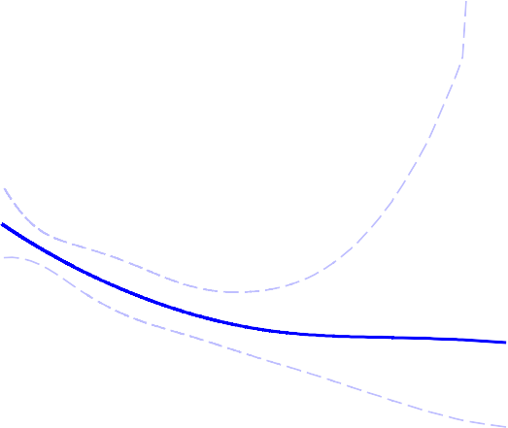
Dose-Response of Hazard Ratio (95% CI) Primary Composite Endpoint by
On-Treatment Serum EPA
Established Cardiovascular Disease or Diabetes with Risk Factors
1-5
Primary Endpoint: Established Cardiovascular Disease
1-5
Primary Endpoint: Diabetes with Risk Factors
2.0
2.0
Hazard Ratio: Reference to EPA = 26 µg/mL
1.8
Hazard Ratio: Reference to EPA = 26 µg/mL
0.2 0.4 0.6 0.8 1.0 1.2 1.4 1.6 1.8
1.6
1.4
1.2
1.0
0.8
0.6
0.4
0.2
26
100 200 300
AUC-Derived Daily Average EPA (µg/mL)
1733 549 67
400
26
100 200 300
AUC-Derived Daily Average EPA (µg/mL)
667 207 20
400
No. of Patients 3765
9
1431
1
P*<0.001 for all
Dose-response hazard ratio
95% Confidence Interval (CI)
Note: Area under the curve (AUC)-derived daily average serum EPA (µg/mL) is the daily average of all available post baseline EPA measurements prior to the event. Dose-response hazard ratio (solid line) and 95% CI (dotted lines) are estimated from the Cox proportional hazard model with a spline term for EPA and adjustment for randomization factors and statin compliance¹, age², sex³, baseline diabetes⁴, hsCRP⁵.
*P value is <0.001 for both non-linear trend and for regression slope.
Bhatt DL. ACC/WCC 2020, Chicago (virtual).

Slide 22
Dose-Response of Hazard Ratio (95% CI) Sudden Cardiac Death, Cardiac Arrest,
New Heart Failure Requiring Hospitalization,
New Heart Failure by On-Treatment Serum EPA
Sudden Cardiac Death¹⁻⁴
Hazard Ratio: Reference to EPA = 26 µg/mL
0.2 0.4 0.6 0.8 1.0 1.2 1.4 1.6 1.8 2.0
26
100 200 300
AUC-Derived Daily Average EPA (µg/mL)
400
No. of
Patients 5226 2471
789
94
12
P*<0.001
Dose-response hazard ratio
95% Confidence Interval (CI)
Note: On-treatment post baseline serum EPA (µg/mL) is the daily average of all available post baseline EPA measurements prior to the event. Dose-response hazard ratio (solid line) and 95% CI (dotted lines) are estimated from the Cox proportional hazard model with a spline term for EPA and adjustment for randomization factors and statin compliance¹, baseline diabetes², and hsCRP³, treatment compliance⁴ age⁵.
*P value is <0.001 for both non-linear trend and for regression slope.
Bhatt DL. ACC/WCC 2020, Chicago (virtual).

Slide 23
Dose-Response of Hazard Ratio (95% CI) Sudden Cardiac Death, Cardiac Arrest,
New Heart Failure Requiring Hospitalization,
New Heart Failure by On-Treatment Serum EPA
Sudden Cardiac Death¹⁻⁴ Cardiac Arrest ¹
Hazard Ratio: Reference to EPA = 26 µg/mL
0.2 0.4 0.6 0.8 1.0 1.2 1.4 1.6 1.8 2.0
Hazard Ratio: Reference to EPA = 26 µg/mL
0.2 0.4 0.6 0.8 1.0 1.2 1.4 1.6 1.8 2.0
26
100
200
300
400
26
100
200
300
400
No. of
Patients 5226
AUC-Derived Daily Average EPA (µg/mL)
AUC-Derived Daily Average EPA (µg/mL)
2471
789
94
12
5225
2471
787
93
12
P*<0.001 for all
Dose-response hazard ratio
95% Confidence Interval (CI)
Note: On-treatment post baseline serum EPA (µg/mL) is the daily average of all available post baseline EPA measurements prior to the event. Dose-response hazard ratio (solid line) and 95% CI (dotted lines) are estimated from the Cox proportional hazard model with a spline term for EPA and adjustment for randomization factors and statin compliance¹, baseline diabetes², and hsCRP³, treatment compliance⁴ age⁵.
*P value is <0.001 for both non-linear trend and for regression slope.
Bhatt DL. ACC/WCC 2020, Chicago (virtual).

Slide 24
Dose-Response of Hazard Ratio (95% CI) Sudden Cardiac Death, Cardiac Arrest,
New Heart Failure Requiring Hospitalization,
New Heart Failure by On-Treatment Serum EPA
New Heart Failure Requiring
Sudden Cardiac Death¹⁻⁴ Cardiac Arrest ¹ Hospitalization^{1-3,5}
2.0
2.0
2.0
Hazard Ratio: Reference to EPA = 26 µg/mL
0.2 0.4 0.6 0.8 1.0 1.2 1.4 1.6 1.8
Hazard Ratio: Reference to EPA = 26 µg/mL
0.2 0.4 0.6 0.8 1.0 1.2 1.4 1.6 1.8
Hazard Ratio: Reference to EPA = 26 µg/mL
0.2 0.4 0.6 0.8 1.0 1.2 1.4 1.6 1.8
26
100 200 300
AUC-Derived Daily Average EPA (µg/mL)
2471 789 94
400
26
100 200 300
AUC-Derived Daily Average EPA (µg/mL)
2471 787 93
400
26
100 200 300
AUC-Derived Daily Average EPA (µg/mL)
400
No. of
Patients 5226
12
5225
12 5221 2461 786 93
12
P*<0.001 for all
Dose-response hazard ratio 95% Confidence Interval (CI)
Note: On-treatment post baseline serum EPA (µg/mL) is the daily average of all available post baseline EPA measurements prior to the event. Dose-response hazard ratio (solid line) and 95% CI (dotted lines) are estimated from the Cox proportional hazard model with a spline term for EPA and adjustment for randomization factors and statin compliance¹, baseline diabetes², and hsCRP³, treatment compliance⁴ age⁵.
*P value is <0.001 for both non-linear trend and for regression slope.
Bhatt DL. ACC/WCC 2020, Chicago (virtual).

Slide 25
Dose-Response of Hazard Ratio (95% CI) Sudden Cardiac Death, Cardiac Arrest,
New Heart Failure Requiring Hospitalization,
New Heart Failure by On-Treatment Serum EPA
New Heart Failure Requiring
Sudden Cardiac Death¹⁻⁴ Cardiac Arrest ¹ Hospitalization^{1-3,5} New Heart Failure^{1-3,5}
2.0
2.0
2.0
2.0
Hazard Ratio: Reference to EPA = 26 µg/mL
0.2 0.4 0.6 0.8 1.0 1.2 1.4 1.6 1.8
Hazard Ratio: Reference to EPA = 26 µg/mL
0.2 0.4 0.6 0.8 1.0 1.2 1.4 1.6 1.8
Hazard Ratio: Reference to EPA = 26 µg/mL
0.2 0.4 0.6 0.8 1.0 1.2 1.4 1.6 1.8
Hazard Ratio: Reference to EPA = 26 µg/mL
0.2 0.4 0.6 0.8 1.0 1.2 1.4 1.6 1.8
26
100 200 300
AUC-Derived Daily Average EPA (µg/mL)
2471 789 94
400
26
100 200 300
AUC-Derived Daily Average EPA (µg/mL)
2471 787 93
400
26
100 200 300
AUC-Derived Daily Average EPA (µg/mL)
400
26
100 200 300
AUC-Derived Daily Average EPA (µg/mL)
2455 780 93
400
No. of
Patients 5226
12
5225
12 5221 2461 786 93
12
5221
12
P*<0.001 for all
Dose-response hazard ratio 95% Confidence Interval (CI)
Note: On-treatment post baseline serum EPA (µg/mL) is the daily average of all available post baseline EPA measurements prior to the event. Dose-response hazard ratio (solid line) and 95% CI (dotted lines) are estimated from the Cox proportional hazard model with a spline term for EPA and adjustment for randomization factors and statin compliance¹, baseline diabetes², and hsCRP³, treatment compliance⁴ age⁵.
*P value is <0.001 for both non-linear trend and for regression slope.
Bhatt DL. ACC/WCC 2020, Chicago (virtual).

Slide 26
Limitations
~14% of the patients did not have baseline EPA levels
Bhatt DL. ACC/WCC 2020, Chicago (virtual).

Slide 27
Limitations
~14% of the patients did not have baseline EPA levels
Though the baseline characteristics and outcomes between those with and without missing data were similar
Bhatt DL. ACC/WCC 2020, Chicago (virtual).

Slide 28
Limitations
~14% of the patients did not have baseline EPA levels
Though the baseline characteristics and outcomes between those with and without missing data were similar
On-treatment dose-response analyses of the hazard ratio for bleeding, serious bleeding, and atrial fibrillation/flutter are not yet available
Bhatt DL. ACC/WCC 2020, Chicago (virtual).

Slide 29
Limitations
~14% of the patients did not have baseline EPA levels
Though the baseline characteristics and outcomes between those with and without missing data were similar
On-treatment dose-response analyses of the hazard ratio for bleeding, serious bleeding, and atrial fibrillation/flutter are not yet available
Results only apply to this specific icosapent ethyl formulation of EPA
Bhatt DL. ACC/WCC 2020, Chicago (virtual).

Slide 30
Limitations
~14% of the patients did not have baseline EPA levels
Though the baseline characteristics and outcomes between those with and without missing data were similar
On-treatment dose-response analyses of the hazard ratio for bleeding, serious bleeding, and atrial fibrillation/flutter are not yet available
Results only apply to this specific icosapent ethyl formulation of EPA
EPA within blood can distribute differentially, possibly resulting in differential downstream tissue distribution
Bhatt DL. ACC/WCC 2020, Chicago (virtual).

Slide 31
Limitations
~14% of the patients did not have baseline EPA levels
Though the baseline characteristics and outcomes between those with and without missing data were similar
On-treatment dose-response analyses of the hazard ratio for bleeding, serious bleeding, and atrial fibrillation/flutter are not yet available
Results only apply to this specific icosapent ethyl formulation of EPA
EPA within blood can distribute differentially, possibly resulting in differential downstream tissue distribution
Omega-3 fatty acid mixtures do not just contain EPA
Bhatt DL. ACC/WCC 2020, Chicago (virtual).

Slide 32
Limitations
~14% of the patients did not have baseline EPA levels
Though the baseline characteristics and outcomes between those with and without missing data were similar
On-treatment dose-response analyses of the hazard ratio for bleeding, serious bleeding, and atrial fibrillation/flutter are not yet available
Results only apply to this specific icosapent ethyl formulation of EPA
EPA within blood can distribute differentially, possibly resulting in differential downstream tissue distribution
Omega-3 fatty acid mixtures do not just contain EPA
EPA and DHA appear to have many differing biological effects in clinical studies and experimental models
Bhatt DL. ACC/WCC 2020, Chicago (virtual).

Slide 33
Limitations
~14% of the patients did not have baseline EPA levels
Though the baseline characteristics and outcomes between those with and without missing data were similar
On-treatment dose-response analyses of the hazard ratio for bleeding, serious bleeding, and atrial fibrillation/flutter are not yet available
Results only apply to this specific icosapent ethyl formulation of EPA
EPA within blood can distribute differentially, possibly resulting in differential downstream tissue distribution
Omega-3 fatty acid mixtures do not just contain EPA
EPA and DHA appear to have many differing biological effects in clinical studies and experimental models
Might explain lack of benefit of other omega-3 trials
Bhatt DL. ACC/WCC 2020, Chicago (virtual).

Slide 34
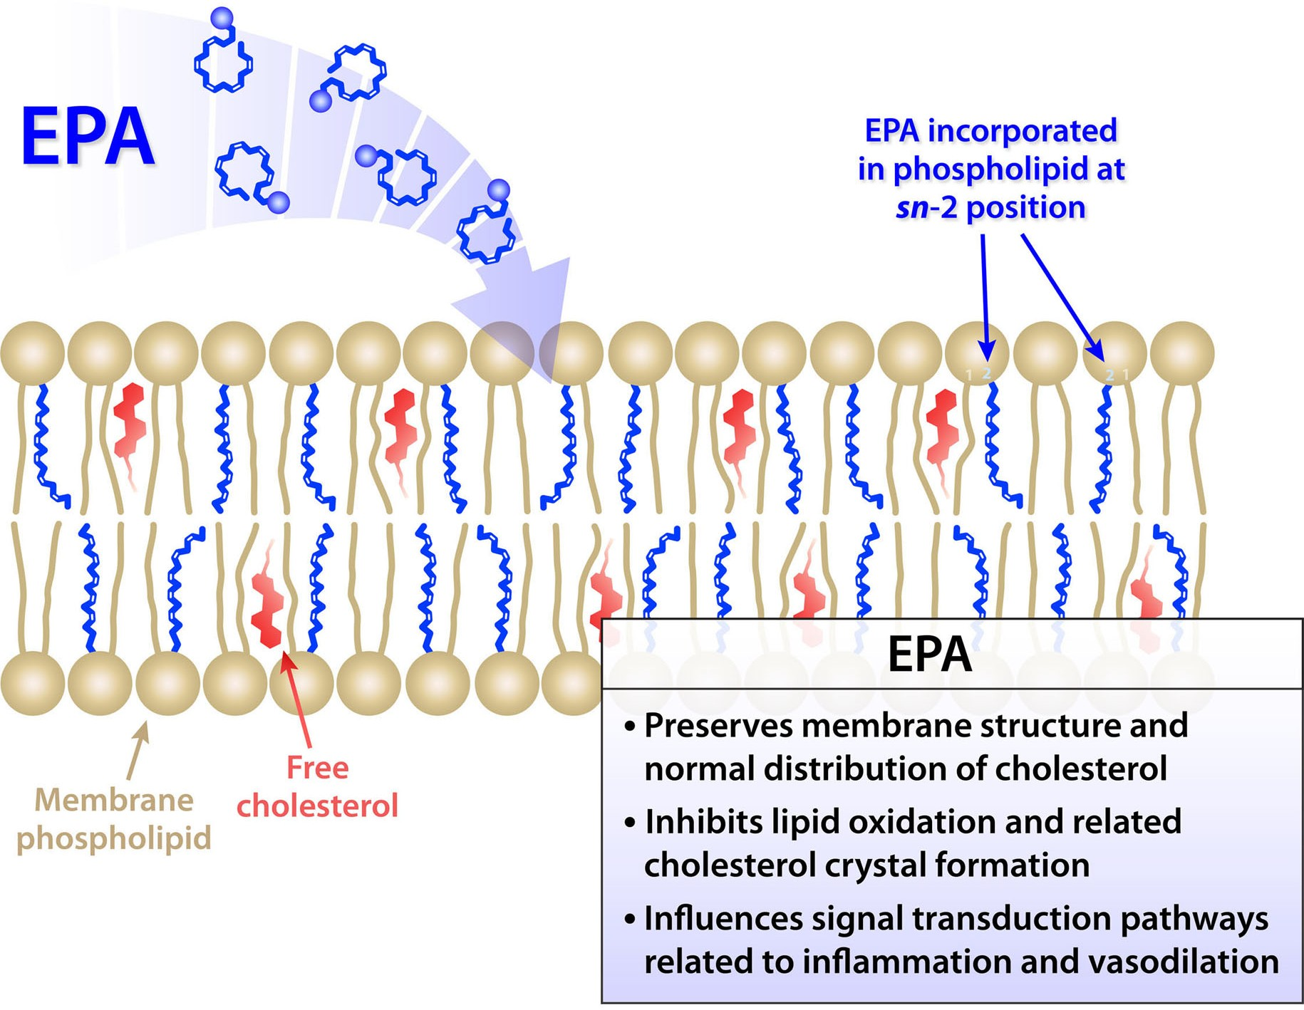
Contrasting Effects of EPA and DHA
Mason PR, Libby P, Bhatt DL. Arteriosclerosis, Thrombosis, and Vascular Biology 2020. In press. Permission Pending.

Slide 35
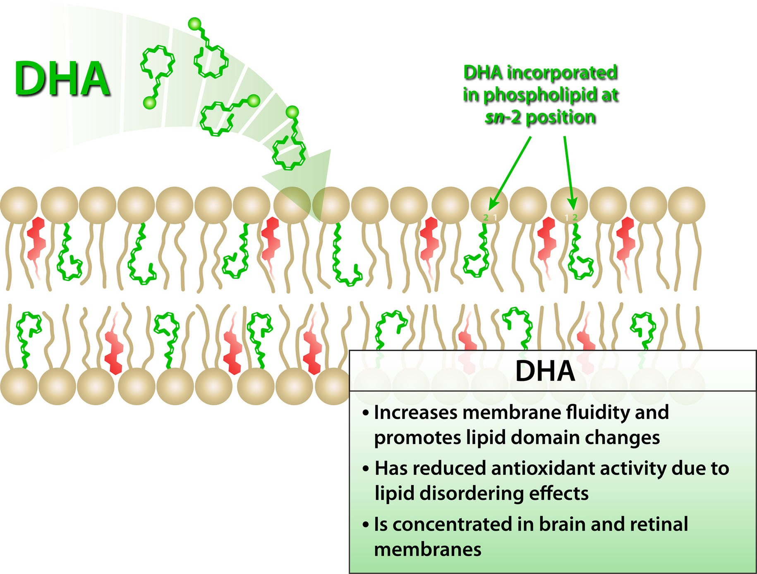
Contrasting Effects of EPA and DHA
Mason PR, Libby P, Bhatt DL. Arteriosclerosis, Thrombosis, and Vascular Biology 2020. In press.

Slide 36
Conclusions
Compared with placebo, icosapent ethyl 4g/day significantly reduced first and total cardiovascular events by 25% and 30%, respectively.
Bhatt DL. ACC/WCC 2020, Chicago (virtual).

Slide 37
Conclusions
Compared with placebo, icosapent ethyl 4g/day significantly reduced first and total cardiovascular events by 25% and 30%, respectively.
These benefits were beyond what can be explained by the degree of triglyceride or other biomarker changes.
Bhatt DL. ACC/WCC 2020, Chicago (virtual).

Slide 38
Conclusions
Compared with placebo, icosapent ethyl 4g/day significantly reduced first and total cardiovascular events by 25% and 30%, respectively.
These benefits were beyond what can be explained by the degree of triglyceride or other biomarker changes.
On-treatment EPA levels via icosapent ethyl correlate strongly with the primary endpoint, the key secondary endpoint, CV death, MI, stroke, coronary revascularization, unstable angina, sudden cardiac death, cardiac arrest, new heart failure, and all-cause mortality.
Bhatt DL. ACC/WCC 2020, Chicago (virtual).

Slide 39
Conclusions
Compared with placebo, icosapent ethyl 4g/day significantly reduced first and total cardiovascular events by 25% and 30%, respectively.
These benefits were beyond what can be explained by the degree of triglyceride or other biomarker changes
On-treatment EPA levels via icosapent ethyl correlate strongly with the primary endpoint, the key secondary endpoint, CV death, MI, stroke, coronary revascularization, unstable angina, sudden cardiac death, cardiac arrest, new heart failure, and all-cause mortality.
These data provide a mechanistic underpinning for the large risk reductions seen in multiple endpoints with icosapent ethyl in REDUCE-IT.
Bhatt DL. ACC/WCC 2020, Chicago (virtual).

Slide 40































































































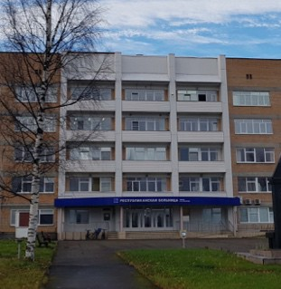










We thank the investigators, the study coordinators, and especially the 8,179 patients in REDUCE-IT!
L--MARC

Slide 41
Slides available for free download: www.acc.org

