Slide 1
Drug Coated Balloons for Coronary Application in US:
Regulatory Requirements
P F Adrian Magee, MD
Division of Cardiovascular Devices
Center for Devices and Radiological Health (CDRH)
adrian.magee@fda.hhs.gov
DCB Technology Symposium
CRT 2015
Washington, DC
February 23, 2015

Slide 2
Conflict of Interest
No conflicts of interest to report.

Slide 3
Presentation Overview
Define Device
  Combination device
Regulatory Pathway
  IDE
  PMA
Preclinical Testing
  Bench Testing
  Animal Testing
Clinical Study
  RCT preferred
Final Regulatory Comments

Slide 4
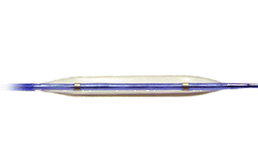
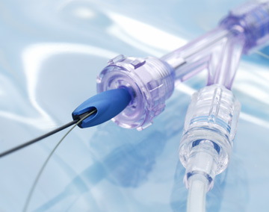
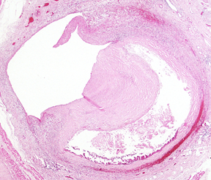
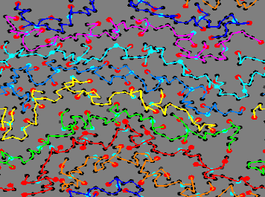
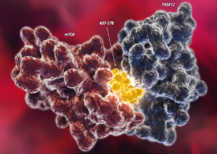
Components of a Drug-Eluting Balloon (DCB)
Combination Product
PTCA Balloon
Delivery System
Coating/Excipient
Therapeutic Agent

Slide 5
DCB Regulatory Submission Pathway
Drug Coated Balloon (DCB) is a Combination Device
  Complex regulatory review process (CDRH/CDER)
  Significant Risk Product (Class III)
    Investigational Device Exemption (IDE) required to conduct clinical study in the US
Premarket Approval Application (PMA)
  Comprehensive review of bench testing, animal studies, & all clinical data
  Threshold for FDA approval is a reasonable assurance of safety and effectiveness

Slide 6
Targeting IDE and PMA Approval
To initiate an IDE study in the US:
  Identify and justify bench & animal studies to provide adequate safety information to support the IDE
  Leverage clinical information, if available
  Include risk mitigation strategies in the clinical study protocol
  Some nonclinical studies can be performed concurrent with clinical studies
For PMA approval:
  Complete characterization of the finished sterilized product
  Review of pivotal trial and other available clinical data
  Benefit-risk assessment

Slide 7
Nonclinical Testing
FDA seeks data to support that the finalized DCB:
  Can be reproducibly manufactured with respect to coating integrity and uniformity and shelf life stability
  Retains a consistent uniform amount of residual drug on the balloon following catheter advancement to the target lesion
  Provides consistent drug delivery to the artery that:
    Delivers drug uniformly along the length of the target lesion
    Can inhibit neointimal growth
    Does not produce local toxic effects
    Does not produce off-target adverse events (from systemic drug concentrations)

Slide 8
Nonclinical Testing:
Bench Testing
Refer to FDA Guidance Documents (FDA Website)
  Combination Product: Current Good Manufacturing Practice Requirements for Combination Products (Draft Document)
  PTCA component: Class II Special Controls Guidance for PTCA Catheters
  Drug component: Coronary DES Guidance (Draft Document)
Bench Testing to Support
  Proposed indication for use (e.g., de novo lesions, small vessels, bifurcation side branches, in-stent restenosis)
  Encompass product matrix (range of balloon diameters/sizes)
  Expected worst case clinical use scenario
Realities of bench testing evaluation
  Some traditional test methods not applicable or lack acceptance criteria
    May be possible to leverage acceptable in vivo animal study safety data and available clinical data to address some concerns e.g., regarding tissue or serum drug levels or particulate generation
Notes:
8

Slide 9
Nonclinical Testing:
Animal Studies
Assess simulated DCB Performance & Handling
  Deliverability
  Balloon inflation
  Balloon withdrawal
Assess local Toxicity from High Dose Drug Delivery
  Vascular healing
  Thrombus & Inflammation
  Re-endothelialization
  Edge effects & remodeling (positive/negative)
  Safety margin overdose studies
  Assess downstream effects (micro embolization)
Notes:
Downstream pathology or clinical signs: myocardium ± gait (peripheral applications)

Slide 10
Nonclinical Testing:
Animal Studies
GLP or justify non-GLP
  See FDA GLP Draft Guidance Document (FDA Website)
Establish expectation of effectiveness
  Inhibition of neointimal proliferation
Typical time points for tissue harvest & analysis
  Swine Model
    3-5 days
    30 days
    90 days*
    180 days
    *Can often be used to support initiation of IDE study, if results acceptable

Slide 11
Clinical Studies
Feasibility Study (Early vs. Traditional)
  Focus on initial assessment of device handling & performance, proof of concept, and safety
  Provide acceptable results to justify a larger pivotal trial
  May Inform design of the pivotal IDE trial
Pivotal trial
  Randomized Control Trial recommended
Worldwide Clinical Experience
  May be possible to leverage OUS data in support of DCB safety and effectiveness

Slide 12
Clinical Studies:
Pivotal Trial Design
Endpoints
  Clinical Endpoint: Target Lesion Failure (preferred for primary endpoint)
  Angiographic Endpoint: %DS/MLD preferable to LLL for DES Vs. DCB
Identify Target lesions
  De novo lesions, small vessels, bifurcation lesions, in-stent restenosis
Consider Appropriate Control Group
  Current ‘standard of care’/approved devices (DES for most coronary subsets)

Slide 13
Clinical Studies:
Other Clinical Trial Considerations
Standardize DCB Procedure
  Pre-dilatation procedure
  Clarify balloon inflation time & single use or multiple inflations of an individual DCB
  Bailout strategy for suboptimal acute result with DCB
Explore Procedural and Device Success
  Device Success (acceptable post-deployment stenosis with the test device alone)
    Assess rates of arterial dissection and vessel recoil
  Procedure Success (DCB plus adjunctive procedures/devices)
    Need for adjunctive stent implantation may confound acute & late results
  Clinical Success (Device success without in-hospital MACE)
Consider Duration of Dual Antiplatelet Therapy (DAPT)
  Propose and justify duration of DAPT use post-DCB use
  Important to capture subject compliance with DAPT

Slide 14
Final Regulatory Comments
Early Discussions with FDA Encouraged
  Avoid wasted steps and misspent resources
    The rate limiting step to initiating an IDE study is most frequently inadequate or incomplete preclinical device testing and characterization rather than clinical study design
  Pre-submission Process (recommended)
    Guidance Document: Pre-Submission Program and Meetings with FDA
  Contact: Adrian.Magee@FDA.HHS.gov

