Slide 1
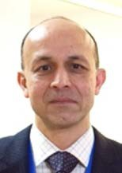
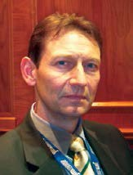
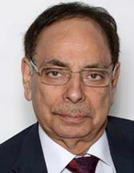
Late-Breaking Trials 2, Co-Sponsored by Circulation
A Randomized Trial Evaluating an Ultra-thin Strut Bioresorbable Polymer-based Coronary Drug Eluting Stent in an All-comers Patients Population
Patrick W. Serruys, MD PhD Imperial College London, United Kingdom Erasmus University, Rotterdam, the Netherlands
Azfar Zaman, Robbert J de Winter, Upendra Kaul On behalf of the TALENT Investigators
Saturday, Sep 22, 2018, 08:30 PM – 08:35 PM, ROOM 7 upper level
1

Slide 2
Disclosure Statement of Financial Interest
Within the past 12 months, I or my spouse/partner have had a financial interest/arrangement or affiliation with the organization(s) listed below.
Affiliation/Financial Relationship
Company
Grant/Research Support
Consulting Fees/Honoraria
Abbott
Biosensors
Medtronic
Micell
Sinomedical Sciences Technology
Philips/Volcano
Xeltis
HeartFlow
All TCT 2018 faculty disclosures are listed online and on the App.
2

Slide 3
The price cap of coronary stent in India
The Indian stent market is around 0.55 million stents annually, with more than 90% DES (values about 531 million USD).
The market is growing around 15% annually.
It is expected to become the 2nd largest international market after China by 2020.
Stent price in India
DES BMS
$1800
New pricing policy
Feb 2017
$670
$440
$110
DES
pre
BMS
DES post BMS
- P ositive im pact -
More people can afford PCI.
More patients with multivessel disease will opt for PCI instead of CABG.
Boost for domestic industry and made in India DES.
> A regulation required for Indian companies to demonstrate that their product is non-inferior to other proven stents, by outcomes data in RCT _{TALENT}
3

Slide 4
Trial organization (investigator-initiated trial)
Sponsor: European Clinical Research Institute (www.ECRI-trials.com)
Grant giver:
SMT (Supraflex SES)
Clinical Research Organization: Cardialysis
Statistical analysis: Cardialysis
Clinical event committee (CEC)
Prof. W. Rutsch (Catheterisation Laboratories Charité, University Clinic Berlin, Germany)
Dr. S. Garg (Central Manchester & Manchester children’s Foundation Trust, East Lancashire NHS Trust United Kingdom)
Dr. J-P. R. Herrman (Onze Lieve Vrouwe Gasthuis, Amsterdam, The Netherlands)
Dr. B. Rensing (St. Antonius Ziekenhuis, Nieuwegein, the Netherlands)
Data and Safety Monitoring Board (DSMB)
Prof. S. James (DSMB Chairman, Uppsala University, Sweden)
Prof. H. Boersma (DSMB Biostatistician, Erasmus Medical Center, Rotterdam, the Netherlands)
Dr. J. ten Berg (DSMB member, St. Antonius Hospital, Nieuwegein, the
Netherlands)
4

Slide 5
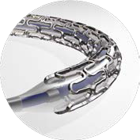
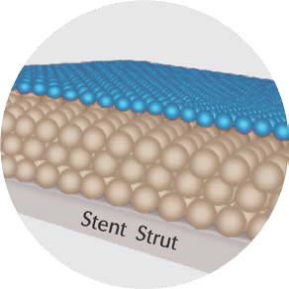
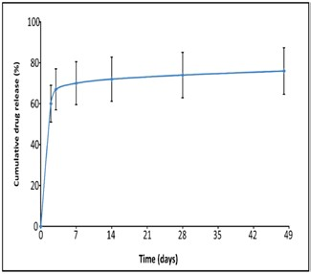
Supraflex SES
Platform
Stent material
CoCr (L605) with
highly flexible ‘S–link’ interconnector
60 μm across all stent diameters (2.0 to 4.5mm)
Top layer
0% drug
Protective layer (PVP: _{poly-vinylpyrrolidone})
100% drug (Sirolimus)
PLLA and PLGA
Circumferential
The average thickness: 4-5 μm
Strut thickness
Carrier
Biodegradable polymer matrix
- Base layer
PVP
PLLA/PLGA
with Sirolimus
Coating
Drug
Sirolimus
1.4 μg/mm²
Release profile
1. Initial burst
70% released within 7 days
Aiming to prevent excessive cell growth
2. Sustained release up to 48 days
5

Slide 6
TALENT study flow chart
“All-comers” population Any ischemic coronary syndrome (STEMI, NSTEMI, UAP,SAP) Any type of lesions Left main SVG CTO Bifurcation ISR etc. Unrestricted use of DES (number, length)
 | Primary Endpoint: non-inferiority comparison of DOCE at 12 months * Intention-to-treat analysis
 | DOCE is defined as a composite of cardiac death, target vessel myocardial infarction**, and clinically-indicated target lesion revascularization
All-comers patient population 1435 patients from 23 enrolling sites
Randomization (1:1)
Supraflex SES N=720
Xience EES N=715
11 withdrew consent
7 withdrew consent 1 lost follow up
709 (98.4%) 707 (98.8%)
- included in ITT analysis - included in ITT analysis
**Definition of MI: SCAI consensus for periprocedural MI with 48 hours after index PCI and 3rd Universal definition later than 48 hours after the index procedure.
8

Slide 7
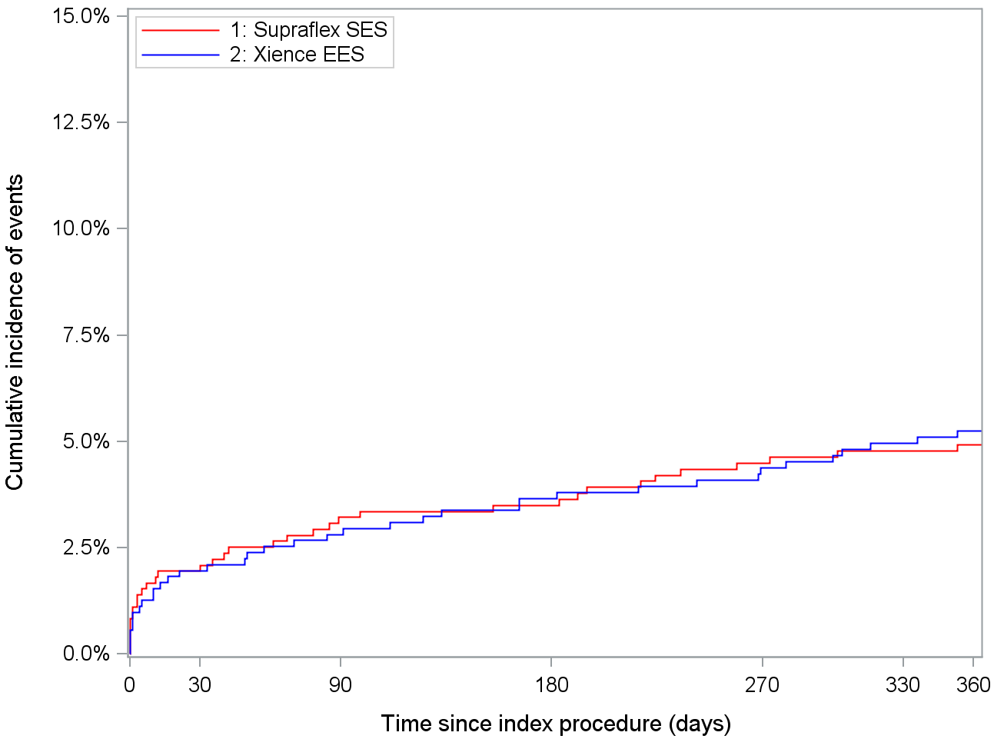
Primary endpoint: DOCE
(ITT)
(A composite of cardiac death, TV-MI, CI-TLR)
Supraflex Xience
-0.3% (95%CI: -2.6 to 2.0%), p=0.801
5.3% (37)
4.9% (35)
Supraflex
Xience
At risk At risk
720 | 689 | 684 | 665 | 655
715 | 686 | 679 | 665 | 653

Slide 8
Primary endpoint: non-inferiority of DOCE
(A composite of cardiac death, TV-MI, CI-TLR)
(ITT)
Primary endpoint | Supraflex n=720 | Xience n=715 | Difference | One sided 95% upper confidence bound | Non- inferiority margin | P-value for non- inferiority
DOCE | 4.9% | 5.3% | -0.3% | 1.6% | ^{2.12%} <=0.0119
4.0%
(35)
(37)
Favors Supraflex
Favors Xience
Resolute All-comers
Non-inferiority margin
Xience arm
One-sided 95%
_{-0.3%} confidence bound
-4%
0
2.12%
4%
8%
8.3%
1.6%
Treatment difference (Supraflex – Xience)
- % of events (DOCE)

Slide 9
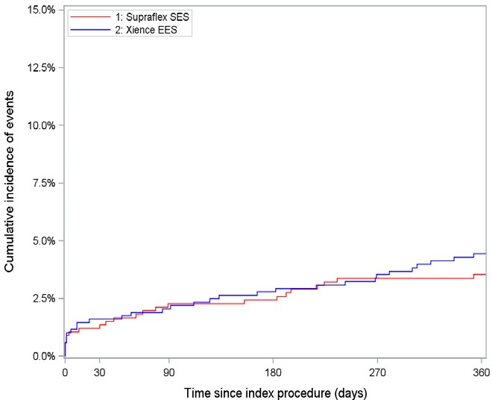
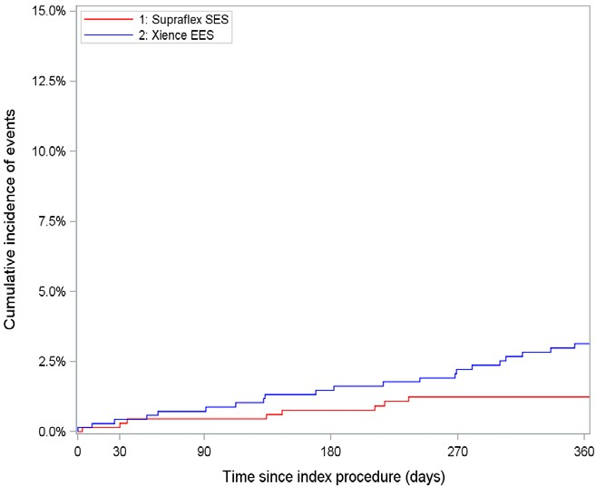
_{Per-protocol analysis} (including patients who have received
only the assigned study stent)
Supraflex |  | Xience
n=660 |  | n=685 | Percentage difference | p
 |  |  | (95% CI) | value
DOCE | 3.5% (23) | 4.4% (30) | -0.9% (-3.0 to 1.2%) | 0.411
Cardiac death | 1.1% (7) | 0.3% (2) | 0.8% (-0.1 to 1.7%) | 0.084
TV-MI | 2.2% (14) | 2.8% (19) | -0.6% (-2.3 to 1.0%) | 0.447
CI-TLR | 1.2% (8) | 3.1% (21) | -1.9% (-3.5 to -0.3%) | 0.021
DOCE
CI-TLR
P for non-inferiority <0.001
(One sided 95% upper confidence bound: 0.9%)
log-rank p=0.411
log-rank p=0.021
61% relative reduction
3.1%
4.4%
3.5%
1.2%
12
9

Slide 10
Conclusion
The Supraflex biodegradable polymer SES was non-inferior to the Xience durable polymer EES for
DOCE at 12 months in an all-comer population with a lower rate of CI-TLR in the per-protocol analysis.
The study results have important economic implications in countries with capped stent prices such as India, and in some European countries with competitive pricing and different models of health care cost savings.
Market competitiveness may influence future decision on which stent to use.
10

Slide 11
14

Slide 12
Backup
15

Slide 13
Supraflex SES
(1046 lesions in 720 patients)
XIENCE EES
(1030 lesions in 715 patients)
Step1. No attempt to cross and deploy allocated stent
49 lesions 27 lesions
Step1. No attempt to cross and deploy allocated stent
Investigators have never tried to use allocated stent
997 lesions
P=0.014
1003 lesions
Step2. No stent delivery and deployment
1 lesions 3 lesions
No stent was able to cross the lesion
Step2. No stent delivery and deployment
99.9% (996)
P=0.371
99.7% (1000)
Step3. Not at the intended location
1 lesion 0 lesion
Dislodgement and failure to retrieve
Step3. Not at the intended location
99.8% (995)
P=1.000
21 lesions 1 lesion
Allocated stent didn’t cross the lesion
99.7% (1000)
Step4. Not allocated stent was implanted
Step4. Not allocated stent was implanted
97.7% (974)
XIENCE: 12 (57%)
P<0.0001
Supraflex: 1 (100%)
99.6% (999)
Others: 9 (43%)
Step5. Residual stenosis ≥30%
1 lesion
1 lesion
P=1.000
Step5. Residual stenosis ≥30%
Device success per target lesion
Device success per target lesion
97.6% (973/997)
P=0.0003
99.5% (998/1003)
16

Slide 14
Device and procedure success
Supraflex n=720 patients n=1046 lesions |  | Xience n=715 patients n=1030 lesions | Difference (95% CI) | p value
Operators attempted to
implant the allocated | 997 lesions | 1003 lesions | -2.1% (-3.7 to - | 0.014
 |  |  | 0.5%)
stent
No stent was able to |  |  | - 0.2% (-0.6 to
cross the lesion | 1 (0.1%) | 3 (0.3%) | 0.2%) | 0.371
Stent dislodgement
and failure to | 1 (0.1%) | 0 (0.0%) | 0.1% (-0.1 to | 1.000
retrieve |  |  | 0.3%)
Allocated stent did |  |  | 1.9% (1.0 to
not cross the lesion | 21 (2.0%) | 1 (0.1%) | 2.8%) | <0.0001
In-stent residual |  |  | -0.0% (-0.3 to
stenosis ≥30% | 1 (0.1%) | 1 (0.1%) | 0.3%) | 1.000
Device success rate |  | 99.5% | -1.9% (-3.0 to -
(per lesion) | 97.6% (973/997) | (998/1003) | 0.9%) | 0.0003
Procedure success rate |  |  | -2.7% (-4.5 to -
(per patient) | 95.6% (673/704) | 98.3% (695/707) | 0.9%) | 0.003

Slide 15
Details of cardiac death
Supraflex: 7 cases
Definite stent thrombosis: 1
Confirmed by autopsy
Associated with clinical presentation or procedure: 2
Residual significant lesion (unable to dilate due to calc.)
STEMI due to flow limiting dissection at the proximal edge of a stent
Heart failure: 2
Unexplained death: 2
Possible stent thrombosis (more than 30 days after index PCI)
Xience: 2 cases
Definite stent thrombosis: 1
Confirmed by autopsy
Associated with clinical presentation or procedure: 1
STEMI presentation and no reflow phenomenon

Slide 16
One year all-cause mortality rate in all-comers trial
TALENT All-comers | Supraflex n=720 patients n=1046 lesions | Xience n=715 patients n=1030 lesions | p value
 | 2·0% | 0·6% | 0·019
TARGET All-comers | Firehawk n=823 patients n=1221 lesions | Xience n=830 patients n=1179 lesions | p value
 | 2·2% | 2·2% | 0·98
BIOSCIENCE All-comers | Orsiro n=1063 patients n=1594 lesions | Xience n=1056 patients n=1545 lesions | p value
 | 3·3% | 2·6% | 0·360
TWENTE All-comers | Resolute n=697 patients n=1080 lesions | Xience n=694 patients n=1036 lesions | p value
 | 2·1% | 2·2% | 0·86
RESOLUTE All-comers | Resolute n= 1140 patients n= 1876 lesions | Xience n= 1152 patients n= 1954 lesions
 | 1·6% | 2·8% | 0·08
BIOFlOW V (not all comers) | Orsiro n=884 patients n= 1111 lesions | Xience n=450 patients n= 589 lesions | p value
 | 1·0% | 1·0% | 0·382

Slide 17
Details of cardiac death
ID and allocation | Days after index procedure | Type of death | Comments
Supraflex Case 1 | 0 days | Explained Witnessed | Patient died 15 minutes after the procedure in the Cath Lab Cardiac death due to residual significant lesion at proximal LAD with heavy calcification No stent thrombosis
Supraflex Case 2 | 0 days | Explained Witnessed | Patient underwent PCI with a stent in the proximal LAD. Cardiac death due to STEMI occurred after index procedure due to linear dissection at the proximal edge of stent. No stent thrombosis confirmed with CAG
Supraflex Case 3 | 67 days | Unexplained Witnessed | Unexplained death more than 30 days after PCI → Possible ST
Supraflex Case 4 | 89 days | Explained Witnessed | Patient died due to decompensation of HF. No stent thrombosis
Supraflex Case 5 | 114 days | Unexplained Witnessed | Unexplained death more than 30 days after PCI → Possible ST
Supraflex Case 6 | 183 days | Explained Unwitnessed | Found dead in a car. Autopsy confirmed complete occlusion of the stent vessel. Definite stent thrombosis.
Supraflex Case 7 | 191 days | Explained Witnessed | Patient died due to decompensation of HF. No stent thrombosis
Xience Case 1 | 1 day | Explained Witnessed | Cardiac death due to STEMI presentation and no reflow phenomenon (final TIMI 1 flow after index PCI) No stent thrombosis
Xience Case 2 | 104 days | Explained Unwitnessed | Patient collapsed at home. Autopsy confirmed complete occlusion of the stent vessel. Definite stent thrombosis. ₂₀

Slide 18
Primary endpoint: non-inferiority of DOCE
(A composite of cardiac death, TV-MI, CI-TLR)
(ITT)
Primary endpoint | Supraflex n=720 | Xience n=715 | Difference | One sided 95% upper confidence bound | Non- inferiority margin | P-value for non- inferiority
DOCE | 4.9% | 5.3% | -0.3% | 1.6% | ^{2.65%} <=0.0016
4.0%
(35)
(37)
Favors Supraflex
Favors Xience
Resolute All-comers
Non-inferiority margin
Xience arm
One-sided 95% confidence bound
-0.3%
-4%
0
2.65%
4%
8%
8.3%
1.6%
Treatment difference (Supraflex – Xience)
- % of events (DOCE)
21

Slide 19
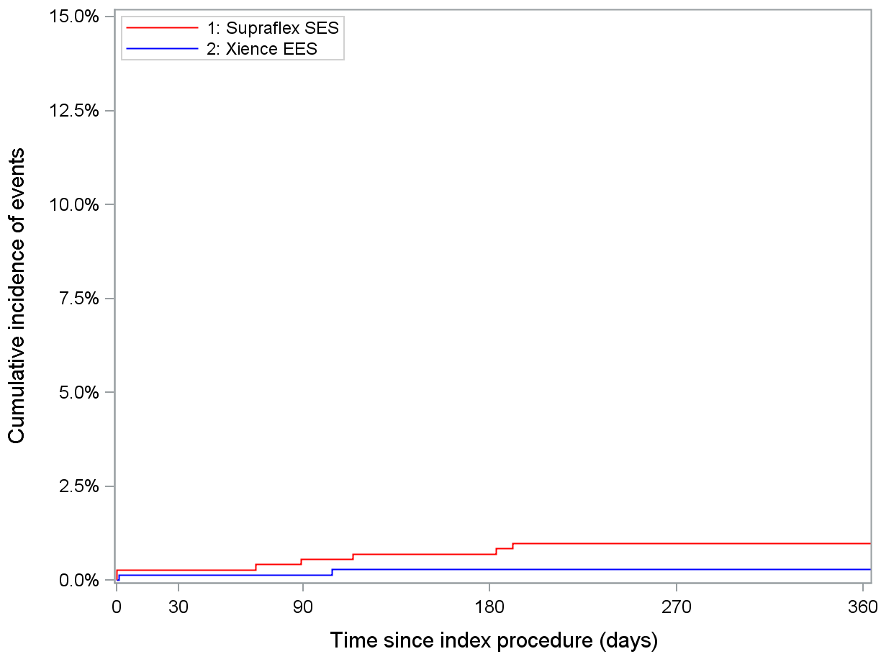
Cardiac death
(ITT)
Supraflex Xience
log-rank p=0.097 0.7% (-0.1 to 2.0%)
1.0% (7)
0.3% (2)
Supraflex
Xience
At risk At risk
720 | 708 | 704 | 689 | 656
715 | 704 | 702 | 691 | 657

Slide 20
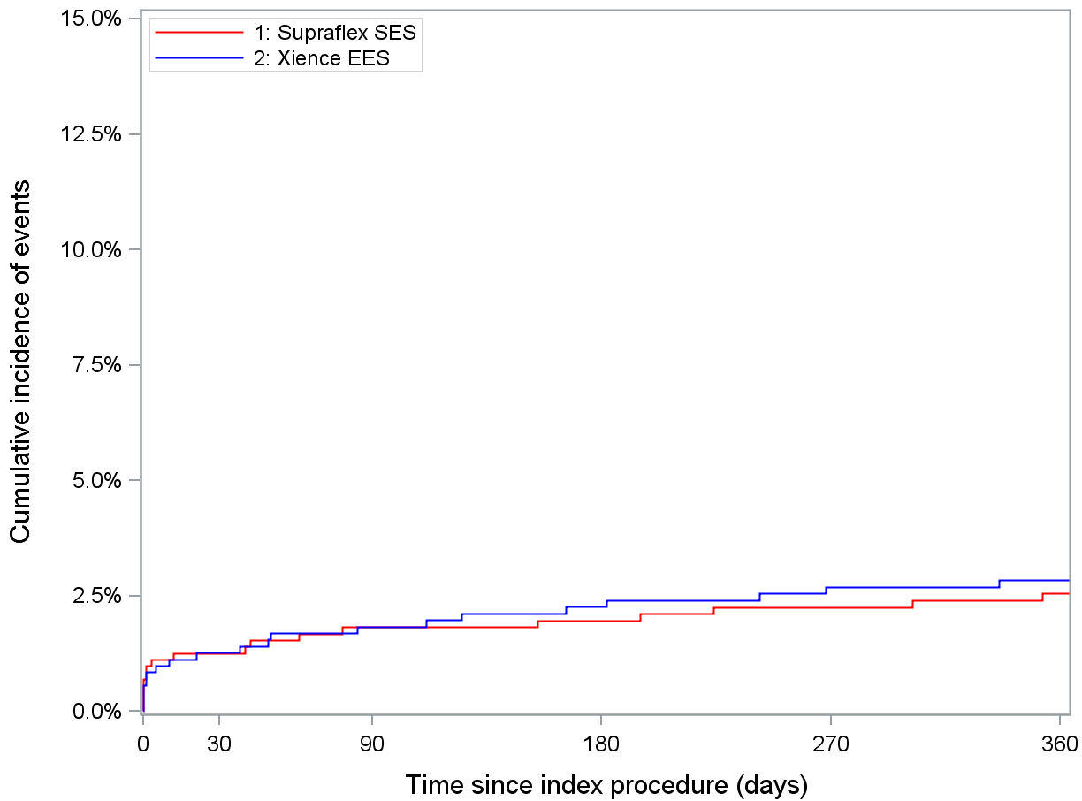
Target vessel myocardial infarction
(ITT)
Supraflex Xience
log-rank p=0.734
-0.3% (-2.0 to 1.4%)
2.8% (20)
2.5% (18)
Supraflex
Xience
At risk At risk
720 | 696 | 692 | 676 | 641
715 | 692 | 688 | 676 | 643

Slide 21
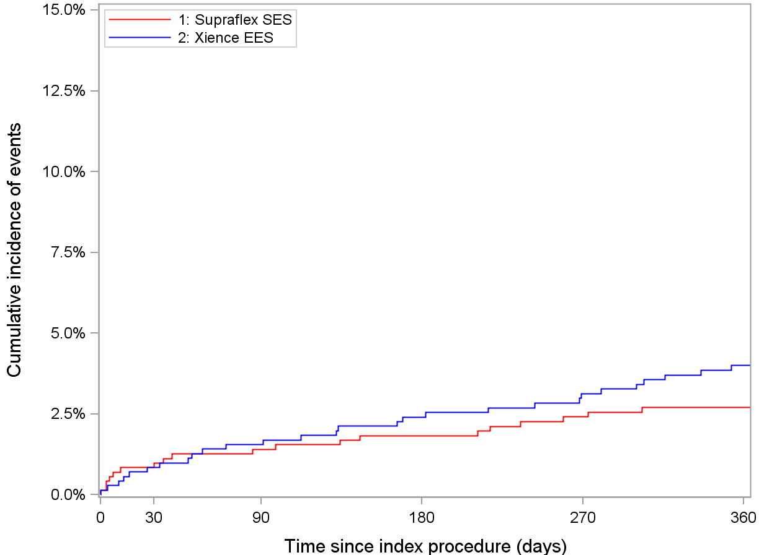
Clinically-indicated TLR (ITT)
Supraflex Xience
log-rank p=0.183
-1.3% (-3.2 to 0.6%)
4.0% (28)
2.7% (19)
Supraflex
Xience
At risk At risk
720 | 698 | 691 | 673 | 638
715 | 693 | 685 | 670 | 633

Slide 22
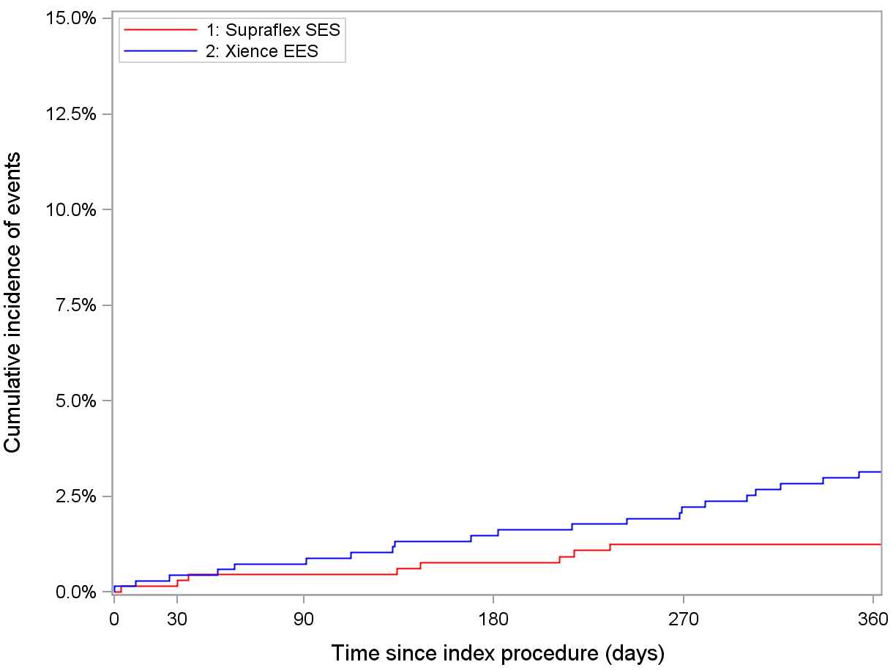
Clinically-indicated TLR
(per-protocol analysis)
Supraflex Xience
log-rank p=0.021
-1.9% (-3.5 to -0.3%)
6 1 % relative reduction
3.1% (21)
1.2% (8)
Supraflex
Xience
At risk At risk
660 | 645 | 639 | 625 | 597
685 | 670 | 664 | 649 | 613

Slide 23
26

Slide 24
Baseline characteristics
Characteristic | Supraflex (n=720) | Xience (n=715) | p-Value
Age (years) | 65.0±10.3 | 64.7±10.1 | 0.600
Male | 75.8% | 76.5% | 0.766
BMI (kg/m²) | 28.3±4.8 | 28.3±4.6 | 0.973
Risk factors
Current smoker | 24.5% | 24.1% | 0.852
Diabetes mellitus | 21.8% | 24.9% | 0.167
Hypertension | 65.3% | 66.1% | 0.741
Hypercholesterolemia | 61.8% | 60.2% | 0.525
Family history of CAD | 46.3% | 45.2% | 0.661
History of
Previous MI | 18.9% | 17.9% | 0.630
Peripheral artery disease | 7.1% | 9.0% | 0.193
Previous PCI | 24.3% | 21.4% | 0.190
Previous CABG | 4.6% < 7.7% |  | 0.014
Heart Failure | 4.7% | 6.9% | 0.084
Renal Insufficiency* | 2.8% | 2.0% | 0.307
Indication
Stable angina | 40.4% | 43.4% | 0.330
ACS | 59.6% | 56.6%
UAP | 16.1% | 13.8% | 0.229
NSTEMI | 26.9% | 26.4% | 0.827
STEMI | 16.5% | 16.4% | 0.933
27
Data are mean±SD (n) or n (%) *Renal insufficiency is defined as serum creatinine >2.5 mg/dL or creatinine clearance ≤ 30mL/min.

Slide 25
Baseline characteristics
Characteristic | Supraflex (n=720) | Xience (n=715) | p-Value
Age (years) | 65.0±10.3 | 64.7±10.1 | 0.600
Male | 546 (75.8%) | 547 (76.5%) | 0.766
BMI (kg/m²) | 28.3±4.8 | 28.3±4.6 | 0.973
Risk factors
Current smoker | 176 (24.5%) | 172 (24.1%) | 0.852
Diabetes mellitus | 157 (21.8%) | 178 (24.9%) | 0.167
Hypertension | 470 (65.3%) | 472 (66.1%) | 0.741
Hypercholesterolemia | 444 (61.8%) | 428 (60.2%) | 0.525
Family history of CAD | 311 (46.3%) | 303 (45.2%) | 0.661
History of
Previous MI | 136 (18.9%) | 128 (17.9%) | 0.630
Peripheral artery disease | 51 (7.1%) | 64 (9.0%) | 0.193
Previous PCI | 175 (24.3%) | 153 (21.4%) | 0.190
Previous CABG | 33 (4.6%) | 55 (7.7%) | 0.014
Heart Failure | 34 (4.7%) | 49 (6.9%) | 0.084
Renal Insufficiency* | 20 (2.8%) | 14 (2.0%) | 0.307
Indication
Stable angina | 291 (40.4%) | 310 (43.4%) | 0.330
ACS | 429 (59.6%) | 405 (56.6%)
UAP | 116 (16.1%) | 99 (13.8%) | 0.229
NSTEMI | 194 (26.9%) | 189 (26.4%) | 0.827
STEMI | 119 (16.5%) | 117 (16.4%) | 0.933
28
Data are mean±SD (n) or n (%) *Renal insufficiency is defined as serum creatinine >2.5 mg/dL or creatinine clearance ≤ 30mL/min.

Slide 26
Lesion and procedural characteristics
Lesion characteristics Procedural characteristics
Supraflex n=1046 lesions
Xience P-value N=1030 lesions
Supraflex
n=1046 lesions
Xience
N=1030 lesions
P-value
Vessel location:
0.070
Pre-dilatation
807 (77.2%)
782 (75.9%)
0.509
LAD
468 (44.7%)
432 (41.9%)
Max pressure (atm)
13.6±4.3
13.5±4.1
0.677
LCX
220 (21.0%)
237 (23.0%)
Max balloon length (mm)
15.75±4.77
15.40±4.50
0.130
RCA
Left main Bypass graft
Number of lesions treated
Total stented length per patients (mm)
Index PCI performed TIMI flow pre
Flow 0
338 (32.3%) | 328 (31.8%) |  | Max balloon diameter | 2.52±0.43 2.46±0.43 0.006
15 (1.4%) | 16 (1.6%) |  | (mm)
5 (0.5%) | 17 (1.7%) |  | Stent characteristics
1.45±0.77 (n=720) | 1.44±0.74 (715) | 0.760 | Number of stents used per lesion | 1.2±0.5 | 1.2±0.5 | 0.592
37.2±27.4 (n=709) | 37.2±27.0 (710) | 0.961 | Total stent length per lesion (mm) Overlapping stents | 25.7±14.5 | 26.0±14.5 | 0.623
 |  |  | per lesion | 221 (21.1%) | 201 (19.5%) | 0.361
715 (99.3%) | 715 (100%) | 0.062 | Stent length per stent (mm) | 21.3±8.3 | 21.8±8.8 | 0.120
143 (13.7%) | 112 (10.9%) | 0.122 | Stent diameter _{per stent (mm)} 3.0±0.5 3.0±0.5 0.186
Flow 1
40 (3.8%) | 42 (4.1%) Post-stenting balloon
66 (6.3%) | _{84 (8.2%)} dilatation
758 (72.5%) | _{744 (72.2%)} Max pressure (atm)
39 (3.7%) | _{48 (4.7%)} Max balloon length
44 (4.2%) 420 (40.2%) | 42 (4.1%) 414 (40.2%) | 0.883 0.999 | (mm) Max balloon diameter (mm) TIMI flow post
518 (49.7%) | 511 (49.6%) | 0.964 | Flow 0 Flow 1
167 (16.0%) | 157 (15.2%) | 0.650 | Flow 2 Flow 3
544 (52.0%)
538 (52.2%)
0.918
Flow 2
Flow 3
17.1±4.3
17.5±3.9
0.096
Not done
13.79±4.83
14.39±4.88
0.041
Restenotic lesion
Small vessel (≤ 2.75
mm)
3.30±0.58
3.29±0.60
0.804
0.198
Long lesion (> 18 mm)
7 (0.7%)
1 (0.1%)
2 (0.2%)
3 (0.3%)
Bifurcation involved
11 (1.1%)
9 (0.9%)
995 (95.1%)
975 (94.7%₂₉)
Data are mean±SD (n) or n (%)
Not done
31 (3.0%)
42 (4.1%)
29

Slide 27
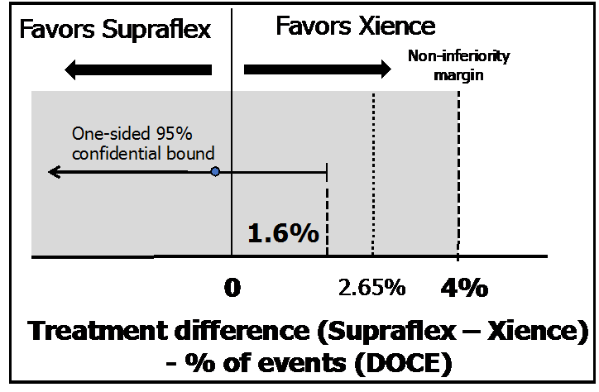
Primary endpoint: DOCE
(ITT)
(A composite of cardiac death, TV-MI, CI-TLR)
Supraflex Xience
log-rank p=0.801
5.3% (37)
P for non-inferiority <0.001
4.9% (35)
Supraflex
Xience
At risk At risk
720 | 689 | 684 | 665 | 659 629
715 | 686 | 679 | 665 | 657 629

Slide 28
Per-protocol analysis
Supraflex |  | Xience
 | n=660 | n=685 | Percentage difference (95% CI) | p value
DOCE | 3.5% (23) | 4.4% (30) | -0.9% (-3.0 to 1.2%) | 0.411
Cardiac death | 1.1% (7) | 0.3% (2) | 0.8% (-0.1 to 1.7%) | 0.084
TV-MI | 2.2% (14) | 2.8% (19) | -0.6% (-2.3 to 1.0%) | 0.447
CI-TLR
1.2% (8)
3.1% (21)
-1.9% (-3.5 to -0.3%)
0.021
DOCE
CI-TLR
P for non-inferiority <0.001 (One sided 95% upper confidence bound: 0.9%)
log-rank p=0.411
log-rank p=0.021
61% relative reduction
3.1%
4.4%
3.5%
1.2%

Slide 29
Primary endpoint: DOCE
(ITT)
(A composite of cardiac death, TV-MI, CI-TLR)
Supraflex Xience
log-rank p=0.801
5.3% (37)
P for non-inferiority <0.001
4.9% (35)
Supraflex
Xience
At risk At risk
720 | 689 | 684 | 665 | 659 629
715 | 686 | 679 | 665 | 657 629

Slide 30
TALENT participating 23 sites
Amsterdam University Medical Center | 224
Prof. R-J. de Winter
Catharina hospital | 217
Dr. P. Tonino
Medisch Centrum Leeuwarden | 154
Dr. S. Hofma
PAKS Chrzanów | 116
Dr. A. Zurakowski
Maasstad ziekenhuis | 100
Dr. P. Smits
PAKS Kędzierzyn- Koźle | 94
Dr. J. Prokopczuk
Hospital La Paz | 69
Dr. R. Moreno
University Hospital of Wales | 65
Dr. A. Choudhury
Freeman Hospital | 63
Prof. A. Zaman
City Clinic Heart and Vascular Institute | 61
Prof. I. Petrov
Bellvitge University Hospital | 53
Dr. A. Cequier
Lister Hospital | 36
Dr. N. Kukreja
Castle Hill Hospital | 33
Dr. A. Hoye
Hospital alvaro Cunqueiro University Hospital of Vigo | 29
Dr. A. Iniguez
Invasive Cardiology Unit, Cardiology Center | 27
Dr. I. Ungi
Hospital de Sant Pau | 23
Dr. A. Serra
Central Hospital of the Internal and Administration Ministry | 13
Prof. R. Gil
Royal Victoria Hospital | 12
Dr. S. Walsh
St. George’s University Multi-profile Hospital for Active Treatment | 11
Dr. G. Tonev
Ospedale San Raffaele | 10
Prof. A. Colombo
Semmelweis University Heart and Vascular Center | 10
Prof. B. Merkely
St Bartholomew's Hospital | 10
Prof. A. Mathur
Amphia Ziekenhuis | 5
Dr. S. IJsselmuiden
From 7 countries in Europe
33

Slide 31
Primary endpoint: non-inferiority of DOCE
(A composite of cardiac death, TV-MI, CI-TLR)
(ITT)
Primary endpoint | Supraflex n=720 | Xience n=715 | Difference | One sided 95% upper confidence bound | Non- inferiority margin | P-value for non- inferiority
DOCE | 4.9% | 5.3% | -0.3% | 1.6% | ^{2.65%} <0.001
4.0%
(35)
(37)
=0.006
5.3% *0.40=2.12%
Favors Supraflex
Favors Xience
Resolute All-comers
Non-inferiority margin
Xience arm
One-sided 95% confidence bound
-0.3%
-4%
0
2.65%
4%
8%
8.3%
1.6%
Treatment difference (Supraflex – Xience)
- % of events (DOCE)

Slide 32
Device and procedure success
Supraflex n=720 patients n=1046 lesions |  | Xience n=715 patients n=1030 lesions | Difference (95% CI) | p value
Device success (per lesion) | 97.6% 99.5% (973/997) < (998/1003) |  | -1.9% (-3.0 to - 0.9%) | 0.0003
In-hospital DOCE | 1.5% (11/720) | 1.4% (10/715) | 0.1% (-1.2 to 1.5%) | 0.837
Procedure success (per patient) | 95.6% 98.3% (673/704) < (695/707) |  | -2.7% (-4.5 to - 0.9%) | 0.003
In spite of the slight difference in device success rates between groups, the device success rates in the Supraflex (97.6%) are comparable or even superior to other DES in all-comers trials.
LEADERS: 95.8% in BioMatrix vs. 94.2% in Cypher
RESOLUTE All-comers: 97% in each group (Xience and Resolute)
DESSOLVE III: 98.3% in Mistent vs. 98.6% in Xience
TARGET AC: 92.4% in Firehawk vs. 94.8% in Xience
The difference of device success rate did not have any bearing on patient outcomes.

Slide 33
Device and procedure success
Supraflex n=720 patients n=1046 lesions |  | Xience n=715 patients n=1030 lesions | Difference (95% CI) | p value
Device success (per lesion) | 97.6% 99.5% (973/997) < (998/1003) |  | -1.9% (-3.0 to - 0.9%) | 0.0003
In-hospital DOCE | 1.5% (11/720) | 1.4% (10/715) | 0.1% (-1.2 to 1.5%) | 0.837
Procedure success (per patient) | 95.6% 98.3% (673/704) < (695/707) |  | -2.7% (-4.5 to - 0.9%) | 0.003
In spite of the slight difference in device success rates between groups, the device success rates in the Supraflex (97.6%) are comparable or even superior to other DES in all-comers trials.
LEADERS: 95.8% in BioMatrix vs. 94.2% in Cypher
RESOLUTE All-comers: 97% in each group (Xience and Resolute)
DESSOLVE III: 98.3% in Mistent vs. 98.6% in Xience
TARGET AC: 92.4% in Firehawk vs. 94.8% in Xience
The difference of device success rate did not have any bearing on patient outcomes.

Slide 34
Device and procedure success
Supraflex n=720 patients n=1046 lesions |  | Xience n=715 patients n=1030 lesions | Difference (95% CI) | p value
Device success (per lesion) | 97.6% 99.5% (973/997) < (998/1003) |  | -1.9% (-3.0 to - 0.9%) | 0.0003
In-hospital DOCE | 1.5% (11/720) | 1.4% (10/715) | 0.1% (-1.2 to 1.5%) | 0.837
Procedure success (per patient) | 95.6% 98.3% (673/704) < (695/707) |  | -2.7% (-4.5 to - 0.9%) | 0.003
In spite of the slight difference in device success rates between groups, the device success rates in the Supraflex (97.6%) are comparable or even superior to other DES in all-comers trials.
TARGET All-comers | Firehawk (89μm), 823 pts | Xience (81 μm), 830 pts | p value
 | 92.4% | 94.8% | 0.025
The SORT OUT VII All-comers | Orsiro (60 μm*), 1261 pts | Nobori (120 μm), 1264 pts | p value
 | 98.4% | 98.3% | 0.36
TWENTE All-comers | Resolute (91 μm), 697 pts | Xience (81 μm), 694 pts | p value
 | 98% | 98.4% | 0.17
RESOLUTE All-comers | Resolute (91 μm), 1140 pts | Xience (81 μm), 1152 pts | p value
 | 97% | 97% | 0.52
BIOFLOW V (not all-comers) | Orsiro (60 μm*), 884 pts | Xience (81 μm), 450 pts | p value
 | 98% | 97% | 0.415
The difference of device success rate did not have any bearing on patient outcomes.
37

Slide 35
TARGET All-comers | Firehawk (89μm) 823 pts | Xience (81 μm) 830 pts | p value
 | 92.4% | 94.8% | 0.025
The SORT OUT VII All-comers | Orsiro (60 μm*) 1261 pts | Nobori (120 μm) 1264 pts | p value
 | 98.4% | 98.3% | 0.36
TWENTE All-comers | Resolute (91 μm) 697 pts | Xience (81 μm) 694 pts | p value
 | 98% | 98.4% | 0.17
RESOLUTE All-comers | Resolute (91 μm) 1140 pts | Xience (81 μm) 1152 pts | p value
 | 97% | 97% | 0.52
BIOFLOW V (not all-comers) | Orsiro (60 μm*) 884 pts | Xience (81 μm) 450 pts | p value
 | 98% | 97% | 0.415
60 μm (2.25 to 3.0 mm)
80 μm (3.5 to 4.0 mm
38

Slide 36
TARGET All-comers | Firehawk (89μm) 823 pts | Xience (81 μm) 830 pts | p value
 | 92.4% | 94.8% | 0.025
BIOSCIENCE All-comers | Orsiro (60 μm*) 1063 pts | Xience (81 μm) 1056 pts | p value
 | NA | NA | NA
The SORT OUT VII All-comers | Orsiro (60 μm*) 1261 pts | Nobori (120 μm) 1264 pts | p value
 | 98.4% | 98.3% | 0.36
TWENTE All-comers | Resolute (91 μm) 697 pts | Xience (81 μm) 694 pts | p value
 | 98% | 98.4% | 0.17
RESOLUTE All-comers | Resolute (91 μm) 1140 pts | Xience (81 μm) 1152 pts | p value
 | 97% | 97% | 0.52
LEADERS All-comers | BioMatrix (120 μm) 857 pts | Cypher (140 μm) 850 pts | p value
 | 95.8% | 94.2% | 0.11
BIOFLOW V (not all-comers) | Orsiro (60 μm*) 884 pts | Xience (81 μm) 450 pts | p value
 | 98% | 97% | 0.415
60 μm (2.25 to 3.0 mm)
80 μm (3.5 to 4.0 mm
39

