Slide 1


Sodium Zirconium Cyclosilicate
and MRA Optimization in Heart Failure With Reduced Ejection Fraction and Hyperkalemia: Main Results From REALIZE-K Randomized Controlled Trial
Mikhail N. Kosiborod¹, David Z.I. Cherney, Akshay S. Desai, Jeffrey M. Testani, Subodh Verma, Magnus Dahl, James M. Eudicone, Lovisa Friberg, Mark C. Petrie
¹Department of Cardiovascular Disease, Saint Luke’s Mid America Heart Institute and University of Missouri,
Kansas City School of Medicine, Kansas City, MO, USA
On behalf of the REALIZE-K Investigators and Trial Committees

Slide 2
Disclosures
Research Grants
  AstraZeneca, Boehringer Ingelheim, and Pfizer
Consultant or Advisory Boards
  35Pharma, Alnylam, Amgen, Applied Therapeutics, Arrowhead Pharmaceuticals, AstraZeneca, Bayer, Boehringer Ingelheim,
Corcept Therapeutics, Cytokinetics, Dexcom, Eli Lilly, Esperion Therapeutics, Imbria Pharmaceuticals, Janssen,
Lexicon Pharmaceuticals, Merck (Diabetes and Cardiovascular), Novo Nordisk, Pfizer, Pharmacosmos, Regeneron, Roche, Sanofi, scPharmaceuticals, Structure Therapeutics, Vifor Pharma, and Youngene Therapeutics
Honoraria
  AstraZeneca, Boehringer Ingelheim, and Novo Nordisk
Other
  Receiving other research support (data analytic center fees [payments to institution]) from AstraZeneca and Vifor Pharma and has stocks in Artera Health and Saghmos Therapeutics
  Will be an employee of AstraZeneca R&D from January 2025
REALIZE-K (ClinicalTrials.gov identifier: NCT04676646) was sponsored by AstraZeneca
Disclosures for Mikhail N. Kosiborod are provided.

Slide 3
Background
MRAs reduce the risk of morbidity and mortality in patients with HFrEF but are underused, partly due to HK risk¹
The advent of novel potassium binders, including SZC, has introduced the concept of enabling the optimal use of MRA in patients with HFrEF who develop hyperkalemia²
We tested whether SZC enables optimization of the MRA spironolactone in patients with HFrEF and HK
HFrEF, heart failure and reduced ejection fraction; HK, hyperkalemia; MRA, mineralocorticoid receptor antagonist; SZC, sodium zirconium cyclosilicate.
1. Heidenreich PA et al. J Am Coll Cardiol. 2022;79:e263–e421. 2. Paolillo S et al. Eur J Intern Med. 2024;119:109–117.

Slide 4




Study Design
Open-label run-in phase
Double-blind, PBO-controlled,
randomized-withdrawal phase
Follow-up
Cohort 1 (with HK)
sK⁺ 5.1‒5.9 mEq/L,
eGFR ≥30 mL/min/1.73 m²
Screening
Start SZC, normalize sK⁺, then initiate/up-titrate spironolactone
SZC + spironolactone
Eligibility criteria
HFrEF
(NYHA II–IV; LVEF ≤40%)
Optimal GDMT
(except MRA)
Prevalent HK or high risk
R 1:1^{b}
Check sK⁺ 7 days after last dose of study drug
4 weeks
Cohort 2 (with NK)
sK⁺ 3.5‒5.0 mEq/L, at risk of HKª
Patients with NK on SZC + spironolactone
≥25 mg daily
PBO + spironolactone
Initiate/up-titrate spironolactone
Start SZC if/when sK⁺ >5.0 mEq/L
6 weeks
6 months^{c}
1 week
MRA optimization during run-in phase and maintenance during randomization phase was protocol-mandated
ªHistory of HK in the previous 36 months and eGFR ≥30 mL/min/1.73 m², or sK⁺ 4.5–5.0 mEq/L and eGFR 30–60 mL/min/1.73 m², or sK⁺ 4.5‒5.0 mEq/L and aged >75 years.
^{b}Stratified by Cohorts 1 and 2. ^{c}Visit Weeks: 1, 2, 5, 9, 13, 17, 21, and 25 (Weeks 5‒25 included in the primary endpoint). eGFR, estimated glomerular filtration rate; GDMT, guideline-directed medical therapy; HFrEF, heart failure and reduced ejection fraction; HK, hyperkalemia; LVEF, left ventricular ejection fraction; MRA, mineralocorticoid receptor antagonist; NK, normokalemia; NYHA,
New York Heart Association; PBO, placebo; R, randomized; sK⁺, serum potassium; SZC, sodium zirconium cyclosilicate. Kosiborod, M, Cherney, D, Connelly, K. et al. Sodium Zirconium Cyclosilicate in HFrEF and Hyperkalemia: REALIZE-K Design and Baseline Characteristics. Presented at ESC-HF 2024, Lisbon, Portugal.

Slide 5
Endpoints
Primary
Percentage with optimal treatment response (NK,ª spironolactone ≥25 mg/daily, and no rescue
therapy since prior visit, Months 1–6 after randomization)
Secondary (tested hierarchically)
Percentage with NK,ª on the randomization dose of spironolactone, and no rescue therapy
Percentage on spironolactone ≥25 mg/daily
Time to first HK episode (sK⁺ >5.0 mEq/L)
Time to first decrease or discontinuation of
spironolactone dose due to HK
KCCQ-CSS at 6 months
Overall safety
AEs and SAEs
Vital signs, physical examination, and laboratory tests
Exploratory
Time to first occurrence of CV death or
worsening HF events^{b}
NTproBNP and daily loop diuretic dose at 6 months post-randomization
Body weight; systolic blood pressure
ªNK defined as sK⁺ 3.5–5.0 mEq/L. ^{b}Worsening HF events defined as HF hospitalizations or urgent visits as adjudicated by a centralized clinical events committee blinded to treatment assignment. AE, adverse event; CV, cardiovascular; HF, heart failure; HK, hyperkalemia; KCCQ-CSS, Kansas City Cardiomyopathy Questionnaire-Clinical Summary Score; NK, normokalemia; NTproBNP,
N-terminal pro-B-type natriuretic peptide; SAE, serious adverse event; sK⁺, serum potassium; SZC, sodium zirconium cyclosilicate.

Slide 6
Participant Disposition
Screened (N=447)
Open-label phase
(N=366)
Cohort 1 (with HK) |  |  | Cohort 2 (with NK)
Hyperkalemiaª and eGFR ≥30 mL/min/1.73 m² (N=95) |  |  | Normokalemia at risk of hyperkalemia^{b} (N=271)
Randomized^{c}
(N=203)
SZC (N=102)^{c}
Placebo (N=101)
Discontinued early
from study (n=14)
Discontinued early
from study (n=14)
Completed study (N=88)
Completed study (N=87)
Included in Full Analysis Set (n=102)^{c}
Included in Full Analysis Set (n=101)
ªDefined as sK⁺ 5.1–5.9 mEq/L. ^{b}Defined as either a history of sK⁺ >5.0 mEq/L within the prior 36 months and eGFR ≥30 ml/min/1.73 m², or sK+ 4.5–5.0 mEq/L with eGFR between 30 and 60 ml/min/1.73 m² or aged >75 years. ^{c}One participant was randomized in error (in the SZC group) and, therefore, 202 participants received treatment.
eGFR, estimated glomerular filtration rate; sK⁺, serum potassium; SZC, sodium zirconium cyclosilicate.

Slide 7
Baseline Characteristics
 |  | SZC (N=102)ª | Placebo (N=101)
Age, years, median (IQR) |  | 73 (67–79) | 69 (63–76)
Sex, male, n (%) |  | 76 (75) | 75 (74)
Race, n (%)
Black or African American | 5 (5) | 5 (5)
Other | 6 (6) | 2 (2)
White | 91 (89) | 94 (93)
Region, n (%)
Latin America | 31 (30) | 19 (19)
North America | 13 (13) | 24 (24)
Europe | 58 (57) | 58 (57)
Type 2 diabetes, n (%) | 27 (27) | 25 (25)
Atrial fibrillation, n (%) | 36 (35) | 36 (36)
Previous HF hospitalization, n (%) |  | 48 (47) | 51 (51)
NYHA class, n (%)
II |  | 85 (83) | 85 (84)
III/IV
17 (17)
16 (16)
ªOne participant was randomized in error (in the SZC group), therefore, 202 participants received treatment.
HF, heart failure; IQR, interquartile range; NYHA, New York Heart Association; SZC, sodium zirconium cyclosilicate.

Slide 8
Baseline Characteristics
 | SZC (N=102)ª | Placebo (N=101)
LVEF, %, median (IQR) | 33 (28–37) | 33 (27–37)
NTproBNP, pg/mL, median (IQR) | 1268 (523–3725) | 910 (378–2858)
eGFR, mL/min/1.73 m², median (IQR) | 48 (42–61) | 60 (45–74)
Serum K⁺, mEq/L, mean (SD) | 5.0 (0.5) | 5.0 (0.5)
HF therapy, n (%)
ARNi (sacubitril/valsartan) | 63 (62) | 67 (66)
ACEi/ARB/ARNi | 101 (99) | 100 (99)
Beta blockers | 96 (95) | 98 (97)
SGLT2 inhibitor, n (%) | 73 (72) | 70 (69)
Low-dose MRA, n (%) | 44 (44) | 62 (61)
Loop diuretics, n (%) | 66 (65) | 49 (48)
Spironolactone dose/day at randomization, n (%)
50 mg | 75 (74) | 83 (82)
ªOne participant was randomized in error (in the SZC group), therefore, 202 participants received treatment. ACEi, angiotensin-converting enzyme inhibitor; ARB, angiotensin receptor blocker; ARNi, angiotensin receptor-neprilysin inhibitor; eGFR, estimated glomerular filtration rate; HF, heart failure; IQR, interquartile range; K⁺, potassium; LVEF, left ventricular ejection fraction; MRA, mineralocorticoid receptor antagonist; NTproBNP, N-terminal pro-B-type natriuretic peptide; SD, standard deviation; SGLT2, sodium-glucose cotransporter-2; SZC, sodium zirconium cyclosilicate.

Slide 9
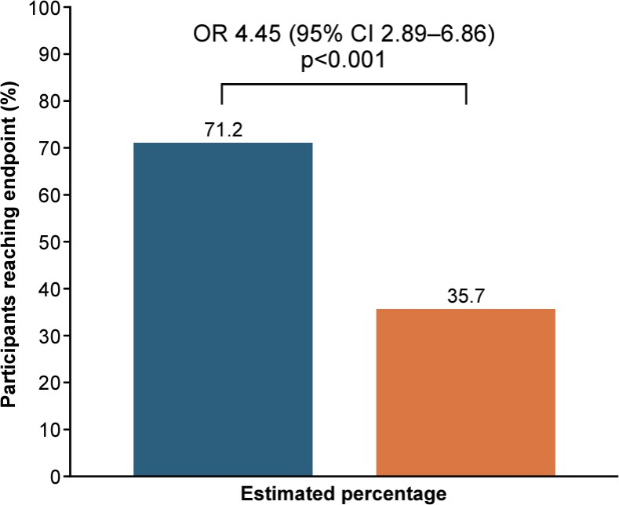
Primary Endpoint: Percentage With Optimal Treatment Response
NK (K⁺ 3.5–5.0 mEq/L)
Spironolactone ≥25 mg/daily
No rescue therapy since prior visit,
Months 1–6
SZC
Placebo
The analysis was performed using a generalized estimating equation model with a binomial family and a log link, a dependent variable of response per visit, fixed independent variables of randomized treatment, participant recruitment country, a per visit indicator variable and open-label period cohort. Each participant was treated as a cluster.
The P-value reflects the two-sided z-test. CI, confidence interval; K⁺, potassium; NK, normokalemia; OR, odds ratio; SZC, sodium zirconium cyclosilicate.

Slide 10

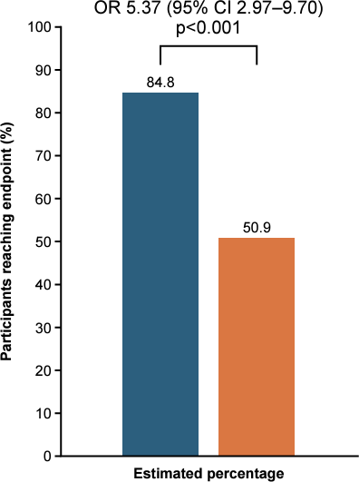
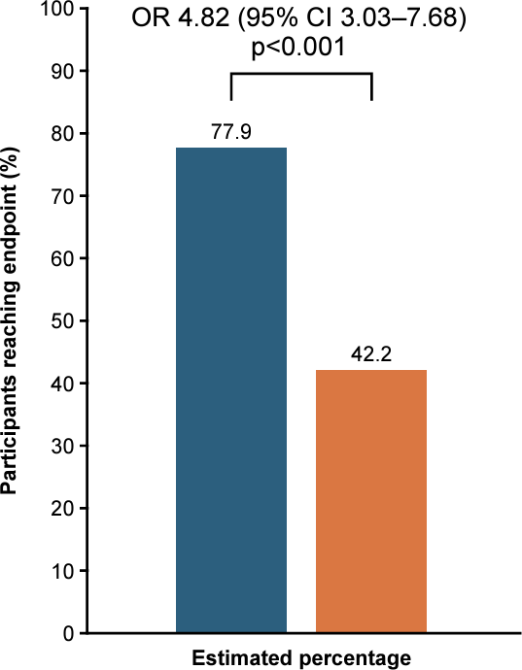
Sensitivity Analyses of Primary Endpoint
Participants receiving the 15-g dose of SZC (or placebo) at randomization were excluded
A more conservative K⁺ threshold to define HK
(K⁺ ≥5.5 mEq/L rather than >5.0 mEq/L) was used
SZC
Placebo
SZC
Placebo
CI, confidence interval; HK, hyperkalemia; K⁺, potassium; OR, odds ratio; SZC, sodium zirconium cyclosilicate.

Slide 11
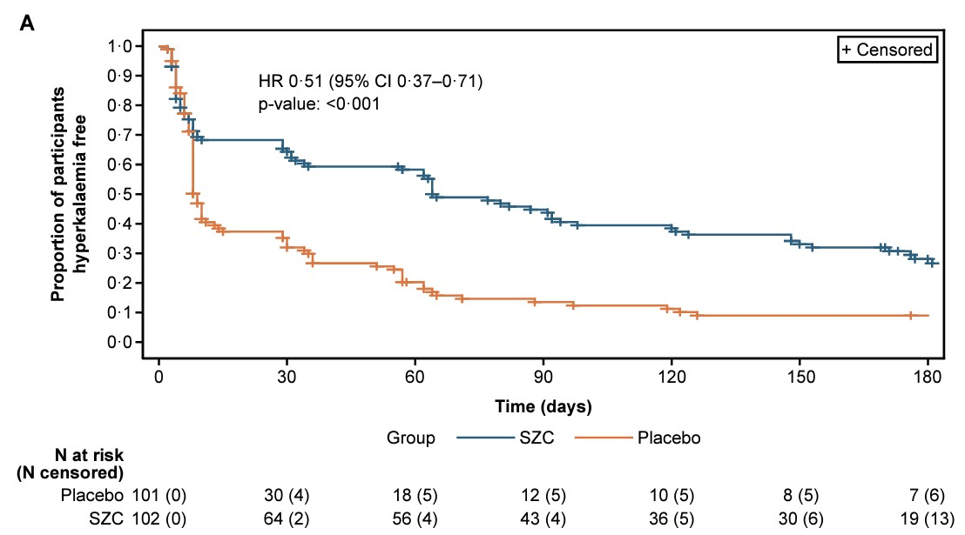
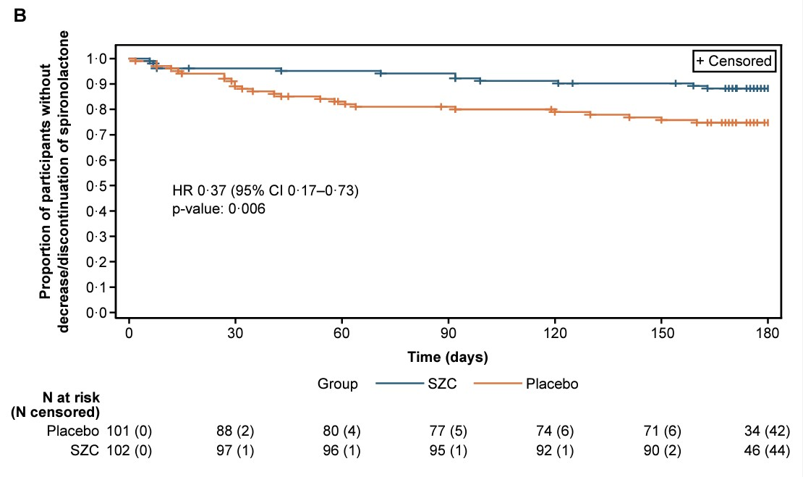
Confirmatory Secondary Endpoints
A
HR 0.51 (95% CI 0.37–0.71) P<0.001
Proportion of participants who are HK free
SZC (vs placebo) improved the first four of five hierarchically tested secondary endpoints
NK on the randomization dose of spironolactone and without rescue therapy for HK (OR 4.58 [2.78–7.55], P<0.001; estimated percentages: 58% vs 23%)
On spironolactone ≥25 mg/daily dose (OR 4.33 [2.50– 7.52], P<0.001; estimated percentages 81% vs 50%)
Time to first HK episode (A)
Time to first decrease or discontinuation of spironolactone dose due to HK (B)
No between-group difference in KCCQ-CSS at
6 months for SZC versus placebo (mean treatment difference −1.01 points [95% CI −6.64 to 4.63], P=0.72)
B
HR 0.37 (95% CI 0.17–0.73) P=0.006
Kaplan–Meier survival curves are truncated at 180 days post-randomization. Analysis of HR was performed using a Cox regression model including randomized treatment group and participant recruitment country, adjusted for
the stratification factor (HK vs NK at study entry). Placebo group was used as the reference level in the Cox model. CI, confidence interval; HK, hyperkalemia; HR, hazard ratio; KCCQ-CSS, Kansas City Cardiomyopathy Questionnaire-Clinical Summary Score; N, number of participants; OR, odds ratio;
SZC, sodium zirconium cyclosilicate.

Slide 12
Overall Safety
AEs and SAEs were balanced between groups
 | SZC (N=101) | Placebo (N=101)
AEs
Any AE, n (%) | 65 (64) | 64 (63)
Any SAE, n (%) | 23 (23) | 22 (22)
AEs leading to discontinuation, n (%) | 6 (6) | 6 (6)
SAEs leading to discontinuation, n (%) | 3 (3) | 2 (2)
Peripheral edema AEs, n (%) | 6 (6) | 2 (2)
Hypokalemia, n (%) | 7 (7) | 0 (0)
AE with outcome of death, n (%) | 1 (1) | 2 (2)
Cardiac failure SAEs, n (%) | 12 (12)* | 4 (4)
Cardiovascular death, n (%) | 1 (1) | 1 (1)
Edema questionnaire dataª
Peripheral edema, n (%) | 22 (22) | 16 (16)
* All events of cardiac failure in the SZC group were resolved or resolving at the end of study
Participants with multiple events in the same category were counted only once in that category. Participants with events in more than one category were counted once in each of those categories. Percentages are based on the total numbers of participants in the treatment group (N). ªAn edema questionnaire was completed at 5, 17, and 25 weeks. Participants with multiple peripheral edema events were counted once only. Location of edema is not mutually exclusive, so multiple locations may apply for each participant.
AE, adverse event; SAE, serious adverse event; SZC, sodium zirconium cyclosilicate.

Slide 13
Exploratory and Post Hoc Analyses
Eleven (11%) participants in the SZC and three (3%) in the placebo group had an adjudicated event of CV death or worsening HF (hospitalization or urgent visit; nominal log-rank P=0.034)
  No difference in CV death (one event in each group)
  More SZC than placebo-treated participants with an adjudicated HF event (n=10 [10%] vs
n=2 [2%])
  In a post hoc exploratory analysis, this difference appeared to be mostly centered among participants with NTproBNP >4000 pg/mL at baseline
NTproBNP at 6 months post-randomization was somewhat higher with SZC versus placebo (1.26 [95% CI 0.99–1.61], nominal P=0.061)
No significant between-group differences in dose of loop diuretics, body weight or systolic blood pressure at 6 months
N numbers represent the numbers of participants with available baseline NTproBNP data.
CI, confidence interval; CV, cardiovascular; HF, heart failure; NTproBNP, N-terminal pro-B-type natriuretic peptide; SZC, sodium zirconium cyclosilicate.

Slide 14
Summary
Efficacy
In participants with symptomatic HFrEF and HK, SZC led to large improvements in optimizing the use and dose of MRA and K⁺ levels, and reduced the risk of HK and down-titration or discontinuation of spironolactone
Safety
No imbalance in total AEs and SAEs
The number of HF*, edema, and hypokalemia events was relatively small, but more participants had such events with SZC than placebo
  In a post hoc, exploratory analysis of HF events, this difference appeared to be mostly centered among participants with very high NTproBNP levels at baseline
Clinical considerations
SZC effectively enables more optimal use of MRA in patients with HFrEF
Although underpowered for clinical outcomes, more participants had HF events with SZC than placebo
despite the more optimal use of spironolactone, which should be factored into clinical decision making
*All events of cardiac failure in the SZC group were resolved or resolving at the end of study.
AE, adverse event; HF, heart failure; HFrEF, heart failure with reduced ejection fraction; HK, hyperkalemia; K⁺, potassium; MRA, mineralocorticoid receptor antagonist;
NTproBNP, N-terminal pro-B-type natriuretic peptide; SAE, serious adverse event; SZC, sodium zirconium cyclosilicate.

Slide 15

Thank you
Simultaneously published in JACC
Thank you to the REALIZE-K Participants, Investigators, and Sponsor
  Steering Committee: David Cherney; Akshay Desai; Mikhail Kosiborod; Mark Petrie; Jeffrey Testani; Subodh Verma
  Data Monitoring Committee: James de Lemos; James Fang; Nancy Sweitzer; Ralph B. D’Agostino Jr
  Clinical Events Committee: Marc Bonaca; Robert Giuliano; Christian Ruff
  National Lead Investigators: Kim Connelly; Anuradha Lala; Vagner Madrini Jr; Bela Merkely; Julio Nuñez; Iain Squire; Jan Václavik; Jerzy Wranicz
  Additional Authors: Khaja Chinnakondepalli, David Dolling, Shachi Patel, Murillo O. Antunes, Luca Kuthi, Miguel Lorenzo, Patrícia O. Guimarães, Marta Cobo Marcos, Iain Squire

