Slide 1
PORTICO™ IDE Trial:
Five-year Outcomes of Portico vs. Commercially Available Valves
Raj Makkar, MD
Gregory Fontana, MD
On behalf of the PORTICO IDE Investigators

Slide 2
Potential Conflicts of Interest
Speaker’s Name : Raj R. Makkar, MD
☑ I have the following potential conflicts of interest to declare: Receipt of research grant and/or consultation fees: Abbott, Edwards
Lifesciences, Boston Scientific, Medtronic

Slide 3
Background
PORTICO RCT trial compared the safety and performance of PORTICO valve with commercially available valves, in high or extreme surgical risk patients with symptomatic severe AS:
PORTICO: Intra-annular, self-expanding valve
Commercially available valves (CAV): Supra-annular, self-expanding valves [or] intra-annular,
balloon-expandable valves
The PORTICO RCT demonstrated prespecified non-inferiority of the Portico valve compared with commercially available TAVR systems in primary safety and efficacy endpoints at 1 year after TAVR. Makkar R. et al. Lancet 2019.

Slide 4
Objectives
Compare 5-year clinical outcomes, hemodynamic performance and durability of Portico valve, compared with commercially available valves, in high or extreme surgical risk patients
Evaluate effects of reduced leaflet motion (RLM) on long-term clinical and
echocardiographic outcomes
Clinical Outcomes at 5-Yrs
All Cause Mortality CV Related Mortality Stroke
New AFib
Aortic Valve Reintervention
Durability
Valve Hemodynamic Performance thru. 5-Yrs*
EOA (cm²)
Mean Transvalvular Gradients (mmHg)
Paravalvular Leak
*Based on independent echo core lab assessments
All analyses are As-Treated

Slide 5
Study Population
750 randomized subjects enrolled at 52 sites in US and AUS between May 2014 - Oct 2017
N=750 Randomized
88% contemporary valves
N=206
Sapien 3
N=110
Evolut R/Pro
N=375
381 Assigned Portico Valve
369 Assigned Commercial Valve
3 Withdrew Consent
2 Died before procedure
1 Did not meet eligibility
1 Randomized after subject expired
3 Did not meet eligibility
2 Withdrew Consent
1 Investigator decision
375 Treatment Initiated (AT)
362 Treatment Initiated (AT)
75 Withdrew Consent/ lost to f/u
10 other/ missed 5-year visit
72 Withdrew Consent/ lost to f/u
8 Other/ missed 5-year visit
As-Treated population with 5 years follow-up
N=289 Portico │ N=282 CAV
AT= As-Treated

Slide 6
Baseline Characteristics
 | Portico (n=375) | CAV (n=362) | P-value
Age, years | 82.96 ± 7.61 | 83.58 ± 7.02 | 0.25
Female | 193 (51.5%) | 193 (53.3%) | 0.62
NYHA functional class III / IV | 267 (71.2%) | 264 (72.6%)
STS % | 6.34 ± 3.42 | 6.55 ± 3.37 | 0.40
EuroSCORE II, % | 6.63 ± 7.23 | 6.68 ± 5.88 | 0.92
Surgical risk |  |  | 0.58
Extreme risk | 69 (18.4%) | 61 (16.9%)
High risk | 306 (81.6%) | 301 (83.1%)
Total frailty score (out of 4) | 1.8 ± 0.9) | 1.9 ± 0.8 | 0.36
Aortic valve area, cm² | 0.68 ± 0.17 | 0.67 ± 0.16 | 0.23
Mean gradient, mmHg | 46.21 ± 11.25 | 46.12 ± 11.79 | 0.91
Comorbidities
Hypertension | 354 (94.4%) | 324 (89.5%) | 0.01
Diabetes | 140 (37.3%) | 142 (39.2%) | 0.60
Kidney disease | 94 (25.1%) | 93 (25.7%) | 0.85

Slide 7
PORTICO RCT| All-Cause Death or Stroke
100%
90%
All-Cause Death
80%
100%
70%
Portico™ valve group 52.0%
CAV group 48.1% P=0.3800
90%
All-Cause Death or Stroke
Death
60%
50%
80%
40%
70%
Portico™ valve group 55.6% CAV group 51.3%
P=0.4154
30%
Death or Stroke
20%
60%
10%
50%
0%
0
40%
30%
Por
100%
20%
90%
Stroke
10%
80%
0%
70%
Portico™ valve group 11.6%
CAV group 12.9%
P=0.5612
0
1
2
3
4
5
All stroke
60%
Years
50%
40%
30%
Portico 375
CAV 362
299
296
250
252
214
207
182
164
81
91
20%
10%
0%
0
1
2
3
4
5
Years
Portico 375
CAV 362
299
296
251
252
214
207
182
164
81
91

Slide 8
Key Clinical Outcomes
 | 1 YEAR
 | Portico (n=375) | CAV (n=362) | P-value
All-cause death or stroke | 17.60% | 15.70% | 0.4314
All-cause death | 14.60% | 11.80% | 0.2104
Cardiovascular death | 9.20% | 7.40% | 0.3583
Stroke | 4.50% | 5.10% | 0.7011
Disabling stroke | 1.60% | 2.60% | 0.4199
Myocardial infarction | 3.90% | 2.50% | 0.3046
New onset atrial fibrillation | 7.50% | 7.10% | 0.8431
Naive permanent pacemaker | 30.40% | 13.40% | <.0001
Rehospitalization | 13.10% | 9.90% | 0.1386

Slide 9
Key Clinical Outcomes
 | 1 YEAR |  |  | 5 YEARS
 | Portico (n=375) | CAV (n=362) | P-value | Portico (n=365) | CAV (n=362) | P-value
All-cause death or stroke | 17.60% | 15.70% | 0.4314 | 55.60% | 51.50% | 0.4154
All-cause death | 14.60% | 11.80% | 0.2104 | 52.00% | 48.10% | 0.38
Cardiovascular death | 9.20% | 7.40% | 0.3583 | 33.40% | 25.40% | 0.0429
Stroke | 4.50% | 5.10% | 0.7011 | 11.60% | 12.90% | 0.5612
Disabling stroke | 1.60% | 2.60% | 0.4199 | NA | NA | NA
Myocardial infarction | 3.90% | 2.50% | 0.3046 | 9.70% | 8.80% | 0.6675
New onset atrial fibrillation | 7.50% | 7.10% | 0.8431 | 18.50% | 15.50% | 0.5048
Naive permanent pacemaker | 30.40% | 13.40% | <.0001 | 35.90% | 20.30% | <0.0001
Rehospitalization | 13.10% | 9.90% | 0.1386 | 13.60% | 12.00% | 0.3136

Slide 10
Echocardiographic Outcomes - Aortic valve area and gradients
Portico (N=375)
CAV (N=362)
 | Portico | CAV | P-value
Aortic valve mean gradient, mmHg
Baseline | 43.75 ± 11.61 (366) | 44.49 ± 13.17 (350) | 0.4301
30 days | 8.35 ± 3.69 (336) | 10.18 ± 4.66 (340) | <0.0001
1 year | 8.55 ± 3.82 (273) | 10.59 ± 5.12 (273) | <0.0001
2 years | 8.09 ± 3.66 (217) | 10.09 ± 5.22 (212) | <0.0001
3 years | 7.51 ± 3.85 (153) | 9.31 ± 4.88 (123) | 0.001
4 years | 7.22 ± 4.52 (115) | 9.94 ± 6.65 (114) | 0.0004
5 years | 7.24 ± 3.01 (74) | 9.48 ± 6.51 (76) | 0.0075
Aortic valve area, cm²
Baseline | 0.73 ± 0.19 (343) | 0.69 ± 0.18 (334) | 0.0075
30 days | 1.85 ± 0.46 (320) | 1.72 ± 0.46 (317) | 0.0002
1 year | 1.81 ± 0.50 (251) | 1.70 ± 0.47 (262) | 0.0076
2 years | 1.86 ± 0.47 (193) | 1.67 ± 0.49 (194) | 0.0001
3 years | 1.85 ± 0.47 (129) | 1.66 ± 0.42 (108) | 0.0012
4 years | 1.86 ± 0.51 (97) | 1.66 ± 0.50 (93) | 0.0054
5 years | 1.78 ± 0.45 (62) | 1.71 ± 0.51 (62) | 0.3964
Data are presented as mean ± SD (number of patients with available data)
60
p=0.0002 p=0.0076 p=0.0001 p=0.0012
p=0.0054 p=0.3964
2.5
Mean transvalvular gradient [mmHg]
50
p=0.4301
2
Aortic valve area [cm²]
40
1.5
30
1
20
p<0.0001 p<0.0001 p<0.0001 p=0.0010 p=0.0004 p=0.0075
10
p=0.0075
0.5
0
0
Baseline 30 d 1 yr 2 yrs 3 yrs 4 yrs 5 yrs
Time since procedure

Slide 11
Echocardiographic Outcomes - Paravalvular leak
P=0.008
P=0.003
P=0.50
6.3
2.1
6.8
1.5
2.8
0
12.5
55.9
47.9
39.3
30.6
39.8
PROPORTION OF PATIENTS [%]
66.7
59.2
45.3
87.5
37.8
58.1
P O R T I C O 3 0 D A Y S N=333
C A V
3 0 D A Y S
N=329
P O R T I C O
1 Y R
N=265
None/trace/trivial
C A V
1 Y R
N=262
Moderate or greater
P O R T I C O
5 Y R S
N=72
C A V
5 Y R S
N=72
Mild

Slide 12
NYHA Class over time
100
0.9
0.9
0.4
1.1
2.3
11.2
9.4
12.1
9.9
8.0
0.4
7.9
5.4
9.2
80
Proportion of patients [%]
39.6
40.5
42.4
33.3
46.3
48.1
60
60
63.5
40
52.0
51.3
51.1
55.2
20
40.7
41.1
28.8
27.1
0
Portico | CAV | Portico | CAV | Portico | CAV | Portico | CAV
Baseline | Baseline | 30 days | 30 days | 1 yr | 1 yr | 5 yrs | 5 yrs
I II III IV

Slide 13
KCCQ QoL Measure
120
100
80
KCCQ (Average ± SD)
72.05
75.53
75.94
74.26
74.36
73.59
74.04
74.4
71.48
73.02
74.64
69.59
60
55.14
54.11
40
20
0
Baseline
30 days
1 year
2 years
3 year
4 years
5 years
Portico (N=375)
CAV (N=362)

Slide 14
Valve durability
 | PORTICO (N=375) | CAV (N=362) | P-value
Bioprosthetic Valve dysfunction | 38.7% | 42.6% | 0.29
Structural valve deterioration Mean gradient ≥ 20mmHg; or rise in gradient by > 10mmHg after discharge; or ≥ moderate transvalvular AR | 1.0% | 3.1% | 0.20
Non-structural valve deterioration | 37.5% | 40.1% | 0.34
≥ Moderate PPM | 24.2% | 36.7% | 0.0003
≥ Moderate PVL | 17.5% | 5.1% | <.0001
Thrombosis | 0.9% | 0.6% | 0.64
Endocarditis | 1.0% | 0.9% | 0.65
Bioprosthetic Valve Failure | 3.8% | 2.8% | 0.25
Valve-related death | 0.4% | 1.6% | 0.30
Aortic valve reintervention* | 3.4% | 1.1% | 0.07
TAV-in-TAV | 3.4% | 0.9% | 0.03
SAVR | 0.0% | 0.3% | 0.31
BAV | 0.0% | 0.3% | 0.31
Bioprosthetic Valve Failure
20%
18%
Bioprosthetic Valve Failure
16%
Portico™ valve group 3.8% CAV group 2.8%
P=0.2455
14%
12%
10%
8%
6%
4%
2%
0%
0
1
2
3
4
5
Years
Portico 375
CAV 362
301
308
256
266
216
219
184
176
86
99
All aortic valve reinterventions were related to paravalvular leak.

Slide 15
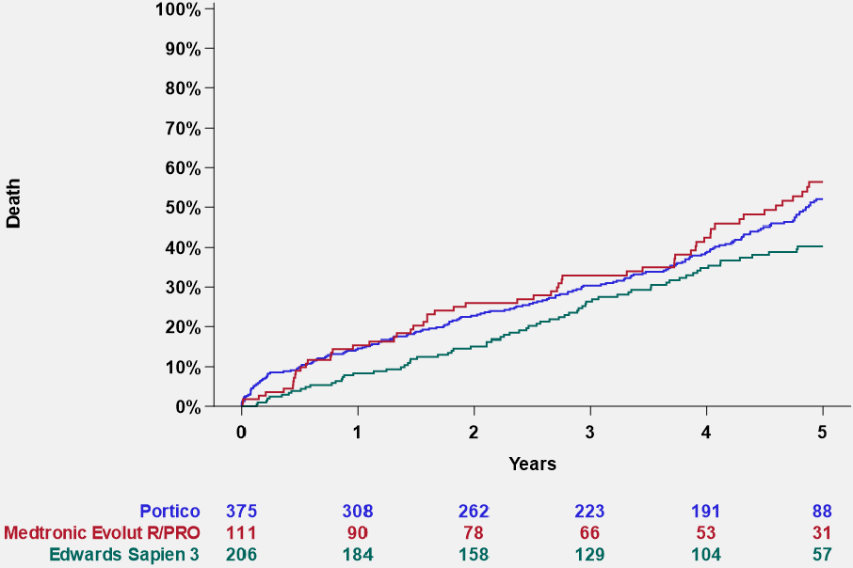
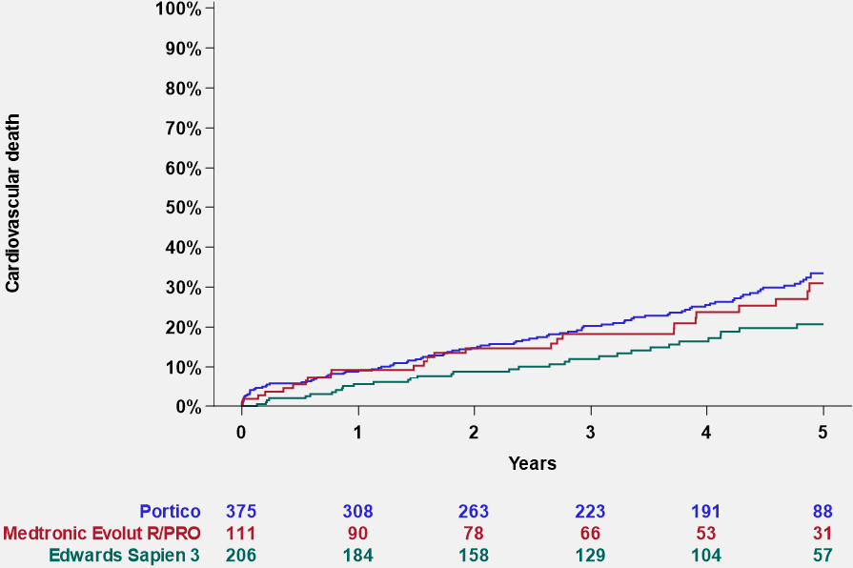
Post-hoc analyses – Clinical outcomes
Death
Cardiovascular death
Portico valve 52.0% Evolut R/PRO valve 56.4% Sapien 3 valve 40.3%
Portico valve 33.4% Evolut R/PRO valve 30.9% Sapien 3 valve 20.7%
Cardiovascular death
Death
Portico valve Evolut R/PRO valve Sapien 3 valve
Portico valve Evolut R/PRO valve Sapien 3 valve

Slide 16
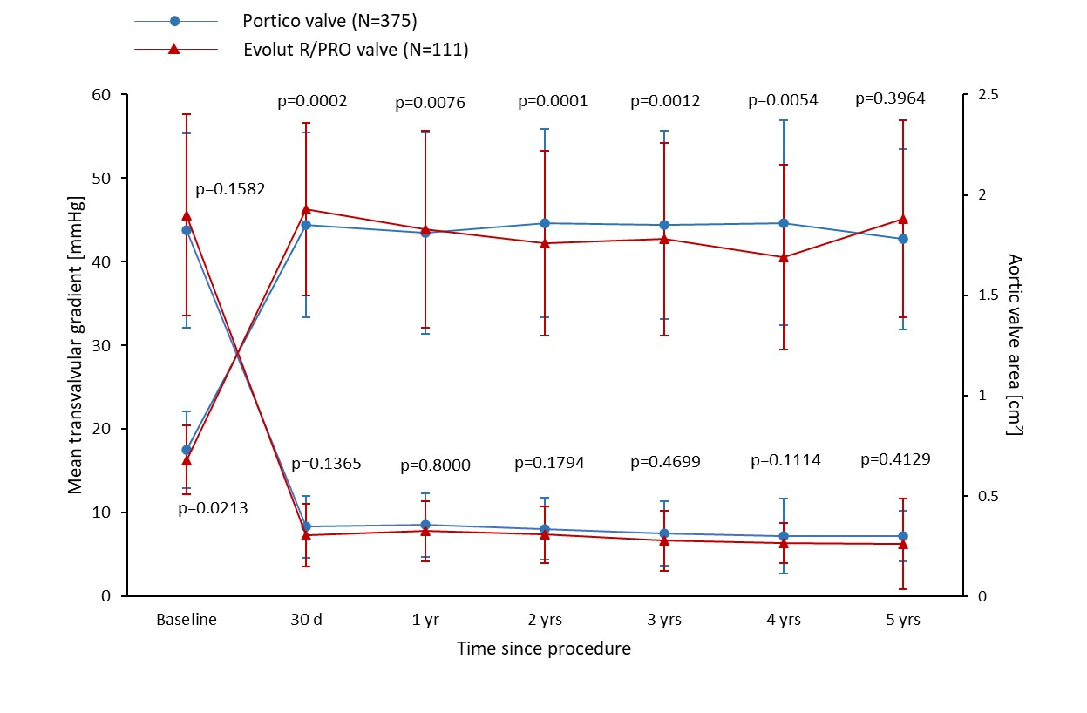
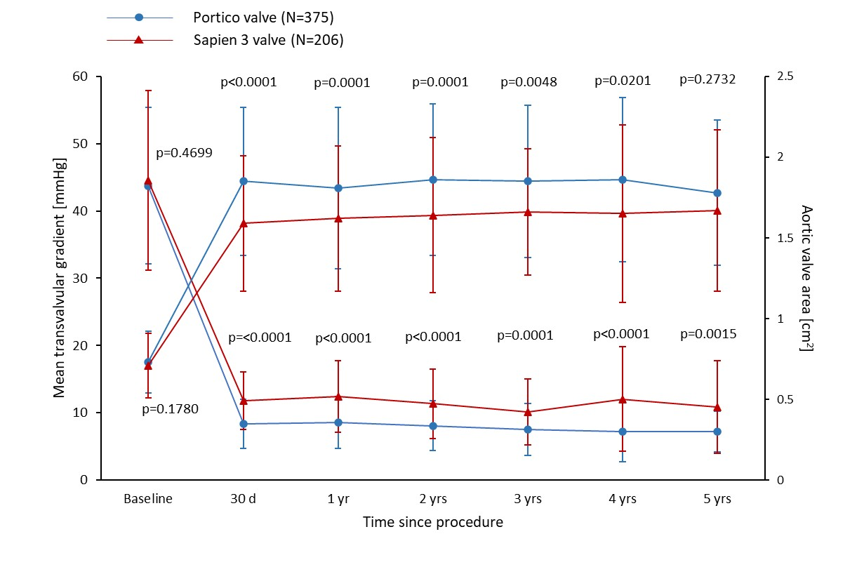
Post-hoc analyses – Portico vs contemporary commercial valve types
Portico vs Evolut R/PRO
Portico vs Sapien 3

Slide 17
RLM Substudy Patient Flow
750 randomized subjects enrolled at 52 sites in US and AUS between May 2014 - Oct 2017
N=750 Randomized (ITT)
381 Assigned Portico Valve
369 Assigned Commercial Valve
375 Treatment Initiated (AT)
362 Treatment Initiated (AT)
364 Enrolled in RLM Sub-Study
168 patients with evaluable imaging at 30 days (159 CT/ 8 TEE)
153 patients with evaluable imaging
at 30 days (145 CT/ 9 TEE)
RLM
Sub-study
321 patients with evaluable imaging at 30 days
238 patients with evaluable imaging at both 30 days and 6 months

Slide 18
RLM substudy – Echocardiographic and clinical outcomes
RLM at 30 days vs no RLM
RLM at 30 Days (N=51)
No RLM (N=270)
100%
All Death
90%
80%
60
2.5
70%
P=0.0026 P=0.9912 P=0.0428 P=0.1397 P=0.3670
P=0.2165 P=0.1442 P=0.4344 P=0.0702
Death
60%
No RLM 52.3%
RLM 37.8% P=0.1008
50%
40%
50
30%
2
20%
10%
40
0%
0
1
2
3
4
5
Mean Aortic Gradient (mmHg)
Years
Aortic Valve Area (cm2)
1.5
No RLM at 30 days 270
RLM at 30 days 51
100%
234
49
211
44
170
35
137
28
65
17
30
Stroke
90%
80%
20
1
70%
Stroke
60%
No RLM 15.1%
RLM 11.2%
P=0.6538
50%
10
40%
30%
0.5
20%
P=0.6079 P=0.5863 P=0.3587 P=0.9693
2 years 3 years 4 years 5 years
10%
0
P=0.1734 P=0.4169 P=0.3000 P=0.0626 P=0.3907
0%
0
1
2
3
4
5
Baseline 30 days
6 1 year months
Years
Discharge
No RLM at 30 days 270
RLM at 30 days 51
224
49
199
43
163
33
127
27
60
16
-10
0

Slide 19
RLM substudy – Echocardiographic and clinical outcomes
RLM at 30 days and/or 6 months vs no RLM
100%
All Death
RLM at 30 days and/or 6 months (N=60)
90%
No RLM (N=172)
80%
70%
No RLM 47.0%
RLM 38.5% P=0.3922
Death
60%
50%
60
p=0.8994 p=0.0092 p=0.0946
p=0.0625
p=0.0904
2.5
40%
p=0.1132
30%
20%
p=0.1214
Mean Aortic Gradient (mmHg)
50
10%
2
0%
0 | 1 | 2 |  | 3 | 4 | 5
178 | 170 | 155 | Years | 121 | 100 | 49
60 | 60 | 53 |  | 43 | 34 | 20
Aortic Valve Area (cm²)
No RLM at 30 day and 6
months RLM at 30 day and/or 6
months
40
1.5
100%
Stroke
30
90%
80%
1
70%
No RLM 12.5%
RLM 12.3% P=0.5965
20
Stroke
60%
p=0.0591
p=0.8855
50%
p=0.8345 p=0.9890
_{p=0.6382} p=0.8201
40%
10
0.5
30%
p=0.0030
20%
10%
0%
0 | 1 | 2 | Years | 3 | 4 | 5
178 | 167 | 149 |  | 119 | 94 | 46
60 | 58 | 51 |  | 40 | 33 | 19
0
0
Baseline 30 days 1 year 2 years 3 years 4 years 5 years
No RLM at 30 day and 6
months RLM at 30 day and/or 6
months

Slide 20
RLM Substudy – Valve durability
 | RLM (N=51) | No RLM (N=270) | P-value
Bioprosthetic Valve Dysfunction | 37.7% | 36.8% | 0.9859
Structural valve deterioration Mean gradient ≥ 20mmHg; or rise in gradient by > 10mmHg after discharge; or ≥ moderate transvalvular AR | 3.6% | 1.7% | 0.8641
Non-structural valve deterioration | 37.7% | 34.7% | 0.8755
≥ Moderate PPM | 31.5% | 27.1% | 0.6254
≥ Moderate PVL | 6.0% | 11.2% | 0.2703
Thrombosis | 0% | 0.8% | 0.5382
Endocarditis | 2.1% | 1.2% | 0.4736
Bioprosthetic Valve Failure | 2.1% | 2.8% | 0.8510
Valve-related death | 2.1% | 0.9% | 0.2448
Aortic valve reintervention* | 0% | 1.9% | 0.3235
TAV-in-TAV | 0% | 1.9% | 0.3235
SAVR | 0% | 0% | NA
BAV | 0% | 0% | NA
Bioprosthetic Valve Failure
20%
Bioprosthetic Valve Failure
RLM 2.1%
No RLM 2.8% P=0.8510
10%
0%
0
No RL
All aortic valve reinterventions were related to paravalvular leak.

Slide 21
Study limitations
First-generation Portico valve and delivery system was compared to more mature
commercially available valves (CAV)
– Current system is the second-generation Navitor valve and FlexNav Delivery System
Choice of valve in the CAV group was left to implanters introducing the possibility for
selection bias
CAV was a mixed group of self-expanding and balloon expandable valves with different
implant and hemodynamic characteristics
Implanters had very limited experience with the Portico system and gained substantial
experience with commercially available valves during trial enrollment period
Very limited data at 5 years, particularly in the RLM substudy

Slide 22
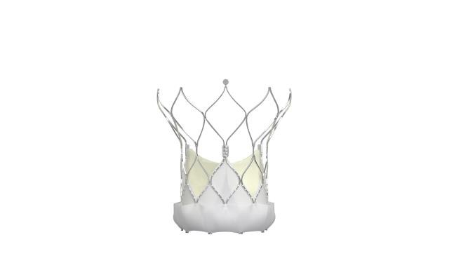
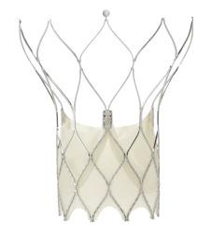
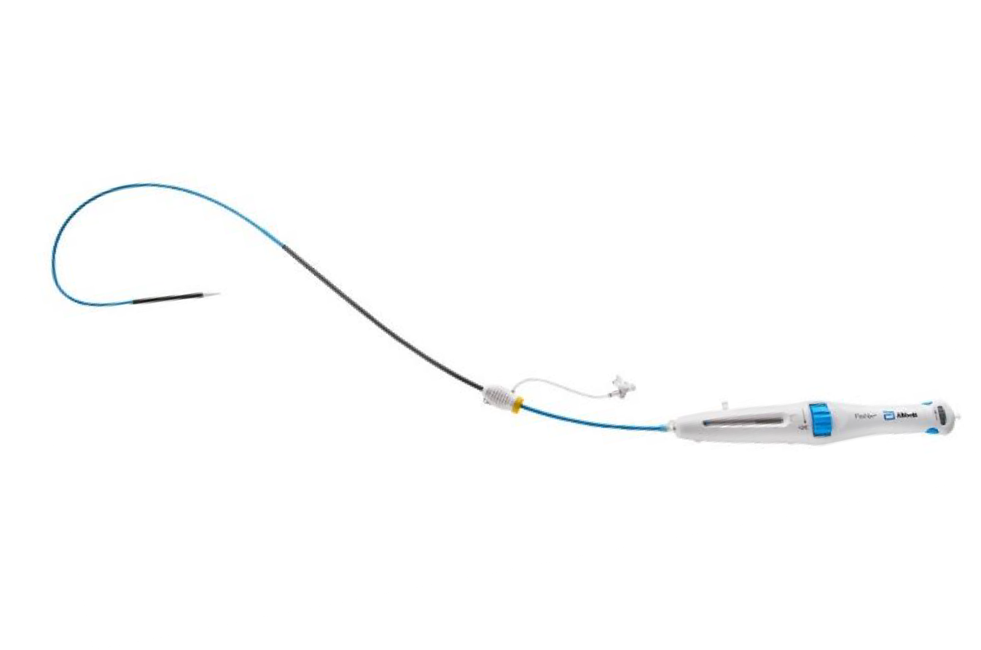
First Generation vs. Current Valve Systems
Portico Valve
Navitor Valve
PORTICO RCT
Navitor 25mm Valve
Portico Valve and Delivery System
No PVL feature
18-19 French
Ability to recapture, reposition, and retrieve
Flexible capsule
Dives into ventricle during deployment
without manipulation at access site
Navitor Valve and FlexNav Delivery System
NaviSeal™ PVL feature
14-15 French equivalent
Stability layer for accurate placement
Integrated sheath
Hydrophilic coating

Slide 23
Summary
In high- or extreme-risk patients with severe aortic stenosis, the first-gen Portico
system, compared with commercial valves, at 5 years had:
Comparable rates of all-cause mortality (52.0% vs 48.1%) or stroke (11.6% vs 12.9%)
Excellent and sustained mean gradients (Portico 7.24 vs CAV 9.48 mmHg) and aortic
valve areas (Portico 1.78 vs CAV 1.71 cm²)
No difference in valve durability
Similar symptom reduction and improvement in QoL
Post-hoc analyses showed differences in individual valve types:
Comparable hemodynamics of Portico, compared with Evolut valves; and better
hemodynamics of Portico, compared with Sapien valves
All-cause mortality was similiar between Portico and Evolut valves, and higher than
Sapien
RLM was not associated with clinical outcomes of death, stroke or valve function

Slide 24
PCRonline.com

