Slide 1
A Landmark Randomized Clinical Trial of Transcatheter Repair for Tricuspid Regurgitation
Paul Sorajja and David H. Adams
On behalf of the TRILUMINATE Pivotal investigators
March 4, 2023

Slide 2
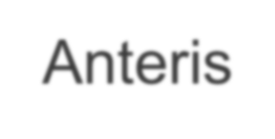
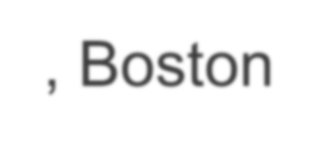
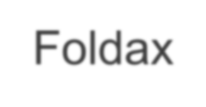
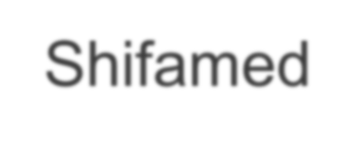
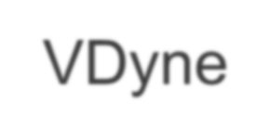
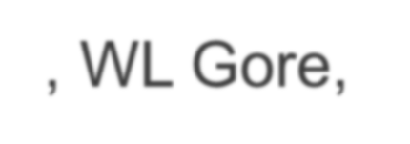
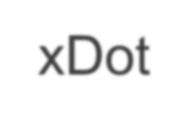
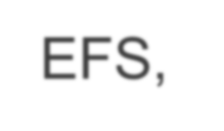
Disclosures
Paul Sorajja, MD
Consulting or Advisory Board: 4C Medical, Abbott Structural, Anteris, Boston Scientific, Edwards Lifesciences, Foldax, Medtronic, Phillips, Siemens, Shifamed, VDyne, WL Gore, xDot
Institutional Research: Abbott Structural, Boston Scientific, Edwards
Lifesciences, Medtronic
National P.I.: EXPAND II, Highlife (US), SUMMIT-MAC, SOAR-EFS, TRILUMINATE Pivotal, VISTA

Slide 3
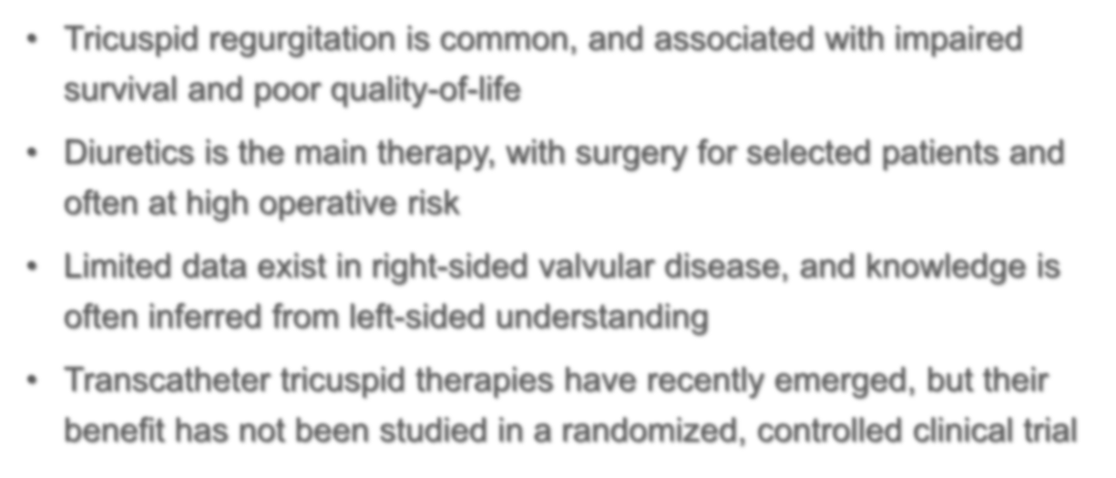
Tricuspid Regurgitation
Tricuspid regurgitation is common, and associated with impaired survival and poor quality-of-life
Diuretics is the main therapy, with surgery for selected patients and often at high operative risk
Limited data exist in right-sided valvular disease, and knowledge is often inferred from left-sided understanding
Transcatheter tricuspid therapies have recently emerged, but their benefit has not been studied in a randomized, controlled clinical trial

Slide 4
Scientific Objective
The TRILUMINATE Pivotal Trial is designed to evaluate the safety and effectiveness of transcatheter tricuspid
repair with the TriClip™ device in symptomatic patients with severe tricuspid regurgitation who are
intermediate or greater estimated risk for mortality
with tricuspid valve surgery

Slide 5
Study Leadership
Steering Committee
David Adams | Mount Sinai Hospital
Jörg Hausleiter | Universität München
Patrick McCarthy | Northwestern University
Paul Sorajja | Minneapolis Heart Institute
Raj Makkar | Cedars-Sinai Medical Center
Ralph Stephan von Bardeleben | University Medicine of the Johannes Gutenberg University Mainz
Randolph Martin | Bay Labs, Inc.
Raymond Benza | Ohio State University
Rebecca Hahn | New York-Presbyterian/CUMC
Saibal Kar | Los Robles Medical Center
Scott Lim | University of Virginia Medical Center
Susheel Kodali | New York-Presbyterian/CUMC
Ulrich Jorde | Montefiore Medical Center
Vinod Thourani | Piedmont Hospital
Anatomic Eligibility Committee
Anita Asgar | Montreal Heart Institute
Brian Whisenant | Intermountain Medical Center
Gagan Singh | UC - Davis Medical Center
Gilbert Tang | Mount Sinai Hospital
Hursh Naik | Arizona CV Research Center
M. Azeem Latib | Montefiore Medical Center
Marta Sitges | Hospital Clinic Barcelona
Matthew Price | Scripps Health
Moody Makar | Cedars-Sinai Medical Center
Neil Fam | St. Michael's Hosital
Paul Sorajja | Minneapolis Heart Institute
Philipp Lurz | Universität Leipzig
Ralph Stephan von Bardeleben | University Medicine of the Johannes Gutenberg University Mainz
Rebecca Hahn | New York-Presbyterian/CUMC
Richard Bae | Minneapolis Heart Institute
Saibal Kar | Los Robles Medical Center
Scott Lim | University of Virginia Medical Center
Susheel Kodali | New York-Presbyterian/CUMC
Tom Smith | UC Davis
Patient Management Eligibility Committee
Andrew Sauer Sandhya Murthy Raymond Benza Ulrich Jorde
Saint Luke's Health System Montefiore Medical Center Ohio State University Montefiore Medical Center
Echocardiographic Core Lab
Rebecca Hahn | Cardiovascular Research Foundation
Nadira Hamid | Cardiovascular Research Foundation

Slide 6
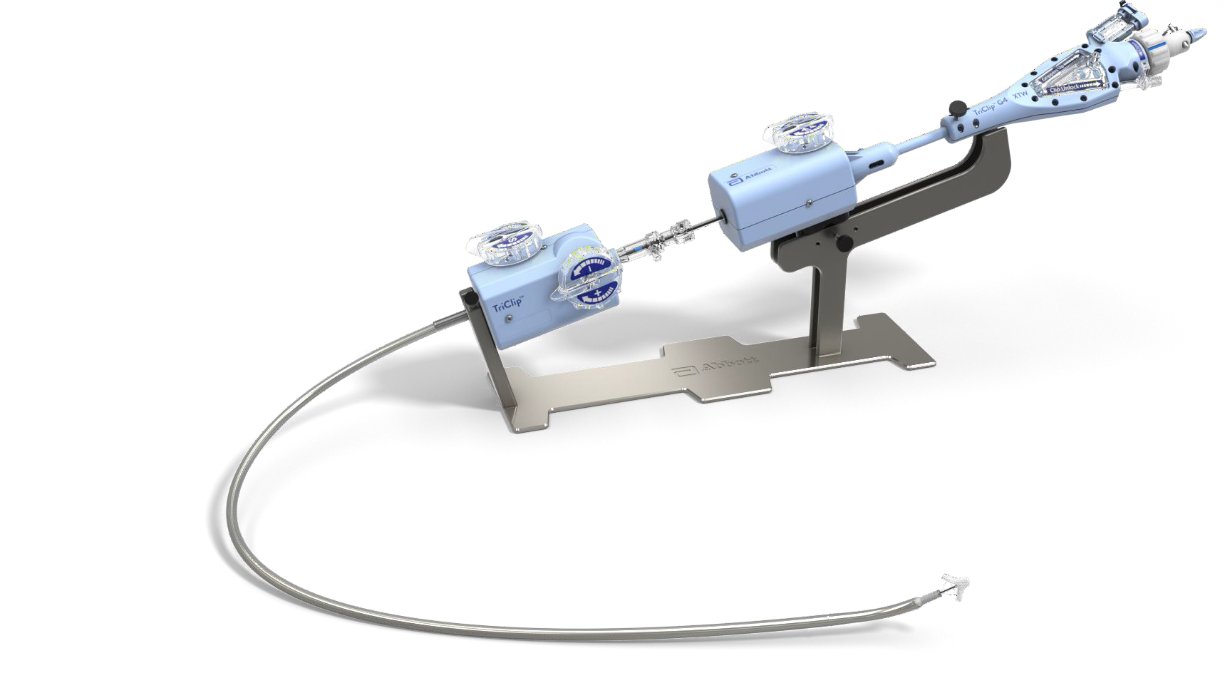
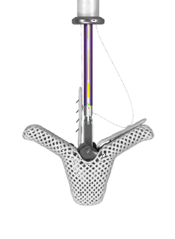
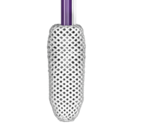
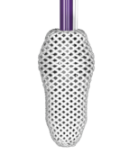
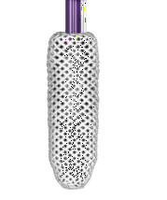
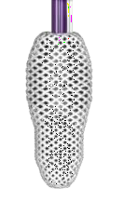
TriClip™ G4 Delivery System
F/E KNOB
Flexes and extends delivery catheter to steer down to the valve plane
CONTROLLED GRIPPER ACTUATION
Ability to optimize leaflet grasping if needed
S/L KNOB
Enables movement in septal or lateral direction
4 CLIP SIZES
Broad range of sizes for tailored treatment
G4 NT G4 NTW G4 XT G4 XTW
4 mm 6 mm 4 mm 6 mm
+/- KNOB
Provides the height needed above the valve plane
NTW/XTW 50% WIDER
IN THE
GRASPING
AREA
DISTAL CURVE
Anatomically designed for direct access to the valve

Slide 7
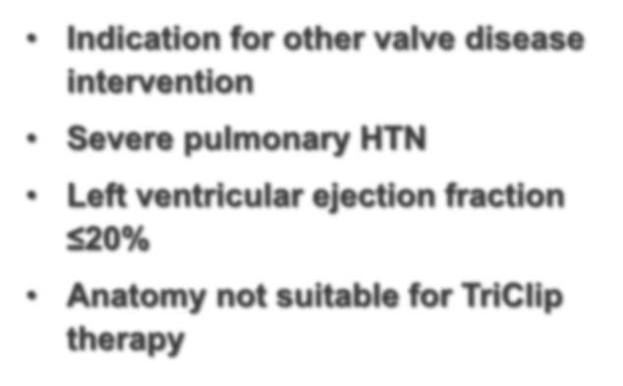
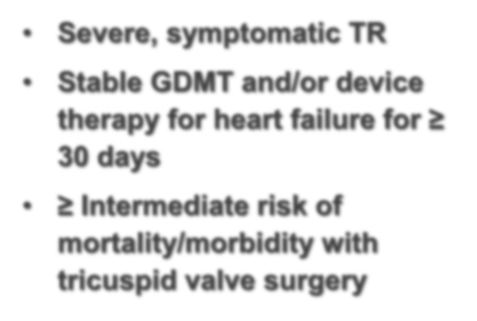
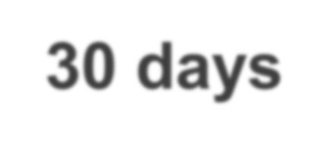
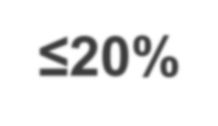
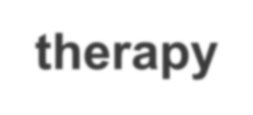
Study Enrollment Criteria
Key Inclusion Criteria Key Exclusion Criteria
Severe, symptomatic TR
Stable GDMT and/or device therapy for heart failure for ≥ 30 days
≥ Intermediate risk of mortality/morbidity with tricuspid valve surgery
Indication for other valve disease intervention
Severe pulmonary HTN
Left ventricular ejection fraction
≤20%
Anatomy not suitable for TriClip
therapy

Slide 8
Enrollment and Treatment Pathway
Subject Selection
Symptomatic, severe TR and at intermediate
or greater risk for TV surgery
YES
Subject meets inclusion/exclusion criteria?
NO
YES
Echo Core Lab
TR Severity Confirmed?
NO
Screen Failure
YES
Eligibility Committees
Confirm optimized medical therapy and valve anatomy clippable
NO
YES
Randomize 1:1
YES
Ability to reduce TR to Moderate or less?
NO
Ability to reduce TR by 1 grade?
YES
Single-Arm
TriClip Device (N=175)
Medical Therapy (N=175)
Completed 12 Month F/U
Completed 12 Month F/U

Slide 9
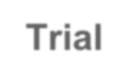
Endpoints and Analysis
Trial Design
Prospective, randomized, controlled, multi-center trial designed to test the superiority of TriClip™ therapy in addition to medical therapy (Device group) over medical therapy alone (Control group)
450+ subjects enrolled at up to 80 sites in the US, Canada, Europe
To be assessed after the first 350 randomized subjects complete 12-month follow-up
A composite of mortality or tricuspid valve surgery, heart failure hospitalizations, and quality of life improvement ≥15 points assessed using the Kansas City Cardiomyopathy Questionnaire (KCCQ), evaluated at 12 months in a hierarchical fashion using the Finkelstein-Schoenfeld methodology
Primary
Endpoint
Assessed hierarchically in the following order:
Freedom from major adverse events (MAE) after procedure attempt (femoral vein puncture) at 30 days (Device group only)
Change in KCCQ at 12 months (superiority of Device vs. Control)
TR Reduction to moderate or less at 30-day post procedure (superiority of Device vs. Control)
Change in 6MWD at 12 months (superiority of Device vs. Control)
Secondary
Endpoint
MAE defined as composite of Cardiovascular Mortality, New Onset Renal Failure,
Endocarditis Requiring Surgery, and Non-Elective Cardiovascular Surgery for TriClip device-related AE post-index procedure.

Slide 10
Broad Geographical Participation
63
6
Medical Center
University of Colorado Hospital
University of Pittsburgh Medical Center
University of Virginia Medical Center
Yale New Haven Hospital
6
Abbott Northwestern Hospital
Allegheny General Hospital- ASRI
Arizona Cardiovascular Research Center
Aurora Medical Group
Austin Heart
Baptist Hospital of Miami
Baylor Scott & White Heart & Vascular Hospital
Beth Israel Deaconess Medical
Center
Brigham & Women's Hospital
Buffalo General Hospital
California Pacific Medical Center - Van Ness Campus
Cardiovascular Institute of the South
Cardiovascular Research Institute of Kansas
Carolinas Medical Center
Cedars-Sinai Medical Center
Centennial Heart Cardiovascular Consultants
Christ Hospital
El Camino Hospital
Hospital of the University of Pennsylvania
Inova Fairfax Hospital
Intermountain Medical Center
JFK Medical Center
Kansas University Medical Center
Los Robles Regional Medical Center
Manatee Memorial Hospital
MedStar Health Research Institute
Methodist Hospital of San Antonio
Montefiore Medical Center - Moses Division
Morton Plant Valve Clinic
Mount Sinai Hospital
New York-Presbyterian/Columbia University Medical Center
North Shore University Hospital
Northshore University HealthSystem
Novant Health Heart and Vascular
Research Institute
Ohio Health Research Institute
Phoenix Cardiovascular Research Group
Piedmont Heart Institute
Providence Heart & Vascular Institute
Providence Medical Foundation
Rush University Medical Center
Scripps Health
Sentara Norfolk General Hospital
St. Thomas Hospital
Sutter Medical Center, Sacramento
Swedish Medical Center
Tallahassee Research Institute
The Cleveland Clinic Foundation
The Methodist Hospital
Tucson Medical Center
University Hospital - Univ. of Alabama at Birmingham (UAB)
University of California - Davis
Hamilton Health Science Centre
Herzzentrum Leipzig GmbH
Hospital Clínic de Barcelona
Institut de Cardiologie de Montreal (Montreal Heart Inst.)
Munchen Grosshadern
Ospedale San Raffaele - Cardiac
Ottawa Heart Institute
St. Michael's Hospital
St. Paul's Hospital
Sunnybrook Health Sciences Centre
Universitatsklinikum Bonn AdoR
Universitatsmedizin der Johannes Gutenberg-Universitat Mainz

Slide 11
Baseline Characteristics
 | Device N=175 # (%) | Control N=175 # (%)
Age, Mean (years) | 78.0 ± 7.4 | 77.8 ± 7.2
Sex (Female) | 98 (56.0) | 94 (53.7)
NYHA class III or IV | 104 (59.4) | 97 (55.4)
KCCQ Score, mean | 56.0 ± 23.4 | 54.1 ± 24.2
Hypertension | 142 (81.1) | 141 (80.6)
Renal disease | 62 (35.4) | 62 (35.4)
Liver disease | 11 (6.3) | 16 (9.1)
Atrial fibrillation | 153 (87.4) | 162 (92.6)
Diabetes | 28 (16.0) | 27 (15.4)
COPD | 19 (10.9) | 24 (13.7)
CRT/CRT-D/ICD/PPM | 28 (16.0) | 24 (13.7)
Prior aortic intervention | 27 (15.4) | 27 (15.4)
Prior mitral intervention | 45 (25.7) | 42 (24.0)
Prior tricuspid intervention | 1 (0.6) | 0 (0.0)
 | Device N=175 # (%) | Control N=175 # (%)
TR Severity Moderate Severe | 4 (2.3) 44 (25.4) | 2 (1.2) 49 (29.7)
Massive 37 (21.4) 30 (18.2) Torrential 88 (50.9) 84 (50.9)
Etiology (functional) | 165 (94.8) | 158 (92.9)
Coaptation Gap, Mean (mm) | 5.5 ± 1.8 | 5.2 ± 1.7
Heart size/function, Mean
RVEDD (base, cm) | 5.0 ± 0.8 | 5.2 ± 0.8
TV annulus diameter (cm) | 4.3 ± 0.7 | 4.5 ± 0.8
RV TAPSE (cm) | 1.7 ± 0.4 | 1.6 ± 0.4
LVEF (%) | 59.3 ± 9.3 | 58.7 ± 10.5
CO (L/min) | 4.1 ± 1.2 | 4.2 ± 1.1

Slide 12
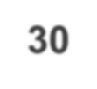
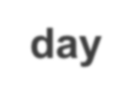
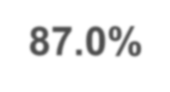
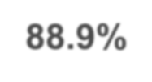
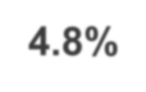
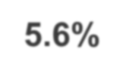
Reduction in TR Severity
Paired Analyses
30-day
Baseline
30-day
Baseline
1-year
100%
100%
13
10.3
11.1
80%
80%
38.3
37.5
38.2
60%
60%
97.7
98.8
95.2
97.1
98.4
94.4
94.4
87.0%
88.9%
40%
p<0.0001
40%
49.7
52.2
50.7
20%
20%
4.1
0.7
2.9
1.6
4
0.8
2.4
3.2
2.3
1.2
4.8%
5.6%
0%
0%
Device (n=173)
Trace/Mild
Control (n=165)
Moderate
Device (n=161)
Control (n=146)
Device (n=136)
Control (n=125)
Device (n=136)
Control (n=125)
Moderate
Device (n=136)
Trace/Mild
Control (n=125)
Severe/Massive/Torrential
Severe/Massive/Torrential

Slide 13
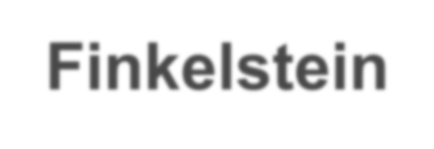
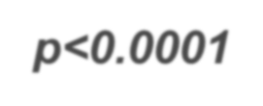
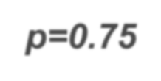
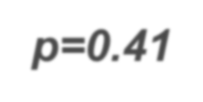
Primary Endpoint
Finkelstein-Schoenfeld Analysis
Win ratio, 1.48
(1.06, 2.13), p=0.02
11348
12000
TriClip™ therapy demonstrated superiority to medical therapy driven by improvement in KCCQ
10000
p<0.0001
8000
7643
6516
6000
p=0.75
p=0.41
2871
4000
2884
2644
1948
2128
2000
0
Total
Death or TV Surgery
HF hospitalization
KCCQ change ≥15 pts
Device Wins
Control Wins

Slide 14
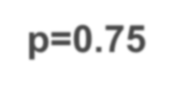
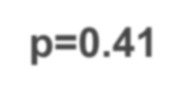
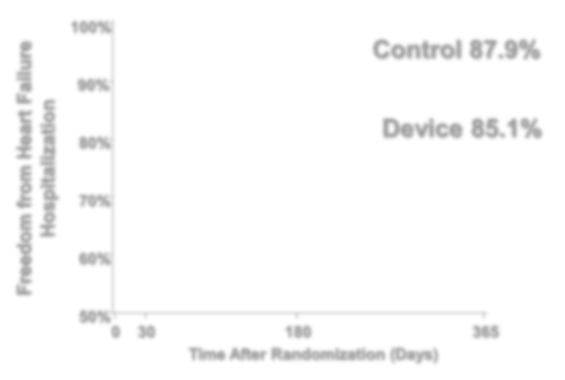
Individual Component Analysis
1st Component: Mortality or TV Surgery
p=0.75
2nd Component:
Heart Failure Hospitalization
p=0.41
100%
Device 90.6%
100%
Patients Free from All-Cause
Mortality or Tricuspid Valve Surgery
Freedom from Heart Failure Hospitalization
Control 87.9%
90%
90%
Control 89.4%
80%
Device 85.1%
80%
70%
70%
60%
60%
50%
0 30
180
Time After Randomization (Days)
50%
365
0 30
180
Time After Randomization (Days)
365

Slide 15
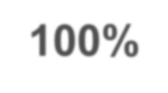
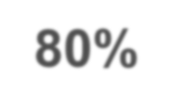
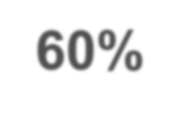
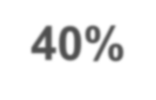
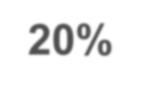
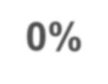
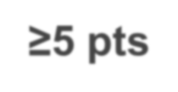
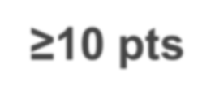
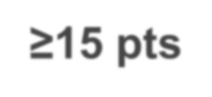
Quality-of-life Improvement
3rd Component, KCCQ change ≥15 pts, baseline to 1-yr
100%
Device Control
Proportion of Patients (%)
80%
64.6%
60%
56.4%
46.6%
49.7%
40%
39.9%
37.2%
26.4%
20%
18.4%
0%
<0 pts
Worse
≥5 pts
Improved
≥10 pts
≥15 pts

Slide 16
Relationship between TR and Quality of Life
Residual TR grade at 1-yr TR severity change, baseline to 1-yr
18
20
KCCQ 8, Baseline to 1-year (pts)
16
KCCQ 8, Baseline to 1-year (pts)
18
16
18
14
16
14
12
12
10
10
8
8
6
6
4
6
4
4
2
2
2
0
0
0
Moderate or less (n=133)
Severe/Massive/Torrential (n=149)
Worsens (n=46)
No change (n=67)
1 grade (n=35)
≥2 grade (n=125)

Slide 17
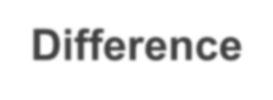
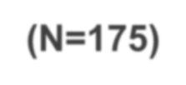
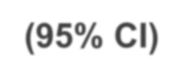
Hierarchical Secondary Endpoints
Device Group (N=175) |  | Control Group (N=175) | Difference (95% CI) | p-value
Freedom from MAE through 30 Days post procedure – Kaplan-Meier estimate of event-free rate (lower 97.5% CI)¹ | 98.3 | - | - | <0.001
Change in KCCQ from baseline to 12 months (pts)² Endpoint analysis Non-imputed data | 12.3 15.2 | 0.6 4.8 | 11.7 10.4 | <0.001 -
TR Severity ≤ Moderate at 30 Days – no./total no (%) | 87.0 | 4.8 | - | <0.001
Change in 6-min walk test distance from baseline to 12 months (m)² Endpoint analysis Non-imputed data | -8.1 11.5 | -25.2 -8.7 | 17.1 20.3 | 0.25 -
¹ MAE Performance Goal 90%
² Subjects who experienced a heart failure related cardiovascular death or received tricuspid valve surgery had KCCQ score and 6MWT distance imputed as 0 at 12 months. 6MWT also imputed as 0 for subjects unable to exercise due to cardiac reasons.

Slide 18
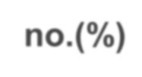
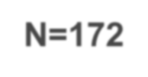
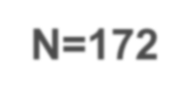
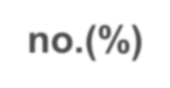
Safety Profile
Major Adverse Event (MAE) Through 30 Days Post-Procedure – no.(%) | Device N=172†
Total | 3 (1.7%)
Cardiovascular mortality | 1 (0.6%)
Endocarditis requiring surgery | 0 (0%)
New-onset renal failure | 2 (1.2%)
Non-elective CV Surgery, TVRS for device- related AE | 0 (0%)
Other Clinical Safety Endpoints Through 30 Days Post-Procedure– no.(%) | Device N=172†
Any-cause mortality | 1 (0.6%)
Tricuspid valve surgery | 1 (0.6%)
Tricuspid valve re-intervention | 3 (1.7%)
Major bleeding# | 8 (4.7%)
Tricuspid mean gradient ≥ 5mmHg | 8 (4.7%)
Single leaflet device attachment (SLDA)* | 12 (7.0%)
Stroke | 1 (0.6%)
Myocardial Infarction | 0 (0%)
Embolization* | 0 (0%)
Thrombosis | 0 (0%)
New CRT/CRT-D/ICD/perm. pacemaker^ | 1 (0.6%)
†Attempted procedure population (3 subjects randomized to Device withdrew consent prior to index procedure)
#Defined as bleeding ≥ Type 3 based on a modified Bleeding Academic Research Consortium (BARC) definition
*SLDA and embolization evaluated through 30-day follow-up
^Assessed through adverse event reporting

Slide 19
Limitations
Since patients were not blinded, a Hawthorne effect may have played a role in outcomes in both groups
The trial was conducted almost entirely during the COVID-19 pandemic, which may have affected clinical outcomes

Slide 20
Summary
TR was reduced by TriClip therapy to moderate or less in 87%,
vs. only 4.8% for the control group, and reduction was sustained to 1- year follow-up
The primary endpoint was met (p=0.02) demonstrating device superiority, driven mainly by significant improvement in QOL
Degree of TR reduction was related to degree of improvement in QOL
The 30-day MAE rate was only 1.7%, and death and pacemaker implant each occurred in 0.6%
Survival free of mortality and TV surgery was high at 1 year in both groups (~90%)

Slide 21
Conclusions
TRILUMINATE Pivotal is a pioneering study as the first RCT in this unique population of patients with severe TR
The TriClip device was highly effective in reducing TR and led to significant improvements in quality of life at one year, without the high procedural risk often associated with tricuspid surgery.
These results are very meaningful for a highly symptomatic population whose quality of life is impacted by TR
With the excellent benefit-to-risk profile of the TriClip system, a historically untreated population will have a treatment option to improve their quality of life

