Slide 1
Antithrombotic Therapy in Patients with Atrial Fibrillation and Acute Coronary Syndrome Treated Medically or with Percutaneous Coronary Intervention or Undergoing Elective Percutaneous Coronary Intervention
Stephan Windecker
on behalf of the AUGUSTUS Investigators

Slide 2
Disclosure Statement of Financial Interest
I, Stephan Windecker, declare the following:
Research grants to the institution from Abbott, Amgen, Bayer, BMS, Boston Scientific, Biotronik, CLS Behring, Edwards Lifesciences, Medtronic, Polares and Sinomed

Slide 3
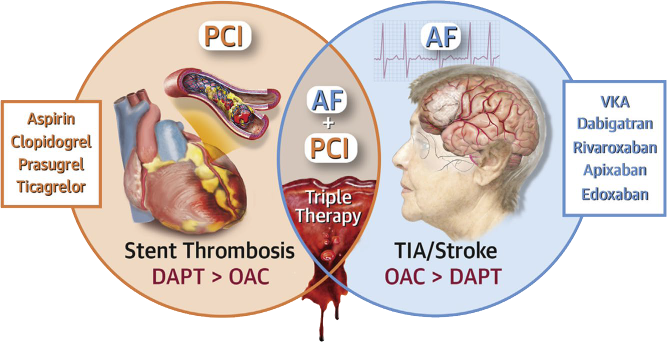
Background
AUGUSTUS trial — AF patients with recent ACS or PCI
Apixaban without aspirin resulted in
  less bleeding
  fewer hospitalizations
  no significant differences in ischemic events
than regimens that included a VKA, aspirin, or both

Slide 4
Pre-Specified Analysis
Using a 2×2 factorial design apixaban was compared with VKA and aspirin with placebo in patients with AF who had ACS or were undergoing PCI and were receiving a P2Y₁₂ inhibitor
We explored bleeding, death, and hospitalization as well as death and ischemic events by antithrombotic strategy in three mutually exclusive, pre-specified subgroups:
  Patients with ACS treated medically (ACS Medical)
  Patients with ACS treated with PCI (ACS PCI)
  Patients undergoing elective PCI (Elective PCI)

Slide 5
Trial Design
INCLUSION
AF (prior, persistent, >6 hr)
– Physician decision for OAC
ACS or PCI
– Planned P2Y₁₂ inhibitor for ≥6 months
Randomize
n=4600 patients
EXCLUSION
Contraindication to DAPT
Other reason for VKA
(prosthetic valve, moderate / severe mitral stenosis)
Apixaban 5 mg BID
Apixaban 2.5 mg BID in selected patients
Open Label
VKA
(INR 2–3)
Aspirin for all on the day of ACS or PCI Aspirin versus placebo after randomization
Aspirin
Double Blind
Placebo
Aspirin
Double Blind
Placebo
Randomization was stratified by indication at time of enrollment
ACS versus elective PCI
Patients with ACS were managed medically or with PCI according to local practice
Lopes RD, et al. Am Heart J. 2018;200:17-23.

Slide 6
Patient Allocation
4614 patients (492 sites, 33 countries)
ACS
61.2%
(n=2811)
Elective PCI
38.8%
(n=1784)
Randomization stratified by ACS vs. elective PCI
ACS
Medical
39.0%
(n=1097)
ACS PCI 61.0%
(n=1714)
Patients with ACS were managed medically or with PCI according to local practice
19 pts with missing information about ACS and PCI

Slide 7
Baseline Characteristics
 | ACS Medical N=1097 | ACS PCI N=1714 | Elective PCI N=1784
Age, median (25th, 75th), yrs | 70 (64, 77) | 71 (64.0, 77.3) | 71 (65, 77)
Female | 39% | 27% | 25%
Diabetes mellitus | 32% | 35% | 41%
CrCl, median (25th, 75th), mL/min | 72 (54, 91) | 76 (57, 96) | 76 (59, 98)
Heart failure | 57% | 39% | 38%
CHA₂DS₂-VASc score, median (25th, 75th) | 4 (3, 5) | 4 (3, 5) | 4 (3, 5)
HAS-BLED score, median (25th, 75th) | 2 (2, 3) | 2 (2, 3) | 3 (2, 3)
Prior OAC | 48% | 42% | 57%
P2Y₁₂ inhibitor
Clopidogrel | 98% | 90% | 93%
Prasugrel | 0.2% | 1.7% | 1.2%
Ticagrelor | 2.1% | 8.7% | 6.3%
Number of days to rand., median (25th, 75th) | 9 (6, 12) | 5 (3, 9) | 5 (2, 9)

Slide 8
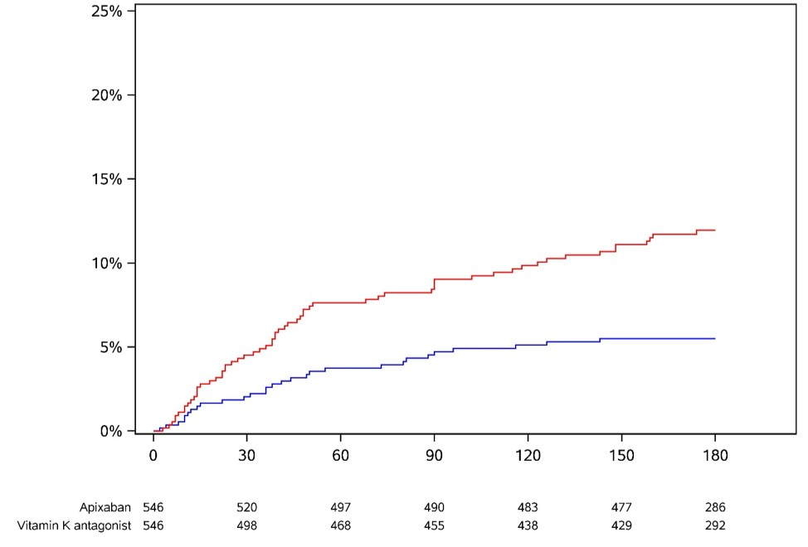
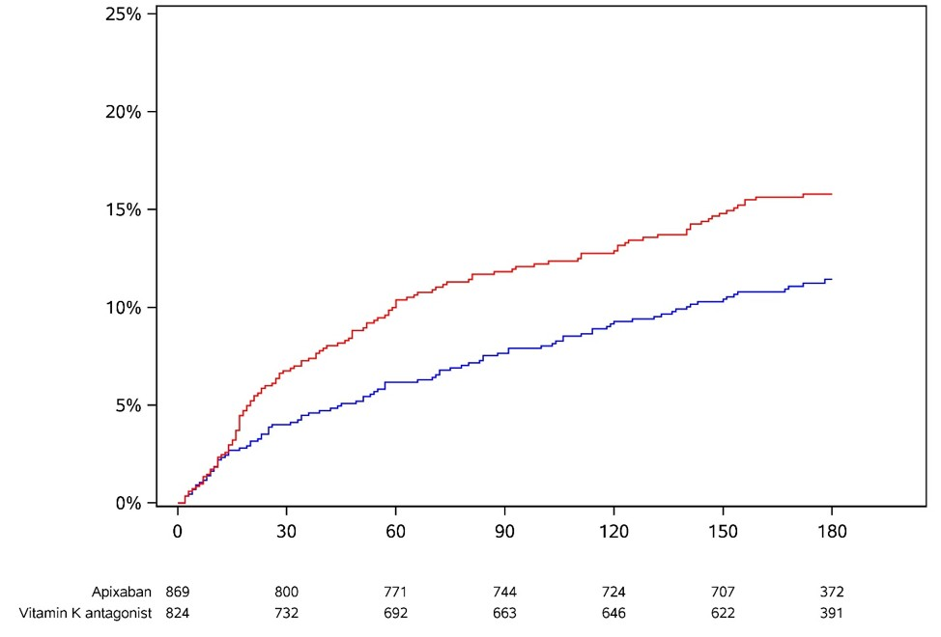
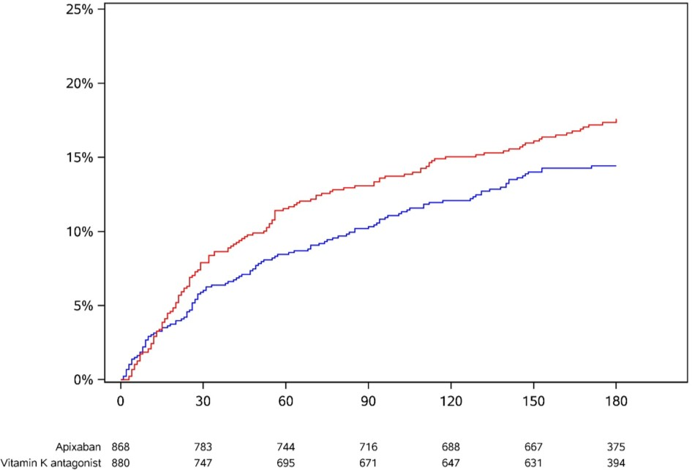
Primary Endpoint: ISTH and CRNM Bleeding Apixaban vs VKA
ACS Medical
N=1097
ACS PCI
N=1714
Elective PCI
N=1784
P for Interaction (ACS Medical, ACS PCI, Elective PCI) = 0.052
Cumulative incidence of event
HR 0.44 (95% CI 0.28–0.68) HR 0.68 (95% CI 0.52–0.89)
HR 0.82 (95% CI 0.64–1.04)
VKA
VKA
VKA
Apixaban
Apixaban
Apixaban
Days since start of intervention
Days since start of intervention
Days since start of intervention

Slide 9
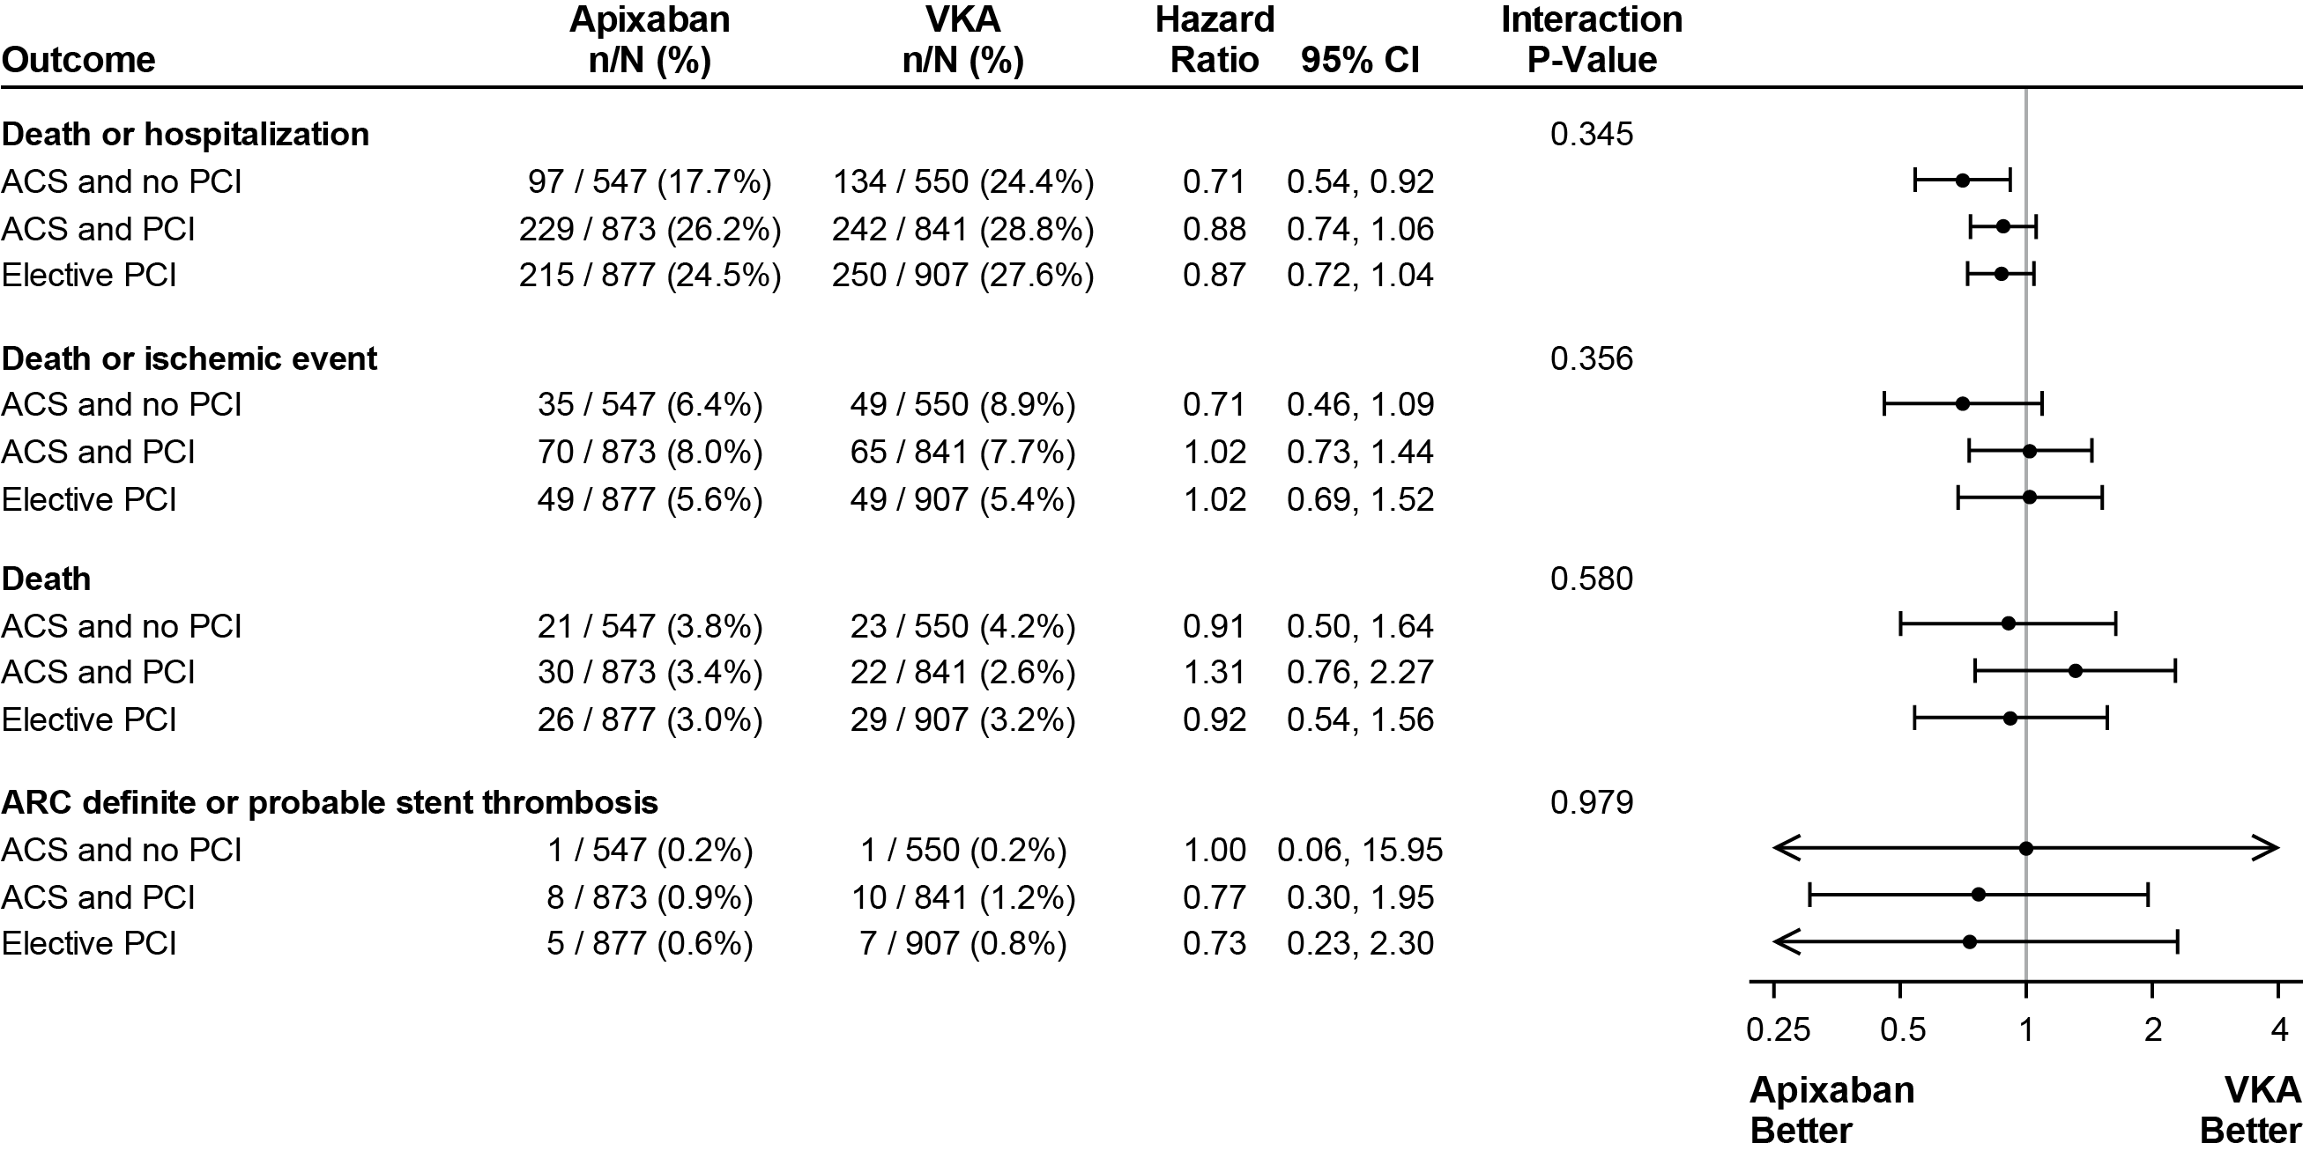
Ischemic Outcomes—Apixaban vs VKA

Slide 10
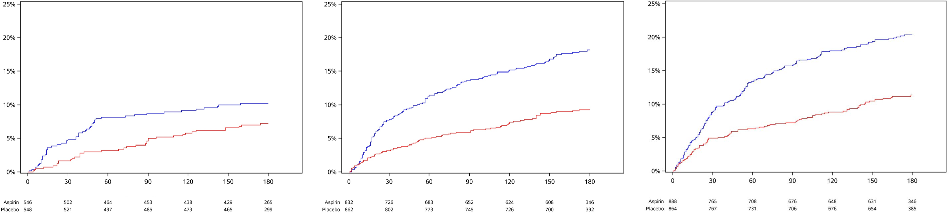
Primary Endpoint: ISTH and CRNM Bleeding Aspirin vs Placebo
ACS Medical
N=1097
ACS PCI
N=1714
Elective PCI
N=1784
P for Interaction (ACS Medical, ACS PCI, Elective PCI) = 0.479
HR 1.49 (95% CI 0.98–2.26)
HR 2.02 (95% CI 1.53–2.67)
Aspirin
HR 1.91 (95% CI 1.48–2.47)
Aspirin
Cumulative incidence of event
Aspirin
Placebo
Placebo
Placebo
Days since start of intervention
Days since start of intervention
Days since start of intervention

Slide 11
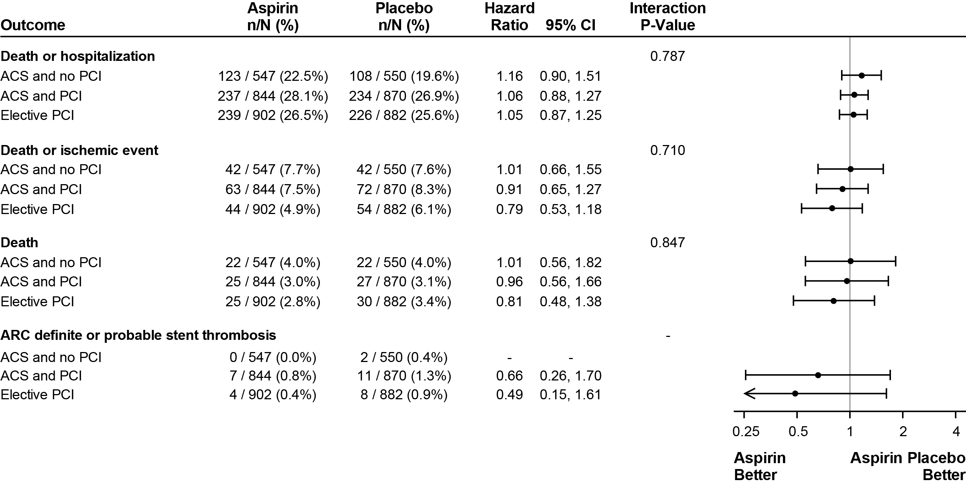
Ischemic Outcomes—Aspirin vs Placebo

Slide 12
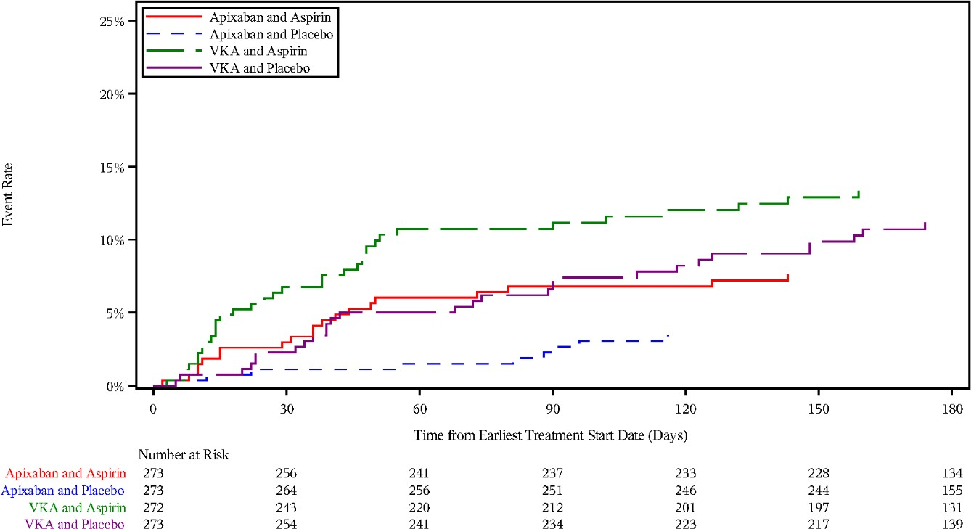
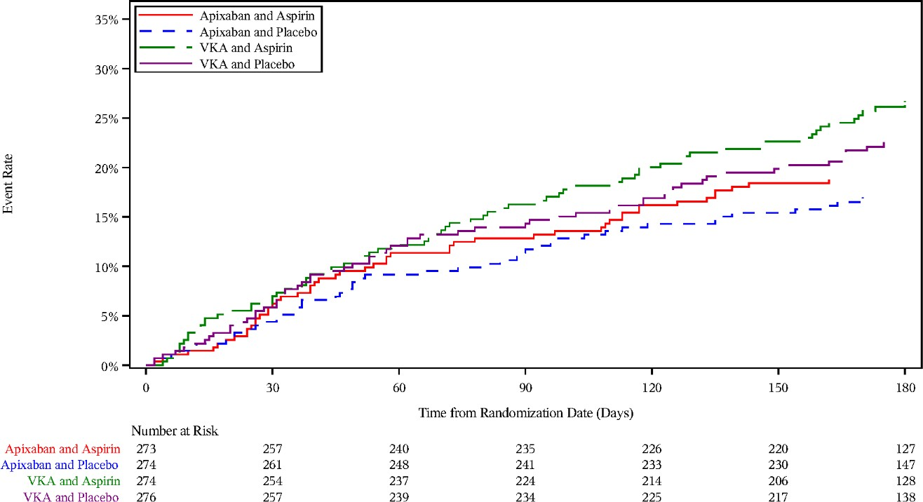
ACS Medical
ISTH/CRNM Bleeding
Death/Hospitalization
Apixaban + Placebo vs. VKA + Aspirin:
10% absolute risk reduction (NNT=10)
Apixaban + Placebo vs. VKA + Aspirin:
10% absolute risk reduction (NNT=10)
VKA + Aspirin (%)
VKA + Placebo (%)
Apixaban + Aspirin (%)
Apixaban + Placebo (%)
VKA + Aspirin (%)
VKA + Placebo (%)
Apixaban + Aspirin (%)
Apixaban + Placebo (%)
Event rate
Event rate
Time from earliest treatment start date (days)
Time from randomization start date (days)

Slide 13
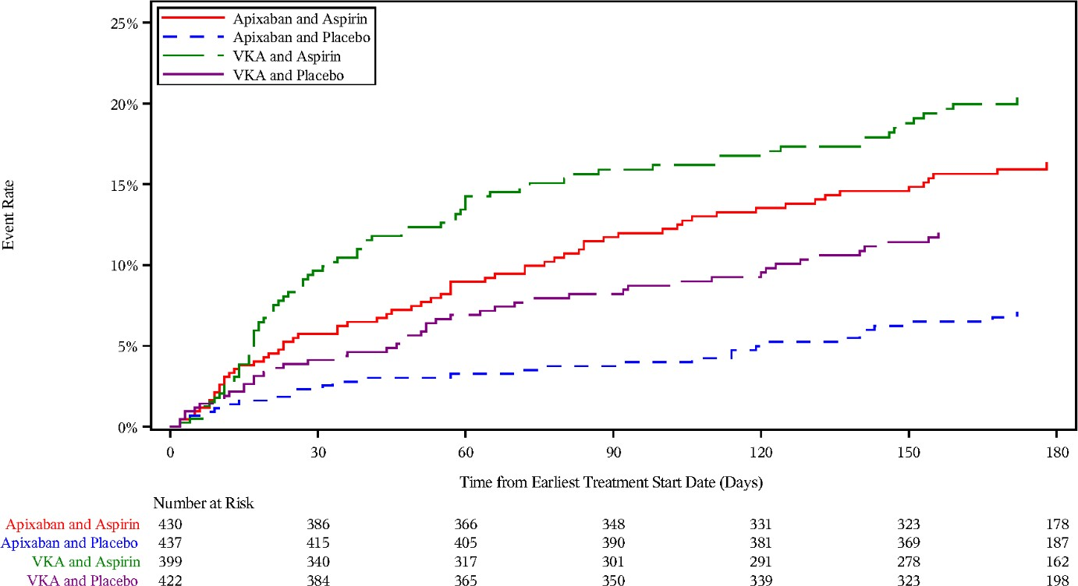
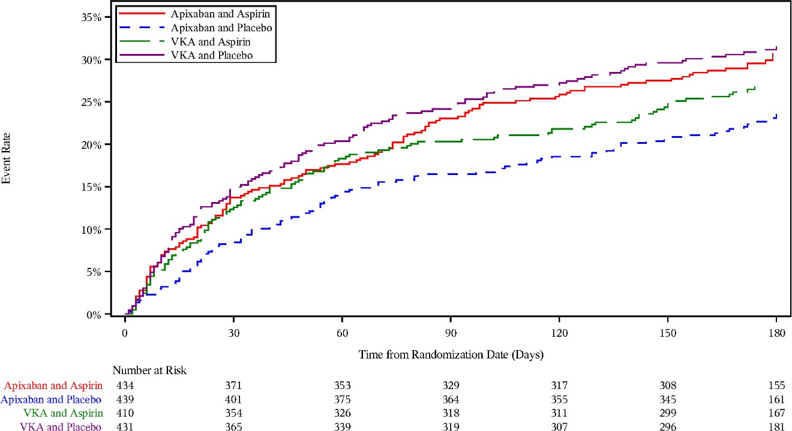
ACS PCI
ISTH/CRNM Bleeding
Death/Hospitalization
Apixaban + Placebo vs. VKA + Aspirin:
12% absolute risk reduction (NNT=8)
Apixaban + Placebo vs. VKA + Aspirin:
3.5% absolute risk reduction (NNT=29)
VKA + Aspirin (%)
VKA + Placebo (%)
Apixaban + Aspirin (%)
Apixaban + Placebo (%)
Event rate
Event rate
VKA + Aspirin (%)
VKA + Placebo (%)
Apixaban + Aspirin (%)
Apixaban + Placebo (%)
Time from earliest treatment start date (days)
Time from randomization start date (days)

Slide 14
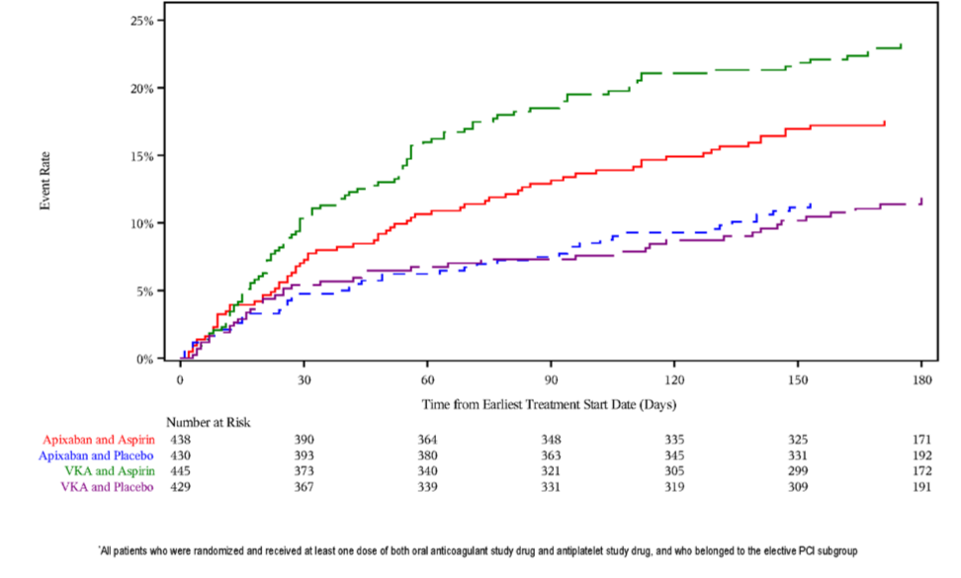
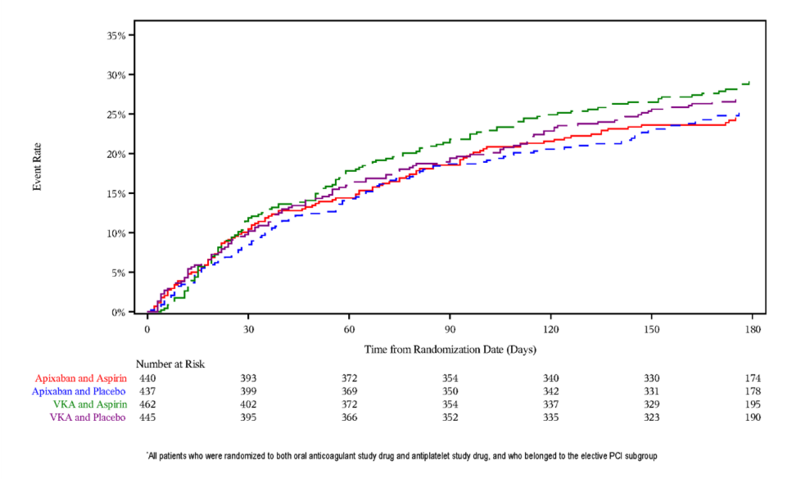
Elective PCI
ISTH/CRNM Bleeding
Death/Hospitalization
Apixaban + Placebo vs. VKA + Aspirin:
11% absolute risk reduction (NNT=9)
Apixaban + Placebo vs. VKA + Aspirin:
3.9% absolute risk reduction (NNT=26)
VKA + Aspirin (%)
VKA + Placebo (%)
Apixaban + Aspirin (%)
Apixaban + Placebo (%)
VKA + Aspirin (%)
VKA + Placebo (%)
Apixaban + Aspirin (%)
Apixaban + Placebo (%)
Event rate
Event rate
Time from earliest treatment start date (days)
Time from randomization start date (days)

Slide 15
Conclusions
The overall results of the AUGUSTUS trial are consistent across the three clinically important subgroups (ACS medical, ACS PCI, elective PCI).
Accordingly, anticoagulation with apixaban, at the dose approved for stroke prevention in patients with AF, combined with a P2Y₁₂ inhibitor without aspirin should be preferred in patients with AF and ACS irrespective of management with medical therapy or PCI, and those undergoing elective PCI than regimens that include VKAs, aspirin, or both.

