Slide 1
Ticagrelor With AspIrin or ALone In HiGH- Risk Patients After Coronary InTervention: Thrombogenicity Substudy
Usman Baber, MD MS and M. Urooj Zafar MBBS on behalf of the TWILIGHT Investigators
Icahn School of Medicine at Mount Sinai, New York, NY
ClinicalTrials.gov Number: NCT04001374

Slide 2
Disclosure Statement of Financial Interest
Within the past 12 months, I or my spouse/partner have had a financial interest, arrangement, or affiliation with the organization(s) listed below:
Affiliation/Financial Relationship | Company
Consulting Fees/Honoraria | AstraZeneca; Boston Scientific

Slide 3
Background
Several trials have shown that monotherapy with a P2Y₁₂ inhibitor alone results in similar rates of adverse ischemic events as compared with dual antiplatelet therapy (DAPT) following percutaneous coronary intervention (PCI).¹⁻⁴
However, most studies were characterized by relatively infrequent^{1,2} or lower than expected rates of ischemic events^{3,4}, thus compromising power to detect signals of harm upon withdrawal of aspirin.
Examining the direct effect of aspirin withdrawal on human endovascular thrombosis may provide a mechanistic basis for these observations and additional support for a clinical strategy of P2Y₁₂ inhibition alone after PCI.
¹Hahn et al., JAMA 2019 ²Watanabe et al., JAMA 2019
³Vranckx et al., Lancet 2018 ⁴Mehran et al., NEJM 2019

Slide 4
Objective
To compare the antithrombotic potency of ticagrelor alone versus ticagrelor plus aspirin on ex-vivo whole blood thrombogenicity among high-risk patients undergoing PCI with drug eluting stents (DES)

Slide 5
Study Schema
Ticagrelor + Aspirin
High-Risk PCI Patients
(N=9006)
Randomized at MSSM
(N=128)
3 months
Short course DAPT with ticagrelor plus aspirin
Enrolled in PD study (N=51)
Ticagrelor + Placebo
First blood draw
Perfusion assay
Platelet aggregation
Second blood draw
Perfusion assay
Platelet aggregation
3 M
4 M
9 M

Slide 6
Endpoints and Experimental Methods
Primary Endpoint
Blood thrombogenicity (platelet-dependent thrombus area) at the post-randomization visit using the Badimon perfusion chamber⁵
Validated, ex-vivo model that generates thrombus under dynamic flow conditions of shear stress that mimic moderate arterial stenosis (high shear; 1690 sec⁻¹).
Native, non-anticoagulated whole blood is perfused over disrupted porcine tunica media, which is then processed and quantified using digital planimetry (µm²).
Secondary Endpoint
Platelet reactivity in whole blood measured with impedance aggregometry (Multiplate Analyzer® DiaPharma - West Chester, OH)
Agonists included adenosine diphosphate (ADP), arachidonic acid (AA), collagen and thrombin receptor activator peptide-6 (TRAP).
⁵Vilahur et al., Circulation 2004

Slide 7
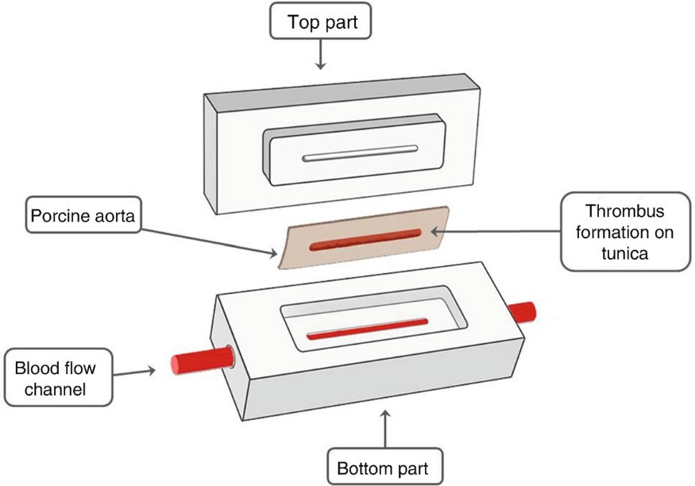
Badimon Perfusion Chamber
Thrombogenic substrate
WATER BATH (37⁰c)
Low shear rate
High shear rate
Peristaltic pump
Discard bin
Thrombus area is quantified

Slide 8
Randomized in TWILIGHT at Mount Sinai
(N=128)
Platelet Substudy Enrolled
(N = 51)
Ticagrelor + Placebo (N = 23)
Ticagrelor + Aspirin (N = 28)
Baseline PD study
Perfusion Assay (N = 23)
Baseline PD study
Perfusion Assay (N = 28)
4 – No longer on therapy
Median (IQR) days between visits 41 (31 – 61)
2 – No longer on therapy 1 – Lost to follow-up
1 – Refused
Follow-up PD study
Perfusion Assay (N = 18)
Follow-up PD study
Perfusion Assay (N = 24)
Paired Perfusion Assay (N = 42)

Slide 9
Clinical Characteristics
Variable | Ticagrelor plus Placebo (n=18) | Ticagrelor plus aspirin (n=24) | p-value
Age, years | 61.9 ± 9.9 | 64.6 ± 9.3 | 0.38
Female Sex | 2 (11.1%) | 3 (12.5%) | 0.89
Nonwhite Race | 11 (61.1%) | 12 (50%) | 0.57
Body mass index, kg/m² | 28.9 ± 4.8 | 28.5 ± 5.4 | 0.81
Diabetes Mellitus | 5 (27.8%) | 10 (41.7%) | 0.35
Current Smoker | 2 (11.1%) | 5 (20.8%) | 0.47
Hypercholesterolemia | 15 (83.3%) | 21 (87.5%) | 0.70
Hypertension | 18 (100.0%) | 21 (87.5%) | 0.12
Prior myocardial infarction | 1 (5.6%) | 5 (20.8%) | 0.16
Prior PCI | 12 (66.7%) | 18 (75.0%) | 0.55
Prior coronary artery bypass | 2 (11.1%) | 2 (8.3%) | 0.76
Chronic kidney disease | 1 (5.6%) | 3 (12.5%) | 0.45
Hemoglobin, g/dl | 12.9 ± 1.2 | 13.4 ± 1.9 | 0.31
Platelet count (x10³/μL) | 243.1 ± 60.2 | 213.6 ± 56.1 | 0.11

Slide 10
Procedural Characteristics
Variable | Ticagrelor plus Placebo (n=18) | Ticagrelor plus aspirin (n=24) | p-value
Indication for PCI
Stable angina | 6 (33.3%) | 10 (41.7%) | 0.58
Acute coronary syndrome | 9 (50%) | 14 (58%) | 0.59
Multivessel CAD | 12 (66.7%) | 11 (45.8%) | 0.18
Number of lesions treated | 1.7 ± 0.8 | 1.6 ± 0.8 | 0.86
LAD | 6 (33.3%) | 11 (45.8%) | 0.41
RCA | 8 (44.4%) | 8 (33.3%) | 0.46
LCx | 8 (44.4%) | 8 (33.3%) | 0.46
Stent length (mm) | 35.8 ± 24.5 | 35.1 ± 21.9 | 0.92
Target lesion morphology
Thrombus (%) | 2 (11.1%) | 4 (16.7%) | 0.61
Calcification, moderate or severe (%) | 3 (16.7%) | 11 (45.8%) | 0.047
Any bifurcation (%) | 6 (33.3%) | 5 (20.8%) | 0.83

Slide 11
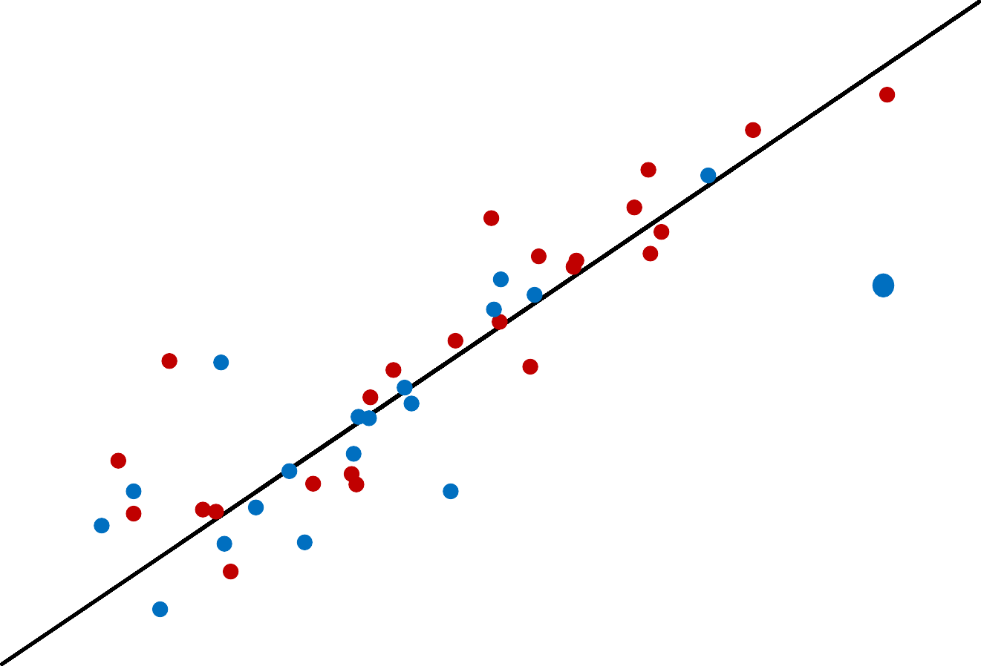
Ex-vivo Thrombus Area by Treatment Group
7000
Thrombus Area at Follow-Up (µm²)
5000
Ticagrelor Plus Aspirin Ticagrelor Plus Placebo
3000
Mean Difference (95% CI) in Thrombus Area Between Groups: 218.2 µm² (-575.9 to 139.9); p=0.22
1000
1000
3000 5000
Thrombus Area at Randomization (µm²)
7000

Slide 12
Within-Group Changes in Thrombus Area
5000
p=0.16
Baseline
Follow-up
3903.8
Thrombus area (um²)
p=0.87
Baseline Follow-up
4000
3741.5
3130.7
3152.4
3000
2000
1000
0
Ticagrelor Plus Placebo
Ticagrelor Plus Aspirin

Slide 13
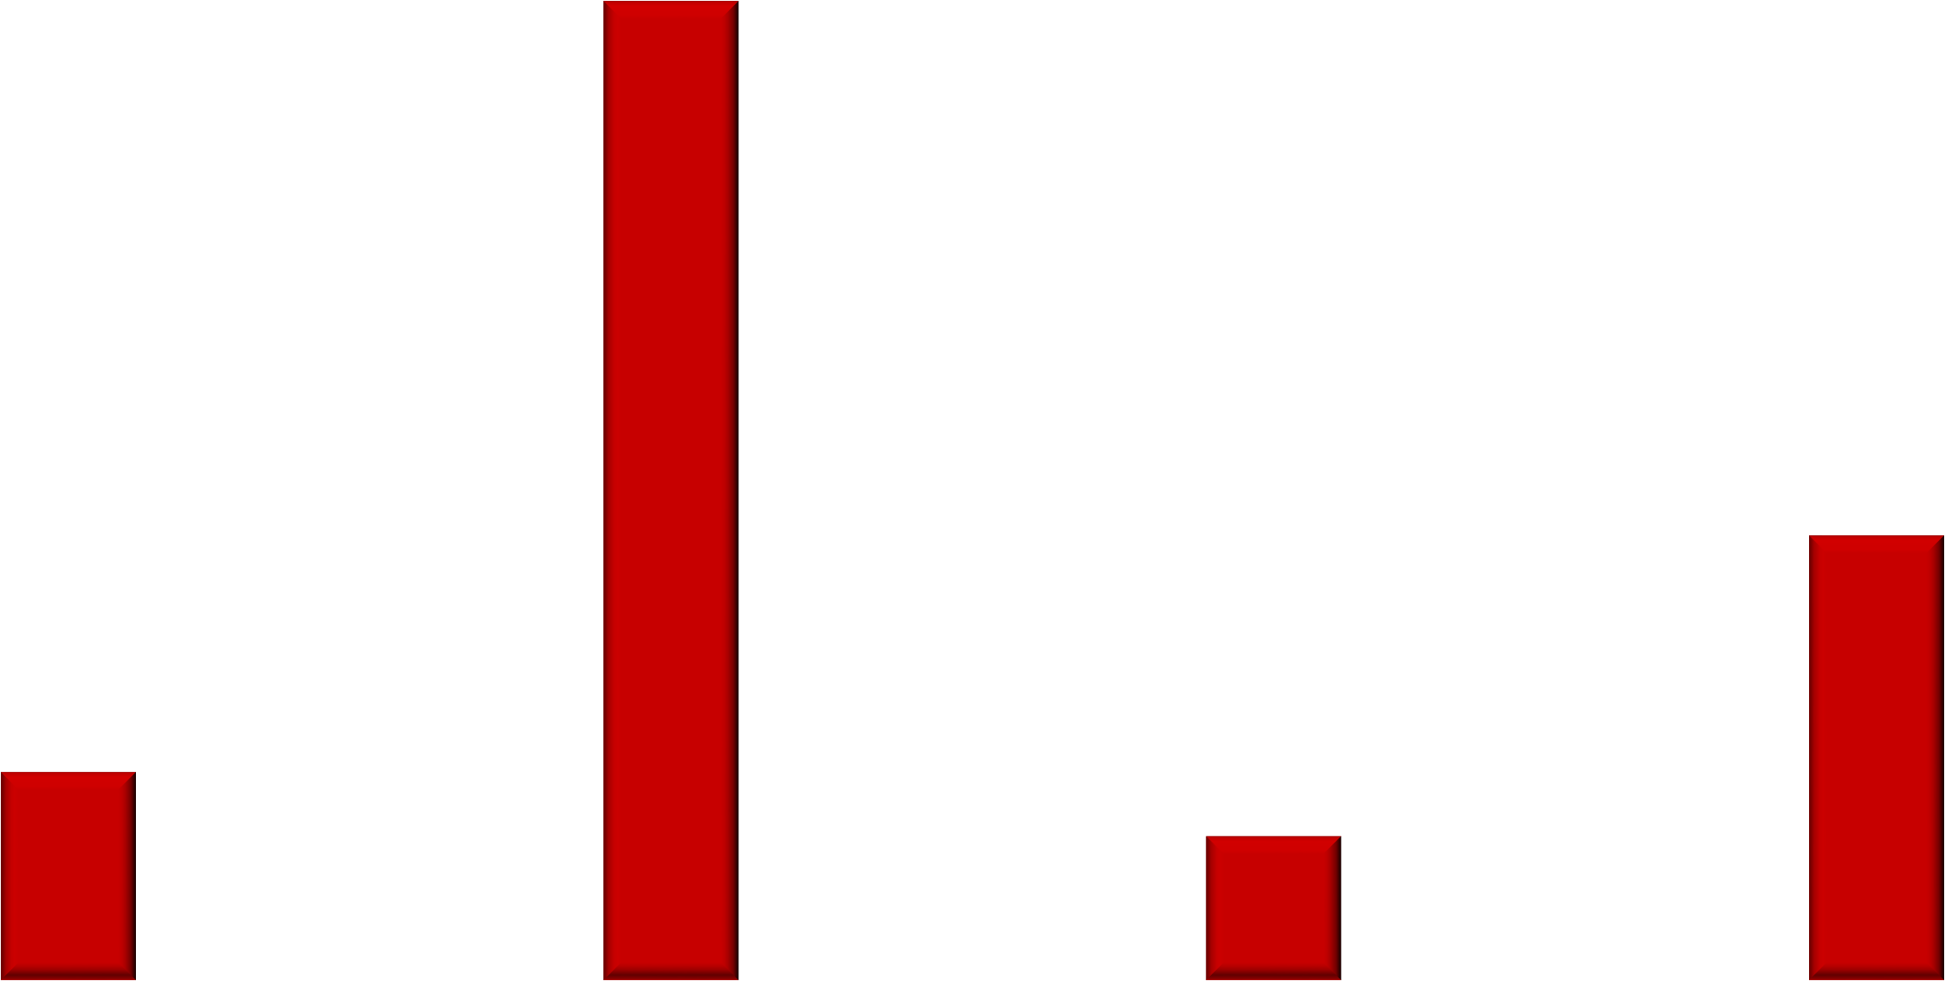
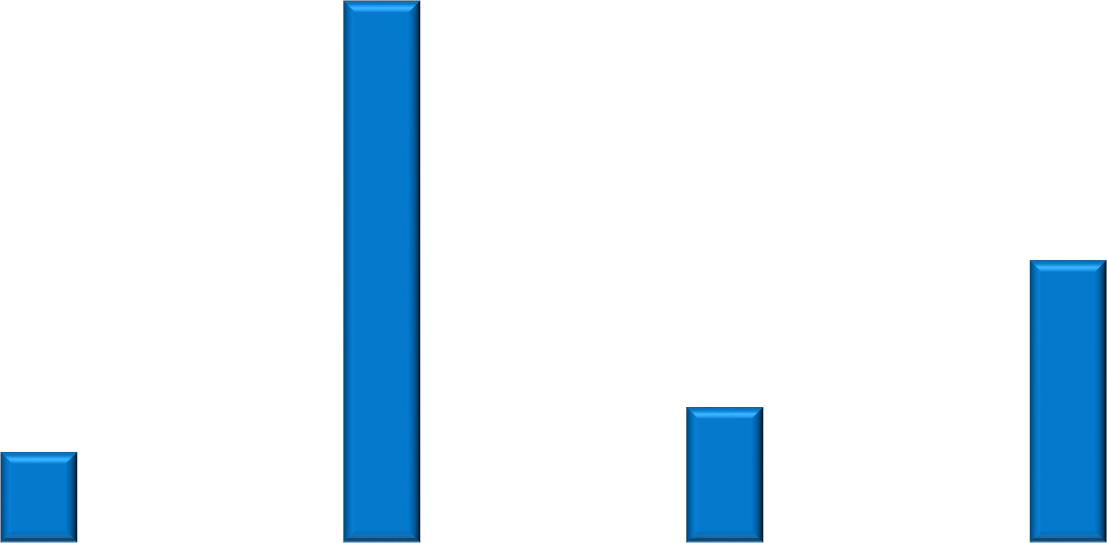
Post-Randomization Platelet Reactivity by Treatment Group
100
p=0.81
Platelet Aggregation (U)
80
77
79.1
60
p=0.03
40.2
35.9
40
p=0.47
p=0.02
19.4
20
16.8
13
11.6
0
Adenosine Diphosphate
Thrombin Receptor Activating Peptide
Ticagrelor Plus Placebo
Arachidonic Acid
Collagen
Ticagrelor Plus Aspirin

Slide 14
Limitations
Baseline differences in parameters that can influence thrombotic potential. However, thrombus was generated under uniform conditions using a common substrate, partially isolating the treatment effect from confounding.
Given the study design, inferences regarding P2Y₁₂ inhibition with prasugrel or clopidogrel with respect to blood thrombogenicity are not possible
Patients were assessed after 3 months of DAPT; earlier time points after PCI may have yielded different results

Slide 15
Conclusions
Ticagrelor monotherapy provides a similar antithrombotic effect to that of ticagrelor plus aspirin as assessed by ex-vivo platelet- dependent thrombus formation.
Platelet reactivity to collagen and AA is increased in the absence of aspirin while aggregation to ADP and thrombin is unchanged with or without aspirin.
These findings suggest that aspirin withdrawal does not modulate ex- vivo blood thrombogenicity in the presence of strong P2Y₁₂ blockade with ticagrelor and corroborates the clinical observations of no incremental ischemic risk upon aspirin withdrawal seen in TWILIGHT

Slide 16
Acknowledgements
Atherothrombosis Research Unit
Juan Badimon, PhD
Urooj Zafar, MBBS
Center for Interventional Cardiovascular Research and Clinical Trials
Roxana Mehran, MD
Samantha Sartori, PhD
Ridhima Goel, MBBS
Nicole Vestril
Cardiovascular Institute at the Icahn School of Medicine at Mount Sinai
Valentin Fuster, MD PhD
Samin K. Sharma
Annapoorna S. Kini, MD
Serdar Farhan, MD PhD
TWILIGHT Executive Committee
George Dangas, MD PhD
Dominick Angiolillo, MD PhD
C. Michael Gibson

