Slide 1




VOYAGER PAD
Vascular Outcomes Study of ASA Along with Rivaroxaban in Endovascular or Surgical Limb Revascularizations for Peripheral Artery Disease
Marc P. Bonaca, Rupert M. Bauersachs, Manesh R. Patel, Sonia S. Anand, Eike Sebastian Debus, Mark N. Nehler, Fabrizio
Fanelli, W arren H. Capell, Nicole Jaeger, Lihong Diao, Connie N. Hess, John
M. Kittelson, Lloyd P. Haskell, Scott D. Berkowitz, W illiam R. Hiatt,
for the VOYAGER PAD Steering Committee & Investigators
American College of Cardiology Virtual Scientific Sessions 2020 Late-Breaking Clinical Trial
March 28, 2020
An Academic Research Organization Affiliated with the University of
Colorado School of Medicine

Slide 2
Disclosures
VOYAGER PAD was funded by Bayer & Janssen
Grant support to CPC Clinical Research from:
Amgen, Aralez, AstraZeneca, Bayer, Janssen, Merck, Novo Nordisk, Pfizer, Sanofi
2

Slide 3
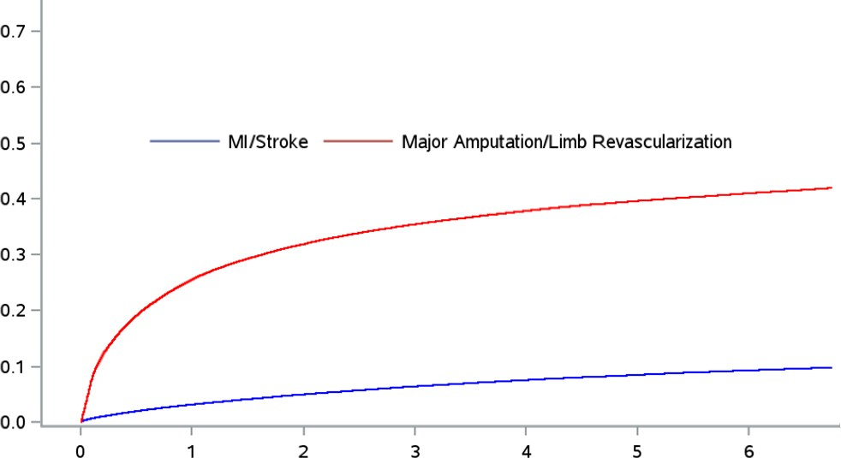
Background
Risk in Patients Undergoing Peripheral Revascularization
N=393,017
Outcomes in Patients with Acute Limb Ischemia
Median hospitalization 8 days (IQR 5-15)
“Acute” Post
Revascularization
“Stable”
Phase
Cumulative Incidence
~4% die at presentation
Major Adverse
Limb Events
~1/5 → major amputation
4x risk of ALI Long-term vs. no Revascularization
~1/3 → prolonged ICU stay
MACE
~3/4 → major surgery
Outcomes after hospitalization are poor with ~15% disabled or dead
Years from Index Revascularization
Hess…Hiatt et al. JACC 2020 Jones…Fowkes et al. Circulation 2017 Bonaca…Sabatine et al. JACC 2017 Bonaca…Morrow et al. Circulation 2016
3

Slide 4
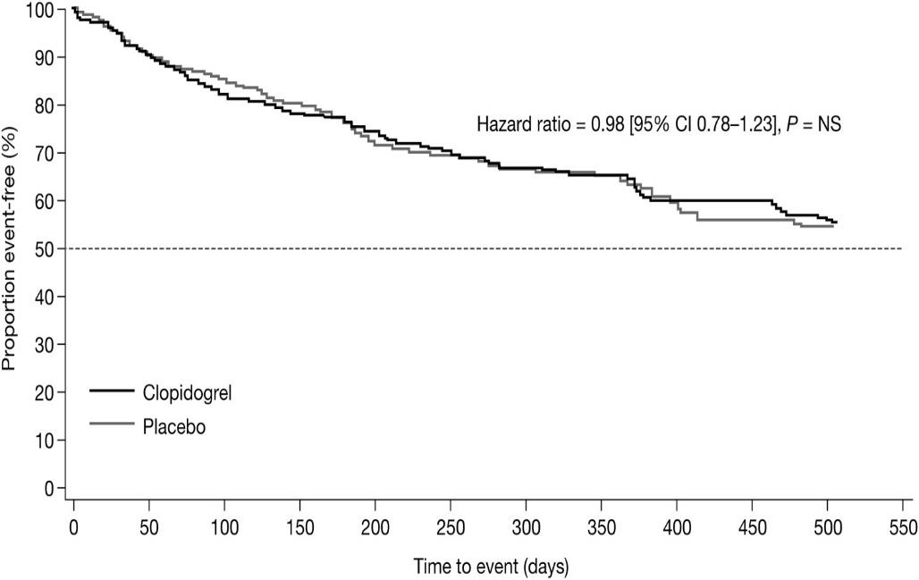
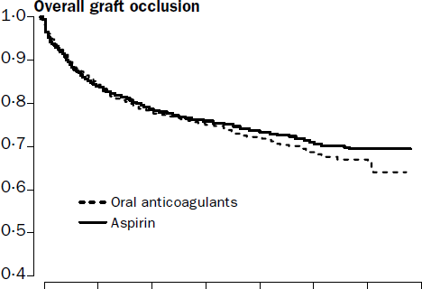
Background
Despite the high risk, currently there is no proven antithrombotic strategy that has demonstrated efficacy for reducing major adverse limb and cardiovascular events after peripheral intervention for ischemia
Index-graft occlusion, revascularization, major amputation, or death
HR 0.98
(95% CI 0.78 – 1.23), P=NS
Graft Occlusions HR 0.95
(95% CI 0.82 – 1.11), P=NS
DAPT with Aspirin and Clopidogrel Increased GUSTO bleeding
HR 2.84 (1.32 – 6.08)
Full Intensity Oral anticoagulation Increased risk of Hemorrhagic Stroke HR 3.48 (1.14 – 10.60)
Belch et al. Journal of Vascular Surgery. 2010
Dutch Bypass Oral anticoagulants or Aspirin (BOA) Study Group. Lancet. 2000
4

Slide 5
Objectives
In PAD patients undergoing lower extremity revascularization for ischemic symptoms:
Test whether rivaroxaban 2.5 mg twice daily added to low dose aspirin reduces the risk of major adverse limb and cardiovascular events compared to aspirin alone
To evaluate the safety of rivaroxaban 2.5 mg twice daily added to low dose aspirin compared to aspirin alone
5

Slide 6
Trial Design
NCT02504216
6,564 Patients with Symptomatic Lower Extremity PAD* Undergoing Peripheral Revascularization
*Ankle Brachial Index < 0.90 and Imaging Evidence of Occlusive Disease
ASA 100 daily for all Patients
Clopidogrel at Investigator’s Discretion
Randomized 1:1 Double Blind
Rivaroxaban 2.5 mg twice daily
Stratified by Revascularization Approach (Surgical or Endovascular)
Placebo
and Use of Clopidogrel
Follow up Q6 Months, Event Driven, Median f/u 28 Months
Primary Efficacy Endpoint: Acute limb ischemia, major amputation of vascular etiology, myocardial infarction, ischemic stroke or cardiovascular death
Principal Safety Outcome: TIMI Major Bleeding
Capell WH, Bonaca MP, Nehler MR…Hiatt WR. AHJ 2018
6

Slide 7
Inclusion & Exclusion
Inclusion
Age ≥ 50
Documented PAD including:
  Ischemic symptoms (functional limitation, rest pain or ischemic ulceration) AND
  Imaging evidence of occlusion AND
  Abnormal ABI
Successful lower extremity revascularization for ischemia
Exclusion
Revascularization for asymptomatic
disease
Recent revascularization (within 10 days) or ALI (2 weeks) or ACS (30 days)
Current major tissue loss
Need for antiplatelet or anticoagulant other than aspirin and/or clopidogrel
Need for long-term DAPT (intended > 6 months)
High risk for bleeding (significant
bleeding in last 6 months, prior stroke or
other high-risk condition)
7

Slide 8
Outcomes
Efficacy
Primary: acute limb ischemia (ALI), major amputation for vascular cause (amputation), myocardial infarction (MI), ischemic stroke or CV death
Secondary (hierarchical):
ALI, amputation, MI, ischemic stroke or coronary heart death
Unplanned index limb revascularization for ischemia
Vascular hospitalization for a coronary or peripheral event of thrombotic nature
ALI, amputation, MI, ischemic stroke or all-cause mortality
ALI, amputation, MI, all stroke or CV death
All-cause mortality
Venous thromboembolism
Safety
Principal: TIMI major bleeding
Secondary: ISTH major bleeding, BARC 3b or above
CPC Clinical Events Committee (CEC) adjudicated all efficacy and safety events
8

Slide 9
Trial Organization
Executive Committee William R. Hiatt (Chair) Marc P. Bonaca
Eike Sebastian Debus Lloyd P. Haskell
Rupert M. Bauersachs (Co-Chair) Sonia S. Anand
Mark R. Nehler Scott D. Berkowitz
Manesh R. Patel Fabrizio Fanelli
CPC Clinical Research
Warren H. Capell (ICAC Chair), Jennifer Armstrong (ICAC Member), Natalia Glebova, (ICAC Member), Connie N. Hess (ICAC Member), Mori Krantz (ICAC Member), Cecilia Low-Wang (ICAC Member), Lisa Cox (Executive Project Manager), Nicole Jaeger (Project Manager), Robin White (Director, Biostatistics and Programming), and Lihong Diao (Biostatistician).
Sponsors: Bayer & Janssen
Scott D. Berkowitz, Lloyd Haskell, Eva Muehlhofer, James Hung, Aneta Woroniecka-Osio MD, Uma Balasubramanian, Juliette Dehay, Alexandra Kley, Claudia Vogt, Akos Ferenc Pap
Independent Data Monitoring Committee
John Dormandy (Chair)*, Joshua Beckman (Chair), Scott Kinlay, Robert McLafferty, Robin Roberts, (Statistician), and William Robinson.
*Deceased
9

Slide 10
Steering Committee and National Lead Investigators
Argentina
R. Diaz
Austria
M. Brodmann
Belgium
F. Vermassen
Brazil
D. Brasil
Bulgaria
V. Chervenkoff
Canada
D. Szalay
Czech Republic
K. Roztocil
China
W. Fu / Z. Shi
Denmark
H. Sillesen
Estonia
P. Põder
*Deceased
Finland
M. Venermo
France
A. Bura-Rivière
J. Baptiste Ricco
Germany
D. Scheinert (Co-Chair)
H. Lawall
Hungary
L. Matyas
Italy
C. Rabbia
M. Antonella Ruffino
F. Violi
Japan
H. Shigematsu
Y. Soga
Y. Yonemitsu
Latvia/Lithuania
D. Krievins
Netherlands
F. Moll
Poland
A. Jawien
Portugal
A. Mansilha
Romania
I. Coman
Russia
A. Svetlikov
Serbia
I. Koncar
Slovokia
J. Maďarič
South Korea
D. Choi
Spain
V. Riambau Alonso
Sweden
L. Norgren
Switzerland
I. Baumgartner
Taiwan
S. Shen Wang
Thailand
P. Mutirangura
Ukraine
I. Gudz
United Kingdom
G. Hamilton
United States
A. Hirsch (Co-Chair)*
R. Powell (Co-Chair)
J. Chung
J. Kittelson (Biostatistician)
J. Mills
J. Mustapha
F. Saab
10

Slide 11
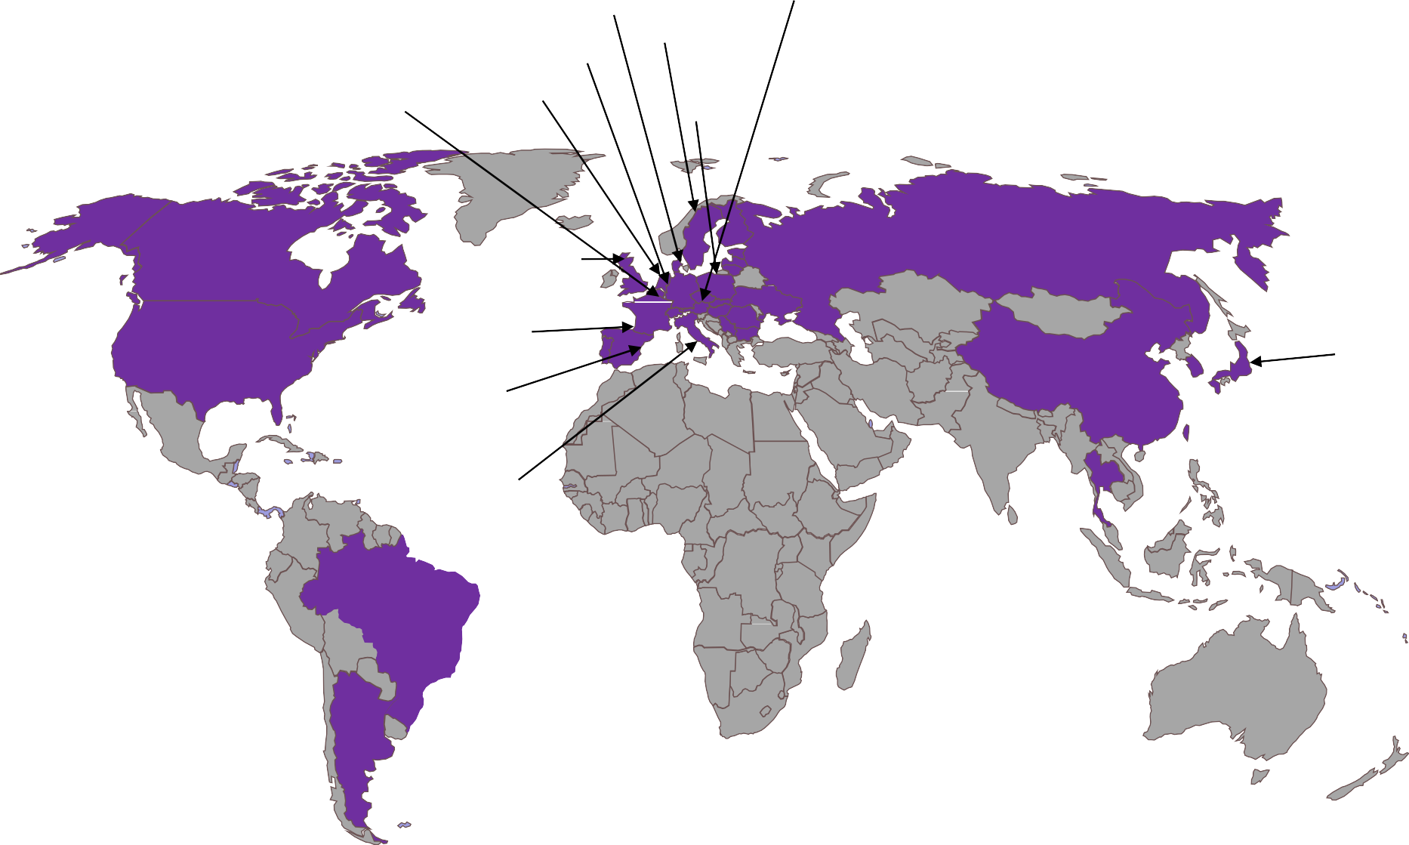
Global Enrollment
6,564 patients randomized at 534 sites in 34 countries between 7/2015 – 1/2018
Finland: 17
Czech Republic: 243
Hungary: 261
Ukraine: 299
Denmark: 78
Estonia: 9
Latvia:
203
Sweden: 42
Belgium:
Germany: 594
Slovakia: 126
126 Netherlands: 78
Poland:
168
Lithuania: 84
Bulgaria: 737
Romania: 214
Canada: 170
United Kingdom:
129
Austria: 212
France: 107
Portugal: 75
Spain: 96
Switzerland: 91
Russia: 188
South Korea: 148
Japan: 459
United States: 524
China: 211
Taiwan: 76
Italy: 184
Serbia:
68
Thailand: 67
Brazil: 185
Argentina: 299
11

Slide 12
Disposition
6,772 Patients Enrolled
6,564 Patients Randomized
Not Randomized = 208
Inclusion/Exclusion 167
Subject decision 29
Adverse event 2
Physician decision 1
Other 9
Rivaroxaban N=3286
Placebo
N=3278
Premature Drug Discontinuation = 1080 (33.2%)
14.2% Annualized
Premature Drug Discontinuation = 1011 (31.1%)
13.2% Annualized
Withdrawal of Consent = 32 (0.97%)
0.42% Annualized
Vital status unknown = 8 (0.24%)
Median Follow-up
28 Months
Withdrawal of Consent = 37 (1.13%)
0.48% Annualized
Vital status unknown = 12 (0.37%)
Lost to Follow up = 3 (0.09%)
Lost to Follow up = 3 (0.09%)
Vital Status Known = 3275 (99.7%)
Vital Status Known = 3263 (99.5%)
Analyzed
ITT = 3286 (100%)
Safety = 3256 (99.1%)
Analyzed
ITT = 3278 (100%)
Safety = 3248 (99.1%)
Complete primary efficacy and principal safety outcome ascertainment in
98.8% of potential patient-years of follow up
12

Slide 13
Baseline Characteristics
Characteristics at Randomization | Rivaroxaban 2.5 mg twice daily + aspirin N=3286 % | Placebo + aspirin N=3278 %
Age, Yrs Median | 67 | 67
Female | 26 | 26
Caucasian | 81 | 81
Diabetes Mellitus | 40 | 40
Current Smoking | 35 | 35
COPD | 11 | 11
eGFR < 60 ml/min/1.73m² | 20 | 20
Coronary Artery Disease | 32 | 31
Prior MI | 11 | 11
Known Carotid Stenosis | 9 | 9
Clopidogrel | 51 | 51
Statin | 79 | 81
ACEi or ARB | 64 | 63
P>0.05 for all comparisons
13

Slide 14
PAD & Procedural Characteristics
Characteristics at Randomization | Rivaroxaban 2.5 mg twice daily + aspirin N=3286 % | Placebo + aspirin N=3278 %
Prior Peripheral Artery Disease History
History of Claudication | 95 | 96
History of Revascularization | 36 | 35
History of Amputation | 6 | 6
Ankle Brachial Index, Median (IQR) | 0.56 (0.42 – 0.67) | 0.56 (0.42 – 0.67)
Indication for Revascularization
Critical limb ischemia | 23 | 24
Claudication | 77 | 76
Type of Revascularization
Surgical | 35 | 35
Endovascular or Hybrid | 66 | 65
Days from Procedure to Randomization, Median (IQR) | 5 (2 – 7) | 5 (2 – 7)
P>0.05 for all comparisons
14

Slide 15
Primary Endpoint
Acute limb ischemia, major amputation for vascular cause, myocardial infarction, ischemic stroke, CV death
20
Placebo Rivaroxaban
19.9%
18
17.3%
16
14
12
10
Cumulative Incidence (KM%)
HR 0.85
95% CI 0.76 – 0.96 P=0.0085
8
6
4
2
0
0
3
6
9
12
15 18 21
Months from Randomization
24
27
30
33
36
90
182
274
366
456
547
639
731
821
912
1004
15

Slide 16
Primary Endpoint
Acute limb ischemia, major amputation for vascular cause, myocardial infarction, ischemic stroke, CV death
3 Year
ARR 2.6%
NNT 39
20
Placebo Rivaroxaban
19.9%
18
17.3%
16
Cumulative Incidence (KM%)
14
1 Year
ARR 2.0%
NNT 50
12
10
6 Months
ARR 1.5%
NNT 65
HR 0.85
95% CI 0.76 – 0.96 P=0.0085
8
6
4
2
0
0
3 6 9 12 15 18 21
Months from Randomization
ARR – absolute risk reduction, NNT number needed to treat
24
27
30
33
36
90
182
274
366
456
547
639
731
821
912
1004
16

Slide 17
Primary Endpoint & Components
 | KM% 3 Years (n) Rivaroxaban N=3286 | KM% 3 Years (n) Placebo N=3278 | HR (95% CI)
Primary Efficacy Outcome | 17.3 | 19.9 | 0.85 (0.76 – 0.96)
Acute Limb Ischemia | 5.24 | 7.74 | 0.67 (0.55 – 0.82)
Major Vascular Amputation | 3.42 | 3.87 | 0.89 (0.68 – 1.16)
Ischemic Stroke | 2.70 | 3.01 | 0.87 (0.63 – 1.19)
Myocardial Infarction | 4.55 | 5.22 | 0.88 (0.70 – 1.12)
CV Death | 7.05 | 6.43 | 1.14 (0.93 – 1.40)
17

Slide 18
Secondary Outcomes*
Placebo Rivaroxaban
HR 0.80
(0.71 – 0.91)
P=0.0008
HR 0.88
(0.79 – 0.99)
P=0.028
ARR 2.48
22.5%
20.0%
584 655
Unplanned Limb Revacularization for Ischemia
HR 0.72
(0.62 – 0.85)
P=0.0001
ARR 3.38
12.1%
8.7%
262 356
Vascular Hosp. for a Coronary or Peripheral Thrombotic Event
HR 0.89
(0.79 – 0.99)
P=0.0289
ARR 2.59
23.2%
20.6%
614 679
MI, Ischemic Stroke, ALI, Amp, All Cause Mortality
HR 0.86
(0.76 – 0.96)
P=0.0103
ARR 2.63
20.1%
17.5%
514 588
MI, All Stroke, CV
Death, ALI, Amp
ARR 3.52
25%
18.2%
14.7% |  |  | 528
 | 433
Cumulative Incidence (KM%) at 3 years
HR 1.08
(0.92 – 1.27)
P=0.3360
11.1% 10.9%
321 297
Mortality
HR 0.61
(0.37 – 1.00)
P=0.0469
1.7%
0.8%
25 41
VTE
Nominal, due to position in hierarchy
20%
15%
10%
5%
0%
MI, Ischemic Stroke,
CHD, ALI, Amp
*Presented in order of hierarchy from left to right
18

Slide 19
Secondary Outcomes*
Placebo Rivaroxaban
HR 0.80 | HR 0.88 | HR 0.72 | HR 0.89 | HR 0.86
(0.71 – 0.91) | (0.79 – 0.99) | (0.62 – 0.85) | (0.79 – 0.99) | (0.76 – 0.96)
P=0.0008 | P=0.028 | P=0.0001 | P=0.0289 | P=0.0103
ARR 3.52 | ARR 2.48 | ARR 3.38 | ARR 2.59 | ARR 2.63
25%
22.5%
23.2%
Cumulative Incidence (KM%) at 3 years
HR 1.08
(0.92 – 1.27)
HR 0.61
(0.37 – 1.00)
20.0%
20.6%
20.1%
20%
P=0.3360
P=0.0469
18.2%
17.5%
15%
14.7%
12.1%
356 614 679
11.1%
10.9%
10%
8.7%
321
297
262
5%
1.7%
0.8%
41
0%
433 528
584
655
514 588
25
MI, Ischemic Stroke, | Unplanned Limb | Vascular Hosp. for a | MI, Ischemic Stroke, | MI, All Stroke, CV | Mortality | VTE
CHD, ALI, Amp | Revacularization for | Coronary or | ALI, Amp, All Cause | Death, ALI, Amp |  | Nominal, due to
 | Ischemia | Peripheral Thrombotic Event | Mortality |  |  | position in hierarchy
*Presented in order of hierarchy from left to right
19

Slide 20
Primary Efficacy Outcome in Selected Subgroups
Characteristic
Rivaroxaban
2.5 mg bid plus ASA daily
n/N (%)
Placebo bid plus ASA daily n/N (%)
HR (95% CI) P-interaction
All subjects
Age
15.5
17.8
0.85 ( 0.76, 0.96)
< 75
15.0
17.0
0.86 ( 0.75, 0.98)
0.8314
≥ 75
17.4
21.0
0.82 ( 0.64, 1.05)
Sex
Male
15.4
18.4
0.82 ( 0.71, 0.94)
0.2385
Female
15.7
16.2
0.97 ( 0.76, 1.23)
Region
North America
18.4
19.3
0.95 ( 0.67, 1.33) 0.2286
Western Europe
12.9
18.4
0.67 ( 0.53, 0.84)
Eastern Europe
16.4
17.6
0.92 ( 0.76, 1.11)
Asia Pacific
13.3
15.2
0.88 ( 0.63, 1.23)
South America
20.2
19.9
1.04 ( 0.70, 1.56)
eGFR (ml/min/1.73m²)
< 60
19.7
21.9
0.90 ( 0.71, 1.15)
0.6177
≥ 60
14.4
16.6
0.85 ( 0.73, 0.97)
Diabetes mellitus
Yes
18.9
19.8
0.94 ( 0.79, 1.11)
0.1588
No
13.2
16.5
0.79 ( 0.67, 0.93)
Coronary Artery Disease
Yes
17.4
21.7
0.78 ( 0.64, 0.95)
0.2872
No
14.6
16.1
0.89 ( 0.77, 1.04)
Critical Limb Ischemia
Yes
20.9
24.4
0.85 ( 0.69, 1.05)
No
13.8
15.8
0.86 ( 0.74, 0.99)
Qualifying Procedure
Surgical
17.9
21.9
0.79 ( 0.66, 0.95)
0.2896
Endovascular
14.2
15.7
0.90 ( 0.77, 1.05)
Rivaroxaban
Better
0.75 1.0 1.50 Placebo
Better
20

Slide 21
Safety
Placebo
Rivaroxaban
HR 1.43
(0.97 – 2.10) P=0.0695
9%
HR 0.78 HR 1.02 HR 0.91
(0.38 – 1.61) (0.33 – 3.15) (0.47 – 1.76)
P=0.50 P=0.98 P=0.79
_{0.6% 0.9% 0.7%} 1.0%
0.2% 0.2%
13 17 ₆ ₆ 17 19
ICH Fatal ICH or Fatal
HR 1.50 HR 1.29 HR 1.42
(0.95 – 2.37) (0.95 – 1.76) (1.10 – 1.84)
P=0.078 P=0.098 P=0.0068
ARI 1.8%
ARI 0.60% / year
5.9%
_{3.9%} 4.1%
2.9%
1.9%
1.2%
46 31 93 73 140 100
TIMI minor BARC 3b or ISTH major
Greater
Secondary Safety Outcomes
Cumulative Incidence (KM%) at 3 years
8%
ARI 0.8%
NNH 125
ARI 0.27% / year
7%
6%
5%
4%
3%
2.7%
62
1.9%
2%
44
1%
0%
TIMI major Principal Safety Outcome
TIMI major
21
ARI – absolute risk increase, NNH number needed to harm

Slide 22
Safety
Placebo
Rivaroxaban
HR 1.43
(0.97 – 2.10) P=0.0695
9%
HR 0.78
(0.38 – 1.61)
P=0.50
HR 1.02
(0.33 – 3.15)
P=0.98
HR 0.91
(0.47 – 1.76)
P=0.79
HR 1.50 | HR 1.29 | HR 1.42
(0.95 – 2.37) | (0.95 – 1.76) | (1.10 – 1.84)
P=0.078 | P=0.098 | P=0.0068
 |  | ARI 1.8% ARI 0.60% / year
Cumulative Incidence (KM%) at 3 years
8%
ARI 0.8%
NNH 125
ARI 0.27% / year
7%
6%
5.9%
140 100
5%
3.9%
4.1%
4%
93 73
2.9%
3%
2.7%
62 44
1.9%
2%
1.9%
46 31
1.0%
1.2%
1%
0.6%
0.9%
0.7%
13
0.2% 0.2%
6 6
17 19
ICH or Fatal
0%
17
TIMI major Principal Safety Outcome
ICH
Fatal
TIMI minor
BARC 3b or ISTH major
Greater
Secondary Safety Outcomes
TIMI major
22
ARI – absolute risk increase, NNH number needed to harm

Slide 23
Principal Safety Outcome in Selected Subgroups
Characteristic
Rivaroxaban
2.5 mg bid plus ASA daily
n/N (%)
Placebo bid plus ASA daily n/N (%)
HR (95% CI) P-Interaction
All subjects
1.9
1.4
1.43 ( 0.97, 2.10)
Age
< 75
1.8
1.1
1.60 ( 1.01, 2.55)
0.3807
≥ 75
2.4
2.3
1.11 ( 0.55, 2.26)
Sex
Male
1.9
1.5
1.35 ( 0.87, 2.10)
0.5974
Female
1.8
1.1
1.79 ( 0.78, 4.09)
Region
North America
2.4
0.9
2.65 ( 0.70, 9.99)
0.9858
Western Europe
2.1
1.7
1.26 ( 0.64, 2.48)
Eastern Europe
0.9
0.9
1.10 ( 0.49, 2.50)
Asia Pacific
4.0
2.9
1.41 ( 0.71, 2.81)
South America
1.7
0.4
3.95 ( 0.44, 35.38)
eGFR (ml/min/1.73m²)
< 60
3.2
1.8
1.86 ( 0.92, 3.79)
0.3726
≥ 60
1.5
1.2
1.27 ( 0.79, 2.05)
Diabetes mellitus
Yes
2.4
1.0
2.45 ( 1.28, 4.69)
0.0334
No
1.6
1.6
1.01 ( 0.61, 1.66)
Coronary artery disease
Yes
2.4
1.1
2.24 ( 1.10, 4.56)
0.1245
No
1.7
1.5
1.15 ( 0.72, 1.84)
Critical Limb Ischemia
Yes
2.0
1.6
1.37 ( 0.64, 2.94)
No
1.9
1.3
1.47 ( 0.94, 2.30)
Qualifying procedure
Surgical
1.2
1.1
1.02 ( 0.47, 2.19)
0.3155
Endovascular
2.3
1.5
1.60 ( 1.02, 2.51)
0.75 1.0 1.50
23

Slide 24
First Events Prevented / Caused for 10,000 Patients Treated* for 1 Year
-181
Primary Efficacy Outcome
Acute Limb Ischemia
(-269 – -94)
-110
(-165 – -56)
Major Amputation of Vascular Etiology
-20
(-53 – 12)
Myocardial Infarction
-42
(-84 – -1)
-19
(-50 – 13)
Ischemic Stroke
Cardiovascular Death
-10
(-48 – 28)
Principal Safety Outcome
29
(-2 – 60)
-6
(-22 – 11)
Intracranial Hemorrhage
0
Fatal Bleeding
(-10 – 11)
-300 -200 -100
Favors Rivaroxaban 2.5 mg twice daily plus aspirin
0
100
200
300
*Efficacy and safety on-treatment
Favors aspirin monotherapy
24

Slide 25
Summary & Conclusion
In symptomatic PAD after revascularization, ~1 in 5 have acute limb ischemia, major amputation of vascular etiology, MI, ischemic stroke or cardiovascular death at 3 years
In this population and setting, rivaroxaban 2.5 mg twice daily with aspirin compared to
aspirin alone:
  Significantly reduces this risk with…
    Benefits apparent early and continued over time
    Consistent benefit across major subgroups
    Broad benefits including reductions in unplanned index limb revascularization
  Increases bleeding: in VOYAGER PAD, there was a numerical increase in TIMI major bleeding and significantly increased ISTH major bleeding but no excess in intracranial or fatal bleeding
  Prevents ~6 times as many ischemic events relative to bleeds caused in PAD patients after revascularization
25

Slide 26
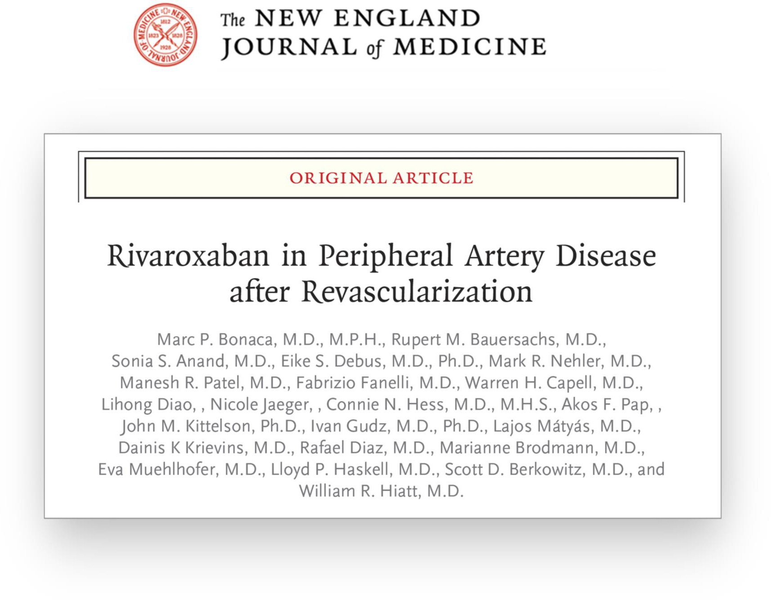
26

Slide 27
Backup Slides
27

Slide 28


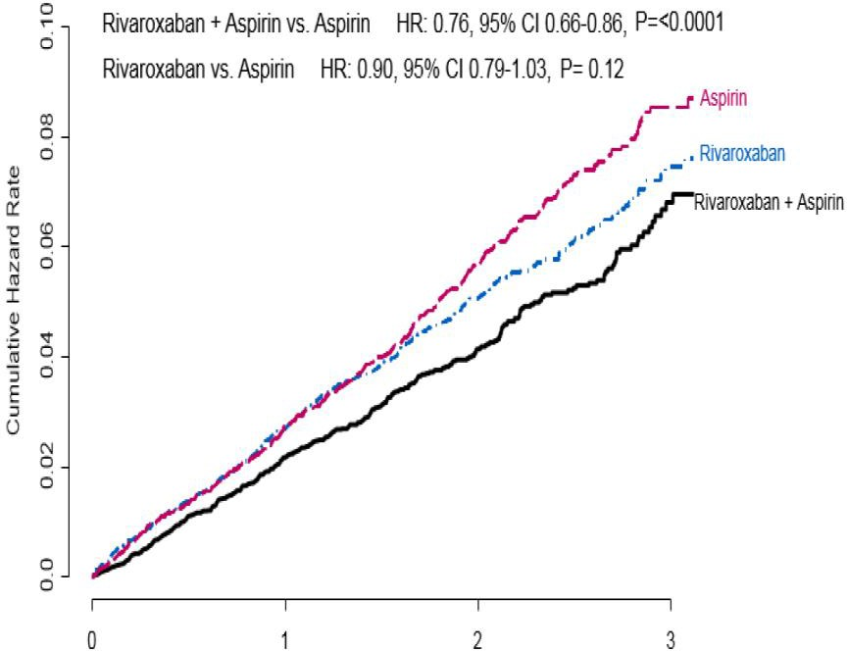
Designed as a PAD Intervention Study:
In PAD Subgroup
Population: symptomatic lower extremity PAD undergoing intervention, without further enrichment for risk
  4-fold risk of ALI long-term vs no revascularization
  ALI outcomes after hospitalization 15% disabled or dead
Setting: post-intervention (particularly high risk for limb and bleeding complications)
Treatment: rivaroxaban on top of standard of care, including clopidogrel
Primary efficacy outcome: severe limb &
cardiovascular events
Primary Endpoint MACE
HR 0.72
(0.57-0.90)
Safety
ISTH major bleeding HR 1.61
(1.12 – 2.31)
Enriched for polyvascular disease (e.g. CAD in ~66%)
Broad definition of PAD (including asymptomatic low ABI)
Stable setting
MACE primary outcome
Clopidogrel not allowed
Anand SA et al. Lancet 2017
28

Slide 29


Perspective
A regimen of rivaroxaban 2.5 mg twice daily added to aspirin reduces the risk of major adverse limb and cardiovascular outcomes from acute intervention to long-term secondary prevention
N=393,017
Cumulative Incidence
“Acute” Post
“Stable”
Revascularization
Phase
Major Adverse Limb Events
MACE
Years from Index Revascularization
Hess…Hiatt et al. JACC 2020
29

Slide 30
First Events Prevented / Caused for 10,000 Patients Treated* for 1 Year
Primary Efficacy Outcome
Events Prevented (95% CI)
(acute limb ischemia, major amputation for vascular cause, MI, ischemic stroke,
or CV death)
Principal Safety Outcome Events Caused (95% CI)
(TIMI major bleeding)
50
+ 29
(-2 to +60)
0
– 181
(-269 to -94)
Number of Events
-50
-100
-150
-200
*Efficacy and safety on-treatment
30

Slide 31
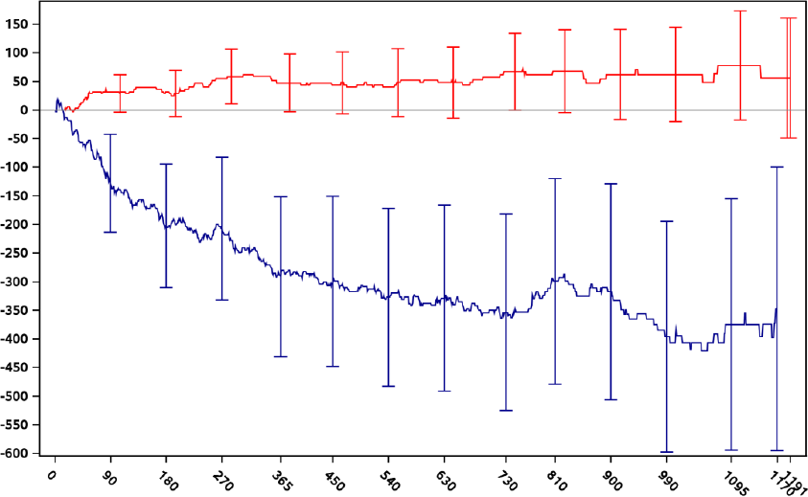
Risk & Benefit Over Time
TIMI major bleeding
Events Prevented or Caused (n)
Primary endpoint composite of acute limb ischemia, major amputation of vascular cause, MI, ischemic stroke or CV death
Days from Randomization
31

Slide 32
Efficacy – Intention To Treat versus & Treatment
Intention To Treat
On Treatment*
0.67
(0.55 – 0.82)
0.89
(0.68 – 1.16)
0.87
(0.63 – 1.19)
0.88
(0.70 – 1.12)
1.14
(0.93 – 1.40)
0.64
(0.51 – 0.80)
0.80
(0.56 – 1.15)
0.80
(0.55 – 1.17)
0.75
(0.56 – 1.00)
0.92
(0.68 – 1.25)
3.5%
3.5%
3.0%
3.1%
3.0%
3.0%
2.5%
2.5%
2.5%
2.2%
2.0%
2.0%
1.9%
1.9%
2.0%
n/100 pt-yr%
1.7%
n/100 pt-yr%
1.7%
1.5%
1.5%
1.5%
1.3%
1.2%
1.3%
1.3%
1.0%
1.0%
0.9%
1.0%
0.9%
1.0%
0.8%
0.8%
0.5%
0.5%
0.0%
0.0%
ALI
Amp
Ischemic
Stroke
Rivaroxaban
MI
CV Death
ALI
Amp
Ischemic
Stroke
Rivaroxaban
MI
CV Death
Placebo
Placebo
*includes events from randomization until 2 days following permanent drug discontinuation
32

Slide 33
Procedural Bleeding
Post-Procedural Bleeding Requiring Unplanned “Take Back” for Management
Any Bleeding Associated with a Revascularization Procedure
5%
5%
4%
4%
N per 100 pt/yrs
3%
N per 100 pt/yrs
3%
2.3%
2.2%
2%
2%
1%
0.9%
0.8%
1%
0%
0%
Rivaroxaban plus Aspirin
Aspirin Alone
Rivaroxaban plus Aspirin
Aspirin Alone
33

Slide 34





Medical Cost Reduction with Rivaroxaban versus Placebo Per Year
Cost per patient-year (2019 US$)
$14,000
_{-$2,104} $12,146
 | $10,042 |  | $12,003 | *
 | $9,841
Costs per 10,000 patient-years (2019 US$)
$12,000
$22.9MM
-$7.3MM
$10,000
*
$15.6MM
$8,000
$15.5MM
-$1.6MM
$13.9MM
$6,000
$13.4MM
-$1.6MM
*
$11.8MM
$4,000
*
$6.1MM
-$838K
$2,000
$5.3MM
$40.3MM
$0
$35.8MM
-$4.5MM
Rivaroxaban + aspirin
Aspirin
$21.9MM
-$5.8MM
$16.1MM
Medical costs of efficacy outcomes (primary + secondary)
Medical costs of major bleeding
$1.4MM
+$579K
$2.0MM
* Hospitalization and emergency room related costs only
Total medical costs reduced = $21MM per 10,000 patient-years
Cost of rivaroxaban for 30-day supply = $470 (@25% discount = $352.5)
Most patients pay between $0 and $47 per month depending on health insurance plan
https://www.xarelto-us.com/xarelto-cost/co-pay-and-li st-price
PAD, peripheral artery disease; ALI, acute limb ischemia; MI, myocardial infarction; IS, ischemic stroke; Revasc, revascularization; Vas Hosp, vascular hospitalization; WAC, wholesale acquisition cost.
34

Slide 35




Medical Cost Reduction with Rivaroxaban versus Placebo Per Year
Cost per patient-year (2019 US$)
$14,000
-$2,200 _{$12,392}
 |  |  |  | $143
 | $10,192
 |  |  |  | *
 |  |  | $12,249
 | $9,991
Costs per 10,000 patient-years (2019 US$)
$12,000
$22.9MM
-$7.3MM
*
$15.6MM
$10,000
$15.5MM
$13.9MM
-$1.6MM
$8,000
$13.4MM
-$1.6MM
*
$11.8MM
$6,000
*
$6.1MM
-$838K
$4,000
$5.3MM
$40.3MM
$2,000
$35.8MM
-$4.5MM
$0
$21.9MM
-$5.8MM
$16.1MM
Rivaroxaban + aspirin
Medical costs of efficacy
Aspirin
$2.5MM
-$965K
$1.5MM
outcomes (primary + secondary)
Medical costs of major bleeding
$1.4MM
$579K
$2.0MM
Cost of rivaroxaban for 30-day supply = $470 (@25% discount = $352.5)
Most patients pay between $0 and $47 per month depending on health insurance plan https://www.xarelto-us.com/xarelto-cost/co-pay-and-list-price
Total medical costs reduced = $22MM per 10,000 patient-years
* Hospitalization and emergency room related costs only
PAD, peripheral artery disease; ALI, acute limb ischemia; MI, myocardial infarction; IS, ischemic stroke; Revasc, revascularization; Vas Hosp, vascular
hospitalization; VTE, venous thromboembolism; WAC, wholesale acquisition cost.
35

Slide 36
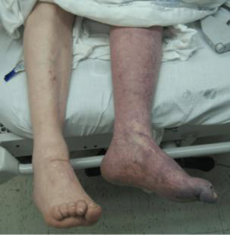
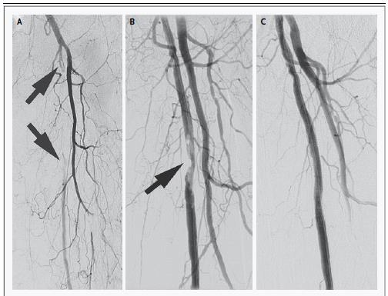
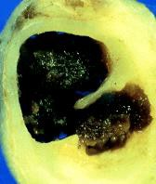
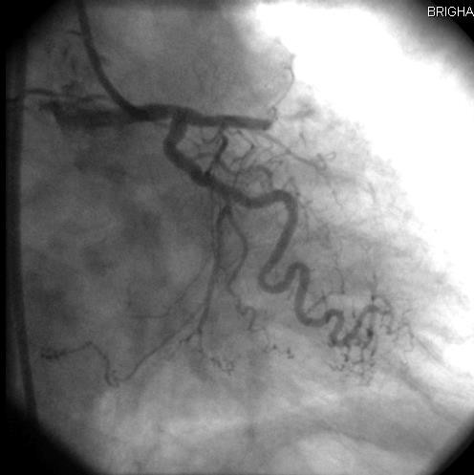
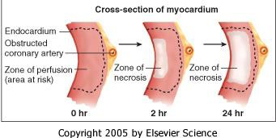
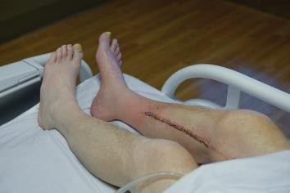
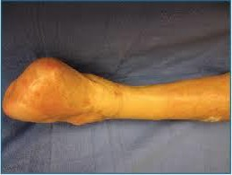
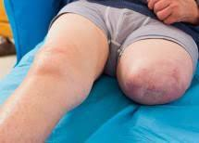
STEMI
ALI
Acute thrombotic occlusion of an artery threatening tissue loss
“Time Is Muscle”
Outcomes determined by time to
acute reperfusion
Reperfusion injury is a complication
Acute thrombotic occlusion of an artery threatening tissue loss
“Time Is Muscle”
Outcomes determined by time to
acute reperfusion
Reperfusion injury is a complication
24 Hour
Mortality at 1 year 12.1%²
MACE 11.7%, Recurrent ALI 24% (1 yr) ²
Amputation at 1-year 27%²
2. Bonaca et al. Circulation 2016
36
0 Hour
Mortality at 1 year 8.1%¹
Recurrent MACE at 1 year 3.4%¹
HF at 1 year 7.4%¹
  Zeymer et al. EORP EU STEMI Registry 2019

