Slide 1
Extracorporeal membrane oxygenation vs. standard care in cardiogenic shock
EUROSHOCK TRIAL
Manel Sabaté on behalf of Euroshock trial investigators*

Slide 2
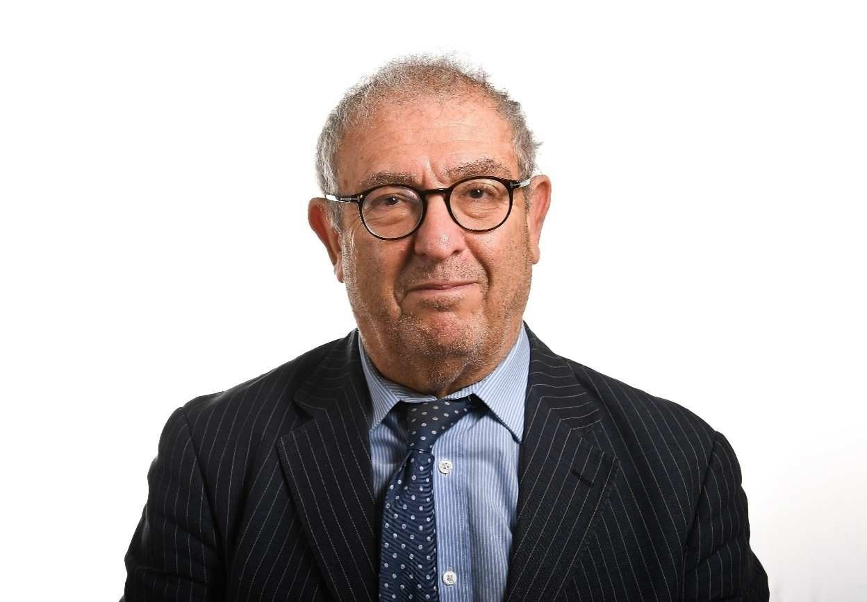
* List of investigators: Amerjeet S Banning, Martin Orban, Jay Gracey, Teresa López-Sobrino,
Steffen Massberg, Adnan Kastrati, Kris Bogaerts, Tom Adriaenssens, Colin Berry, Andrejs Erglis,
Steven Haine, Truls Hakeem Yusuff, Chris Salvatore Brugaletta, Marta Farrero, Xavi Bellera, Bruno Garc Garcia, Santiago M Duran Cambra, Anto Montserrat Vila Per
Prof Anthony H Gershlick
nis, Victoria Vilalta, rshlick, Rut Andrea, Ana García-Álvarez, ena Sandoval, Neus epa Mauri, Cosme di Aizpurua, Albert anel Tauron Ferrer, aniel Vilar, Monika
Myrmel, Sameer Patel, Irene Buera, Alessandro Sio
tiaan Vrints, David Adlam, Marcus Flather, Anthony H Ge
María Angeles Castel, Manuel Castellá, Oriol de Diego, er Freixa, Omar Abdul Jawad-Alisent, Ander Regueiro, El ia del Blanco, Angeles Carmona, Ignacio Ferreira, Jos oreno, Christian Muñoz, Xavier Carrillo, Dabit Arzamen nino Ginel Iglesias, Tobias Koeller, Antonio Serra, M ales, F Xavier Jiménez-Fábrega, Jorge A Morales, D Baylacher, Leonhard Binzenhöefer, Aija Maca-Kaleja nathan Breeze, Iain Carroll, Milena Chee, Richard Fis sa Morgan, Nilesh Pareek, Sheetal Patale, Tasneem Pira
hitehorne, Chris Willars, Chris Harvey, Caroline Sampso thew Charlton, Vasileios Zochios, Elizabeth Wadey,
PCRonline.com
Neumyer, Monika
, Georg Auzinger,
Jonathan Byrne, Jo Robert Loveridge, Li Ian Webb, Michael W Graziella Isgro, Mat
her, Elton Gelandt, ni, Andre Vercueil, n, Dr Susan Dashey, Gail Faulkner, Mel
Ferguson, Marie-Claude Morice, Laure Morsiani, Sharon Keane, Claire Kerr, Mairi Warren, Sarah Boyle, Jacqueline Strehler, Jeanette Mueller.

Slide 3
Potential conflicts of interest
Speaker's name : Manel Sabaté
☑ I do not have any potential conflict of interest to declare
EURO SHOCK has received funding from the European Union’s Horizons 2020 research and innovation programme under grant agreement number 754946-2
EuroPCR.com

Slide 4
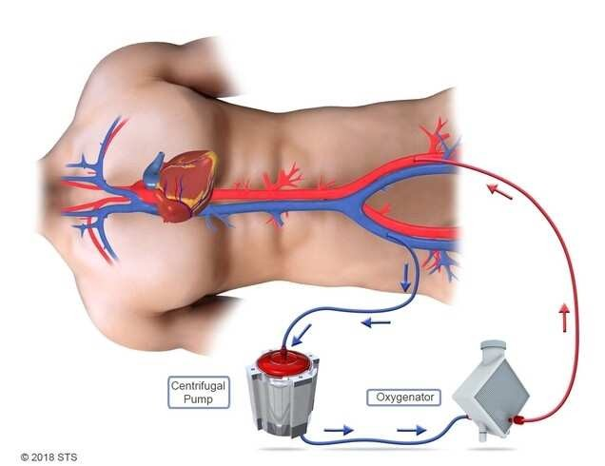
Why this study?
Cardiogenic shock (CG myocardial infarction revascularization.
Mechanical circulato
patients presenting w
However, there is a l
circulatory support d
S) occurs in 10% of patients pre
(AMI), with in-hospital mortality
ry support devices allow for hae ith CGS.
ack of evidence regarding the be evices in the context of CGS com
senting with acute
rates of 40-50% despite
modynamic support in
nefit of mechanical plicating AMI.
Therefore, the EURO SHOCK trial aimed to determine if early use of Veno- arterial Extra-Corporeal Membrane Oxygenation (V-A ECMO) in patients with persistent CGS following primary percutaneous coronary intervention could improve outcomes.
EuroPCR.com

Slide 5
What did we study?
Patients (18-90 y) with CGS within 24hrs of onset of ACS.
CGS secondary to Type I MI (STEMI or NSTEMI), or secondary to Acute/Subacute Stent Thrombosis.
Persistence of CGS 30mins after successful or unsuccessful attempt at revascularization of culprit artery.
CGS defined as:
SBP <90 mmHg for at least 30’ (or need of inotropes/vasopressor therapy to maintain SBP >90mmHg).
Clinical signs of pulmonary congestion, plus signs of impaired organ perfusion including at least one of the following:
Altered mental status
Cold and clammy skin and limbs
Oliguria with a urine output of less than 30ml/hr.
Lactate > 2.0 mmol/L on admission.
EuroPCR.com

Slide 6
What didn’t we study?
1.
2.
3.
4.
5.
Unwilling to provide informed consent / consultee declaration Echo evidence of mechanical complication of MI causing CGS
Shock from another cause (sepsis, hypovolaemic, anaphylaxis, myocarditis).
Known severe PVD (precluding access for VA-ECMO)
OHCA under any of the following circumstances:
➢
➢
➢
Without ROSC (ongoing CPR)
With pH < 7
Without bystander CPR within 10 mins of collapse
Severe allergy or intolerance to pharmacological or antithombotic antiplatelet agents
Significant systemic illness
Deemed too frail (CFS > 5)
Known dementia of any severity
Comorbidity with life expectancy <12 months
Involved in another randomised research trial within the last 12 months
Pregnant or nursing mother
EuroPCR.com

Slide 7
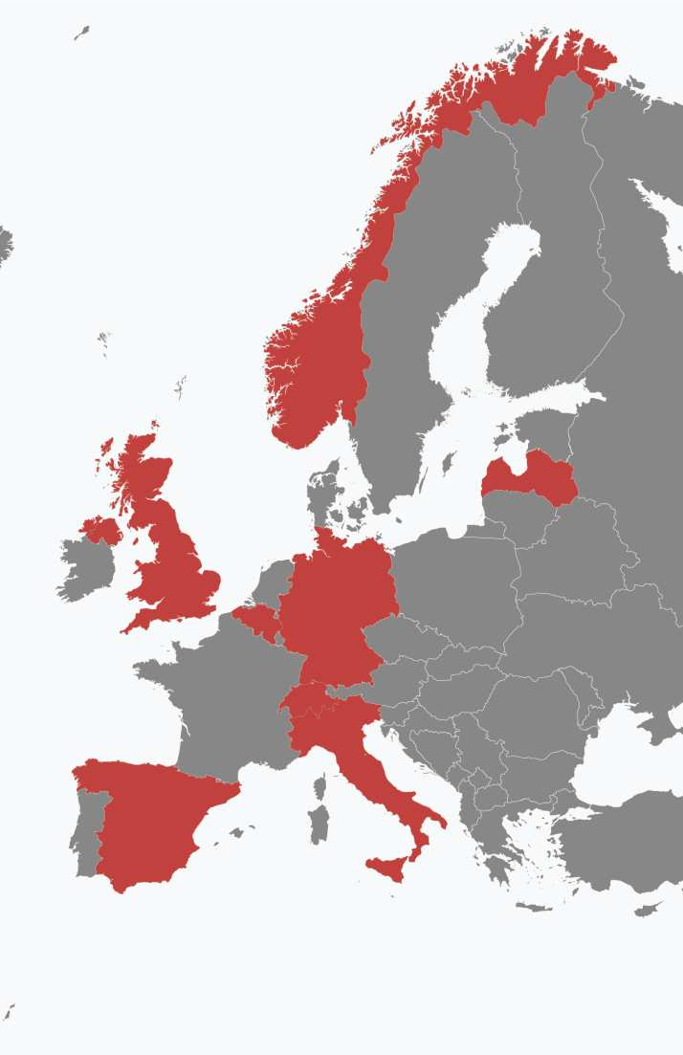
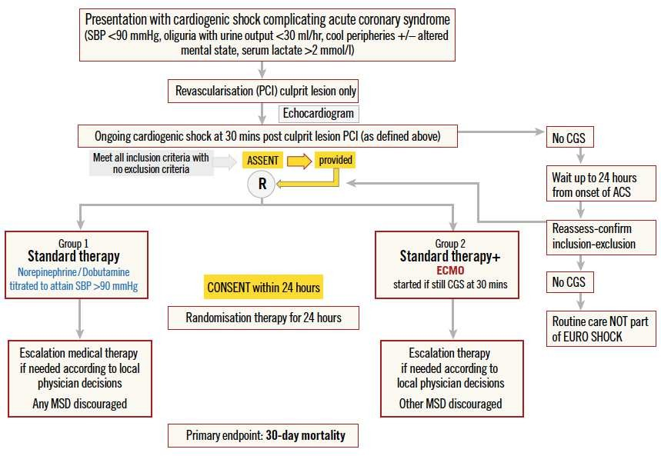
How was the study executed?
EuroPCR.com

Slide 8
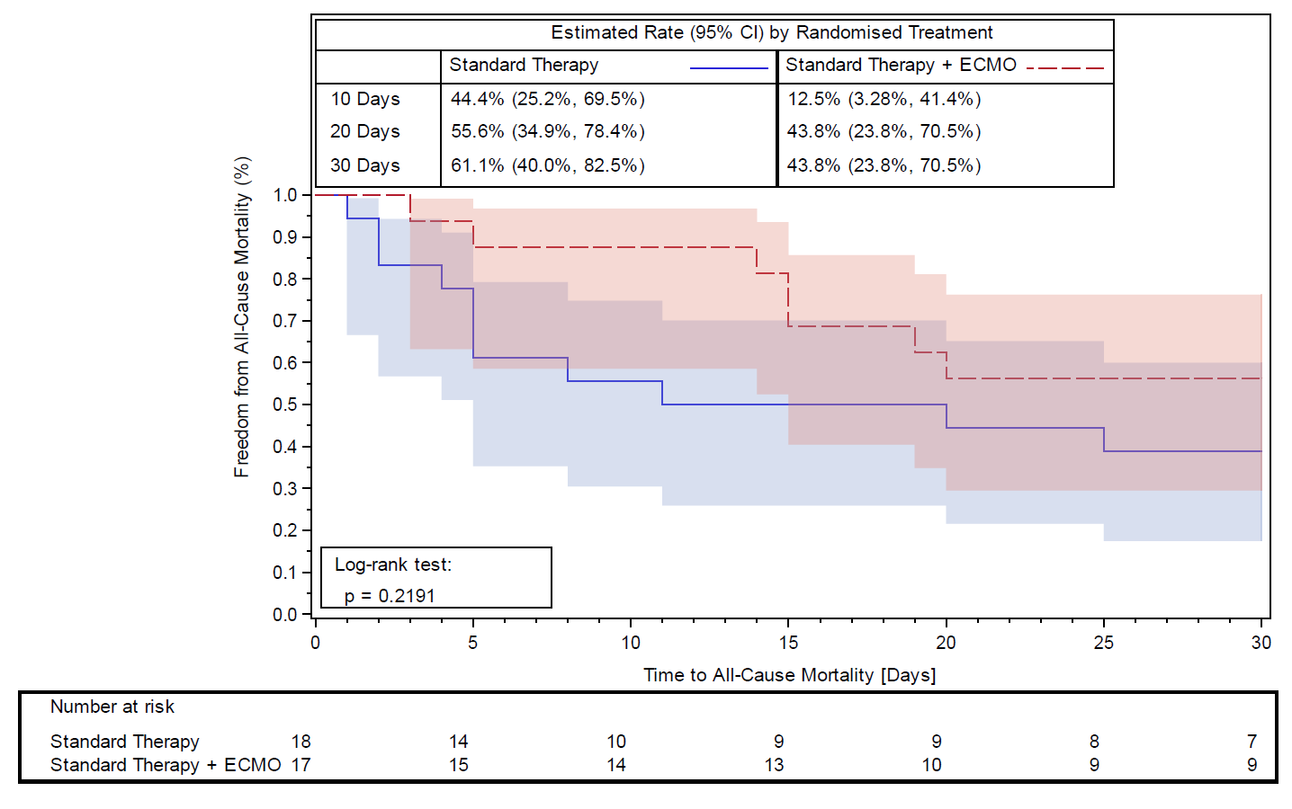
What are the essential results?
All-cause Mortality at 30 d (ITT)
D
w ra EC
re ca
rial fter V-A
ned
ons
ue to the impact of the COVID-19 pandemic, the t
as stopped before completion of recruitment a ndomisation of 35 patients (Standard therapy n=18, MO n=17), which is less than 10% of the initial plan cruitment (n=428). As a result, no definitive conclusi n be drawn from these data.
EuroPCR.com

Slide 9
What are the essential results?
80
In-hospital complications (ITT)
72
70
60
50
50
44.4
40
35.7
30
28.6
21.4
20
11
11
10
5.6
0
0
0
0
All-cause death
Stroke
Recurrent MI
Bleeding BARC 3-5
Vascular complications
AKI
Standard Standard + ECMO
EuroPCR.com

Slide 10
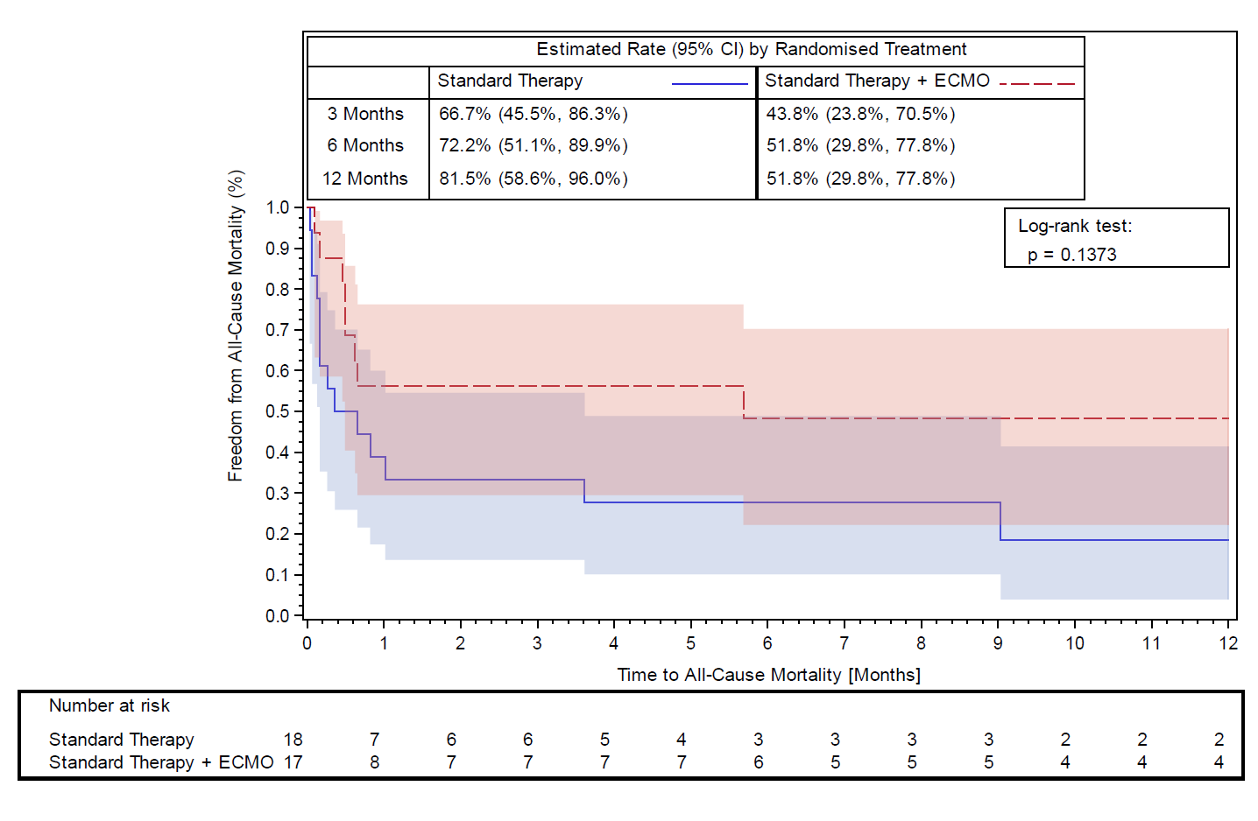
What are the essential results?
All-cause Mortality at 1 year (ITT)
EuroPCR.com

Slide 11
Why is this important?
Although underpowered due to poor recruitment, the findings from the trial support further RCTs into the early use of V-A ECMO in CGS complicating AMI that does not improve following primary PCI of the culprit lesion.
These data may contribute to future meta-analyses of forthcoming RCTs comparing use of V-A ECMO with standard care in CGS patients following AMI.
EuroPCR.com

Slide 12
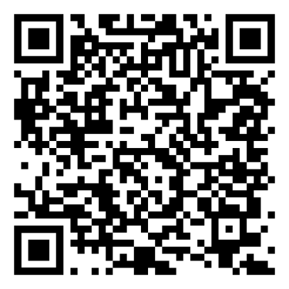
The essentials to remember
The Euroshock was the first trial powered to demonstrate the benefit of V-A ECMO in CGS complicating AMI. However, it has been prematurely stopped due to low recruitment. Results are hypothesis-generating.
Why? There is lack of evidence on the benefit of ECMO in CGS
What? Patients with CGS complicating AMI not resolved after pPCI
How? Multicenter randomised trial (ECMO vs standard of care)
What are the results? All-cause mortality numerically reduced at 30d and at 1 year. More vascular and bleeding complications with V-A ECMO
Why is this important? These results set the stage for larger RCTs in this setting and may contribute to further meta-analysis.
EuroPCR.com

Slide 13
PCRonline.com

