Slide 1
LAA Closure with the Amulet Device
Sameer A. Gafoor, MD
¹Swedish Heart and Vascular: Ming Zhang, Paul Huang, Darryl Wells, Adam Zivin, Eric Williams,
John Petersen II, Madalena Petrescu, Nimish Muni, Robert Bersin, Eric Lehr, Sam Youssef, Glenn Barnhart, Irina Penev, Amanda Ray, Cale Peterson, Julia Antonyuk, Thearry Deap, Zachary Newhart,
²CVC Frankfurt: Jennifer Franke, Simon Lam, Stefan Bertog, Laura Vaskelyte,
Ilona Hofmann, Markus Reinartz, Horst Sievert
Swedish Heart and Vascular: Swedish Medical Center, Seattle, WA, USA
CVC: CardioVascular Center Frankfurt, Frankfurt, Germany

Slide 2
Disclosure Statement of Financial Interest
Within the past 12 months, I or my spouse/partner have had a financial interest/arrangement or affiliation with the organization(s) listed below.
Affiliation/Financial Relationship
Company
Grant/Research Support
Consulting Fees/Honoraria
Boston Sci, Abbott Vasc, Medtronic
Boston Sci, Abbott Vasc, Medtronic

Slide 3
Topics
Device
Case
Data

Slide 4
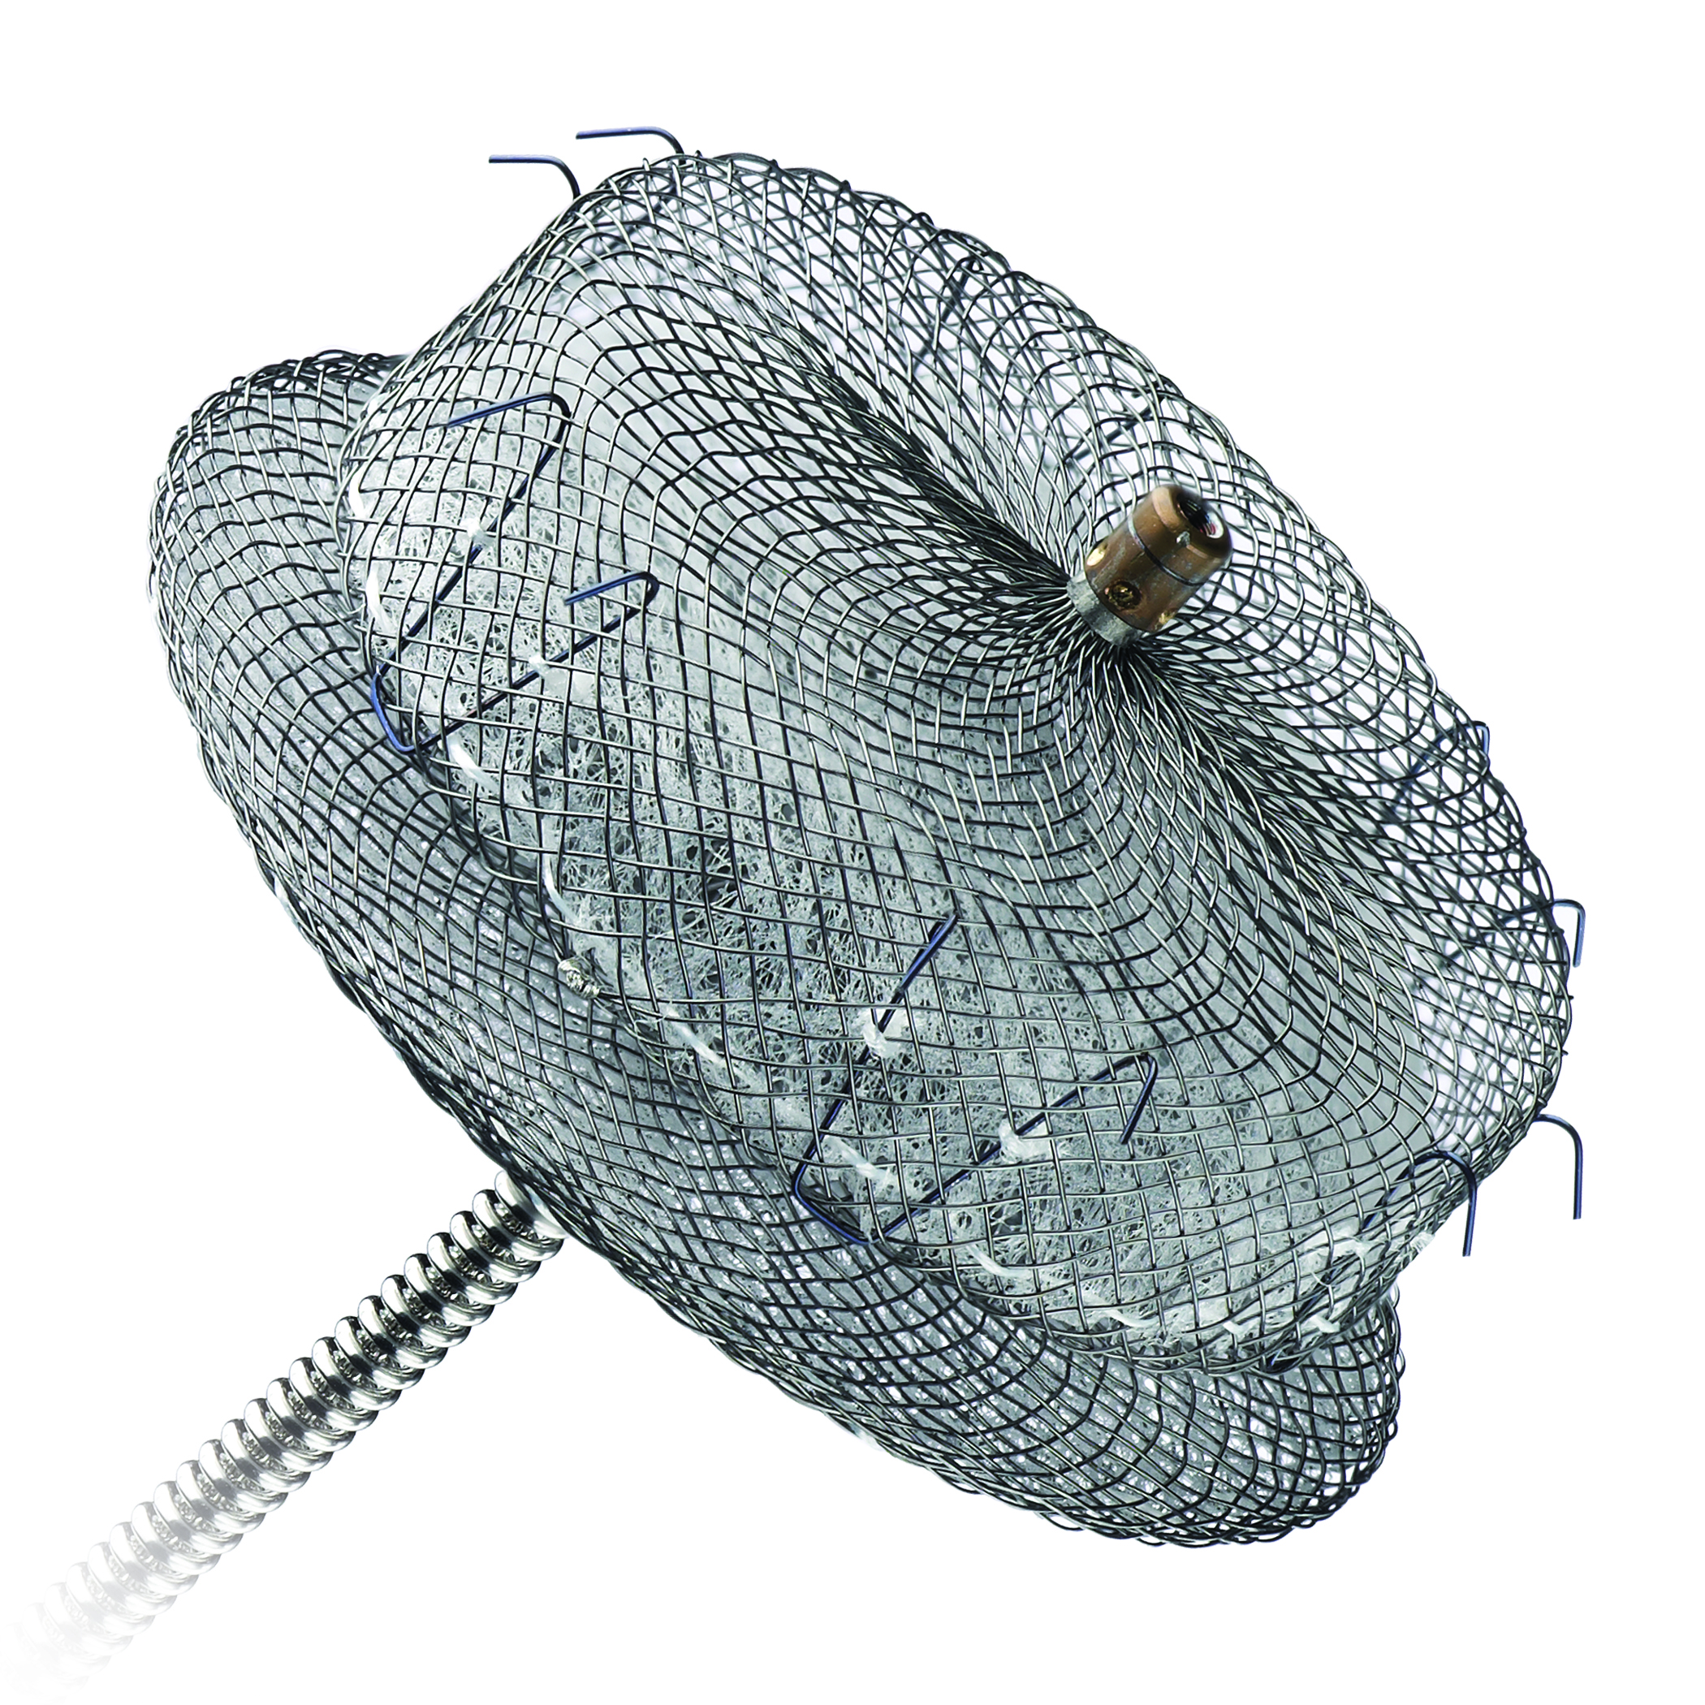
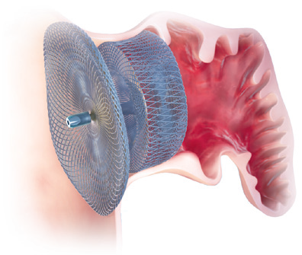
Amplatzer Cardiac Plug
Lobe diameter 16-30mm
Lobe length 6.5mm
Disk diameter 20-36mm
9, 10 or 13F sheath

Slide 5
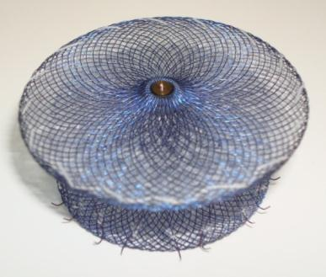
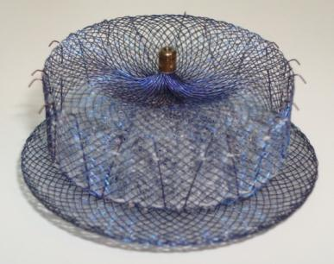
Amulet
Pre-loaded
Recessed end screw
Larger disc diameter
Longer lobe length
Longer waist length
Larger sizes up to 34mm
Stiffer stabilizing wires (.0065)
More stabilizing wires on larger devices

Slide 6
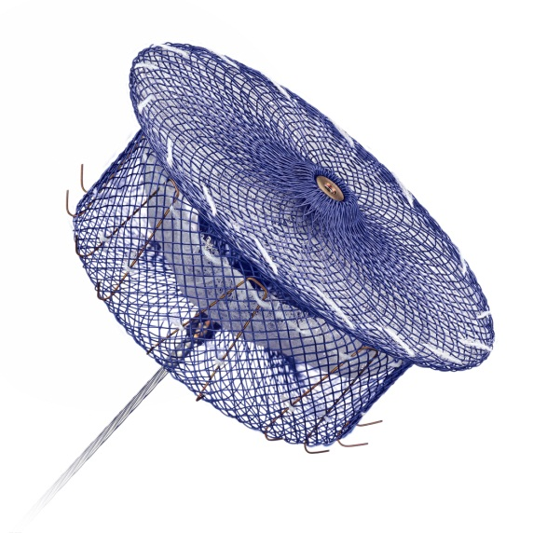
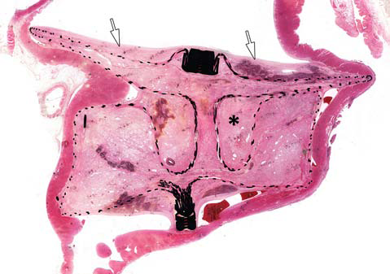
Recessed End Screw
Recessed end screw creates a uniform surface in the left atrium
90 days — Preclinical canine model
Notes:
The end screw on the Amulet™ device, where the delivery cable is attached to the implant, has been recessed. By eliminating the protruding end screw, this change is intended to create a more uniform surface in the left atrium once the device has been released.

Slide 7
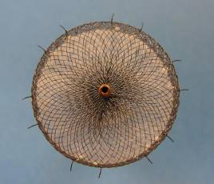
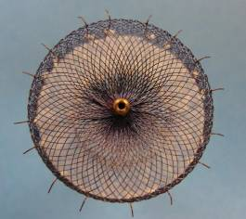
Stabilizing Wire Changes
Number of stabilizing wires dependent on lobe diameter
Designed to increase stability of the lobe inside the left atrial appendage
AMPLATZER™ Cardiac Plug
Sizes 16 – 30 mm: 6 pairs
Amulet™ Device
Sizes 16 – 18 mm: 6 pairs
Sizes 20 – 25 mm: 8 pairs
Sizes 28 – 34 mm: 10 pairs
Notes:
For the Amulet™ device, the number of stabilizing wires is dependent on the diameter of the lobe. In larger sized Amulet devices, the number of stabilizing wires has been increased. This was done to make the gap between stabilizing wires more consistent across the entire size range, and increase the overall stability of the Amulet device particularly among the larger sizes.

Slide 8
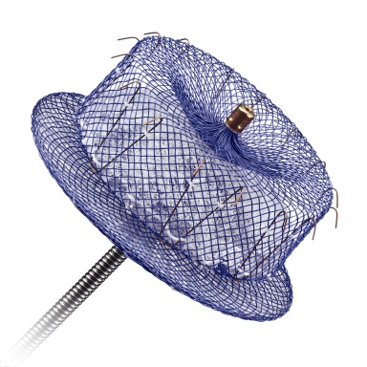
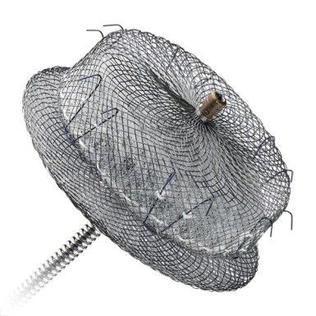
Device Specifications
Feature | AMPLATZER™ Amulet™ |  |  |  |  |  |  |  | AMPLATZER™ Cardiac Plug
Size / Lobe Diameter (mm) | 16 | 18 | 20 | 22 | 25 | 28 | 31 | 34 | 16 | 18 | 20 | 22 | 24 |  | 26 | 28 | 30
Disc Diameter | Lobe + 6 mm |  |  |  | Lobe + 7 mm |  |  |  | Lobe + 4 mm |  |  |  | Lobe + 6 mm
Lobe Length | 7.5 mm |  |  |  | 10 mm |  |  |  | 6.5 mm
Waist Length | 5.5 mm |  |  |  | 8 mm |  |  |  | 4 mm
Stabilizing Wires | 6 pairs |  | 8 pairs |  |  | 10 pairs |  |  | 6 pairs
Sheath Diameter | 12F 14F (with Adaptor) |  |  |  |  | 14F |  |  | 9F | 10F |  |  |  | 13F
Notes:
The AMPLATZER™ Amulet™ has undergone several dimensional changes in relation to the AMPLATZER™ Cardiac Plug.
The lobe diameter now has a range from 16mm to 34mm, allowing device implantation in larger appendages.
The disc diameter has been increased slightly to allow for better coverage of the LAA orifice.
The lobe length has been increased to 7.5mm on the smaller devices and 10mm on the larger devices. This allows the lobe to get more surface contact with the left atrial appendage, and is intended to improve the overall stability of the implant.
The waist length of the device has also been increased. This allows for more flexibility in identifying the appropriate landing zone and positioning the lobe in more challenging or anatomies, while still allowing the disc to fully cover the LAA orifice.
The sheath sizes used for the Amulet™ device are 12 French and 14 French. There is also an adaptor supplied with the Amulet device which will allow the 14 French sheath to be used with all device sizes, depending on operator preference.

Slide 9
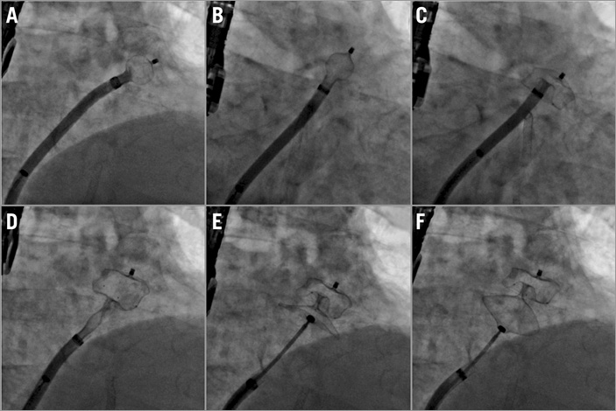
Ball position
Counterclokckwise rotation
Deployment of lobe
D. Deployment of disc
E. Device stability evaluation
F. Gentle tug test

Slide 10
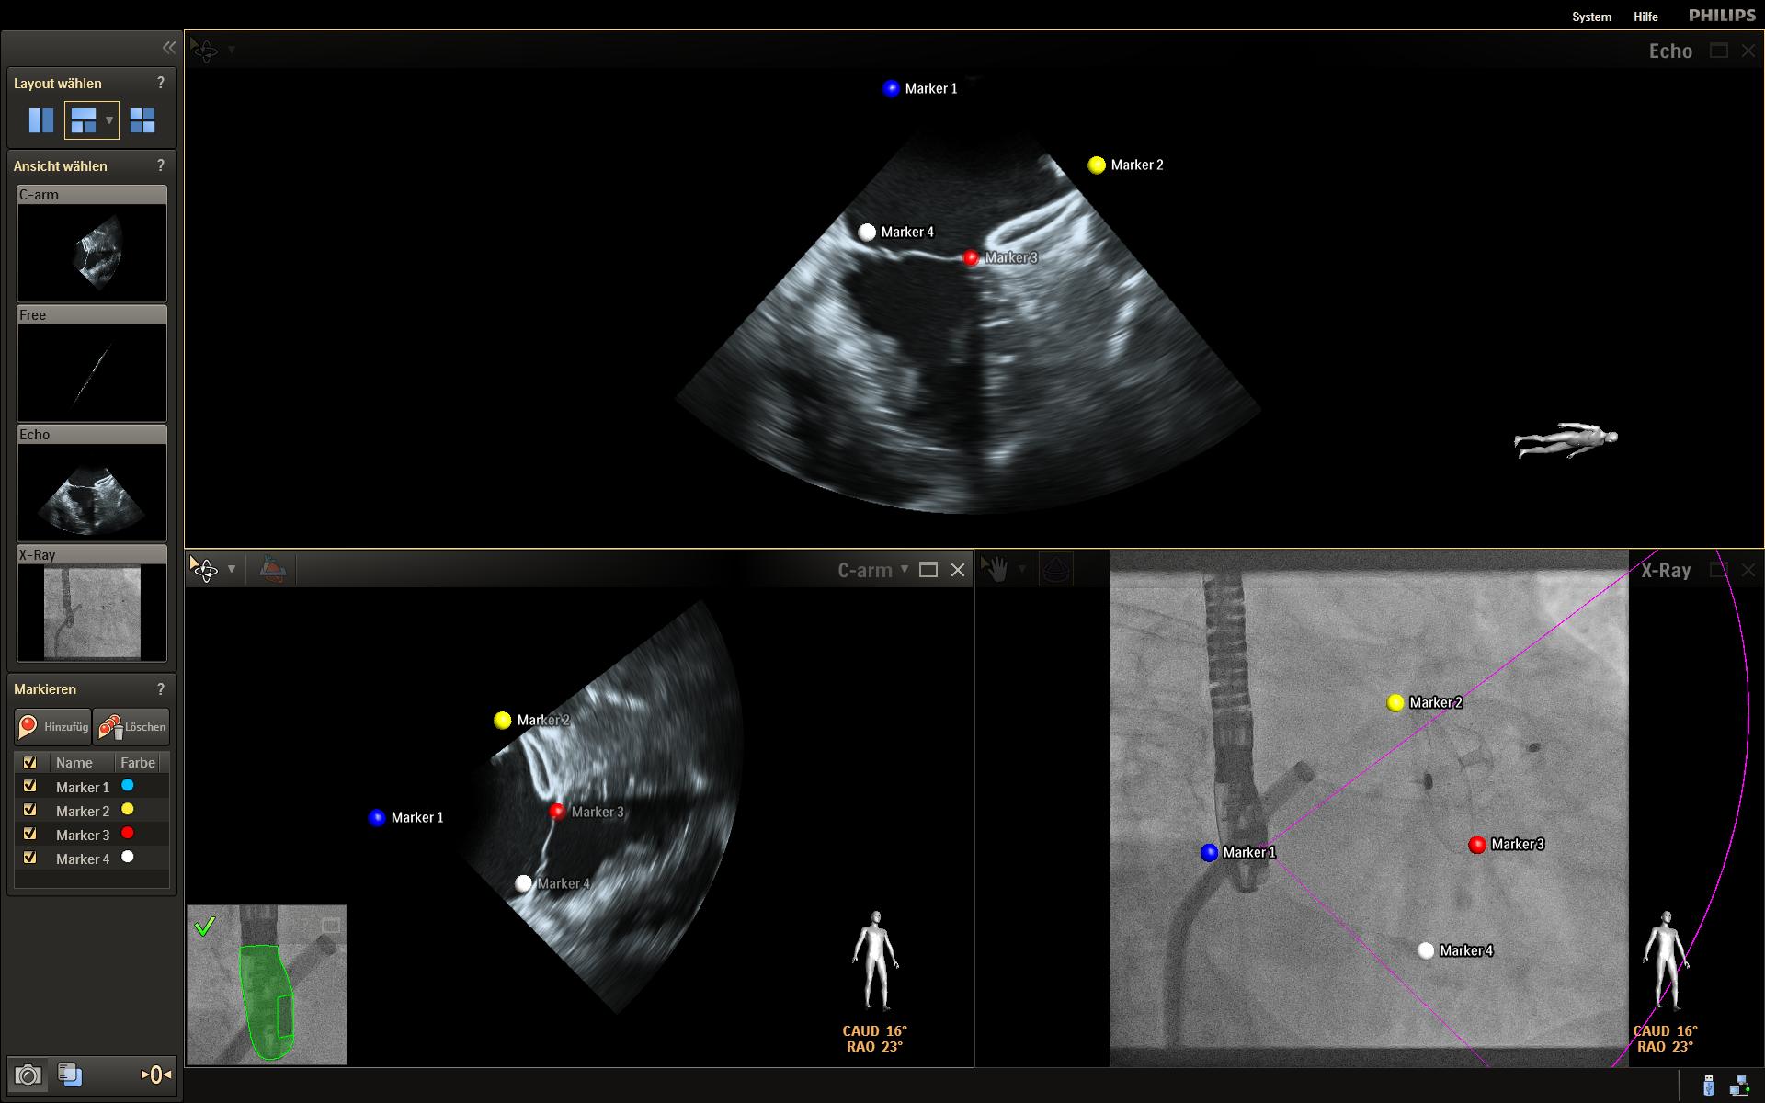
Yellow and red marks the device
Red and white marks the mitral valve

Slide 11
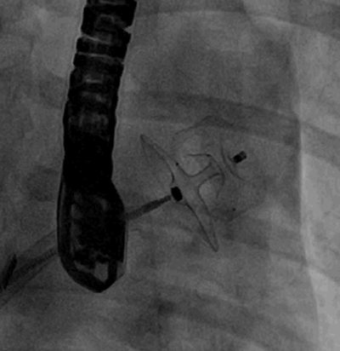
Five Signs of Proper Deployment
Before device release, always check the five signs of proper Amulet™ deployment:
Compression on the lobe
Separation between the device lobe and disc
Concave disc
Axis of device lobe in line with axis of the LAA neck
Two-thirds device lobe distal to the left circumflex artery
If device position is unsatisfactory, recapture the device and redeploy per the IFU.
Notes:
As with the AMPLATZER™ Cardiac Plug, there are five signs used to assess whether the Amulet™ device has been deployed appropriately. These should be evaluated prior to the device release.
The device lobe should show good compression.
There should be separation between the lobe and disc
The disc should be concave to show that the device is under tension
The axis of the device lobe should be parallel with the axis of the left atrial appendage neck
On echocardiography, the device lobe should be at least two thirds distal to the circumflex artery
If the device position is unsatisfactory, the device should be recaptured and redeployed.

Slide 12
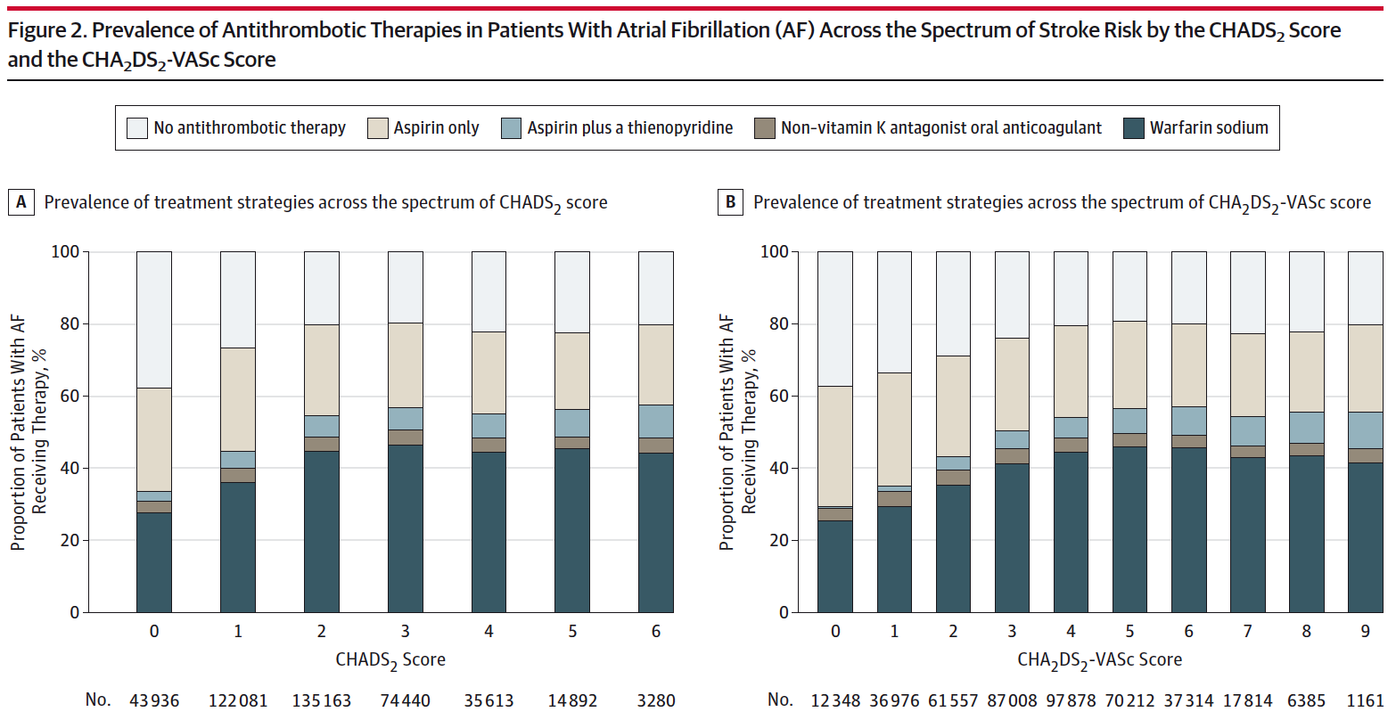
Real World OAC for AF – PINNACLE Registry
In this 429 417 patients US registry <50% of patients are treated according to the Guidelines!
From: OAC Therapy Prescription in Patients With AF Across the Spectrum of Stroke Risk: Insights From the NCDR PINNACLE Registry
JAMA Cardiol. 2016;1(1):55-62

Slide 13
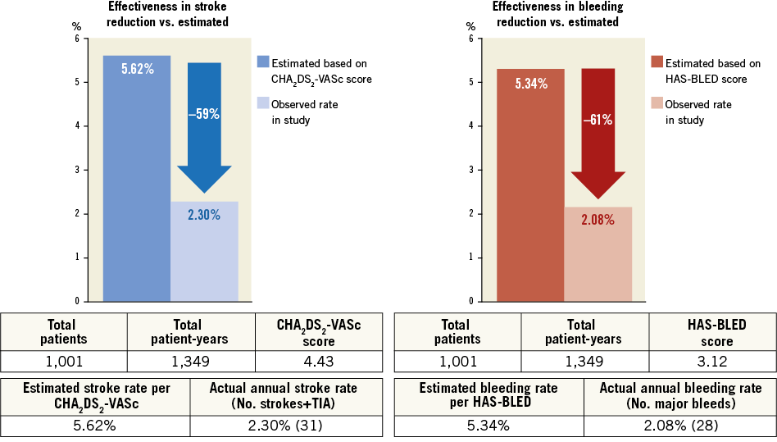
Multicentre experience with the AMPLATZER Cardiac Plug
Tzikas A et al, EuroIntervention. 2016 Feb 20;11(10):1170-9

Slide 14
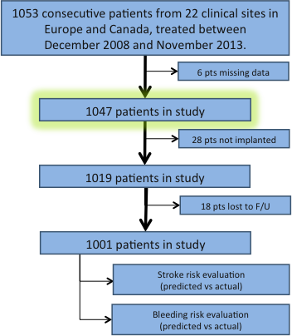
Study Flow Chart
DESIGN: Non-randomized, single-arm, multi-center clinical evaluation of the ACP for stroke prevention in non-rheumatic AF patients
OBJECTIVE: To evaluate the acute and long-term safety and effectiveness of the ACP in clinical practice
PRINCIPAL INVESTIGATOR Apostolos Tzikas, Greece
Tzikas 2015
Notes:
14
This is the Bulleted List slide.
To create this particular slide, click the NEW SLIDE button on your toolbar and choose the BULLETED LIST format. (Top row, second from left)
The Sub-Heading and footnote will not appear when you insert a new slide. If you need either one, copy and paste it from the sample slide.
If you choose not to use a Sub-Heading, let us know when you hand in your presentation for clean-up and we’ll adjust where the bullets begin on your master page.
Also, be sure to insert the presentation title onto the BULLETED LIST MASTER as follows:
Choose View / Master / Slide Master from your menu.
Select the text at the bottom of the slide and type in a short version of your presentation title.
Click the SLIDE VIEW button in the lower left hand part of your screen to return to the slide show. (Small white rectangle)

Slide 15
Indications for LAAO
N=1047
Composite of previous bleeding (major or minor) and high bleeding risk = 73%
Notes:
15
This is the Bulleted List slide.
To create this particular slide, click the NEW SLIDE button on your toolbar and choose the BULLETED LIST format. (Top row, second from left)
The Sub-Heading and footnote will not appear when you insert a new slide. If you need either one, copy and paste it from the sample slide.
If you choose not to use a Sub-Heading, let us know when you hand in your presentation for clean-up and we’ll adjust where the bullets begin on your master page.
Also, be sure to insert the presentation title onto the BULLETED LIST MASTER as follows:
Choose View / Master / Slide Master from your menu.
Select the text at the bottom of the slide and type in a short version of your presentation title.
Click the SLIDE VIEW button in the lower left hand part of your screen to return to the slide show. (Small white rectangle)

Slide 16
Multicentre experience with the AMPLATZER Cardiac Plug
Tzikas A et al, EuroIntervention. 2016 Feb 20;11(10):1170-9

Slide 17
Stroke & Bleeding Reduction – ICB patients
-75%
-55%
-59%
-89%
-47%
-60%
 | Patients | Total Patient Years | CHA₂DS₂-VASc Score
IC Bleeding | 188 | 287 | 4.5
Other | 813 | 1062 | 4.4
Total | 1001 | 1349 | 4.4
 | Patients | Total Patient Years | HAS-BLED Score
IC Bleeding | 188 | 287 | 3.5
Other | 813 | 1062 | 3.1
Total | 1001 | 1349 | 3.1
 | Estimated Annual Stroke Rate per CHA₂DS₂-VASc | Observed Annual Stroke Rate (N strokes + TIA)
IC Bleeding | 5.8% | 1.4% (4)
Other | 5.6% | 2.5% (27)
Total | 5.6% | 2.3% (31)
 | Estimated Annual Bleeding Rate per HAS-BLED | Observed Annual Bleeding Rate (N Bleedings)
IC Bleeding | 6.4% | 0.7% (2)
Other | 5.1% | 2.4% (26)
Total | 5.7% | 2.1% (28)
Notes:
17
This is the Bulleted List slide.
To create this particular slide, click the NEW SLIDE button on your toolbar and choose the BULLETED LIST format. (Top row, second from left)
The Sub-Heading and footnote will not appear when you insert a new slide. If you need either one, copy and paste it from the sample slide.
If you choose not to use a Sub-Heading, let us know when you hand in your presentation for clean-up and we’ll adjust where the bullets begin on your master page.
Also, be sure to insert the presentation title onto the BULLETED LIST MASTER as follows:
Choose View / Master / Slide Master from your menu.
Select the text at the bottom of the slide and type in a short version of your presentation title.
Click the SLIDE VIEW button in the lower left hand part of your screen to return to the slide show. (Small white rectangle)

Slide 18
LAA occlusion vs. standard care in patients with AF and intracerebral hemorrhage A propensity score matched follow-up study
LAAO in IC Bleeding patients
Endpoint and Results
Primary composite endpoint of all-cause mortality, ischemic stroke and major bleeding
LAAO: Lower risk of composite outcome (Relative Risk Reduction: 81%)
LAAO: Lower risk of mortality (Relative Risk Reduction: 92%)
LAAO: Reduced risk for Stroke and major bleeding (Stroke RR 65%, major bleeding: 61%)
LAAO is suggested to be of major clinical benefit in AF patients with prior ICH
AF + ICH
LAAO
Standard
176
787
Propensity Score Match*
147
147
STROKECLOSE
RCT
J-E Nielsen-Kudsk – EuroPCR 2016

Slide 19
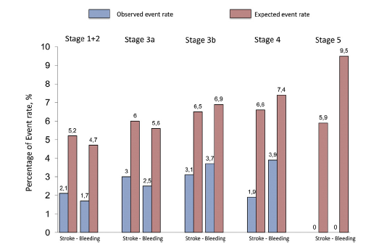
LAAO & Renal Disease
375 patients with Chronic Kidney Disease (GFR<60)
Similar procedural safety
Dramatic reduction in Stroke/TIA, persistent in all stages of CKD
Patients with end-stage CKD had overall lower survival but the same frequency of MAEs at FU
Int J Cardiol 2016
Tzikas 2016

Slide 20
LAAO in the Elderly
LAAO was associated with:
similar procedural success in patients aged <75 and ≥75 years
older patients had a higher incidence of cardiac tamponade
At follow-up:
stroke and major bleeding rates were similar among groups
Am J Card 2016
Tzikas 2016

Slide 21
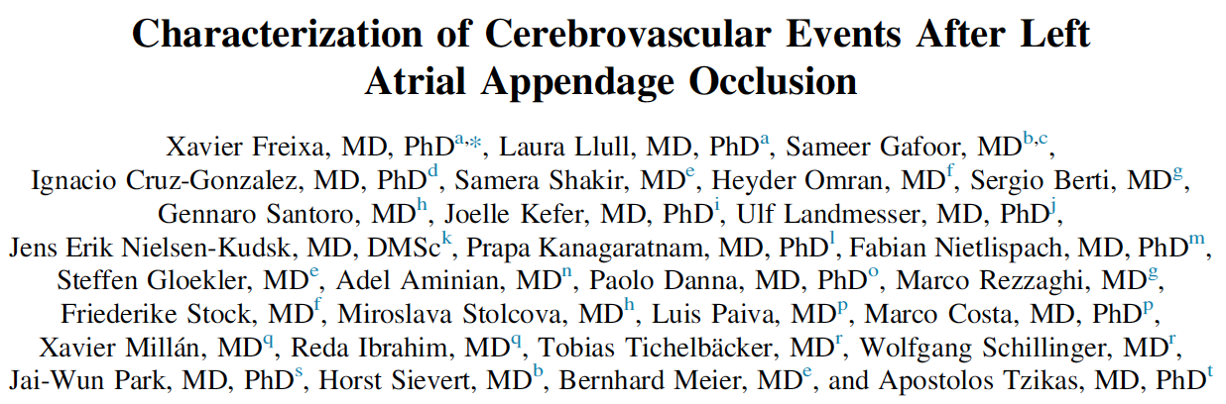
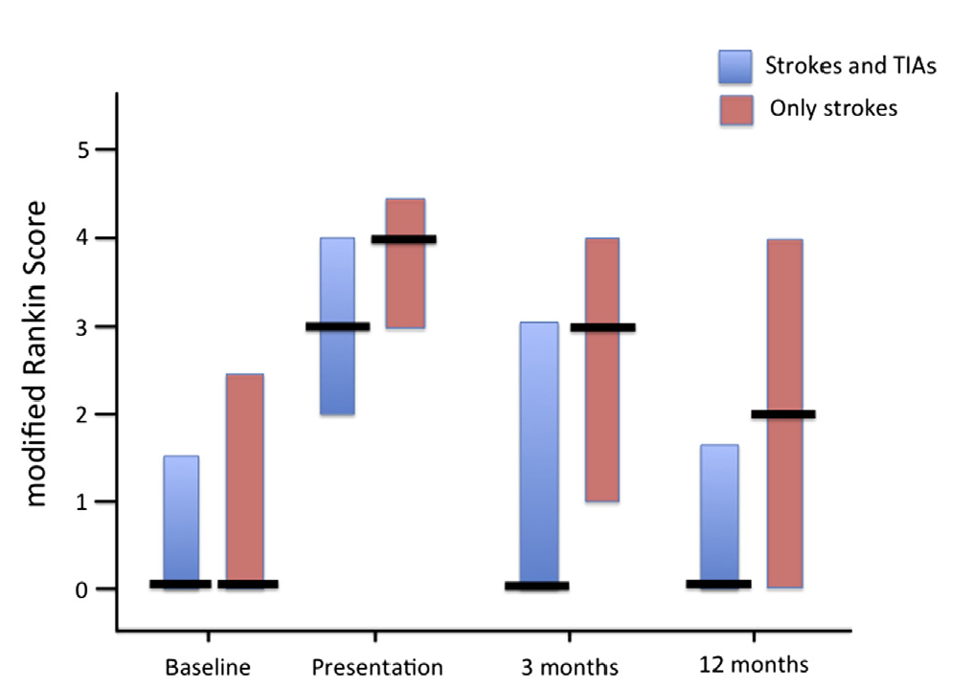
Stroke Severity after LAAO?
LAAO with ACP: 1001 patients
N of Strokes at FU: 0.8% per year
81% of Strokes were Non Disabling (mRS<3)
Am J Cardiol. 2016 (in press)

Slide 22
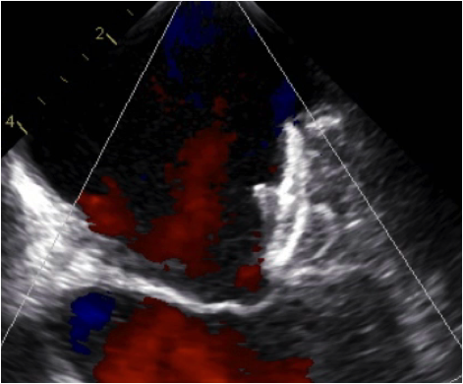
Peri-device Leaks
Incidence and clinical impact of device-associated thrombus and peri-device leak following left atrial appendage closure with the Amplatzer Cardiac Plug
Jacqueline Saw¹, MD, Apostolos Tzikas^{2,3}, MD, PhD, Samera Shakir⁴, MD, Sameer Gafoor⁵, MD, Heyder Omran⁶, MD, Jens Erik Nielsen-Kudsk⁷, MD, Joelle Kefer⁸, MD, Adel Aminian⁹, MD, Sergio Berti¹⁰, MD, Gennaro Santoro¹¹, MD, Fabian Nietlispach¹², MD, Aris Moschovitis⁴ , MD, Ignacio Cruz-Gonzalez¹³, MD, Francis Stammen¹⁴, MD, Tobias Tichelbäcker¹⁵, MD, Xavier Freixa¹⁶, MD, Reda Ibrahim¹⁷, MD, Wolfgang Schillinger¹⁵, MD, Bernhard Meier⁴, MD, Horst Sievert⁵, MD, Steffen Gloekler⁴, MD
344 post procedural TEEs
Independent adjudication (Cardialysis)
Device-associated thrombus 3.2%
Peri-device leaks
minimal (<1mm) 5.5%
mild (1-3mm) 5.8%
moderate (3-5mm) 0.6%
severe (>5mm) 0.6%
JACC Int 2016 (in press)

Slide 23
Thank You

