Slide 1
Catheter-based Renal Denervation in the Absence of Antihypertensive Medications:
Primary Results from the
SPYRAL HTN-OFF MED Pivotal Trial
Michael Böhm
Klinik für Innere Medizin III, Universitätsklinikum des Saarlandes, Homburg/Saar, Germany
michael.boehm@uks.eu
and Kazuomi Kario, David Kandzari, Felix Mahfoud, Michael Weber, Roland Schmieder, Konstantinos Tsioufis, Stuart Pocock, Martin Fahy, Vanessa DeBruin, Sidney Cohen, Sandeep Brar, Raymond Townsend
on behalf of the SPYRAL HTN-OFF MED PIVOTAL Trial Investigators
Notes:
ACC.20 World Congress of Cardiology
Session 406 – Late Breaking Clinical Trials III
Session time: March 29, 2020 at 10:45 am - 12:00 pm Central Time

Slide 2
Disclosure Statement of Financial Interest Prof. Michael Böhm
Consultant – Abbott, Amgen, Astra, Boehringer-Ingelheim, Cytokinetics, Medtronic, Novartis, ReCor, Servier, Vifor
Grant support – German Research Foundation (DFG)

Slide 3
Background
Over 1/3 adults have hypertension (HTN)
Increased risk of cardiovascular events and stroke
Many patients remain uncontrolled
Unmet need for HTN treatment
SPYRAL HTN-OFF MED
Pilot trial: showed proof of principle that renal denervation (RDN) reduces blood pressure¹
Pivotal trial: prospectively powered RCT evaluating RDN independent of drug effects and adherence
¹ Townsend R, et al. Lancet. 2017;390(10108):2160-2170
Notes:
Over 1/3 adults have hypertension (HTN)
Increased risk of cardiovascular events and stroke, especially at night
Medication typically reduces office blood pressure (BP) in range of 5-10 mmHg
Many patients remain uncontrolled; medication adherence is a major issue
Unmet need for HTN treatment, independent of daily patient adherence
Renal denervation (RDN) targets the sympathetic nervous system to reduce BP

Slide 4
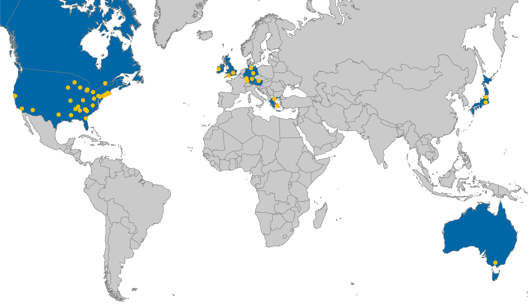
SPYRAL HTN – OFF MED
Participating Centers
44 Recruiting sites in:
Australia
Austria
Canada
Germany
Greece
Ireland
Japan
United Kingdom
USA
Dr. Tsioufis Athens, Greece
Dr. Weber Wels, Austria
Dr. Weil Lübeck, Germany
Dr. Zeller Bad Krozingen, Germany
Dr. Walton
Melbourne, Australia

Slide 5
SPYRAL HTN – OFF MED PIVOTAL
Randomized, Sham-controlled Trial
SCREENING
TREATMENT
SHAM CONTROL
Follow-up every 2 weeks
3M
4M
6M
12-36M
ABPM
Office BP
Drug testing
2-week
safety check
1-2 weeks
Start drugs
if OSBP ≥140
VISIT 1
VISIT 2
R
Office BP
Drug naïve or medications discontinued
3-4 weeks
Office BP (baseline)
24-hr ABPM
Drug testing
RENAL DENERVATION
Follow-up every 2 weeks
3M
4M
6M
12-36M
Primary endpoint
Unblinding and optional crossover
Screen failure if OSBP ≥180 or DBP <90 mmHg
Safety escape criteria met if OSBP ≥180 mmHg
NCT02439749
Böhm M, et al. Clin Res Cardiol. 2020;109(3):289-302
Notes:
The SPYRAL HTN-OFF MED PIVOTAL trial is evaluating renal denervation in the absence of any antihypertensive medications compared to a sham-controlled population.
Prior to randomization, patients will undergo an antihypertensive medication washout period of three to four weeks.
Patients in both groups will be systematically titrated back into anti-hypertensive medical therapy as appropriate three months following randomization. The off-medication trial will help isolate the effect of renal denervation on blood pressure reduction, and was requested by both the FDA and many clinicians.

Slide 6
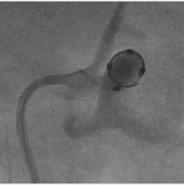
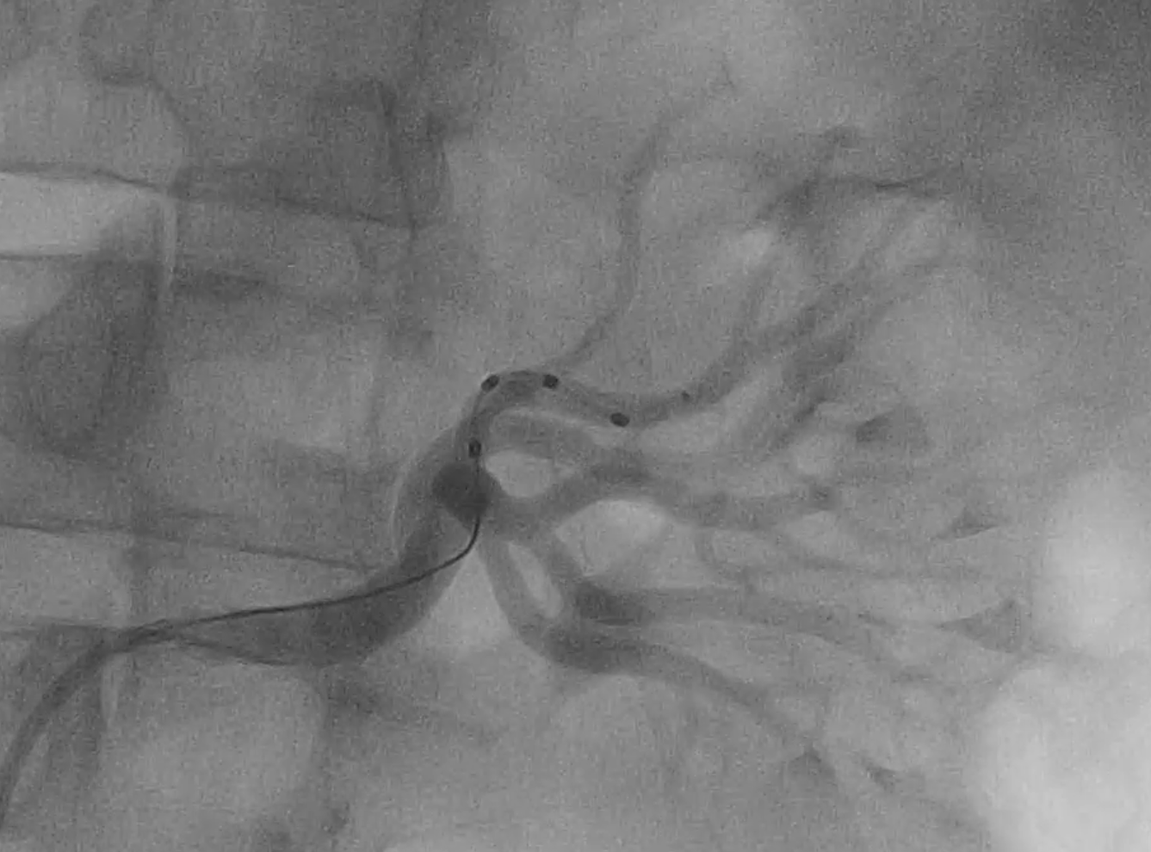
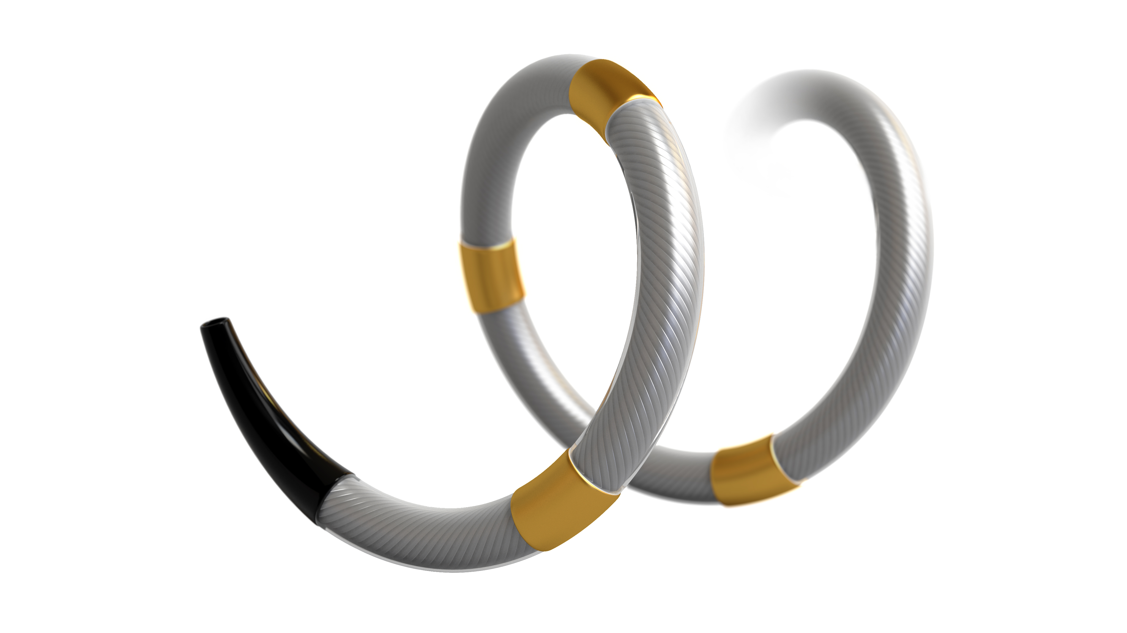
Symplicity Spyral™ Catheter
Multi-electrode catheter with quadrantic vessel contact for simultaneous ablation in up to 4 electrodes
60-second simultaneous energy delivery
Vessel diameter range: 3 – 8 mm
Flexible catheter allows branch treatment
6F guiding catheter compatible

Slide 7
SPYRAL HTN – OFF MED
Key Patient Eligibility Criteria
Inclusion
Patient is either:
Not on antihypertensive medications, OR
Permitting discontinuation of drug therapy
2. Office SBP ≥ 150 and < 180 mmHg
3. Office DBP ≥ 90 mmHg
4. Systolic 24-hour mean ABPM ≥ 140 and < 170 mmHg
Exclusion
Ineligible renal artery anatomy (accessory arteries allowed)
eGFR < 45 mL/min/1.73m²
Type 1 diabetes mellitus or type 2 diabetes mellitus with HbA1C > 8.0%
Secondary causes of hypertension
NCT02439749
Böhm M, et al. Clin Res Cardiol. 2020;109(3):289-302

Slide 8
SPYRAL HTN – OFF MED PRIMARY ANALYSIS
Study Endpoints
Powered EFFICACY Endpoints
SAFETY at 1 and 3 Months
1°: Change in 24-hr SBP at 3 months
2°: Change in Office SBP at 3 months
Major Adverse Events (MAE):
All-cause mortality
End stage renal disease (ESRD)
Significant embolic event resulting in end-organ damage
Renal artery perforation or dissection requiring intervention
Vascular complications
Hospitalization for hypertensive crisis

Slide 9
SPYRAL HTN – OFF MED
Bayesian Adaptive Study Design¹ With Informative Prior
SPYRAL HTN - OFF MED
Pilot Trial
SPYRAL HTN - OFF MED
Pivotal Trial
N = 80 randomized patients²
N = max 353 randomized patients
PRIMARY ANALYSIS Dataset (N = max 433 randomized patients)¹
1st Planned analysis
N = 210 pts*
2nd Planned analysis
N = 240 pts*
3rd Planned analysis
N = 300 pts*
Stopping criteria:
>97.5% probability of superiority on both primary and secondary efficacy endpoints
Stopping criteria met?
yes
STOP
Enrollment
¹ Böhm M, et al. Clin Res Cardiol. 2020 Mar;109(3):289-302
² Townsend R, et al. Lancet. 2017;390(10108):2160-2170
* Evaluable patients with 3-month follow-up data
Notes:
The SPYRAL HTN OFF MED Pivotal trial utilizes a Bayesian adaptive design that efficiently leverages data from the SPYRAL HTN OFF MED Pilot trial to support the Pivotal results
Bayesian methodology:
Design and analyses developed in collaboration with academia, industry, and FDA
Uses prior data (pilot study) to be included in the analysis based on its similarity to the pivotal data
Benefits:
Reduces patient risk (less patients with HTN exposed to sham control, ie without any BP treatment)
Allows for the results to be announced faster

Slide 10
SPYRAL HTN – OFF MED
Patient Flowchart
80 Patients randomized in
SPYRAL HTN – OFF MED Pilot trial
251 Patients randomized in
SPYRAL HTN – OFF MED Pivotal cohort
331 Randomized patients
(Primary Analysis)
RDN group
N = 166 patients (ITT)
Sham control group
N = 165 patients (ITT)
3: missed visit
1: withdrew consent
1: missed visit
3-Month Clinical FU
n=162 (97.6%)
3-Month Clinical FU
n=164 (99.4%)

Slide 11
SPYRAL HTN – OFF MED PRIMARY ANALYSIS
Patient Baseline Characteristics
Mean ± SD or % | RDN (N = 166) | Sham Control (N = 165)
Age (years) | 52.4 ± 10.9 | 52.6 ± 10.4
Male | 64.5 | 68.5
Length of hypertension diagnosis > 5 yrs | 55.4 | 54.5
US African American race | 21.7 | 18.8
BMI (kg/m²) | 31.1 ± 6.0 | 30.9 ± 5.5
Diabetes (type 2) | 3.6 | 5.5
Current smoker | 16.9 | 16.4
Obstructive sleep apnea | 8.4 | 7.3
History of coronary artery disease* | 0.0 | 4.8
History of stroke / transient ischemic attack* | 0.6 | 0.0
* Occurring > 3 months before randomization

Slide 12
SPYRAL HTN – OFF MED PRIMARY ANALYSIS
Baseline Blood Pressure
Mean ± SD | RDN | Sham Control
Office measurements | N = 166 | N = 165
Systolic BP (mmHg) | 162.7 ± 7.8 | 162.9 ± 7.5
Diastolic BP (mmHg) | 101.2 ± 7.0 | 102.0 ± 7.1
24-hour measurements | N = 164 | N = 165
Mean systolic BP (mmHg) | 151.4 ± 8.1 | 151.0 ± 7.5
Mean diastolic BP (mmHg) | 98.0 ± 7.7 | 99.0 ± 7.4

Slide 13
SPYRAL HTN – OFF MED PRIMARY ANALYSIS
Procedural Details
Mean ± SD | RDN (N = 166) | Sham Control (N = 165)
Number of main renal arteries treated / pt | 2.2 ± 0.6 | NA
Number of branches treated / pt | 5.8 ± 2.7 | NA
Total number of ablations / pt | 46.9 ± 15.6 | NA
Main artery ablation | 18.3 ± 9.9 | NA
Branch ablations | 28.6 ± 15.4 | NA
Catheter time (min)¹ | 60.2 ± 25.0 | NA
Contrast volume used (cc) | 208.7 ± 96.3 | 73.7 ± 35.6
Successful procedure² | 100% | NA
¹ Defined as time from insertion to removal of device
² Defined as successful delivery of any RF energy in the absence of in-hospital MAE

Slide 14
SPYRAL HTN – OFF MED PRIMARY ANALYSIS
Safety Results at 1 Month
% | RDN (n = 166) | Sham Control (n = 165)
Major Adverse Events | 0 | 0
Death | 0 | 0
New-onset end-stage renal disease | 0 | 0
Sign. embolic event resulting in end-organ damage | 0 | 0
Renal artery perforation or dissection requiring intervention | 0 | 0
Vascular complications | 0 | 0
Hospitalization for hypertensive crisis/emergency | 0 | 0
New stroke | 0 | 0
Major bleeding (TIMI) | 0 | 0
Serum creatinine elevation >50% | 0 | 0
New myocardial infarction | 0 | 0

Slide 15
SPYRAL HTN – OFF MED PRIMARY ANALYSIS
Safety Results at 3 Months
n (%) | RDN (n = 165) | Sham Control (n = 165)
Major Adverse Events | 1 (0.6) | 0
Death | 0 | 0
New-onset end-stage renal disease | 0 | 0
Sign. embolic event resulting in end-organ damage | 0 | 0
Renal artery perforation or dissection requiring intervention | 0 | 0
Vascular complications | 0 | 0
Hospitalization for hypertensive crisis/emergency | 1 (0.6) | 0
New stroke | 0 | 1 (0.6)
Major bleeding (TIMI) | 0 | 0
Serum creatinine elevation >50% | 0 | 0
New myocardial infarction | 0 | 0

Slide 16
SPYRAL HTN – OFF MED PRIMARY ANALYSIS
Medications
Safety Escape n (%) | RDN (N = 166) | Sham Control (N = 165) | P
Patients meeting safety escape criteria¹ (<3 months after randomization) | 16 (9.6%) | 28 (17.0%) | 0.049
Off Med Compliance (%) | RDN (N = 166) | Sham Control (N = 165) | P
No anti-HTN drug identified by drug testing²
At baseline | 90.9 | 87.3 | 0.38
At 3 months³ | 91.2 | 94.9 | 0.26
At baseline and 3 months³ | 85.1 | 89.7 | 0.29
¹ Escape criteria: office SBP >180 mmHg or safety reasons, allowing patients to be placed back on antihypertensive medication
² Drug testing of Urine and Serum by tandem HPLC and Mass Spectroscopy
³ Excluding safety escape patients

Slide 17
SPYRAL HTN – OFF MED PRIMARY ANALYSIS
Blood Pressure Changes at 3 Months
24-hr SBP
24-hr DBP
Office SBP
Office DBP
0
Baseline
151
151
98
99
163
163
101
102
(mmHg)
n=140
n=134
n=140
n=134
n=156
n=150
n=156
n=150
-0.6
-0.8
-1.0
-2.5
-4
-3.7
-4.7
-5.1
Blood pressure change at 3 months (mmHg)
-8
Δ -4.0 mmHg
(-6.2, -1.8)
P <0.001
Δ -3.1 mmHg
(-4.6, -1.7)
P <0.001
Δ -4.4 mmHg
(-6.2, -2.6)
P <0.001
-9.2
-12
Δ -6.6 mmHg
(-9.6, -3.5)
P <0.001
RDN
Frequentist ANCOVA adjusted analysis
Sham control

Slide 18
SPYRAL HTN – OFF MED PRIMARY ANALYSIS
Consistent Treatment Effects by Dataset
24-hr SBP |  | 95% CI | P | P_{interaction}
Pilot (N=70) |  | -4.9 (-9.6, -0.3) | 0.037 | 0.57
Pivotal (N=204) |  | -3.6 (-6.2, -1.0) | 0.006
Overall (N=274) |  | -4.0 (-6.2, -1.8) | <0.001
Office SBP
Pilot (N=78) |  | -7.1 (-13.2, -1.1) | 0.021 | 0.80
Pivotal (N=228) |  | -6.4 (-9.9, -2.8) | <0.001
Overall (N=306) |  | -6.6 (-9.6, -3.5) | <0.001
Treatment difference (mmHg)
Notes:
Remove linked datafile

Slide 19
SPYRAL HTN – OFF MED PRIMARY ANALYSIS
Bayesian Primary Endpoint Analysis
24-hr SBP
>99.9% probability of superiority
Office SBP
>99.9% probability of superiority
superior
inferior
superior
inferior
0.3
0.2
1° Powered Efficacy Endpoint Met
2° Powered Efficacy Endpoint Met
Density
0.2
Density
0.1
0.1
-3.9 (95%BCI: -6.2, -1.6)
-6.5 (95%BCI: -9.6, -3.5)
0.0
0.0
-10
-8
-6
-4
-2
0
2
-15
-10
-5
0
24-hr ASBP treatment effect (mmHg)
Office SBP treatment effect (mmHg)
Posterior distribution of between-group differences, ANCOVA adjusted for baseline BP
Notes:
We used Bayesian design and analysis to allow more efficient trial design and analysis. By being able to utilize data generated in the pilot study, we were able to shorten enrollment time and decrease the number of subjects exposed to sham control.
At the first pre-specified interim analysis, the Bayesian Analysis plotted here in what is called a “prior distribution” demonstrates that with >99.9% probability that RDN is superior to the sham control for both 24 hour systolic BP and office BP.
That is demonstrated by the density plot showing almost all of the data to the left of the red line at “0” plotted here for both BP measurement methods.
The treatment effect was -3.9mmHg for 24hr SBP and -6.5mmHg for office, matching very closely the prespecified frequentist analysis BP decreases of 4.0mmHg and 6.6mmHg.
In conclusion, both powered efficacy endpoints were met

Slide 20
SPYRAL HTN – OFF MED PRIMARY ANALYSIS
24-Hr Systolic Blood Pressure
RDN
Sham Control
Baseline mean
Baseline mean
Systolic Blood Pressure (mmHg)
3M mean
3M mean
Baseline (n=164)
Baseline (n=164)
3 Months (n=143)
3 Months (n=134)
Nighttime
P<0.001
Morning
P<0.001
Daytime
P<0.001
Nighttime
P=0.85
Morning
P=0.73
Daytime
P=0.64
Notes:
Remove linked data

Slide 21
SPYRAL HTN – OFF MED PRIMARY ANALYSIS
24-Hr Diastolic Blood Pressure
RDN
Sham Control
Diastolic Blood Pressure (mmHg)
Baseline mean
Baseline mean
3M mean
3M mean
Baseline (n=164)
Baseline (n=164)
3 Months (n=143)
3 Months (n=134)
Nighttime
P<0.001
Morning
P<0.001
Daytime
P<0.001
Nighttime
P=0.70
Morning
P=0.58
Daytime
P=0.25
Notes:
Remove linked data

Slide 22
SPYRAL HTN – OFF MED PRIMARY ANALYSIS
Subgroup Analysis (3-Month Change in 24-hr SBP)
 |  | Treatment difference (mmHg) | P _{interaction}
Age | < 65 years (N=294) |  | 0.55
 | ≥ 65 years (N=37)
Sex | Male (N=220) |  | 0.35
 | Female (N=111)
BMI | < 28.1 kg/m² (N=110) |  | 0.85
 | 28.1 to 32.1 kg/m² (N=111)
 | ≥ 32.1 kg/m² (N=110)
Smoking | Current (N=55) |  | 0.35
 | Former (N=92)
 | Never (N=184)
Diabetes type 2 | Yes (N=15) |  | 0.77
 | No (N=316)
US African American | Yes (N=67) |  | 0.87
 | No (N=95)
Frequentist ANCOVA analysis adjusted for baseline BP
Notes:
Remove linked data

Slide 23
SPYRAL HTN – OFF MED PRIMARY ANALYSIS
Limitations
Follow-up limited to 3 months
For ethical reasons, medication had to be restarted for safety
Previous RDN studies showed further BP reduced after 3 months^{1,2}
RDN effect disadvantaged by more safety escape patients in the sham group
Despite off-med protocol, antihypertensive drugs detected in 36 patients
Consistent results in per protocol analysis (excluding meds)
¹ Kandzari D, et al. Lancet. 2018;391(10137):2346-2355.
² Mahfoud F. EuroPCR 2019

Slide 24
SPYRAL HTN – OFF MED PRIMARY ANALYSIS
Conclusions
Powered trial demonstrates that RDN lowers BP
Uncontrolled hypertensive patients in the absence of medications
In both 24-hr and office BP
Compared to sham control
Clinically meaningful BP reductions at 3 months
Treatment is “always on” for 24 hrs
Independent of patient adherence to medication
Consistent BP reduction during nighttime when CV risk is highest
No major device- or procedure-related safety events through 3 months
SPYRAL HTN – ON MED trial is enrolling¹
¹ NCT02439775
Notes:
This rigorously designed, powered, hypothesis driven trial demonstrated that RDN lowers BP

Slide 25
SPYRAL HTN – OFF MED PRIMARY ANALYSIS
Publication
Placeholder for Lancet publication
M Böhm, et al. Lancet, published online 29 March 2020

Slide 26
The following persons participated in the SPYRAL HTN – OFF MED trial
Executive Committee
Prof. Michael Böhm (Chairman, Homburg/Saar, Germany), David E. Kandzari (Atlanta, GA, USA), Prof. Kazuomi Kario (Tochigi, Japan), Prof. Felix Mahfoud (Homburg/Saar, Germany), Stuart Pocock (London, United Kingdom), Prof. Roland E. Schmieder (Erlangen Germany), Raymond R. Townsend (Philadelphia, PA, USA), Prof. Konstantinos Tsioufis (Athens, Greece), Michael A. Weber (New York, NY, USA), Manuela Negoita (Medtronic), Sidney A. Cohen (Medtronic)
Clinical Event Committee
Clive Rosendorff (chairman), Steven Marx (co-chairman), Ladan Golestaneh, Michele H. Mokrzycki, Joel Neugarten, Judy Tingley (non-voting member, Cardiovascular Research Foundation, NY, USA)
Data Safety Monitoring Board
Bernard J. Gersh (chairman), John A. Ambrose, Phyllis August, David L. Demets, Rajat Mukherjee (non-voting member, Cytel, Waltham, MA)
Core Laboratories
Angiographic Core Laboratory: Beth Israel Deaconess Medical Center, Inc.
Blood Core Laboratory: ACM Global Laboratory
Central Registration and Randomization Center: ICON Clinical Research
Clinical Events Committee (CEC): Cardiovascular Research Foundation
Data Safety Monitoring Board (DSMB): Cardiovascular Research Foundation
Drug Testing Core Laboratory: Klinische Toxikologie Universitätsklinikum des Saarlandes
Imaging and File Upload: Medidata
MRA/CTA Core Laboratory: Cardiovascular Core Lab, Morristown Medical Center
Renal Artery Duplex Ultrasound Core Laboratory: VasCore – The Vascular Ultrasound Core Laboratory
Statistical Programming and Data Analysis: Cytel Inc.
Study Sites and Investigators
Australia
The Alfred Hospital, Melbourne, VIC
Investigators: Tony Walton (PI), Ingrid Hopper, Jason Bloom, Julia Stehli
Research Coordinators: Louise Hammond, Rozanne Johnston, Brianna Davidson, Elisha Gartner, Samantha Holland
Austria
Klinikum Wels-Grieskirchen, Wels
Investigators: Thomas Weber (PI), Markus Suppan, Wolfgang Helmreich
Research Coordinators: Markus Suppan,Wolfgang Helmreich
Canada
Montreal Heart Institute, Montreal, QC
Investigators: Philippe L'Allier (PI), Jean-François Dorval, Shaun Selcer, Marc Andre Lavoie
Research Coordinators: Jessica Drouin, Sarah Samson, Cyntia Pennestri, Jessica Desriveaux
Germany
Herzzentrum Leipzig, Leipzig
Investigators: Philipp Lurz (PI), Karl Fengler, Karl-Philipp Rommel, Phillip Munch, Matthias Lerche, Christian Binner, Phillip Hartung
Research Coordinators: Margit Büttner, Martin Petzold, Sabrina Weinschenk, Kai Trautman, Jacqueline Banderlow
Universitäts-Herz-Zentrum Freiburg, Bad Krozingen
Investigator: Thomas Zeller (PI)
Universitätsklinikum des Saarlandes, Homburg / Saar
Investigators: Michael Böhm, Felix Mahfoud, Sebastian Ewen, Yvonne Bewarder, Juliane Dederer, Saarraangan Kulenthiran, Jelena Lucic, Dominic Millenaar, Lucas Lauder
Research Coordinators: Christina Koch, Angelika Wachter, Judith Bour, Svenja Weber, Jeanette Obermann, Barbara Neurath, Samira Carina Geib
Universitätsklinikum Erlangen, Erlangen, Germany
Investigators: Roland E. Schmieder (PI), Christian Ott, Axel Schmid, Dennis Kannenkeril, Karl Bihlmaier, Ertan Akarca, Susanne Jung, Thomas Dienemann, Kristina Striepe
Research Coordinators: Simone Pejkovic, Ulrike Heinritz, Wiebke Maurer, Ingrid Fleischmann, Kerstin Fröhlich-Endres
Sana Kliniken Lübeck, Lübeck, Germany
Investigators: Joachim Weil (PI), Udo Desch, Tolga Agdirlioglu
Research Coordinators: Tanja Koellner, Corinna Lüdemann, Anja Rusch, Stephanie Redlich, Katja Schaie, Petra Hupfeld
Greece
University General Hospital of Thessaloniki AHEPA, Thessaloniki
Investigators: Antonios Ziakas (PI), Matthaios Didangelos, Antonios Kouparanis, Emanouela Petteinidou
Research Coordinators: Fotini Ereliadou, Matthaios Didagelos, Emanouela Petteinidou, Anthoula Patsiala
Hippokration General Hospital of Athens, Athens
Investigators: Konstantinos Tsioufis (PI), Kyriakos Dimitriadis, Alexandros Kasiakogias, Eirini Andrikou, Theodoros Kalos, Dimitris Konstantinidis
Research Coordinators: Konstantina Kaplantzi, Konstantinos Kyriazopoulos, Dimitris Konstantinidis
Ireland
Galway University Hospitals - University Hospital Galway (UHG), Galway
Investigators: Faisal Sharif (PI), Ronan Cusack, Brian McGrath, John Barton, Tim O'Connor, Liesbeth Rosseel, Niall Connolly
Research Coordinators: Nora Barrett, John Killilea, Nicola Glynn, Eileen Coen
Japan
Jichi Medical University Hospital, Tochigi
Investigators: Kazuomi Kario (PI), Hayato Shimizu, Masahisa Shimpo, Yukiyo Ogata, Yukako Ogoyama, Hirotaka Waki, Yusuke Oba, Satoshi Hoshide, Takahiro Komori
Research Coordinators: Akiko Kikuchi, Hiromi Ishiyama, Mayumi Ishikawa
Mitsui Memorial Hospital, Tokyo
Investigator: Jiro Aoki (PI), Tanabe, Kazuyuki Yahagi, Kota Komiyama, Tetsu Tanaka, Masahiko Asami, Kai Ninomiya, Daijiro Tomii, Hosei Kikushima, Fumiko Mori, Yu Horiuchi
Research Coordinators: Rika Yamamoto, Chihiro Maki, Rika Nakazawa, Maki Takaoku
United Kingdom
Imperial College Healthcare NHS Trust, Hammersmith Hospital, London
Investigators: Neil Chapman (PI), Sayan Sen, Daniel Keene, Matthew Shun Shin, James Howard, Ahran Arnold, Justin Davies
Research Coordinators: Joanna Smee, Silvia Moreira, Katherine Samuel, Lorna Orriss-Dib, Najira Yasmin
Child Health Building Royal Devon & Exeter Hospital, Exeter
Investigators: Andrew S.P. Sharp (PI), Richard D'Souza (PI), Sarah Statton
Research Coordinators: Christopher Holgate, John Kirkwood, Nicola Pamphilon
United States
Huntsville Hospital, Huntsville, AL
Investigators: Joshua Krasnow (PI), Mihar Kanitkar, George Soliman, Michael Butler, James Murphy, Walter Herbert Haught, Alejandro Vasquez, Shi-Chi Cheng, Carl Gessler, Enrique Velasquez, Phillip Laney, Thomas Wright
Research Coordinators: Carolyn Keefer, Temika Battle, Lisa Eskridge, Jennifer Curran, Adam McMahan, Krisitna Hensley, April Jackson, Karen Hensley, Beth Lamb
HonorHealth Scottsdale Shea Medical Center, Scottsdale, AZ
Investigators: Bimal Padaliya (PI), Robert Burke, David Rizik
Research Coordinators: Patricia Williams, Rachel Rich-Shea, Kevin Stone, Bethany Toner, Marcia Freeman, Alisha VanDriel, Lisa Wachendorf, Joanne Saczynski
Kaiser Permanente Los Angeles Medical Center, Los Angeles, CA
Investigators: Somjot Brar (PI), Rabia Razi, Jose Saavedra, Ramin Shadman, Ray Zadegan, Naing Moore, Prakash Mansukhani
Research Coordinators: Elizabeth Castorena, Pam Pyrzynski, Catherine Lui
Stanford Hospital and Clinics, Stanford, CA
Investigators: David P. Lee (PI), Adrian Ma, Alan Yeung
Research Coordinators: Arohi Bapat, Kalyani Boralkar, Sarah Magee, Jhina Patro, Maria Perlas, May Sarcos, Lindsay Thomas, Pragya Tripathi, Vidya Wakharkar
Yale New Haven Hospital, New Haven, CT
Investigators: Michael Remetz (PI), Shannon Lynch, Christopher Regan, Samit Shah
Research Coordinators: Dawn Shaddinger, Jacqueline Gamberdella, Lynn Wilson, Juan Carmona, Jordan Revis, Nancy Hinchion
Baptist Medical Center, Jacksonville, FL
Investigators: Bharat Gummadi (PI), Fidel Garcia
Research Coordinators: Jeanine Richmond, Elizabeth Rhodes, Marcia Dubin, Kristy Clemmer, Doran Cassidy
Emory University Hospital Midtown, Atlanta, GA
Investigators: Chandan M. Devireddy (PI), Janice Lea, Bryan Wells
Research Coordinators: Sydney Derrick, Amanda Fiebach, Aparna Kanjhlia, Claudia Merlin, Theresa Sanders
Piedmont Hospital, Atlanta, GA
Investigators: David E. Kandzari (PI), Denise Reedus
Research Coordinators: Bola Ajose, Suzanne Corley, Festus Oyedokun, Akimi Rhodes, Crystal Song, Reema Vallabh, Brittney Truss
Mercy Medical Center - Des Moines, Des Moines, IA
Investigators: Magdi Ghali (PI), Randolph Rough, Beth Chia, Rachel Onsrud
Research Coordinators: Ketra Smith, Lindsay Risk, Jennifer Young, Kassandra Seitz, Sara Burg, Donna Prouty, Megan Murphy
University of Kentucky Albert B Chandler Hospital, Lexington, KY
Investigators: Khaled Ziada (PI), Craig Chasen, John Kotter, Peggy Hardesty
Research Coordinator: Jennifer Isaacs
Saint Joseph Mercy Oakland, Bloomfield Hills, MI
Investigators: Kirit Patel (PI), Anjani Rao, Jacqueline Sennott
Research Coordinators: Jenny Romlein, Susan Oblak, Lynn Boomer
Providence Hospital, Southfield, MI
Investigators: Shukri David (PI), Samer Kazziha, Sarwan Kumar, Susan Steigerwalt, Souheil Saba, Yassir Sirajeldin, Nishit Choksi
Research Coordinators: Kathryn Telck, Candice Edillo, Michael Cribbs, Katherine Russell, Marianne Lahey, Jean Kelly
Abbott Northwestern Hospital, Minneapolis, MN
Investigators: Yale Wang (PI), Desmond Jay, Nedaa Skeik, Jay Traverse, Martin Nicholas Burke, Santiago Garcia, Robert Schwartz
Research Coordinators: Rose Peterson, JoAnne Goldman, Carina Benson, Teresa Dalager, Emilie Rose, Amy McMeans, Lisa Tindell
Barnes-Jewish Hospital, Saint Louis, MO
Investigators: Jasvindar Singh (PI), Angela Brown, Marcos Rothstein
Research Coordinators: Jackie Friedhoff, Margie Palazzolo, Kim Striler
Forrest General Hospital/Hattiesburg Clinic, Hattiesburg, MS
Investigators: Bryan Batson (PI), Robert Wilkins
Research Coordinators: Chasity Tedford, Frances Findley
North Mississippi Medical Center, Tupelo, MS
Investigators: Barry Bertolet (PI), Benjamin Blossom, Katie McDuffie, Wanda Ikeda, Steve Carroll, Francisco Sierra, Chris Bell, Douglas Hill, Nelson Little, John Estess, Amit Gupta, William Calhoun, James Johnson, Lee Ferguson
Research Coordinators: Kelly Hollis, Amber Schmitz, Angela Long, Laurie Harlow, Kristin Eads, Debbie Roth
Saint Barnabas Medical Center, Livingston, NJ
Investigators: Sabino Torre (PI) Sarah Fan, Wendy Porr
Research Coordinators: Monika Tiemeyer, Christine Moniz
North Shore University Hospital, Manhasset, NY
Investigators: Avneet Singh (PI), Rajiv Jauhar, Perwaiz Meraj
Research Coordinators: Vidya Seeratan, Kristine McGowan, Kiersten Daly, Shannon Cedeno, Jillian Pelc, Ian Dalangin
Mount Sinai Medical Center, New York, NY
Investigators: George Dangas (PI), Johanna Contreras, Valentin Fuster
Research Coordinators: Sherif Elsayed, Santa Jimenez, Nicole Saint Vrestil
Duke University Medical Center, Durham, NC
Investigators: Manesh Patel (PI), Marat Fudim, Laura Svetkey, Crystal Tyson, Sreekanth Vemulapalli, Schuyler Jones, Antonio Gutierrez, Neha Pagidipati
Research Coordinators: Krista Camuglia, Inneke Johnson, Mary Beth Summers
University Hospitals Cleveland Medical Center, Cleveland, OH
Investigators: Mehdi Shishehbor (PI), David Zidar, Monique Robinson, Elena Linesky, Ashley Meade
Research Coordinators: Maria Zeuli, Dan Nwosu, Jonathan Allotey, Terence Semenec, Stacey Mazzurco, Lauren Huntington, Cheryl Redmond
UPMC Pinnacle Harrisburg Campus, Harrisburg, PA
Investigators: William Bachinsky (PI), Jason Stuck, Alex Garton
Research Coordinators: Gretchen Meise, Laura Wells, Courtney Rodgers, Joanna Miller, Patricia Enders, Megan Alexander
Hospital of the University of Pennsylvania Philadelphia, PA
Investigators: Debbie L. Cohen (PI), Robert Wilennsky, Taisei Kobayashi, Matthew Denker, Yonghong Haun, Jordana Cohen Research Coordinators: Stacey Lau, Thomas Lightfoot, Elizabeth Medenilla, Sasha Naidu, Robin Neubauer, Pranay Vissa, Thu Vo
Rhode Island Hospital, Providence, RI
Investigators: Herbert Aronow (PI), Douglas Shemin
Research Coordinators: Kelly Franchetti, Liz Coccio, Elizabeth Nowak, Jassira Gomes, Lina Felix, Lori-Ann DeSimone
AnMed Health Medical Center, Anderson, SC
Investigators: Brent McLaurin (PI), Carl Lomboy
Research Coordinators: Veronica Thrasher, Melissa Frankum, Andrea Franks, Sonya Bair, Charlesa Davis
TriStar Centennial Medical Center, Nashville, TN
Investigators: Brian K. Jefferson (PI), David Reyes, Thomas Johnston
Research Coordinators: Hallie Hank, Cameron (Drew) Quillen, Charita Braker, Molly Harper, Abdullah Shamsuddin
Baylor Scott & White Heart and Vascular Hospital, Dallas, TX
Investigators: James W. Choi (PI), Cara East, Kyle Bass
Research Coordinators: Elizabeth Beene, Merielle Boatman, Pamela Coker, Ja'karsha Culton, Janet Dunkerley, Natalia Feliz, Janet Jackson, Emily Laible, Aaron Mercado-Reza, Poupak Moshayedi
Charleston Area Medical Center Memorial Hospital, Charleston, WV
Investigators: Aravinda Nanjundappa (PI), James Campbell, Ganpat Takker
Research Coordinators: Mariah Preast, Nancy Duvall, Anthony Bell, Jerri Walker, Alicia Pekar
Aurora Saint Luke’s Medical Center, Milwaukee, WI
Investigators: Suhail Allaqaband (PI), Fued Jan, Jayant Khitha, Sara Hays, Jennifer Murray
Research Coordinators: Gina Behr, Don Lobacz, Dena Burke
And thank you to all participating patients and their families!
Thank You!
We thank all patients, investigators, site personnel, committee members and staff for their contribution!

Slide 27
SPYRAL HTN – OFF MED PRIMARY ANALYSIS
Blood Pressure Changes at 3 Months – Per Protocol Analysis
24-hr SBP
24-hr DBP
Office SBP
Office DBP
Baseline
150
150
98
99
163
162
102
102
(mmHg)
n=117
n=116
n=117
n=116
n=123
n=121
n=123
n=121
Δ -3.5 mmHg
(-5.9, -1.1)
P =0.004
Δ -2.8 mmHg
(-4.3, -1.3)
P <0.001
Δ -4.3 mmHg
(-6.2, -2.3)
P <0.001
Δ -7.0 mmHg
(-10.2, -3.8)
P <0.001
RDN
ANCOVA adjusted
Per protocol analysis excludes patients who met escape criteria or who had antihypertensive medications detected during drug testing
Sham control

Slide 28
Risk Reduction For a 10 mmHg Fall in Office SBP
Irrespective of baseline BP or pre-existing conditions
N = 613,815
Ettehad D, et al. Lancet. 2016;387:957-67
Notes:
Source: Ettehad D, et al. Blood pressure lowering for prevention of cardiovascular disease and death: a systematic review and meta-analysis. Lancet 2016; 387: 957-67
ABSTRACT:
BACKGROUND: The benefits of blood pressure lowering treatment for prevention of cardiovascular disease are well established. However, the extent to which these effects differ by baseline blood pressure, presence of comorbidities, or drug class is less clear. We therefore performed a systematic review and meta-analysis to clarify these differences.
METHOD: For this systematic review and meta-analysis, we searched MEDLINE for large-scale blood pressure lowering trials, published between Jan 1, 1966, and July 7, 2015, and we searched the medical literature to identify trials up to Nov 9, 2015. All randomised controlled trials of blood pressure lowering treatment were eligible for inclusion if they included a minimum of 1000 patient-years of follow-up in each study arm. No trials were excluded because of presence of baseline comorbidities, and trials of antihypertensive drugs for indications other than hypertension were eligible. We extracted summary-level data about study characteristics and the outcomes of major cardiovascular disease events, coronary heart disease, stroke, heart failure, renal failure, and all-cause mortality. We used inverse variance weighted fixed-effects meta-analyses to pool the estimates.
RESULTS: We identified 123 studies with 613,815 participants for the tabular meta-analysis. Meta-regression analyses showed relative risk reductions proportional to the magnitude of the blood pressure reductions achieved. Every 10 mm Hg reduction in systolic blood pressure significantly reduced the risk of major cardiovascular disease events (relative risk [RR] 0·80, 95% CI 0·77-0·83), coronary heart disease (0·83, 0·78-0·88), stroke (0·73, 0·68-0·77), and heart failure (0·72, 0·67-0·78), which, in the populations studied, led to a significant 13% reduction in all-cause mortality (0·87, 0·84-0·91). However, the effect on renal failure was not significant (0·95, 0·84-1·07). Similar proportional risk reductions (per 10 mm Hg lower systolic blood pressure) were noted in trials with higher mean baseline systolic blood pressure and trials with lower mean baseline systolic blood pressure (all ptrend>0·05). There was no clear evidence that proportional risk reductions in major cardiovascular disease differed by baseline disease history, except for diabetes and chronic kidney disease, for which smaller, but significant, risk reductions were detected. β blockers were inferior to other drugs for the prevention of major cardiovascular disease events, stroke, and renal failure. Calcium channel blockers were superior to other drugs for the prevention of stroke. For the prevention of heart failure, calcium channel blockers were inferior and diuretics were superior to other drug classes. Risk of bias was judged to be low for 113 trials and unclear for 10 trials. Heterogeneity for outcomes was low to moderate; the I(2) statistic for heterogeneity for major cardiovascular disease events was 41%, for coronary heart disease 25%, for stroke 26%, for heart failure 37%, for renal failure 28%, and for all-cause mortality 35%.
INTERPRETATION: Blood pressure lowering significantly reduces vascular risk across various baseline blood pressure levels and comorbidities. Our results provide strong support for lowering blood pressure to systolic blood pressures less than 130 mm Hg and providing blood pressure lowering treatment to individuals with a history of cardiovascular disease, coronary heart disease, stroke, diabetes, heart failure, and chronic kidney disease.

