Slide 1
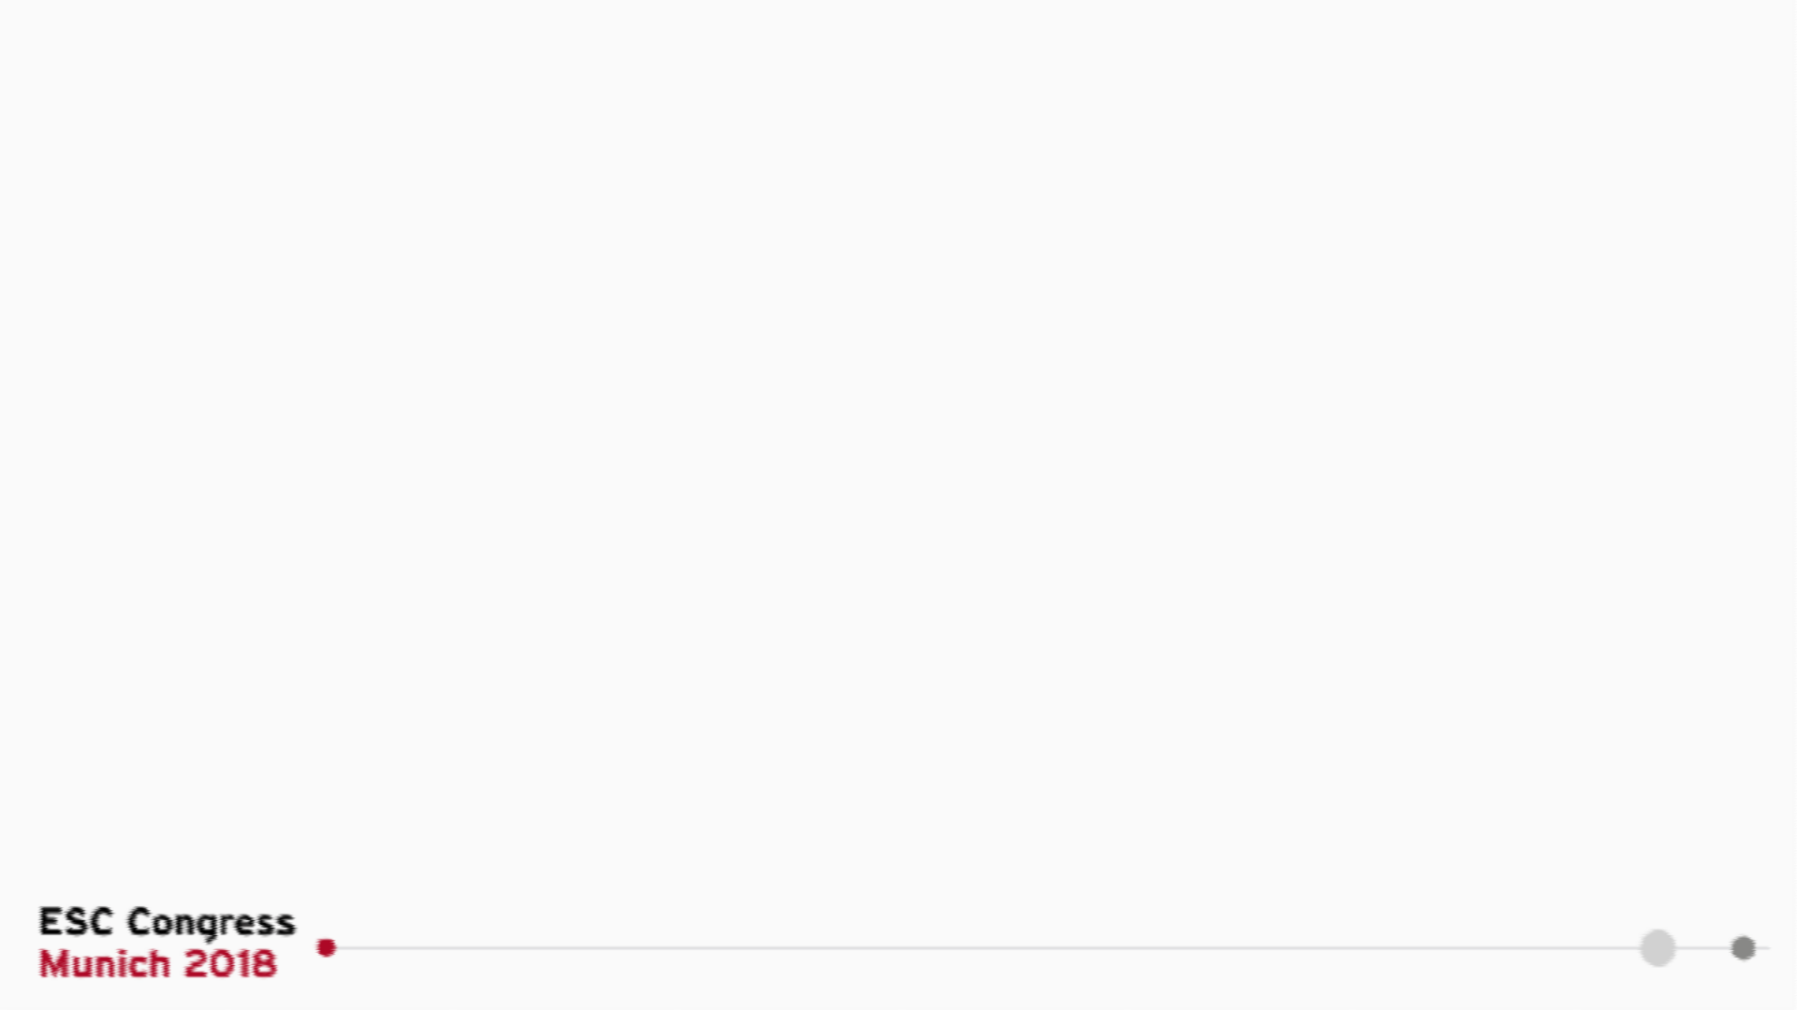


Partial oral treatment of left-sided infectious endocarditis
The POET trial
Henning Bundgaard, MD
on behalf of the POET Investigators

Slide 2
Declaration of interest
None

Slide 3
Background
According to guidelines we treat left-sided infectious endocarditis with intravenous (IV) antibiotics for up to 6 weeks – in-hospital
Endocarditis is associated with high in-hospital complication- and mortality rates - but mainly in the early phase
After stabilization the main reason for staying in hospital is to receive iv antibiotics
Hospital stays per se may cause complications

Slide 4
Objectives
To determine - in stabilised patients with endocarditis - whether
Orally administered antibiotics and
Intravenously administered antibiotics
have similar efficacy and safety

Slide 5
Study design
Non-inferiority trial (delta =10%)
Randomised, unblinded
Nationwide including all Danish heart centres
Cardiologists, microbiologist, infectious disease specialists, cardiothoracic surgeons

Slide 6
Choice of antibiotics
Intravenous antibiotics: Given according to ESC guidelines
Oral antibiotics regimens: Developed as part of the study;
Antibiotics with
  Moderate to high bioavailability
In all cases two antibiotics;
  Different drug classes, antimicrobial mechanisms and metabolization
Minimal inhibitory concentration determinations
Adjustments acc. to plasma-antibiotics (pharmacokinetics T ½, 1, 2, 4, 6 h)

Slide 7
Inclusion criteria
Left-sided endocarditis based on the modified Duke criteria caused by
  Streptococci or
  Enterococcus faecalis or
  Staphylococcus aureus or
  Coagulase-negative staphylococci
≥10 days of appropriate intravenous antibiotic treatment, and ≥1 week after valve surgery
T <38.0 °C >2 days
C-reactive protein fall to ≤25% of peak value or <20 mg/L
White blood cell count <15 x 10⁹/L
By transesophageal echocardiography ≤48 h prior to randomization: No sign of abscess formation or valve abnormalities requiring surgery

Slide 8
Exclusion criteria
Suspicion of reduced absorption of oral treatment due to abdominal disorder
Body mass index >40 kg/m²
Concomitant infection requiring intravenous antibiotic therapy
Inability to give informed consent to participation
Reduced compliance

Slide 9
The POET trial design
Investigator initiated, nationwide, randomised, unblinded clinical trial
Treatment period
Follow–up
Infectious Endocarditis diagnosis
6 months
Oral antibiotic treatment
Optional: outpatient treatment
R
≥10 days IV Tx - and/ or
≥7 days IV Tx after surgery
Intravenous antibiotic treatment
In-hospital treatment

Slide 10
Primary endpoint
A composite endpoint ≤6 months of
  All cause mortality
  Unplanned cardiac surgery
  Embolic events
  Relapse of bacteremia with the primary pathogen

Slide 11
Enrollment
1,954 patients screened for participation
Major reasons for non-inclusion
Not fulfilling modified Duke Criteria (n=428) Endocarditis caused by other bacteria (n=174) Too high level of CRP and/or WBC (n=132) Signs of abscess formation (n=130)
Suspected reduced GI uptake (n=14) Not willing or able to consent (n=303) Death prior to randomization (n=71)
400 patients eligible for randomization
199 patients assigned to
intravenous therapy
201 patients assigned to
oral therapy

Slide 12
Baseline characteristics
 | Intravenous treatment (n=199) | Oral treatment (n=201)
Age (years), mean (SD) | 67.3 (12.0) | 67.6 (12.6)
Gender (female), n (%) | 50 (25.3) | 42 (20.9)
Co-morbidities
Diabetes, n (%) | 36 (18.1) | 31 (15.6)
Renal failure, n (%) | 25 (12.6) | 21 (10.6)
Dialysis, n (%) | 13 (6.5) | 15 (7.5)
COPD, n (%) | 17 (8.5) | 9 (4.5)
Cancer, n (%) | 14 (7.1) | 18 (9.1)
Microbiology
Streptococcus spp, n (%) | 104 (52.3) | 92 (45.8)
Enterococcus faecalis, n (%) | 46 (23.1) | 51 (25.4)
Staphylococcus aureus, n (%) | 40 (20.1) | 47 (23.4)
Coagulase-negative staphylococci, n (%) | 10 (5.0) | 13 (6.6)

Slide 13
Baseline characteristics
 | Intravenous treatment (n=199) | Oral treatment (n=201)
Pre-existing cardiac disease or condition
Prosthetic heart valve | 53 (26.6) | 54 (27.0)
Other known valve disease | 82 (41.4) | 90 (44.8)
Cardiac involvement at randomization
Mitral valve endocarditis | 65 (32.7) | 72 (35.8)
Aortic valve endocarditis | 109 (54.8) | 109 (54.2)
Mitral and aortic valve endocarditis | 23 (11.6) | 20 (10.2)
Valve surgery during present disease- | 75 (37.7) | 77 (38.3)
course

Slide 14
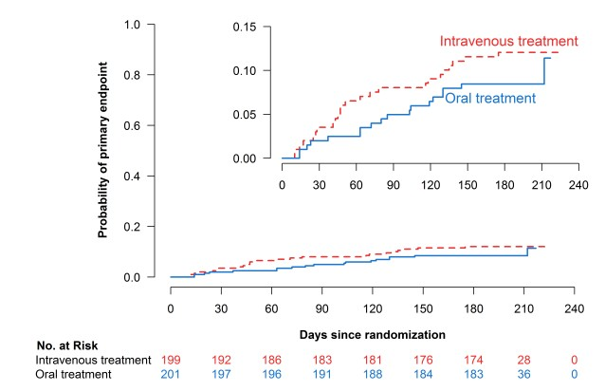
Primary endpoint
(All cause mortality, unplanned cardiac surgery, embolic events or relapse of bacteremia)
Difference 3.1%, 95% CI: -3.4% - 9.6%, Non-inferiority met
HR 0.72, 95% CI 0.39-1.33

Slide 15
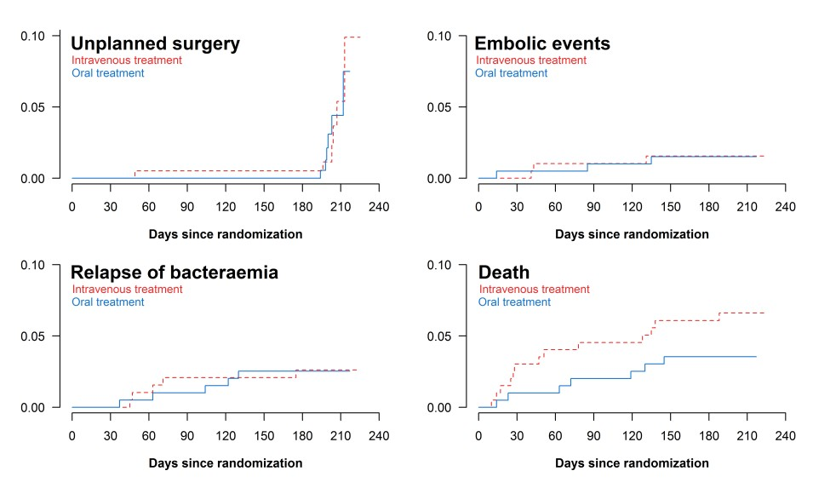

Components of primary endpoint

Slide 16
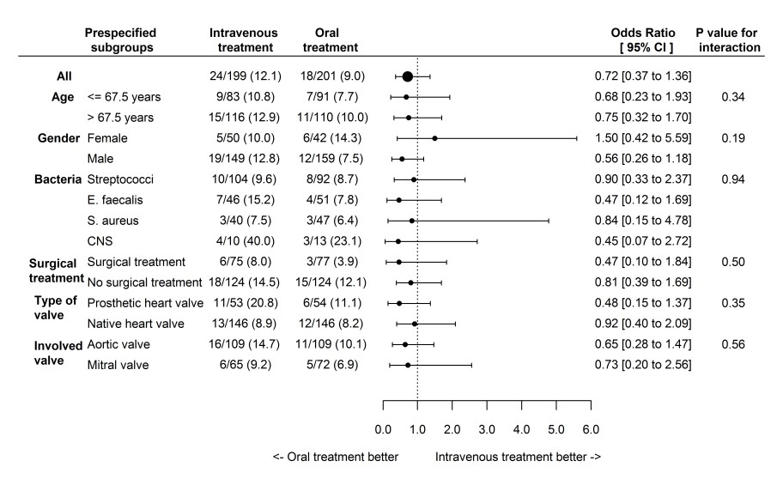

Primary endpoint – prespecified groups

Slide 17
Safety and side-effects
Sub-therapeutic plasma levels for one orally administered antibiotic in 7 patients
  Pharmacokinetic results did not necessitate change of antibiotic regimens in any cases
Side-effects; Intravenous 12 (6%), oral 10 (5%)
  Allergy (50%), bone marrow suppression (27%) and gastro-intestinal side effects (14%) (ns)

Slide 18
Outpatient treatment
 | Intravenous | Oral | P
Time from IE diagnosis to randomisation* | 17 (13-23) | 17 (12-24) | 0.42
Treatment after randomisation* | 19 (14-25) | 17 (14-25) | 0.48
Length of hospital stays after
19 (14-25) 3 (1-10) <0.001
randomisation*
*In days (median) (IQR)

Slide 19
Conclusions
Efficacy and safety of shifting to oral antibiotic treatment was non-inferior to continued intravenous antibiotic treatment in
  stabilized patients with left-sided endocarditis caused by
  streptococcus spp, Enterococcus faecalis, Staphylococcus aureus, or coagulase- negative staphylococci
  across co-morbidities, native vs prosthetic valve and surgically vs conservatively Tx
Oral antibiotics may safely be administered during approximately
  half of the recommended antibiotic treatment period
  potentially as outpatient treatment
More than 50% of patients with endocarditis may be candidates to partial oral antibiotic treatment

Slide 20
Acknowledgements
Investigators;
Kasper Iversen, Nikolaj Ihlemann, Sabine U Gill, Trine Madsen, Hanne Elming, Kaare Troels Jensen, Niels Eske Bruun, Dan Eik Høfsten, Kurt Fursted, Jens Jørgen Christensen, Martin Schultz, Christine F Klein, Emil Loldrup Fosbøll, Flemming Rosenvinge, Henrik Carl Schønheyder, Lars Køber, Christian Torp-Pedersen, Jannik Helweg-Larsen, Niels Tønder, Claus Moser, Henning Bundgaard
Funding;
The study was supported by unrestricted grants from The Danish Heart Foundation, The Capital Regions Research Council, The Hartmann’s Foundation and Svend Andersens Foundation.
We thank study coordinators, study nurses, safety monitoring board members, adjudication committee members and participants.

Slide 21
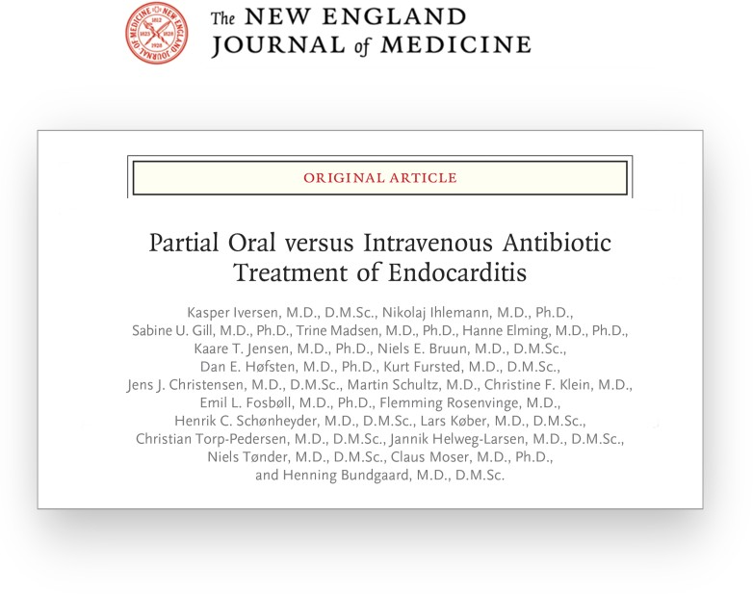
August 28, 2018, at NEJM.org.

Slide 22
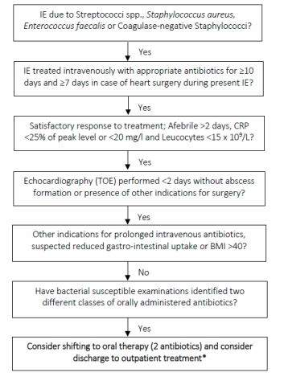
Proposal; criteria for shifting from intravenous to oral antibiotic therapy in patients with left-sided endocarditis

Slide 23
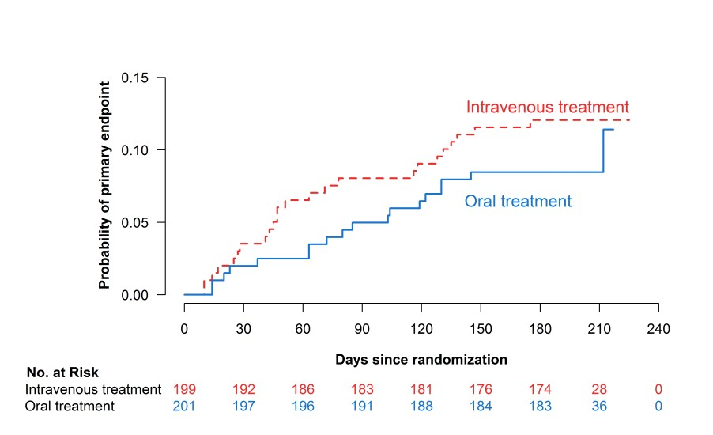
Primary endpoint
Difference 3.1%, 95% CI: -3.4% - 9.6%, Non-inferiority met
HR 0.72, 95% CI 0.39-1.33

Slide 24
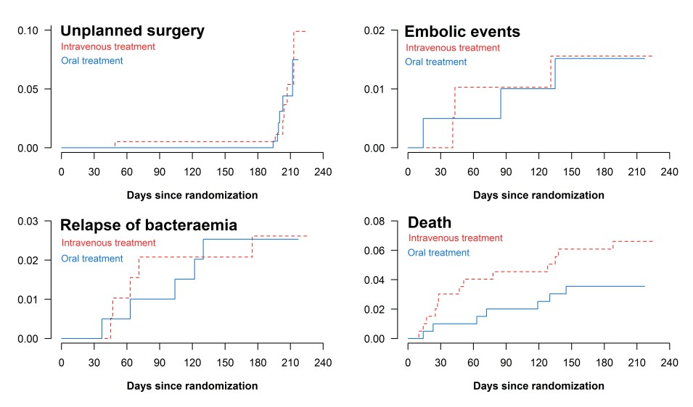
Components of primary endpoint

Slide 25
August 28, 2018, at NEJM.org.

