Slide 1
Paclitaxel-Coated Balloon versus Uncoated Balloon for Coronary In-Stent Restenosis – Two-year Outcomes of the AGENT IDE Trial
Jeffrey Moses, MD
Columbia University Irving Medical Center/NewYork-Presbyterian Hospital and the Cardiovascular Research Foundation, New York, NY St Francis Heart Center, Roslyn, NY
On behalf of the AGENT IDE investigators

Slide 2
Jeffrey Moses, MD
I have financial relationships with companies listed below.
Nonfinancial Support: Orchestra BioMed

Slide 3
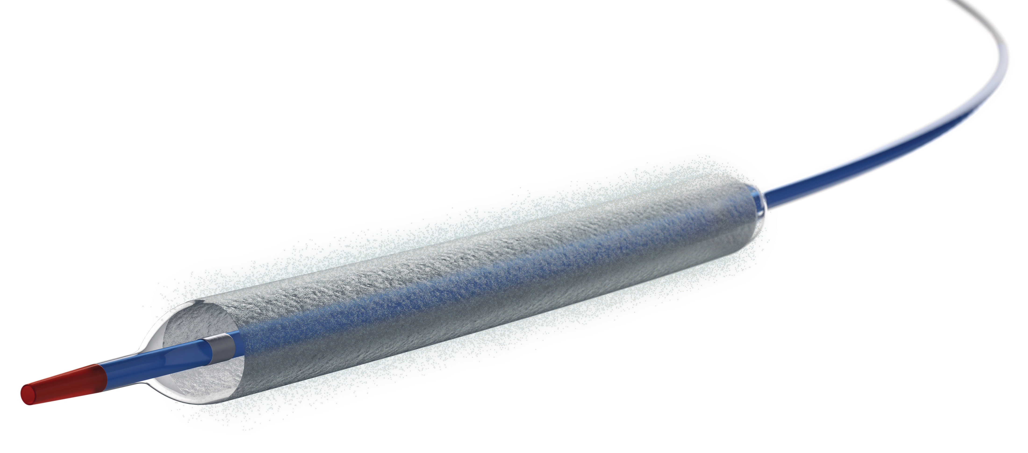
Introduction
In-stent restenosis (ISR) occurs in ~10% patients undergoing PCI
The AGENT drug coated balloon (DCB) delivers a therapeutic dose of paclitaxel directly to the vessel wall, eliminating the need for a permanent metal implant
AGENT IDE is a pivotal randomized trial comparing the safety and efficacy of the AGENT DCB to conventional balloon angioplasty in patients with ISR
AGENT is the first DCB to receive FDA approval for use in patients with ISR based on the primary data from the AGENT IDE trial
Yeh RW et al. JAMA. 2024;331(12):1015–1024

Slide 4
AGENT IDE Study Design
Prospective, randomized, multicenter, superiority trial across 40 US sites
Clinical and Angiographic Eligibility Criteria
✓ ISR length <26 mm; RVD >2.0 - ≤4.0 mm | X Recent STEMI, bifurcation, LM
✓ %DS >70 - <100% (asymptomatic) | X SVG or arterial graft
✓ %DS >50 - <100% (symptomatic) | X Thrombus in target vessel
N=600
Randomized 2:1
Device Group
AGENT DCB
Control Group
Balloon Angioplasty
Primary Endpoint:
Superiority of AGENT DCB to Balloon Angioplasty with respect to 1-Year Target Lesion Failure
DAPT required for at least a month; Antiplatelet monotherapy through the duration of the study
Yeh RW et al. JAMA. 2024;331(12):1015–1024

Slide 5
Patient Disposition
600 patients were eligible for randomization
406 randomized to AGENT DCB
194 randomized to BA
382 patients (94.1%) had 2-year clinical follow-up or death
1 Investigator discretion
1 Lost to follow-up
9 Withdrew consent
13 Missed 2-year visit
182 patients (93.8%) had 2-year clinical follow-up or death
1 Investigator discretion
0 Lost to follow-up
4 Withdrew consent
7 Missed 2-year visit

Slide 6
Baseline Clinical Characteristics
Sex
68±10 years
26%
74%
BMI: 30
Non-White: 25%
 | AGENT DCB (N=406) |  | Balloon Angioplasty (N=194)
Diabetes | 51% |  | 50%
Prior CABG | 31% |  | 29%
Hx of Multivessel Disease | 79% |  | 78%
Hx of Left Main Disease | 23% |  | 21%
Indication for Procedure
NSTE-ACS | 37% |  | 38%
Stable Angina | 55% |  | 52%
Other Indication | 8% |  | 11%
Yeh RW et al. JAMA. 2024;331(12):1015–1024

Slide 7
Angiographic Lesion Characteristics
 | AGENT DCB N=407 Lesions† |  | Balloon Angioplasty N=194 Lesions
Multiple stent layers | 43% |  | 42%
Target vessel treated
RCA | 38% |  | 36%
LAD | 35% |  | 36%
LCx | 24% |  | 24%
LMCA | 3% |  | 5%
Lesion Length, mm | 12.8 ± 6.3 |  | 11.8 ± 6.6
10 – 20 mm | 48% |  | 43%
>20 mm | 15% |  | 10%
Reference Vessel Diameter, mm | 2.7 ± 0.5 |  | 2.7 ± 0.5
In-Lesion Diameter Stenosis, % | 65 ± 12 |  | 66 ± 13
†One patient in the AGENT arm had two target lesions treated with DCB that was counted as a protocol deviation; Yeh RW et al. JAMA. 2024;331(12):1015–1024

Slide 8
Procedural Characteristics
 | AGENT DCB N=406 |  | Balloon Angioplasty N=194
Procedure time (min) | 56.2 ± 29.8 |  | 53.2 ± 27.1
Hospital Length of Stay (days) | 0.6 ± 0.9 |  | 0.7 ± 1.8
Balloon Length (mm) | 22.9 ± 6.5 |  | 17.8 ± 7.3
Patients with only target lesion treated | 87% |  | 87%
Intravascular imaging use during procedure | 72% |  | 77%
Technical success (Post-procedure diameter stenosis of <30% in 2 near-orthogonal projections with TIMI 3 flow) | 93% |  | 90%
Clinical procedural success (Technical success with no in-hospital MI, TVR, or cardiac death) | 92% |  | 89%
*In-lesion values; †One patient in the AGENT arm had two target lesions treated with DCB that was counted as a protocol deviation; Yeh RW et al. JAMA. 2024;331(12):1015–1024

Slide 9
Antiplatelet Medication Usage
DAPT required for at least a month; Antiplatelet monotherapy through the duration of the study

Slide 10
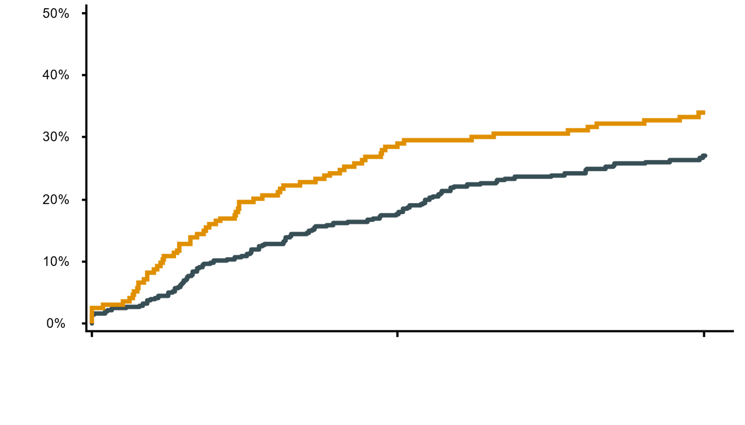
TLF at 2 Years
AGENT DCB
Balloon Angioplasty
50%
1° Endpoint:
P_{superiority}=0.003
2 years:
HR 0.73 (95% CI 0.53 to 0.99)
P=0.04
40%
29%
34%
30%
TLF
27%
18%
20%
10%
0%
Months Since Index Procedure
# at risk | 0 |  |  |  | 12 |  | 24
AGENT | 406 |  |  |  | 333 |  | 276
BA | 194 |  |  |  | 147 |  | 118
KM Event Rate; Log-rank P values

Slide 11
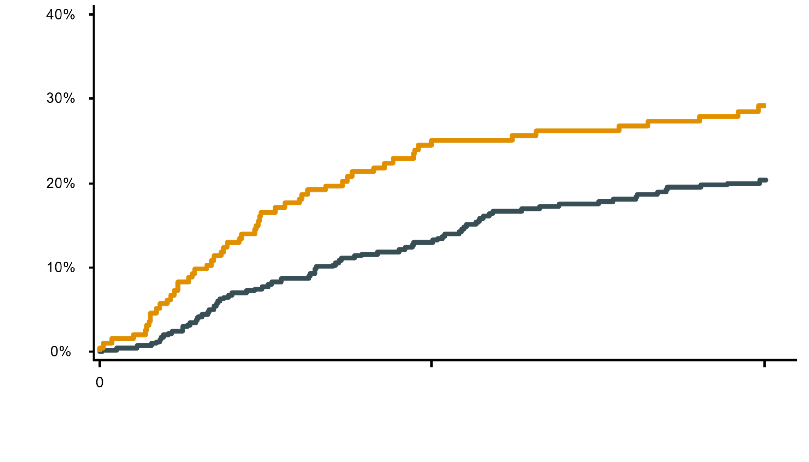
TLR at 2 Years
AGENT DCB
Balloon Angioplasty
40%
First TLR only
HR 0.63 (95% CI 0.45 to 0.89); P=0.009
30%
29%
Cumulative First TLR
20%
20%
10%
0%
Months Since Index Procedure
# at risk | 0 |  |  |  | 12 |  | 24
AGENT | 406 |  |  |  | 340 |  | 278
BA | 194 |  |  |  | 149 |  | 118
KM Event Rate Cox proportional hazard model; Log-rank P values

Slide 12
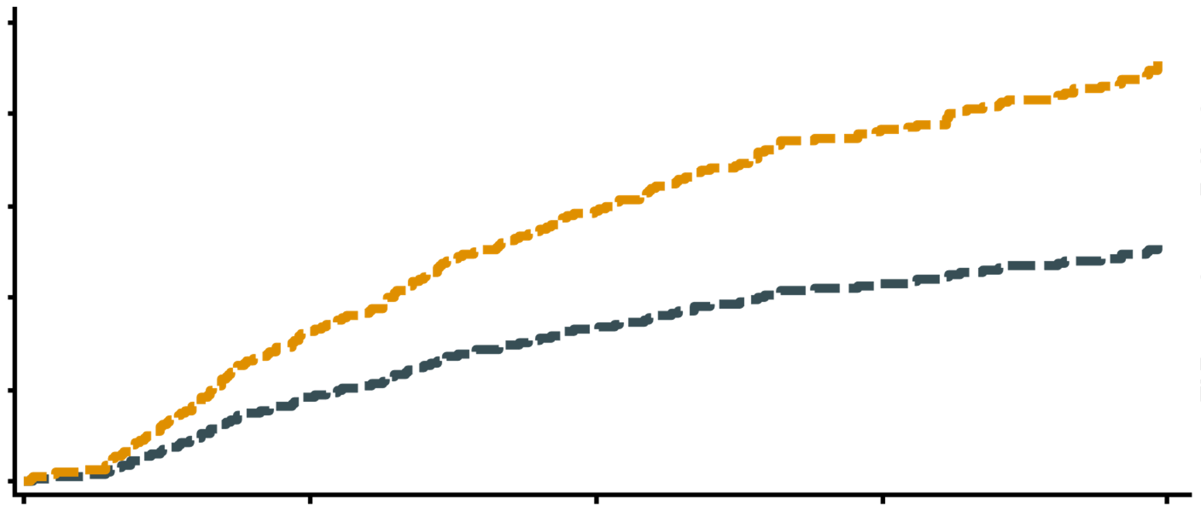
All TLR Through 2 Years
AGENT DCB
Balloon Angioplasty
0.5
All TLR (LWYY Method)
HR 0.56 (95% CI 0.40 to 0.80); P=0.001
0.4
0.3
Cumulative TLR
0.2
0.1
0.0
0
6
12
18
24
Months Since Index Procedure
Lin Wei Yang Ying (LWYY) method for recurrent event analysis

Slide 13
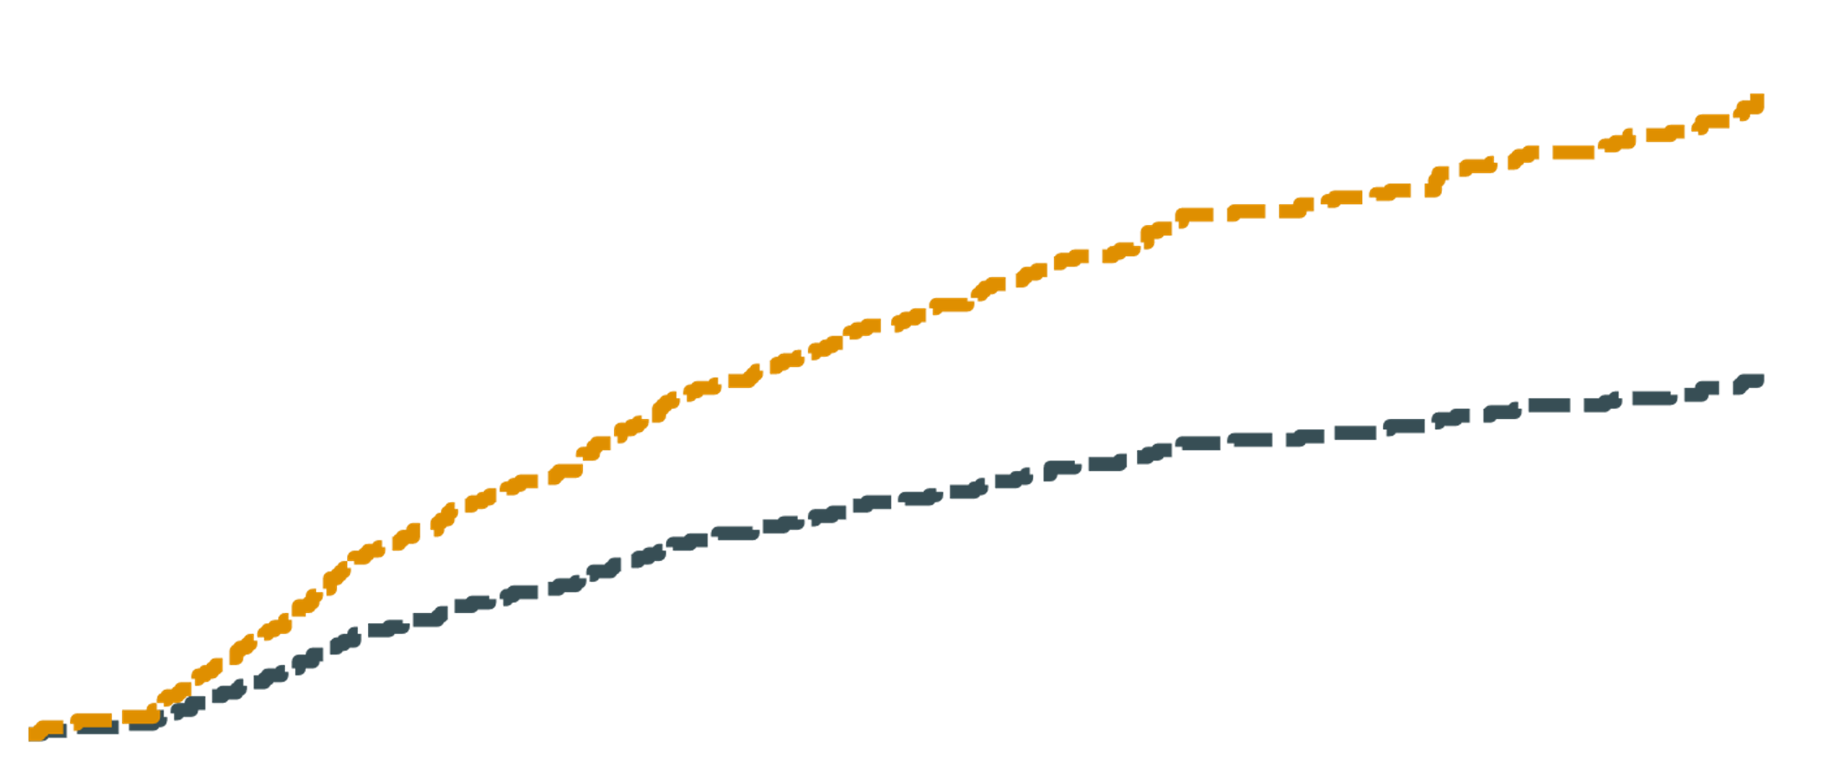
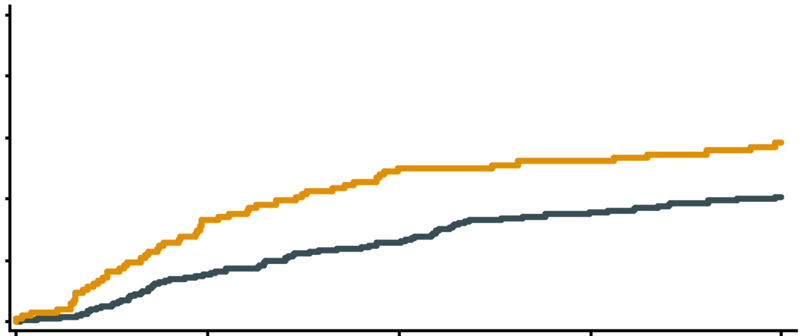
All TLR Through 2 Years
First TLR-DCB
First TLR-BA
All TLR-DCB
All TLR-BA
0.5
All TLR: HR 0.56 (95% CI 0.40 to 0.80); P=0.001
0.4
0.3
Cumulative TLR
0.2
0.1
First TLR only: HR 0.63 (95% CI 0.45 to 0.89); P=0.009
0.0
0
6
12
18
24
Months Since Index Procedure
Cox proportional hazard model for time to first event;
Lin Wei Yang Ying (LWYY) method for recurrent event analysis

Slide 14
Recurrent TLR Through 2 Years
2-Year TLR
RR, 0.54 (95% CI, 0.38-0.77)
P=0.001
Difference between groups
-20.2
Additional TLR
RR, 0.31 (95% CI, 0.15-0.64)
P=0.002
-11.1
First TLR
HR, 0.63 (95% CI, 0.45-0.89)
P=0.009
-9.1
AGENT DCB
Balloon Angioplasty
Cox proportional hazard model for time to first TLR; Negative binomial model for recurrent event analysis; RR=Risk Ratio

Slide 15
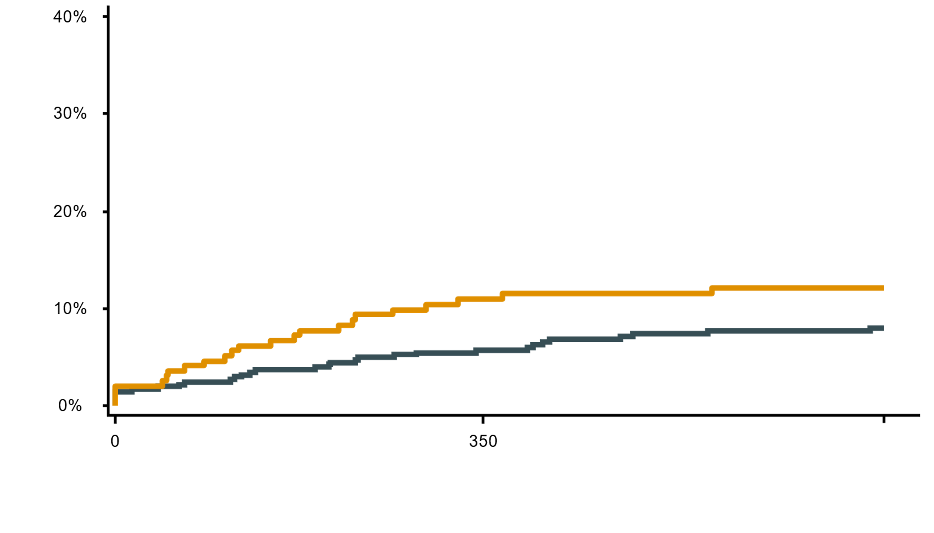
TV-MI at 2 Years
AGENT DCB
Balloon Angioplasty
40%
2 years:
HR 0.63 (95% CI 0.37 to 1.08)
P=0.09
30%
Target Vessel-MI
20%
12%
10%
8%
0%
Months Since Index Procedure
# at risk | 0 |  |  |  | 12 |  | 24
AGENT | 406 |  |  |  | 366 |  | 302
BA | 194 |  |  |  | 168 |  | 139
KM Event Rate; Log-rank P values

Slide 16
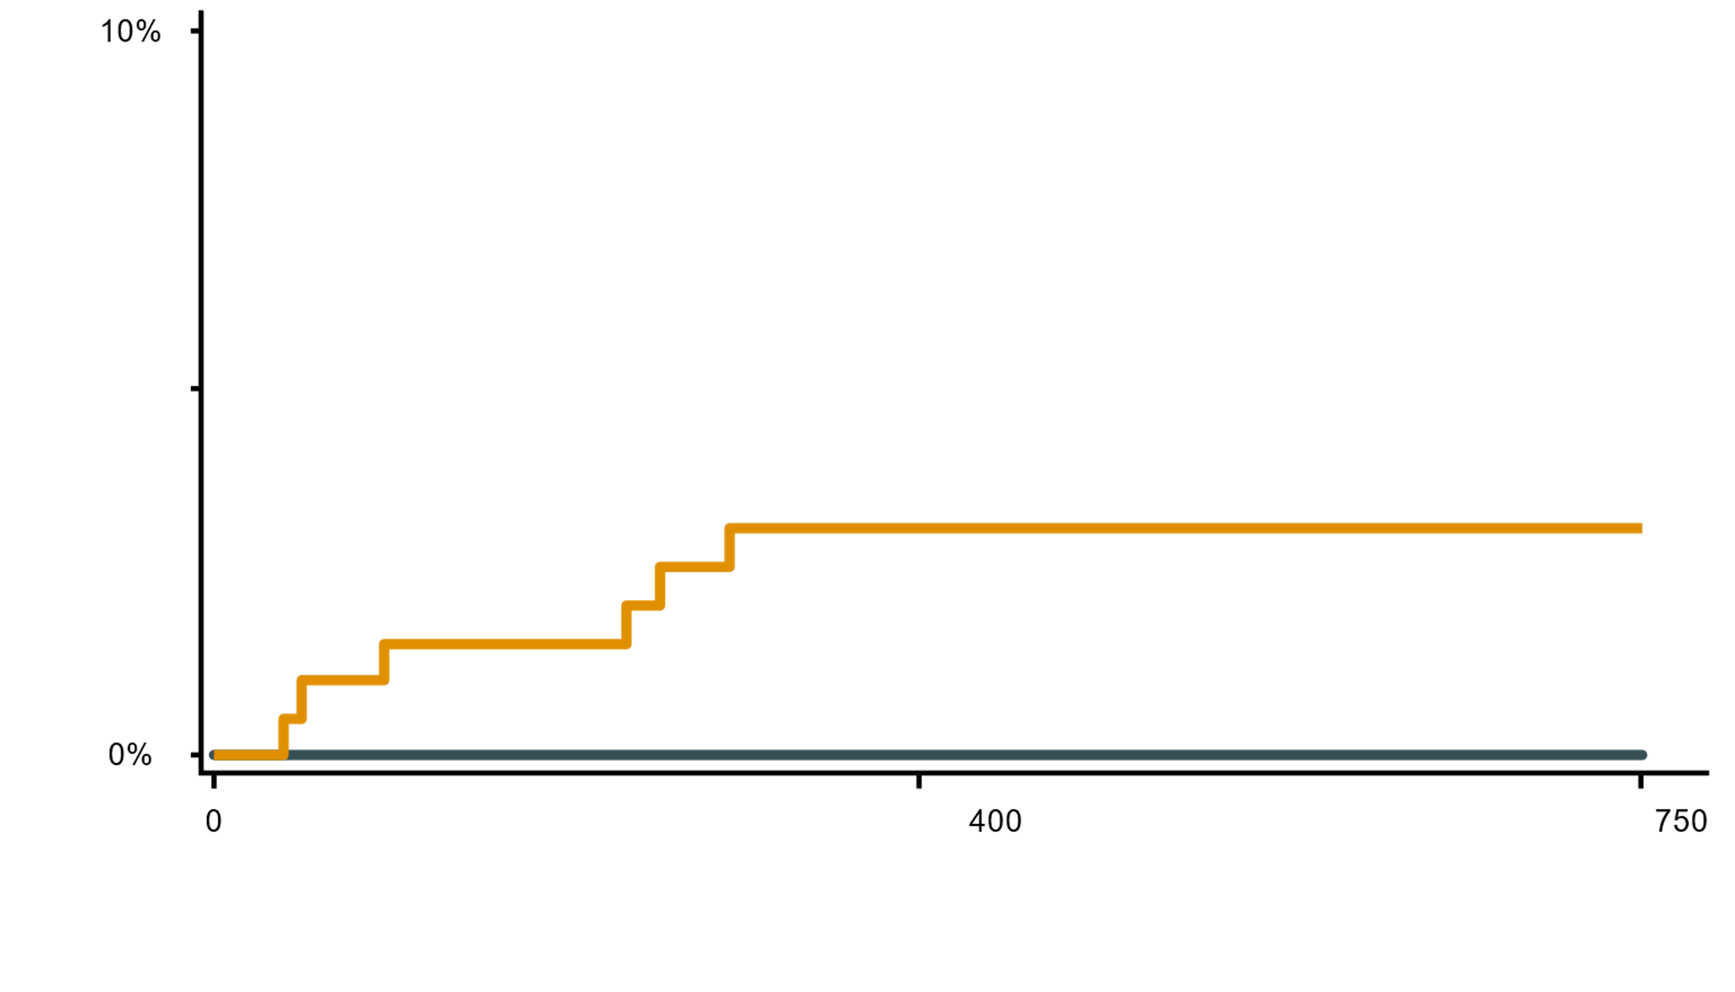
Definite/Probable ST at 2 Years
AGENT DCB
Balloon Angioplasty
10%
AGENT 0.0% vs. BA 3.1%
P=0.0004
Definite/Probable ST
All STs occurred in patients with multilayer ISR
5%
0%
Months Since Index Procedure
# at risk | 0 |  |  |  | 12 |  | 24
AGENT | 406 |  |  |  | 383 |  | 315
BA | 194 |  |  |  | 179 |  | 149
KM Event Rate; Log-rank P values

Slide 17
Subgroup Analyses of 2-Year TLF
Subgroup | Subgroup | AGENT DCB | BA | Hazard Ratio [95% CI] | P-Interaction
All Patients | All Patients | 27.0% | 34.0%
Sex | Female (N=157) | 24.1% | 30.5% |  | 0.91
 | Male (N=443) | 28.0% | 35.3%
Age | <75 years (N=436) | 27.2% | 33.7% |  | 0.67
 | ≥75 years (N=164) | 26.4% | 34.6%
Diabetes | Yes* (N=269) | 28.6% | 34.2% |  | 0.54
 | No† (N=329) | 25.4% | 33.9%
Vessel size‡ | Small (RVD<2.75 mm) (N=332) | 27.5% | 34.4% |  | 0.93
 | Large (RVD≥2.75 mm) (N=265) | 26.6% | 34.4%
Stent Layer§ | Single (N=341) | 20.7% | 26.6% |  | 0.86
 | Multiple (N=258) | 35.4% | 44.0%
AGENT better
BA better
*Diabetic patients requiring medical treatment; †Diabetic patients treated with diet only or patients without diabetes; ‡RVD based on angiographic core lab data.

Slide 18
Additional Endpoints at 2 Years
P=0.67
P=0.36
P=0.15
P=0.18
P=0.009
P=0.03
All death
Cardiac death
MI
Non-Q-wave MI
TVR
TVF
KM Event Rate; Log-rank P values

Slide 19
Conclusions
AGENT IDE is the first RCT conducted in the US examining the efficacy and safety of DCB in patients with coronary ISR
AGENT DCB was superior to conventional balloon angioplasty for the primary endpoint of TLF at 1-year
Consistent results were observed through 2 years of follow-up
Significantly reduced incidence of TLF, driven by ~37% reduction in rate of first TLR after treatment with AGENT DCB compared with BA
The recurrent TLR analysis showed significantly more repeat events per patient with BA
No definite/probable thromboses occurred in the AGENT arm (0.0% vs. 3.1%; P=0.0004)
These data support the use of AGENT DCB for the treatment of coronary ISR

Slide 20
THANK YOU

