Slide 1






Natural History Of Symptoms
And Stress Echo Findings In Patients With Moderate Or Severe Ischemia And No Obstructive
CAD (INOCA): The
NHLBI-funded CIAO Ancillary
Study To The ISCHEMIA Trial
Harmony Reynolds, MD
NYU School of Medicine For the CIAO-ISCHEMIA Investigators

Slide 2
Ischemia with No Obstructive Coronary Artery Disease (INOCA)
Signs or symptoms of ischemic heart disease with <50% maximal stenosis on coronary angiography
Estimated 3-4 million women and men affected
Mechanisms include:
  Reduced coronary flow reserve
  Epicardial and/or microvascular coronary spasm
Associated with increased risk of death, MI, HF and stroke
High healthcare costs, similar to patients with CAD
Bairey Merz CN et al, INOCA think tank Circ 2017; Bairey Merz et al, Insights from the WISE Circ 2008; Shaw LJ et al Circ 2006; Jespersen L et al PLOS One 2014; Ford TJ et al, CorMicA Circ Cardiovasc Interv 2019; Taqueti V et al EHJ 2017

Slide 3
Rationale for CIAO study
Persistent symptoms and positive stress testing, e.g., stress echocardiography, are markers of risk among INOCA patients
However, whether myocardial ischemia is solely responsible for angina in INOCA patients is uncertain
Expert recommendations focus on symptom management
Aim: to investigate changes in symptoms and stress testing in INOCA patients over 1 year, leveraging the enrollment process of the international, NHLBI-funded ISCHEMIA trial
Johnson BD et al, EHJ 2006; Sicari R et al EHJ 2005; Wei J, Cheng S and Bairey Merz CN JAMA 2019

Slide 4

Study Design
Stable Patient Moderate or severe ischemia
(determined by site; read by core lab)
CCTA not required, e.g., eGFR 30 to <60 or coronary anatomy previously defined
Blinded CCTA
No obstructive CAD (21% of CCTA)
Core lab anatomy eligible?
Screen failure
YES
RANDOMIZE
Ischemic symptoms, enrolled after stress echo
INVASIVE Strategy OMT + Cath +
Optimal Revascularization
CONSERVATIVE Strategy OMT alone
Cath reserved for OMT failure
Angina assessment (SAQ) at enrollment, 6 mos, 1 yr Stress echo repeated at 1 yr
Stress echocardiograms read at core laboratory, blinded to CAD vs. INOCA and to timing

Slide 5
Analyses
Comparison between INOCA patients (CIAO) and CAD patients (randomized into ISCHEMIA after stress echocardiography)
Longitudinal assessment of CIAO participants from baseline to 1 year
Primary endpoint: correlation between change in ischemia and change in angina

Slide 6
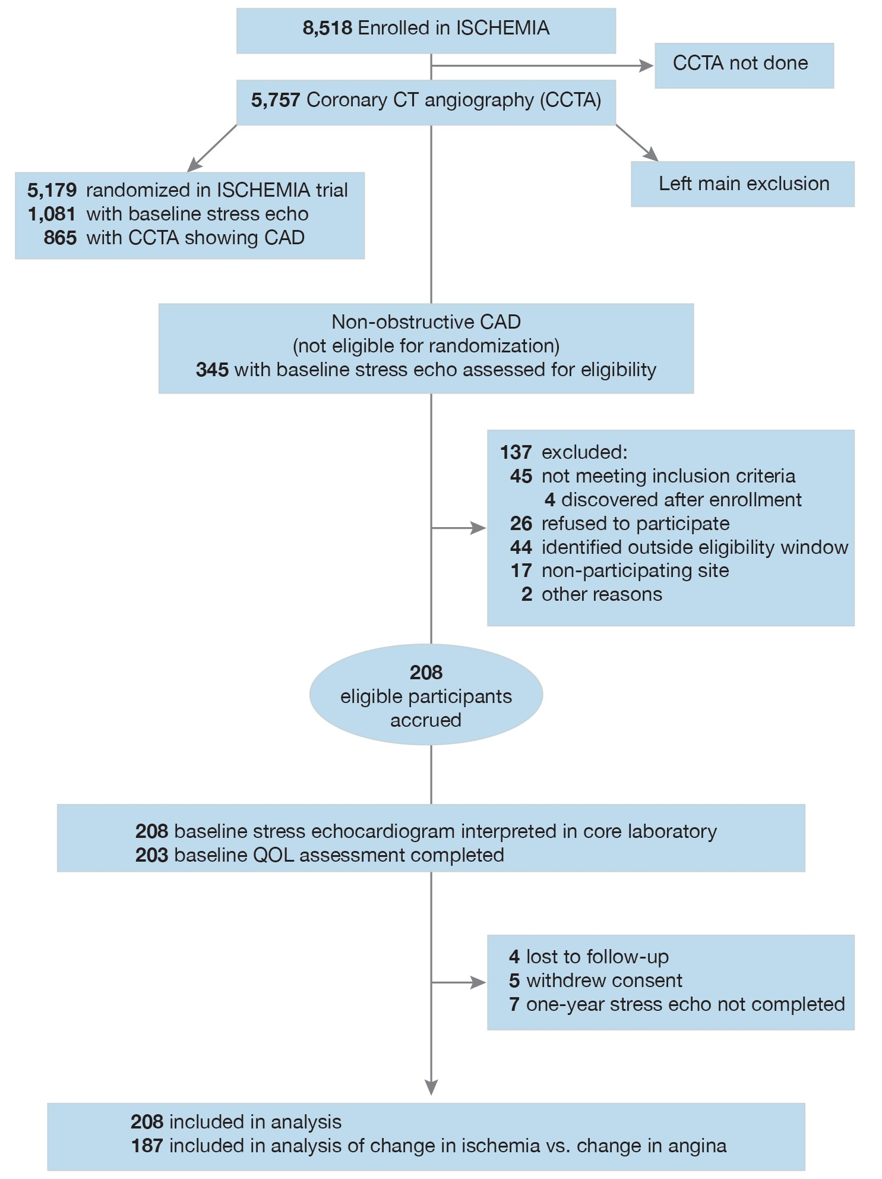
Study Flow
CIAO
participants were enrolled at 39 sites in 11 countries

Slide 7
Demographics and Medical History
 | INOCA (n=208) | CAD (n=865) | p
Age (years) median (IQR) | 63 (56, 70) | 66 (59, 72) | 0.004
Female Sex | 137 (66%) | 221 (26%) | <0.001
Hypertension n (%) | 132/207 (64%) | 585/857 (68%) | 0.196
Diabetes (%) | 40/207 (19%) | 286 (33%) | <0.001
Prior MI (%) | 4 (2%) | 129/860 (15%) | <0.001
Current or Former Smoker (%) | 74 (41%) | 482 (56%) | 0.001
Depression (%) | 40/206 (19%) | 80/861 (9%) | <0.001

Slide 8

INOCA Indications for Stress Testing
 | INOCA (n=208)
Typical angina | 104 (50%)
Atypical chest pain | 67 (32%)
Shortness of breath | 102 (49%)
Arm, neck, jaw or throat discomfort | 17 (8%)
Abdominal discomfort | 6 (3%)
Fatigue | 29 (14%)
Screening with no symptoms or other | 18 (9%)
71%
Some had multiple indications; indications for stress test not collected in ISCHEMIA

Slide 9
Ischemia severity at enrollment on stress echocardiography
INOCA n=208
CAD n=865
Median 4 segments ischemic (IQR 3-5) |  | P=0.03
44% anterior ischemia | 58% anterior ischemia | p<0.001
80% exercise stress echo | 78% exercise stress echo | p=0.23

Slide 10
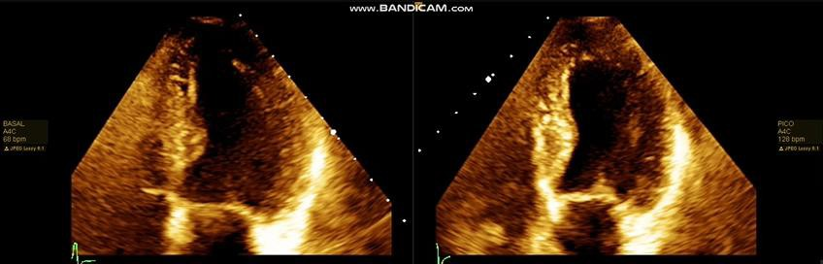
Sample INOCA Stress Echocardiogram – Apical 4 Chamber View
Normal wall motion at rest
Severe hypokinesis of mid and apical septal, mid and apical lateral segments after exercise stress

Slide 11
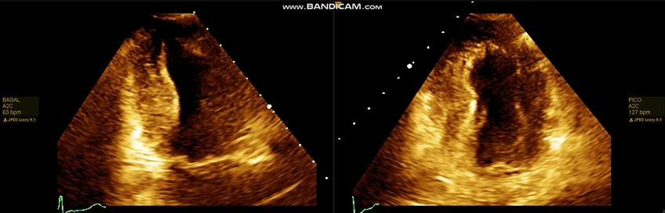
Sample INOCA Stress Echocardiogram – Apical 2 Chamber View
Normal wall motion at rest
Severe hypokinesis of the mid and apical anterior and apical inferior segments after exercise stress

Slide 12
Symptom Severity
 | INOCA at enrollment (N=203) | CAD at enrollment (N=865) | P
SAQ-7, median (IQR) | 83 (66-93) | 78 (64, 92) | 0.036
SAQ Angina Frequency score – median (IQR) | 90 (70-100) N=201 | 100 (90, 100) | <0.001
No angina in last month (SAQ AF = 100) | 81 (41%) | 534 (62%) | <0.001
Monthly angina (SAQ AF = 61-99) | 86 (42%) | 293 (34%)
Weekly angina (SAQ AF = 31-60) | 28 (14%) | 31 (3.6%)
Daily angina (SAQ AF = 0-30) | 5 (2.5%) | 5 (0.6%)
Lower scores indicate poorer health status

Slide 13
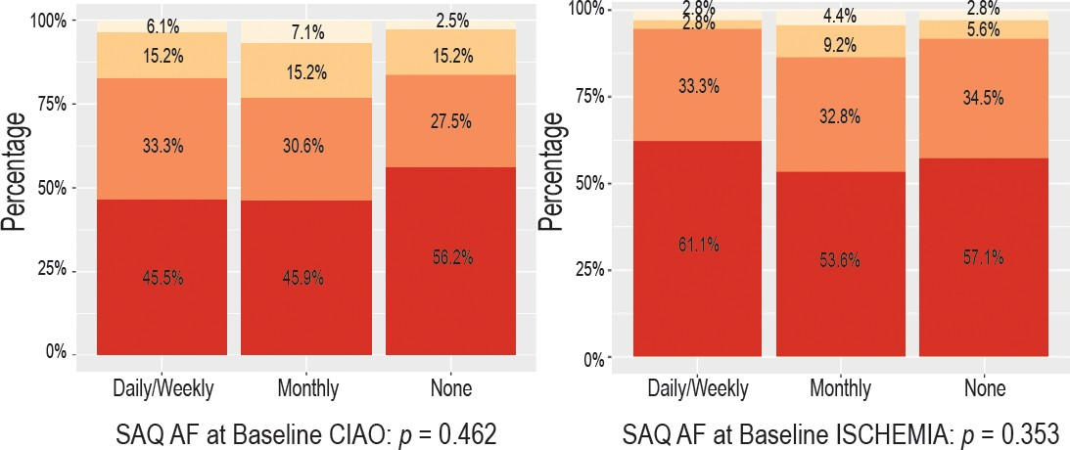
Correlation between Ischemia and Angina at Enrollment
INOCA
CAD
Ischemia
none
mild moderate
severe

Slide 14
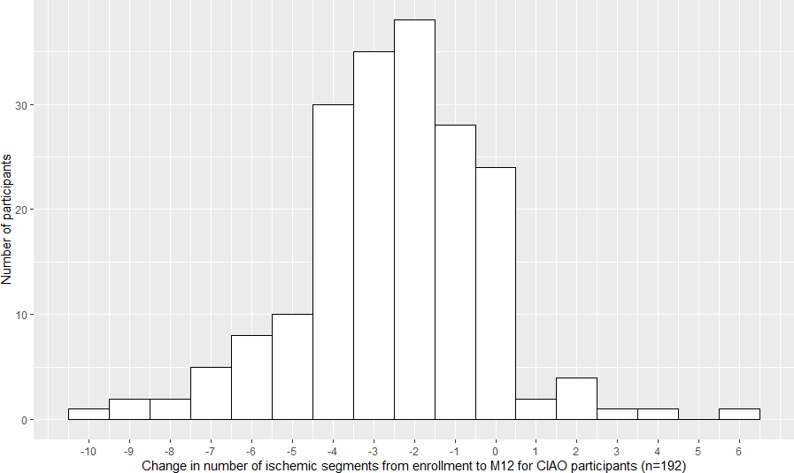
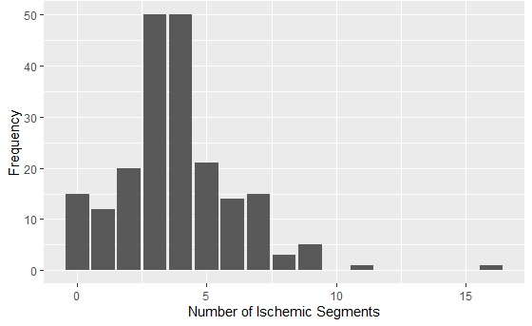
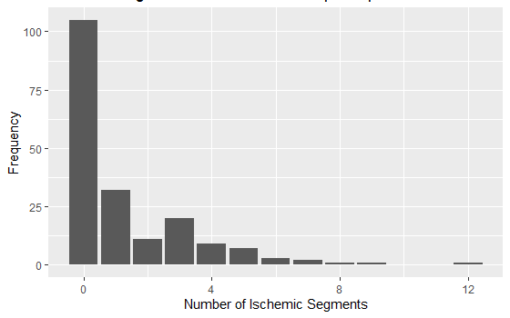
Change in Ischemic Segments: INOCA Enrollment to 1 Year
50% normalized
45% unchanged or worse
1-year Change
Blinded core lab read
Enrollment
1 year

Slide 15
Change in Angina over 1 year in INOCA Patients
 | INOCA at enrollment (N=203) | INOCA 1 year (N=197) | p
SAQ-7, median (IQR) | 83 (66-93) | 90 (77-100) | <0.001
SAQ Angina Frequency score, median (IQR) | 90 (70-100) N=201 | 100 (80-100) | <0.001
No angina in last month (SAQ AF = 100) | 81 (41%) | 117 (59%) | <0.001
Monthly angina (SAQ AF = 61-99) | 86 (42%) | 64 (32%)
Weekly angina (SAQ AF = 31-60) | 28 (14%) | 15 (7.6%)
Daily angina (SAQ AF = 0-30) | 5 (2.5%) | 1 (0.5%)
Improvement in SAQ AF ≥ 10 points in 39%, SAQ-7 ≥ 5 points in 52%
Median number of anti-anginal medications was 1 at enrollment and at 1 year

Slide 16
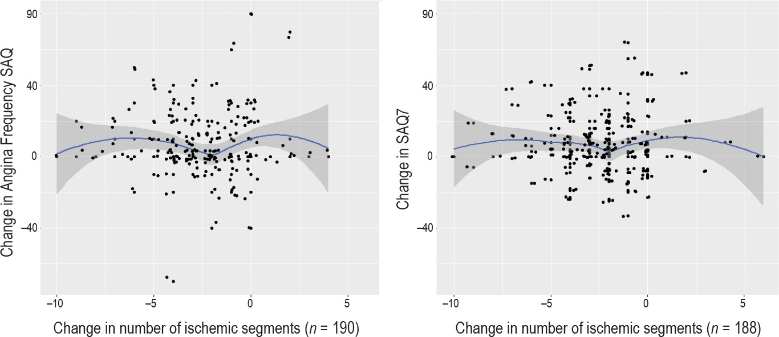
No correlation between 1-year changes in ischemia and angina
Also true in subgroups with: exercise stress at baseline; achieved >85% maximal predicted peak heart rate; typical CP at enrollment; ST depression on qualifying stress echo; symptoms during qualifying stress echo, SAQ <100 at enrollment

Slide 17
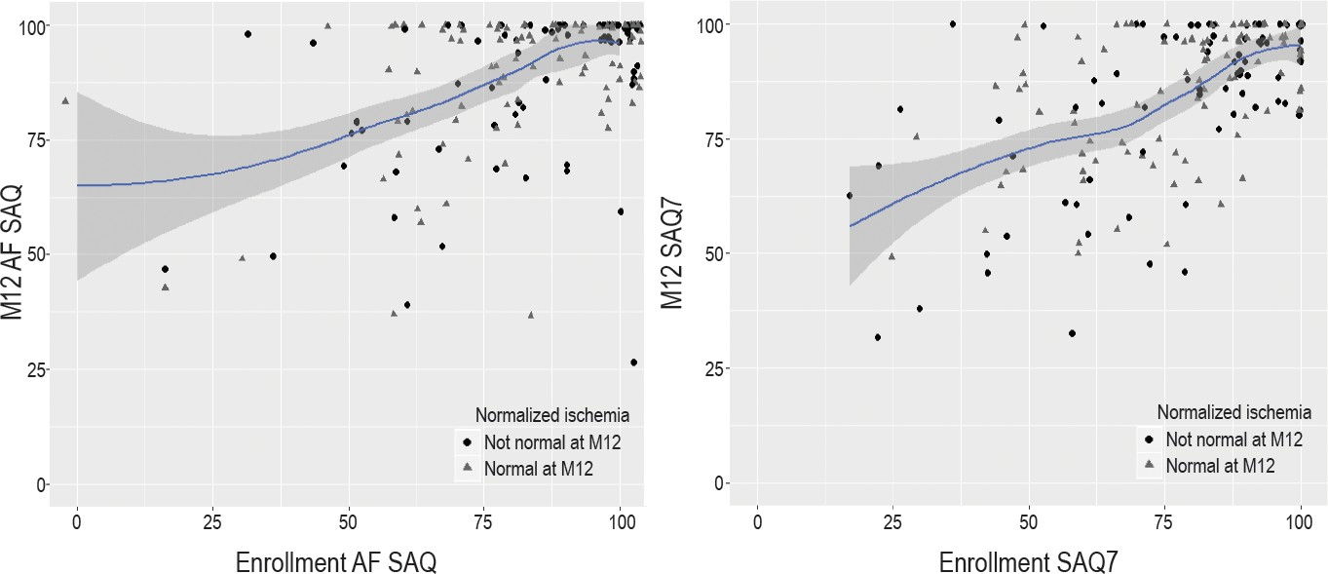
Change in angina over 1 year based on 1-year stress echo
showing ischemia or no ischemia
r=0.49, p<0.001
r=0.58, p<0.001

Slide 18
Limitations
No invasive testing for microvascular disease or spasm
  but such testing is recommended by experts when medications fail
  Prior studies show most INOCA patients have abnormal invasive testing
False positive stress echo and false negative CCTA both possible
Trial program excluded patients with unacceptable degree of angina
ISCHEMIA patients not required to have angina
Medications not specified by protocol

Slide 19
In this study in which INOCA and CAD patients were enrolled with the same stress test and clinical eligibility criteria, with stress tests interpreted by the same blinded core laboratory…
INOCA patients
  Far more likely to be female
  Largely similar severity of ischemia on stress echo to CAD patients
  More frequent angina but better overall angina-related quality of life
In half of INOCA patients, stress echo normal at 1 year, 45% same or worse
Angina frequency improved by a clinically meaningful amount in 39% of INOCA pts, despite little change in anti-anginal medication
No correlation between change in angina and change in ischemia

Slide 20
Thanks to the CIAO Investigators and Participants

Slide 21
Why was there so much change in symptoms and ischemia,
without correlation between the two?
INOCA underlying causes are dynamic over time
  Microvascular coronary disease
  Coronary artery spasm
Angina pathogenesis is complex
  Changing activity level and mental stress over time
  Autonomic nervous system input
  Patient-specific pain sensitivity
  Oxygen carrying capacity

Slide 22
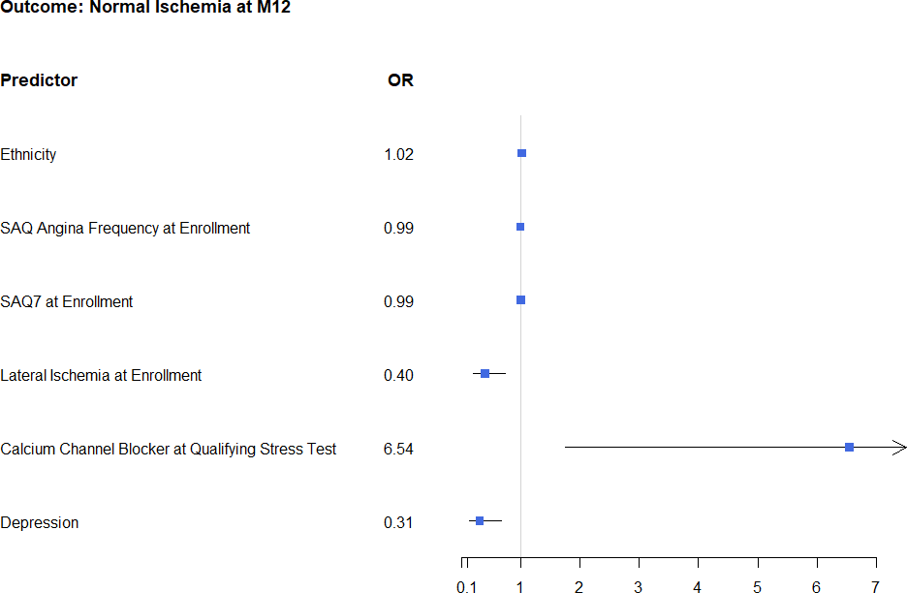

Predictors of Normal Stress Echo at 1 Year
Less likely to normalize
More likely to normalize

Slide 23
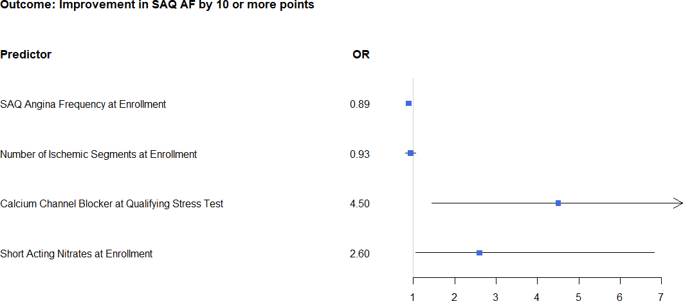
Predictors of Improved SAQ AF Score ≥ 10 points
More frequent angina in follow up
Less frequent angina in follow up

