Slide 1
Real-world Usage of Prevail Paclitaxel-Coated Balloon Compared with Other Contemporary Drug-Coated Balloons
Sacharias von Koch MD, Erika Frank MSc, Katja Gabrysch PhD, Stefan James MD, PhD, Matthias Götberg MD, PhD, Moman A. Mohammad MD, PhD, David Erlinge MD, PhD.

Slide 2
Sacharias von Koch, MD
Research Support:
Medtronic

Slide 3
Background
There are a variety of drug coated balloons (DCB) available in Europe, differing in their drug type (paclitaxel and sirolimus), coating technology and balloon design
In Sweden there are currently 5 frequently used DCB devices (Braun SeQuent® Please, Boston Scientific Agent™, Biotronik Pantera® Lux, Selution™ and Prevail™)
The use of coronary DCB has been rapidly growing in a variety of lesion and patient populations
Studies have shown that there are clinical outcome differences among DCB^{1,2} and thus, data for each DCB device are warranted
¹ Bondesson P et al. EuroIntervention 2012;8:444-9.
² Jeger RV, et al. JACC Cardiovasc Interv. 2020;13(12):1391-1402.

Slide 4
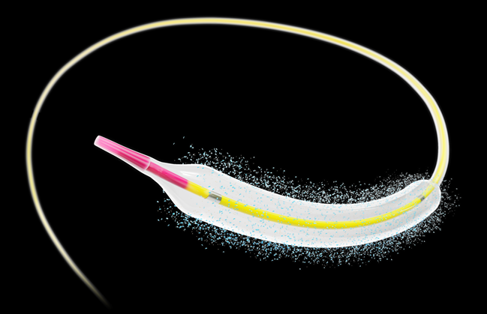
Prevail DCB (Medtronic)
The Prevail™ DCB was introduced in Sweden in 2021 and is now one of the most common DCB
This balloon utilizes paclitaxel with a target dose of 3.5 µg/mm² and urea as an excipient
Drug formulation is applied using open coating technology
Image source: Medtronic

Slide 5
Objective
The aim of this study is to describe the use of Prevail DCB compared with other, contemporary DCB, in a real-world clinical practice in Sweden.

Slide 6
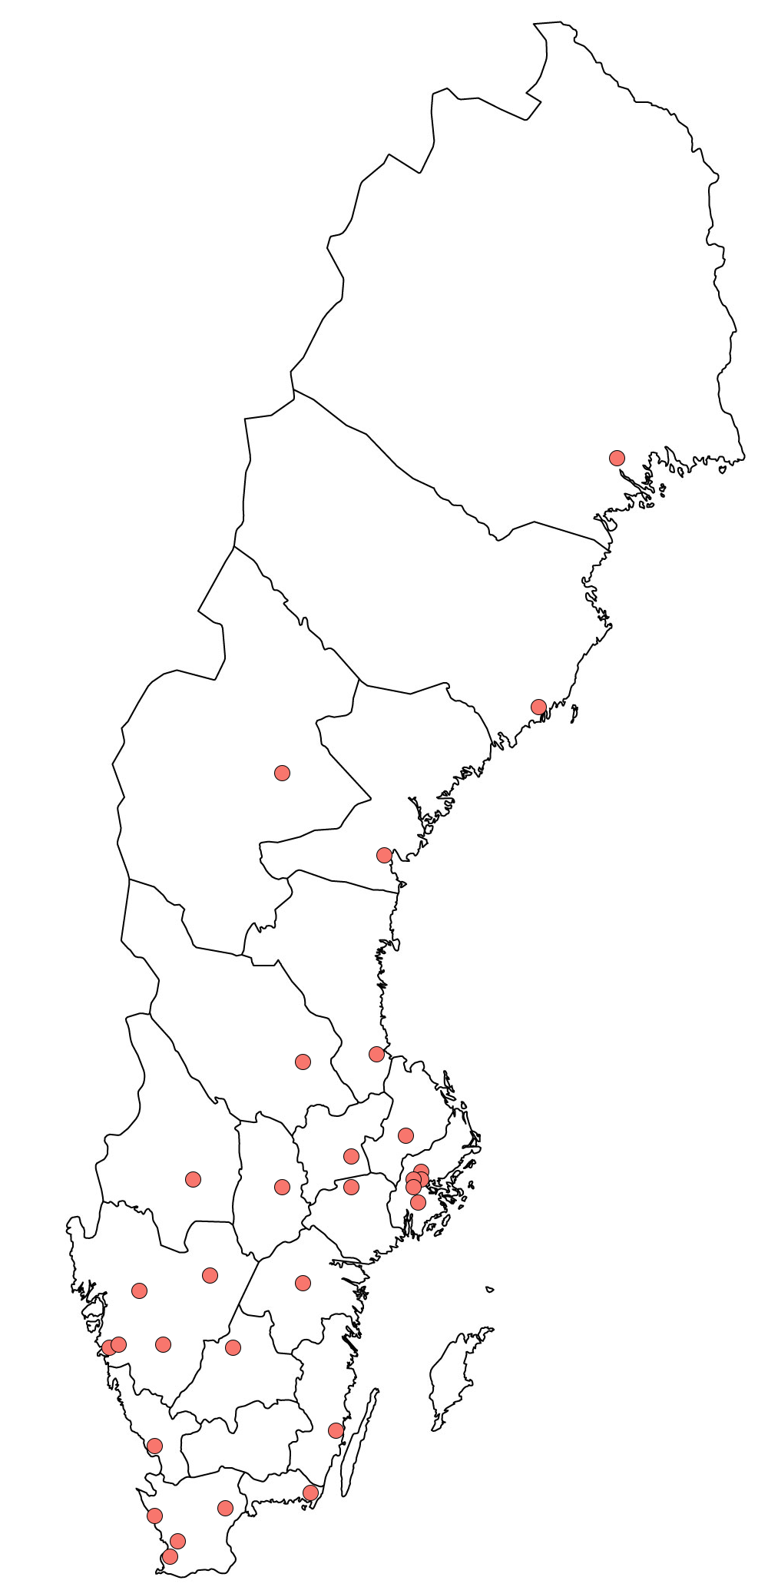
Methods: SCAAR
Dataset: Swedish Coronary Angiography and Angioplasty Registry (SCAAR)
Population: All patients undergoing PCI in Sweden are captured in this nationwide registry
Study design: Cohort study with patients treated with DCB with near complete follow-up of all patients (>99%)

Slide 7
Methods: Current Analysis
Study period: 2/Aug/2021 – 16/May/2024
Study population: All patients undergoing PCI with DCB were divided into two groups:
Treated with Prevail DCB
Treated with Other DCB
Statistics: Kaplan-Meier estimates and adjusted Cox regression through 2 years
All PCI procedures with DCB
in Sweden
N=6,649
Excluded (n=161)
Use of uncommon¹ DCB (n=113)
Use of both DCB types (n=48)
Study population
N=6,488 procedures, N=8,054 devices
Prevail DCB
N=1,797 procedures
N=2,289 devices
Other DCB
N=4,694 procedures
N=5,765 devices
1. <100 DCB devices used during the study period

Slide 8
Patient Characteristics
Median (IQR) or % | Prevail DCB N=1,797 | Other DCB N=4,691
Age | 70.1 (61.8 – 77.9) | 72.2 (63.2 – 78.5)
Female | 22.2 | 21.9
Diabetes mellitus | 31.9 | 32.7
Hyperlipidemia | 71.8 | 73.9
Hypertension | 79.0 | 81.4
BMI (kg/m²) | 26.9 (24.4 – 29.8) | 27.1 (24.5 – 30.1)
Previous MI | 45.0 | 48.5
Previous PCI | 55.8 | 60.0
Previous CABG | 10.6 | 10.2
ACS Unstable angina NSTEMI STEMI | 61.0 12.5 37.3 11.2 | 65.4 11.8 39.4 14.1
Multi-vessel disease presentation | 46.9 | 42.8
Overall similar patient characteristics
More than 60% ACS
High proportion of multi-vessel disease

Slide 9
Device/Lesion Characteristics
Median (IQR) or % | Prevail DCB N=2,289 | Other DCB N=5,765
DCB + stent in same vessel (hybrid PCI) | 48.4 | 44.4
Use of intravascular imaging (IVUS/OCT) | 23.3 | 19.5
DCB length (mm) | 20.0 (20.0 – 30.0) | 20.0 (15.0 – 30.0)
DCB diameter (mm) | 2.5 (2.2 – 3.0) | 2.5 (2.2 – 3.0)
Treated vessel: RCA LAD LCx LM Graft | 19.5 50.9 26.2 1.6 1.8 | 19.7 48.2 26.8 2.2 3.1
De novo | 71.2 | 63.6
In-stent restenosis | 28.0 | 35.0
B2/C lesion | 55.3 | 50.9
Bifurcation | 22.8 | 19.7
Total occlusion >3 mo / CTO | 10.4 3.3 | 13.4 3.6
Procedure success* | 98.7 | 98.4
Median DCB diameter was 2.5 mm in both groups
Procedure success was >98% in both groups
*Defined as treated stenosis of ≥50%, with a reduction of at least 20% leading to a final stenosis degree of <50%, accompanied by good flow and no major complication.

Slide 10
Patient-Level Analysis
Prevail DCB
Other DCB
All-cause Mortality
Myocardial Infarction
New PCI
aHR: 1.06 (95% CI: 0.81-1.39)
aHR: 0.82 (95% CI: 0.60-1.12)
aHR: 1.02 (95% CI: 0.83-1.24)
15%
20%
14.9
10%
8.0
15%
14.6
10%
8.2
9.7
4.8
6.1
10%
5.0
7.2
5%
8.8
5%
4.7
3.4
5%
0%
0%
0%
0
1
2
0
1
2
0
1
2
Time since PCI (years)
Time since PCI (years)
Time since PCI (years)
Number at risk
1797 |  | 726 |  | 176
4691 |  | 2932 |  | 1294
Number at risk
1797 |  | 706 |  | 165
4691 |  | 2800 |  | 1197
Number at risk
1797 |  | 666 |  | 150
4691 |  | 2666 |  | 1111

Slide 11
Device-Level Analysis
Prevail DCB
Other DCB
Definite Thrombosis
TLR
TVR
2.0%
aHR: 0.87 (95% CI: 0.39-1.94)
aHR: 0.99 (95% CI: 0.74-1.32)
aHR: 1.03 (95% CI: 0.79-1.33)
15%
10%
8.7
11.3
1.5%
1.3
10%
10.5
5.5
7.4
7.1
1.0%
0.8
0.6
5%
6.6
4.6
5%
0.5%
0.3
0%
0%
0%
0
1
2
0
1
2
0
1
2
Time since PCI (years)
Time since PCI (years)
Time since PCI (years)
Number at risk
2289 |  | 866 |  | 201
5765 |  | 3449 |  | 1470
Number at risk
2289 |  | 858 |  | 196
5765 |  | 3402 |  | 1433
Number at risk
2289 |  | 840 |  | 187
5765 |  | 3350 |  | 1397

Slide 12
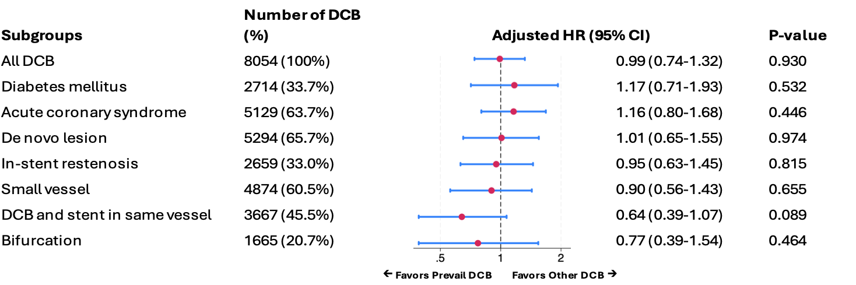
Subgroup Analysis: TLR at 2 Years

Slide 13
Subgroup Analysis: Myocardial Infarction at 2 Years

Slide 14
Sensitivity Analysis
Prevail DCB
Sirolimus DCB
Other paclitaxel DCB
All-cause Mortality
Myocardial Infarction
New PCI
20%
18.4%
21.1%
15%
20%
8.3%
15%
14.6%
7.2%
15%
14.6%
10%
4.9%
10%
7.8%
10%
6.1%
5%
5%
5%
0%
0%
0%
0
1
2
0
1
2
0
1
2
Time since PCI (years)
Time since PCI (years)
Time since PCI (years)
Number at risk
1797 |  | 726 |  | 176
4470 |  | 2818 |  | 1272
192 |  | 94 |  | 15
Number at risk
1797 |  | 706 |  | 165
4470 |  | 2691 |  | 1179
192 |  | 91 |  | 11
Number at risk
1797 |  | 666 |  | 150
4470 |  | 2565 |  | 1097
192 |  | 85 |  | 9

Slide 15
Sensitivity Analysis
Prevail DCB
Sirolimus DCB
Other paclitaxel DCB
Definite Thrombosis
TLR
TVR
3%
30%
30%
2.0%
22.1%
23.2%
2%
1.3%
20%
20%
0.8%
10.6%
1%
10%
7.9%
10%
10.5%
7.4%
0%
0%
0%
0
1
2
0
1
2
0
1
2
Time since PCI (years)
Time since PCI (years)
Time since PCI (years)
Number at risk
2289 |  | 866 |  | 201
5438 |  | 3291 |  | 1437
253 |  | 113 |  | 19
Number at risk
2289 |  | 858 |  | 196
5438 |  | 3250 |  | 1406
253 |  | 110 |  | 13
Number at risk
2289 |  | 840 |  | 187
5438 |  | 3198 |  | 1370
253 |  | 110 |  | 13

Slide 16
Conclusions
The current analysis of over 8,000 DCB devices is the largest study to date comparing different DCB products
The Prevail™ DCB had comparable outcomes with other contemporary DCB at 2 years, in an unrestricted, real-world patient population
Subgroup analysis showed that outcomes were robust in a wide variety of patient and lesion complexities

