Slide 1
Chlorthalidone compared with Hydrochlorothiazide for the prevention of cardiovascular events in patients with hypertension: The Diuretic Comparison Project (DCP)
Areef Ishani, MD MS
Director Primary Care and Specialty Care ICC Minneapolis VAHCS
Director Specialty Care ICC VISN 23
Vice Chair and Professor, Department of Medicine, UMN
Twitter @areefishani

Slide 2
Disclosure
I am an employee of the VA
None otherwise

Slide 3
Thanks
Co-Authors: William C. Cushman, MD, Sarah M. Leatherman, PhD, Robert A. Lew, PhD, Patricia Woods, MSN, RN, Peter A. Glassman, MBBS, MSc, Addison A. Taylor, MD, Cynthia Hau, MPH, Alison Klint, MS, Grant D. Huang, MPH, PhD, Mary T. Brophy, MD, MPH, Louis D. Fiore, MD MPH, Ryan E. Ferguson, ScD, MPH
Data and Safety Monitoring Committee: Drs. Christopher Cannon, Cynthia Coffman, Larry Fine, and Gina Wei
Study Coordinators/Assistants: Jade Fiotto, Maura Flynn, Amanda Guski, Robert Hall, Colleen Hynes, Srihari Raju, Gregory Robben, Christal Sadatis, Linda Sweeney, Liang Zhu, Olivia Taylor, Jacob McPherson, Eustacia Ikeri, Abhinav Tella, William Vang, Katherine Perkey, Alicia Zhang, William Vang
In Memoriam: Frank Lederle, MD

Slide 4
DCP: Background
Does treatment with chlorthalidone reduce major adverse cardiovascular events (MACE) compared with hydrochlorothiazide (HCTZ) in older veterans with hypertension?
Early studies suggested better cardiovascular (CV) outcomes with chlorthalidone (CTD)
Better 24-hour BP control
Pleiotropic effects
Recent observational studies – no CVD benefit to chlortalidone
Greater risk of adverse events (hypokalemia, AKI, and CKD)

Slide 5
Study consent flow
Mailed letter and informed consent document to potential patients
Centralized callers call patients and get verbal informed consent
Provider assent to randomize patient
Consent order through EMR to provider
Identify panel patient on 25 or 50 mg HCTZ
Order CTD and discontinue HCTZ
Randomize Patient to CTD or HCTZ
Outcomes
VA EMR/Claims
Medicare Claims
National Death Index
Usual Care for study drug and hypertension management
Drug filled by local VA pharmacy
Keep on HCTZ

Slide 6
Pragmatic Nature
All study related tasks done by central staff (Boston or Minneapolis)
No study staff at any site
Centralized:
Recruitment
Consenting
Randomization
Filling out drug order
Assessing outcomes
Usual Care:
Signing drug order
Filling prescription
Managing study drug and hypertension

Slide 7
Inclusion criteria
Over the age of 65 years (half outcomes from Medicare)
On HCTZ 25 or 50 mg/d from VA (not on combination drug)
Most recent SBP (in EMR) ≥ 120 mm Hg
Study Intervention
Open-label study – Patient randomized to remain on their current dose HCTZ (25 or 50 mg), or convert them to equipotent dose of CTD (12.5 or 25 mg)

Slide 8
Primary Outcome- MACE
Time to first occurrence of any of the following:
Stroke
Myocardial infarction
Non-cancer death
Hospitalization for Acute Heart Failure
Urgent coronary revascularization 2° unstable angina
Stats/Sample Size
Assumed 3% per year event rate in HCTZ group
17.5% reduction in CTD group
Planned for 1,055 primary outcomes

Slide 9
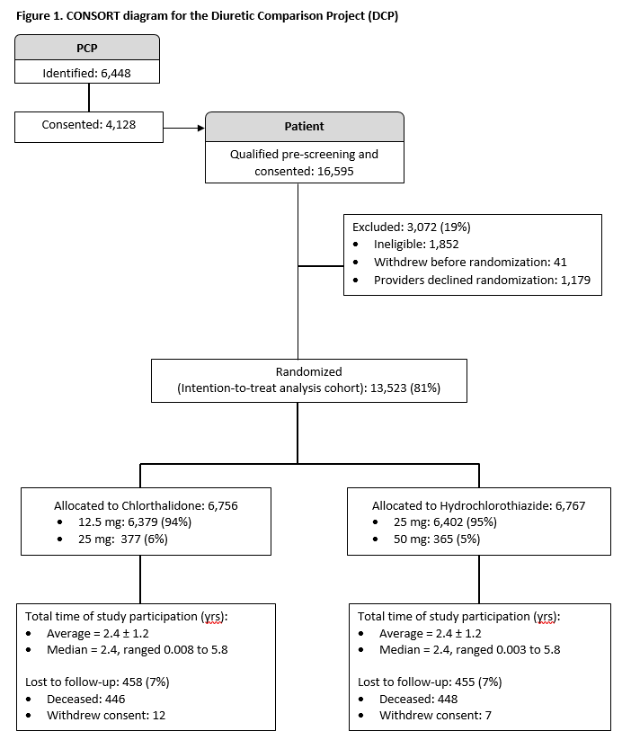
S
68.5% of approached providers consented to participate!!

Slide 10
 | Chlorthalidone (n=6,756) | Hydrochlorothiazide (n=6,767)
Age, yrs mean ± sd | 72.4 ± 5.4 | 72.5 ± 5.3
Male sex - n (%) | 6,536 (96.7) | 6,556 (96.9)
Race - n (%)
Black or African American | 1,004 (14.9) | 1,023 (15.1)
Caucasian | 5,229 (77.4) | 5,225 (77.2)
Resided in rural areas - n (%) ª | 3,043 (45.0) | 3,079 (45.5)
BMI mean ± sd– kg/m² | 31.7 ± 5.8 | 31.8 ± 5.9
Medical History - n (%)
Diabetes | 2,967 (43.9) | 3,062 (45.2)
Heart failure | 525 (7.8) | 526 (7.8)
Myocardial infarction or Stroke | 733 (10.8) | 722 (10.8)
HCTZ 25 mg - n (%) | 6,379 (94.4) | 6,402 (94.6)
Systolic blood pressure, mmHg – mean ± sd | 139 ± 14 | 139 ± 14
Number of antihypertensive medications – n (%)
HCTZ alone | 889 (13.2) | 866 (12.8)
HCTZ plus 1 additional BP med | 2,352 (34.8) | 2,284 (33.8)
HCTZ plus 2 additional BP meds | 2,180 (32.3) | 2,221 (32.8)
HCTZ plus 3 additional BP meds | 1,061 (15.7) | 1,090 (16.1)
HCTZ plus 4 additional BP meds | 274 (4.1) | 306 (4.5)

Slide 11
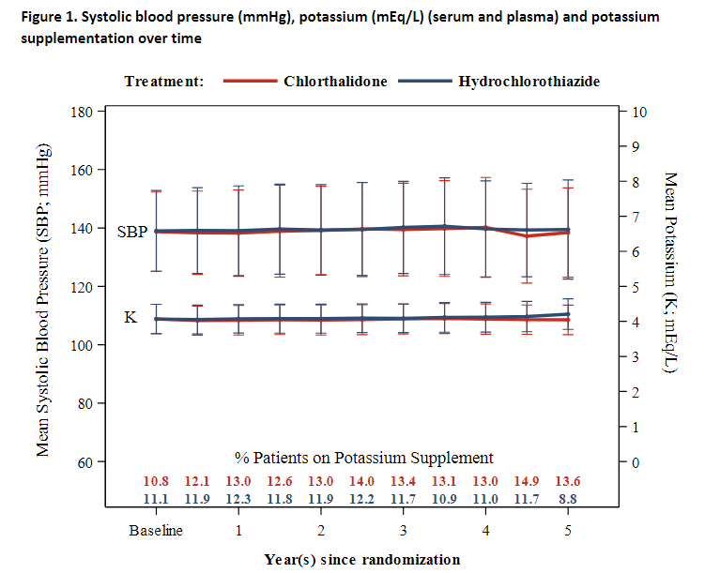

Slide 12
Time to the Primary Outcome

Slide 13
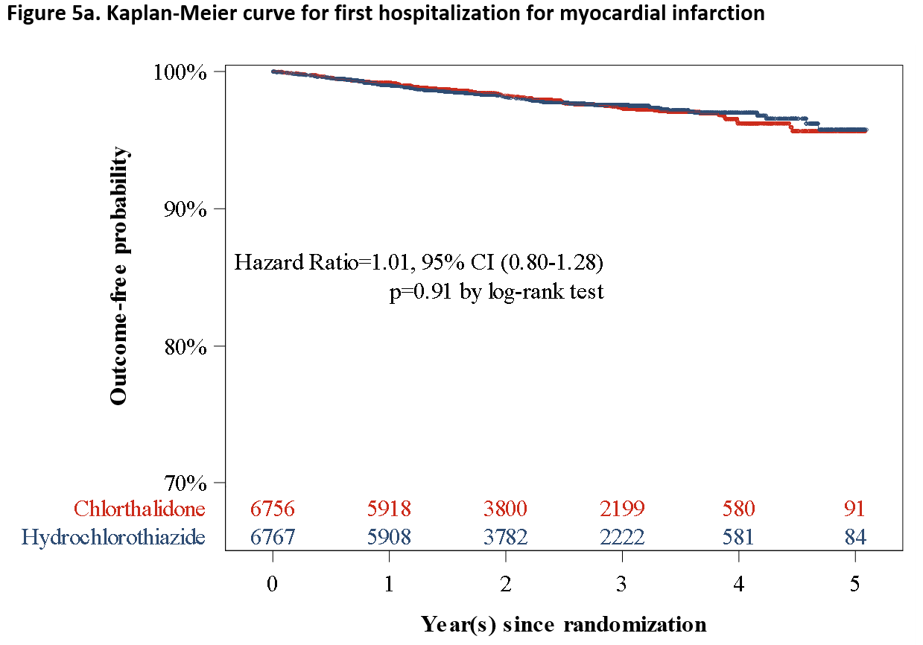
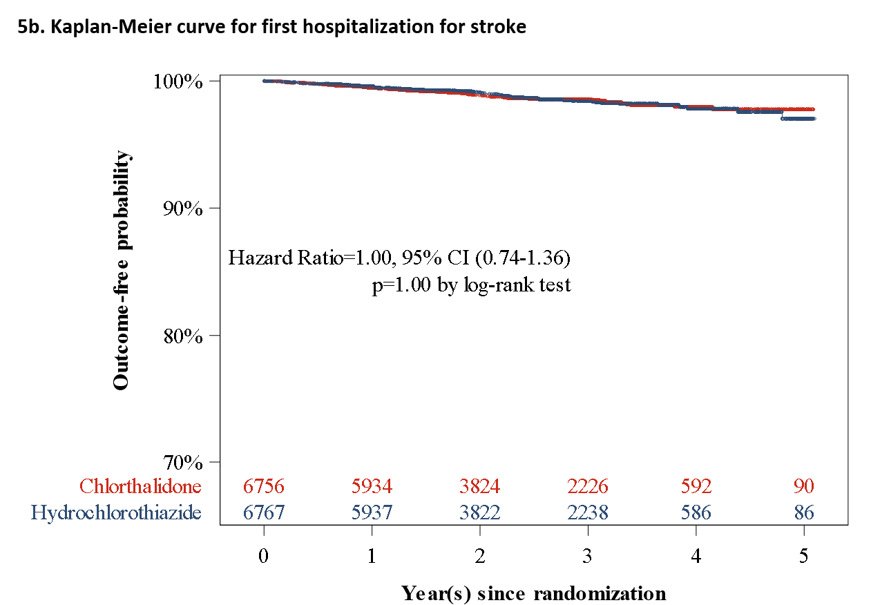

Slide 14
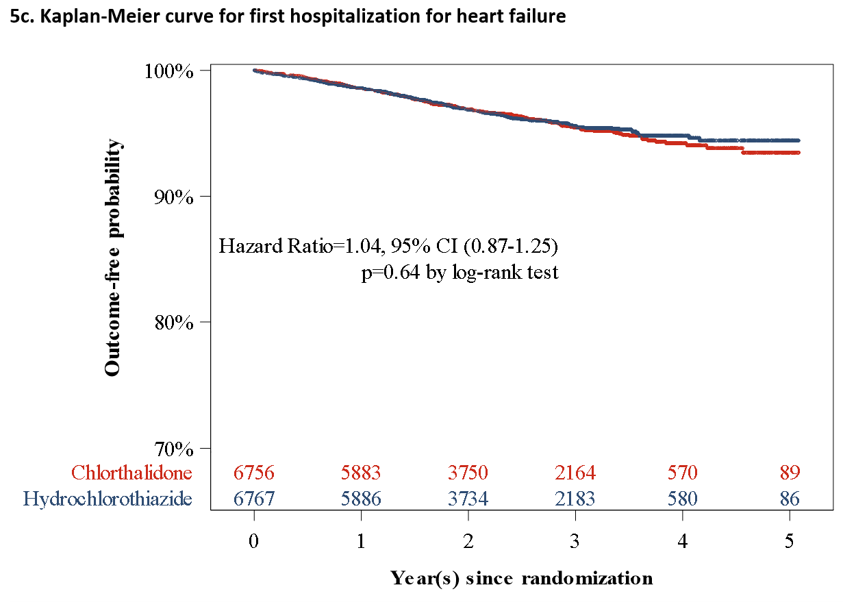
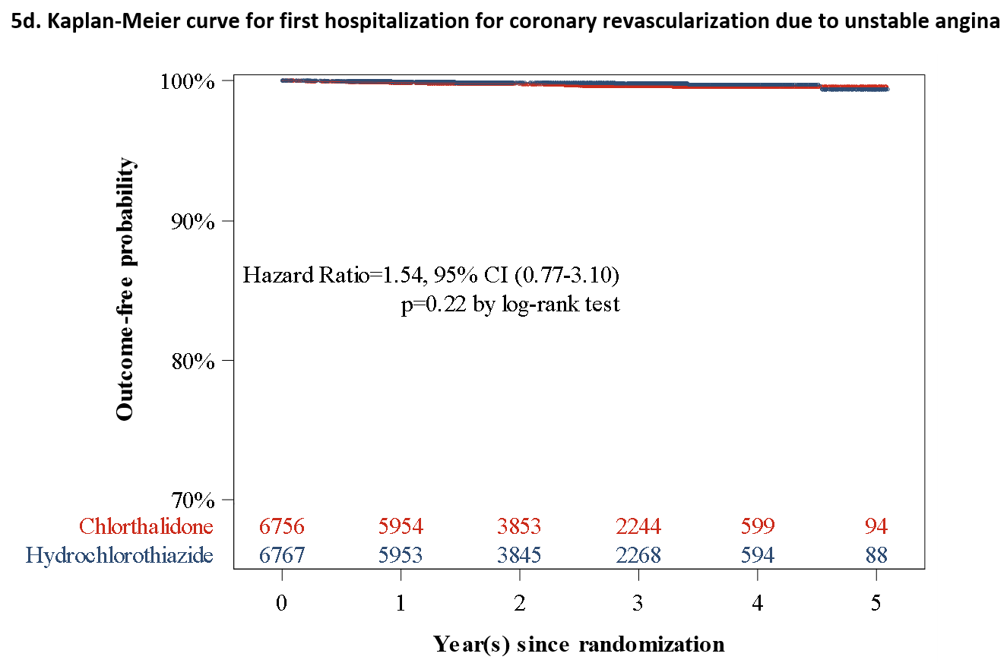

Slide 15
Pre-Defined Subgroup Analysis
P for interaction:
- Unadjusted 0.002
- Multiplicity Adjusted
0.035
CTD better
HCTZ better

Slide 16
Pre-Defined Subgroup Analysis
P for interaction:
- Unadjusted 0.002
- Multiplicity Adjusted
0.035

Slide 17
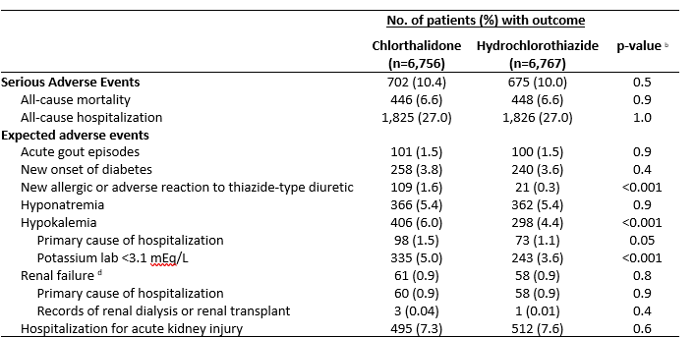
Adverse Events

Slide 18
DCP Conclusions
Chlorthalidone did not reduce the incidence of major cardiovascular outcomes or non-cancer deaths, compared to HCTZ at doses commonly used in clinical practice CTD 12.5mg/HCTZ 25mg)
Subgroup analysis suggested a difference in the primary outcome by the presence or absence of prior stroke/MI
Unclear how to interpret in the context of a negative study – may be a chance finding. Future studies will need to explore
CTD was associated with an increased risk of hypokalemia
Pragmatic Trials are possible to perform in the VA system

