Slide 1
MitraClip for Secondary MR:
COAPT Update
Ted Feldman, M.D., MSCAI FACC FESC
Evanston Hospital
CRT
Cardiovascular Research Technologies
Washington D.C.
February 20-23rd, 2016
Notes:
The Essentials on Mitral Clip: Treating Mitral Regurgitation, Addressing Patient Selection and Therapy in Complex Valvular Heart Disease (Lunch Symposium)
12:20 p.m. – 1:30 p.m.
Session Moderators & Panelists: Ted Feldman, MD, MSCAI; Ince Hüseyin; James Hermiller, MD, FSCAI
12:20 PM
Lunch
12:30 PM
Mitral Clip For Functional MR: Pitfalls and Pearls
Presenter: Scott Lim, MD
12:40 PM
High-risk DMR MitralClip in US Practice
Presenter: William Gray, MD, FSCAI
12:50 PM
Impact of Cardiac Imaging in Mitral Clip for Patients with Functional Mitral Regurgitation
Presenter: Thierry Mesana, MD, PhD
1:00 PM
Mitral Clip for Secondary MR: COAPT Update
Presenter: Ted Feldman, MD, MSCAI
1:10 PM
Is Percutaneous Mitral Repair Effective for the Treatment of Heart Failure?
Presenter: Alec Vahanian, MD 1:20 PM
Break

Slide 2
Ted Feldman MD, MSCAI FACC FESC
Disclosure Information
The following relationships exist:
Grant support: Abbott, BSC, Cardiokinetics, Edwards, WL Gore
Consultant: Abbott, BSC, Coherex, Edwards, JenaValve, Mitralign,
Diiachi Sankyo-Lilly, WL Gore
Off label use of products and investigational devices
will be discussed in this presentation

Slide 3
Registries
Prospective-Multicenter
Study | n
REALISM US Continued Access | 899
REALISM Compassionate/Emergency Use | 66
ACCESS Europe Phase I | 567
ACCESS Europe Phase II | 286
German Transcatheter Mitral Valve Interventions (TRAMI) | 1002
GRASP-It | 304
MitraSwiss registry nationwide | 265
Sentinel Registry EURObservational Research Programme ESC | 628
MitraClip Asia-Pacific Registry (MARS) | 145
ANZ MitraClip Registry | 45

Slide 4

COAPT Trial: Overview
Cardiovascular Outcomes Assessment of the MitraClip Percutaneous Therapy for Heart Failure Patients with
Functional Mitral Regurgitation

Slide 5
Objective
To evaluate the safety and effectiveness of the MitraClip System for treatment of functional mitral regurgitation (FMR ≥3+) in symptomatic heart failure subjects who are treated per standard of care and who have been determined by the site’s local heart team as not appropriate for mitral valve surgery
COAPT is the first randomized controlled clinical trial to compare non-surgical (medical) standard of care treatment to a percutaneous intervention to reduce MR
Notes:
5

Slide 6
Clinical Outcomes Assessment of the MitraClip Percutaneous Therapy for High Surgical Risk
~430 patients enrolled at up to 75 US sites
Significant FMR ≥3+ core lab; EF<50%; CHF hospitalization or BNP>300
High risk for mitral valve surgery- Local Heart Team
Specific valve anatomic criteria
Randomize 1:1
Control group
Standard of care
MitraClip
Safety: Composite death, stroke, worsening renal function, LVAD implant, heart transplant at 12 months
Effectiveness: Recurrent heart failure hospitalizations
Protocol conditionally approved by FDA July 26, 2012

Slide 7
Key Inclusion Criteria (ii)
The subject has had at least 1 HF hospitalization in the 12 months prior to enrollment and/or a corrected BNP ≥300 pg/ml or nT-proBNP ≥1500 pg/ml measured within 90 days prior to registration
Subject has been adequately treated per applicable standards for CAD, LV dysfunction, MR or HF (CRT, revascularization, and/or GDMT)
The primary regurgitant jet is non-commissural. If secondary MR jets exist, they must be considered clinically insignificant.
CK-MB obtained within prior 14 days less than local laboratory upper limit of normal (ULN)
Notes:
7

Slide 8
Key Exclusion Criteria (i)
Leaflet anatomy which may preclude MitraClip implantation, proper MitraClip positioning on the leaflets, or sufficient MR reduction by the MitraClip
MV orifice area <4.0 cm², confirmed by the Site 90 days prior to registration
CABG, PCI, or Transcatheter Aortic Valve Replacement (TAVR) in prior 30 days
CVA within 30 days prior to subject registration
Carotid surgery or stenting within 30 days prior to subject registration
Severe symptomatic carotid stenosis (>70% by ultrasound)

Slide 9
Primary Endpoints
Primary Effectiveness
Recurrent heart failure hospitalizations through 24 months (analyzed when last subject completes 12 months follow-up)
Primary Safety
  Composite of Single Leaflet Device Attachment (SLDA), device embolizations, endocarditis requiring surgery, Echocardiography Core Laboratory confirmed mitral stenosis requiring surgery, LVAD implant, heart transplant, and any device related complications requiring non-elective cardiovascular surgery at 12 months
Notes:
9

Slide 10
Secondary Endpoints
Secondary Effectiveness
  MR severity at 12 months
  Change in 6MWD at 12 months
  Change in Quality of Life score (KCCQ) at 12 months
  Change in LVEDV at 12 months
  Reduction to NYHA Functional Class I/II at 12 months
  Hierarchical composite of death and recurrent HF hospitalization (analyzed when the last subject completes 12 months of follow-up)
  Recurrent hospitalizations – all-cause (analyzed when the last subject completes 12 months of follow-up)
  Secondary Safety
  Composite of death (all-cause), stroke, MI, non-elective CV surgery for device related complications in Device group at 30 days
  All-cause mortality at 12 months

Slide 11
COAPT Case Example
a 72YO male with history of prior posterior, inferior and lateral MI, CABG with patent grafts
severe mitral regurgitation and acute and chronic systolic and diastolic heart failure, LVEF 45%
recent HF hospitalization was 1/5-1/9/2015 with weight gain, LE edema, SOB with exertion and BNP > 2500
STS risk score for replacement: 10.9% and for repair: 7.35%

Slide 12
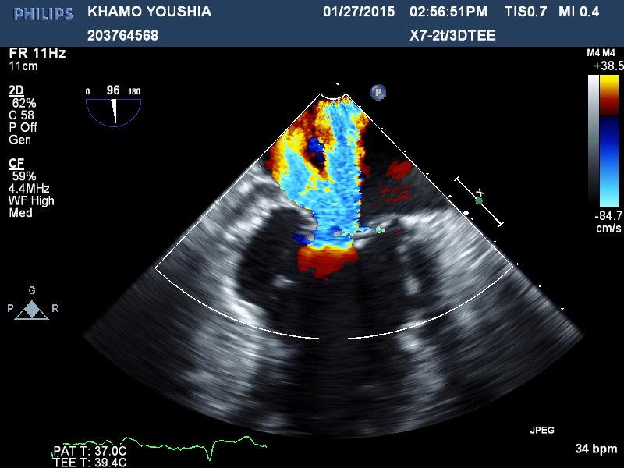
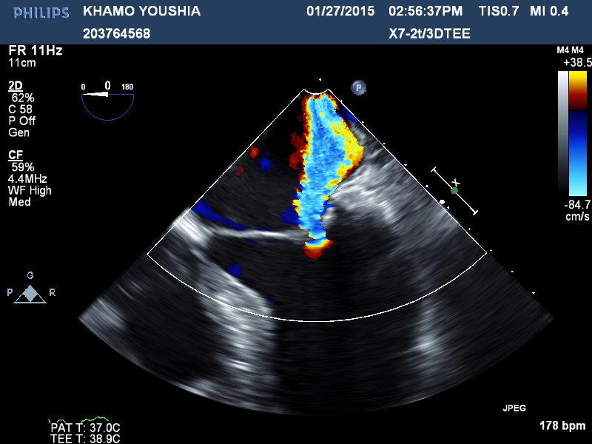
TEE Pre

Slide 13
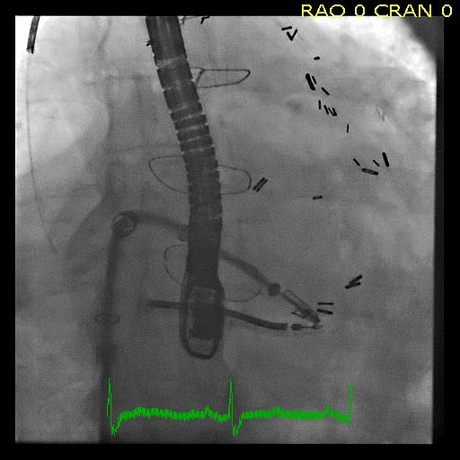
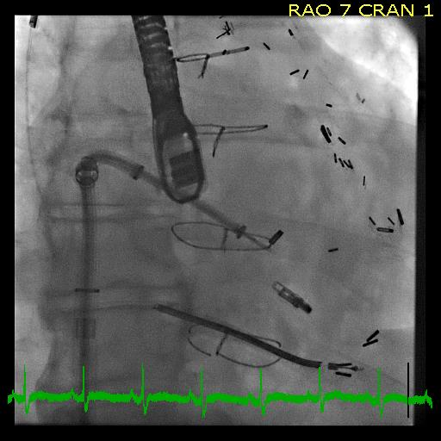
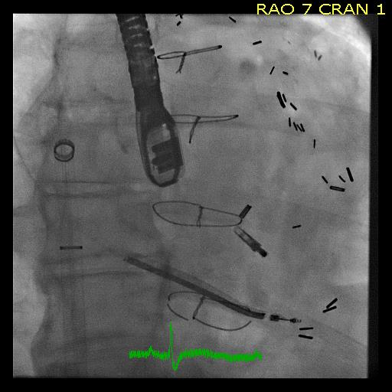
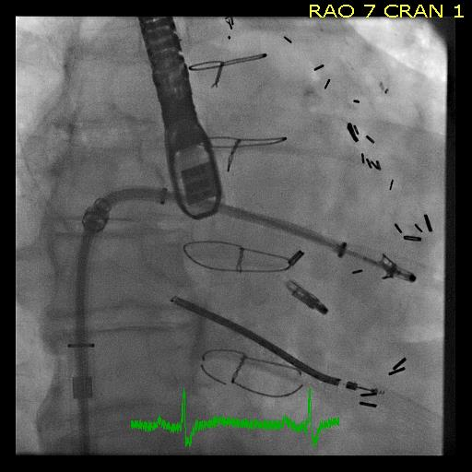
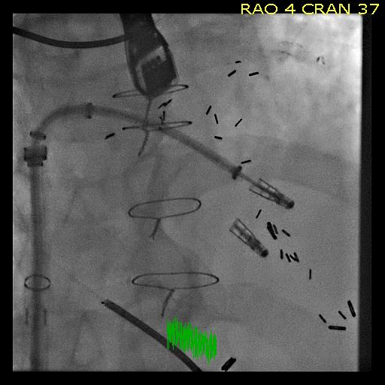
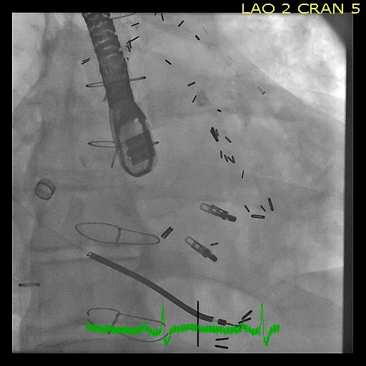

Slide 14
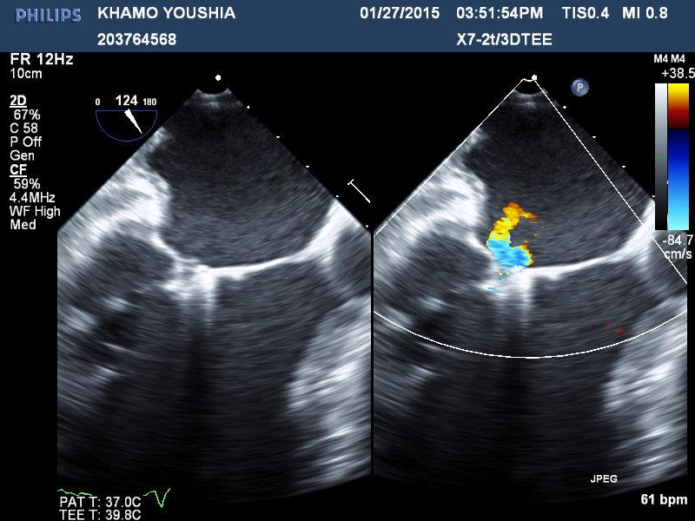
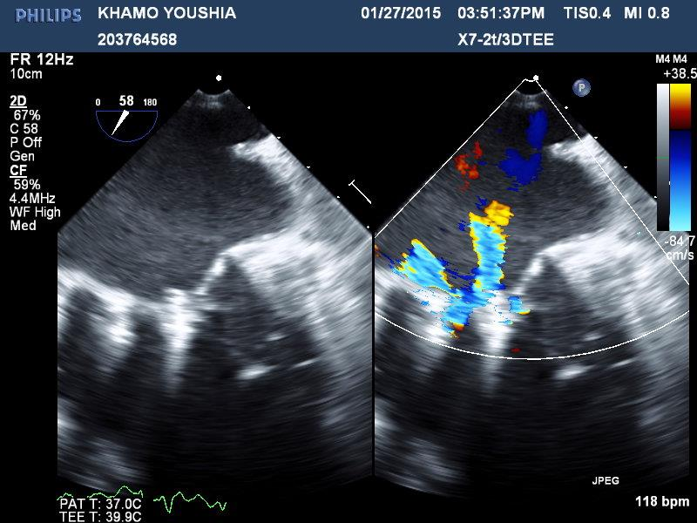
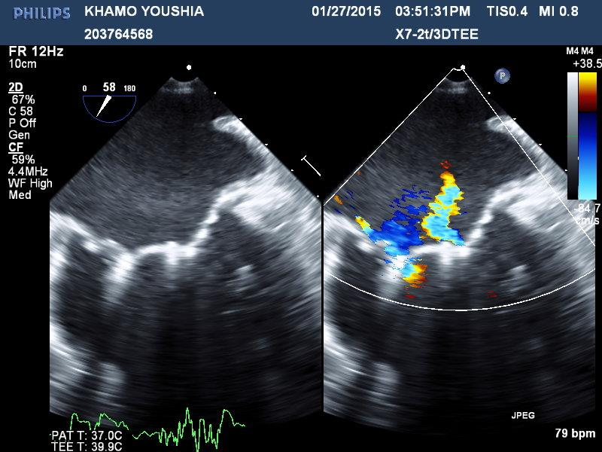
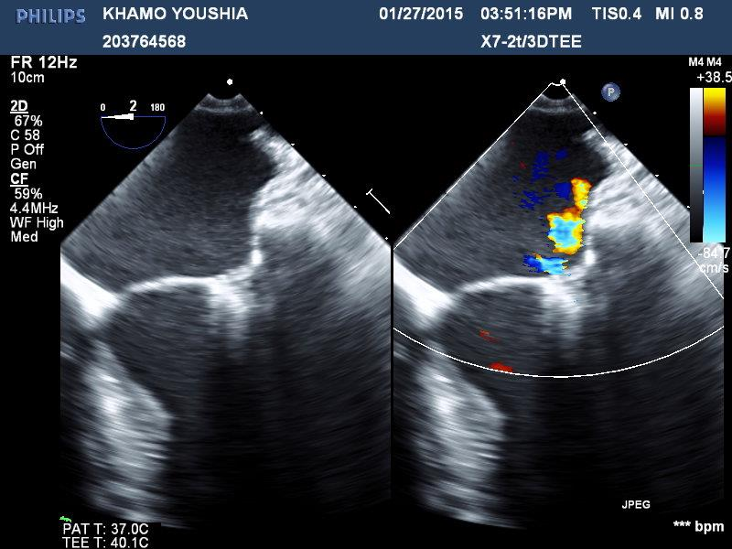
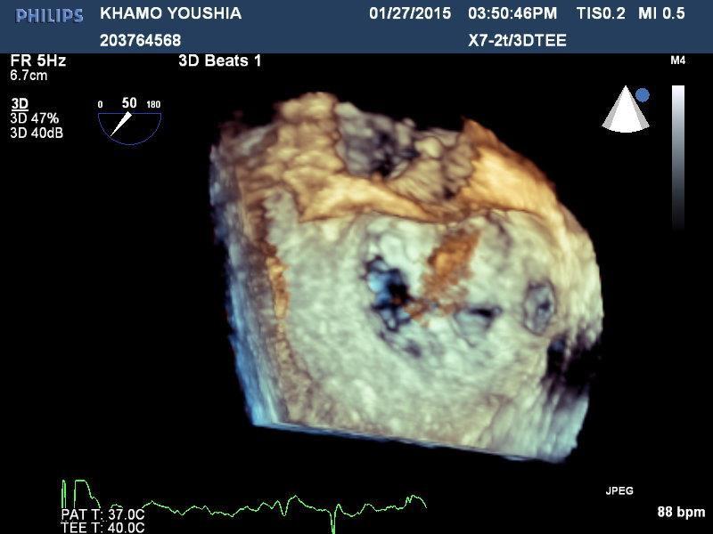

Slide 15
TEE Post

Slide 16
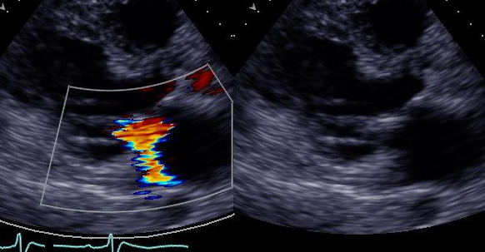
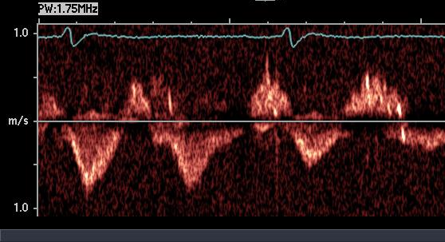
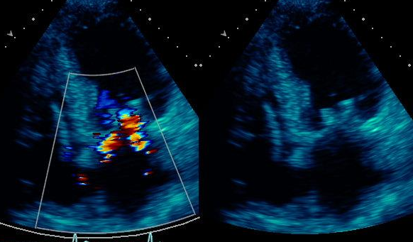
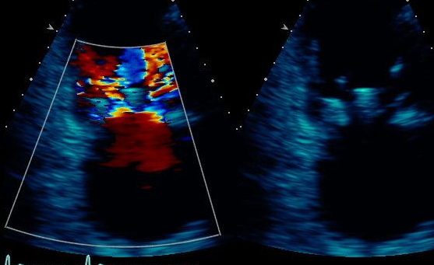
Discharge TTE

Slide 17
MitraClip RCTs in Functional MR
1348 patients
Heart failure and FMR
MitraClip vs. GDMT or MV Surgery
COAPT – 300/430 (70%)
MITRA-FR – ~145/288 (50%)
RESHAPE-HF-2 – 43/420 (10%)
MATTERHORN (vs MVS) – 4/210 (4%)

Slide 18
COAPT Enrollment Feb 16, 2016
81 active sites
Notes:
Subject:
FW: COAPT-Enrollment Report (04 Jan 2016)
Top ten sites have enrolled n=141 (43.5%)
27 sites enrolled 0-3 cases
28 sites enrolled 4-9 cases
0-12 sites
1-15
2-11
3-11
4-7
5-6
6-3
7-4
8-3
9-1
________________________________
From: Tish O'Mara [mailto:pomara@novellaclinical.com]
Sent: Monday, January 04, 2016 12:35 PM
To: Tish O'Mara
Cc: 'Gregg Stone (gstone@crf.org) (gstone@crf.org)'; 'MichaeMa@BaylorHealth.edu'; 'joann.lindenfeld@vanderbilt.edu'; 'william.abraham@osumc.edu'; QXA79874-PMF; QXA79874-ClinMon; Nicole Kilburn; 'Morey, Vicky'; Elek, Candace L; Tish O'Mara
Subject: COAPT-Enrollment Report (04 Jan 2016)
Greetings COAPT Investigators and Research Coordinators,
Happy New Year! Please find attached the most recent enrollment report. As of today, 324 patients are randomized and 47 patients are roll-ins (total 371 registered). Currently, eighty three (83) sites are activated and approved to enroll. (106 patients to be randomized in order to complete enrollment.)
Jan 4, 2016
Tish O’Mara
Sr. Project Manager, Medical Device & Diagnostics
CardioVascular Therapies
pomara@novellaclinical.com<mailto:pomara@novellaclinical.com>
Office Phone: 919.972.7392
Mobile Phone: 518.744.0046
Global Headquarters: 1700 Perimeter Park Drive, Morrisville, NC 27560

Slide 19
TVT Registry: Residual MR
p
Age (↑)
0.12
Male gender
0.17
FMR
0.07
EDD (↑)
0.03
ESD (↑)
0.29
Baseline MR (↑)
0.03
A2-P2 implant
0.01
> 1 clip placed
0.12
MAC
0.90
Mitral gradient (↑)
0.33
MVA <4 cm²
0.23
Severe TR
0.43
Case volume (↑)
0.01
0
1
2
3
⬅More MR
Odds Ratios
Less MR➔
Paul Sorajja ACC 2015
Notes:
Too small font?
Change this back to original

