Slide 1
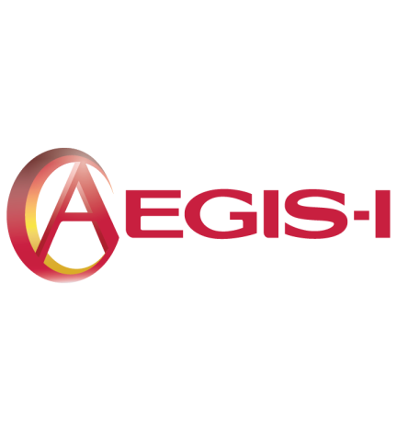
The Safety and Tolerability of CSL112, a Reconstituted, Infusible, Plasma-Derived Human ApoA-I, After Acute Myocardial Infarction: The ApoA-I Event reducinG in Ischemic Syndromes I Trial (AEGIS-I)
C. Michael Gibson, MS, MD on behalf of the AEGIS-1 Investigators
Gibson et al. AHA 2016

Slide 2
Conflict of Interest Statement
Present Research/Grant Funding
Angel Medical Corporation
Bayer Corp.
CSL, Inc.
Ikaria, Inc.
Janssen Pharmaceuticals
Johnson & Johnson Corporation
Portola Pharmaceuticals
Stealth Peptides, Inc.
St. Jude Medical
Peer to Peer Communications
Eli Lilly and Company
The Medicines Company
Royalties as a Contributor
UpToDate in Cardiovascular Medicine
Spouse:
Employee of Boston Clin Res Institute with equity
Consultant
(all with moderate support)
Amarin Pharama
Amgen
Boston Clinical Research Institute
Cardiovascular Research Foundation
CSL Behring
Eli Lilly and Company
Gilead
Novo Nordisk
Pfizer
Pharma Mar
Roche Diagnostics
St. Francis Hospital
St. Jude Medical
The Medicines Company
Web MD
Consultant (with $0.00 monies received by Dr. Gibson)
Bayer Corporation
Janssen Pharmaceuticals
Johnson & Johnson Corporation
Ortho McNeil
Gibson et al. AHA 2016

Slide 3
Background
CSL112 is plasma-derived apolipoprotein A-I (apoA-I).
ApoA-I is the primary functional component of high-density lipoprotein (HDL) and supports the rapid removal of cholesterol from plaque.
Upon infusion, CSL112 produces an immediate and robust increase in cholesterol efflux capacity.
Efflux is the first step of reverse cholesterol transport, the process by which HDL transports excess cholesterol to the liver for removal from the body.
Gibson et al. AHA 2016

Slide 4
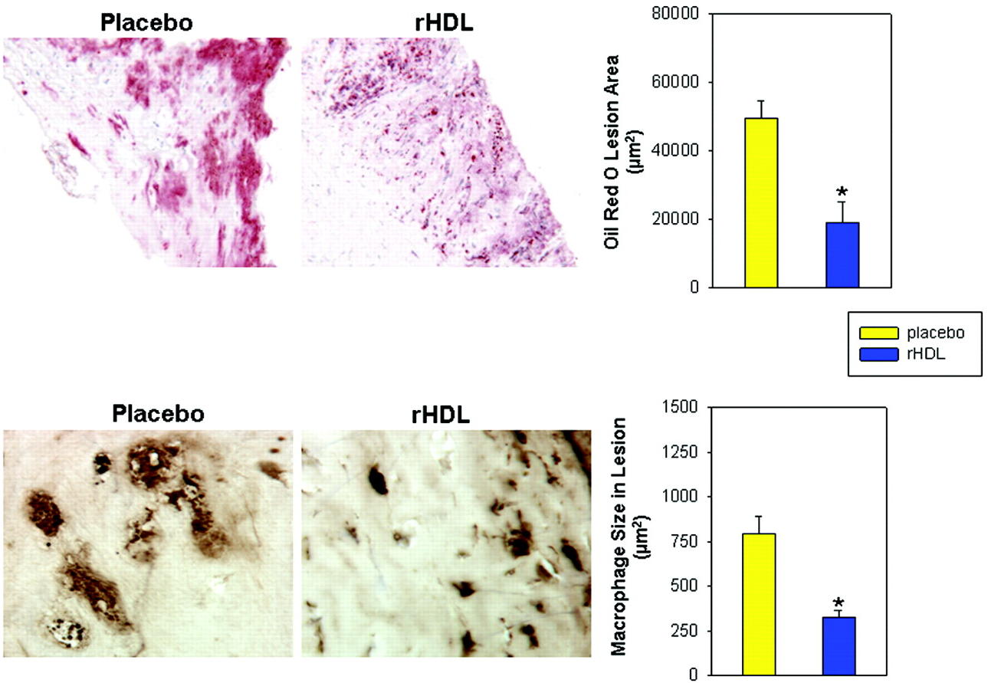
Single 80 mg/kg Infusion of Reconstituted ApoA-I Reduced Human Femoral Plaque Lipid & Macrophage Size > 50% in 5-7 Days
Gibson et al. AHA 2016
Shaw et al. Circ Res. 2008;103:1084-91

Slide 5
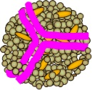
Cholesterol Efflux From Macrophages
HDL
Gibson et al. AHA 2016

Slide 6
Cholesterol Efflux is an Independent Predictor of Cardiovascular Risk
HDL cholesterol
Unadjusted analysis |  | 0.64 (0.40-1.03)
Analysis adjusted
For traditional risk factors |  | 0.80 (0.47–1.37)
For traditional risk factors and HDL particle concentration |  | 1.08 (0.59–1.99)
Cholesterol efflux capacity
Unadjusted analysis |  | 0.44 (0.27–0.73)
Analysis adjusted
For traditional risk factors |  | 0.30 (0.18–0.50)
For traditional risk factors and HDL cholesterol |  | 0.31 (0.18–0.52)
For traditional risk factors and HDL particle concentration |  | 0.34 (0.20–0.56)
For traditional risk factors, HDL cholesterol, and HDL particle concentration |  | 0.33 (0.19–0.55)
Slide prepared by C. Michael Gibson, M.S., M.D.
Rohatgi et al. N Engl J Med. 2014;371(25):2383-93
Notes:
In a fully adjusted model including risk factors, HDL cholesterol, and HDL particle concentration, the highest quartile of efflux capacity was associated with a 67% reduced risk of incident atherosclerotic cardiovascular events.

Slide 7
Mechanism of Action and Rationale
CSL112 can rapidly elevate cholesterol efflux capacity and may potentially reduce early recurrent cardiovascular events following ACS
Gibson et al. AHA 2016
Notes:
The short-term mortality and morbidity associated with both the index coronary event and recurrent cardiovascular events can range as high as 20% per year
ApoA-I AUC and C_{max} increased in an approximately dose-proportional manner with increasing dose. T_{max} of approximately 2 hr. was coincident for apoA-I, PC, and cholate.
CSL112 is a novel formulation of apoA-I purified from human plasma and reconstituted to form HDL particles. It is being developed for use in patients with acute coronary syndrome (ACS) for the reduction in risk of recurrent cardiovascular events via the action of ApoA-I. Even after recovery from an acute episode of ACS, patients continue to be at heightened risk. The risk of recurrent cardiovascular events is high despite advances in medical therapy and standard therapeutic regimens that have produced important improvements in the prognosis of patients with ACS. Effective and safe therapies that provide clinically important reductions in recurrent cardiovascular events are needed for patients with ACS.
It is the central premise of the CSL112 program that infusion of apoA-I via reconstituted HDL will provide therapeutic benefit to patients with ACS in the subacute period through its delivery (infusion).
Based on the previous clinical data and modeling and simulation, 2 g and 6 g of CSL112 will raise cholesterol efflux capacity by a meaningful amount (greater than one standard deviation increase of AUEC_{0-24h}). The increase in cholesterol efflux capacity of blood plasma will enable the acceptance of excess cholesterol from atherosclerotic plaque. The resulting reduction in plaque cholesterol will render the plaques more stable and less likely to rupture. This and other purported apoA-I related actions will translate to a reduction in the subacute risk of cardiac ischemia and recurrent CV events in patients with AMI.

Slide 8
Background
CSL112 is apoA-I reconstituted into disc-shaped lipoproteins with phosphatidylcholine and stabilized with sucrose.
An earlier formulation of apoA-I was associated with a dose-related elevation in transaminases related to its phosphatidylcholine content.
A potential risk for acute kidney injury has been observed with other infusible agents that contain very high levels of sucrose.
CSL112 contains low concentrations of both of these excipients.
Gibson et al. AHA 2016

Slide 9
Hypothesis
Infusion of apoA-I (CSL112) in addition to standard of care in post MI subjects does not cause a clinically significant alteration in either liver or kidney function when compared to placebo.
Gibson et al. AHA 2016
Notes:
It is the central premise of the CSL112 program that infusion of apoA-I via reconstituted HDL will provide therapeutic benefit to patients with ACS in the subacute period
Based on the previous clinical data and modeling and simulation, 2 g and 6 g of CSL112 will raise cholesterol efflux capacity by a meaningful amount (greater than one standard deviation increase of AUEC_{0-24h}). The increase in cholesterol efflux capacity of blood plasma will enable the acceptance of excess cholesterol from atherosclerotic plaque. The resulting reduction in plaque cholesterol will render the plaques more stable and less likely to rupture. This and other purported apoA-I related actions will translate to a reduction in the subacute risk of cardiac ischemia and recurrent CV events in patients with AMI.

Slide 10
Trial Organization
Trial Leadership
Co-Chairs: C. Michael Gibson, Robert Harrington
Executive Committee
John Alexander, Pierluigi Tricoci, Philippe G. Steg, A. Michael Lincoff, John J.P. Kastelein, Roxana Mehran, Denise D’Andrea (Sponsor representative)
Data and Safety Monitoring Board
Douglas Weaver, Michel Bertrand, David Faxon, Bruce Molitoris, Jan Tijssen, David Waters, Irene Katzan, Andrew Muir
Clinical Operations
PERFUSE (Beth Israel Deaconess Medical Center) – Boston, Quintiles, Duke Clinical Research Institute - Durham NC
Clinical Event Committee
C5R at Cleveland Clinic; Venu Menon , Chair
Statistics
PERFUSE study group, Megan Yee, Purva Jain; Quintiles
Sponsor
CSL Behring
Gibson et al. AHA 2016

Slide 11
CSL112 Phase 2b Trial
Study Design
Patients > 18 years with spontaneous Type 1 MI within 7 days excluding CKD; CIN; ALT > 3x ULN; T bili > 1.5 x ULN; SBP < 100; LVEF <30; Killip CHF Class 3 or 4
Stratification
Normal renal function
Mild renal impairment
eGFR ≥ 90
eGFR 60-90
R
R
Low dose (2g CSL112)
Q Wk x 4 (n = 419)
High Dose (6g CSL112)
Q Wk x 4 (n = 421)
Placebo
Q Wk x 4 (n = 418)
All: Safety follow-up Day 112
Variable: Follow-up to 1 year
Co-primary Endpoints (Safety): Clinically significant changes in hepatic and renal function
Secondary and Exploratory Endpoints: 1. Composite of CV death, nonfatal MI, ischemic stroke, and hospitalization for unstable angina; 2. Cholesterol efflux parameters
Gibson et al. AHA 2016
Notes:
This is a multicenter randomized, double-blind, placebo-controlled, parallel-group, dose-ranging phase 2b study to investigate the hepatic and renal safety and tolerability of multiple dose administration of two dose levels of CSL112 (low dose [2 g] or high dose [6 g]) compared with placebo in subjects with acute myocardial infarction (AMI).

Slide 12
Country Leaders &
Enrollment
POLAND (204) |  | BULGARIA (140) |  | DENMARK (28) |  | SPAIN (17)
J. Trebacz |  | N. Gotcheva |  | S. Jensen |  | A. Betriu
HUNGARY (202) |  | CZECH REPUBLIC (104) |  | CANADA (25) |  | UNITED KINGDOM (9)
B. Merkely |  | M. Solar |  | P. Armstrong |  | A. Gershlick
UNITED STATES (167) |  | GERMANY (86) |  | ITALY (22) |  | AUSTRIA (7)
P. Tricoci |  | C. Bode |  | G. Ambrosio |  | K. Huber
NETHERLANDS (145) |  | ISRAEL (81) |  | AUSTRALIA (18) |  | FRANCE (3)
J. Cornel |  | B. Lewis |  | P. Aylward |  | G. Montalescot
16 Countries 188 Sites
Gibson et al. AHA 2016
Notes:
12

Slide 13
CONSORT Diagram
1401 Assessed for eligibility
143 Did not meet inclusion or exclusion criteria
Lost to follow up
CSL112 High Dose (6g) - 1 CSL112 Low Dose (2g) - 0
Placebo – 0 Withdrew Consent
CSL112 High Dose (6g) - 3 CSL112 Low Dose (2g) - 7
Placebo - 4
1258 Randomized
Stratified by renal function
578 Normal renal function
680 Mild renal impairment
ITT
Population
419 CSL112 Low Dose (2g)
195 Normal renal function
224 Mild renal impairment
421 CSL112 High Dose (6g)
192 Normal renal function
229 Mild renal impairment
418 Placebo
191 Normal renal function
227 Mild renal impairment
4 Did not receive study drug
5 Did not receive study drug
5 Did not receive study drug
Safety
Population
415 CSL112 Low Dose (2g)
193 Normal renal function
222 Mild renal impairment
416 CSL112 High Dose (6g)
190 Normal renal function
226 Mild renal impairment
413 Placebo
189 Normal renal function
224 Mild renal impairment
Gibson et al. AHA 2016
Notes:
Discontinued study: Any subject who did not complete all scheduled study visits up to and including Visit 8.

Slide 14
Baseline Characteristics
 | Low Dose (2g) (N=419) | High Dose (6g) (N=421) | Placebo (N=418)
Age (years), mean ± SD | 57.7 ± 10.1 | 59.2 ± 9.9 | 58.1 ± 10.6
Male sex, % | 80.4% | 76.7% | 81.6%
Mild renal impairment, % | 47.9% | 52.0% | 50.7%
Current/former smoker, % | 71.4% | 69.4% | 74.6%
Diabetes mellitus, % | 24.8% | 19.2% | 22.7%
CHF, % | 5.7% | 2.6% | 4.3%
Hypertension, % | 64.2% | 61.1% | 57.4%
STEMI, % | 59.7% | 65.1% | 60.1%
NSTEMI, % | 40.3% | 34.9% | 40.0%
Time from First Medical Contact to First Dose (hrs), mean ± SD | 103.5 ± 38.2 | 99.1 ± 41.9 | 101.8 ± 38.3
Time from Angiography to First Dose (hrs), mean ± SD | 89.9 ± 38.7 | 89.9 ± 41.8 | 91.6 ± 39.9
There were no statistical differences in baseline characteristics between the 3 study arms. Percentages are based on number of subjects with data.
Gibson et al. AHA 2016

Slide 15
Concomitant Therapy
 | Low Dose (2g) (N=419) | High Dose (6g) (N=421) | Placebo (N=418)
Statins, % | 94.2% | 90.1% | 93.7%
Other lipid lowering agents†, % | 3.4% | 2.6% | 3.2%
ACE Inhibitor/ARB, % | 77.8% | 78.1% | 78.0%
Beta Blockers, % | 80.2% | 76.7% | 77.7%
Aspirin, % | 97.8% | 94.7% | 96.9%
Antiplatelet Agents, % | 92.8% | 95.0% | 94.9%
Anticoagulants, % | 8.2% | 8.9% | 10.2%
There were no statistical differences in concomitant therapy between the 3 study arms. Percentages are based on number of subjects with data.
† Ezetimibe or PCSK9 Inhibitors
Gibson et al. AHA 2016

Slide 16
Baseline Plasma and Lipid Values
 | Low Dose (2g) (N=419) | High Dose (6g) (N=421) | Placebo (N=418)
ApoA-I mg/dL, Mean ± SD | 124.6 ± 24.6 | 127.7 ± 25.2 | 126.1 ± 24.7
Apolipoprotein B mg/dL, Mean ± SD | 90.8 ± 24.3 | 92.8 ± 25.3 | 91.9 ± 25.4
Total Cholesterol mg/dL, Mean ± SD | 164.7 ± 39.3 | 169.3 ± 41.0 | 166.5 ± 41.6
HDL Cholesterol mg/dL, Mean ± SD | 40.2 ± 11.0 | 41.6 ± 10.7 | 40.8 ± 11.0
Non-HDL Cholesterol mg/dL, Mean ± SD | 124.2 ± 38.9 | 127.6 ± 40.4 | 125.8 ± 40.9
LDL Cholesterol mg/dL, Mean ± SD | 92.1 ± 35.0 | 94.7 ± 34.9 | 92.1 ± 34.4
Triglycerides mg/dL, Mean ± SD | 168.8 ± 99.5 | 168.0 ± 91.3 | 170.2 ± 95.1
There were no statistical differences in baseline lipid values between the 3 study arms. Percentages are based on number of subjects with data.
HDL denotes high density lipoprotein, LDL low density lipoprotein,
Gibson et al. AHA 2016

Slide 17
Co-primary Safety Endpoint Definitions
Hepatic Safety:
Increase in ALT > 3 x the upper limit of normal (ULN)
OR
Increase in total bilirubin > 2 x ULN
Incidence in treatment group within pre-defined non-inferiority margin of 4%
Renal Safety:
Increase in serum creatinine > 1.5 x baseline
OR
New requirement for renal replacement
Incidence in treatment group within pre-defined non-inferiority margin of 5%
Gibson et al. AHA 2016

Slide 18
Difference in Co-primary Safety Endpoints
Point Estimates and 95% Confidence Intervals
Hepatic Endpoint
Non-inferiority boundary
2g v Placebo
-0.1
1.0
2.5
4/415 (1.0%), p=0.12
6g v Placebo
-0.5
0.5
1.7
2/416 (0.5%), p=0.50
0/413 (0.0%)
-1.0 %
0.0%
1.0%
2.0%
3.0%
4.0%
Renal Endpoint
Non-inferiority boundary
2g v Placebo
-1.4
-0.2
0.7
0/415 (0.0%), p=0.50
6g v Placebo
-0.7
0.5
1.9
3/416 (0.7%), p=0.62
1/413 (0.2%)
-2.0 %
-1.0 %
0.0%
1.0%
2.0%
3.0%
4.0%
5.0%
Placebo > CSL
CSL > Placebo
Gibson et al. AHA 2016

Slide 19
Treatment Emergent Adverse Events and Key Lab Values of Interest – Safety Population
 | Low Dose (2g) (N=415) | High Dose (6g) (N=416) | Placebo (N=413)
Any adverse event | 210 (50.6%) | 214 (51.4 %) | 205 (49.6%)
Adverse event related to study drug | 33 (8.0%) | 33 (7.9%) | 26 (6.3%)
Adverse events leading to death | 3 (0.7%) | 2 (0.5%) | 1 (0.2%)
Adverse events leading to permanent discontinuation of study drug | 11 (2.7%) | 8 (1.9%) | 9 (2.2%)
Any AE with CTCAE grade ≥3 | 77 (18.6%) | 54 (13.0%) | 65 (15.7%)
Serious adverse events | 66 (15.9%) | 53 (12.7%) | 54 (13.1%)
Serious related adverse events | 1 (0.2%) | 0 (0.0%) | 2 (0.5%)
On treatment worst case lab abnormalities
ALT > 3 x ULN | 7 (1.7%) | 4 (1.0%) | 8 (2.0%)
Total bilirubin > 2 x ULN | 0 (0.0%) | 0 (0.0%) | 0 (0.0%)
Serum Creatinine: Rises to > ULN (> 0.3 mg/dL from baseline) | 13 (3.1%) | 19 (4.6%) | 16 (3.9%)
Serum Creatinine: > 2-fold rise from baseline | 0 (0.0%) | 1 (0.2%) | 2 (0.5%)
Gibson et al. AHA 2016

Slide 20
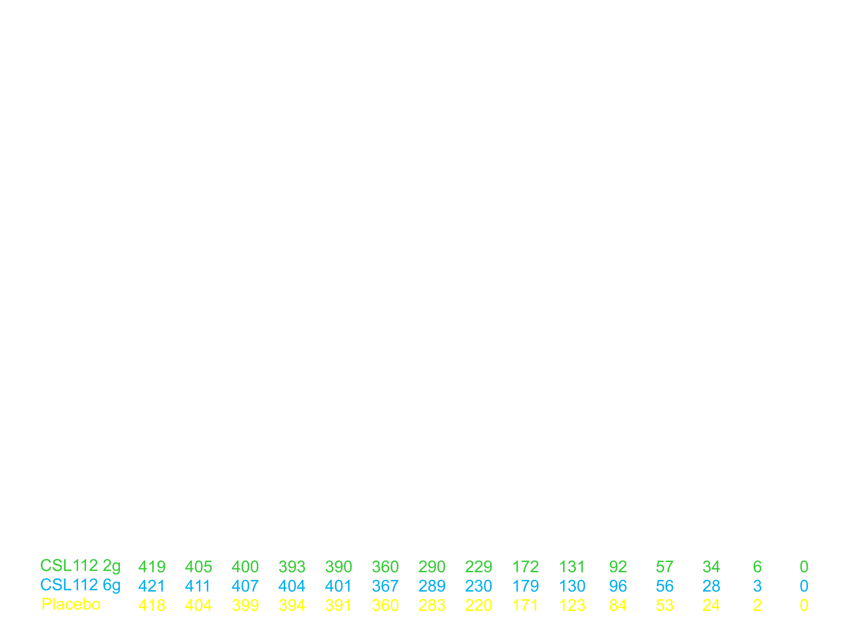
Time-to-First MACE
CV Death, Nonfatal MI, Ischemic Stroke, UA Hospitalization
Through Study Day 112
Low Dose CSL112 vs. Placebo
HR (95% CI) = 1.12 (0.58 – 2.16)
High Dose CSL112 vs. Placebo
HR (95% CI) = 0.81 (0.40 – 1.64)
8.3%
7.1%
6.7%
Low Dose
CSL112 (2g)
Cumulative Incidence of MACE (%)
Placebo
Through End of Study
High Dose
CSL112 (6g)
Low Dose CSL112 vs. Placebo
HR (95% CI) = 1.18 (0.67 – 2.05)
High Dose CSL112 vs. Placebo
HR (95% CI) = 1.02 (0.57 – 1.80)
No. at risk
Time (Days)
Gibson et al. AHA 2016

Slide 21
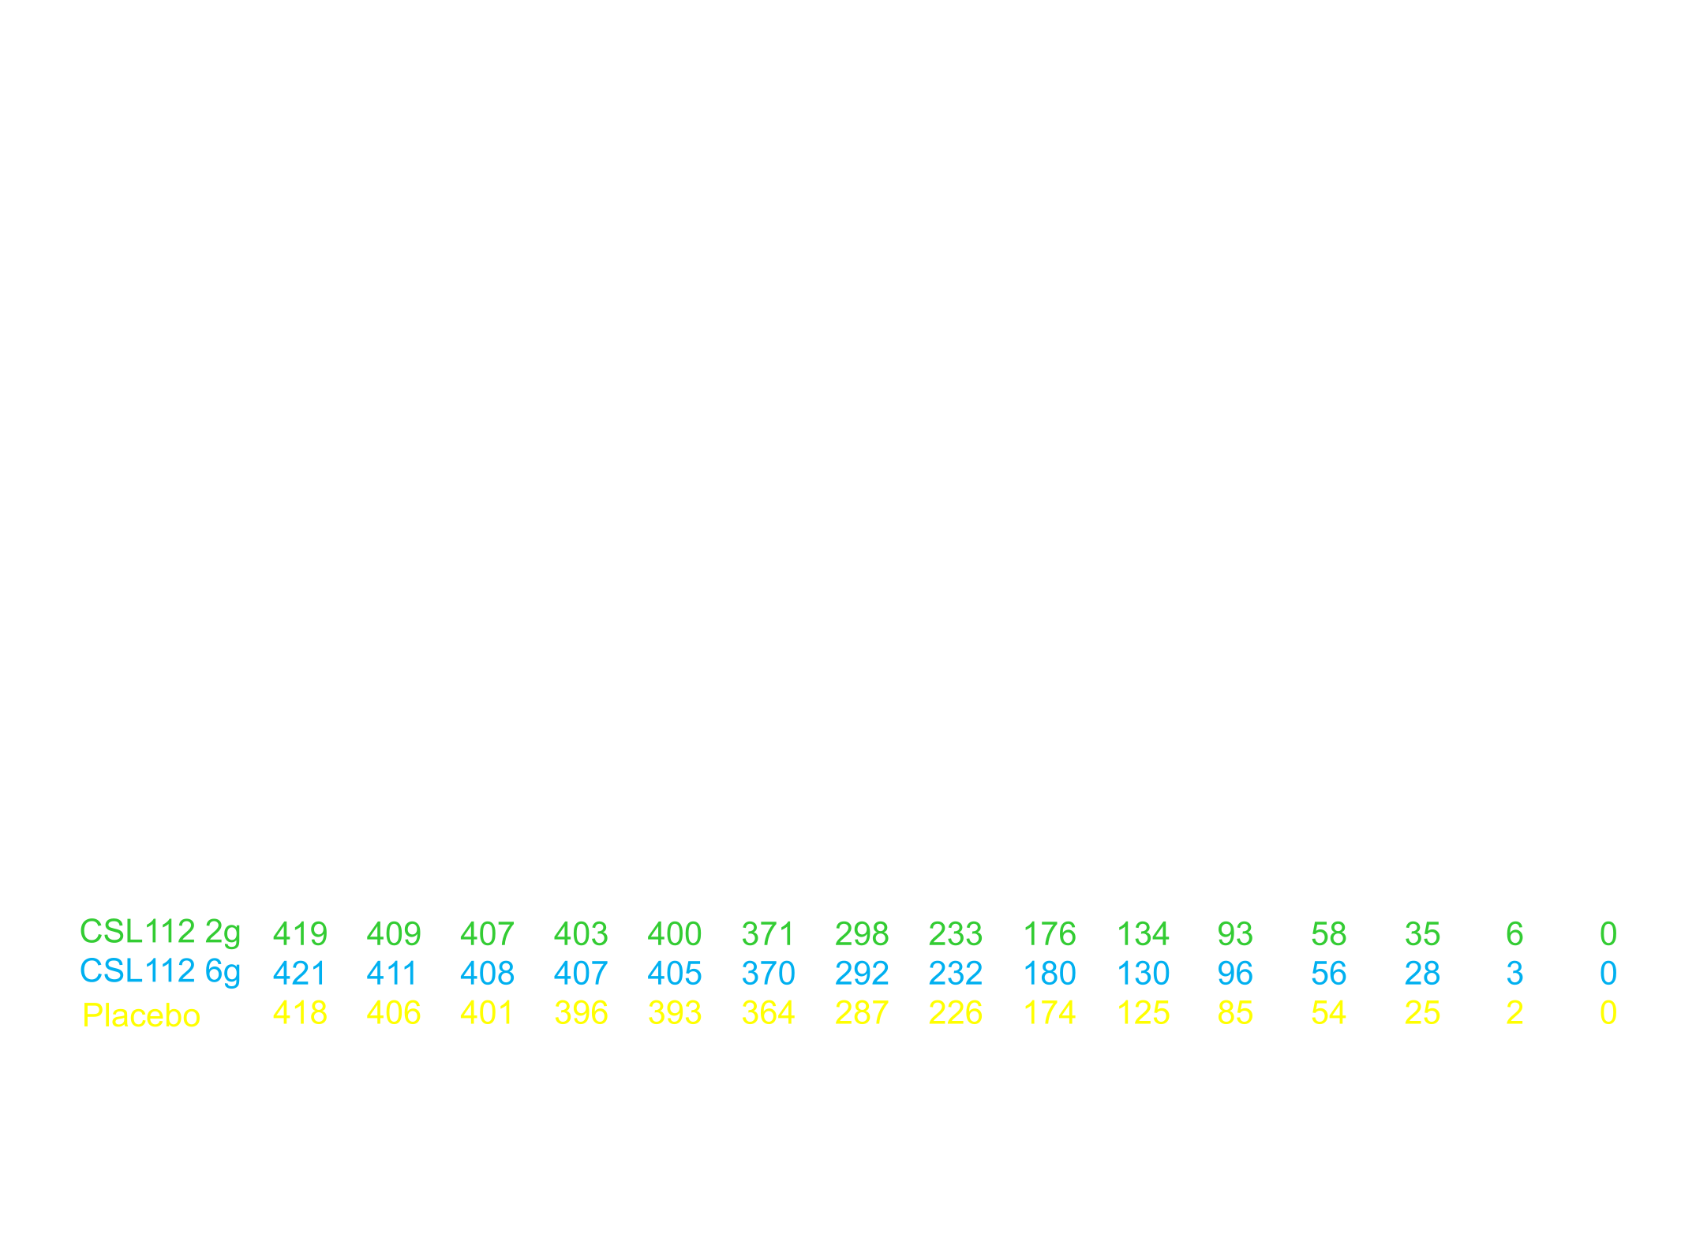
Pre-Specified Exploratory MACE Endpoint
CV Death, Nonfatal MI, Stroke
Through Study Day 112
Low Dose CSL112 vs. Placebo
HR (95% CI) = 0.60 (0.26 – 1.37)
High Dose CSL112 vs. Placebo
HR (95% CI) = 0.66 (0.30 – 1.46)
6.6%
High Dose
CSL112 (6g)
Cumulative Incidence of MACE (%)
4.5%
Placebo
4.3%
Through End of Study
Low Dose
CSL112 (2g)
Low Dose CSL112 vs. Placebo
HR (95% CI) = 0.93 (0.47 – 1.85)
High Dose CSL112 vs. Placebo
HR (95% CI) = 1.15 (0.60 – 2.20)
No. at risk
Time (Days)
Gibson et al. AHA 2016

Slide 22
Individual Components of MACE Endpoint
MACE Endpoint | Low Dose (2g) (N=419) | High Dose (6g) (N=421) | Placebo (N=418)
Composite 2° Endpoint | 27 (6.4%) | 24 (5.7%) | 23 (5.5%)
CV death | 2 (0.5%) | 4 (1.0%)* | 0 (0.0%)
Nonfatal MI | 14 (3.3%) | 13 (3.1%) | 14 (3.3%)
Any strokes | 0 (0.0%) | 4 (1.0%) | 3 (0.7%)
Ischemic stroke | 0 (0.0%) | 3 (0.7%) | 3 (0.7%)
Hemorrhagic stroke | 0 (0.0%) | 1 (0.2%) | 0 (0.0%)
Hosp. for unstable angina | 13 (3.1%) | 6 (1.4%) | 7 (1.7%)
All-cause mortality | 5 (1.2%) | 4 (1.0%) | 1 (0.2%)
Non-CV death | 3 (0.7%) | 0 (0.0%) | 1 (0.2%)
Heart failure | 5 (1.2%) | 4 (1.0%) | 1 (0.2%)
Coronary revascularization | 26 (6.2%) | 17 (4.0%) | 25 (6.0%)
*p = 0.048, not adjusted for multiplicity. Percentages proportion of patients with an event, not a KM estimate.
No events were classified as stroke indeterminate
Gibson et al. AHA 2016
Notes:
The number of MACE events overall was low (n=74) as was the number of subjects with complete follow-up through one year (89/1258). The statistical power to assess the secondary MACE endpoint was very low, approximately 8.4% (supplementary Table S7). MACE rates were generally comparable between groups, although cardiovascular mortality was higher in the 6g group compared to placebo (4 vs 0 deaths, p=0.0477). The calculated p-value was not adjusted for the multiplicity of 32 efficacy comparisons. There was no clustering of death in proximity to the CSL112 infusion (Supplementary Table S6 and Figure S1). It should be noted that indeterminant causes of death were included as cardiovascular death. The isolated difference in mortality was inconsistent with the overall similarity in MACE rates.

Slide 23
Fold Elevation in Cholesterol Efflux Capacity, ApoA-I and HDL after First Infusion of CSL112
p<0.001 for 6g & 2g vs placebo
p<0.001 for 6g vs 2g
Total Cholesterol Efflux Capacity (%/4h)
ABCA1-Dependent
Cholesterol Efflux Capacity (%/4h)
ApoA-I
HDL Cholesterol
Fold elevation at peak compared with baseline All analyses were performed using patients with available data.
Gibson et al. AHA 2016
Notes:
The fold elevation of ABCA1 dependent efflux was substantially greater than the fold elevation of apoA-I. The mechanisms underlying this strong elevation were presented yesterday at AHA and involve CSL112-driven remodeling with circulating HDL with formation of small, highly functional HDL species.

Slide 24
Summary
Infusion of CSL112 following MI and contrast was well tolerated and does not significantly alter liver or kidney function.
CSL112 elevates cholesterol efflux capacity in a dose dependent fashion.
Assessment of the efficacy of CSL112 will require further evaluation in an adequately powered phase 3 trial.
Gibson et al. AHA 2016

