Slide 1

Apixaban for treatment of venous thromboembolism associated with cancer
Giancarlo Agnelli
for the Caravaggio Steering Committee University of Perugia, Italy

Slide 2
Study background
The high risk of recurrent venous thromboembolism and bleeding in patients with cancer requires specific studies on anticoagulant treatment
Major guidelines recommend low-molecular-weight heparin and have recently added edoxaban and rivaroxaban
The clinical benefit of these oral agents is limited by the high risk of bleeding, mainly occurring at gastrointestinal sites

Slide 3



The Caravaggio study
Aim: To assess whether oral apixaban was non-inferior to subcutaneous dalteparin for the treatment of proximal DVT and/or PE in patients with cancer
Design: Randomized, open-label, PROBE, non-inferiority study
End of Treatment
Apixaban
Apixaban
Objectively confirmed acute proximal DVT and/or PE
10 mg bid
5 mg bid
<72 hrs
R
30 days observation period
Dalteparin, sc
Dalteparin , sc
200 IU/kg od 150 IU/kg od
Day 1 Day 7 Day 30 6 months
Investigator-Initiated Study supported by an unrestricted grant from the Bristol-Myers Squibb/Pfizer Alliance

Slide 4
Inclusion criteria (I)
Consecutive patients with objectively confirmed:
symptomatic or incidental*, proximal lower-limb DVT or
symptomatic pulmonary embolism or
incidental* pulmonary embolism in a segmental or more proximal pulmonary artery
* Incidental DVT or PE were events detected on imaging tests performed for reasons other than clinical suspicion of venous thromboembolism. The maximum proportion of patients entering the study with incidental VTE was set at 20% of the overall study population

Slide 5
Inclusion criteria (II)
Any type of cancer other than basal-cell or squamous-cell carcinoma of the skin, primary brain tumor or known cerebral metastases and acute leukemia
Active cancer
defined as diagnosis of cancer within six months before the study inclusion, or receiving treatment for cancer at the time of inclusion or any treatment for cancer during 6 months prior to randomization, or recurrent locally advanced or metastatic cancer
History of cancer*
Cancer diagnosed within 2 years before the study inclusion
* The maximum proportion of patients entering the study with history of cancer was set at 20% of the overall study population

Slide 6
Main exclusion criteria
Age lower than 18 years
ECOG Performance Status III or IV
Life expectancy of less than 6 months
Therapeutic doses of LMWH, fondaparinux, UFH or VKA for >72 hours before randomization
Indication for anticoagulant treatment for a disease other than the index VTE
Concomitant use of strong inhibitors or inducers of both CYP-3A4 and P-gp
Concomitant thienopyridine therapy (clopidogrel, prasugrel, or ticagrelor) or aspirin over 165 mg daily or dual antiplatelet therapy
Active bleeding or a high risk of bleeding contraindicating anticoagulant treatment
Hb < 8 g/dL or platelet count < 75x10⁹/L or creatinine clearance < 30 ml /min)

Slide 7
Study outcomes
Efficacy:
Objectively confirmed recurrent proximal DVT or PE occurring during the study treatment period:
proximal DVT of the lower limbs (symptomatic or incidental)
DVT of the upper limbs (symptomatic)
pulmonary embolism (symptomatic or incidental)
Safety:
Major bleeding (EMA definition*)
* EMA definition: ISTH criteria (acute clinically overt bleeding with ≥ 1 of the following: decrease in hemoglobin ≥ 2 g/dl; transfusion ≥ 2 units of packed red blood cells, occurring in at least one of the following critical sites: intracranial, intra-spinal, intraocular, pericardial, intra-articular, intramuscular with compartment syndrome or retroperitoneal; fatal) and bleeding that necessitates acute surgical intervention

Slide 8
Study hypothesis: statistics and analysis
Hypothesis: apixaban non-inferior to conventional therapy for primary efficacy outcome (VTE recurrence)
Estimated rate of VTE with dalteparin: 7% at 6 months
Hazard rate non-inferiority margin of 2.00
80% power, at a one-sided alpha level of 0.025
Sample size: 1168 patients
Drop-out rate of 20% lost in total patient-years
Primary analysis population: modified intention-to-treat (m-ITT)
This estimate is consistent with a drop-out rate of 40% assuming patients discontinued uniformly during the follow-up (mean discontinuation time equal to 3 months)

Slide 9
Patient disposition
1170 Patients randomized
585 Assigned to receive apixaban
585 Assigned to receive dalteparin
9 Did not receive the assigned treatment
6 Did not receive the assigned treatment
576 Included in the mITT and safety populations
579 Included in the mITT and safety populations
2 With a preliminary diagnosis of index VTE not confirmed
1 With a preliminary diagnosis of Cancer not
confirmed
177 Did not complete the study period
137 Died
12 Were lost to follow-up 28 Had other reason
2 With a preliminary diagnosis of index VTE not confirmed
1 With a preliminary diagnosis of Cancer not
confirmed
197 Did not complete the study period
149 Died
8 Were lost to follow-up 40 Had other reason

Slide 10
Patient characteristics at baseline
 | Apixaban | Dalteparin
 | N=576 | N=579
Mean age, y (SD) | 67.2 (11.3) | 67.2 (10.9)
Male sex, n (%) | 292 (50.7) | 276 (47.7)
Mean weight, kg (SD) | 75.7 (16.1) | 76.1 (16.7)
PE with or without DVT | 304 (52.8) | 334 (57.7)
DVT only | 272 (47.2) | 245 (42.3)
Symptomatic DVT or PE | 460 (79.9) | 465 (80.3)
Incidental DVT or PE * | 116 (20.1) | 114 (19.7)
Active cancer, n (%) | 559 (97.0) | 565 (97.6)
Recurrent Locally Advanced or Metastatic cancer, n (%) | 389 (67.5) | 396 (68.4)
§ Treatment for cancer at the time of inclusion, n (%) | 350 (60.8) | 367 (63.4)
§ Treatment for cancer within previous 6 months, n (%) | 143 (24.8) | 129 (22.3)
§ Treatment for cancer during the study period, n (%) | 344 (59.7) | 346 (59.8)
Previous venous thromboembolism, n (%) | 45 (7.8) | 61 (10.5)
Platelet count < 100,000 per mm³, n (%) | 21 (3.6) | 22 (3.8)
Creatinine clearance ≤50 ml/min, n (%) | 51 (8.9) | 61 (10.5)
§ Cancer treatment includes anticancer drug therapy (cytotoxic, hormonal, targeted or immunomodulatory), radiotherapy, surgery, or a combination of these therapies

Slide 11
Type of cancer
 | Apixaban N=576 | Dalteparin N=579
Solid tumor, n(%) | 543 (94.3) | 527 (91.0)
Colorectal | 121 (21.0) | 113 (19.5)
Lung | 105 (18.2) | 95 (16.4)
Breast | 79 (13.7) | 76 (13.1)
Genitourinary | 66 (11.5) | 73 (12.6)
Gynecological | 60 (10.4) | 59 (10.2)
Pancreatic or hepatobiliary | 44 (7.6) | 43 (7.4)
Upper gastrointestinal | 23 (4.0) | 31 (5.4)
Head and Neck | 14 (2.4) | 8 (1.4)
Bone/soft tissue | 11 (1.9) | 7 (1.2)
Skin-melanoma | 4 (0.7) | 7 (1.2)
Other | 16 (2.8) | 15 (2.6)
Hematological malignancy, n (%) | 33 (5.7) | 52 (9.0)

Slide 12
Primary efficacy outcomes
 | Apixaban N=576 | Dalteparin N=579 | Hazard Ratio (95% CI) | P Value
Recurrent VTE, n (%) | 32 (5.6) | 46 (7.9) | 0.63 (0.37–1.07) | <0.001 for noninferiority 0.08 for superiority
Recurrent DVT, n (%) | 13 (2.3) | 15 (2.6) | 0.87 (0.34–2.21)
Recurrent PE, n (%) | 19 (3.3) | 32 (5.5) | 0.54 (0.29–1.03)
Fatal PE, n (%) | 4 (0.7) | 3 (0.5) | 1.93 (0.40–9.41)

Slide 13
Primary and secondary safety outcomes
Apixaban
Dalteparin
Hazard Ratio
P Value
 | N=576 | N=579 | (95% CI)
Major Bleeding, n (%) | 22 (3.8) | 23 (4.0) | 0.82 (0.40–1.69) | 0.60
Major GI bleeding, n (%) | 11 (1.9) | 10 (1.7) | 1.05 (0.44–2.50)
Major non GI bleeding, n (%) | 11 (1.9) | 13 (2.2) | 0.68 (0.21–2.20)
CRNMB, n (%) | 52 (9.0) | 35 (6.0) | 1.42 (0.88-2.30)
MB & CRNMB, n (%) | 70 (12.2) | 56 (9.7) | 1.16 (0.77-1.75)
CRNMB, clinically relevant nonmajor bleeding

Slide 14
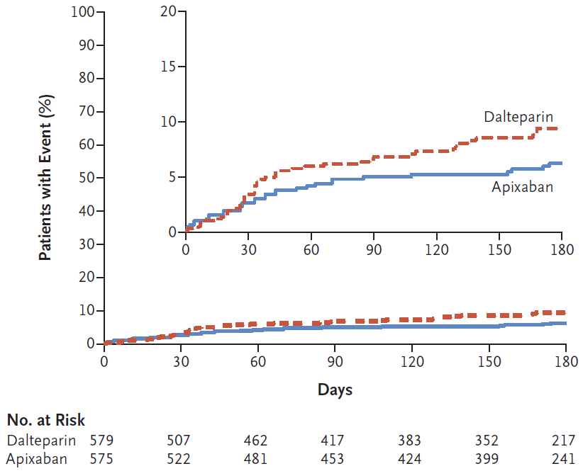
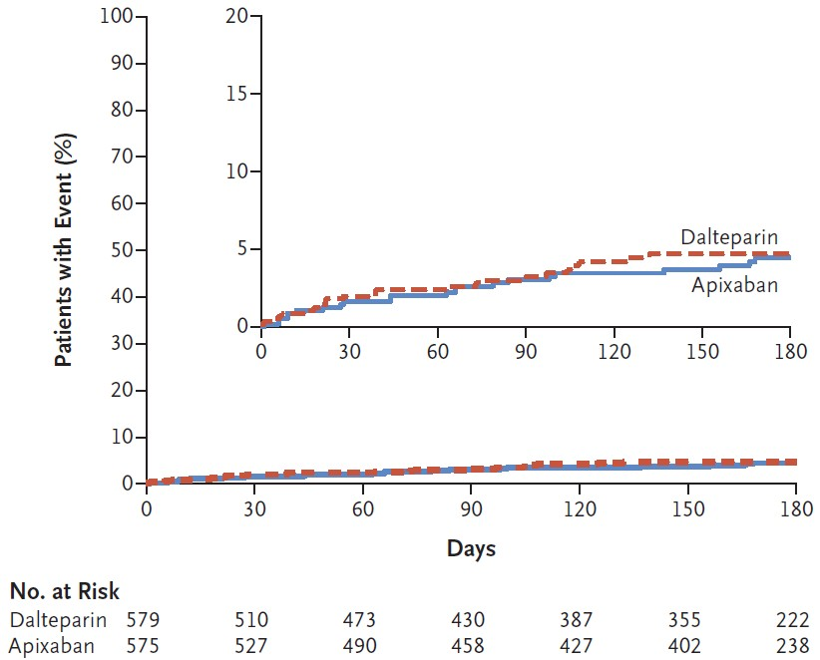
Cumulative event rate of VTE recurrences and major bleeding
Recurrent VTE
Major Bleeding

Slide 15
Conclusions
Oral apixaban was noninferior to subcutaneous dalteparin for the treatment of cancer-associated venous thromboembolism
No increase in the risk of major bleeding was observed in particular at the gastrointestinal sites.
Findings of Caravaggio expand the proportion of patients with cancer-associated thrombosis who are eligible for treatment with the oral direct anticoagulants, including patients with gastrointestinal cancer

Slide 16
Study Committees
Steering Committee | Data Monitoring Committee | Central Adjudication Committee
Giancarlo Agnelli, Cecilia Becattini, Guy Meyer, Andres Muñoz, Menno V. Huisman, Jean Marie Connors, Alexander Cohen, Rupert Bauersachs, Benjamin Brenner, Adam Torbicki, Maria Rosales Sueiro, Catherine Lambert, | Henri Bounameaux, Sabine Eichinger, Claudio Cimminiello | Walter Ageno, Michele Duranti, Francesco Guercini, David Jimenez Castro, Sonia Fatigoni, Arnaud Perrier, Marco Moia
Gualberto Gussoni, Mauro Campanini, Andrea Fontanella, Giorgio Vescovo, Melina Verso

