Slide 1
POPULAR TAVI TRIAL
A Randomized, Open Label, Multicenter Study of Oral Anticoagulation with or without Clopidogrel after Transcatheter Aortic Valve Implantation
Vincent J Nijenhuis, MD
St. Antonius hospital, Nieuwegein, the Netherlands
on behalf of the POPULAR TAVI investigators PI Dr. Jurrien ten Berg, MD, PhD, FACC, FESC

Slide 2
Disclosures Dr Nijenhuis
None.

Slide 3
Background
TAVI remains associated with frequent complications:
  Major and life-threatening bleeding: 3-15%
  Stroke: 1-8%
Approximately 30% of patients have atrial fibrillation (AF)
In these patients, the risk of thromboembolic events is higher
Mack et al. Transcatheter Aortic-Valve Replacement with a Balloon-Expandable Valve in Low-Risk Patients. N Engl J Med 2019;380(18):1695–705.
Popma et al. Transcatheter Aortic-Valve Replacement with a Self-Expanding Valve in Low-Risk Patients. N Engl J Med 2019;380(18):1706–15.
Leon et al. Transcatheter or Surgical Aortic-Valve Replacement in Intermediate-Risk Patients. N Engl J Med 2016;374(17):1609–20.
Reardon et al. Surgical or Transcatheter Aortic-Valve Replacement in Intermediate-Risk Patients. N Engl J Med 2017;376(14):1321–31.
Thyregod et al. 1-year results from the all-comers NOTION randomized clinical trial. J Am Coll Cardiol 2015;65(20):2184–94.

Slide 4
Background
Patients with AF undergoing TAVI are in need of oral anticoagulation (OAC) to reduce stroke and thromboembolism
Antiplatelet therapy in addition to OAC may decrease thromboembolism after TAVI but increases bleeding
Kosmidou et al. Antithrombotic Therapy and Cardiovascular Outcomes After Transcatheter Aortic Valve Replacement in Patients With Atrial Fibrillation. JACC Cardiovasc Interv 2019;12(16):1580–9
Abdul-Jawad Altisent et al. Warfarin and Antiplatelet Therapy Versus Warfarin Alone for Treating Patients With Atrial Fibrillation Undergoing Transcatheter Aortic Valve Replacement. JACC Cardiovasc Interv 2016;9(16):1706–17.

Slide 5

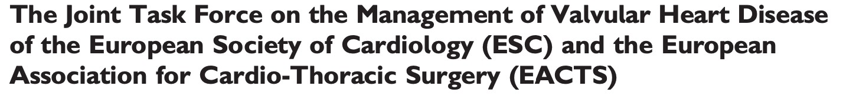



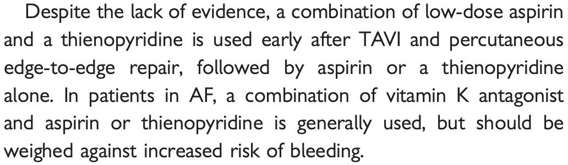


Background
POPULAR TAVI COHORT A PATIENTS WITHOUT OAC N=665
POPULAR TAVI COHORT B PATIENTS WITH OAC N=313

Slide 6

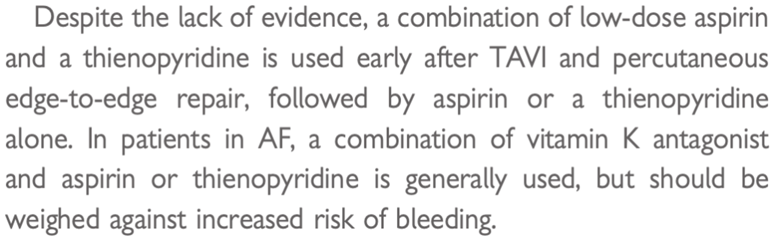
Background
POPULAR TAVI COHORT B PATIENTS WITH OAC N=313

Slide 7
Hypothesis
OAC alone vs. OAC + 3 months clopidogrel, is:
Superior for bleeding (primary outcome),
Non-inferior for the composite of CV death, stroke, MI, non-procedural bleeding (secondary outcome),
Non-inferior for the composite of CV death, ischemic stroke, MI (secondary outcome).

Slide 8
Trial Organization
Trial Design
  Investigator initiated, randomised, open-label, blinded CEC
Sponsor and coordinating center
  St. Antonius Hospital, Nieuwegein, The Netherlands
Funding and Support
  Dutch Organization for Health Research and Development ZonMw (project no. 836031014)

Slide 9

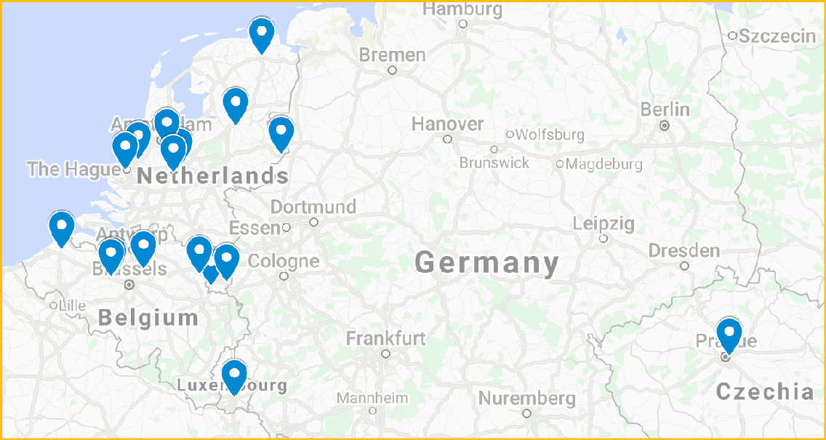
Recruitment
Participating Sites (17)
  Netherlands
  Belgium
  Luxembourg
  Czech Republic

Slide 10
Study Population
Inclusion
Exclusion
•
Long-term indication for OAC
Written informed consent
DES within 3 months before TAVI
BMS within 1 month before TAVI
Allergy or contraindication to OAC or clopidogrel

Slide 11



















PLANNED TAVI AND ON OAC (COHORT B)
RANDOMIZATION 1:1
PRIOR TO TAVI
N=326
OAC ALONE
N=164
OAC + 3M CLOPIDOGREL
N=162
7 EXCLUDED
4 withdrew consent
2 TAVI not initiated/completed 1 screen failure
6 EXCLUDED
1 withdrew consent
3 TAVI not initiated/completed 2 screen failure
Modified ITT ANALYSIS
N=157
Modified ITT ANALYSIS
N=156
FOLLOW-UP: 1 YEAR
CO-PRIMARY OUTCOMES: 1. All bleeding (VARC-2)
2. Non-procedural bleeding (BARC)
CO-SECONDARY OUTCOMES: 1. CV mortality, non-procedural bleeding, all-cause stroke, and MI
2. CV mortality, ischemic stroke, and MI

Slide 12
Study Power
Primary outcomes:
  Superiority, power 80%, alpha 0.05
  Expected event rate OAC vs. OAC + clopidogrel: 18% vs. 36%
Secondary outcomes:
  Non-inferiority, non-inferiority margin: 7.5%
  Expected event rate OAC vs. OAC + clopidogrel: 31% vs. 39%

Slide 13
Adherence and Cross-Overs
Adherence for 3 months clopidogrel: 95.5%
Duration clopidogrel: median 91 days [IQR 89-92]
Cross-overs: one in each group

Slide 14
Baseline
 | OAC (N=157) | OAC + CLOPIDOGREL (N=156)
Age - yr | 81±6 | 81±6
Female - no. (%) | 69 (43.9) | 73 (46.8)
NYHA class III or IV – no. (%) | 119 (75.8) | 110 (70.1)
STS risk score - % [IQR] | 3.2 [2.2 - 4.8] | 3.1 [2.3 - 4.5]
Atrial fibrillation - no. (%) | 150 (95.5) | 147 (94.2)
Coronary artery disease - no. (%) | 65 (41.4) | 69 (44.2)
Peripheral artery disease - no. (%) | 30 (19.1) | 28 (17.9)
Previous stroke - no. (%) | 15 (9.6) | 15 (9.6)
Estimated GFR - ml/min/1.73 m² | 53±18 | 56±17
LVEF – no. (%)
>50% | 91 (58.0) | 97 (62.2)
30-50% | 54 (34.4) | 46 (29.5)
≤30% | 12 (7.6) | 13 (8.3)

Slide 15
Anticoagulation
 | OAC (N=157) | OAC + CLOPIDOGREL (N=156)
Vitamin K antagonist – no. (%) | 118 (75.2) | 110 (70.5)
Acenocoumarol | 97 (61.8) | 91 (58.3)
Phenprocoumon | 18 (11.5) | 16 (10.3)
Warfarin | 3 (1.9) | 3 (1.9)
Direct oral anticoagulant – no. (%) | 37 (23.6) | 46 (29.5)
Apixaban | 14 (8.9) | 25 (16.0)
Dabigatran | 7 (4.5) | 4 (2.6)
Edoxaban | 4 (2.5) | 4 (2.6)
Rivaroxaban | 12 (7.6) | 12 (7.6)
Low molecular weight heparin – no (%) | 2 (1.3) | 0 (0)

Slide 16
Procedure
 | OAC (N=157) | OAC + CLOPIDOGREL (N=156)
Approach
Transfemoral | 136 (86.6) | 132 (84.6)
Other | 21 (13.4) | 24 (15.4)
Unfractionated heparin – no. (%) | 157 (100) | 156 (100)
Maximal ACT – seconds [IQR] | 285 [246-319] | 290 [240-330]
Prosthesis – no. (%)
Sapien 3, Edwards Lifesciences | 65 (41.4) | 82 (52.6)
CoreValve Evolut R, Medtronic | 45 (28.7) | 36 (23.1)
Other | 47 (29.9) | 38 (24.3)
Embolic protection device use – no. (%) | 4 (2.5) | 6 (3.8)
VARC-2 vascular complication – no (%) | 20 (12.7) | 35 (22.4)
Minor vascular complication | 12 (7.6) | 17 (10.9)
Major vascular complication | 8 (5.1) | 18 (11.5)

Slide 17
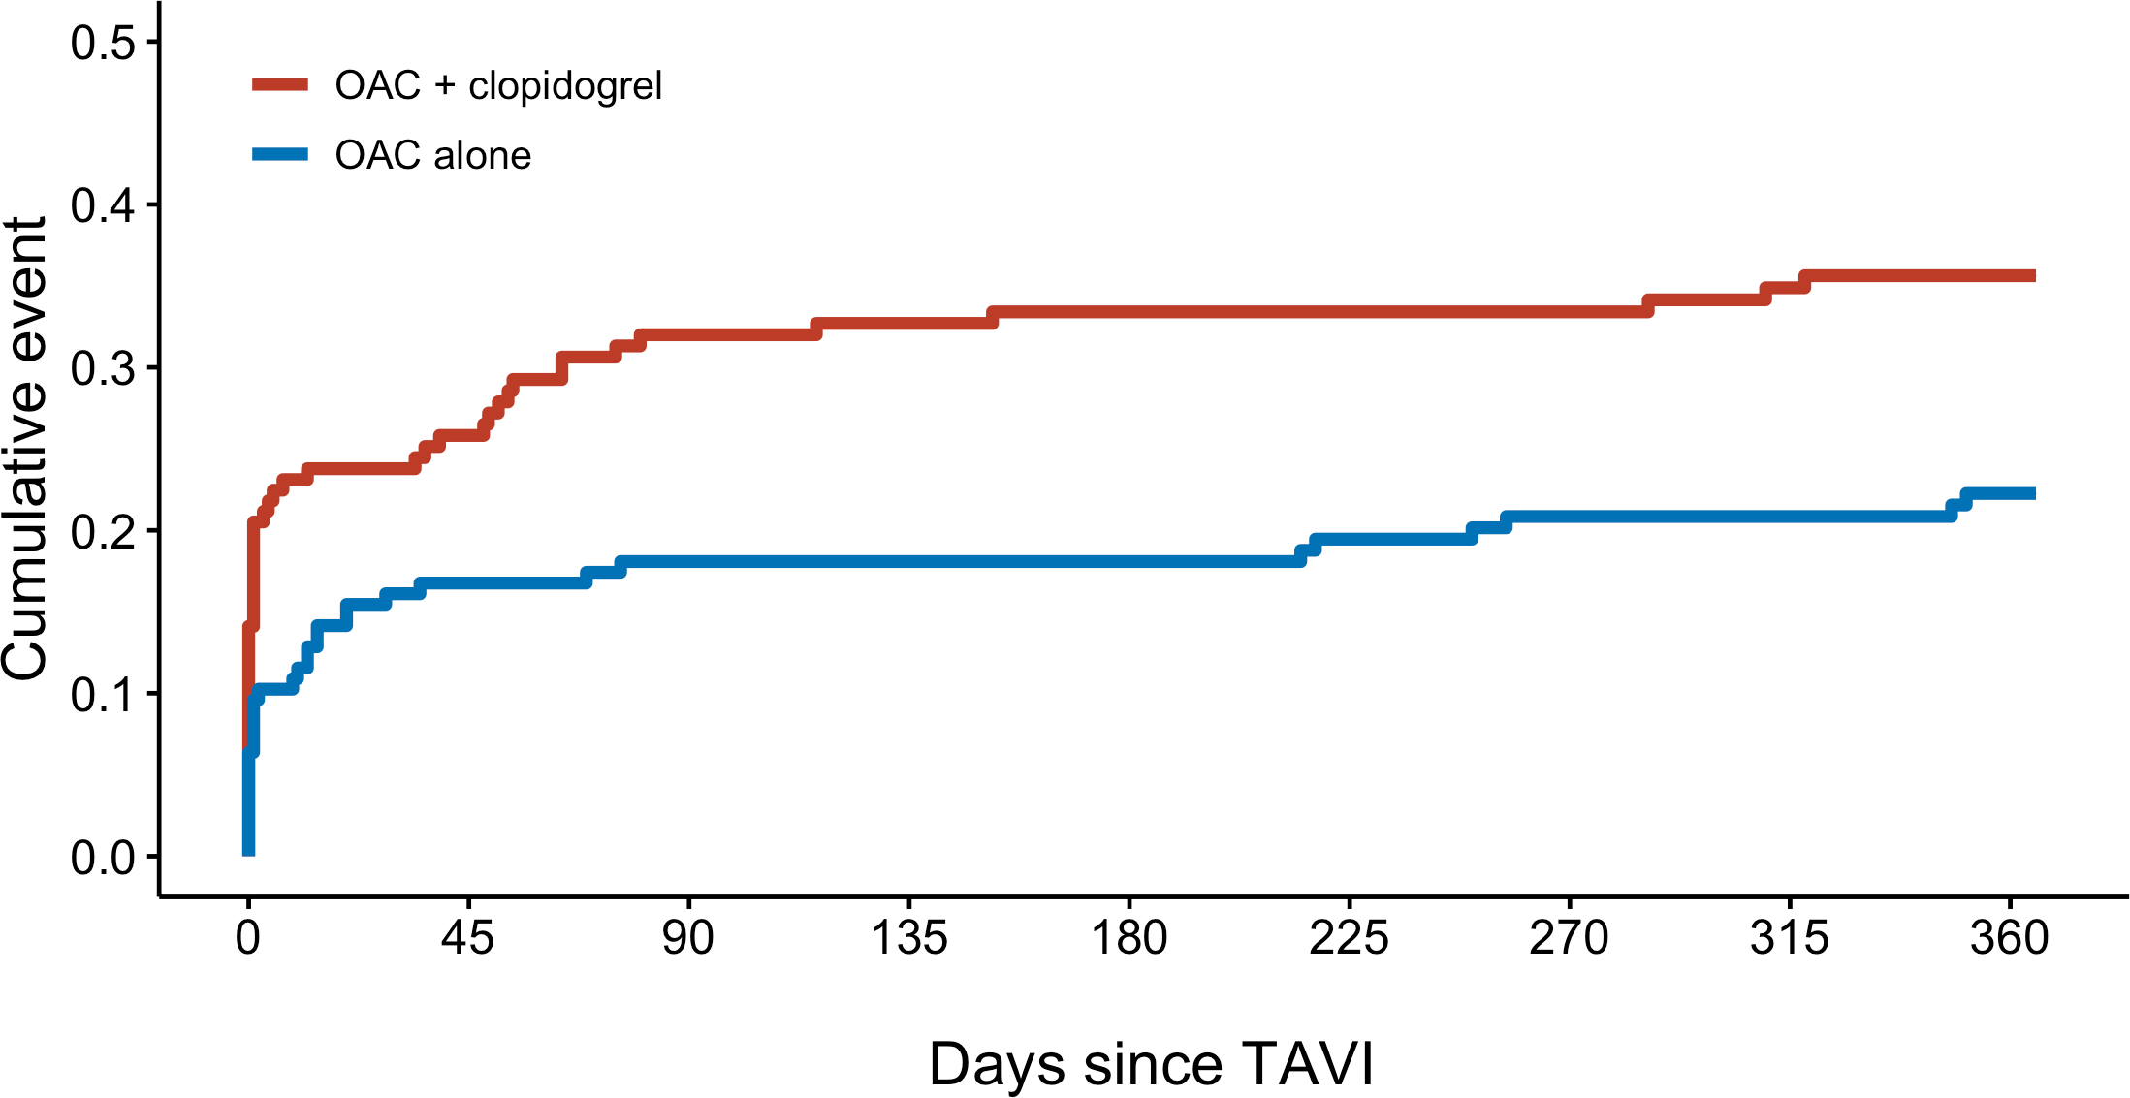
All Bleeding
34.6%
21.7%
RR 0.63
95% CI 0.43 to 0.90
P = 0.011

Slide 18
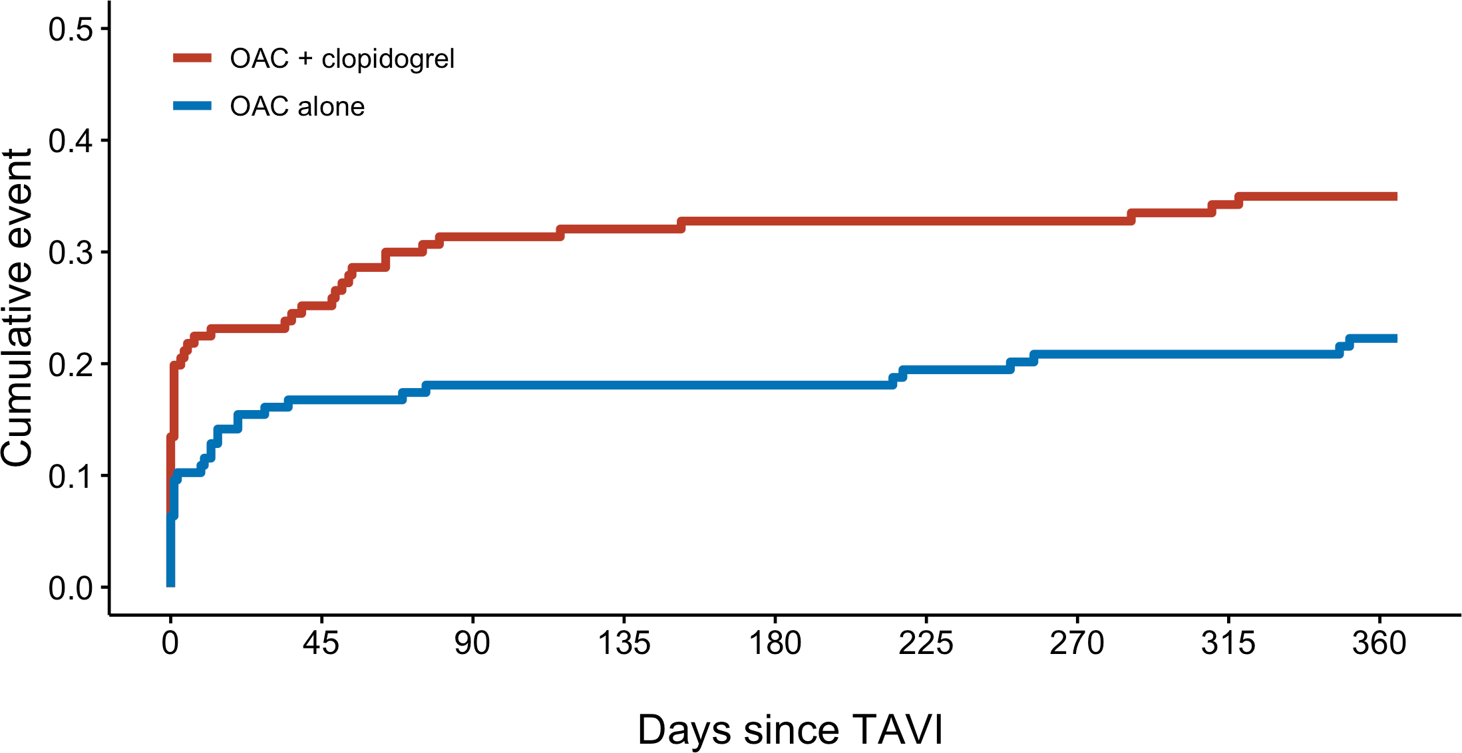
Non-Procedural Bleeding
34.0%
21.7%
RR 0.64
95% CI 0.44 to 0.92
P = 0.015

Slide 19
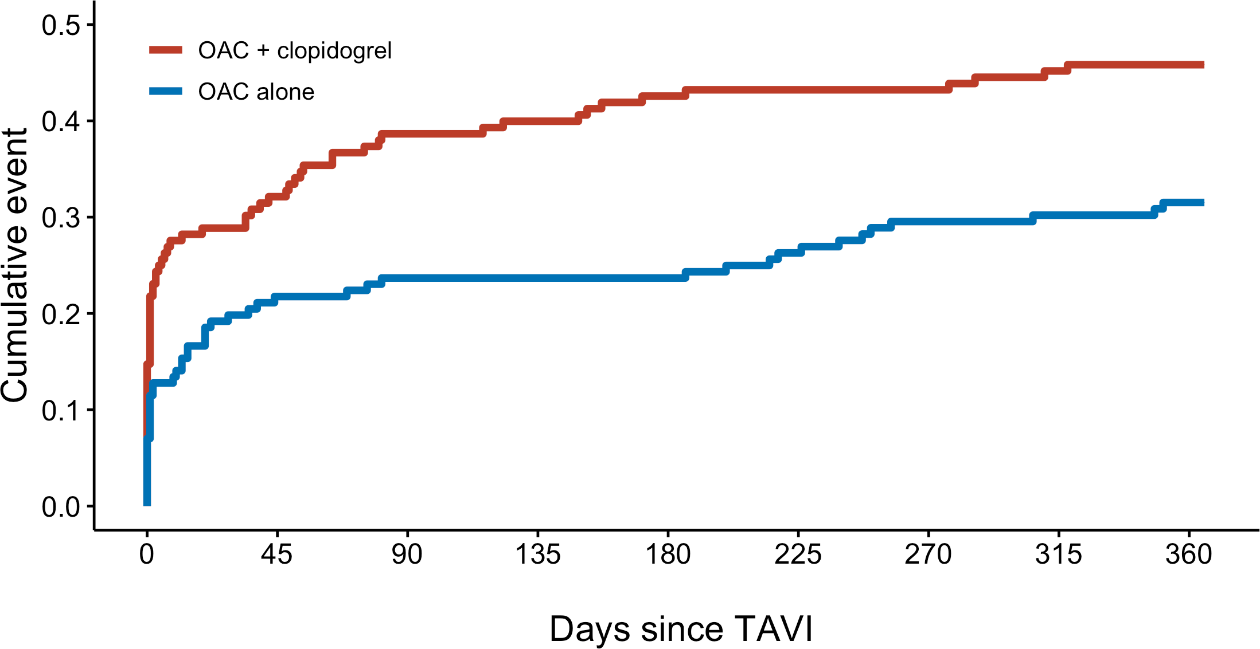
CV Mortality, Non-Procedural Bleeding, Stroke, MI
45.5%
31.2%
RR 0.69
95% CI 0.51 to 0.92
-14.3% (-25.0 to -3.6)
Non-inferiority margin +7.5%

Slide 20
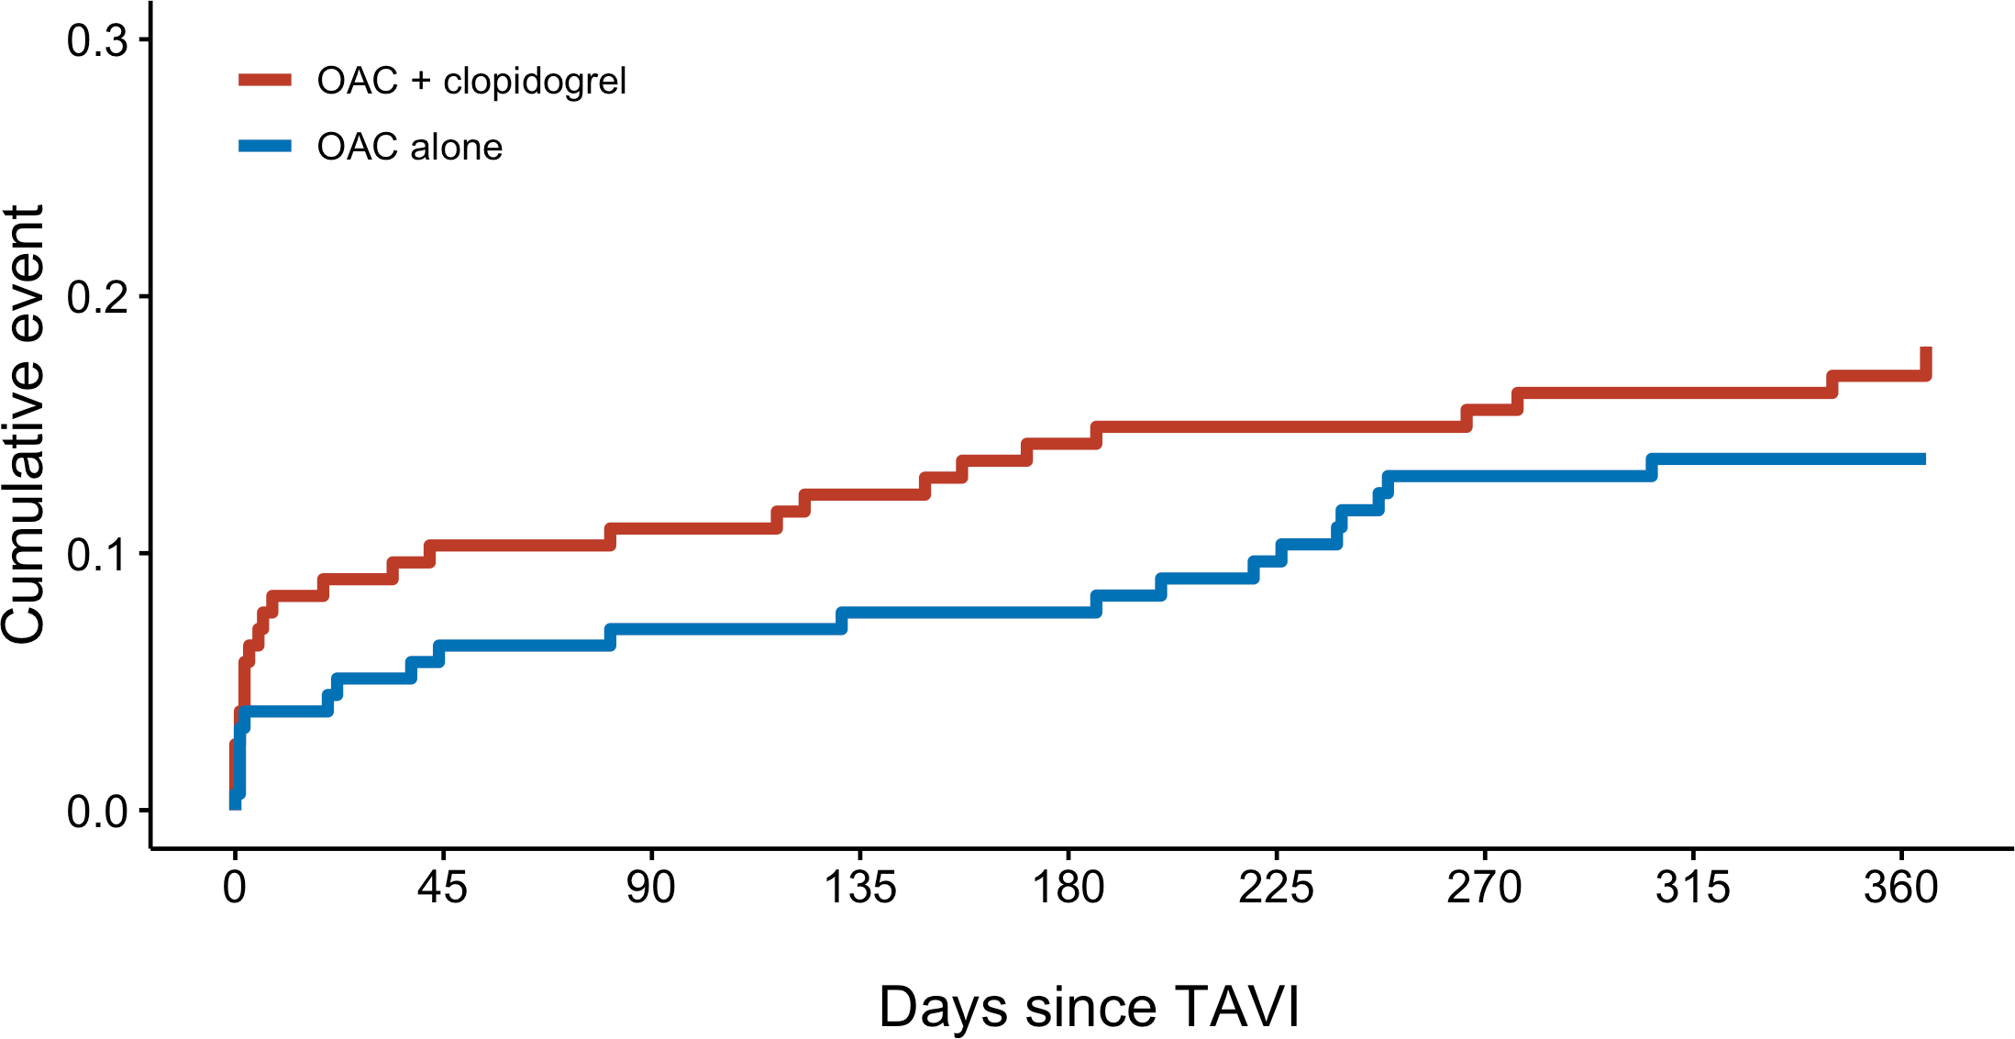
CV Mortality, Ischemic Stroke, MI
17.3%
13.4%
RR 0.77
95% CI 0.46 to 1.31
-3.9% (-11.9 to 4.0)
Non-inferiority margin +7.5%

Slide 21
Secondary outcomes
 | OAC (N=157) | OAC + CLOPIDOGREL (N=156) | RISK RATIO (95% CI)
Death
Death from any cause | 21 (13.4) | 24 (15.4) | 0.87 (0.51 to 1.50)
Death from cardiovascular causes | 13 (8.3) | 20 (12.8) | 0.65 (0.33 to 1.25)
Stroke
Ischemic | 8 (5.1) | 9 (5.8) | 0.88 (0.35 to 2.23)
Hemorrhagic | 1 (0.6) | 0
Myocardial infarction | 1 (0.6) | 1 (0.6) | 0.99 (0.06 to 15.75)
Bleeding
Major, life-threatening, or disabling | 14 (8.9) | 26 (16.7) | 0.54 (0.29 to 0.99)
Minor | 20 (12.7) | 28 (17.9) | 0.71 (0.42 to 1.21)

Slide 22
Conclusions POPULAR TAVI COHORT B
In patients with an established indication for OAC undergoing TAVI,
OAC alone as compared to OAC + clopidogrel:
Reduces the rate of bleeding events, including major, life-threatening, or disabling bleeding
Does not increase the rate of thrombotic events

Slide 23
Acknowledgments
Investigators
Jorn Brouwer (Coordinating I.) Ronak Delewi
Renicus S. Hermanides
Wouter Holvoet Christophe L.F. Dubois Peter Frambach Bernard De Bruyne
Gert K. van Houwelingen Jan A.S. Van Der Heyden Petr Toušek
Frank van der Kley Ian Buysschaert
Carl E. Schotborgh
(Continued)
Bert Ferdinande Pim van der Harst John Roosen
Joyce Peper Frederick W.F. Thielen
Leo Veenstra
Dean R.P.P. Chan Pin Yin Martin J. Swaans
Benno J.W.M. Rensing Arnoud W.J. van ‘t Hof Leo Timmers Johannes C. Kelder Pieter R. Stella
(Continued)
Jan Baan
Jurriën M. ten Berg (PI)
Steering Committee Jurrien M. Ten Berg Pieter R. Stella
Jan Baan
Arie P. Kappetein
Data Safety Monitoring Board
Thijs Plokker Freek Verheugt
J.J. Koolen
Funding
ZonMW
Endpoint Adjudication Committee
Egbert Bal
B.M. Swinkels Bert Everaert

