Slide 1
Effect of Evolocumab on
Coronary Plaque Characteristics in Stable
Coronary Artery Disease:
a Multimodality Imaging
Study (The YELLOW III Study)
Annapoorna S. Kini, K Yasumura, Y Vengrenyuk, JM Sweeny, S Khera, V Kapur, P Melarcode-Krishnamoorthy, A Hooda, N Baruah, DA Pineda, V Chen, D Gozdenovich, E Ellis, A Hahn, P Krishnan, PR Moreno, R Mehran, J Narula, R Sebra, SK Sharma
Mount Sinai Hospital, New York, NY

Slide 2
Disclosure Statement of Financial Interest
This research was conducted with support from the Investigator-Initiated Study Program of Amgen Inc. and partial support from Abbott Vascular Inc.

Slide 3
YELLOW III: Background
Despite high intensity statin therapy, a considerable residual risk of cardiovascular events remains in patients with CAD. PCSK9 inhibitors has reduced this residual risk.
Evaluation of these effects are associated with:
Reduction in percent atheroma volume (PAV) by IVUS in patients with stable CAD (GLAGOV)¹
Increase in minimum fibrous cap thickness (FCT) by Optical Coherence Tomography (OCT) in NSTEMI (HUYGENS)²
Reduction of Lipid Core Burden Index (maxLCBI4 mm) by NIRS (PACMAN-AMI)³
Previous studies from our group showed reduced maxLCBI4 mm (YELLOW I)⁴ and increased FCT (YELLOW II)⁵ in obstructive lesions of patients with CAD after rosuvastatin 40 mg for 6-12 weeks.
¹ Nicholls et al., JAMA 2016;316:2373-2384
² Nicholls et al., JACC Cardiovasc Imaging 2022;15:1308-1321
³ Räber et al., JAMA 2022;327:1771-1781
⁴ Kini et al., JACC 2013; 62(1):21-29
⁵ Kini et al., JACC 2017; 69(6):628-640

Slide 4
YELLOW III
Aim: assess the effect of 26 weeks of evolocumab on coronary plaque morphology using intravascular imaging (OCT and NIRS/IVUS) and peripheral blood mononuclear cell (PBMC) gene expression analysis in patients with stable CAD on maximally tolerated statin therapy
Primary endpoints:
Change in minimal fibrous cap thickness (FCT) assessed by OCT
Change in maximal lipid-core burden index within 4 mm (maxLCBI_{4mm}) by NIRS
Secondary endpoints:
Change in maximal lipid arc, lipid length, lipid volume index, macrophage accumulation and calcification assessed by OCT
Change in percent atheroma volume (PAV) and total atheroma volume (TAV) assessed by IVUS
Changes in PBMC gene expression

Slide 5
YELLOW III: Study Design
LDL-C ≥ 80 mg/dL (low/moderate) LDL-C ≥ 60 mg/dL (high-dose statin)
LDL-C ≥ 100 mg/dL (statin intolerance)
Patients with stable CAD undergoing cardiac catheterization (at least 4 weeks on max tolerated statin therapy)
Non-obstructive lesion (30-50% stenosis) identified by angiography in a non-culprit vessel
Lipid rich plaque: Max Lipid Arc >90° Minimal FCT ≤ 120 µm
Baseline
After culprit vessel PCI: OCT of the study lesion
Yes
NIRS/IVUS of the study lesion
No
EXCLUDE
Evolocumab: 140 mg every 2 weeks in addition to statins (26 weeks)
PBMC mRNA analysis at Baseline and Follow-up
Follow-up
OCT and NIRS/IVUS of the study lesion
Clinical follow-up at 1, 6, 12 month

Slide 6
Results: Flow of Patients
329 Patients screened for enrollment
192 Excluded
89 LDL-C criteria not met
84 No suitable lesion on angiography 14 No lipid plaque with thin FCT on OCT 4 Withdrew consent before procedure
1 Creatinine criteria not met
137 Patients enrolled
(8 statin intolerant)
27 Excluded
11 Patient preference (no FU, took drug) 7 Consent withdrawal
4 Lost to follow-up
2 Withdrew consent before taking 1st dose
2 Died
1 Treatment discontinuation (f/u done)
110 Completed 26-week follow-up (7 statin intolerant )

Slide 7
YELLOW III: Baseline Characteristics
 | N=137
Age, y | 66.0 (9.7)
Men | 98 (71.5)
BMI, | 31.6 (19.3)
Hypertension | 127 (92.7)
Previous PCI | 97 (70.8)
Previous MI | 32 (23.4)
Current smoking | 14 (10.2)
History of smoking | 51 (37.2)
Diabetes | 74 (54.0)
Baseline statin use | N = 129*
High intensity** | 91 (71)
Moderate intensity | 38 (29)
Low intensity | 0
Coronary vessel
LAD | 29
LCX | 36
RCA | 70
RI | 2
* 8 statin intolerant patients
** atorvastatin ≥40 mg or rosuvastatin ≥20 mg

Slide 8
Results: Biochemical Measures
N =110 | Baseline | Follow up (26 weeks) | Absolute Change | P Value
Total cholesterol, md/dL | 168.7 ± 48.7 | 104.7 ± 33.5 | -64.0 ± 45.9 | <0.001
LDL cholesterol, md/dL | 96.8 ± 31.1 | 39.1 ± 27.2 | -57.7 ± 29.0 | <0.001
HDL cholesterol, md/dL | 43.4 ± 9.8 | 45.2 ± 12.3 | 1.8 ± 8.4 | 0.05
Triglycerides, mg/dL | 132.0 ± 91.0 | 103.4 ± 66.8 | -28.6 ± 78.8 | 0.32
Total/HDL cholesterol | 4.5 ± 3.8 | 2.8 ± 4.4 | -1.7 ± 5.9 | 0.004
High-sensitivity CRP, mg/L | 3.2 ± 4.7 | 3.7 ± 6.7 | 0.34 ± 4.1 | 0.87

Slide 9
Results: Primary Imaging Endpoints
N =110 | Baseline | Follow up (26 weeks) | Absolute Change | P Value
OCT
Minimal fibrous cap thickness, µm | 70.9 ± 21.7 | 97.7 ± 31.1 | 26.8 ± 22.3 | <0.001
FCT < 65 µm, N(%) | 53 (48) | 14 (13) |  | <0.001
Patients with increased fibrous cap*, N(%) |  | 88 (80)
NIRS
maxLCBI_{4mm} | 306.8 ± 177.6 | 213.1 ± 168.0 | -93.7 ± 140.5 | <0.001
Patients with decreased maxLCBI_{4mm}, N(%) |  | 86 (76)
* 22 (20%) non-responders, of which 10 patients had FCT < 65 µm

Slide 10
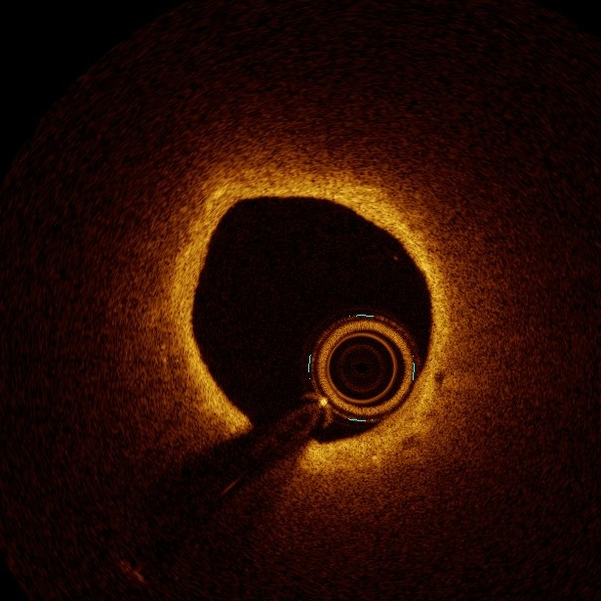
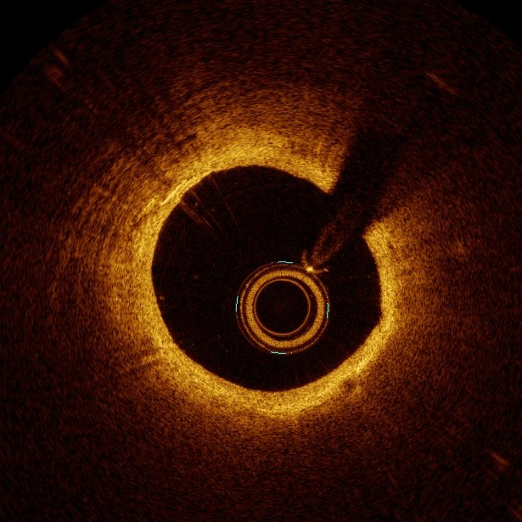
Results: Increase in Minimal Fibrous Cap Thickness (OCT)
P<0.001
120
97.3
90
70.9
2
6.8
60
60 µm
90 µm
30
Baseline
Follow-up
0
BL
1
FU

Slide 11
Results: Increase in Minimal Fibrous Cap Thickness (OCT)
100%
26
75%
61
FTC, n (%) | Baseline | Follow-up
<54 µm | 27 (25) | 7 (6)
55-84 | 54 (49) | 36 (33)
>84 | 29 (26) | 67 (61)
50%
49
25%
33
25
0%
6
Baseline
Follow-up
FCT <54 FCT 54-84 FCT>84

Slide 12
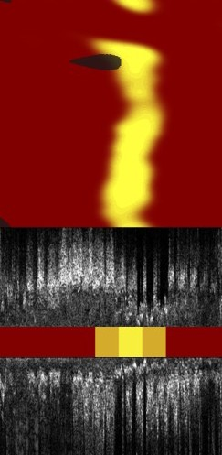
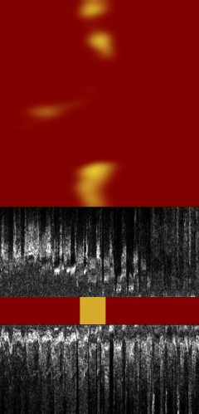
Results: MaxLCBI4mm Reduction (NIRS)
400
P<0.001
306.8
300
213.1
782
235
200
100
Baseline
Follow-up
0
1
FU
BL

Slide 13
Results: Secondary Imaging Endpoints OCT
OCT | Baseline | Follow up (26 weeks) | Absolute Change | P Value
Lipid
Maximum lipid arc,° | 189.1 ± 73.4 | 161.6 ± 68.7 | -28.3 ± 38.7 | <0.001
Average lipid arc,° | 114.5 ± 43.0 | 100.3 ± 36.1 | -14.8 ± 24.6 | <0.001
Lipid length, mm | 10.4 ± 6.0 | 8.9 ± 5.6 | -1.5 ± 2.2 | <0.001
Lipid volume index, mm° | 1259.4 ± 994.5 | 972.0 ± 855.7 | -290.2 ± 369.9 | <0.001
Macrophages
Maximum macrophage arc,° | 148.2 ± 72.5 | 122.1 ± 67.7 | -26.5 ± 41.3 | <0.001
Average macrophage arc,° | 83.4 ± 36.5 | 71.2 ± 32.0 | -11.6 ± 24.8 | <0.001
Macrophage length, mm | 9.6 ± 5.7 | 7.6 ± 5.2 | -2.0 ± 2.4 | <0.001
Macrophage volume index,° | 876.4 ± 757.6 | 590.0 ± 557.3 | -288.6 ± 369.7 | <0.001
Calcium
Maximum calcium arc,° | 98.6 ± 55.7 | 98.6 ± 54.6 | 3.0 ± 25.0 | 0.36
Average calcium arc,° | 61.1 ± 26.1 | 61.2 ± 25.1 | 0.3 ± 16.7 | 0.72
Calcium length, mm | 6.4 ± 4.9 | 6.7 ± 4.7 | 0.45 ± 1.80 | 0.03

Slide 14
Results: Secondary Imaging Endpoints IVUS and NIRS
 | Baseline | Follow up (26 weeks) | Absolute Change | P Value
IVUS
Total atheroma volume, mm³ | 137.2 ± 72.8 | 131.2 ± 71.8 | -6.0 ± 12.5 | <0.001
Patients with reduced TAV, N(%) |  | 81 (74)
Percent atheroma volume, % | 51.6 ± 8.9 | 50.2 ± 8.7 | -1.38 ± 1.48 | <0.001
Patients with reduced PAV, N(%) |  | 91 (83)
NIRS
Lesion LCBI | 139.7 ± 96.2 | 90.1 ± 82.7 | -49.6 ± 80.6 | <0.001
Patients with decreased lesion LCBI, N(%) |  | 79 (72)

Slide 15
PCSK9 Inhibition and FCT
200
LDL-C BL
LDL-FU
200
FCT BL
FCT FU
169.4
154.8
150
140.4
150
100.6
107
100
96.8
100
97.3
70.9
56.6
50
39.1
50
28.1
23.6
0 0
YELLOW III HUYGENS PACMAN-MI
YELLOW III HUYGENS PACMAN-MI
YELLOW III: HUYGENS¹:
26 weeks evolocumab in patients with stable CAD, OCT lipid and FCT ≤ 120 µm 52 weeks evolocumab in NSTEMI, OCT lipid and FCT ≤ 120 µm
PACMAN-MI²: 52 weeks alirocumab in STEMI/NSTEMI (11% on statin at BL)
¹ Nicholls et al., JACC Cardiovasc Imaging 2022;15:1308-21
² Räber et al., JAMA 2022;327:1771-1781

Slide 16
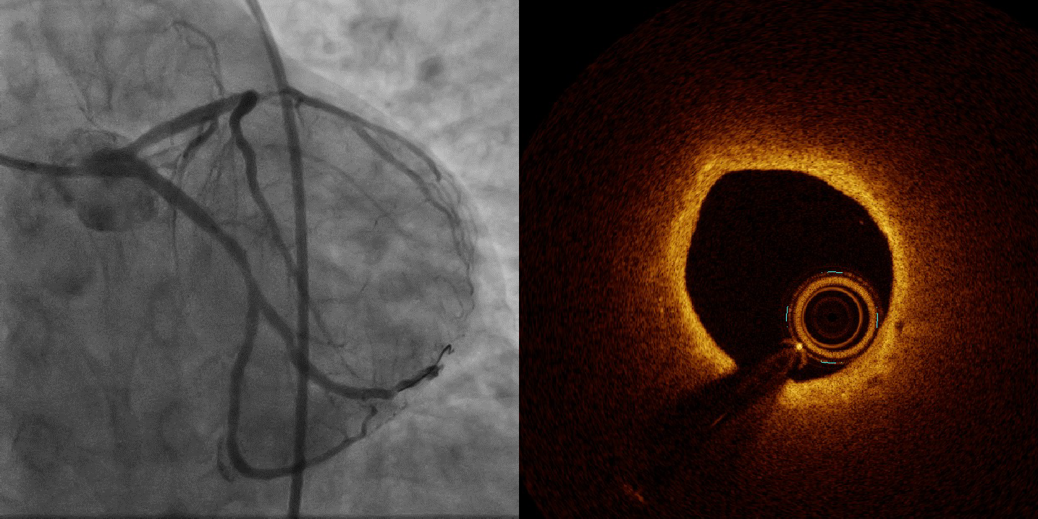
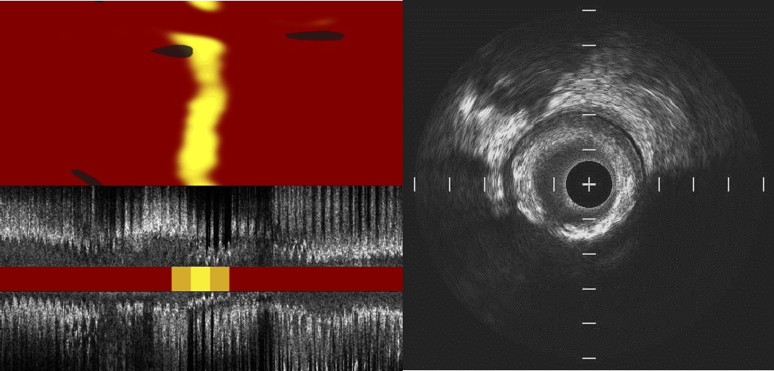
Case 1: Plaque Stabilization
mFCT ↑, LCBI ↓
Baseline
LDL-C: 80.4 mg/dl
mFCT: 60 µm
maxLCBI4mm: 782
PAV: 48.7%
Follow-up
LDL-C: 34 mg/dl
mFCT: 90 µm
maxLCBI4mm: 235
PAV: 45.2%

Slide 17
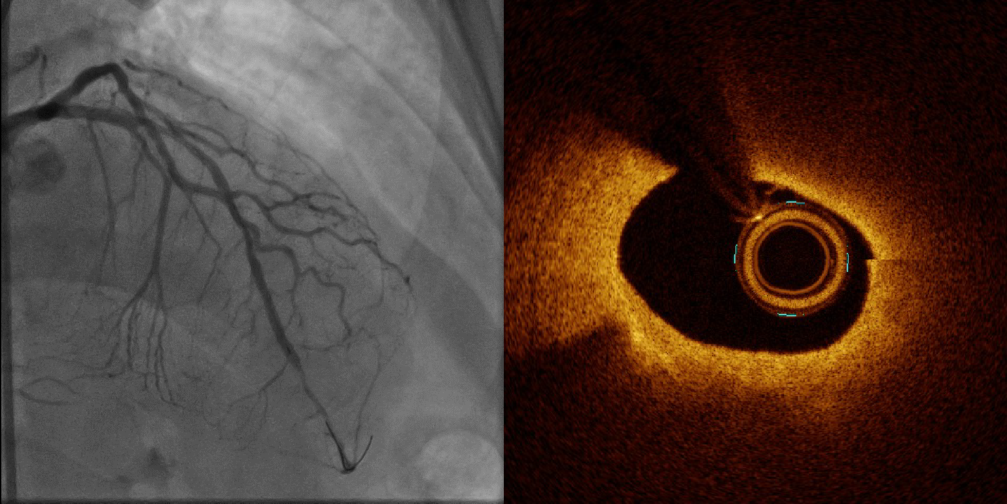
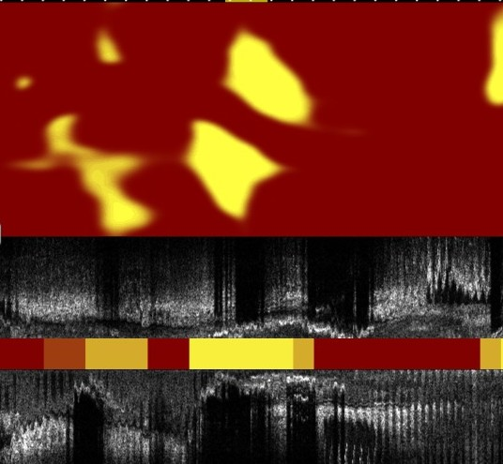
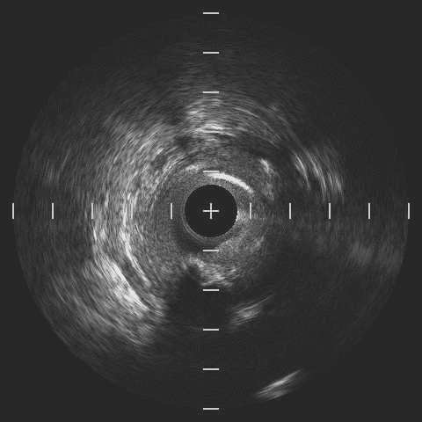
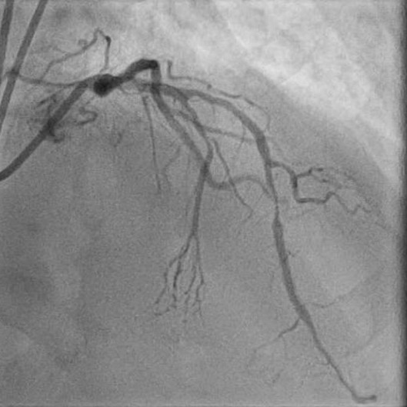
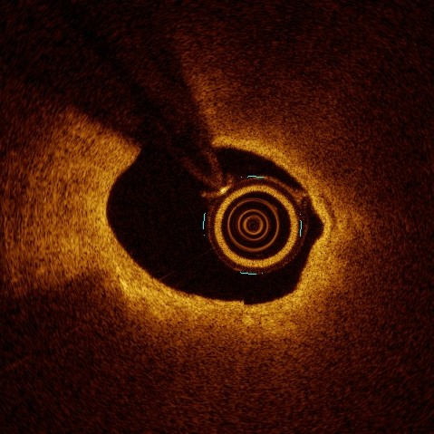
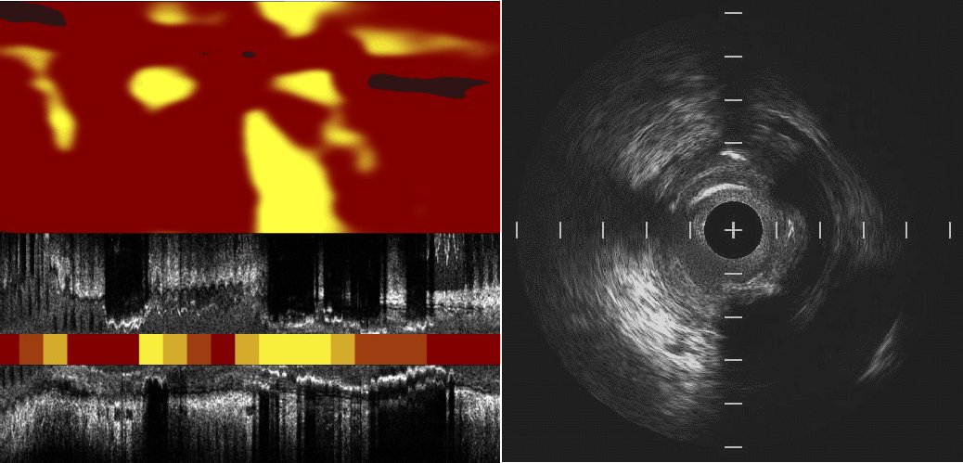
Case 2: No beneficial changes in
plaque morphology
LDL-C: 78.2 mg/dl
mFCT →, LCBI ↑
Baseline
mFCT: 50 µm
maxLCBI4mm: 586
PAV: 67.9%
Follow-up
LDL-C: 7 mg/dl
mFCT: 50 µm
maxLCBI4mm: 690
PAV: 67.2%

Slide 18
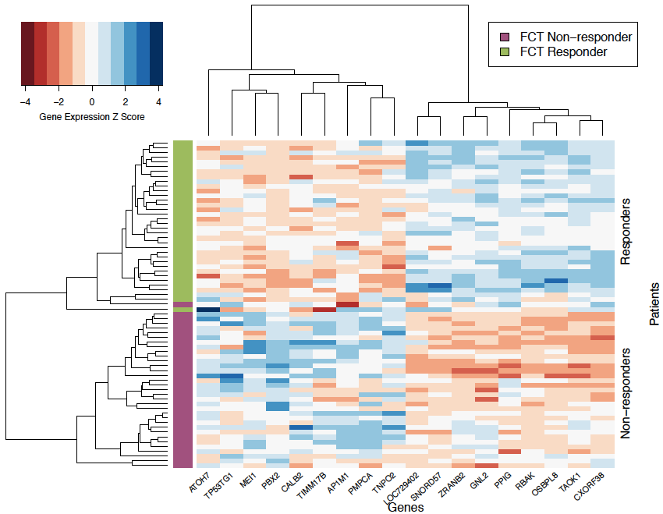
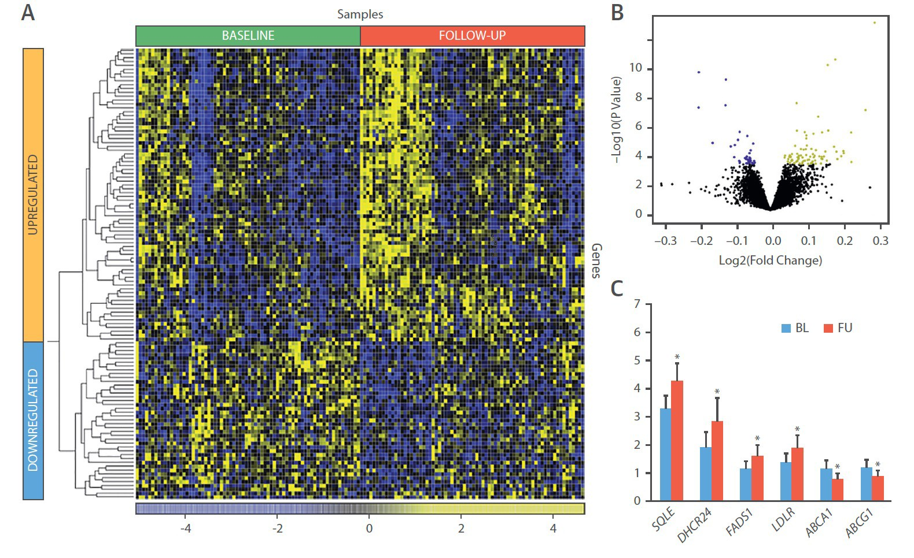
Genotypic characterization of maximum
STATIN dose
On creating a predictive transcriptomic ML model to predict increase in FCT in response to high-dose statins: personalized Medicine
Transcriptomic Landscape of Differentially Expressed Genes in PBMC
Kini et al. JACC 2017; 69(6):628-640
Johnson et al. EBioMedicine 2019; 44:41-49

Slide 19
Conclusions
In patients with stable CAD on maximally tolerated statins, more intensive lipid lowering with addition of evolocumab for 26 weeks resulted in significant and substantial increase in the minimum FCT by OCT, reduction in NIRS maxLCBI_{4mm} and reduction in atheroma volume by IVUS in angiographically non-obstructive lesions
The prevalence of high-risk vulnerable TCFA lesions was reduced from 48% to 13%
First multimodality imaging report in stable patients with non-obstructive lesions and lower levels of LDL-C at baseline (compared to previous trials) further supports aggressive lipid lowering in the patient population
At 6 month follow-up, 20% patients did not demonstrate FCT thickening and 24% subjects did not experience LCBI reduction. PBMC transcriptomic data will allow create predictive models for detecting subjects who demonstrate the greatest response regarding plaque morphology to PCSK9 inhibition therapy

Slide 20
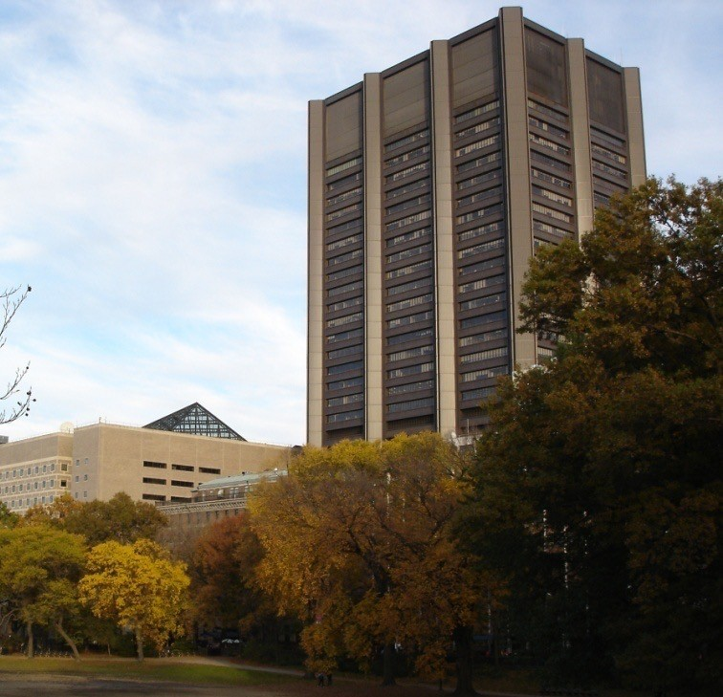
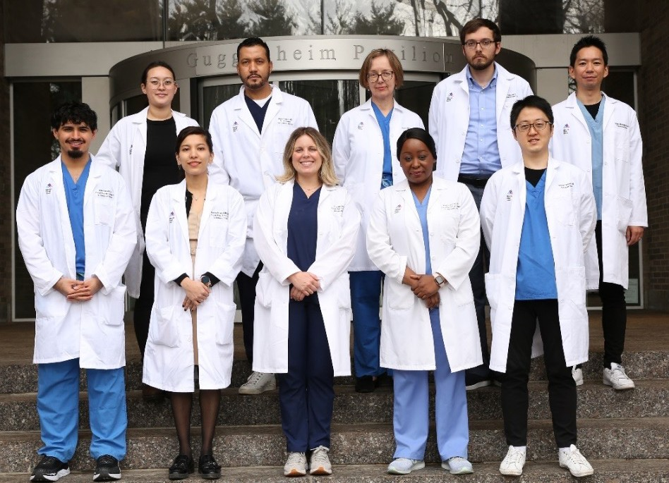
Thank you
Mount Sinai Hospital Cath Lab:
A Kini, K Yasumura, J Sweeny, S Khera, V Kapur, P Melarcode-Krishnamoorthy, A Hooda, N Baruah, D Pineda, P Krishnan, P Moreno, R Mehran, S Sharma
The Center for Advanced Genomics Technology, Icahn School of Medicine at Mount Sinai, New York, NY:
R Sebra, V Chen, D Gozdenovich, E Ellis, A Hahn
MSH Intravascular Imaging Core Lab, New York, NY:
J Narula, Y Vengrenyuk, S Minatoguchi
Interventional Cardiovascular Research and Clinical Trials, Icahn School of Medicine at Mount Sinai, New York, NY
R Mehran, S Sartori

