Slide 1
DISCO RADIAL
Distal versus conventional radial access for coronary angiography and intervention
Adel Aminian, MD
On behalf of Gregory Sgueglia, Shigeru Saito and the
DISCO RADIAL investigators

Slide 2
Potential conflicts of interest
Speaker's name : Adel Aminian
☑ I have the following potential conflicts of interest to declare:
Receipt of honoraria or consultation fees: Abbott, Boston Scientific,
Terumo Interventional Systems

Slide 3
BACKGROUND
Transradial access (TRA) is the recommended access for coronary procedures owing to increased safety (ESC/EACTS, ACC/AHA/SCAI guidelines)
Radial artery occlusion (RAO) is the most frequent complication of
TRA
The real-world reported incidence of RAO remains high, with wide
variability in the uptake of RAO preventive strategies
Recently, distal radial access (DRA) has emerged as a promising
alternative access to minimize RAO risk
A Large-scale, international, randomized trial investigating the benefits of DRA with respect to conventional TRA providing systematic implementation of best practices to reduce RAO is still lacking

Slide 4
DISCO RADIAL: Objectives and Methods
To assess the superiority of DRA compared to conventional TRA
with respect to forearm RAO.
International, muticenter, randomized, controlled trial in which patients with an indication to percutaneous coronary procedures using the 6Fr Glidesheath Slender (Terumo) were randomized to DRA or TRA with systematic implementation of best practices to reduce RAO¹.
Primary endpoint= incidence of forearm RAO assessed by US-
Doppler at discharge.
Key secondary endpoints included cross-over rates, hemostasis
time, spasm and access-site related complications.
1. Bernat I, Aminian A et al. JACC Cardiovasc Interv. 2019;12:2235-2246

Slide 5
DISCO RADIAL: Key Inlusion/Exclusion Criterias
Inclusion criteria
Patient is undergoing diagnostic coronary angiography and/or PCI.
Patient is suitable for both DRA and TRA using 6Fr GSS.
Exclusion criteria
Patients on chronic hemodialysis.
Patients presenting with ST-elevated myocardial infarction
(STEMI).
CTO recanalization procedures

Slide 6
DISCO RADIAL: Operators Selection
Single operators qualified for the study providing:
They were experienced operators regularly performing TR PCI in
the whole spectrum of coronary artery disease
They were fully independent with DRA
They had performed a minimum of 100 procedures by DRA.

Slide 7
DISCO RADIAL: sample size and power analysis for the primary endpoint (forearm RAO): superiority trial!
The assumption was that 3.5% of TRA patients would experience
a RAO based on the RAP and BEAT study² and 1.0% for DRA.
For a statistical power of 80% and a 2-sided alpha error of 0.05, assuming a cross-over rate of 10% and a drop-out rate of 5%, 648 patients per group were needed. The total sample size was therefore set to 1300 patients.
The primary endpoint analysis has been performed on the intention-to-treat (ITT) population
The per-protocol analysis excluded patients who crossed over or had major violations to the study protocol.
2. Aminian A, Saito S et al. EuroIntervention. 2017;13:e549-e556

Slide 8
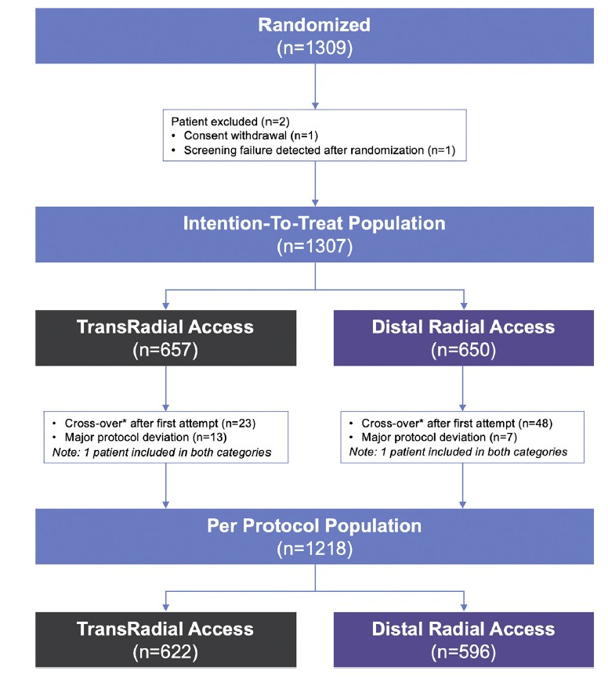
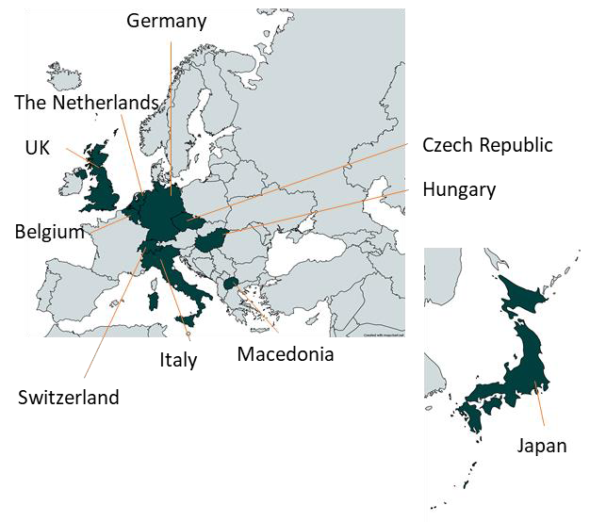
DISCO RADIAL: STUDY FLOWCHART
15 participating centres across Europe and Japan

Slide 9
DISCO RADIAL: BASELINE CHARACTERISTICS (i)
 | TRA N=657 | DRA N=650 | P-value
Age, years | 68.2 ± 11.1 | 68.0 ± 10.7 | 0.74
Male, % | 71.2 | 73.7 | 0.32
Body mass index, kg/m² | 28.2 ± 5.1 | 27.7 ± 5.1 | 0.081
Current smoking, % | 21.4 | 22.4 | 0.68
Diabetes, % | 28.9 | 30.2 | 0.61
Hypertension, % | 79.6 | 76.7 | 0.19
Previous PCI with radial, % | 34.8 | 32.8 | 0.46
Peripheral artery disease, % | 10.4 | 10.5 | 0.97
Chronic coronary syndrome
Silent ischemia, % | 33.6 | 36.3 | 0.31
Stable angina, % | 50.2 | 49.7 | 0.85
Acute coronary syndrome
Unstable angina, % | 8.7 | 7.2 | 0.33
NSTEMI, % | 7.5 | 6.8 | 0.63

Slide 10
DISCO RADIAL: BASELINE CHARACTERISTICS (ii)
 | TRA N=657 | DRA N=650 | P-value
Hemoglobin, g/L | 139.3±16.9 | 139.7±17.3 | 0.63
Serum creatinine, µmol/L | 87.8±27.1 | 88.1±27.1 | 0.82
Antiplatelet medication, %
Aspirin | 69.3 | 63.7 | 0.033
Clopidogrel | 21.8 | 23.1 | 0.57
Ticagrelor | 7.8 | 6.0 | 0.21
Prasugrel | 5.0 | 3.7 | 0.24
Oral anticoagulants, % | 13.7 | 15.1 | 0.48

Slide 11
DISCO RADIAL: PERI-PROCEDURAL CHARACTERISTICS
 | TRA N=657 | DRA N=650 | P-value
Right access side, % | 80.5 | 80.8 | 0.90
Diagnostic angiography only, % | 62.7 | 63.5 | 0.76
PCI, % | 37.3 | 36.5 | 0.76
Cross-over rate, % | 3.5 | 7.4 | 0.002
To the other access, same side | 0.2 | 4.6
To the other access, other side | 0.0 | 0.3
To the other side, same access | 1.5 | 0.5
To ulnar or brachial | 0.3 | 0.2
To femoral | 1.5 | 1.9
Median sheath insertion time, min | 1 (1-3) | 2 (1-4) | <0.001
6-Fr slender introducer sheath used, % | 99.4 | 99.7 | 0.69
Median procedure time, min | 24 (14-42) | 27 (15-45) | 0.12
Contrast volume, mL | 95.2±73.1 | 91.8 ±65.0 | 0.44
Radiation dose, mGy | 1222±2846 | 1298±3143 | 0.70
Activated clotting time, sec | 250±87 | 247±87 | 0.63
Closure device |  |  | <0.001
Selective compression device | 99.2 | 88.0
Bandage | 0.8 | 12.0

Slide 12
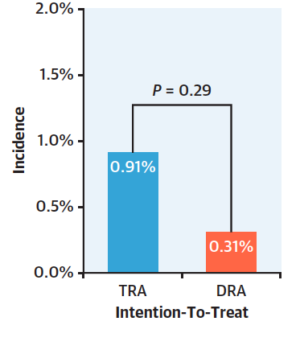
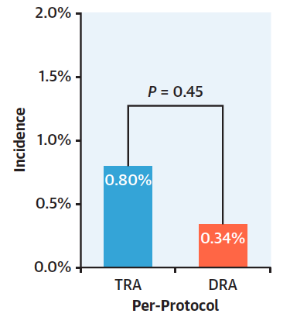
DISCO RADIAL: Primary Endpoint
FOREARM RAO

Slide 13
DISCO RADIAL: Key Secondary Endpoints
 | Intention to treat |  |  | Per-protocol
 | TRA N=657 | DRA N=650 | P- value | TRA N=622 | DRA N=596 | P-value
Radial artery spasms, % | 2.7 | 5.4 | 0.015 | 2.1 | 4.4 | 0.024
Pain, Median Visual Analogue Scale | 2 (0-3) | 2 (0-4) | 0.067 | 2 (0-3) | 2 (0-4) | 0.045
Median hemostasis time, min | 180 (134–292) | 153 (105-242) | <0.0001 | 180 (130-292) | 148 (101-240) | <0.0001
Patent haemostasis achieved*, % | 94.4 | NA | - | 95.3 | NA | -
Bleeding, % | 5.5 | 6.8 | 0.33 | 5.5 | 5.7 | 0.86
Puncture site-related bleeding | 5.2 | 6.8 | 0.22 | 5.1 | 5.7 | 0.67
Vascular complications, % | 1.2 | 1.1 | 0.81 | 0.5 | 0.5 | 0.99

Slide 14
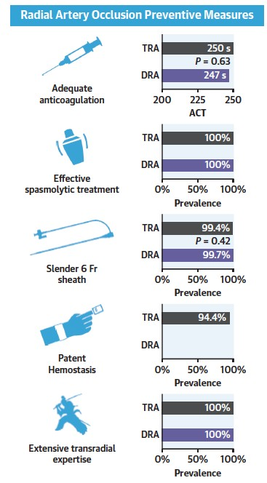
DISCO RADIAL: Key Findings
FOREARM RAO

Slide 15
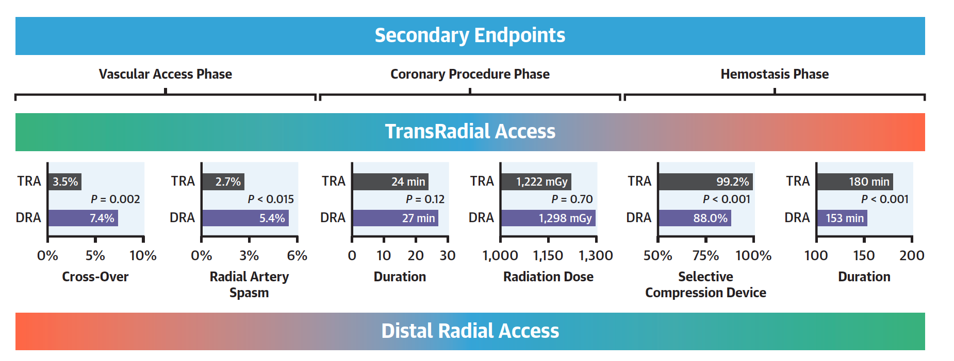
DISCO RADIAL: Key Findings
More
demanding
No impact
Easier

Slide 16
DISCO RADIAL: Conclusions
Results from the large, international, multicenter DISCO RADIAL randomized controlled trial showed equally very low incidence of forearm RAO for DRA and conventional TRA.
These results establish compliance to best practice recommendations for RAO avoidance as a mandatory new reference in TR practice.
At the same time, distal radial artery arises as a valid alternative associated with higher cross-over rates, but with a simpler and shorter hemostasis process.
Further study is required to determine whether such a strict fulfilment of conventional TRA to best RAO prevention practices is maintained in real-world settings.
Also, predictors of distal radial access failure are to be explored.

Slide 17
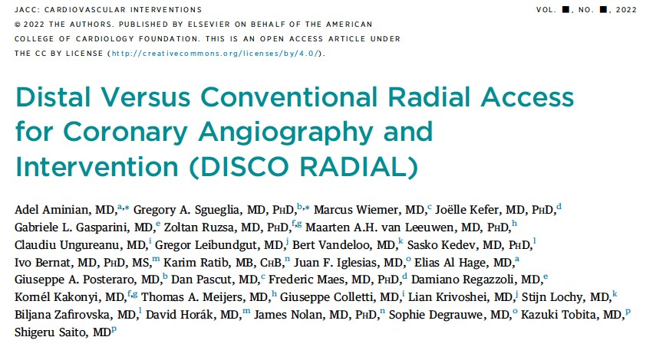
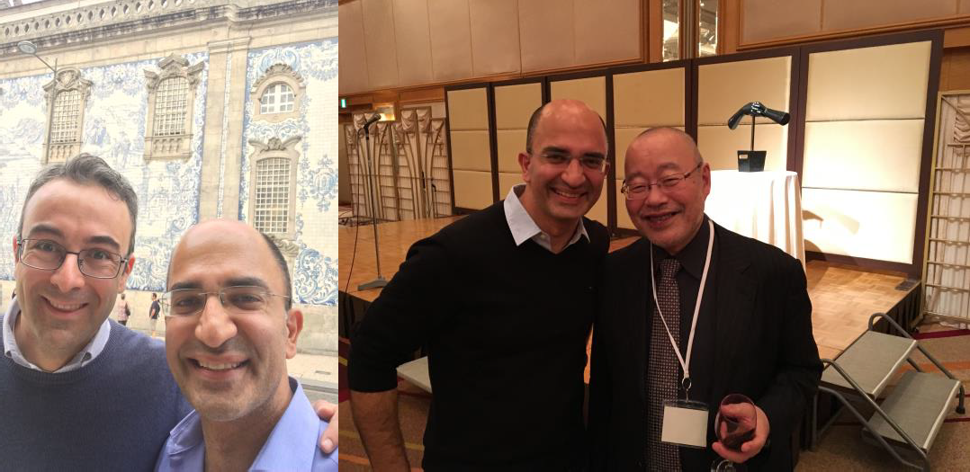
PUBLISHED IN JACC CI

Slide 18
PCRonline.com

