Slide 1
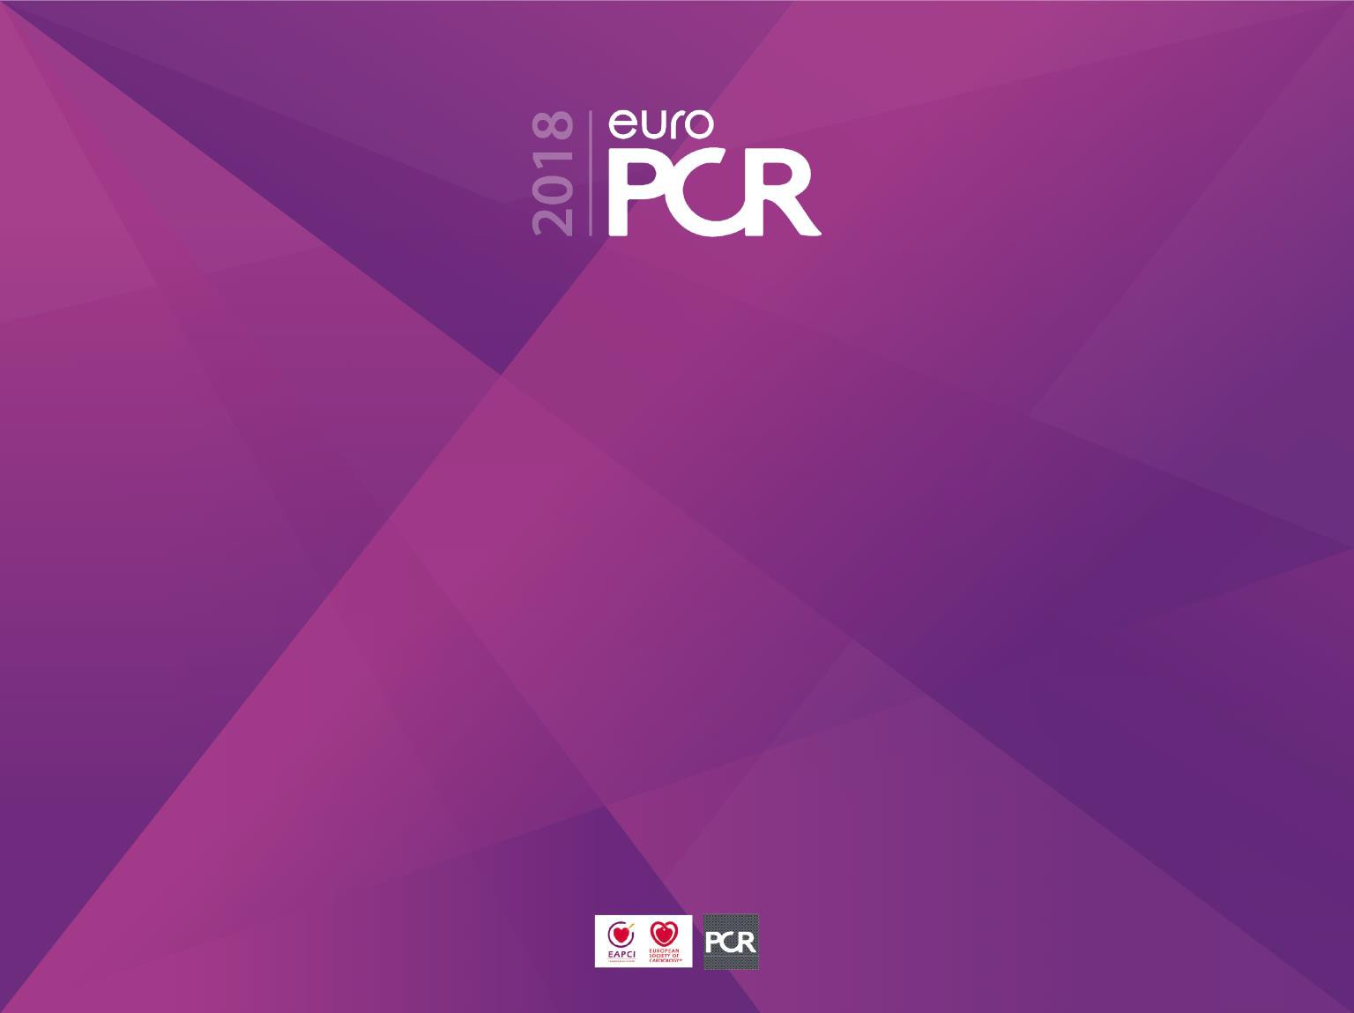


Two year results of COMPARE-ACUTE Randomised trial of FFR-guided complete revascularization
versus
infarct artery only treatment
in
multivessel STEMI patients
On behalf of all COMPARE-ACUTE investigators Pieter Smits
Maasstad Hospital Rotterdam, The Netherlands

Slide 2
Potential conflicts of interest
Speaker's name : Pieter, Smits, Rotterdam
☑ I have the following potential conflicts of interest to report:
Participation in a company sponsored speaker’s events: Abbott
Receipt of grants / research supports: Abbott, St. Jude,
Terumo

Slide 3
Introduction
Approximately 50% of the STEMI patients have multivessel disease at presentation; meaning 50% or more diameter stenosis in one or more non-infarct- related arteries (non-IRAs)
Recent randomized controlled trials showed benefit of complete revascularizaton (angio or FFR guided) acutely or early staged compared to infarct-artery- only treatment strategy

Slide 4
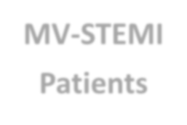

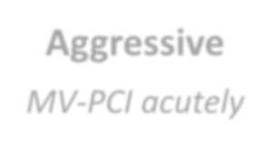
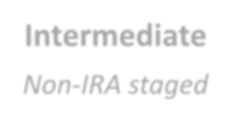
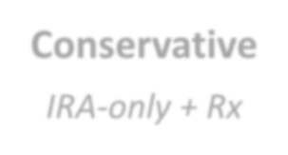
 |  |  | MV-STEMI Patients
Aggressive MV-PCI acutely |  |  | Intermediate Non-IRA staged |  |  | Conservative IRA-only + Rx
Revasc. based on angio
Revasc. based on FFR
Revasc. based on angio
Revasc. based on FFR
Revasc.
based on Ischemia / sympt.
PRAMI
CvLPRIT
DANAMI - PRIMULTI
COMPARE ACUTE
PRAMI: Wald et al. NEJM 2013; 369: 1115-23 CvLPRIT: Gerschlick et al. JACC 2015; 65: 963-72
DANAMI-3-PRIMULTI: Engstrom et al. Lancet 2015; 386: 665-71 COMPARE-ACUTE: Smits et al. NEJM 2017; 376:1234-44

Slide 5
Introduction
Unknown is the long-term outcome of a FFR-guided complete revascularization strategy compared to an infarct-artery-only treatment strategy
This presentation shows the two year results of COMPARE-ACUTE

Slide 6



COMPARE-ACUTE trial
The COMPARE-ACUTE trial is an investigator initiated multicenter randomized controlled trial.
The trial is conducted by Maasstad Cardiovascular Research Organisation (Rotterdam, The Netherlands), which received research grants from Abbott Vascular and St. Jude Medical
The trial was conducted in 8 countries and 24 sites.

Slide 7
The Netherlands
Maasstad Ziekenhuis, Rotterdam
Haga Ziekenhuis, Den Haag
Atrium Medisch Centrum, Heerlen
Rijnstate Ziekenhuis, Arnhem
Universitair Medisch Centrum, Groningen
Sweden
Sahlgrenska Hospital, Götheborg
Germany
Herzzentrum Segeberger Kliniken, Bad Segeberg
University Hospital, Rostock
Herzzentrum Bad Krozingen, Bad Krozingen
Klinikum Ingolstadt, Ingolstadt
Klinikum Links der Weser, Bremen
Norway
Rigshospitalet University of Oslo, Oslo
Singapore
Tan Tock Seng Hospital
Khoo Teck Puat Hospital
Czech Republic
University Hospital, Brno
Liberic Regional Hospital, Liberic
Hungary
Hungarian Institute of Hungary, Budapest
Szabolcs-Szatmar-Bereg County Hospital
Szent-Györgyi Albert Klinika, Zseged
Zala Megyei Korhaz, Zalaegerszeg
Poland
MSWiA w Warsawie, Warsaw
4 Wojskowy Szpital, Wroclaw
Miedziowe Centrum Zdrowia, Lubin
Kliniki Kardiologii Allenort, Warsaw

Slide 8








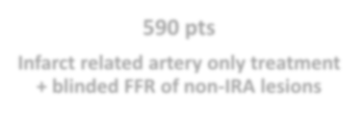

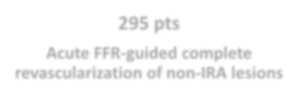






Trial design COMPARE-ACUTE
Acute STEMI patiënts undergoing primary PCI
885 stable multivessel STEMI pts. randomized
1 : 2 randomization
FFR was measured in rest and after adenosine iv or ic
295 pts
Acute FFR-guided complete revascularization of non-IRA lesions
590 pts
Infarct related artery only treatment
+ blinded FFR of non-IRA lesions
45 day treatment window for elective clinically indicated PCI
Follow-up at 30 days, 12, 24 and 36 months

Slide 9













885 Patients with acute STEMI and multivessel disease were randomized (1:2)
295 Were assigned to FFR guide
complete revascularization
590 Were assigned to infarct
artery only revascularization
292 Underwent 450 FFR procedures of non infarct artery lesions
575 Underwent 865 blinded FFR procedures of non infarct artery lesions
289 Received allocated treatment
589 Received allocated treatment
286 Were alive and included at 24
mo. follow-up 7 Died
3 Withdrew informed consent 2 Lost to follow up
572 Were alive and included at 24
mo. follow-up 16 Died
1 Withdrew informed consent 2 Lost to follow
295 Were included in- intention-to-treat analysis
590 Were included in- intention-to-treat analysis

Slide 10
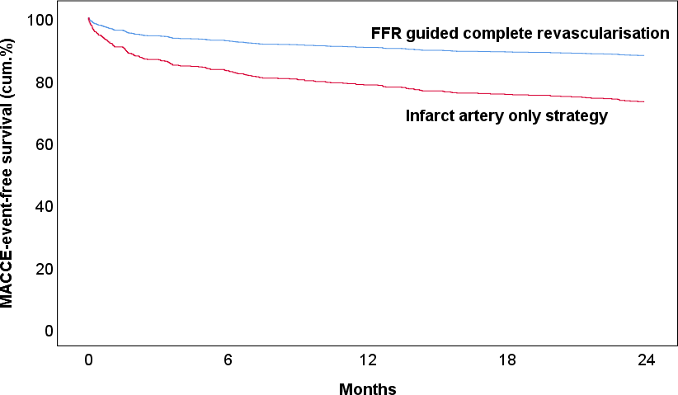
Primary Endpoint MACCE @ 2 year
(all cause death, MI, revascularization,
stroke)
MACCE
Rate
∆ 12.7%
12.2%
∆ 14.6%
26.8%
HR 0.35
95%CI (0.22-0.55)
P< 0.0001
HR 0.41
95%CI (0.29-0.59)
P< 0.0001
No. at risk
FFR guided complete | 295 | 281 | 269 | 260 | 119
Culprit lesion only | 590 | 481 | 458 | 441 | 203

Slide 11
MACCE Components Results
All cause death
Myocardial infarction
Revascularization
Cerebrovascular accident

Slide 12
Endpoints @ 2 year
 | FFR guided Complete (n=295) | Infarct Artery Only (n=590) | RR | 95% CI | P value
MACCE | 36 (12.2%) | 158 (26.8%) | 0.46 | 0.33 – 0.64 | <0.001
Death, all cause | 7 (2.4%) | 16 (2.7%) | 0.88 | 0.36 – 2.10 | 0.77
Cardiac death | 4 (1.4%) | 6 (1.0%) | 1.33 | 0.38 – 4.69 | 0.49
Myocardial Infarct. | 15 (5.1%) | 41 (6,9%) | 0.73 | 0.41 - 1.30 | 0.29
Spontaneous | 12 (4,1%) | 29 (4.9%) | 0.83 | 0.43 – 1.60 | 0.57
Peri-procedural | 2 (0.7%) | 12 (2.0%) | 0.33 | 0.08 – 1.48 | 0.15
Revascularization | 28 (9.5%) | 134 (22.7%) | 0.42 | 0.29 – 0.61 | <0.001
PCI | 24 (8.1%) | 127 (21.5%) | 0.38 | 0.25 – 0.57 | <0.001
CABG | 4 (1.4%) | 9 (1.5%) | 0.89 | 0.28 – 2.86 | 0.84
Cerebrovasc. event | 1 (0.3%) | 7 (1.2%) | 0.29 | 0.03– 2.31 | 0.24
NACE | 35 (11.9%) | 198 (33.6%) | 0.26 | 0.18 – 0.39 | <0.001
Cardiac death + MI | 22 (7.5%) | 56 (9.5%) | 0.74 | 0.46 -1.19 | 0.21
Stent thrombosis | 4 (1.4%) | 10 (1.7%) | 0.80 | 0.25 – 2.52 | 0.38
NACE = cardiac death, myocardial infarction, any revascularization, stroke and major bleeding

Slide 13
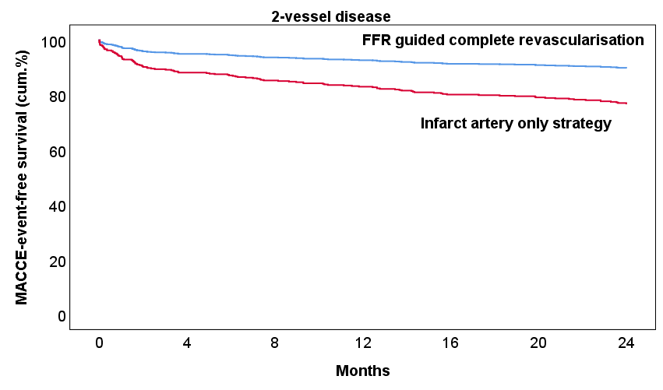
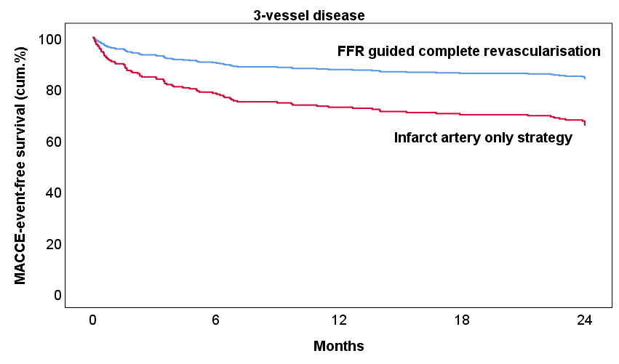
MACCE sub-analysis by 2 or 3 vessel
disease
MACCE Rate
10.3%
P<0.001
23.2%
MACCE Rate
16.5%
34.0%
P<0.001

Slide 14
Revascularization @ 2 year
Patients | FFR guided complete revascularization | Infarct-artery-only revascularization
TLR (re-stenosis) | 5/28 (18%) | 22/120 (18%)
Non-TLR (de-novo) | 23/28 (82%) | 107/120 (89%)
Lesions | FFR guided complete revascularization | Infarct-artery-only revascularization
TLR (re-stenosis) | 7/28 (25%) | 22/179 (12%)
Non-TLR (de-novo) | 2/28 (75%) | 157/179 (88%)

Slide 15
Conclusions
In multivessel STEMI patients, FFR-guided complete revascularization of non-infarct-related lesions in the acute phase of primary PCI significantly reduces the risk of the composite MACCE outcome as compared to a strategy of treatment of the infarct-related artery only
This reduction is sustainable and progressive up to 2 year follow-up and remains mainly driven by the decreased need for subsequent revascularization and is irrespective of the presence of 2 or 3 vessel disease

Slide 16


