Slide 1
PROACT: Can we prevent chemotherapy-related heart damage in patients with breast cancer and lymphoma?
Dr David Austin
Chief Investigator, PROACT
Consultant Cardiologist, Academic Cardiovascular Unit The James Cook University Hospital, Middlesbrough, UK @ACUSouthTees @akaplatini

Slide 6
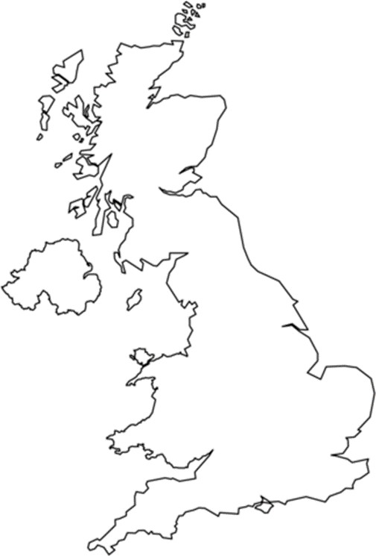
hs Trop I
BHF Cardiovascular Biomarker Lab,
University of Edinburgh
hs Trop T
Royal Victoria Infirmary, Newcastle Upon Tyne
Echocardiographic Core lab
The James Cook University Hospital, Middlesbrough

Slide 9
Patients with breast cancer or NHL considered
Exclusions
Informed consent, baseline echocardiogram and troponin
Exclusions
Randomization to enalapril up to 10mg bd, or usual care 1:1
Cycle 1
Cycle 2
Cycle 3
Cycle 4
Cycle 5
Cycle 6
Cycle 1
Cycle 2
Cycle 3
Cycle 4
Cycle 5
Cycle 6
cTnT and cTnI , <72 hours before planned chemotherapy
Final blinded hs troponin T and hs troponin I assessment Echocardiogram

Slide 10
North Tyneside General Hospital, Northumbria
Freeman Hospital, Newcastle upon Tyne
Sunderland Royal Hospital, Sunderland
County Durham and Darlington
University Hospital of North Tees, Stockton
The James Cook University Hospital, Middlesbrough
Castle Hill Hospital, Hull
Blackpool Victoria Hospital, Blackpool
Clatterbridge Hospital, Liverpool
Weston Park Hospital, Sheffield
Royal Berkshire Hospital, Reading
Kent and Canterbury Hospital, Canterbury
Derriford Hospital, Plymouth
Recruitment: October 2017 to March 2023

Slide 11
318 Patients w1ith Breast Cancer or NHL were considered for the triall
124 patiient,sconsent:edl
113 excluded after consent and prior to randomization:
9 had raised troponin
II had systolic blood pressure
that was too llow
II required urge:n1t uea.tment II had reduced LVEF on Eehoc.ardiogram,
I , reason unknown
Prior to consent, excllusions were as follows:
60 1Declli1nedl trial
27 Timing preclucledlparticipation 24 Alr,eady on AOEIIor RAASI
17 lneligibl!e chemotherapy regimen planned
114 INlot for chemotherapy/too
unwelll for chemot!hera;py 9 Declimedlchemo
8 Inadequate cardiac function 8 Previous or current s:econdl canc,er
7 Ineligible, reason unkcnown 7 Reason unknown
4 Patient unabl!e to be contacted 3 Participating i1n another trial
3 Too far for extra visiits
II Tumour Lysi1s:Risk
I Known rai.sed Troponin T
I lneli,gible, clinician decisiom
,
IIIrandomi:z:ed
I I
I
 | 56 randomiiz.ed to ,enala;prill (1intervention)
Primary Analysis: 54 prov1ided primary endpoint data (,cTnT) and were included 1in the fi1nall anallys11s Secondary Analysis: 50 patients provided echocardiograms (available pai1red LVEF n=49; available pai1red LV GLS n =47)
55 randomized to standard,care (comparator)
Pr1imary Analysis:
54 provided primary endpoint data (cTnT) and were included in the final
analysis
Secondary Anallysis:
50 patiients provided,e,chocardi1ograms (availab le paired LVEF n=48; available
paired LV GLS n =41)

Slide 12
Characteristics |  |  | Enalapril (n = 56) | Standard care (n = 55)
Demographic
Age at randomization, mean (SD) |  |  | 58 (11) | 58 (12)
Female, no. (%) |  |  | 45 (80.4) | 41 (74.5)
Ethnicity |  | White | 55 (98.2) | 52 (94.5)
 |  | Non white | 1 (1.8) | 3 (5.5)
Body Mass Index, mean (SD) |  |  | 28.3 (4.8) | 28.2 (5.5)
Clinical history, no (%)
Breast cancer |  |  | 35 (62.5) | 34 (61.8)
Non-Hodgkin Lymphoma |  |  | 21 (37.5) | 21 (38.2)
NYHA functional class
 | I |  | 48 (85.7) | 48 (88.9)
 | II |  | 8 (14.3) | 6 (11.1)
ECOG performance status scale
 | Grade 0 |  | 49 (87.5) | 48 (87.3)
 | Grade 1 |  | 6 (10.7) | 7 (12.7)
 | Grade 2 |  | 1 (1.8) | 0 (0.0)
Coronary Heart Disease |  |  | 2 (3.6) | 2 (3.6)
Diabetes |  |  | 5 (8.9) | 3 (5.5)
Hypertension |  |  | 12 (21.4) | 5 (9.1)
Current or ex-smoker |  |  | 29 (51.7) | 18 (32.7)
Chemotherapy regimen, No (%)
 | FEC75 |  | 8 (14.3) | 9 (16.4)
 | EC90 |  | 27 (48.2) | 25 (45.5)
 | (R-)CHOP |  | 21 (37.5) | 21 (38.2)

Slide 13
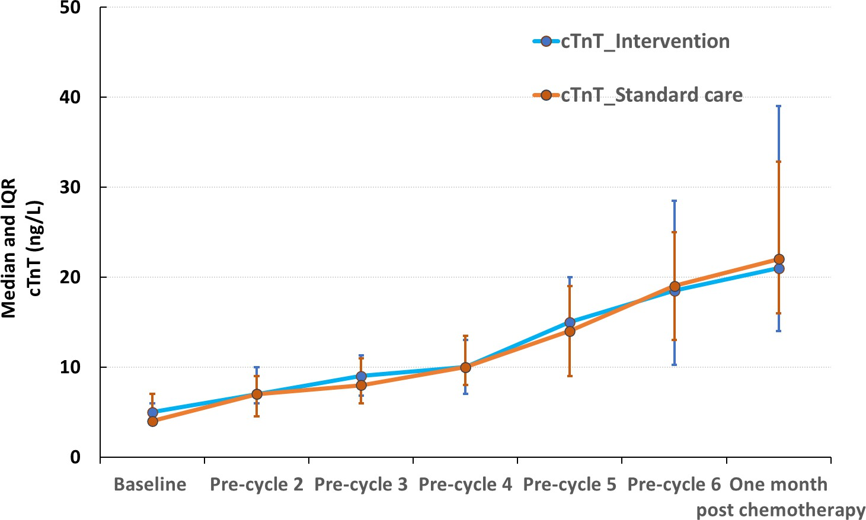
Indicator | Groups | Total n/N (%) | Adjusted Odds Ratio (95% CI) | P value
cTnT | Enalapril | 42/54 (78) | 0.65 (0.23- 1.78) | 0.405
 | Standard care | 45/54 (83)

Slide 14
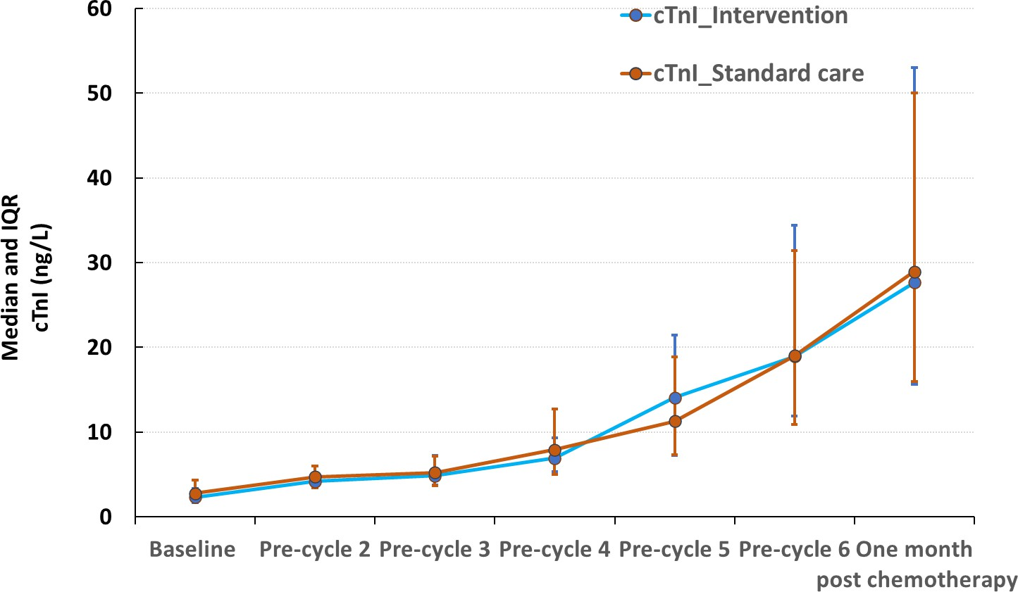
Indicator | Groups | Total n/N (%) | Adjusted Odds Ratio (95% CI) | P value
cTnI | Enalapril | 25/53 (47) | 1.10 (0.50- 2.38) | 0.819
 | Standard care | 24/53 (45)

Slide 15
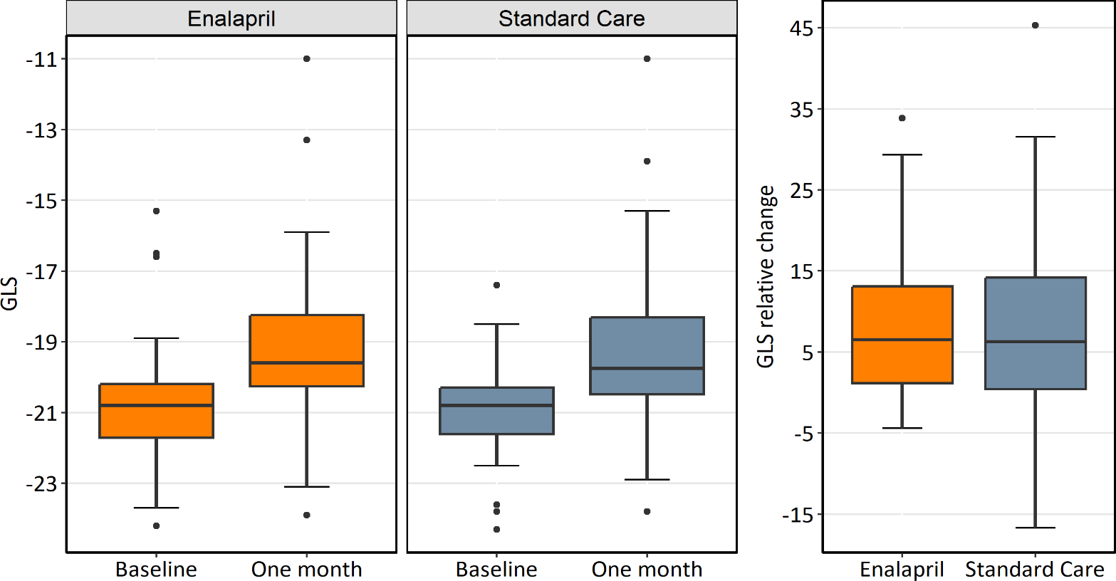
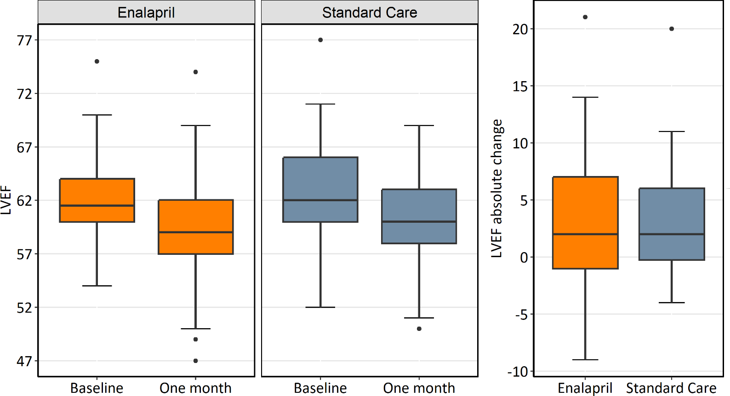
Cardiac function: LV EF
Cardiac function: LV GLS
Indicator | Groups | Total n/N (%) | Adjusted Odds Ratio (95% CI) | p
LV GLS | Enalapril | 10/47 (21) | 0.95 (0.33- 2.74) | 0.921
 | Standard care | 9/41 (22)
Indicator | Groups | Total n/N (%) | Adjusted Odds Ratio (95% CI) | p
LVEF | Enalapril | 2/49 (4) | 4.89 (0.40- 674.62 | 0.236
 | Standard care | 0/48 (0)

