Slide 1


TIM-HF2 Trial –
Remote Patient Management in Heart Failure
Prof. Friedrich Koehler, MD, FESC
On behalf of the TIM-HF2 Investigators
Clinicaltrials.gov identifier: NCT01878630

Slide 2
Declaration of interest
Research contracts (Public Funding of the TIM-HF2 trial by: German Federal Ministry of Education and Research)
Consulting/Royalties/Owner/ Stockholder of a healthcare company (Honorariu from: Novartis, presentations/ lectures; Medtronic, presentations/lectures; Abbott scientific, advisory board)
• •
ESC Congress
Munich 2018 •

Slide 3

Background
Remote Patient Management (RPM) consists of multiple components including
  telemonitoring, (b) patient education, and (c) cooperation between a Telemedical Centre (TMC), patients and GPs/ local cardiologists.
RPM may help to detect early signs and symptoms of cardiac decompensation.
Many RCTs have been performed concerning the impact of RPM in HF management but have reported inconsistent results.
Post-hoc analyses of the TIM-HF trial (NCT 00543881 ) suggested that patients with a recent HF hospitalisation and who were not depressed could potentially benefit from an RPM intervention.

Slide 4
Trial Objectives
The Telemedical Interventional Management in Heart Failure II trial (TIM-HF2) was designed
to investigate the impact of RPM on mortality, morbidity and Quality of Life focusing on a HF population recently hospitalised for worsening HF and who do not have major depression.
to determine if regional differences in HF care – i.e. rural versus metropolitan area – have impact on outcome.

Slide 5

Study Design and Study Flow
Prospective, randomised (1:1), controlled, open, parallel-group, multi-centre trial
Recruitment: 1538 patients recruited between Aug 2013 and May 2017 (765 RPM, 773 Usual Care)
Screening Visit
done by GP or Cardiologist
Baseline Visit done by
Cardiologist;
Randomisation
RPM Group Daily data transfers to the TMC
3 month visit
done by GP or Cardiologist
6 month visit
done by GP or Cardiologist
9 month visit
done by GP or Cardiologist
12 month final visit done by Cardiologist
Usual Care Group

Slide 6
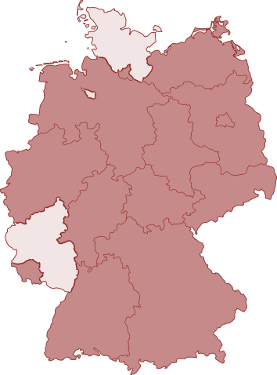
Participating Sites
113 Cardiology sites
  43 Regional / local hospitals
  10 University hospitals
  60 Cardiology outpatient practices
87 General practitioners
Sites were located in 14 metropolitan areas
and 11 rural areas within 13 of 16 German states.
German states

Slide 7



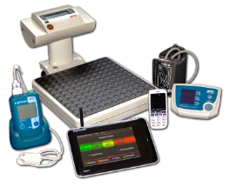




RPM Intervention used in TIM-HF2
Vital parameters
Usual Care
EHR
Electronic Health Record
Emergency call
Daily review of vital parame- ters
General
Cardiologist
RPM
Practitioners
intervention
(Threshold
TMC
Telemedical Centre
24h/7d
crossing)
Immediate reaction
Immediate reaction
Hospital / Emergency Care
Telemedical Centre with physicians and nurses
Inpatient and outpatient care
Measuring devices
PATIENT‘S HOME
HEART FAILURE CARE

Slide 8
Patient Profile
Inclusion Criteria
Diagnosed with HF – NYHA class II or III
HF hospitalisation within maximally 12 months prior to randomisation
Depression score PHQ-9 <10
LVEF ≤45% or
LVEF >45% + oral diuretics
Written informed consent
Main Exclusion Criteria
Hospitalisation 7 days before randomisation
Implanted cardiac assist system
ACS ≤7 days before randomisation
Urgent status for heart transplantation
Planned revascularisation, TAVI, MitraClip and/or CRT-implantation within 3 months after randomisation
Revascularisation and/or CRT-implantation
≤28 days before randomisation
Terminal renal insufficiency with hemodialysis
Life expectancy < 1 year
Koehler F et al. Eur J Heart Fail 2018, in press

Slide 9
Main Study Outcomes
Primary Outcome
% days lost due to unplanned CV hospitalisations or all cause death
Main Secondary Outcomes
All-cause mortality
CV mortality
% days lost due to unplanned CV hospitalisations
% days lost due to unplanned HF hospitalisations
Change in MLHFQ questionnaire global score
Change in NT-proBNP and of MR-proADM levels

Slide 10
Main Baseline Characteristics
 | RPM (n=765) | Usual Care (n=773)
Age (years) | 70 (11) | 70 (10)
Men | 533 (70%) | 537 (69%)
Living in rural area | 457 (60%) | 458 (59%)
Living in urban area | 308 (40%) | 315 (41%)
NYHA Class II | 400 (52%) | 396 (51%)
NYHA Class III | 359 (47%) | 367 (47%)
Left ventricular ejection fraction (LVEF, %) LVEF ≤ 45% LVEF > 45% | 41 (13) 492 (64%) 273 (36%) | 41 (13) 509 (66%) 264 (34%)
Days since last HF hospitalisation | 92 (81) | 93 (82)
N-terminal-pro-B-type natriuretic peptide (pg/ml) | 1407 (626-3142) | 1488 (594-3069)
Data are mean (SD) or patients (%)

Slide 11
Baseline Therapy
 | RPM (n=765) | Usual Care (n=773)
ACE inhibitor or ARB | 628 (82%) | 641 (83%)
ARN inhibitor | 44 (6%) | 47 (6%)
Beta-blocker | 702 (92%) | 711 (92%)
Aldosterone antagonist | 441 (58%) | 405 (52%)
Loop diuretics | 717 (94%) | 721 (93%)
Thiazides | 191 (25%) | 185 (24%)
Implantable cardioverter defibrillator (ICD) | 222 (29%) | 234 (30%)
Cardiac resynchronisation therapy (CRT) | 118 (15%) | 122 (16%)
Data are patients (%)

Slide 12
Primary Outcome
% days lost due to unplanned CV hospitalisations and all-cause death
 | RPM (n=765) |  | Usual Care (n=773) |  | Ratio RPM vs. UC (95% CI) | P
 | # Patients with event (%) | Weighted Average of Percentages (95% CI) | # Patients with event (%) | Weighted average of percentages (95% CI)
% days lost due to unplanned CV hosp. and all-cause death | 265 (35) | 4.88 (4.55, 5.23) | 290 (38) | 6.64 (6.19, 7.13) | 0.804 (0.65, 0.99) | 0.046
Days lost | 17.8 |  | 24.2
(days/year) | (16.6, 19.1) |  | (22.6, 26.0)

Slide 13
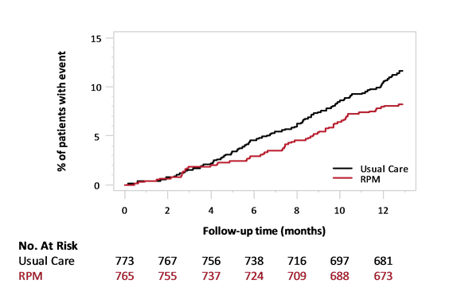
Main Secondary Outcomes (1)
All-cause mortality
RPM vs. UC
HR 0.70
95% CI 0.50, 0.96 P=0.028
Usual Care
RPM

Slide 14
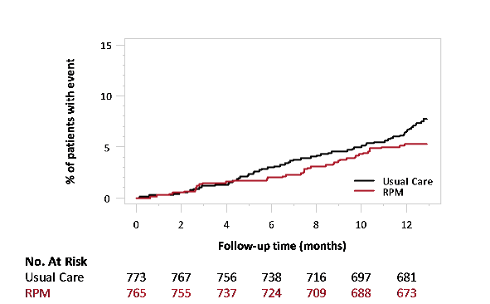
Main Secondary Outcomes (2)
CV mortality
RPM vs. UC
HR 0.67
95% CI 0.45, 1.01 P=0.056
Usual Care
RPM

Slide 15
Main Secondary Outcomes (3)
% days lost due to unplanned HF hospitalisations
 | RPM (n=765) | Usual Care (n=773) | Ratio RPM vs. UC (95% CI) | P
 | # Patients ^{Weighted} _{with event} Average of _{(%)} Percentages (95% CI) | # Patients ^{Weighted} _{with event} average of _{(%)} percentages (95% CI)
% days lost due to unplanned HF hospitalisations | 140 1.04 (18) (0.96, 1.11) | 193 1.53 (25) (1.43, 1.64) | 0.797 (0.67, 0.95) | 0.007
Days lost (days/year) | 3.8 (3.5, 4.1) | 5.6 (5.2, 6.0)

Slide 16
Main Secondary Outcomes (4)
Change in MLHFQ-questionnaire global score between baseline and 365 days
 | RPM (n=765) | Usual Care (n=773) | Difference RPM vs. UC (95% CI) | P
 | _{# Patients} Mean change (95% CI) | _{# Patients} Mean change (95% CI)
Change in MLHFQ Global Score | 649 -3.08 (-4.42, -1.75) | 624 -1.98 (-3.34, -0.61) | -1.10 (-3.01, 0.80) | 0.25
Change in NT-proBNP between baseline and 365 days
 | RPM (n=765) | Usual Care (n=773) | Difference RPM vs. UC (95%CI) | P
 | _{# Patients} Geometric Mean (95% CI) | _{# Patients} Geometric Mean (95% CI)
NT-proBNP change from baseline [pg/ml] | 664 -24.7 (-29.7, -19.3) | 628 -18.7 (-24.3, -12.8) | -7.3 (-16.0, 2.3) | 0.13

Slide 17
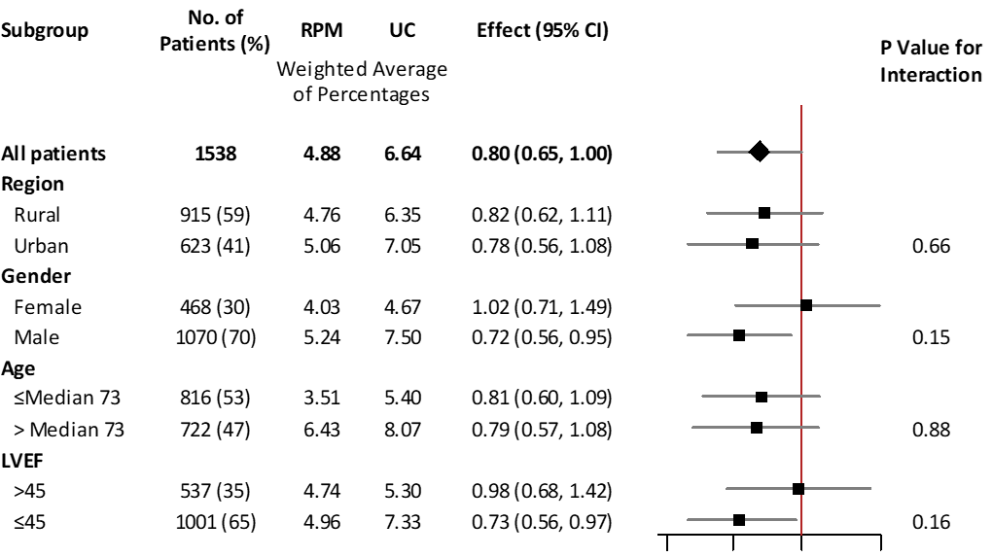
Selected Subgroups – unplanned CV hosp. and all-cause mortality
0.25 0.5
Favours RPM
1
Favours Usual Care

Slide 18
Conclusions
The TIM-HF2 trial results indicate that, in a well-defined HF population followed for 12 months, a holistic RPM approach reduces:
  Days lost due to unplanned CV hospitalisations and all-cause death
  Total mortality and
  Days lost due to unplanned HF hospitalisations.
A well structured Telemedical Centre, providing 24/7 service, is a key element within the RPM intervention.
The subgroup analysis suggests that RPM is an effective approach to overcome regional differences in HF management.

Slide 19
Acknowledgements
Patients
Investigators
Steering Committee
Data Safety Management Board
Independent Clinical Endpoint Committee
Sponsor (German Federal Ministry of Education and Research)
TMC-Team

Slide 20
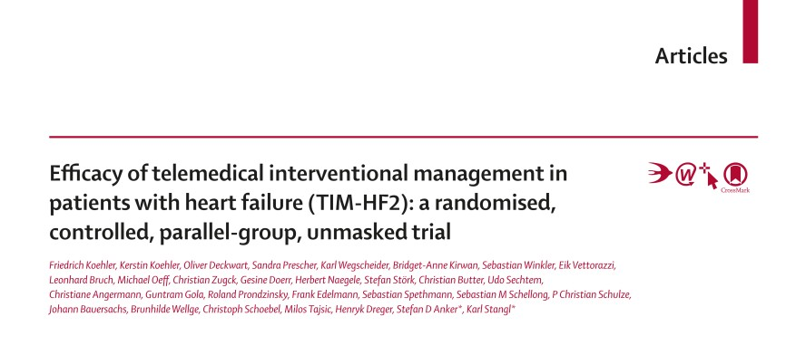

Published online August 25, 2018 · www.thelancet.com http://dx.doi.org/10.1016/S0140-6736(18)31880-4

