Slide 1
Clopidogrel Versus Aspirin in the Chronic Maintenance Period Following Percutaneous Coronary Intervention
in Patients with Acute Coronary Syndrome
Kyung Woo Park, MD, Jeehoon Kang, MD, Jaewook Chung, MD, Huijin Lee, MD, Doyeon Hwang, MD, Han-Mo Yang, MD, Jung-Kyu Han, MD, Eun-Seok Shin, MD, Bon-Kwon Koo, MD, Hyo-Soo Kim, MD

Slide 2
Kyung Woo, Park, MD, PhD, MBA
<Board Member>: EzCaretech
<Honoraria and Speaker’s fee>: Daiichi Sankyo, InnoN Pharmaceutical, Daewoong Pharmaceutical

Slide 3
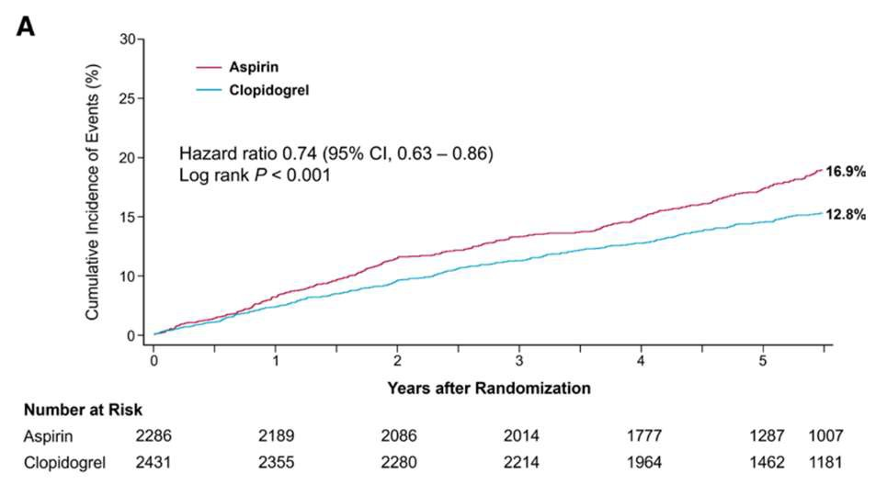
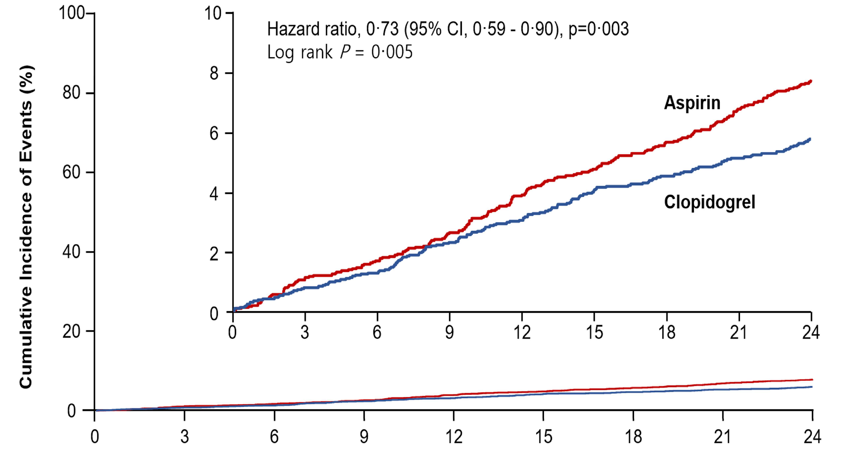
Background
After the initial 6- to 12-months of default dual antiplatelet therapy (DAPT), guidelines recommend indefinite maintenance of single antiplatelet therapy for long term secondary prevention of cardiovascular events.
The HOST-EXAM trial reported superiority of Clopidogrel over Aspirin monotherapy during a 2-year follow-up in stable CAD pts who were event-free during DAPT for 12month (±6mo) after PCI with DES, and the beneficial effect was sustained during an extended follow-up
BK Koo, J Kang, KW Park, HS Kim et al. Lancet 2021,
J Kang, KW Park,HS Kim, et al. Circulation 2023

Slide 4
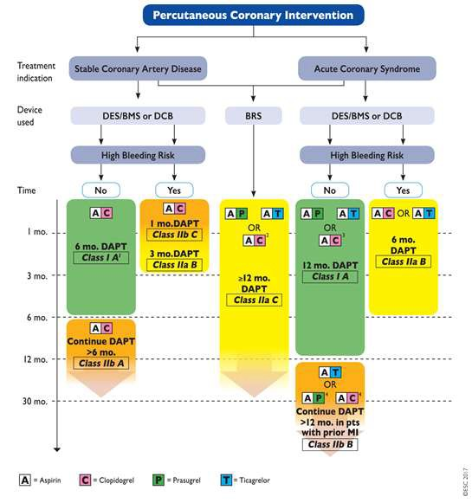
Background
Antiplatelet therapy is especially important in patients with a initial presentation of Acute Coronary Syndrome (ACS) owing to the higher risk of atherothrombotic events compared to those with stable angina.
PCI has dramatically improved short-term patient outcomes, however, patients who survive ACS still have a heightened risk of a future major cardiovascular events.
Are the benefits of clopidogrel monotherapy sustained long term in those with initial presentation of ACS?
M Valgimigli et al. Eur Heart J 2018.

Slide 5
Study Population
5,530 eligible patients screened, from 37 centers in Korea
HOST-EXAM IN-TRIAL period
HOST-EXAM POST-TRIAL period
Aspirin monotherapy
Aspirin Group
Event-free under DAPT for 12±6 months after PCI
Clopidogrel monotherapy
Clopidogrel Group
Primary analysis of the HOST-EXAM RCT
(2yrs after randomization)
Primary analysis of the HOST-
EXAM Extended study (median 5.8yrs after randomization)
Index PCI
Randomization
The total population was classified into two groups according to the initial clinical diagnosis at the time-point of Index PCI; ACS or non-ACS.

Slide 6
Study Endpoints
Primary Endpoint: POCO (Patient Oriented Composite outcome)
All-cause death, nonfatal myocardial infarction, stroke, readmission due to ACS, and major bleeding complications (defined as BARC type ≥3 bleeding)
Key Secondary Endpoints
Thrombotic composite endpoint
Cardiac death, nonfatal myocardial infarction, ischemic stroke, readmission due to ACS and stent thrombosis (definite & probable)
Bleeding endpoint
BARC type ≥2 bleeding

Slide 7
Study Flow
5530 patients were enrolled
92 were excluded from randomization
50 did not meet the eligibility criteria 28 declined to participate
14 randomization error
5438 underwent randomization
3921 in the ACS group
1517 in the non-ACS group
1964 allocated to Clopidogrel monotherapy
1957 allocated to Aspirin monotherapy
746 allocated to Clopidogrel monotherapy
771 allocated to Aspirin monotherapy
5 Withdrew consent 33 Lost to follow-up 167 Used a different antiplatelet regimen
1 Withdrew consent 37 Lost to follow-up 288 Used a different antiplatelet regimen
3 Withdrew consent 9 Lost to follow-up 62 Used a different antiplatelet regimen
14 Withdrew consent 5 Lost to follow-up 97 Used a different antiplatelet regimen
1964 included in the intention- to-treat analysis
1957 included in the intention- to-treat analysis
746 included in the intention- to-treat analysis
771 included in the intention- to-treat analysis

Slide 8
Baseline characteristics
Clinical Characteristics
 | ACS |  |  | Non-ACS
 | Clopidogrel (N=1,964) | Aspirin (N=1,957) | p-value | Clopidogrel (N=746) | Aspirin (N=771) | p-value
Age, years | 63.2±10.8 | 62.6±10.9 | 0.084 | 64.2±10.2 | 65.4±10.1 | 0.073
Body mass index, kg/m² | 24.9±3.1 | 24.8±3.4 | 0.884 | 24.8±3.0 | 24.8±3.1 | 0.584
Male | 1,475 (75.1) | 1,485 (75.9) | 0.596 | 540 (72.4) | 554 (71.9) | 0.862
Diabetes | 677 (34.5) | 669 (34.2) | 0.877 | 247 (33.1) | 267 (34.6) | 0.568
Hypertension | 1,174 (59.8) | 1171 (59.8) | 0.995 | 490 (65.7) | 503 (65.2) | 0.898
Dyslipidemia | 1,315 (67.0) | 1291 (66.0) | 0.535 | 569 (76.3) | 592 (76.8) | 0.862
Current smoker | 436 (22.2) | 452 (23.1) | 0.527 | 109 (14.6) | 129 (16.7) | 0.287
Chronic kidney disease | 243 (12.4) | 232 (11.9) | 0.654 | 112 (15.0) | 106 (13.7) | 0.529
Previous myocardial infarction | 366 (18.6) | 358 (18.3) | 0.814 | 71 (9.5) | 77 (10.0) | 0.825
Clinical indication of PCI |  |  | 0.916 |  |  | 0.411
- Silent ischemia | - | - |  | 58 (7.8) | 70 (9.1)
- Stable angina | - | - |  | 688 (92.2) | 701 (90.9)
- Unstable angina | 975 (49.6) | 959 (49.0) |  | - | -
- NSTEMI | 526 (26.8) | 528 (27.0) |  | - | -
- STEMI | 463 (23.6) | 470 (24.0) |  | - | -

Slide 9
Baseline characteristics
Angiographic Characteristics
 | ACS |  |  | Non-ACS
 | Clopidogrel (N=1,964) | Aspirin (N=1,957) | p-value | Clopidogrel (N=746) | Aspirin (N=771) | p-value
Extent of CAD One-vessel disease Two-vessel disease Three-vessel disease Left main disease PCI for bifurcation lesion - Two-stenting PCI for CTO lesion Number of treated lesions Mean diameter of stents, mm Min. diameter of stents, mm Total length of stents, mm Total number of stents |  |  | 0.264 |  |  | 0.044
 | 978 (49.8) | 1025 (52.4) |  | 389 (52.1) | 351 (45.5)
 | 628 (32.0) | 589 (30.1) |  | 227 (30.4) | 255 (33.1)
 | 358 (18.2) | 343 (17.5) |  | 130 (17.4) | 164 (21.3)
 | 99 (5.0) | 73 (3.7) | 0.054 | 43 (5.8) | 57 (7.4) | 0.240
 | 210 (10.7) | 197 (10.1) | 0.555 | 75 (10.1) | 98 (12.7) | 0.122
 | 32 (1.6) | 26 (1.3) | 0.517 | 14 (1.9) | 16 (2.1) | 0.926
 | 184 (9.4) | 191 (9.8) | 0.717 | 73 (9.8) | 63 (8.2) | 0.312
 | 1.3±0.6 | 1.3±0.6 | 0.723 | 1.3±0.6 | 1.3±0.6 | 0.662
 | 3.1±0.4 | 3.1±0.4 | 0.917 | 3.1±0.4 | 3.1±0.4 | 0.581
 | 3.0±0.5 | 3.0±0.5 | 0.823 | 3.0±0.5 | 3.0±0.4 | 0.739
 | 35.5±23.9 | 35.1±23.2 | 0.575 | 37.6±24.9 | 37.3±24.6 | 0.833
 | 1.5±0.8 | 1.5±0.8 | 0.549 | 1.5±0.9 | 1.5±0.8 | 0.743

Slide 10
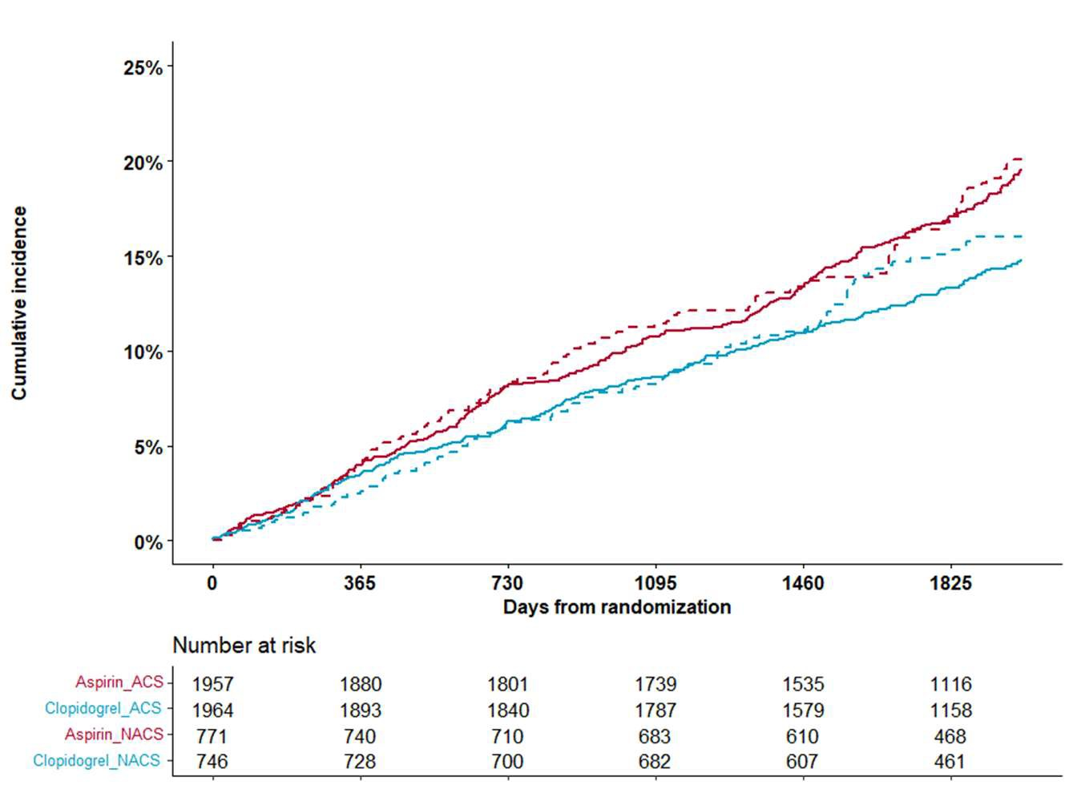
Outcomes
Primary Endpoint: POCO (Patient Oriented Composite outcome)
POCO: All-cause death, nonfatal myocardial infarction, stroke, readmission due to ACS, and major bleeding complications (defined as BARC type ≥3 bleeding)
ACS group
: HR 0.78 (95% CI 0.66-0.92);
Log-rank p = 0.003
18.2%
17.7%
14.8%
13.7%
Non-ACS group
: HR 0.82 (95% CI 0.63-1.06);
Log-rank p = 0.100
P-interaction = 0.751
ACS group, Aspirin monotherapy
ACS group, Clopidogrel monotherapy Non-ACS group, Aspirin monotherapy
Non-ACS group, Clopidogrel monotherapy
ACS group, Aspirin
ACS group, Clopidogrel
Non-ACS group, Aspirin
Non-ACS group, Clopidogrel

Slide 11
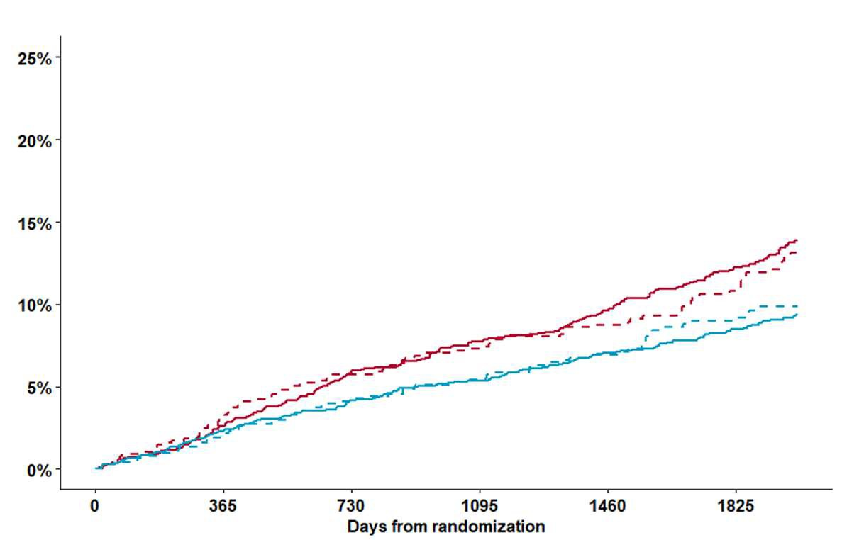
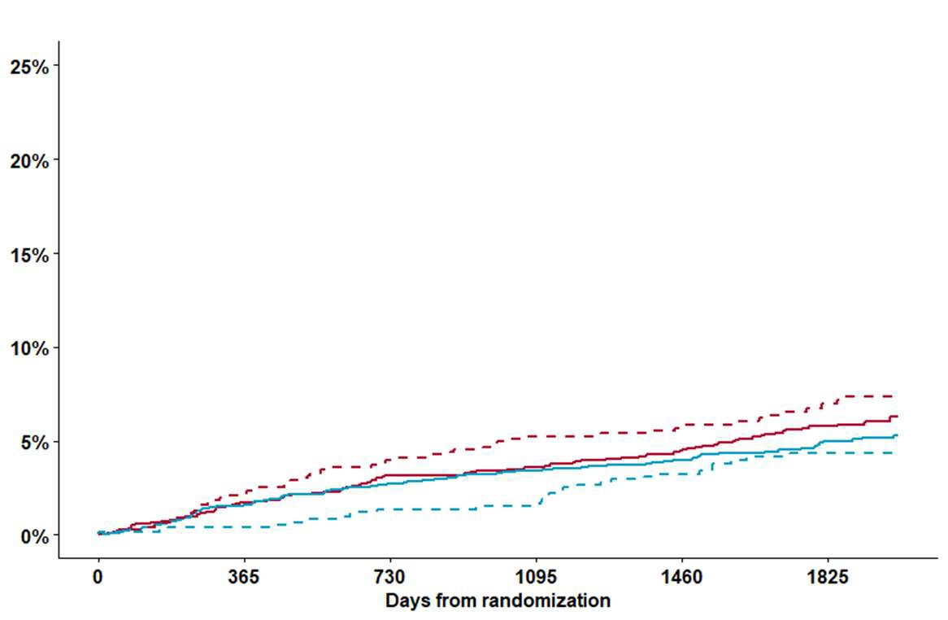
Outcomes
Secondary Endpoints
< Thrombotic composite endpoint >
< Bleeding endpoint >
ACS group
: HR 0.69 (95% CI 0.56-0.85); Log-rank p < 0.001
Non-ACS group
: HR 0.77 (95% CI 0.56-1.07); Log-rank p = 0.100
ACS group
: HR 0.85 (95% CI 0.65-1.13); Log-rank p = 0.200
Non-ACS group
: HR 0.58 (95% CI 0.37-0.92); Log-rank p = 0.020
12.9%
12.3%
9.4%
9.0%
P-interaction = 0.581
P-interaction = 0.156
7.1%
6.1%
5.1%
4.2%
ACS group, Aspirin monotherapy
ACS group, Clopidogrel monotherapy
Non-ACS group, Aspirin monotherapy Non-ACS group, Clopidogrel monotherapy

Slide 12
Outcomes
Absolute risk reduction and Number
< Thrombotic composite endpoint >
< Bleeding endpoint >
1.0
0.9
0.8
0.7
0.6
0.5
ARR 4.0%
1.0
0.9
0.8
0.7
0.6
0.5
4.0%
4.0%
HR 0.77 ARR 2.9%
HR 0.85
ARR 2.9%
3.0%
3.0%
HR 0.69
2.0%
HR 0.58
2.0%
1.0%
ARR 0.9%
1.0%
0.0
ACS group
Non-ACS group
0.0%
0.0
ACS group
Non-ACS group
0.0%
Hazard ratio (HR)
Absolute risk reduction (ARR)
Hazard ratio (HR)
Absolute risk reduction (ARR)
The risk reduction by clopidogrel monotherapy was larger for the thrombotic endpoint in the ACS group, while that was larger for bleeding endpoint in the non-ACS group.

Slide 13
Outcomes
Other Secondary Endpoints
 | ACS |  |  |  | Non-ACS |  |  |  | Interaction p-value
 | Clopidogrel (N=1,964) | Aspirin (N=1,957) | HR (95% CI) | p-value | Clopidogrel (N=746) | Aspirin (N=771) | HR (95% CI) | p-value
All-cause death | 120 (6.7%) | 107 (6.2%) | 1.13 (0.87-1.47) | 0.364 | 55 (8.0%) | 54 (8.0%) | 1.06 (0.73-1.55) | 0.757 | 0.790
Cardiac death | 58 (3.3%) | 58 (3.4%) | 1.01 (0.70-1.45) | 0.974 | 23 (3.4%) | 26 (4.0%) | 1.09 (0.53-1.61) | 0.772 | 0.795
Non-cardiac death | 62 (3.5%) | 49 (2.8%) | 1.27 (0.88-1.85) | 0.207 | 32 (4.7%) | 28 (4.2%) | 1.19 (0.72-1.98) | 0.498 | 0.835
Non-fatal myocardial infarction | 32 (1.6%) | 53 (2.7%) | 0.60 (0.39-0.93) | 0.022 | 13 (1.7%) | 9 (1.2%) | 1.50 (0.64-3.51) | 0.351 | 0.060
Stroke | 35 (1.8%) | 57 (2.9%) | 0.61 (0.40-0.93) | 0.020 | 11 (1.5%) | 17 (2.2%) | 0.66 (0.31-1.42) | 0.292 | 0.838
Readmission due to ACS | 92 (4.7%) | 149 (7.6%) | 0.61 (0.47-0.79) | <0.001 | 34 (4.6%) | 49 (6.4%) | 0.71 (0.46-1.10) | 0.124 | 0.550
Major bleeding (BARC type ≥3) | 55 (2.8%) | 71 (3.6%) | 0.77 (0.54-1.09) | 0.144 | 12 (1.6%) | 31 (4.0%) | 0.40 (0.20-0.77) | 0.006 | 0.083
Any revascularization | 98 (5.0%) | 121 (6.2%) | 0.80 (0.62-1.05) | 0.106 | 49 (6.6%) | 59 (7.7%) | 0.86 (0.59-1.25) | 0.634 | 0.785
Stent thrombosis | 6 (0.3%) | 15 (0.8%) | 0.40 (0.16-1.03) | 0.058 | 7 (1.0%) | 4 (0.5%) | 1.82 (0.53-6.21) | 0.340 | 0.056

Slide 14
Limitations
The current analysis is a post-hoc subgroup analysis, randomization was not stratified according to initial presentation as ACS.
This study was not statistically powered to show differences in outcome, and thus the present results should be taken as hypothesis-generating.
The study population was all East Asians, who are considered to have a different ischemia/bleeding risk profile in response to antiplatelet therapy known as the “East Asian paradox”.
Enrolled patients were stable patients with no clinical event within the first year post-PCI. The time-point of when to switch to monotherapy in ACS patients was not covered in the current analysis.

Slide 15
Conclusion
Among patients presenting as ACS or non-ACS, who maintained dual antiplatelet therapy without any ischemic and major bleeding events for 6- 18 months after PCI, the beneficial effect of clopidogrel was consistent irrespective of the clinical presentation.
The risk reduction by clopidogrel monotherapy tended to be more pronounced for the thrombotic risk in patients with ACS and for the bleeding risk in patients with non-ACS.

Slide 16
We thank all co-investigators of the HOST-EXAM study
Ki-Bum Won, MD, PhD, Ulsan University Hospital Eun-Seok Shin, MD, PhD, Ulsan University Hospital
Seung-Woon Rha, MD, PhD, Korea University Guro Hospital
Jang-Whan Bae, MD, PhD, Chungbuk National University College of Medicine Nam Ho Lee, MD, PhD, Kangnam Sacred Heart Hospital, Hallym University Seung-Ho Hur, MD, PhD, Keimyung University Dongsan Hospital
Junghan Yoon, MD, PhD, Yonsei University Wonju Severance Christian
Hospital
Tae-Ho Park, MD, PhD, Dong-A University Hospital
Bum Soo Kim, MD, PhD, Kangbuk Samsung Hospital, Sungkyunkwan University Sang Wook Lim, MD, PhD, CHA Bundang Medical Center, CHA University
Yoon Haeng Cho, MD, PhD, Soonchunhyang University Bucheon Hospital
Dong Woon Jeon, MD, PhD, National Health Insurance Service Ilsan Hospital Sang-Hyun Kim, MD, PhD, Boramae Medical Center
Kyoo-Rok Han, MD, PhD, Kangdong Sacred Heart Hospital, Hallym University Keon-Woong Moon, MD, PhD, St.Vincent’s Hospital, The Catholic University Seok Kyu Oh, MD, PhD, Wonkwang University Hospital
Ung Kim, MD, PhD, Yeungnam University Hospital
Moo-Yong Rhee, MD, PhD, Dongguk University Ilsan Hospital Doo-Il Kim, MD, PhD, Haeundae Paik Hospital, Inje University
Song-Yi Kim, MD, PhD, College of Medicine, Jeju National University Sung-Yun Lee, MD, PhD, Ilsan Paik Hospital, Inje University, Ilsan Seung Uk Lee, MD, PhD, Kwangju Christian Hospital
Sang-Wook Kim, MD, PhD, Chung-Ang University Hospital Seok Yeon Kim, MD, PhD, Seoul Medical Center
Hui-Kyung Jeon, MD, PhD, Uijeongbu St. Mary’s Hospital
Kwang Soo Cha, MD, PhD, Pusan National University School of Medicine Sang-Ho Jo, MD, PhD, Hallym University Sacred Heart Hospital
Jae Kean Ryu, MD, PhD, Daegu Catholic University Medical Center Il-Woo Suh, MD, PhD, Anyang SAM Medical Center
Hyun-Hee Choi, MD, PhD, Chuncheon Sacred Heart Hospital, Hallym University
Seoung-Il Woo, MD, PhD, Inha University Hospital
In-Ho Chae, MD, PhD, Seoul National University Bundang Hospital
Won-Yong Shin, MD, PhD, Soonchunhyang University Cheonan Hospital Dae-Kyeong Kim, MD, PhD, Busan Paik Hospital, Inje University
Ju Hyeon Oh, MD, PhD, Samsung Changwon Hospital, Sungkyunkwan University
Myung Ho Jeong, MD, PhD, Chonnam National University Hospital
Yong Hoon Kim, MD, PhD, Kangwon National University, School of Medicine

Slide 17
THANK YOU FOR YOUR ATTENTION

Slide 18
LATE-BREAKING TRIALS | SESSION TWO Location: Regency Ballroom
Moderator: Robert A. Byrne, MD, BCh, PhD – Mater Private Hospital, RCSI University of Medicine and Health Sciences, Dublin, Ireland
Moderator: Gregg W. Stone, MD, FACC, MSCAI – Mount Sinai
Panel Discussant: Alexandre A. Abizaid, MD, PhD – Incor
Panel Discussant: George Dangas, MD, MACC, MSCAI – The Mount Sinai Hospital
Panel Discussant: Aloke V. Finn, MD – CVPath
Panel Discussant: Kendra J. Grubb, MD – Emory University
Panel Discussant: Michael H. Joner, MD – Deutsches Herzzentrum Muenchen
Panel Discussant: Spencer B. King, III, MD, MACC, MSCAI – Emory University
Panel Discussant: Thomas MacGillivray, MD
Panel Discussant: Vinod Thourani, MD, FACC, FACS – Piedmont Heart Institute
Panel Discussant: Ron Waksman, MD, MSCAI – MedStar Washington Hospital Center, MedStar Heart and Vascular Institute
Late-Breaking Trials Session Two

