Slide 1
Investigation of effects of dietary nitrate on vascular function, platelet reactivity and restenosis in stable angina (NITRATE-OCT Study)
Dr Krishnaraj Rathod
Anthony Mathur (PI)
Amrita Ahluwalia (CI)
On behalf of the NITRATE-OCT Study Investigators

Slide 2
Krishnaraj Rathod, MBBS, BMedSci (Hons), PhD, MRCP, FHEA, QDip
I have no relevant financial relationships

Slide 3
Background
Coronary heart disease is the commonest cause of death in UK
Stable angina – An area of significant morbidity
1.3 million people in the UK & 14.1 million people in the USA
8% of men and 3% of women in UK & 4.2 % of men and 4% of women in USA
200,000 new cases a year in the UK and 500,000 in the USA
An effective treatment for stable angina is PCI
Accounts for 30,000 PCI procedures (UK) and 300,000 PCI procedures (USA)
Can reduce the severity of symptoms

Slide 4
Complications after PCI
Restenosis rates:
Simple lesions: 5 years, repeat intervention rates are ~ 5%.
Complex lesions: 5% at 2 years
Stent thrombosis rates (AMI, HF, death)
1% at 1 year and 0.6% yearly after
Studies have shown that it can cost $15 billion in the USA
Is there a single treatment that can reduce restenosis or stent thrombosis following?

Slide 5
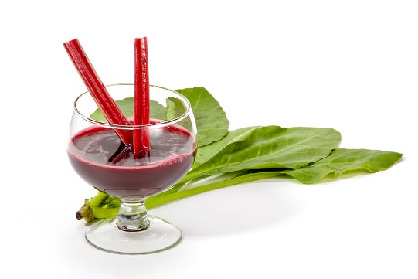
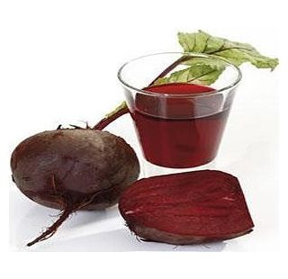
The Solution
Nitrate (NO₃⁻)

Slide 6
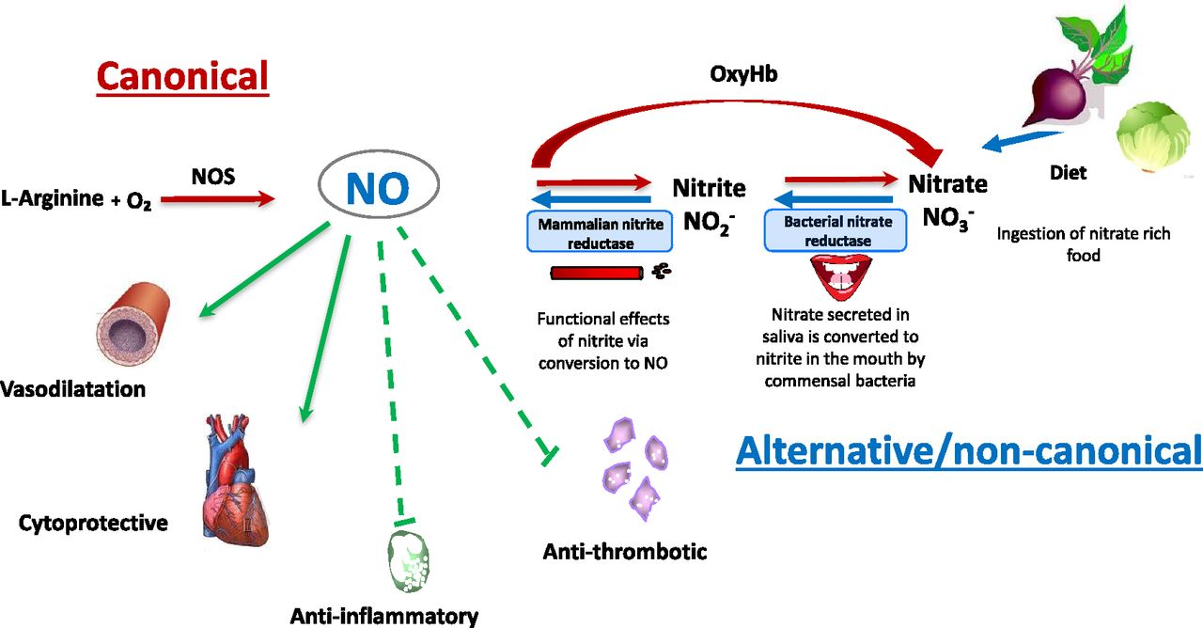
Pathways of nitric oxide synthesis
Vikas Kapil 2011 ©
V. Kapil et al. Pharmacol Rev 2020;72:692-766

Slide 7
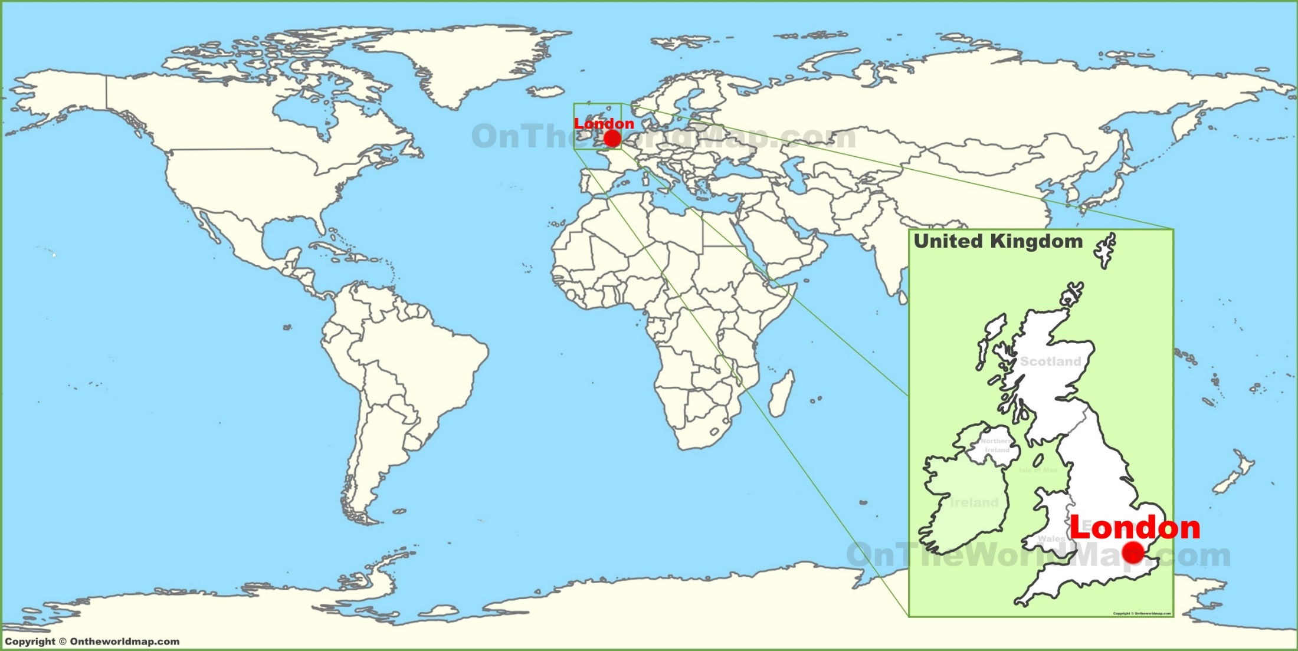
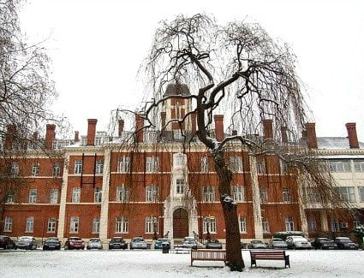
Study design
Hypothesis: Once a day oral dietary nitrate (beetroot juice) reduces restenosis in patients undergoing elective angioplasty for stable angina (Phase II study) (NITRATE-OCT)
Design
Phase II single-centre, double-blind, randomized placebo-controlled trial
300 patients in total
London Chest Hospital/Barts Heart Centre, performing over 3000 angioplasties a year:- Professor Mathur (Regenerate AMI, DCM, IHD, BAMI Trial)
Patients aged at least 18 years undergoing elective angioplasty for angina on OMT
Haemodynamically stable (systolic BP > 100 mmHg)
Intervention 4-5 mmol of dietary nitrate in the form of a daily shot of nitrate-rich beetroot juice for 6 months
Placebo is nitrate-deplete beetroot juice (identical to treatment arm in all other ways)
1:1 randomisation to Nitrate rich beetroot juice / Nitrate deplete beetroot juice.
Treatment and control juice was started prior to angioplasty and continued for 6 months

Slide 8
End-points
Primary endpoint: Assessment of restenosis made by measurement of in-stent late-loss assessed by angiography using QCA at 6 months ± 1 month.
OCT imaging at 6 months as an exploratory / mechanistic endpoint
Secondary endpoints:
Clinical
Assessment of MACE endpoints at 3, 9, 12 and 24 months (death, MI, need for repeat revascularisation and stent thrombosis)
Mechanistic
Change in Flow mediated dilation
Measuring markers of platelet reactivity
Measuring markers of inflammation
Measuring NO pathway

Slide 9
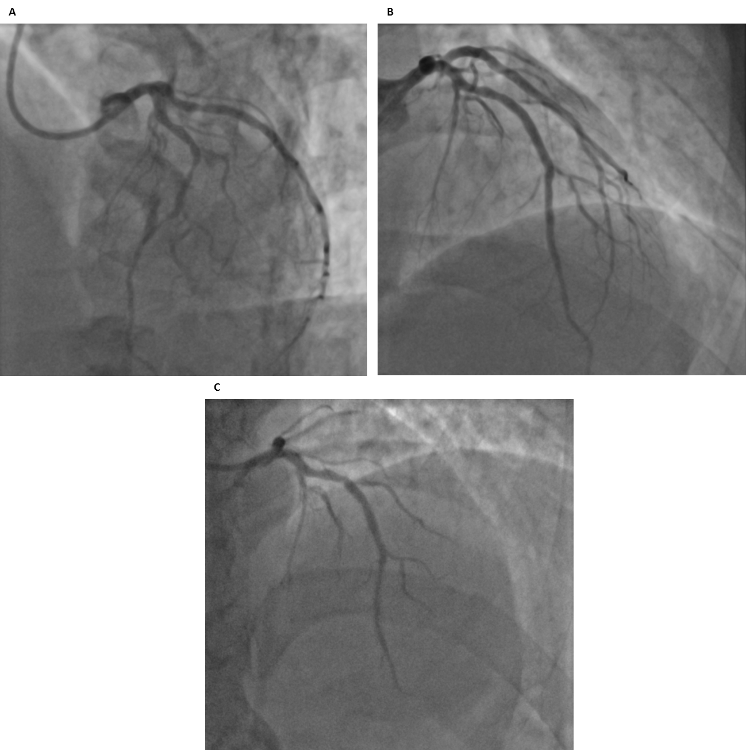
Baseline
Baseline
Post Stent
6 months

Slide 10
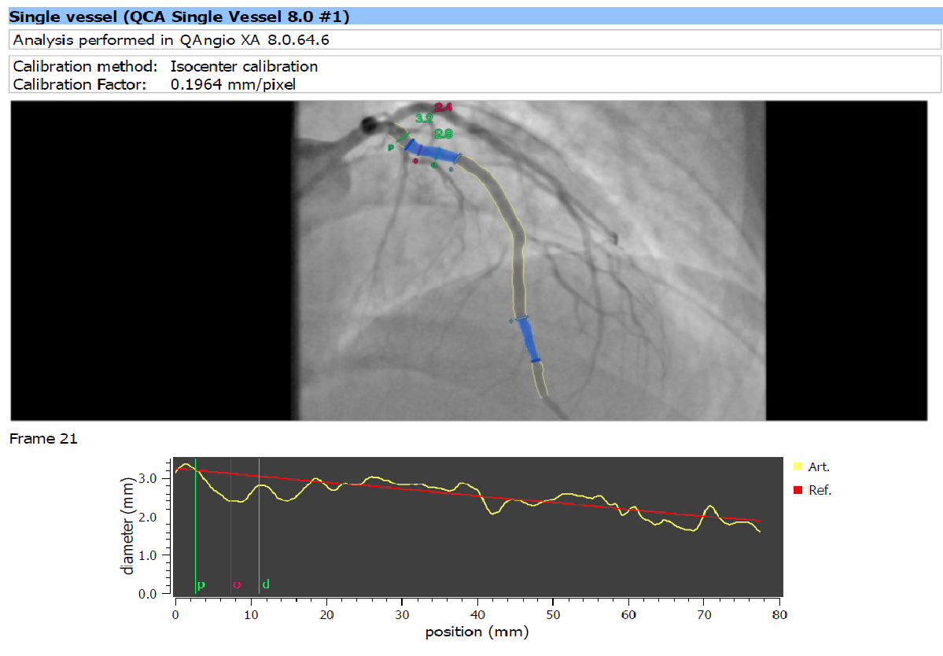
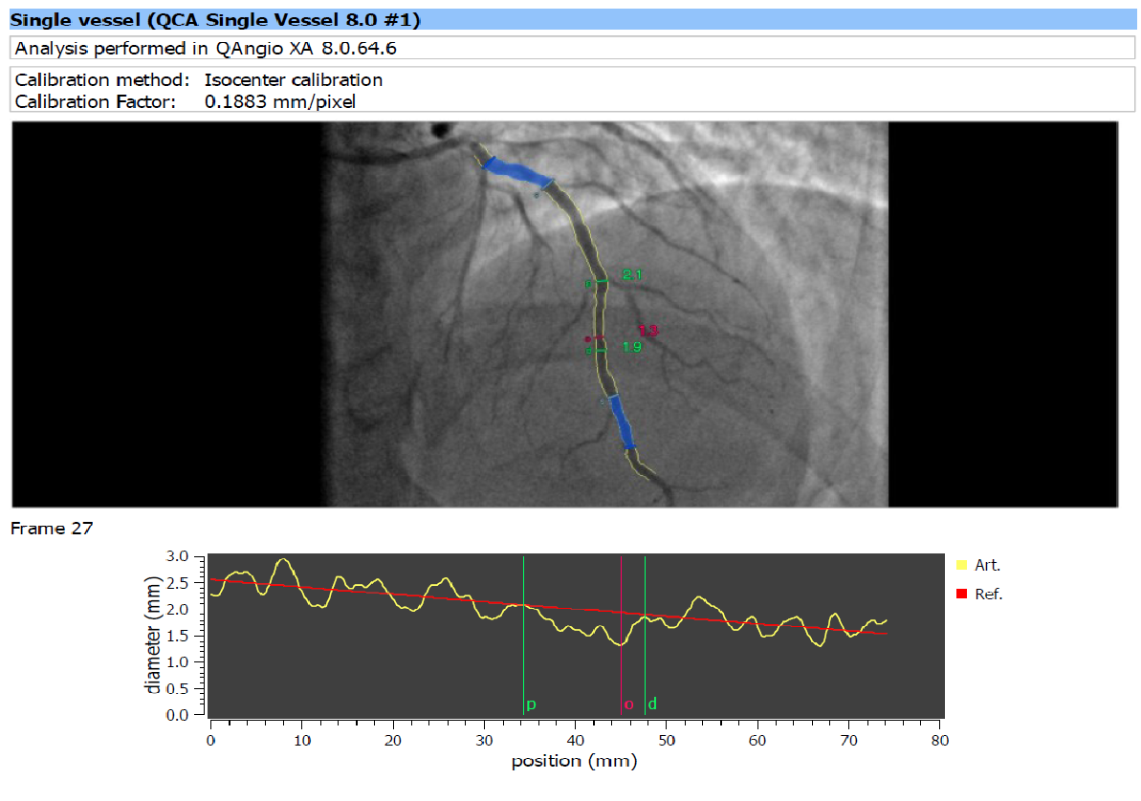
Adjudicated QCA analysis
Primary endpoint: Assessment of restenosis will be made by measurement of in-stent late-loss assessed by angiography and optical coherence tomography (OCT) at 6 months ± 1 month.
Second angiogram with OCT imaging at 6 months

Slide 11
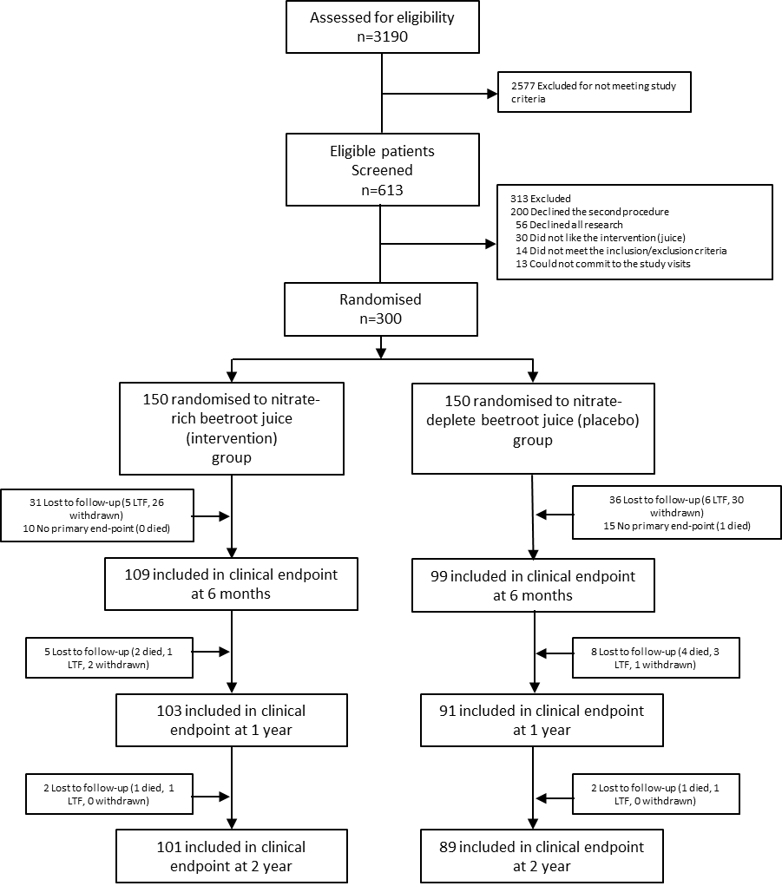
Consort

Slide 12
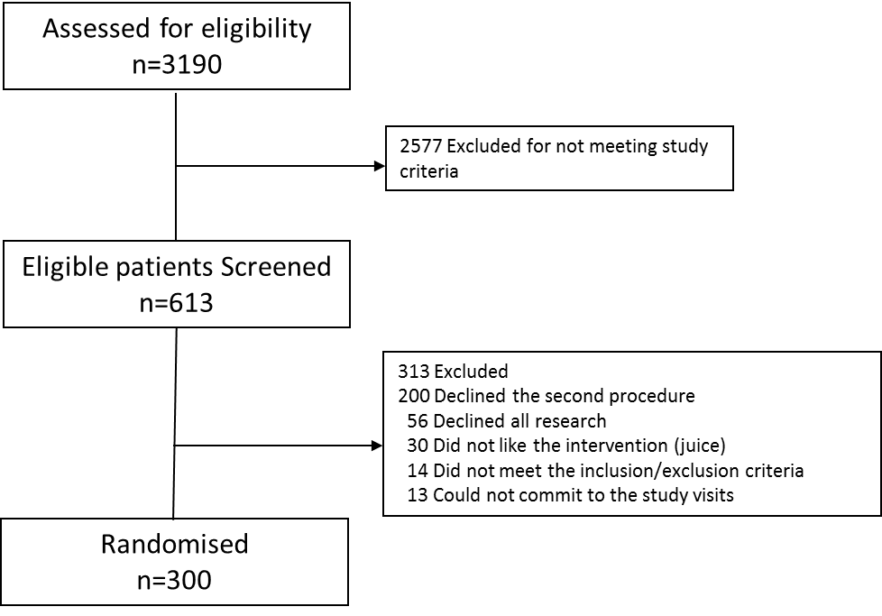
Consort

Slide 13
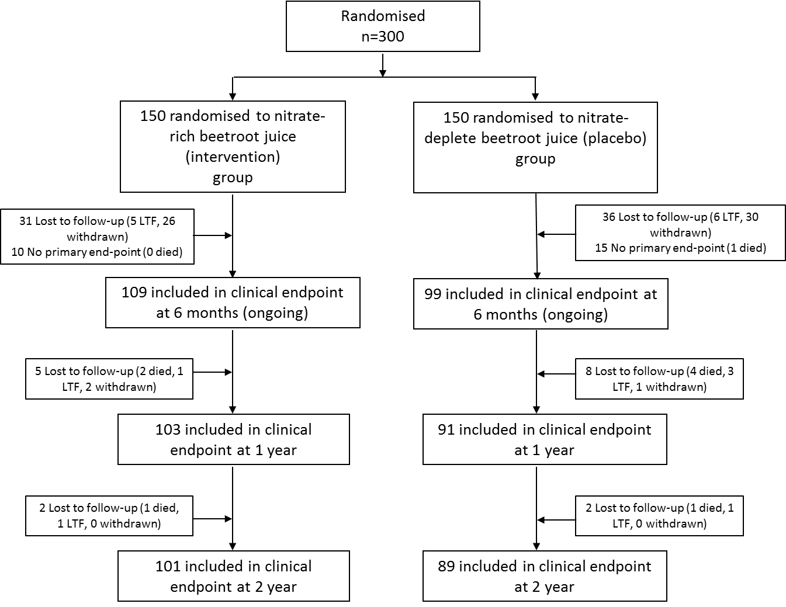
Consort

Slide 14
Baseline characteristics
 | Intervention (n=150) | Placebo (n=150)
Age (yr) (Mean±SD) | 61.59 ± 9.79 | 61.59 ± 8.88
Sex (Male) | 130 (86.7%) | 131 (87.3%)
Ethnicity Caucasian | 119 (79.3%) | 120 (80.0%)
Afro-Caribbean | 10 (6.7%) | 10 (6.7%)
Asian | 18 (12%) | 18 (12.0%)
East Asian | 2 (1.3%) | 2 (1.3%)
Diabetes mellitus | 33 (22%) | 33 (22.0%)
Type I | 1 (0.7%) | 1 (0.7%)
Type II | 32 (21.3%) | 32 (21.3%)
Body-mass index (kg/m²) (Mean±SD)ª | 28.81 ± 4.44 | 28.95 ± 4.77
Hypertension | 110 (73.3%) | 111 (74.0%)
Hypercholesterolaemia | 104 (69.3%) | 112 (74.7%)
Previous MI | 55 (36.7%) | 56 (37.3%)
Previous PCI | 47 (31.3%) | 55 (36.7%)
Previous CABG | 6 (4.0%) | 8 (5.3%)
Current Smoker | 22 (14.7%) | 33 (22.0%)
Previous Smoker | 74 (49.3%) | 65 (43.3%)
PVD | 11 (7.3%) | 10 (6.7%)
CVA/TIA | 7 (4.7%) | 7 (4.7%)
 | Intervention (n=150) | Placebo (n=150)
NYHA
Class I | 6 (4.0%) | 10 (6.7%)
Class II | 8 (5.3%) | 6 (4.0%)
Class III | 0 | 2 (1.3%)
CCS
CCS I | 28 (18.7%) | 27 (18.0%)
CCS II | 53 (29.4%) | 52 (34.7%)
CCS III | 66 (44.0%) | 66 (44.0%)
CCS IV | 1 (0.7%) | 4 (2.7%)
Asthma | 17 (11.3%) | 13 (8.7%)
COPD | 9 (6.0%) | 9 (6.0%)
Previous History of CAD | 75 (50.0%) | 80 (53.3%)
Heart rate (BPM) (Mean±SD) | 69.49 ± 13.78 | 66.85 ± 12.40
Systolic BP (mmHg) (Mean±SD) | 137.18 ± 16.86 | 136.79 ± 16.85
Diastolic BP (mmHg) (Mean±SD) | 78.97 ± 9.90 | 77.43 ± 10.12
Culprit Vessel
Left main stem | 0 | 0
Left anterior descending | 55 (36.7%) | 66 (44.0%)
Diagonal (First) | 5 (3.3%) | 0
Intermediate Artery | 2 (1.3%) | 3 (2.0%)
Circumflex | 26 (17.3%) | 19 (12.7%)
Obtuse Marginal | 4 (2.7%) | 4 (2.7%)
Right coronary | 46 (30.7%) | 41 (27.3%)

Slide 15
Procedural Characteristics & Medications
 | Intervention (n= 150) | Placebo (n=150)
Access site
Radial | 124 (82.7%) | 121 (80.7%)
DES use | 138 (92.0%) | 134 (89.3%)
Number of stents used (Mean±SD) | 1.30 ± 0.52 | 1.39 ± 0.71
Stent Type
Xience | 104 (69.3%) | 111 (74.0%)
Resolute Integrity | 6 (4.0%) | 3 (2.0%)
Promus Premier | 13 (8.7%) | 9 (6.0%)
Biofreedom | 1 (0.7%) | 1 (0.7%)
Synergy | 5 (3.3%) | 7 (4.7%)
Biomatrix | 1 (0.7%) | 0
Stent length (Mean±SD)
First Stent | 26.88 ± 9.96 | 27.36 ± 10.26
Second Stent | 21.79 ± 8.51 | 21.94 ± 11.29
Third Stent | 17.30 ± 7.38 | 16.20 ± 7.16
Fourth Stent | 26.50 ± 16.63
Stent width (Mean±SD)
First Stent | 3.13 ±0.46 | 3.10 ± 0.46
Second Stent | 3.26 ± 0.48 | 3.64 ± 2.98
Third Stent | 3.25 ±0.49 | 3.60 ± 0.42
Fourth Stent | 3.00 ± 0.71
Procedural Success | 150 (100%) | 150 (100%)
 | Intervention (n= 150) | Placebo (n=150)
Medication at discharge
ACE inhibitor | 89 (59.3%) | 70 (46.7%)
ARB | 21 (14.0%) | 25 (16.7%)
Diuretic | 19 (12.7%) | 21 (14.0%)
Amlodipine | 37 (24.7%) | 36 (24.0%)
β Blocker | 102 (68.0%) | 112 (74.7%)
Statin | 135 (90.0%) | 136 (90.7%)
Aspirin | 150 (100%) | 150 (100%)
Clopidogrel | 125 (83.3%) | 118 (78.7%)
Ticagrelor | 27 (18.0%) | 34 (22.7%)
Nicorandil | 9 (6.0%) | 12 (8.0%)
Organic Nitrate | 28 (18.7%) | 27 (18.0%)
GTN | 76 (50.7%) | 90 (60.0%)
Ranolazine | 3 (2.0%) | 5 (3.3%)
Warfarin | 1 (0.7%) | 3 (2.0%)
NOAC | 4 (2.7%) | 5 (3.3%)

Slide 16
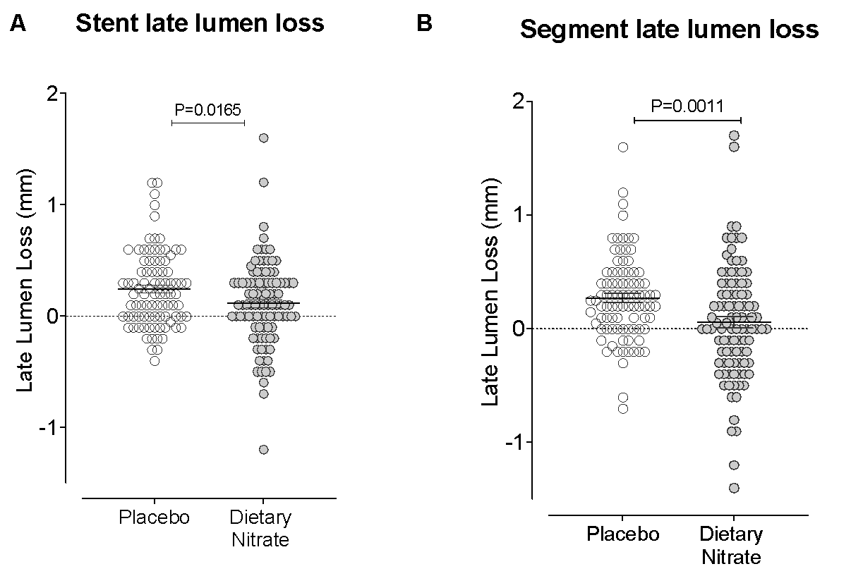
Significant difference in Late Lumen Loss between the treatment groups
Placebo (Mean, SD) | Nitrate (Mean, SD) | P value
Primary endpoint: Stent late lumen loss assessed by QCA
0.244 ± 0.04 (n=89) | 0.117 ± 0.04 (n=99) | 0.0165
Primary endpoint: Segment late lumen loss assessed by QCA
0.269 ± 0.37 (n=89) | 0.055 ± 0.50 (n=99) | 0.0011
Significance shown for unpaired t test between groups

Slide 17
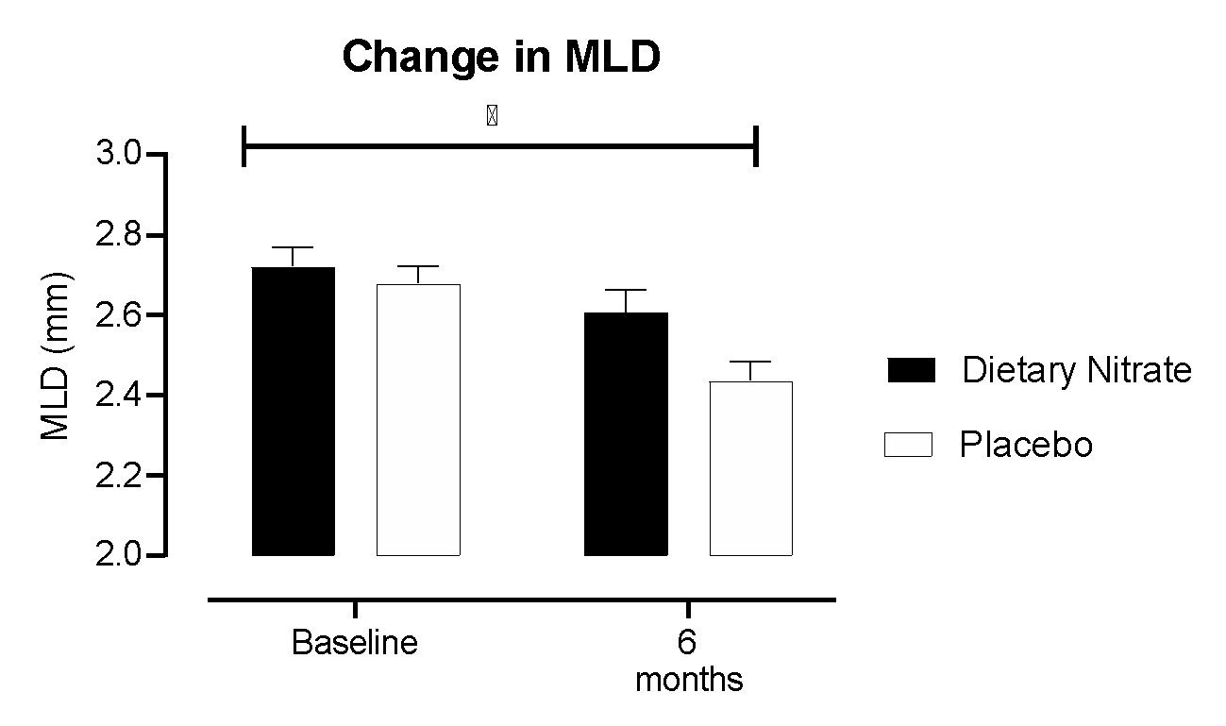
Nitrate resulted in larger Minimum Lumen Diameter at 6 months
Significance shown for paired t test within groups
Significance shown for two-way ANNOVA between groups

Slide 18
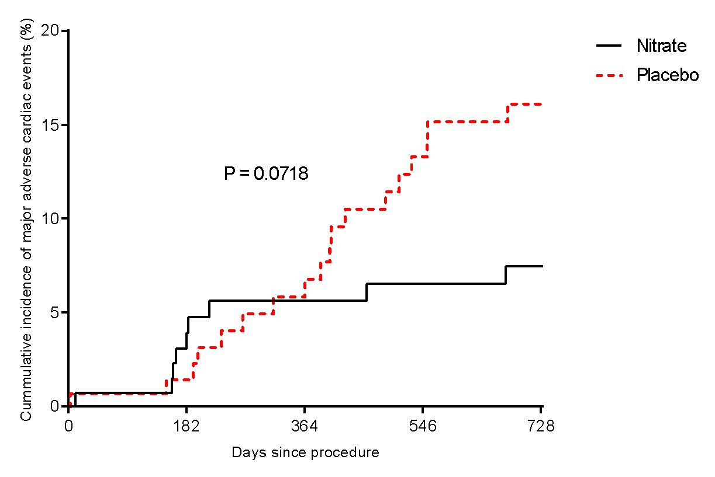
2 year MACE (ITT)
MACE Time (months) | Nitrate (150) | Placebo (150)
3 | 1 | 1
6 | 5 | 2
9 | 7 | 5
12 | 7 | 8
24 | 9 | 18
MACE | Nitrate (150) | Placebo (150)
Death | 2 | 5
MI | 1 | 6
TVR | 6 | 7
ST | 0 | 0
Log Rank test used for survival analysis

Slide 19
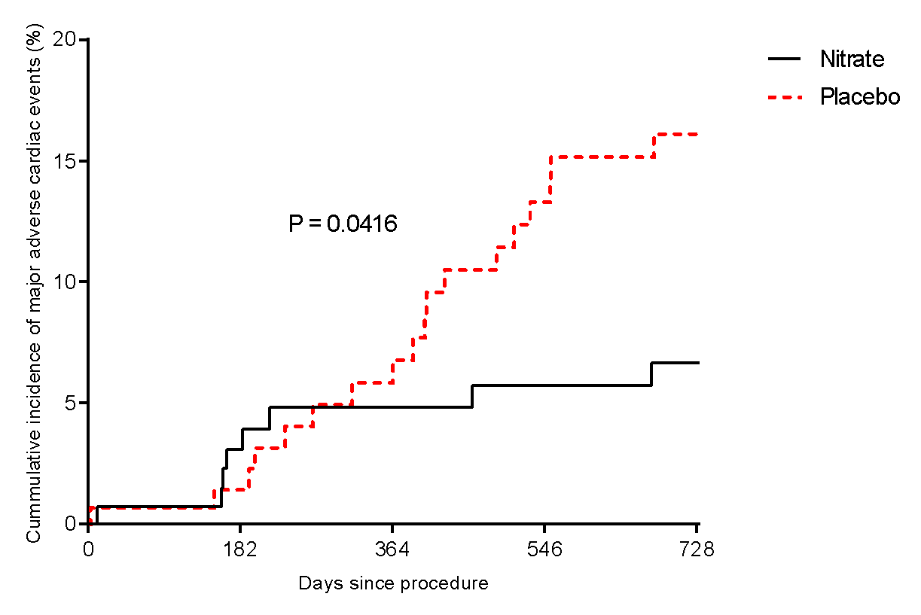
2 year MACE
MACE Time (months) | Nitrate (150) | Placebo (150)
3 | 1 | 1
6 | 4 | 2
9 | 6 | 5
12 | 6 | 8
24 | 8 | 18
MACE | Nitrate (150) | Placebo (150)
Death | 2 | 5
MI | 1 | 6
TVR | 5 | 7
ST | 0 | 0
Log Rank test used for survival analysis

Slide 20
Summary and Conclusions
Dietary nitrate resulted in a significant reduction in late lumen loss at 6 months
(~53% reduction in LLL)
Dietary nitrate demonstrated a trend towards a reduction in 2 year MACE
Once a day oral dietary nitrate for 6 months was well tolerated and safe in patients with stable angina undergoing elective PCI with stent implantation
These results suggest that dietary nitrate may have a therapeutic role in reducing restenosis following PCI for stable angina
This warrants further investigation in larger clinical trials

Slide 21
Acknowledgements
Study CI/PI: Amrita Ahluwalia, Anthony Mathur
Clinical Pharmacology / CCMD
Core Lab (MedStar Washington Hospital Center)
Hector Garcia-Garcia
London Chest Hospital / Barts Heart Centre
Christos Bourantas, Anantharaman Ramasamy, Vincenzo Turafo
Consultants, SpRs at London Chest Hospital, Barts Heart Centre
Trial Steering Committee: Raymand Macallister, Tasheen Chowdhury, David Peel, Nick Lanyon, Emanulea Falaschetti
Data Safety and Monitoring Committee: Chris Thiemermann, Peter Mills, Jan Sargent, Thomas Godec
Imperial College CTU: Neil Poulter, Hilda Tsang
Most importantly: All the patients from screening to end of end-points

Slide 22
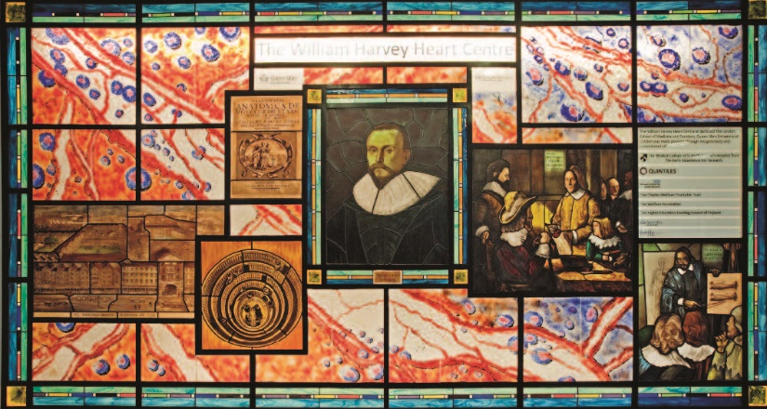
Any questions?

Slide 23
OCT Data
 | Intervention | Placebo | P value
Max_diam | 3.891 ± 0.069 | 3.745 ± 0.068 | 0.135
Min_diam | 2.226 ± 0.049 | 2.174 ± 0.046 | 0.449
Min_stent_diam | 2.520 ± 0.046 | 2.476 ± 0.043 | 0.487
Max_stent_diam | 3.892 ± 0.063 | 3.797 ± 0.064 | 0.290
Min_stent_area | 6.179 ± 0.210 | 5.931 ± 0.208 | 0.404
Max_stent_area | 10.13 ± 0.301 | 9.557 ± 0.307 | 0.186
Mean_stent_area | 8.047 ± 0.237 | 7.677 ± 0.246 | 0.280
Min_lumen_area | 5.148 ± 0.206 | 4.843 ± 0.203 | 0.294
Max_lumen_area | 9.933 ± 0.345 | 8.984 ± 0.319 | 0.046
Mean_diam | 2.983 ± 0.049 | 2.903 ± 0.051 | 0.257
Mean_lumen_area | 7.247 ± 0.240 | 6.863 ± 0.245 | 0.265
Nstent | 28.52 ± 1.195 | 27.07 ± 1.175 | 0.390
Nlumen | 31.84 ± 1.349 | 30.39 ± 1.240 | 0.432
Eccentricity_index | 0.875 ± 0.003 | 0.874 ± 0.004 | 0.946
Eccentricity_index_msa | 0.871 ± 0.007 | 0.866 ± 0.007 | 0.647
Mean_stent_diameter | 3.156 ± 0.048 | 3.082 ± 0.049 | 0.284
Symmetry_index | 0.348 ± 0.009 | 0.342 ± 0.009 | 0.660
Distal_reference_area | 6.261 ± 0.272 | 5.518 ± 0.224 | 0.039
Proximal_reference_area | 7.847 ± 0.353 | 7.068 ± 0.276 | 0.082
Reference_lumen_area | 6.897 ± 0.258 | 6.236 ± 0.215 | 0.054
Apposed | 0.448 ± 0.105 | 0.348 ± 0.069 | 0.434
Malapposed | 2.251 ± 0.444 | 1.855 ± 0.360 | 0.494
Covered | 97.30 ± 0.463 | 97.54 ± 0.389 | 0.700
Neointimalthickness | 0.109 ± 0.005 | 0.109 ± 0.005 | 0.918
 | Intervention | Placebo | P value
TotalNrOfStruts | 293.3 ± 13.30 | 281.0 ± 12.79 | 0.510
TotalAreaInStentLumen_a | 0.814 ± 0.039 | 0.793 ± 0.042 | 0.717
AvgThickInStentLumen_a | 0.099 ± 0.004 | 0.098 ± 0.005 | 0.919
AvgThickOutStentLumen_a | 0.023 ± 0.005 | 0.013 ± 0.002 | 0.121
LargThickInStentLumen_a | 0.440 ± 0.024 | 0.424 ± 0.019 | 0.602
LargAreaInStentLumen_a | 1.923 ± 0.118 | 1.801 ± 0.111 | 0.455
LargAreaOutStentLumen_a | 0.830 ± 0.183 | 0.433 ± 0.107 | 0.069
TotalOutStentLumen_a | 0.085 ± 0.031 | 0.031 ± 0.008 | 0.108
PCT_NIH | 10.72 ± 0.463 | 11.06 ± 0.591 | 0.644
Neointimal_volume | 27.41 ± 2.055 | 25.10 ± 1.868 | 0.407
Totalinstentlumen_z | 0.922 ± 0.046 | 0.892 ± 0.044 | 0.642
TotalOutStentLumen_z | 0.187 ± 0.046 | 0.076 ± 0.019 | 0.032
LumenVolume | 225.4 ± 12.39 | 201.3 ± 11.26 | 0.154
StentVolume | 253.5 ± 14.05 | 226.9 ± 12.41 | 0.160
Pct_RAS | 7.800 ± 2.053 | 5.218 ± 2.033 | 0.375
Percent_volume_obstruction | 11.08 ± 0.488 | 11.46 ± 0.612 | 0.624
Significance shown for unpaired t test between groups

Slide 24
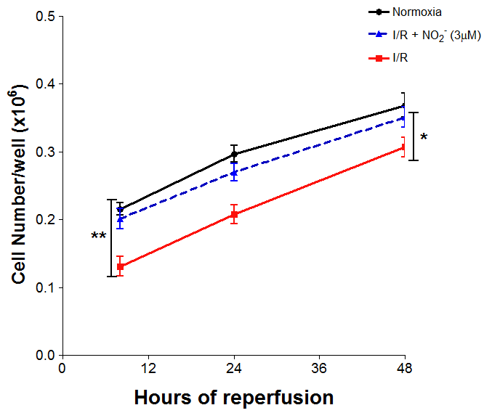
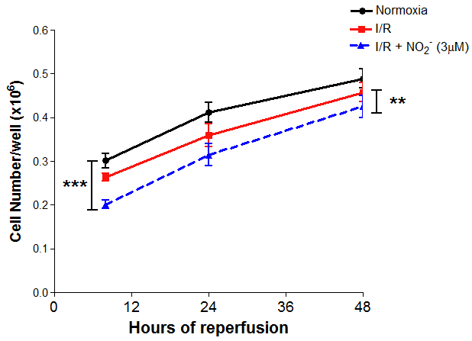
An alternative source of endogenous NO
Human coronary artery
endothelial cells
Human coronary artery
smooth muscle cells

