Slide 1
Evolut Low Risk Trial of self-expanding TAVI vs. SAVR: full 1-year results and economic implications
Michael J. Reardon, Benjamin P. Geisler,
Jan B. Pietzsch, Antony Walton, Didier Tchétché,
G. Michael Deeb, Steven J. Yakubov, and Jeffrey J. Popma for the Evolut Low Risk Investigators

Slide 2

Potential conflicts of interest
Speaker's name : Michael J Reardon
☑ I have the following potential conflicts of interest to declare:
Consultation fees from Medtronic
Michael J. Reardon, MD

Slide 3
Background and objective
The Evolut Low Risk Trial demonstrated that TAVI was non-inferior to SAVR for the primary endpoint of the estimated 2-year rate of all-cause mortality or disabling stroke (per VARC-2) based on a Bayesian study design.
At the time of the Bayesian analysis 850 of 1,403 as-treated patients had been followed through 1 year.
All eligible patients have now completed 1-year follow-up.
Objective: To report the complete 1-year follow-up of the Evolut Low Risk trial with a focus on the implications for healthcare costs related to use of TAVI vs SAVR in patients at low operative risk.
Michael J Reardon, MD

Slide 4
What did we study?
Evolut Low Risk is a prospective, international multicenter trial that randomised patients with severe aortic valve stenosis at low risk of 30-day surgical mortality.
Eligible patients had an estimated risk of surgical mortality <3% and were randomised (1:1) to TAVI with the self-expanding CoreValve, Evolut R or Evolut PRO valves versus SAVR.
A health-economic model was used to project scenarios of long-term survival and to evaluate cost-effectiveness.
Michael J. Reardon, MD

Slide 5
What are the essential results?
TAVI
SAVR
Log-rank P = 0.075
All-cause mortality or
disabling stroke
6.6%
4.4%
No. at risk
TAVI | 730 | 715 | 697 | 615 | 406
SAVR | 684 | 648 | 619 | 538 | 334
Time in cath lab or OR
Hospital length of stay
Discharge home
P<0.0001
P<0.0001
P<0.0001
277.0 ± 79.4
Days
Michael J. Reardon, MD
6.2 ± 3.3
Minutes
148.1 ± 55.2
2.6 ± 2.1
TAVI
SAVR
TAVI
SAVR
TAVI
SAVR

Slide 6
Kaplan-Meier clinical event rates
 | 1 year |  |  | 2 years
 | TAVI | SAVR | P-value | TAVI | SAVR | P-value
All-cause mortality or disabling stroke | 2.5% | 4.3% | 0.06 | 4.4% | 6.6% | 0.08
All-cause mortality | 2.1% | 2.7% | 0.45 | 3.5% | 4.4% | 0.35
Disabling stroke | 0.8% | 2.2% | 0.03 | 1.6% | 2.9% | 0.07
AV rehospitalization | 3.3% | 5.9% | 0.02 | 4.9% | 7.2% | 0.07
AV reinterventions | 0.6% | 0.4% | 0.78 | 0.9% | 0.9% | 0.89
Myocardial infarction | 1.8% | 1.6% | 0.82 | 2.1% | 1.6% | 0.56
New pacemaker implantation¹ | 19.6% | 7.1% | <0.001 | 22.5% | 8.0% | <0.001
New pacemaker implantation² | 19.0% | 6.8% | <0.001 | 21.8% | 7.7% | <0.001
Acute kidney injury, stage 3 | 0.4% | 1.9% | < 0.01 | 0.4% | 1.9% | < 0.01
Major vascular complication | 3.7% | 3.4% | 0.73 | 3.9% | 3.6% | 0.76
Michael J. Reardon, MD
¹Patients with pacemaker or ICD at baseline are not included
²Patients with pacemaker or ICD at baseline are included
AV = aortic valve

Slide 7
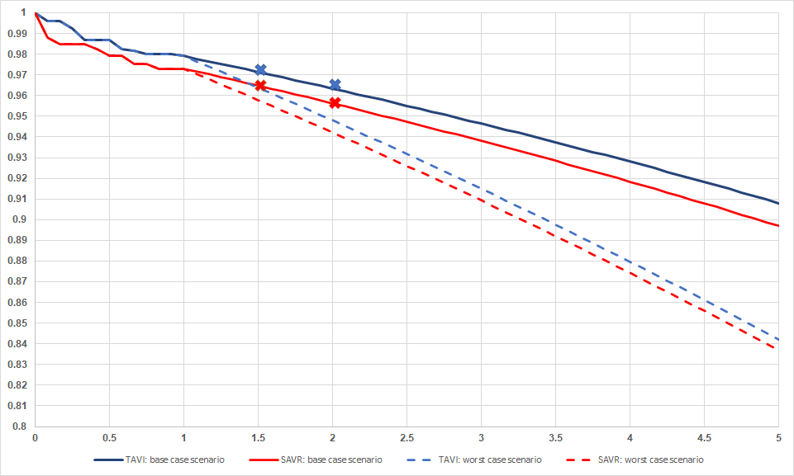
Health economic models of life year and QALY gain
Survival Projections
The lifetime benefit of TAVI depends on survival projections beyond 12 months:
  Optimistic assumption:
    0.32 life years (LYs)
    0.57 quality-adjusted life years (QALYs)
  Pessimistic assumption:
    0.07 LYs
    0.08 QALYs
100%
95%
90%
85%
80%
Observed
TAVI
Optimistic assumption
Projected
SAVR
Pessimistic assumption
Michael J. Reardon, MD
0 0.5 1.0 1.5 2.0 2.5 3.0 3.5 4.0 4.5 5.0
Optimistic assumption: small observed mortality benefit for TAVI between 6 and 24M data continues lifelong
Pessimistic assumption: general population mortality, no survival difference beyond 12M

Slide 8
Health economics: U.S. analysis
Breakdown of Costs by Strategy Over Time
Cost difference of ~$4k at 30 days and 1 year based on differences in
  Procedure cost (including device)
  Adverse event costs
  Resource utilization (index hospitalization and rehab)
Lifetime cost difference of $5.5-12.5k suggests TAVI is cost-effective (ICER ~$21-87k/QALY)*
$269-326k
Lifetime
+5.5-12.5k
$263-314k
1-year
+$4.3k
$60,000
$18.6k
$0.3k
$18.2k
$4.5k
$2.6k
$40,000
$4.0k
$6.4k
$5.9k
$38.7k
30-day
+$3.9k
$20,000
$28.7k
Michael J. Reardon, MD
$0
TAVI
SAVR
Index w/o AEs
Physician fees
Index AEs
Rehabilitation
First year f/u
Index cost calculations based on analysis of 2018 Medicare costs, adjusted to Evolut LR trial based billing data sample of n=109 subjects from three U.S. trial sites.
* ICER: Incremental cost-effectiveness ratio. Cost-effectiveness determined based on U.S. willingness-to-pay threshold of $150,000 per QALY gained.

Slide 9
Health-economic implications for Europe
Potential drivers for cost-effectiveness in Europe:
  Procedure time and LOS in real world setting
  Reimbursement structures and treatment protocols
  Country-specific interplay of admission, device, and adverse event costs
TAVI would be cost-effective if lifetime incremental costs are
  Less than ~£2.0-8.0k in the UK*
  Less than ~€4.0-16.0k in Germany/France/Italy/The Netherlands*
Michael J. Reardon, MD
* Considering willingness-to-pay thresholds of £25,000 (UK) and €50,000 per QALY (other countries)

Slide 10
Conclusions
Analysis of the Evolut Low Risk trial using full 1 year follow-up is consistent with the prior Bayesian results demonstrating that TAVI is noninferior to SAVR for all-cause mortality or disabling stroke at 2 years.
At 1 year the rates of disabling stroke and AV hospitalization are significantly lower with TAVI compared to SAVR.
For the U.S., TAVI is projected to be cost-effective for low risk patients.
This may hold true in the European context, depending on country-specific cost differences and willingness-to-pay.
Michael J. Reardon, MD

