Slide 1
EuroPCR 2019
Hotlines and Late-Breaking Trials
08:43 – 08:51, Thursday, 23 May 2019
Theatre Bordeaux
Long-term ticagrelor monotherapy for 23 months following 1-month DAPT after PCI in complex clinical scenarios: Prespecified subgroup analyses from the GLOBAL LEADERS study
P. W. Serruys*, P. Chichareon, Y. Onuma,
C. Hamm*, R. Anderson, M. Dominici, P.G. Steg*,
P. Jüni*, P. Vranckx*, M. Valgimigli*, S. Windecker*
On behalf of the Global Leaders investigators
*Steering committee of the Global Leaders study

Slide 2
Disclosure Statement of Financial Interest
Patrick W. Serruys, MD. PhD.
Within the past 12 months, I or my spouse/partner have had a financial interest/arrangement or affiliation with the organization(s) listed below.
Affiliation/Financial Relationship
Grant/Research Support
Consulting Fees/Honoraria
Company
Abbott
Boston Scientific
Biosensors
Medtronic
Philips/Volcano
Sinomedical Sciences Technology
SMT
Xeltis

Slide 3
Why this study?
Advanced age, female, impaired renal function, obesity and COPD… are factors associated with increased risk for both ischemic and bleeding complications. Nevertheless, these subgroups tend to be under-represented in contemporary PCI trials (1).
The efficacy and safety of ticagrelor monotherapy in comparison to the conventional 12-month DAPT has not yet been evaluated specifically in these high risk clinical subgroups.
1. Sardar et l. JAMA 2014; 174: 1868-70.

Slide 4
Study design
Experimental strategy
“All-comers” PCI population N = 15,991
1:1 Randomisation, open-label design, 130 centers worldwide
ACS +
Stable CAD
 | ASA 75-100 mg/d
Ticagrelor 90 mg bid
Less bleeding than DAPT
Ticagrelor monotherapy better than ASA monotherapy
Reference strategy
ACS: UA+NSTEMI+STEMI
 | Ticagrelor 90 mg bid
ASA 75-100 mg/d
⦁Any type of lesions: Left main, SVG, CTO bifurcation, ISR, etc.
⦁Unrestricted use of DES (number, length)
Stable CAD | ASA 75-100 mg/d
 | Clopidogrel 75 mg/d
Bivalirudin-supported
0 30 d 90 d 120 d
1 year
1.5 years
2 years
BioMatrix DES by default
ECG ECG
discharge 90D
ECG 2Y

Slide 5
Baseline characteristics
Pre-specified groups in the protocol (in red) | Experimental Strategy | Reference Strategy
Total number of patients | N = 7980 | N = 7988
Age (years)* | 64.5 ± 10.3 | 64.6 ± 10.3
Females | 23.4 % | 23.1 %
Body Mass Index (kg/m²) | 28.2 ± 4.6 | 28.2 ± 4.6
Medical history/comorbidities
Diabetes mellitus* | 25.7 % | 24.9 %
Insulin-dependent diabetes mellitus | 7.6 % | 7.7 %
Hypertension | 74.0 % | 73.3 %
Hypercholesterolemia | 69.3 % | 70.0 %
Current smoker | 25.9 % | 26.3 %
Peripheral Vascular Disease* | 6.0 % | 6.7 %
Chronic obstructive pulmonary disease | 5.1 % | 5.2 %
Previous Major bleeding | 0.6 % | 0.7 %
Impaired renal function* (eGFR < 60 ml/min/1.73m²) | 13.9 % | 13.5 %
Previous stroke | 2.6 % | 2.6 %
Previous myocardial infarction | 23.0 % | 23.6 %
Previous PCI | 32.7 % | 32.7 %
Previous CABG | 5.6 % | 6.2 %
*Previously reported in the Lancet

Slide 6
Baseline characteristics
Pre-specified groups in the protocol (in red) | Experimental Strategy | Reference Strategy
Total number of patients | N = 7980 | N = 7988
Clinical presentation
Stable Coronary Artery Disease* | 53.0 % | 53.2 %
Acute Coronary Syndrome* | 47.0 % | 46.8 %
Unstable Angina | 12.6 % | 12.7 %
Non-STEMI | 21.1 % | 21.1 %
STEMI | 13.3 % | 12.9 %
Procedural characteristics
PCI performed | 99.5 % | 99.4 %
Radial artery access | 73.9 % | 74.2 %
BioMatrix DES | 94.8 % | 94.4 %
Bivalirudin-assisted PCI | 87.4 % | 87.2 %
Number of lesions treated per patient
One lesion | 74.6 % | 74.7 %
Two lesions | 20.5 % | 19.8 %
Three or more lesions | 5.0 % | 5.5 %
*Previously reported in the Lancet

Slide 7
What did we study?
Primary endpoint
All-cause death and non-fatal new Q wave MI at 2 years
Secondary (safety) endpoints
Investigator-reported BARC 3 or 5 bleeding up to 2 years post randomization
Additional secondary endpoints
Investigator reported endpoints up to 2 years
Composite of all-cause mortality, stroke and non-fatal new Q-wave MI
All-cause death
Stroke: ischemic and/or hemorrhagic
Myocardial infarction (Third Universal Definition)
Coronary revascularization (TVR, NTVR)
Definite stent thrombosis according to the Academic Research Consortium
Patient oriented composite endpoints (POCE: all-cause death, any type of stroke, MI, revascularization) and net adverse cardiac events (NACE: POCE and BARC type 3 or 5 bleeding)

Slide 8
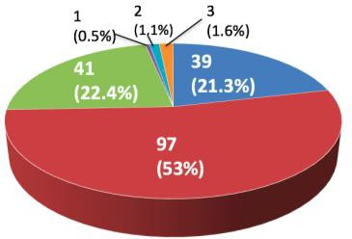
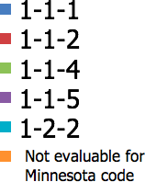
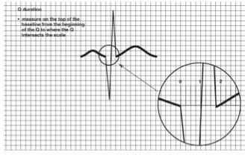
How was the study executed?
… with robust endpoints
Randomization and follow-up status
15,991 pts randomized (all-cause mortality)
23 pts : Data deletion requested
No search for vital status
ECG centrally adjudicated (~48,000 ECGs)
New Q-waves detected according to the
Minnesota Code
(Major criteria 1-1-1 to 1-2-8)
8 pts with unknown vital status
15,960 pts with known vital status 15,259 pts : Site reported
701 pts : From public domain
99.95% with known vital status
183 new Q waves diagnosed
3 new LBBB (Q wave equivalent)
Trial organisation (investigator-initiated trial)
Sponsor: European Clinical Research Institute (www.ECRI-trials.com)
Grant giver: AstraZeneca (Ticagrelor), Biosensors International (Biomatrix DES), The Medicines Company (Bivalirudin)
Clinical Research Organization, ECG and angiographic core laboratory: Cardialysis, Rotterdam
Statistical analysis: Cardialysis, Academic Research Team (ART), Rotterdam and Clinical Trials Unit (CTU), Bern university
Data and Safety Monitoring Board (DSMB): Jan G.P.Tijssen, Laura Mauri, Freek W.A. Verheugt

Slide 9
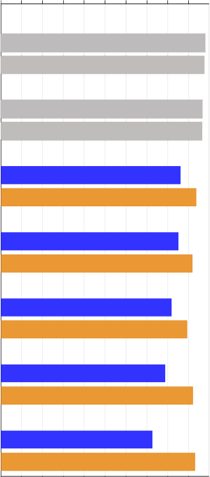
Adherence to treatment strategies
Primary and secondary outcomes at 12 months (Intention to treat)
0% 25% 50% 75% 100%
Discharge
Percentage
98 %
97 %
96 %
96 %
86 %
94 %
85 %
92 %
82 %
89 %
Ticagrelor mono in ACS and SA In ACS: Ticagrelor + ASA
In SA: Clopidogrel + ASA
 | Experimental group | Reference group | Risk Ratio (95% CI) | p-value
Number of pts. | N=7980 | N=7988
All-cause mortality or new Q-wave MI* | 1.95 %, (156) | 2.47 %, (197) | 0.79 (0.64-0.98) | 0.028
All-cause mortality | 1.35 % (108) | 1.64 % (131) | 0.82 (0.64-1.06) | 0.138
New Q-wave MI | 0.60 % (48) | 0.86 % (69) | 0.70 (0.48-1.00) | 0.052
BARC 3 or 5 Bleeding** | 1.47 % | 1.70 % | 0.86 (0.67-1.11) | 0.243
BARC 5 Bleeding | 0.18 % | 0.20 % | 0.88 (0.43-1.80) | 0.722
BARC 3 Bleeding | 1.34 % | 1.60 % | 0.84 (0.65-1.08) | 0.179
Experimental arm Reference arm
Follow-up 1 M
Experimental arm Reference arm
Follow-up 3 M
Experimental arm
Reference arm
Follow-up 6 M
Experimental arm Reference arm
Follow-up 12 M
Experimental arm
Reference arm
Follow-up 18 M
Experimental arm Reference arm
Follow-up 24 M
*Mantel-Cox method based on time of death or diagnosis of new Q wave MI
**Mantel-Cox log-rank method for secondary safety endpoints
Vranckx et al. Lancet 2018; 392: 940-949.
Experimental arm Reference arm

Slide 10
Adherence to treatment strategies
Primary and secondary outcomes at 24 months (Intention to treat)
0% 25% 50% 75% 100%
Discharge
Percentage
98 %
97 %
96 %
96 %
86 %
94 %
85 %
92 %
82 %
89 %
79 %
92 %
78 %
93 %
 | Experimental group | Reference group | Risk Ratio (95% CI) | p-value
Number of pts. | N=7980 | N=7988
All-cause mortality or new Q-wave MI | 3.81 %, (304) | 4.37 %, (349) | 0.87 (0.75-1.01) | 0.073
All-cause mortality | 2.81 % (224) | 3.17 % (253) | 0.88 (0.74-1.06) | 0.18
New Q-wave MI | 1.04 % (83) | 1.29 % (103) | 0.80 (0.60-1.07) | 0.14
BARC 3 or 5 Bleeding | 2.04 % | 2.12 % | 0.97 (0.78-1.20) | 0.77
BARC 5 Bleeding | 0.28 % | 0.30 % | 0.92 (0.52-1.64) | 0.78
BARC 3 Bleeding | 1.88 % | 1.99 % | 0.95 (0.76-1.18) | 0.63
Experimental arm Reference arm
Follow-up 1 M
Experimental arm Reference arm
Follow-up 3 M
Experimental arm
Reference arm
Follow-up 6 M
Experimental arm Reference arm
Follow-up 12 M
Experimental arm
Reference arm
Follow-up 18 M
Experimental arm Reference arm
Follow-up 24 M
Ticagrelor monotherapy in ACS and SA
ASA monotherapy in ACS and SA
Vranckx et al. Lancet 2018; 392: 940-949.
Experimental arm Reference arm

Slide 11
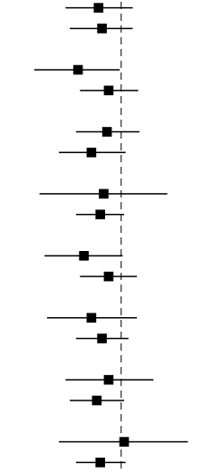
All-cause mortality or new Q wave MI at 2 years
Pre-specified subgroup | Experimental arm | Reference arm | HR exp/ref (95% CI) | Exp. better | Ref. better | P int.
Indication |  |  |  |  |  | 0.92
ACS | 147/3750 (3.93) | 169/3737 (4.52) | 0.86 (0.69-1.08)
Stable CAD | 157/4230 (3.72) | 180/4251 (4.24) | 0.88 (0.71-1.08)
Age |  |  |  |  |  | 0.23
Age > 75 | 93/1292 (7.22) | 120/1273 (9.44) | 0.75 (0.56-0.99)
Age ≤ 75 | 211/6688 (3.16) | 229/6715 (3.41) | 0.92 (0.76-1.12)
Body mass index |  |  |  |  |  | 0.51
BMI ≥ 27 | 163/4477 (3.65) | 180/4516 (3.99) | 0.91 (0.74-1.13)
BMI < 27 | 141/3502 (4.03) | 169/3471 (4.87) | 0.82 (0.66-1.03)
COPD |  |  |  |  |  | 0.92
COPD | 39/404 (9.68) | 45/417 (10.82) | 0.89 (0.58-1.36)
No COPD | 262/7543 (3.48) | 301/7532 (4.00) | 0.87 (0.74-1.02)
Diabetes |  |  |  |  |  | 0.33
Diabetes | 102/2049 (4.99) | 126/1989 (6.34) | 0.78 (0.60-1.01)
Non-diabetes | 202/5925 (3.41) | 222/5994 (3.71) | 0.92 (0.76-1.11)
Renal function |  |  |  |  |  | 0.68
Impaired renal function | 79/1099 (7.20) | 93/1072 (8.68) | 0.82 (0.61-1.11)
Non-impaired renal function | 224/6835 (3.28) | 255/6877 (3.71) | 0.88 (0.74-1.05)
Sex |  |  |  |  |  | 0.64
Female | 85/1865 (4.56) | 91/1849 (4.93) | 0.92 (0.69-1.24)
Male | 219/6115 (3.59) | 258/6139 (4.21) | 0.85 (0.71-1.02)
Peripheral vascular disease |  |  |  |  |  | 0.52
Yes | 40/476 (8.40) | 44/529 (8.32) | 1.02 (0.66-1.56)
No | 260/7428 (3.51) | 295/7389 (4.00) | 0.87 (0.74-1.03)
Vranckx et al. Lancet 2018; 392: 940-949.

Slide 12
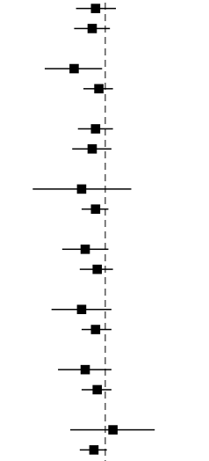
Patient oriented composite endpoints at 2 years
Pre-specified subgroup | Experimental arm | Reference arm | HR exp/ref (95% CI) | Exp. better | Ref. better | P int.
Indication |  |  |  |  |  | 0.71
ACS | 492/3750 (13.28) | 518/3737 (13.97) | 0.94 (0.83-1.07)
Stable CAD | 558/4230 (13.38) | 613/4251 (14.54) | 0.92 (0.82-1.03)
Age |  |  |  |  |  | 0.13
Age > 75 | 207/1292 (16.37) | 248/1273 (19.80) | 0.82 (0.68-0.98)
Age ≤ 75 | 843/6688 (12.75) | 883/6715 (13.24) | 0.96 (0.87-1.05)
Body mass index |  |  |  |  |  | 0.83
BMI ≥ 27 | 598/4477 (13.55) | 645/4516 (14.38) | 0.94 (0.84-1.05)
BMI < 27 | 452/3502 (13.05) | 486/3471 (14.14) | 0.92 (0.81-1.04)
COPD |  |  |  |  |  | 0.64
COPD | 74/404 (18.72) | 88/417 (21.50) | 0.86 (0.63-1.18)
No COPD | 972/7543 (13.05) | 1037/7532 (13.87) | 0.94 (0.86-1.02)
Diabetes |  |  |  |  |  | 0.44
Diabetes | 338/2049 (16.66) | 369/1989 (18.72) | 0.88 (0.76-1.02)
Non-diabetes | 711/5925 (12.17) | 761/5994 (12.79) | 0.95 (0.85-1.05)
Renal function |  |  |  |  |  | 0.47
Impaired renal function | 194/1099 (17.93) | 219/1072 (20.68) | 0.86 (0.71-1.04)
Non-impaired renal function | 847/6835 (12.55) | 908/6877 (13.30) | 0.94 (0.86-1.04)
Sex |  |  |  |  |  | 0.45
Female | 243/1865 (13.23) | 273/1849 (14.94) | 0.88 (0.74-1.04)
Male | 807/6115 (13.36) | 858/6139 (14.07) | 0.95 (0.86-1.04)
Peripheral vascular disease |  |  |  |  |  | 0.40
Yes | 101/476 (21.43) | 108/529 (20.59) | 1.05 (0.80-1.37)
No | 942/7428 (12.85) | 1010/7389 (13.78) | 0.93 (0.85-1.01)
Serruys et al. EuroIntervention 2019.

Slide 13
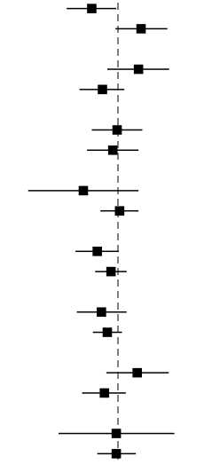
BARC 3 or 5 bleeding at 2 years
Pre-specified subgroup | Experimental arm | Reference arm | HR exp/ref (95% CI) | Exp. better | Ref. better | P int.
Indication |  |  |  |  |  | 0.01
ACS | 73/3750 (1.98) | 100/3737 (2.72) | 0.73 (0.54-0.98)
Stable CAD | 90/4230 (2.17) | 69/4251 (1.65) | 1.32 (0.97-1.81)
Age |  |  |  |  |  | 0.06
Age > 75 | 65/1292 (5.24) | 50/1273 (4.08) | 1.28 (0.88-1.85)
Age ≤ 75 | 98/6688 (1.49) | 119/6715 (1.79) | 0.83 (0.63-1.08)
Body mass index |  |  |  |  |  | 0.81
BMI ≥ 27 | 83/4477 (1.89) | 85/4516 (1.91) | 0.99 (0.73-1.34)
BMI < 27 | 80/3502 (2.33) | 84/3471 (2.46) | 0.94 (0.69-1.28)
COPD |  |  |  |  |  | 0.23
COPD | 14/404 (3.60) | 22/417 (5.47) | 0.66 (0.34-1.28)
No COPD | 149/7543 (2.01) | 146/7532 (1.97) | 1.02 (0.81-1.28)
Diabetes |  |  |  |  |  | 0.33
Diabetes | 52/2049 (2.59) | 47/1989 (2.42) | 0.78 (0.60-1.01)
Non-diabetes | 111/5925 (1.91) | 122/5994 (2.06) | 0.92 (0.76-1.11)
Renal function |  |  |  |  |  | 0.68
Impaired renal function | 43/1099 (4.03) | 38/1072 (3.67) | 0.82 (0.61-1.11)
Non-impaired renal function | 120/6835 (1.79) | 130/6877 (1.91) | 0.88 (0.74-1.05)
Sex |  |  |  |  |  | 0.09
Female | 61/1865 (3.33) | 48/1849 (2.65) | 1.26 (0.87-1.84)
Male | 102/6115 (1.70) | 121/6139 (2.00) | 0.85 (0.65-1.10)
Peripheral vascular disease |  |  |  |  |  | 0.99
Yes | 15/476 (3.25) | 17/529 (3.28) | 0.98 (0.49-1.97)
No | 148/7428 (2.03) | 150/7389 (2.06) | 0.98 (0.78-1.24)
Manuscript submitted to EHJ

Slide 14
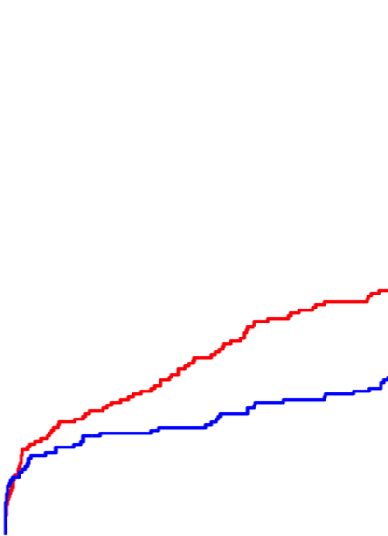
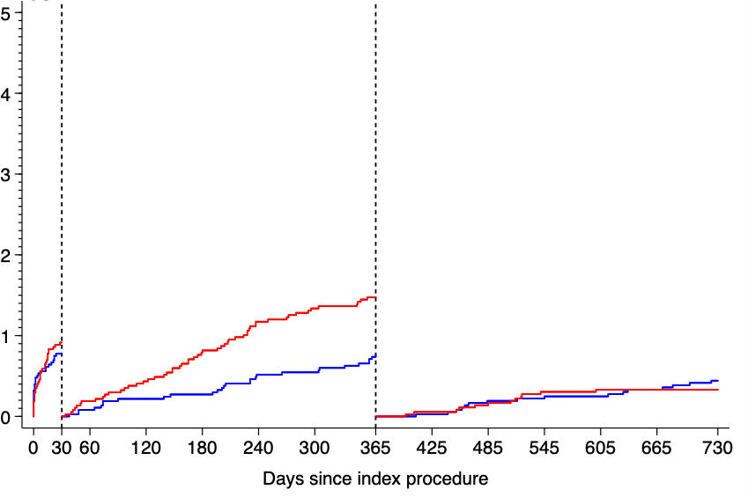
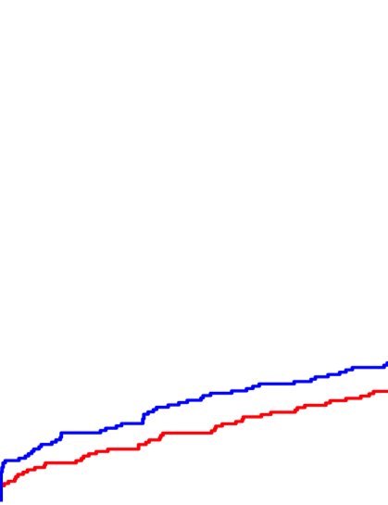
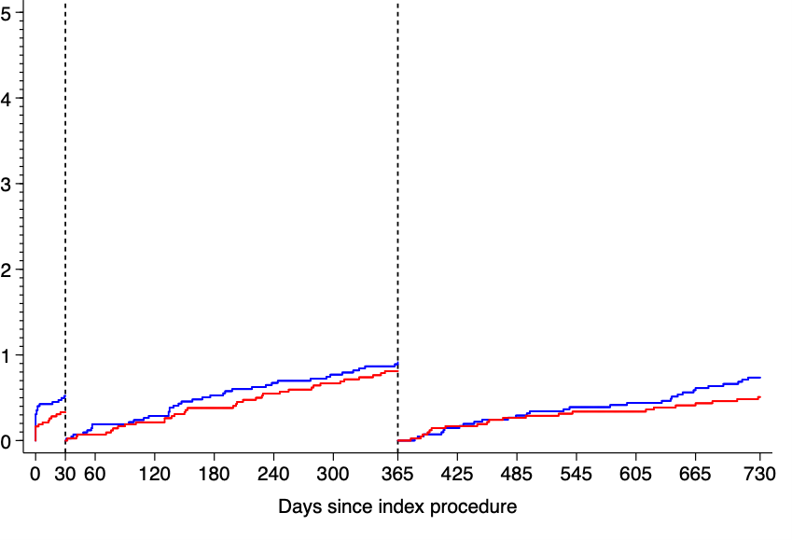
KM curves of BARC 3 or 5 bleeding up to 30 days, from 31 days to
1 year and from 1 year to end of follow-up by clinical presentation
ACS
Reference arm Experimental arm
Stable CAD
Reference arm Experimental arm
BARC 3 or 5 bleeding (%)
BARC 3 or 5 bleeding (%)
HR 0.64 (0.46-0.90)
HR 1.26 (0.86-1.85)
2.39%
1.54%
1.44%
1.14%
0.91%
0.77%
0.75%
0.45%
0.52%
0.33%
0.51%
0.34%
Days since index procedure
Days since index procedure
Ref.
DAPT (Ticagrelor)
ASA mono
Ref.
DAPT (Clopidogrel)
ASA mono
DAPT
DAPT
Exp.
Ticagrelor Mono
Exp.
Ticagrelor Mono
Manuscript submitted to EHJ

Slide 15
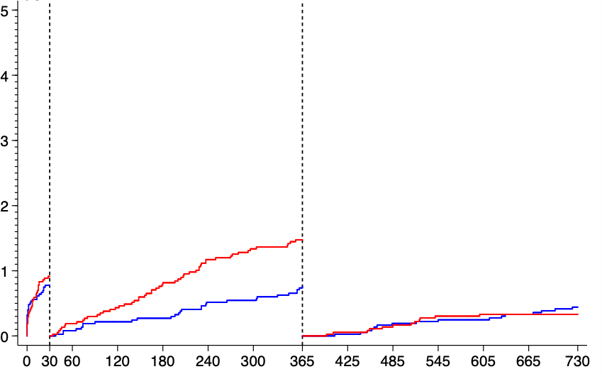
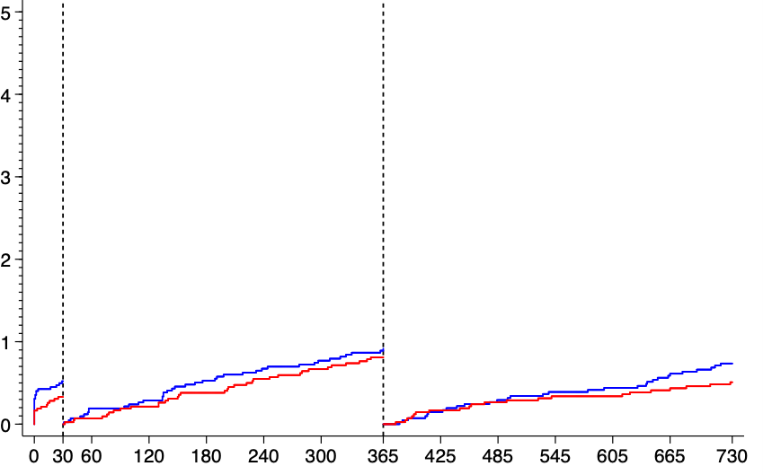
KM curves of BARC 3 or 5 bleeding up to 30 days, from 31 days to
1 year and from 1 year to end of follow-up by clinical presentation
ACS
Reference arm Experimental arm
Stable CAD
Reference arm Experimental arm
BARC 3 or 5 bleeding (%)
BARC 3 or 5 bleeding (%)
1.47%
0.91%
0.77%
0.92%
0.81%
0.75%
0.76%
0.45%
0.52%
0.33%
0.51%
0.34%
Days since index procedure
Days since index procedure
Ref.
DAPT (Ticagrelor)
ASA mono
Ref.
DAPT (Clopidogrel)
ASA mono
DAPT
DAPT
Exp.
Ticagrelor Mono
Exp.
Ticagrelor Mono
Manuscript submitted to EHJ

Slide 16
Limitations
Although these subgroup population were pre-specified in the protocol, the analysis should be considered as exploratory due to the inherent limitations of sub-analyses including multiple testing. Therefore, our findings need to be interpreted only as hypothesis-generating and call for confirmatory randomized trials specifically in ACS.
All endpoints were site-reported.
However, seven on-site monitoring visits were performed in each participating center, 20% of the reported events were checked according to source documents and the trial was regularly monitored for event under-reporting and event definition consistency.

Slide 17
The essentials to remember
What are the results?
There was no significant interaction between treatment effect and prespecified subgroups throughout safety and efficacy endpoints except for BARC 3 or 5 bleeding in ACS population that benefits from ticagrelor monotherapy whereas stable angina does not.
Ticagrelor monotherapy appeared to reduce the risk of bleeding without an increase in the ischemic risk when compared with standard DAPT in ACS patients.
Why is this important?
Ticagrelor monotherapy following 1-month DAPT may reduce the risk of bleeding in ACS patients and it seems safe in various clinical scenarios (female, elderly, diabetes, obesity, COPD, and renal function impairment).

Slide 18
Ana Hernández Antolin, Emanuel Barbato, Peter Barlis, Pascal Barraud, Edouard Benit , Olivier Bertrand, Leonardo
Mohamed Abdellaoui, David Adlam, Ibrahim Akin, Manuel Almeida, Adel Aminian , Richard Anderson, Michael Angioi, Rosa
Bolognese, Roberto Botelho, Philippe Brunel, Paweł Buszman, Ian Buysschaert, Pedro Canas da Silva, Didier Carrie, Angel Cequier, Saqib Chowdhary, Antonio Colombo, James Cotton, Rui Cruz Ferreira, Salvatore Curello, Nick Curzen, Marcello Dominici, István Édes, Eric Eeckhout, Ingo Eitel, Beygui Farzin, Farzin Fath-Ordoubadi, Maurizio Ferrario, Geza Fontos, Jose Francisco Diaz, Bernhard Frey, Guy Fridreich, Gavin Galasko, Grzegorz Galuszka, Vasco Gama Ribeiro, Scot Garg, Tobias Geisler, Valeri Gelev, Javier Goicolea, Agustin Albarran Gonzalez-Trevilla, Tommaso Gori, Christian Hamm, Michael
Haude, David Hildick-Smith, Stephen Hoole, Iván Horváth,
ECRI/Cardialysis - THANK YOU
Sjoerd Hofma, Lene Holmvang,
Kurt Huber, Karim ibrahim, Andres Werner Jung, Georg Delle Karth,
Iñiguez, Karl Isaaz, Zoltán Jambrik, Luc Janssens, Pawel Jasionowicz, Faluközy József,
René Koning, Mariana Konteva, Zsolt Kőszegi, Florian Krackhardt, Neville Kukreja, Pierre Lantelme, Sergio Leandro, Gregor Leibundgut, Pedro Alves Lemos Neto, Christoph Liebetrau, Carlos Macaya Miguel, Michael Magro, Luc Maillard, Bela Merkely, Adam Młodziankowski, Tiziano Moccetti, Helger Mollmann, Jean-francois Morelle, Aris Moschovitis, Michael Munndt Ottesen, Christoph Kurt Naber, Franz-Josef Neumann, Keith G. Oloyd, Paul Ong, Ivo Petrov, Sylvain Plante, Janusz Prokopczuk, Edgard F. Quintella, Christopher Raffel, Benno Rensing, Marco Roffi, Kees Jan Royaards, Manel Sabate, Volker Schächinger, Tim Seidler, Antonio Serra Peñaranda, Ton Slagboom, Amanda Sousa, Rod H Stables, Gabriel Steg, Clemens Steinwender, Ruth Strasser, Eduardas Subkovas, Harry Suryapranata, Suneel Talwar, Emmanuel Teiger, Koh Tian Hai, Gincho Tonev, Diana Trendafilova-Lazarova, Carlo Tumscitz, Victor Umans, Imre Ungi, Veselin Valkov, Pim van der Harst, Robert Jan van Geuns, Dobrin Vassilev, Vasil Velchev, Jürgen vom Dahl, Pascal Vranckx, Mathias Vrolix, Simon Walsh, Nikos Werner, Stephan Windecker, Azfar Zaman, Krzysztof Żmudka, Bernhard Zrenner, Aleksander Żurakowski, Robert Zweiker

