Slide 1
If you can’t see it, Transduce It
By Lawrence J. Charles, MD, Anezi Uzendu, MD, and Scott Lilly, MD

Slide 2
Case
An 85 year old male with a past medical history of sick sinus syndrome with a permanent pacemaker, coronary artery disease, and hypertension presents with a year of progressive dyspnea on exertion. He denied syncope, chest pain, dizziness, or chest pain. His vital signs were significant for mild hypotension. On exam he had a systolic murmur heard throughout his precordium that increased in intensity with expiration. Labs including d-dimer were unremarkable and EKG revealed left ventricular hypertrophy without any signs of ischemia. Given the patient’s history and profound murmur, the patient underwent an echo with concern for hypertrophic obstructive cardiomyopathy (HOCM). However, the scan revealed an ejection fraction 70%, with concentric hypertrophy and no left ventricular outflow gradient. His septal diameter was 2.1 cm. However due to his impressive exam findings left heart catheterization was pursued to definitively assess ischemia and HOCM. His catheterization confirmed HOCM as shown below and he is scheduled for an alcohol septal ablation.

Slide 3
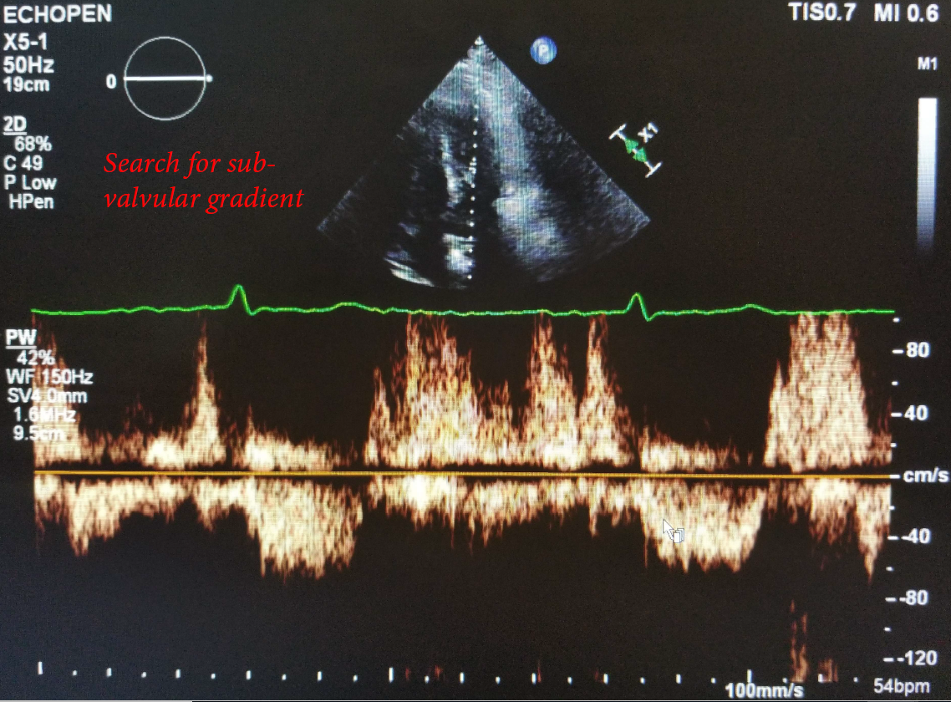
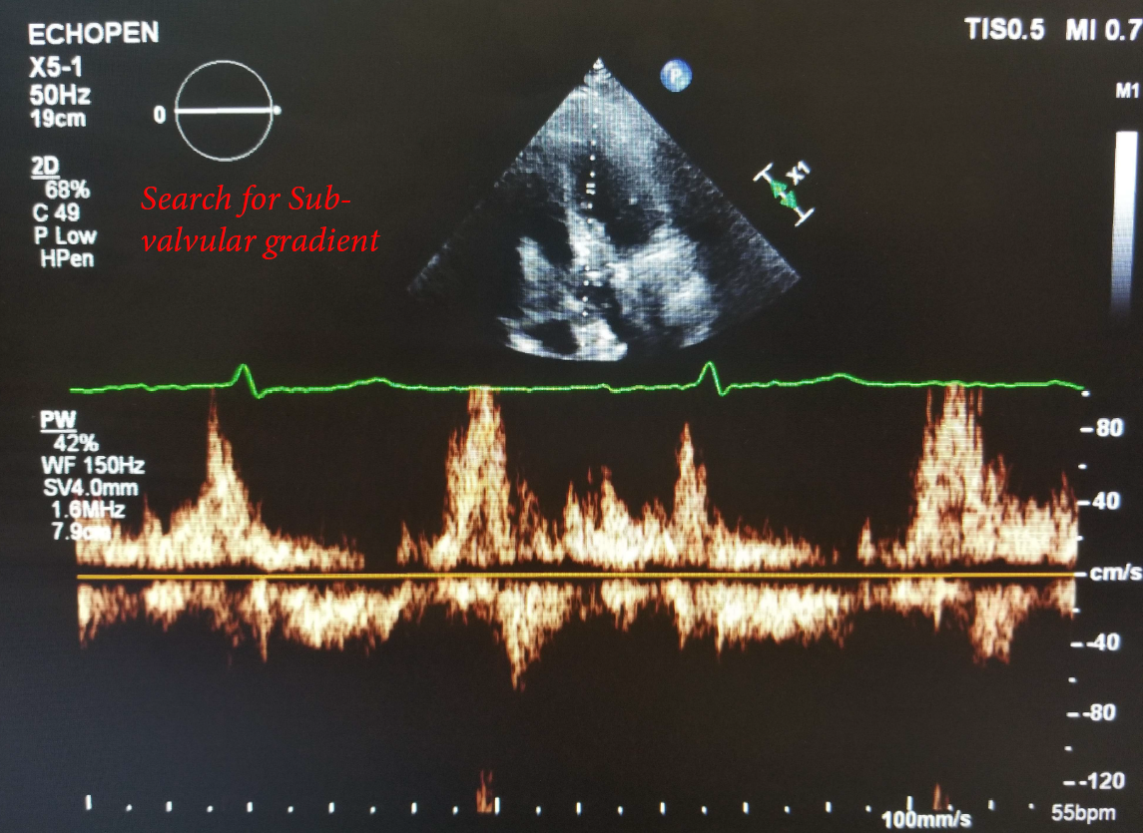
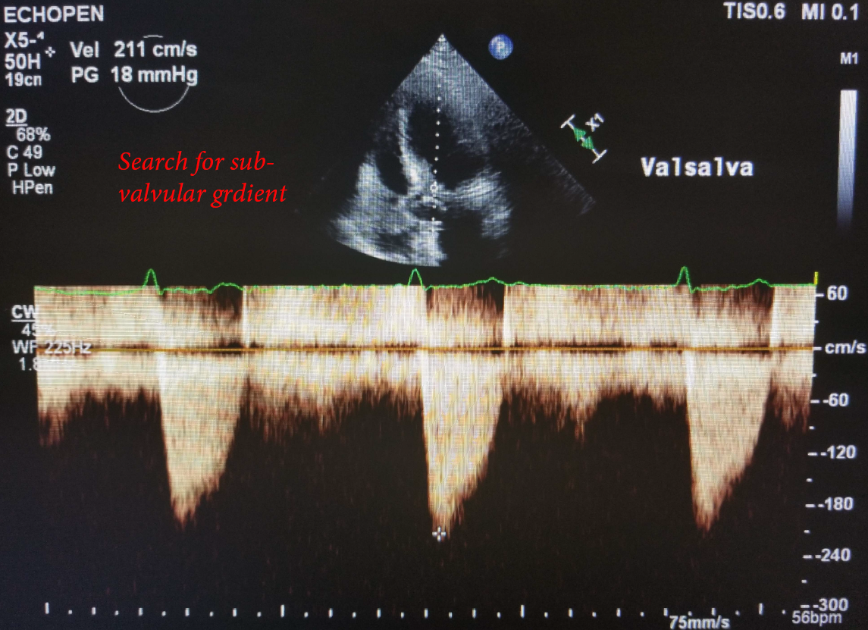
Echo Images

Slide 4
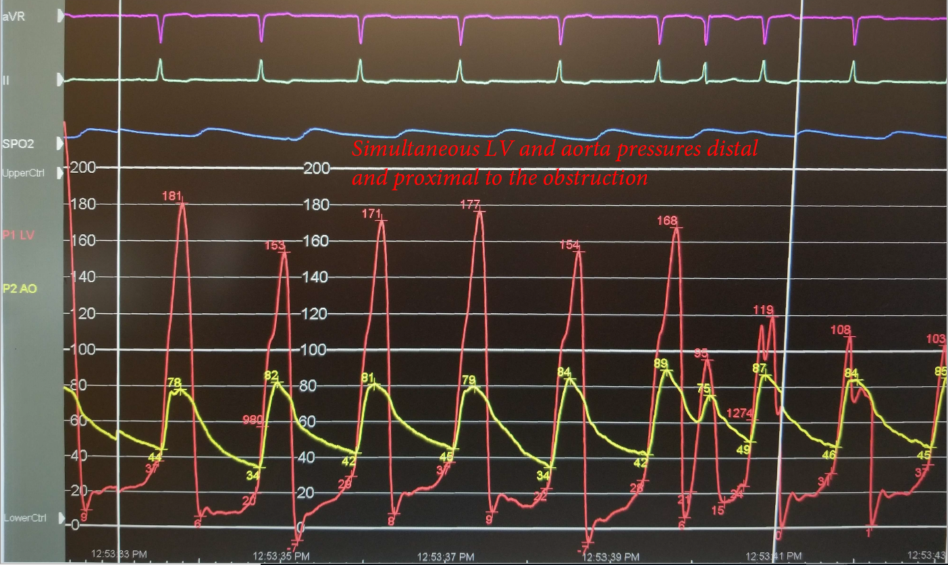
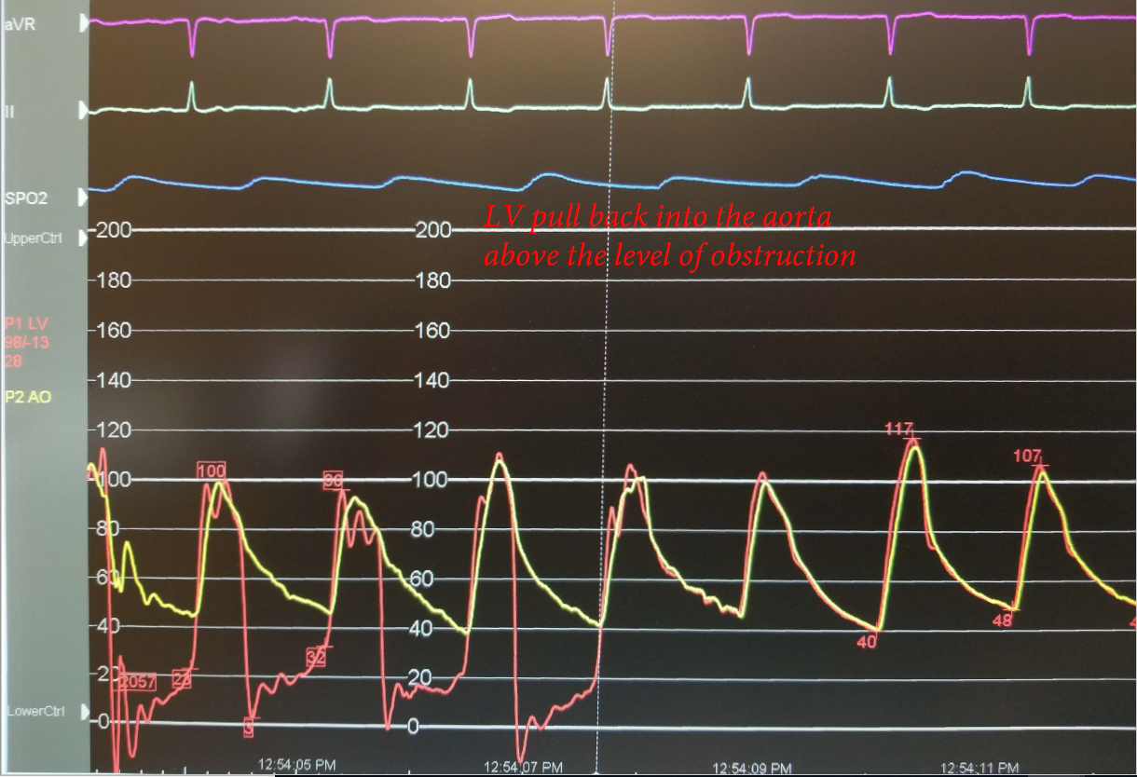
Transducer Images

Slide 5
Discussion
Hypertrophic cardiomyopathy is frequently accompanied by dynamic left ventricular outflow tract obstruction which when severe can cause crippling symptoms. On exam this can be appreciated by maneuvers that decrease preload and thereby worsening the obstruction/ gradient. In the catheterization lab this is noted by transducing simultaneous pressures in the left ventricle and aorta and noting a gradient below the aortic valve at rest or with provocative maneuvers.
Echocardiography is commonly used as a less invasive surrogate; however, we can see in this case it has its downfalls. Despite a resting gradient close to 100mmHg, non-invasive imaging was unable to appreciate the obstruction, even with Valsalva. This should serve as a reminder that when clinical suspicion is high, in the face of a negative test, proceeding to definitive testing with the gold standard is necessary.

Slide 6
Discussion Cont.
It is also important to note that management of HCM in the elderly can be challenging. In the young, it is typical focused on four items a) symptom management, b) avoiding low preload c) family screening and d) sudden cardiac death risk management. However, the yield of genetic testing in elderly HOCM patients with negative family history is low, and late onset HOCM does not confer increased mortality (2.2% versus 1.9) as early onset does. This makes the benefit of family screening and primary prevention defibrillators questionable. Finally, with imaging up to 10% of elderly patients have benign ventricular septal bulges which are not pathologic but can be confused with HOCM. Careful thought must take place in our elder patients with this pathology.

Slide 7
Conclusion
In patients with classic exam findings and history congruent with HOCM, non-invasive studies should be performed to cinch the diagnosis. However, if these are non-diagnostic, heart catheterization should be pursued. In the elderly, special attention should be paid to this subpopulation’s clinical course to decide on management.

