Slide 1
The ARAMIS trial
Anakinra versus Placebo, a Double Blind Randomized Controlled Trial, for the Treatment of Acute Myocarditis
Mathieu Kerneis, MD, PhD; Fleur Cohen, MD, PhD; Alain Combes, MD, PhD; Eric Vicaut MD, PhD; Gilles Montalescot, MD, PhD
On Behalf of the ARAMIS investigators

Slide 2
Declaration of interest
Dr Mathieu Kerneis reports :
consulting/lectures fees from Kiniksa, Eligo, Sanofi, Bayer.
Research grants from Federation Francaise de Cardiologie and French Health Ministry
Patent for the use of Abatacept in ICI induced myocarditis
All Disclosures are available on www.action-group.org

Slide 3
Background

Slide 4
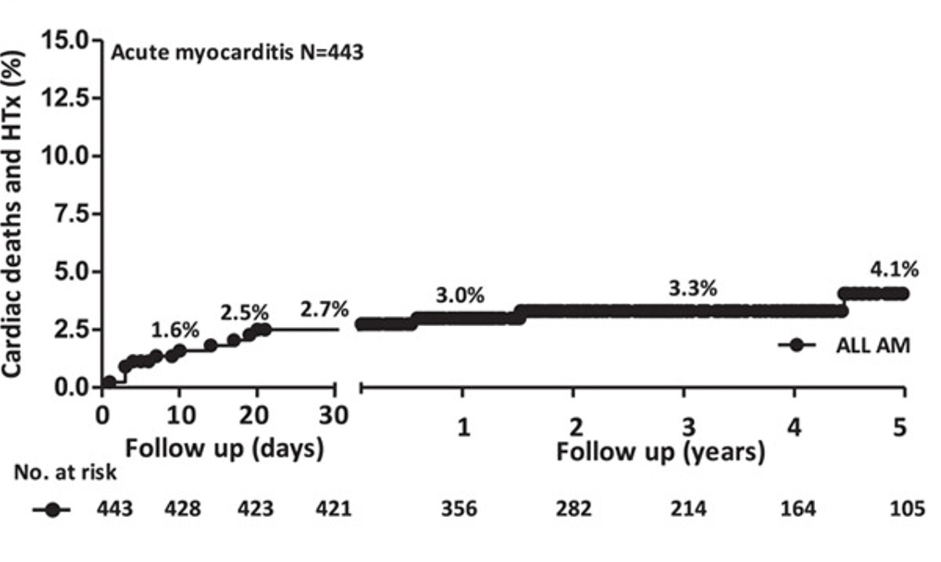
Acute Myocarditis
Acute myocarditis (AM) is an inflammation of the myocardium that can cause life-threatening events
Ammirati et al. Circ 2018

Slide 5
Treatment of Acute Myocarditis
There is no evidence to support the routine use of immunosuppressive therapy or treatment
targeting inflammation in myocarditis patients ¹
A strategy of immunomodulation has not been evaluated in acute myocarditis patients with unknown viral replication (without EMB)
Experimental studies and case reports suggest that blockade of the IL1-β pathway could be effective in AM². Anakinra, an IL1-R antagonist, is already used in inflammatory diseases with an acceptable safety profile³
¹ Masson et al., NEJM 1995 ² Tschöpe, et al. Circ Research 2019 ³Brucato A et al., JAMA, 2016

Slide 6
Goal
To perform a pragmatic trial evaluating the inhibition of the IL-1β immune innate pathway with anakinra, to reduce the risk of clinical events in acute myocarditis patients

Slide 7
Study design

Slide 8
Study Organization
ARAMIS = Academic Trial
Academic coordinating center : Institute of Cardiology – ACTION Group Pitie-Salpetriere Hospital
Academic Sponsor : Assistance Publique-Hopitaux de Paris
Academic Global Trial Operations : URC Lariboisiere, ACTION Group, Paris
Academic Funding : French Ministry of Health (PHRC)
Investigation Sites : 6 academic centers in France
All analyses were performed by an independent academic statistician

Slide 9
Study Design of the ARAMIS Trial
Randomized, Double Blind, Multicenter, Phase IIb trial
AM patients
Treatment
Diagnosis Follow-up
Placebo
+ SOC (BB + ACE inh)
Number of days alive free of any myocarditis complications
R
Anakinra 100mg sc o.d.
+ SOC (BB + ACE inh)
Within 72 hours
28 days
Admission
For a Suspected AM
Confirmation of diagnosis and randomization
Hospital Discharge
Time
Primary Endpoint
Number of days considered for the Primary Endpoint
Kerneis et al. ACVD 2023

Slide 10
Inclusion/Exclusion Criteria
Inclusion
Myocarditis was defined as follows :
Chest Pain
AND
elevated Troponin (at least 1.5 X ULN)
AND
CMR Lake Louise Criteria
AND Normal Coronary angiography or CTA in > 40 y/o or with CV risk factors
Exclusion
< 18 y/o or > 65 y/o LV assistance
Mechanical Ventilation
Any clinical suspicion of autoimmune, giant cell, eosinophilic, or sarcoidosis related myocarditis
Renal Failure
Anti-TNF, CTC/NSAID use Malignancy
Kerneis et al. ACVD 2023

Slide 11
Endpoints
@28 days post hospitalization discharge
Efficacy = Number of days alive free of any myocarditis complications
Heart Failure requiring hospitalization
Chest Pain requiring an additional medication
LVEF < 50% in TTE
Ventricular arrhythmia (VT or VF)
Safety = SAEs including those potentially related to the drug :
Severe infection
Thrombopenia < 50 000 mm3
BARC> 3
Anaphylactic reaction
100% ↑ of LDL Cholesterol
ALT/AST > 10x ULN
Neutropenia < 1. 109/L
Renal failure (↑ 50% creat)

Slide 12
Sample Size
Superiority trial
We have, a priori, considered that :
↑ of the number of days free of myocarditis complications > 1.5 days = clinically meaningful
The standard deviation for the 1°EP was estimated to be 2.3
based on the AMPHIBIA registry (NCT04844151)
N = 120 patients
60 patients in each group to demonstrate a 1.5 days difference in the days free of conplication between randomization and 28 days post discharge
⇒ 80% power
⇒ 5% two-sided significance level
Kerneis et al. ACVD 2023

Slide 13
Flow Chart
120 subjects were randomized between 2017 and 2021
59 were assigned to anakinra
61 were assigned to placebo
1 study discontinuation (no ttt) 1 consent withdrawal
1 administrative reason
57 subjects in the ITT population
60 subjects in the ITT population
1 randomized in the placebo arm have received anakinra
1 randomized in the placebo arm have received anakinra
58 subjects in the safety population
59 subjects in the safety population

Slide 14
Patient characteristics

Slide 15
Clinical Presentation (1/2)
 | Anakinra N=57 | Placebo N=60
Median Age, (Q1;Q3), yrs | 28.0 (22.8 ; 38.1) | 29.0 (23.2 ; 34.0)
Male — no of patients (%) | 52 (91.2%) | 50 (83.3%)
Current smoker — no. (%) | 30 (52.6%) | 30 (50.0%)
Past Medical History
Prior myocarditis — no. (%) | 1 (1.8%) | 3 (5.0%)
Recent Bacterial infection— no. (%) | 9 (15.8%) | 6 (10.0%)
Recent Viral infection — no. (%) | 25 (43.9%) | 27 (45.0%)
Chest Pain — no.(%) | 57 (100%) | 60 (100%)
Dyspnea — no. (%) | 4 (7.0%) | 9 (15.0%)
Cardiogenic shock — no. (%) | 1 (1.8%) | 0 (0.0%)
Ventricular fibrillation — no. (%) | 1 (1.8%) | 0 (0.0%)
Conduction disorders — no. (%) | 0 (0.0%) | 1 (1.7%)
Clinical infectious syndrome — no. (%) | 16 (28.1%) | 18 (30.0%)

Slide 16
Clinical Presentation (2/2)
 | Anakinra N=57 | Placebo N=60
Troponin in fold increase of the ULN - Median (Q1;Q3) | 98 (33 ;194) | 75 (22;217)
CRP, mg/L - Median (Q1;Q3) | 37 (16;68) | 23 (14;52)
(NTpro)BNP, in fold increase of the ULN - Median (Q1;Q3) | 0.9 (0.4;1.9) | 0.5 (0.3;1.0)
Right or Left BB block — no. (%) | 5 (8.8%) | 4 (6.7%)
ST-segment elevation — no. (%) | 37 (64.9%) | 39 (65.0%)
ST segment depression — no. (%) | 5 (8.8%) | 7 (11.7%)
Coronary Imaging — no. (%) | 48 (84.2%) | 47 (78.3)
0 patient with EMB

Slide 17
Non Invasive Imaging
 | Anakinra N=57 | Placebo N=60
Left ventricular ejection fraction (TTE), %
Median (Q1;Q3) | 60 (50;61) | 60 (50;60)
Min, Max | 40, 73 | 35, 66
Ventricular dysfunction with TTE (LVEF<50%) — no. (%) | 7 (12.3%) | 5 (8.3%)
Regional wall motion abnormalities (TTE) — no. (%) | 18 (31.6%) | 16 (26.7%)
Left ventricular ejection fraction (MRI), %
Median (Q1;Q3) | 54 (50;60) | 55 (52;60)
Min, Max | 36, 72 | 38, 70
Ventricular dysfunction with MRI ( LVEF<50%) — no. (%) | 13 (22.8%) | 10 (16.7%)
Absence of pericardial effusion — no. (%) | 48 (85.7%) | 47 (78.3%)

Slide 18
Results

Slide 19
Study course
Admission
Diagnosis
Treatment
Composite Outcome 13.7%
Follow-up
28 days
2 days (1;3)
Min–Max = 0-4
2 days (1;3)
Min – Max = 1 - 6
No Corticosteroids in both arms
110 (94%) patients were treated with betablockers
97 (83%) patients were treated with ACE inh.
CCU Admission For a Suspected AM
Confirmation of diagnosis and randomization
Hospital Discharge
Primary Endpoint
Time
Number of days considered for the Primary Endpoint

Slide 20
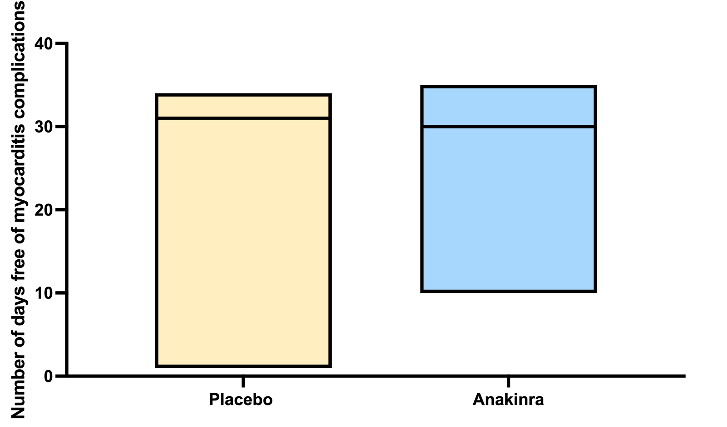
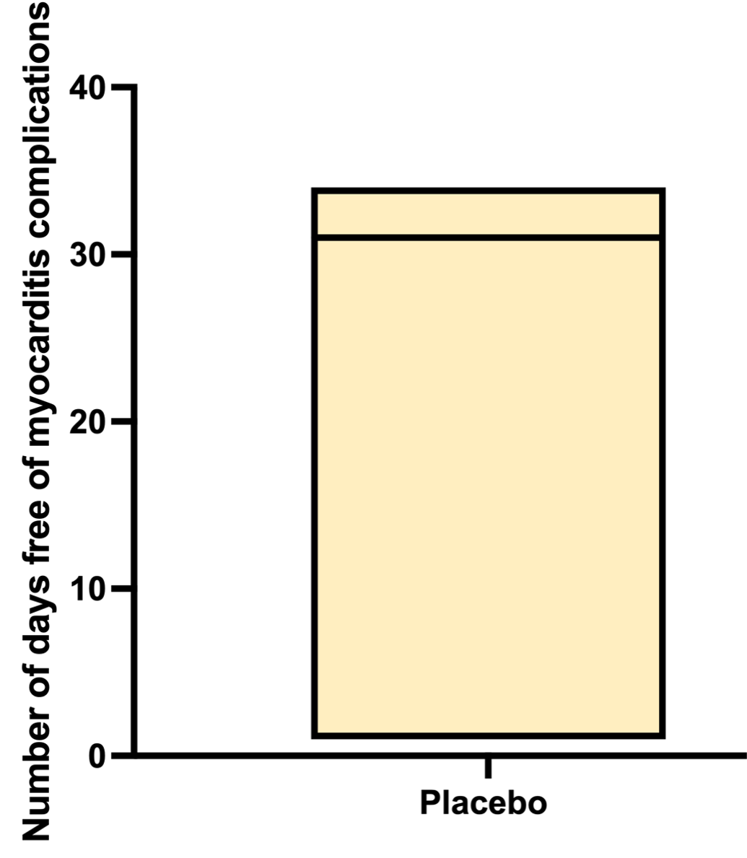
Primary Endpoint
Number of days free of complications
95% CI 0.0 (-1.0;0.0)¤
p-value = 0.168*
,
31
(30-32)
Median (Q1, Q3)
30
(30-32)
Median (Q1, Q3)
Red Line = Median
Box = Min-Max
¤ Hodges-Lehmann's median difference
* Wilcoxon-Mann Whitney test
Non parametric Ancova p-value = 0.192
Mean ± sd
29.72 ± 5.66
29.75 ± 4.18

Slide 21
Clinical Events
All events were adjudicated by an independent CEC blinded to the randomization groups
 | Anakinra N=57 | Placebo N=60 | Odds Ratio (95% CI)
Composite outcome * @28 days post discharge — no. (%) | 6 (10.5%) | 10 (16.7%) | 0.59 (0.19; 1.78)
Heart Failure | 0 | 0 | -
Ventricular arrhythmia | 1 (1.8%) | 1 (1.7%) | -
Chest pain requiring new medication | 2 (3.5%) | 6 (10.0%) | 0.33 (0.06; 1.76)
Ventricular dysfunction (LVEF<50%) | 4 (8.5%) | 4 (7.4%) | 1.16 (0.27; 5.09)
*HF, ventricular arrhythmia, chest pain requiring medication or LVEF<50% at 28 days post discharge — no. (%)

Slide 22
Safety Endpoints
 | Anakinra N=58 | Placebo N=59 | OR* (95% CI) | OR** (95% CI)
Serious Adverse Events @ 28 days post discharge — no. of patients (%) | 7 (12.1%) | 6 (10.2%) | 1.21 (0.37; 3.94) | 1.20 (0.35; 4.07)
 | Anakinra | Placebo
Number of SAEs potentially related to the drug
Severe Infection | 0 | 0
Mild hepatic cytolysis (spontaneous recovery) | 1 | 0
Others | 0 | 0
* Unadjusted Odds Ratio. **Adjusted Odds Ratio for Age and baseline LVEF

Slide 23
Conclusions

Slide 24
ARAMIS, the largest RCT in acute myocarditis, enrolled for the first time an all-comer acute
myocarditis population diagnosed on CMR, mostly at low risk of events.
A short administration of anakinra did not increase the number of days free of myocarditis complications
There was no safety issue with anakinra administered during the acute phase of myocarditis diagnosed without EMB (no proof of absence of viral replication)
Further RCTs are needed to explore the potential benefit of the anti-inflammatory strategy among acute myocarditis patients at higher risk of events
Larger studies are needed to evaluate prolonged anti inflammatory strategies among acute myocarditis patients at « low-to-moderate risk » (16% of events at M1)

Slide 25
Thank You to the ARAMIS Team
Steering Commitee : Dr Mathieu Kerneis, Pr Fleur Cohen, Pr Alain Combes, Pr Eric Vicaut, Pr Gilles Montalescot
Pitié-Salpetrière Hospital
Dr Mathieu KERNEIS
Pr Gilles MONTALESCOT Pr Johanne SILVAIN
Dr Alexandre CECCALDI
Pr Jean Philippe COLLET Dr Olivier BARTHELEMY Dr Stephan MANKIKIAN Dr Florent HUANG
Dr Paul GUEDENEY
Dr Nassim BRAIK
ACTION Group Delphine BRUGIER Karine BROCHARD Benjamin BERTIN Nicolas VIGNOLLES Zakiya BATOO
Ambroise Pare Hospital
Dr Marie HAUGUEL-MOREAU
Lariboisiere Hospital
Dr Jean Guillaume DILLINGER Dr Mathilde BAUDET
Dr Thiziri SI MOUSSI
Dr Jean Guillaume DILLINGER Dr Goergios SIDERIS
Dr Elise PAVEN Dr Céline LUC
Pr Patrick HENRY Dr Léa CACOUB
URC
Pr Eric VICAUT Véronique JOUIS Carine PARE Luminita NECULAITA Niven MUNIAN Samira DJABALI Antoine BROCHARD El-Hadi MEDEGHRI
Abdourahmane DIALLO
AGEPS
Dr Blandine LEHMANN Robin CHARRETEUR
CHU Nimes
Pr. Benoit LATTUCA Pr Guillaume CAYLA
Bichat Hospital
Dr Jérémie ABTAN Dr Quentin FISCHER Dr Philippe DEGRELL
Dr Victor-Xavier TADROS Dr Zaven TERZIAN
Dr Arthur DARMON
European Hospital Georges Pompidou
Pr Etienne PUYMIRAT
Dr Julia CAUDRON Dr Victoria TEAH
DRCI
Fadila AMER ALI
CEC : Pr Estelle Gandbakhch, Dr Guillaume Hekimian, Pr Joe-Elie Salem
DSMB : Pr Ariel Cohen, Pr Thomas Cuisset, Pr Corine Albertini
INSERM : Dr Michel Zeitouni

