Slide 1
Clinical Trial Organizations: Roles and Responsibilities of CRO’s and ARO’s
William S. Weintraub, MD

Slide 2
Disclosure
None

Slide 3
AROs CRO?
ARO: Academic research organization
CRO: Contract research organization
Both manage sites, data and analysis for multisite clinical trials

Slide 4
Emory Center for Outcomes Reseach

Slide 5
Developing the Proposal
Work with clinical leadership on proposal development
Biostatisticians in DCC prepare statistical analysis plan
Develop data handling component
Work with clinicians on IRB/regulatory issues
Present biostatistics/data handling/IRB to sponsor

Slide 6
From Proposal to Protocol 1
Work with clinical leadership on expanding the proposal as needed
Biostatisticians in DCC review statistical analysis plan, including power calculation
Establish data workflow
Assure data safety
Work with clinicians on presentation to IRB(s)

Slide 7
From Proposal to Protocol 2
Work with clinical leadership on CRF development
Program trial database
Work with clinical leadership on site selection
Work with sites on contracting and regulatory issues
Site initiation: train sites on screening, enrollment, data collection, followup

Slide 8
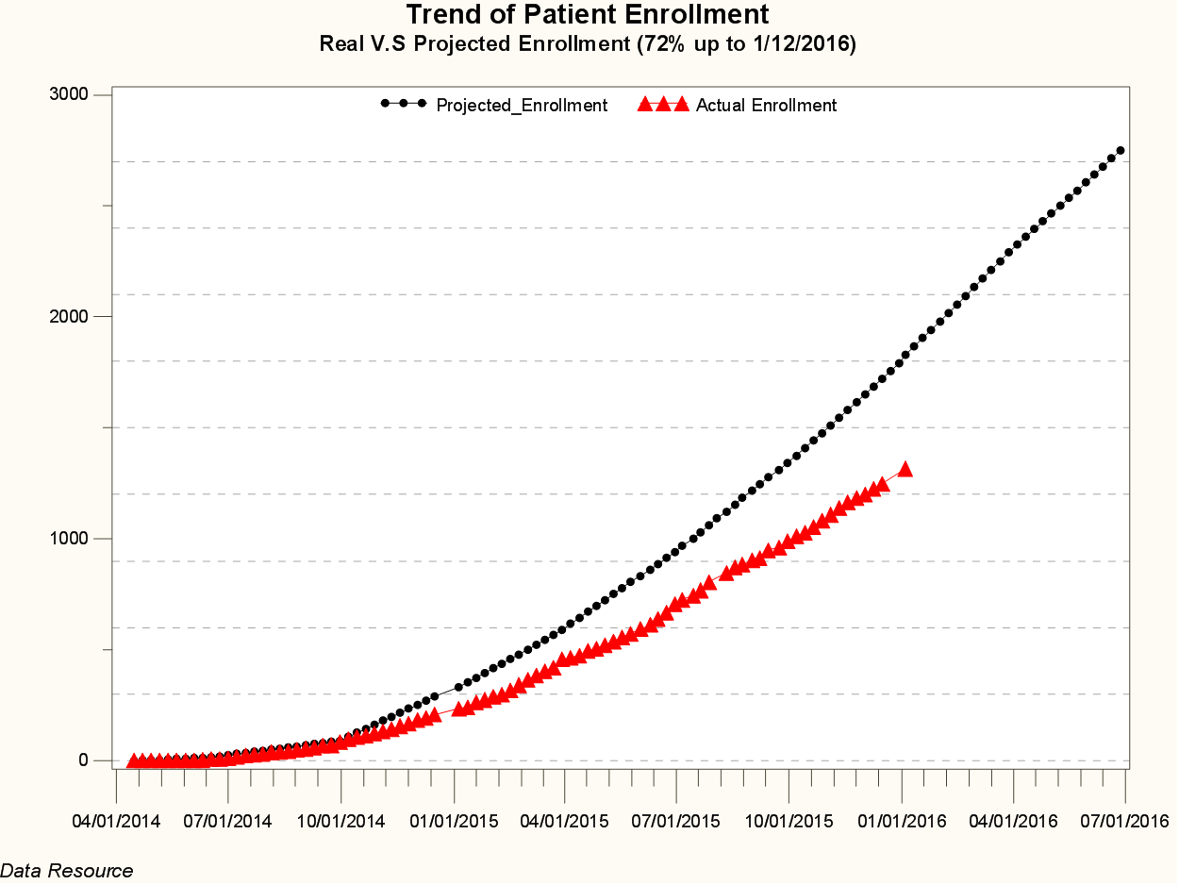
Study Execution 1
Monitor enrollment

Slide 9
Study Execution 2
Work with the sites
Enrollment
Missing data
IRB issues
Reporting to study leadership and sponsor
Enrollment
Missing data
Event adjudication

Slide 10
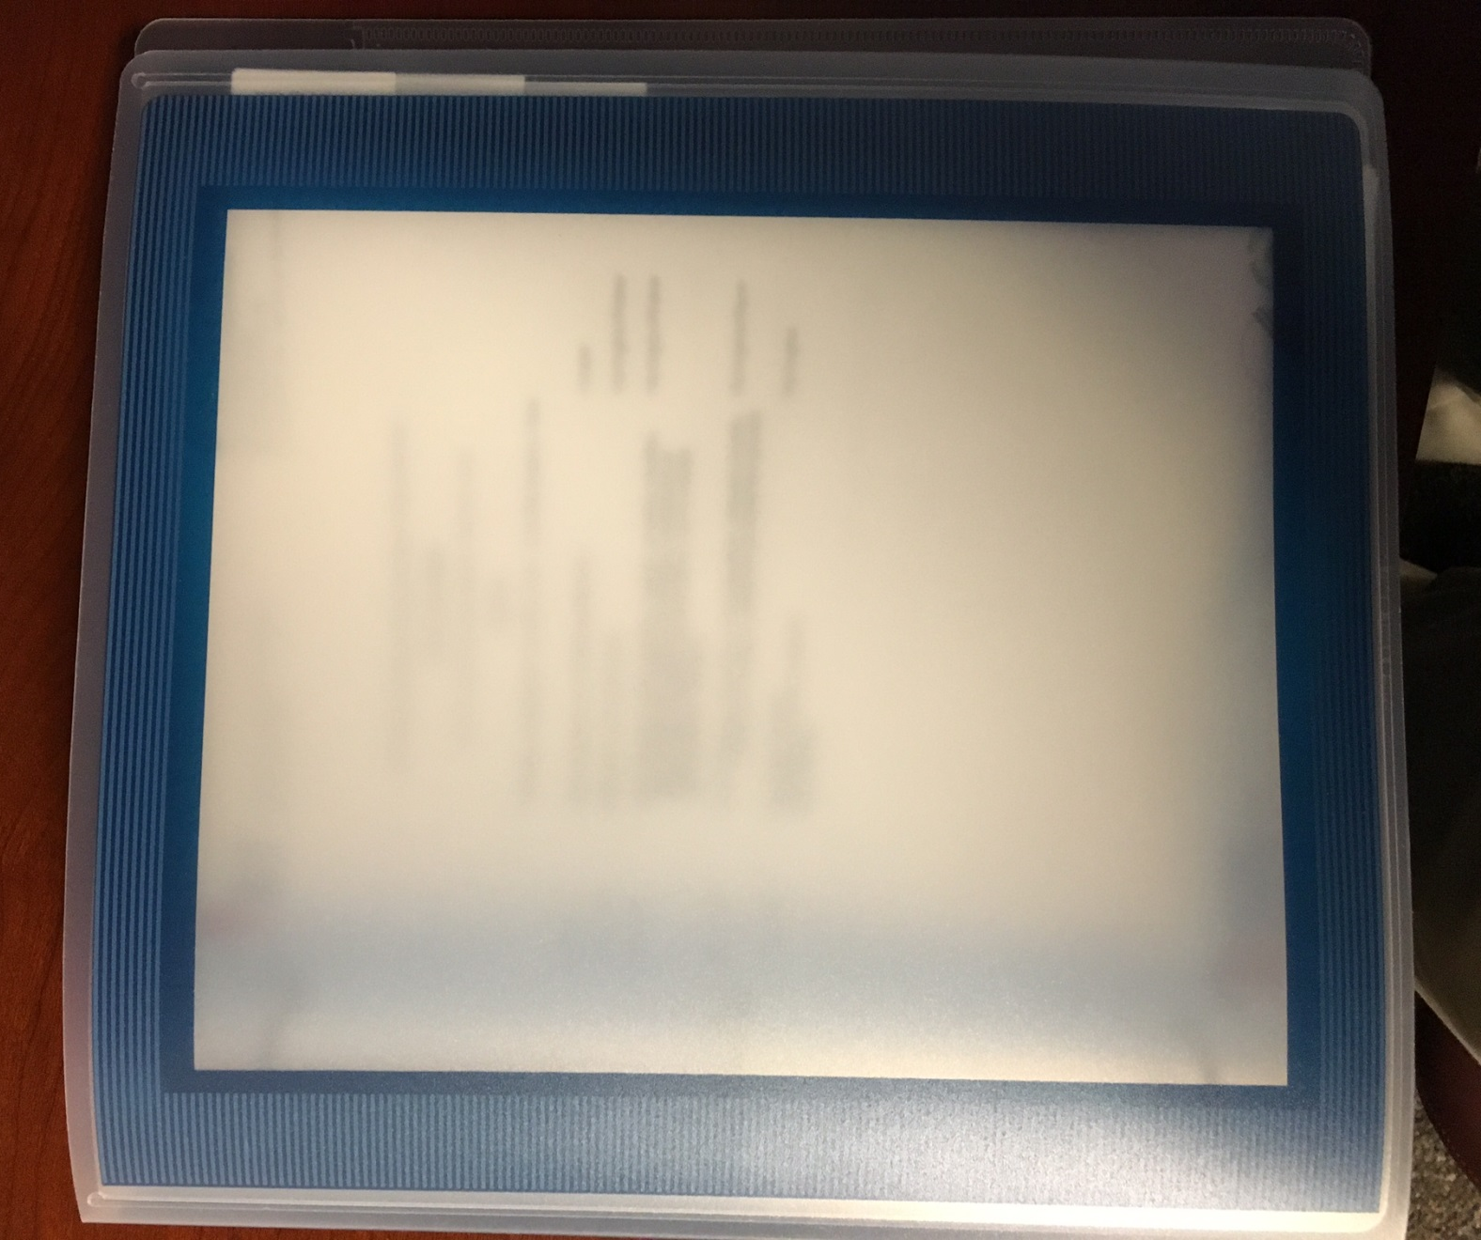
DSMB Report

Slide 11
Study Execution 3
Work with the DSMB
Work with clinical leadership to prepare report
Enrollment
Missing data
Event adjudication
Endpoints, blinded and unblinded

Slide 12
Study Closeout
Finalize data, database lock
Final report to DSMB, sponsor
Unblind investigators
Final data analysis
Prepare data for presentation
Manuscript:
Prepare data in tables and graphs
Write statistical analysis section

Slide 13
ACOS and CROs
CROs and AROs
More similar than different
AROs generally more involved in manuscripts, presentations at national meetings
CROs tend to disappear after the data are finalized
Sometimes the work together with CROs doing site management, ARO functioning as the Data Coordinating Center (DCC)
NIH multicenter proposals, both RFAs and investigator initiated often require separate Clinical Coordinating Center and Data Coordinating Center applications. These will be more appropriate for ARS

Slide 14
Other Types of Analysis
Registries
Health Care Economics
Patient Reported Outcomes
Simulations

Slide 15
Final Thoughts
This is a field requiring considerable expertise and experienced
It is generally expensive
Do not try to set up a multicenter trial without an ARO or CRO in place
Commercial sponsors often pick the CRO and will pay for them independently of the clinical leadership
The NIH will be very demanding of the choice of AROs and will set high standards for their performance

