Slide 1
Transcatheter vs Surgical Aortic Valve Replacement in Low Risk Patients:
3-Year Outcomes from the Evolut Low Risk Trial
John K. Forrest, MD
Director of Interventional Cardiology Director of Structural Heart Program Yale University School of Medicine Yale New Haven Health System @johnkforrest
For the Evolut Low Risk Trial Investigators

Slide 2
Within the past 12 months, I have had a financial interest/arrangement or affiliation with the organization(s) listed below
Financial Relationship Research grants, consulting fees, honoraria, speakers bureau fees
Company Medtronic, Edwards Lifesciences

Slide 3
Executive Committee
Principal Investigators
Michael Reardon, MD
Methodist DeBakey Heart and Vascular Center
John Forrest, MD Yale University School of Medicine
Michael Reardon, MD
Methodist DeBakey
Heart and Vascular Center
G. Michael Deeb, MD
University of Michigan
Health Systems
Steven Yakubov, MD OhioHealth Riverside Methodist Hospital
Steering Committee
David Adams, Stanley Chetcuti, G. Michael Deeb, John Forrest, John Heiser, William Merhi, Mubashir Mumtaz, Daniel O’Hair, Jon Resar, Joshua Rovin, Michael Reardon, Paul Teirstein, Steven Yakubov, George Zorn
Screening Committee: Michael Reardon, G. Michael Deeb, Steven Yakubov, Robert Stoler, Thomas Gleason
Echo Core Laboratory: Jae Oh, Mayo Clinic
Statistical Analyses: Jian Huang, Medtronic
Sponsor: Medtronic

Slide 4
Now approved for all patients with aortic stenosis regardless of surgical risk, TAVR has become the dominant form of AVR in the US.
Current ACC/AHA guidelines recommend that heart teams utilize a shared decision-making process when discussing AVR with patients aged 65-80 years.¹
In younger lower-risk patients the faster recovery and short- term benefits after TAVR must be balanced with long-term durability, however limited intermediate and long-term data exist to guide such discussions in this patient population.
¹Otto CM, et al. 2020 ACC/AHA Guideline for the Management of Patients With Valvular Heart Disease. JACC 2021;77:e25-e197.

Slide 5
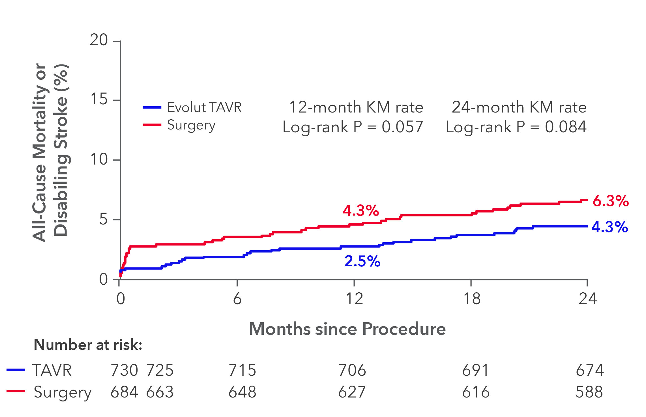
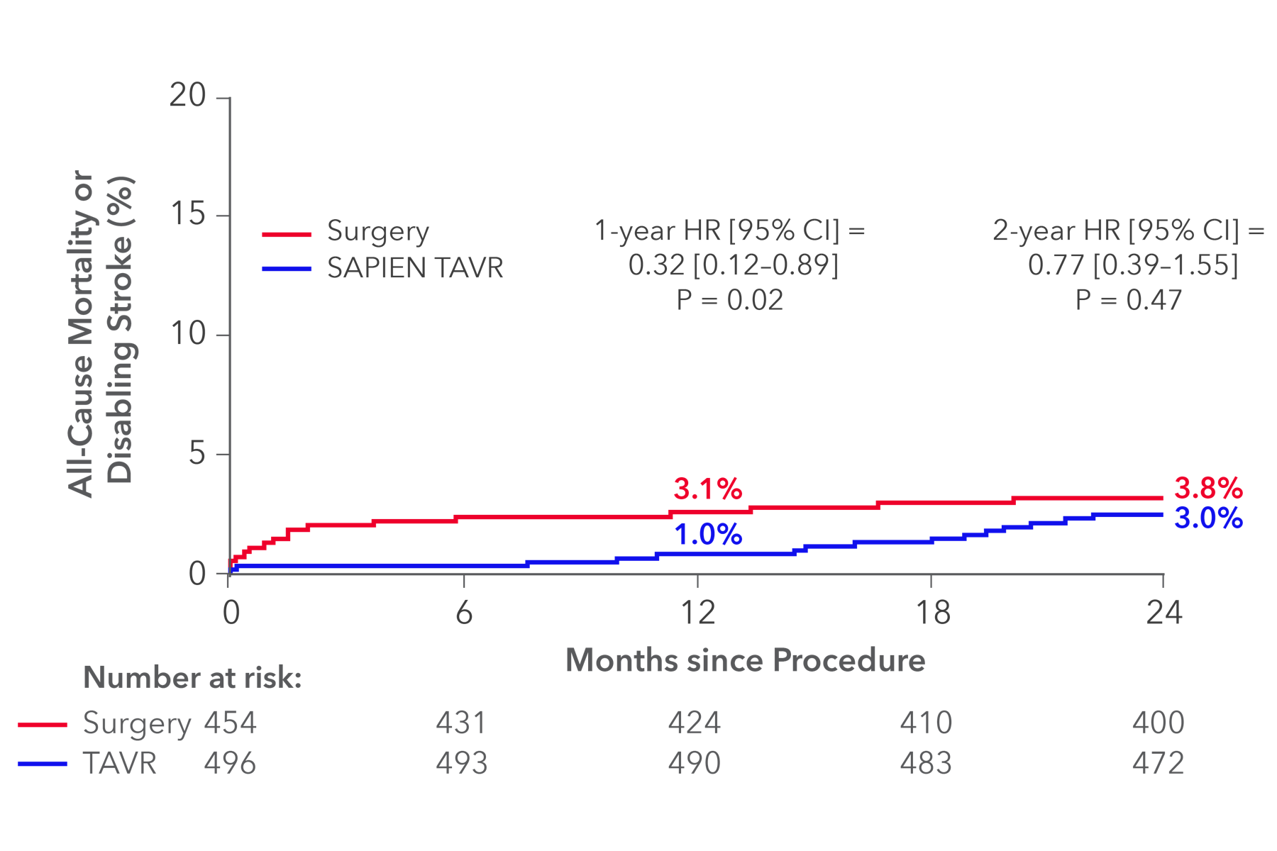
Randomized data of TAVR vs surgery from high and intermediate risk patients demonstrate similar survival outcomes at 5 years.¹⁻⁴
Data in low-risk patients have shown promising short-term outcomes, but continued follow-up to guide shared decision is needed.
Evolut Low Risk – 2 years⁵ PARTNER 3 – 2 years⁶
20
15
20
All-Cause Mortality or Disabling Stroke, %
All-Cause Mortality or Disabling Stroke, %
Evolut TAVR
15
SAPIEN TAVR
Surgery
Surgery
12 Months
24 Months
10
10
P = 0.057
P = 0.084
12 Months
P = 0.02
24 Months
P = 0.47
5
4.3%
6.3%
4.3%
5
3.1%
3.8%
0
2.5%
1.0%
3.0%
0
6
12 18
Months Since Procedure
24
0
0
6
12 18
Months Since Procedure
24
Number at risk
Number at risk
TAVR | 730 | 725 | 715 | 706 | 691 | 674 |  | TAVR | 496 |  | 493 | 490 | 483 | 472
Surgery | 684 | 663 | 648 | 627 | 616 | 588 |  | Surgery | 454 |  | 431 | 424 | 410 | 400
¹Gleason TG, et al. JACC 2018;72:2687-2696. ²Mack MJ, et al. Lancet 2015;385:2477-2484. ³Van Mieghem NM, et al. JAMA Cardiol 2022;7:1000-1008. ⁴Makkar RR, et al. NEJM 2020;382:799-809. ⁵Forrest JK, et al. JACC 2022;79:882-896. ⁶Leon MB, et al. JACC 2021;77:1149-1161.

Slide 6
Patients with Severe AS
Low risk of death (<3%) from surgery Anatomy suitable for both TAVR and SAVR
Heart Team Evaluation
Screening Committee
Confirmed eligibility
1:1 Randomization
May 2016 to May 2019
Clinical Events Committee
Adjudicated all endpoints
TAVR N=730
Surgery N=684
Echo Core Laboratory
Evaluated all echocardiograms

Slide 7
As Treated Cohort
N = 1414
I
Attempted TAVR
Attempted Surgery
N = 730
N = 684
-
1-------------+
5 withdrew
1 lost to follow-up
30 withdrew
2 lost to follow-up
1-Year follow-up
1-Year follow-up
N = 724
N = 652
1-------------+
7 withdrew
2 lost to follow-up
1-------------+
12 withdrew
6 lost to follow-up
2-Year follow-up
2-Year follow-up
N = 715
N = 634
-
11 withdrew
0 lost to follow-up
r----+
9 withdrew
1 lost to follow-up
3-Year follow-up N = 704
3-Year follow-up
N = 624
TOGETHER WITH cc
ACC.23
..... w

Slide 8
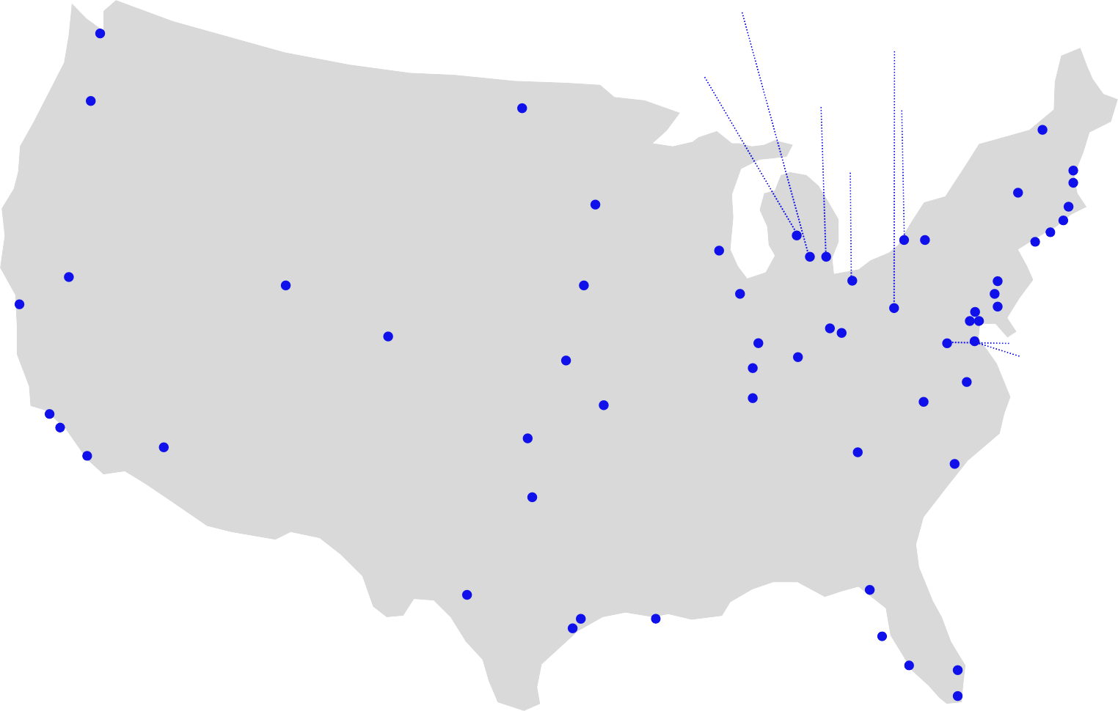
Spectrum Health Univ. of
Univ. of Pittsburgh
Strong Memorial
Swedish MC
Michigan
St. John Hospital
Oregon Health & Science Univ.
Sanford MC
Case MC
Univ. Vermont MC Mass General
Beth Israel Deaconess
Yale New Haven Hospital North Shore Univ. Hospital
Baystate MC
Abbott NW
St. Lukes/Aurora
St. Joseph’s
Hospital
St. Francis Hospital
Mercy General Hospital
El Camino
The Mount Sinai MC
Univ. of Utah
Mercy Medical Ctr
Loyola
Riverside Methodist & OSU
Good Samaritan
Geisinger MC
U Pittsburg Pinnacle Health Lehigh Valley Hospital
Univ. of Colorado Hospital
Univ. of Kansas
Mercy
St. Vincent Jewish Hospital
Vanderbilt
Johns Hopkins, MedStar Union, & Univ. of Maryland MC
Winchester MC
Bon Secours Heart & Vascular Institute Duke Univ.
Wake Forest Baptist MC
Keck Hospital
Los Robles Hospital
Hospital
Abrazo Arizona
Integris Baptist MC
Piedmont Heart Institute
Scripps Hospital
Heart Hospital
Baylor Heart & Vascular
Medical Univ. of South Carolina
Methodist Hospital
Methodist DeBakey
& Baylor College of Medicine
CV Institute
Tallahassee Research Institute
of the South
Morton Plant
Lee Memorial Health System
Delray Medical Center Univ. of Miami

Slide 9
CHRU de Lille Jacques Cartier
St. Antonius Hospital
Erasmus
Catherina Hospital
Sapporo Higashi Taoushukai Hospital
Clinique Pasteur
IUCPQ
McGill University & Montreal Heart Institute
Toronto General Hospital, Sunnybrook Health & London Health Sciences
Sendai Kousei Hospital
Sakakibara Heart Institute Shonan Kamakura General Hospital
Osaka General Hospital & NCCC
Kokura Memorial Hospital
Waikato Hospital
Royal North Shore
Fiona Stanley Hospital
St. Vincent’s
Hospital The Alfred Hospital & MonashHeart

Slide 10
Mean ± SD or % | Evolut TAVR (N = 730) | Surgery (N = 684)
Age | 74.1 ± 5.8 | 73.7 ± 5.9
Female | 36.4 | 34.1
Left ventricular ejection fraction, % | 61.7 ± 7.9 | 61.9 ± 7.7
STS-PROM score, % | 2.0 ± 0.7 | 1.9 ± 0.7
NYHA class III/IV | 24.9 | 28.2
Hypertension | 84.8 | 82.6
Chronic lung disease, COPD | 15.1 | 18.0
Previous CABG | 2.5 | 2.0
Previous PCI | 14.1 | 12.9
Atrial fibrillation/atrial flutter | 15.4 | 14.4
Pre-existing permanent pacemaker or defibrillator | 3.3 | 3.8
No significant differences between treatment groups

Slide 11
20%
Evolut TAVR
Surgery
All-Cause Mortality or Disabling Stroke
3 Years
Δ -2.9%
P = 0.051
HR 0.70 (95% CI 0.49-1.00)
10.4%
7.4%
15%
10%
2 Years
_{1 Year} Δ -2.0%
_{Δ -1.8%} P = 0.084
P = 0.057 ^{6.3%}
4.3%
4.3%
2.5%
30 Days
Δ -1.8%
P = 0.006
2.5%
0.7%
5%
0%
0
6
12 18
Months Since Procedure
24
30
36
TAVR | 730 | 725 | 715 | 706 | 695 | 685 | 667 | 624
Surgery | 684 | 663 | 648 | 628 | 616 | 594 | 568 | 537

Slide 12
All-Cause Mortality
Disabling Stroke
15%
Evolut TAVR Surgery
Log-rank p value = 0.16
15%
Evolut TAVR Surgery
All-Cause Mortality
Disabling Stroke
10%
10%
Log-rank p value = 0.19
8.3%
6.3%
5%
5%
3.4%
2.3%
0%
0%
6 12 18 24
Months Since Procedure
0
6 12 18 24
Months Since Procedure
30
36
0
30
36
TAVR | 730 | 727 | 718 | 709 | 699 | 691 | 674 | 632
Surgery | 684 | 672 | 656 | 637 | 624 | 604 | 579 | 548
TAVR | 730 | 725 | 715 | 706 | 695 | 685 | 667 | 624
Surgery | 684 | 663 | 648 | 628 | 616 | 594 | 568 | 537

Slide 13
Variable
KM rate at 3 years Evolut TAVR Surgery
HR (95% CI)
P value for Interaction
Age, years
< 75
≥ 75
0.95
5.7
9.1
8.0
13.0
0.71 (0.40-1.26)
0.68 (0.43-1.07)
Sex
Male Female
0.41
7.8
6.8
11.7
7.8
0.64 (0.41-0.98)
0.89 (0.46-1.73)
BMI, kg/m²
≤ 30
> 30
0.71
6.6
8.2
9.9
10.8
0.65 (0.39-1.10)
0.75 (0.45-1.23)
STS Score, %
< 2
≥ 2
0.55
5.8
9.4
9.0
12.0
0.62 (0.37-1.06)
0.77 (0.47-1.26)
NYHA I/II III/IV
0.71
6.7
9.7
9.7
11.9
0.78 (0.41-1.47)
0.77 (0.47-1.26)
Baseline KCCQ
≤ 72
> 72
0.43
8.1
6.5
12.7
7.8
0.62 (0.38-0.99)
0.83 (0.47-1.45)
COPD
No Yes
0.63
7.8
7.6
10.9
8.8
0.89 (0.35-2.25)
0.83 (0.47-1.45)
0
Favors TAVR
1
10
Favors Surgery

Slide 14
 | Kaplan-Meier estimate, % | Evolut TAVR (N=730) | Surgery (N=684) | Log-rank P Value
 | All-cause mortality or disabling stroke | 7.4 | 10.4 | 0.051
 | All-cause mortality | 6.3 | 8.3 | 0.16
 | Cardiovascular death | 4.1 | 5.6 | 0.18
 | All stroke | 7.4 | 6.6 | 0.55
 | Disabling stroke | 2.3 | 3.4 | 0.19
 | AV hospitalizationª | 7.4 | 9.2 | 0.20
 | All-cause mortality, disabling stroke, or AV hospitalization | 13.2 | 16.8 | 0.050
 | Myocardial infarction | 3.4 | 2.3 | 0.25
 | Permanent pacemaker implant^{b} | 23.2 | 9.1 | <0.001
 | Atrial fibrillation | 13.1 | 40.0 | <0.001
 | Valve endocarditis | 0.7 | 1.3 | 0.30
ªNot adjudicated by the Clinical Events Committee (CEC). ^{b}Patients with pacemaker or ICD at baseline are not included. Not adjudicated by the CEC.

Slide 15
% (n)ª | Evolut TAVR | Surgery | P Value
Paravalvular regurgitation | N=541 | N=447
None/trace | 78.7 (426) | 97.3 (435)
≥ Mild | 21.3 (115) | 2.7 (12) | <0.001
≥ Moderate | 0.9 (5) | 0.2 (1) | 0.16
Prosthesis-Patient Mismatch (VARC-3) | N=489 | N=394
None | 89.4 (437) | 74.9 (295)
Moderate | 9.2 (45) | 20.3 (80)
Severe | 1.4 (7) | 4.8 (19) | 0.003
≥ Moderate | 10.6 (52) | 25.1 (99) | <0.001
Total valve thrombosis | 0.7 (5) | 0.6 (4) | 0.84
Clinical valve thrombosis | 0.3 (2) | 0.2 (1) | 0.61
Subclinical valve thrombosis | 0.4 (3) | 0.5 (3) | 0.91
Reintervention | 1.0 (7) | 0.9 (6) | 0.92
ªPVR and PPM are reported as proportion % (n) and compared by chi-square test, with number of patients with echos at 3 years shown in the top row for each. Reintervention and valve thrombosis are reported as Kaplan-Meier estimate % (n) and compared by log-rank test.
Most TAVs in the study were Evolut R (73%) and did not have an external pericardial wrap. PVR and PPM were based on Echo Core Laboratory assessment.

Slide 16
Landmarked at 1-Month Echo
20%
PVR ≥ Mild at 1 month PVR None/trace at 1 month
Log-rank p value = 0.40
All-Cause Mortality or Disabling Stroke
15%
10%
8.6%
7.0%
5%
0%
0 1
6
12 18 24
Time since 1-month echo assessment (months)
30
36
None/trace PVR | 430 | 428 | 419 | 416 |  | 405 |  | 351
≥ Mild PVR | 278 | 277 | 275 | 269 |  | 257 |  | 202
PVR = paravalvular regurgitation
PVR was based on Echo Core Laboratory assessment.

Slide 17
Significantly better MG and EOA with Evolut TAVR at all follow-up timepoints (p < 0.01)
3.0
Evolut TAVR
Surgery
60.0
Effective Orifice Area, cm²
2.5
2.2
2.1
2.2
2.2
2.2
Mean Gradient, mm Hg
44.8
44.2
50.0
2.0
2.0
2.0
2.0
40.0
1.5
30.0
1.0
0.9
0.8
20.0
12.3
9.7
11.3
8.7
11.7
9.0
12.1
9.1
0.5
10.0
0.0
0.0
Baseline
Discharge
1 Year
2 Years
3 Years
No. of patients |  |  | Time Since Procedure
TAVR EOA | 637 | 576 | 565 | 535 | 493
Surgery EOA | 596 | 406 | 525 | 434 | 396
TAVR MG | 717 | 703 | 662 | 607 | 547
Surgery MG | 679 | 632 | 597 | 514 | 456

Slide 18
100
95
90
85
80
75
70
65
60
KCCQ Overall Summary Score
Evolut TAVR Surgery
90.6
90.1
89.7
90.1
88.6
90.5
90.4
78.7
69.4
68.6
Baseline
1 Month
1 Year
2 Years
3 Years
Change from Baseline
TAVR
Surgery P value
20.0 ± 21.1
9.2 ± 22.3
<0.001
21.6 ± 20.6
20.7 ± 20.3
0.42
20.9 ± 20.8
20.0 ± 20.0
0.44
20.1 ± 20.6
19.3 ± 21.1
0.53

Slide 19
At 3 years, the rate of all-cause mortality or disabling stroke was 7.4% with TAVR and 10.4% with surgery.
The absolute difference between treatment arms remained consistent over time, with a 30% relative reduction in hazard (p = 0.051) for death or disabling stroke.
TAVR patients continued to have better valve hemodynamics at 3 years.
Residual paravalvular regurgitation 3 years after TAVR was none/trace in nearly 80% of patients and there was no difference in >mild PVL.
Rates of new pacemaker implantation were higher after TAVR and the frequency of new onset atrial fibrillation was more common after surgery.

Slide 20
These results provide patients and heart teams important data to aid in the shared decision-making process.
The excellent valve performance and durable outcomes out to 3 years in low-risk patients affirms the role of TAVR in this population.
Longer-term data are needed and the potential impact that hemodynamics, valve design, new pacemakers, and other secondary endpoints have on long-term outcomes will be important to follow in this group of low-risk patients.

Slide 21
Follow the QR code link to the open access article in JACC
Screen shot of manuscript cover page
Thank you to the patients, physicians, and clinical study teams who made this work possible.

