Slide 1
Does completeness of revascularisation affect clinical outcomes?
Insights from REVIVED-BCIS2
Dr Margaret McEntegart Director of Cath Labs
Associate Professor of Medicine Columbia University Medical Center, New York

Slide 2
Potential conflicts of interest
Speaker's name : Margaret Mcentegart
☑ I have the following potential conflicts of interest to declare:
Receipt of honoraria or consultation fees: Boston Scientific, Shockwave Medical

Slide 3
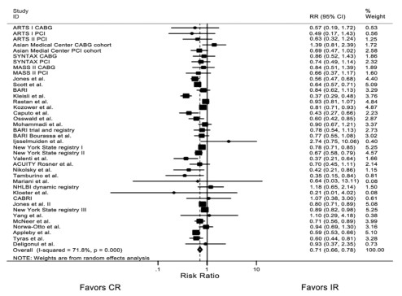
Why this study?
Complete vs Incomplete Revascularization in stable CAD
Mortality
Garcia et al JACC 2013

Slide 4
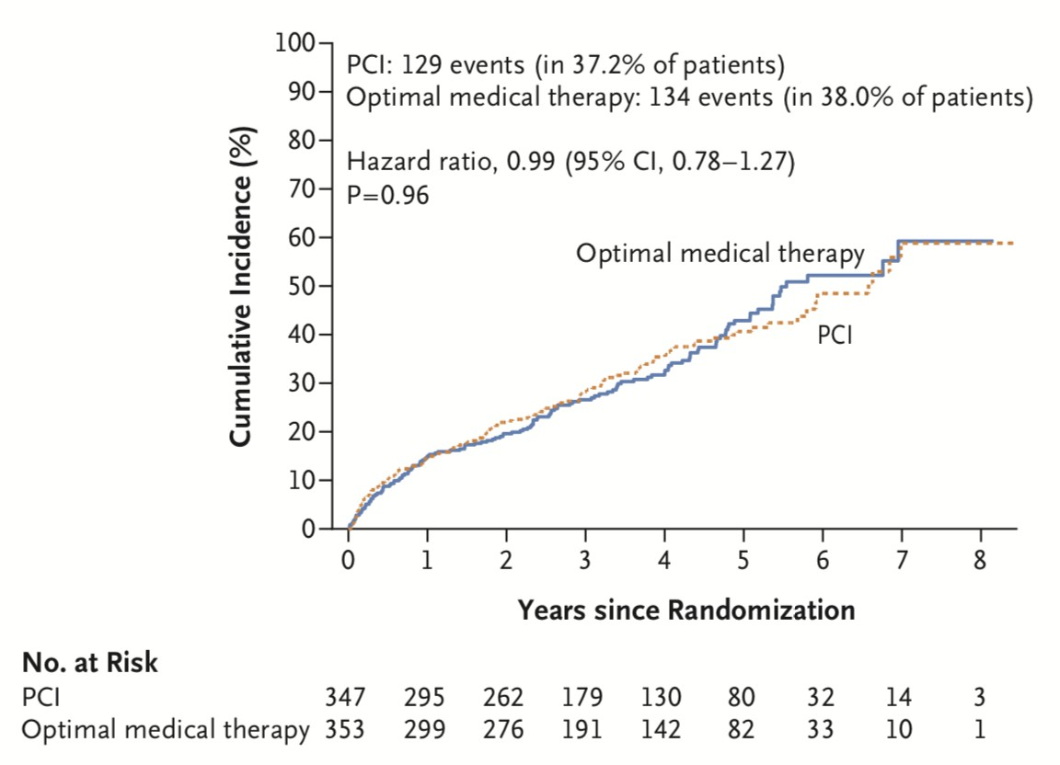
Why this study?
REVIVED-BCIS2
Inclusion Criteria
LVEF <35%
Stable CAD
BCIS Jeopardy Score ≥6 Viability in ≥4 myocardial segments
Primary Outcome
All Cause Death or Hospitalization for
Heart Failure
Perera et al NEJM 2022

Slide 5
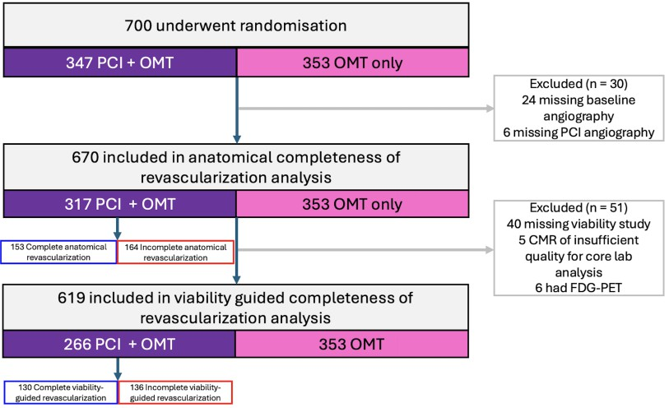
What did we study?
*Protocol recommended revascularization of all major proximal coronary vessels and side branches ≥2.5mm that subtended viable myocardium
*
Angiographic Core Lab
91%
CMR and Echo Core Labs
77%

Slide 6
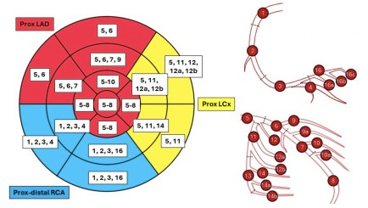
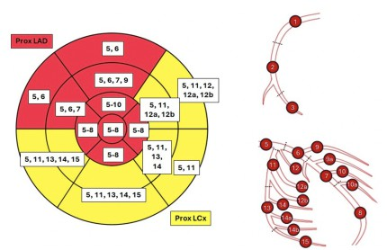
Core Lab Analysis
Angiographic stenosis significance was defined as ≥70% for non-left main stem, and ≥50% for left main stem, by visual assessment
Successful revascularization was defined as <30% residual diameter stenosis with TIMI III flow
For CMR and DSE, AHA 17 segment myocardial model was used and co-registered with coronary artery segments according to circulation dominance
A viable segment was defined as normal wall motion at rest, or dysfunctional at rest with <50% transmural late gadolinium scar on CMR or contractile reserve on DSE

Slide 7
Core Lab Analysis
Definitions of Completeness of Revascularization
Anatomical
Coronary Revascularization Index
RI_{coro}= [change in BCIS Jeopardy Score (BCIS-JS)] / [baseline BCIS-JS]
Viability-guided
Myocardial Revascularization Index
= [number of revascularized viable segments] / [number of viable segments supplied by diseased vessels]
Patients dichotomized as Complete Revascularization (CR) or Incomplete Revascularization (IR)
by median RI_{coro} and RI_{myo}

Slide 8
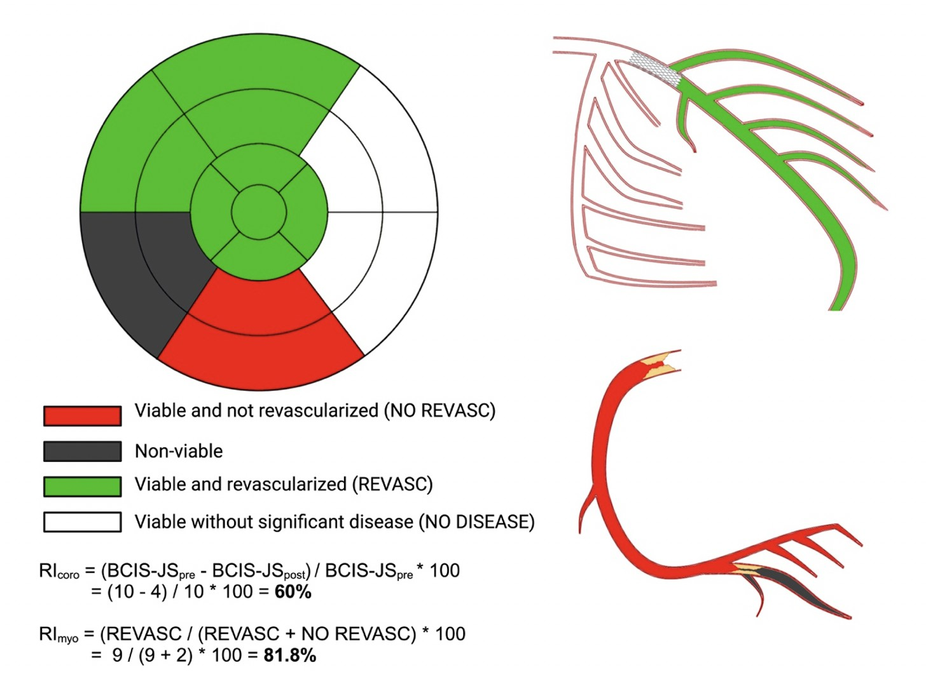
Core Lab Analysis
Definitions of Completeness of Revascularization [RI_{coro} and RI_{myo}]

Slide 9
Baseline Demographics
 | Revived trial (N=700) | Anatomical CoR (N=670) | Viability-guided CoR (N=619)
Male sex (%) | 614 (87.7) | 587 (87.6) | 544 (87.9)
Diabetes (%) | 289 (41.3) | 277 (41.3) | 260 (42.0)
History of MI (%) | 372 (53.1) | 356 (53.1) | 327 (52.8)
Hospitalisation for HF in prior 2 years (%) | 233 (33.3) | 221 (33.0) | 213 (34.4)
Previous CABG (%) | 34 (4.9) | 33 (4.9) | 31 (5.0)
CCS Angina Class 0 1 2 3 4 | 464 (66.6) 143 (20.5) 75 (10.8) 14 (2.0) 1 (0.1) | 448 (67.2) 137 (20.5) 70 (10.5) 12 (1.8) 0 (0.0) | 418 (67.9) 126 (20.5) 61 (9.9) 11 (1.8) 0 (0.0)
NYHA Class I II III IV | 126 (18.1) 387 (55.7) 172 (24.7) 10 (1.4) | 121 (18.2) 373 (56.1) 163 (24.5) 8 (1.2) | 115 (18.7) 347 (56.5) 145 (23.6) 7 (1.1)
Cardiac medication (%) RAAS inhibitor Beta blocker Mineralocorticoid receptor antagonist | 584 (83.5) 634 (90.6) 364 (49.4) | 557 (83.3) 608 (90.7) 332 (49.6) | 511 (82.7) 561 (90.6) 308 (49.8)

Slide 10
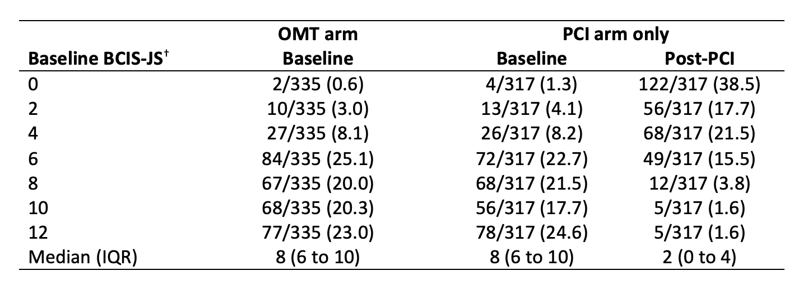
Angiographic Analysis
Core-lab adjudicated BCIS-Jeopardy Score
12% 14%
Median baseline BCIS-JS 8 (6 to 10)
Median baseline SYNTAX score 22 (15 to 28)

Slide 11
Angiographic Analysis
Core-lab adjudicated BCIS-Jeopardy Score
12% 14% 23%
Median baseline BCIS-JS 8 (6 to 10) Median baseline SYNTAX score 22 (15 to 28) |  | Median post BCIS-JS 2 (0 to 4) Median post SYNTAX score 8 (6 to 10)

Slide 12
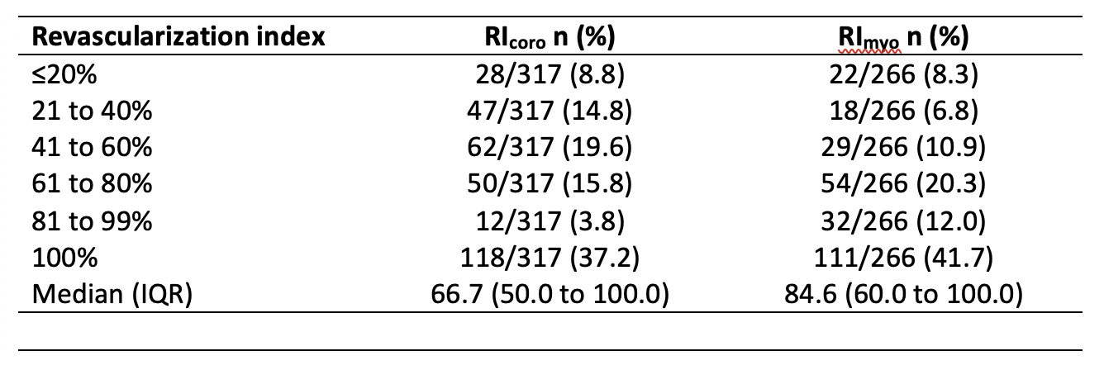
Angiographic Analysis
Core-lab adjudicated Completeness of Revascularization
Median RI_{coro} 67% (50 to 100)
Median RI_{myo} 85% (60 to 100)
Median no. of viable segments 7 (4 to 10)
CMR 79% DSE 21%

Slide 13
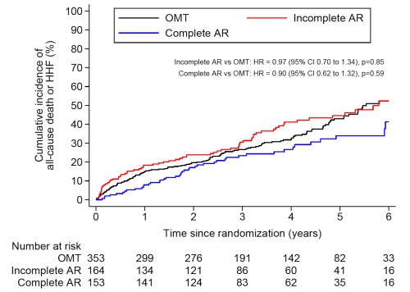
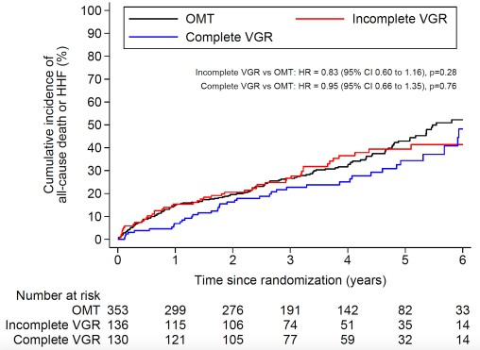
Primary Outcome by Completeness of Revascularization
Anatomical Revascularization Viability-Guided Revascularization
[RI_{coro} >67%]
[RI_{myo} >85%]
[Adjusted for: Age, sex, previous heart failure hospitalization, diabetes, chronic renal failure, LVEF, extent of CAD, presence of CTOand (for RIcoro only) no. of non-viable segments]

Slide 14
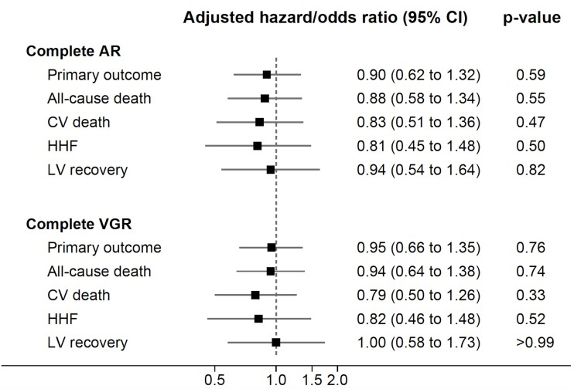
Primary and Secondary Outcomes by Completeness of Revascularization

Slide 15
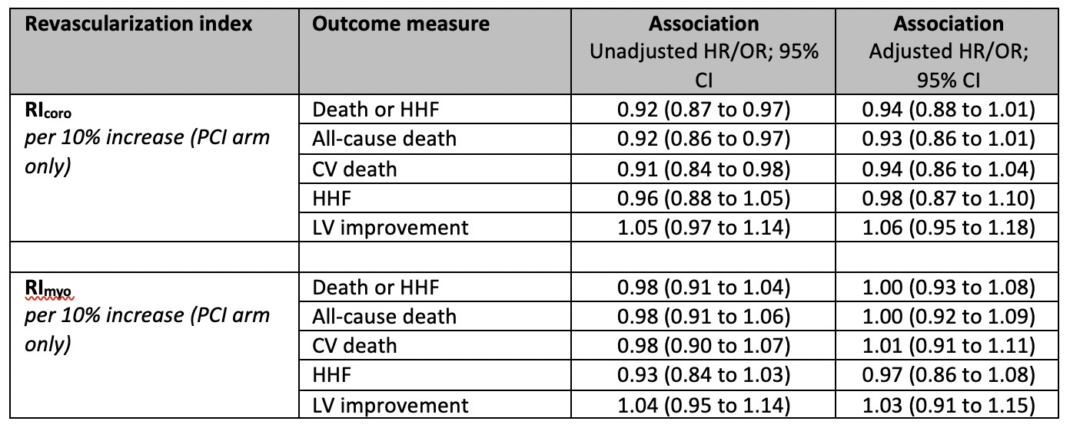
Outcomes by Revascularization (RI_{coro} and RI_{myo} as continuous variables)

Slide 16
Outcomes by Revascularization (RI_{coro} and RI_{myo} as continuous variables)

Slide 17
Limitations
Sub-study
Patients were not randomized to complete vs incomplete revascularization
Patients with incomplete revascularization were older, had more co- morbidity, and higher baseline BCIS-JS and SYNTAX scores
Heterogeneity of the complexity of coronary artery disease requires further exploration

Slide 18
Conclusion
In REVIVED-BCIS2, in patients with stable CAD and severe LVSD, neither anatomical nor viability-guided complete revascularization significantly impacted clinical outcomes
Impact of Anatomical and Viability-Guided Completeness of Revascularization on Clinical Outcomes in Ischemic Cardiomyopathy
J Am Coll Cardiol 2024; online before print
Saad M. Ezad MBBCh^{a*}, Margaret McEntegart PhD^{b,c*}, Matthew Dodd MSc^{d}, Matthaios Didagelos MD^{b}, Novalia Sidik PhD^{b}, Matthew Li Kam Wa MBBSª, Holly P. Morgan MBBChª, Antonis Pavlidis PhDe,
Roshan Weerackody PhD^{f}, Simon J. Walsh MD^{g}, James C. Spratt MD^{h}, Julian Strange MD^{i}, Peter Ludman MD^{j}, Amedeo Chiribiri PhD^{e,k}, Tim Clayton MSc^{d}, Mark C. Petrie MD^{l}, Peter O’Kane MD^{m} and Divaka Perera MD^{a,e} on behalf of the REVIVED-BCIS2 investigators

Slide 19
PCRonline.com

