Slide 1
1-year outcomes of the transfemoral transcatheter tricuspid valve replacement with the EVOQUE System:
A multicenter, early compassionate use experience
Dr John G Webb MD, Dr Anthony Chuang MBBS
Neil P Fam, MD Rebecca Hahn, MD Martin B Leon, MD Mark D Peterson, MD Paul A Grayburn, MD
Michael J Mack, MD Jian Ye, MD
Robert Boone, MD Vinayak Bapat, MD Robert Moss, MD
Robert L Smith, MD Molly Szerlip, MD Jörg Hausleiter MD Susheel K Kodali, MD
Stephan von Bardeleben, MD
Janarthanan Sathananthan, MD Andrew G Chatfield, MD Mariama Akodad, MD
David Meier, MD Mirjam Wild, MD

Slide 2
Disclosure Statement of Financial Interest
I, Anthony Chuang DO NOT have a financial interest/arrangement or affiliation with one or more organizations that could be perceived as a real or apparent conflict of interest in the context of the subject of this presentation.
Faculty disclosure information can be found on the app

Slide 3
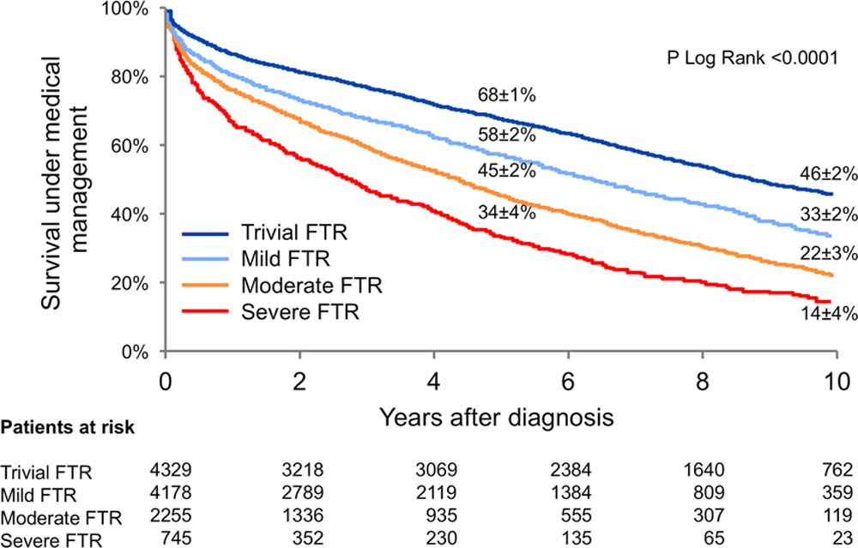
Tricuspid Regurgitation Negatively Impacts Survival
EVOQUE CU
Survival is significantly worse in patients with moderate and severe tricuspid regurgitation
Especially in patients with chronic heart failure
Benfari et al. Excess Mortality Associated with Functional TR Complicating Heart Failure with Reduced EF; Circulation 2019; 140: 196-206

Slide 4
1.6M
Tricuspid Regurgitation is Prevalent but Rarely Treated with Surgery
Moderate to severe TR prevalence
<8k
Surgical procedures annually
Reflective of US data
Stuge et al. J Thorac and Cardiovasc Surg 2006;1258-61 McCarthy et al. Curr Treat Options Cardiovasc Med 2010;587-597

Slide 5
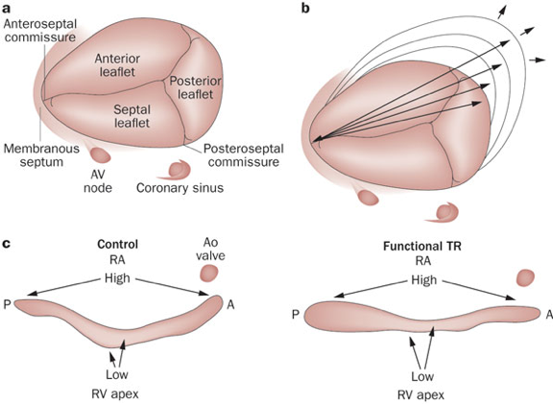
Current Challenges for Tricuspid Technologies
EVOQUE CU
Position/size of the regurgitant jet
Variable shape and size of tricuspid annulus
Variable number of leaflets
Presence of pacemaker leads
Per—procedural imaging
Difficulty capturing tethered leaflets
Proximity of RCA
Proximity to AV node
Mas PT et al. Heart. 2015; 101:1840-8.

Slide 6
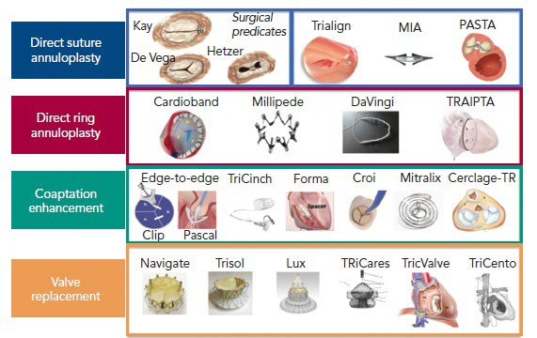
EVOQUE CU
Current Tricuspid Technologies
Curio J, Latib A et al. (2019). Interventional Cardiology Review 2019;14(2):54–61.

Slide 7
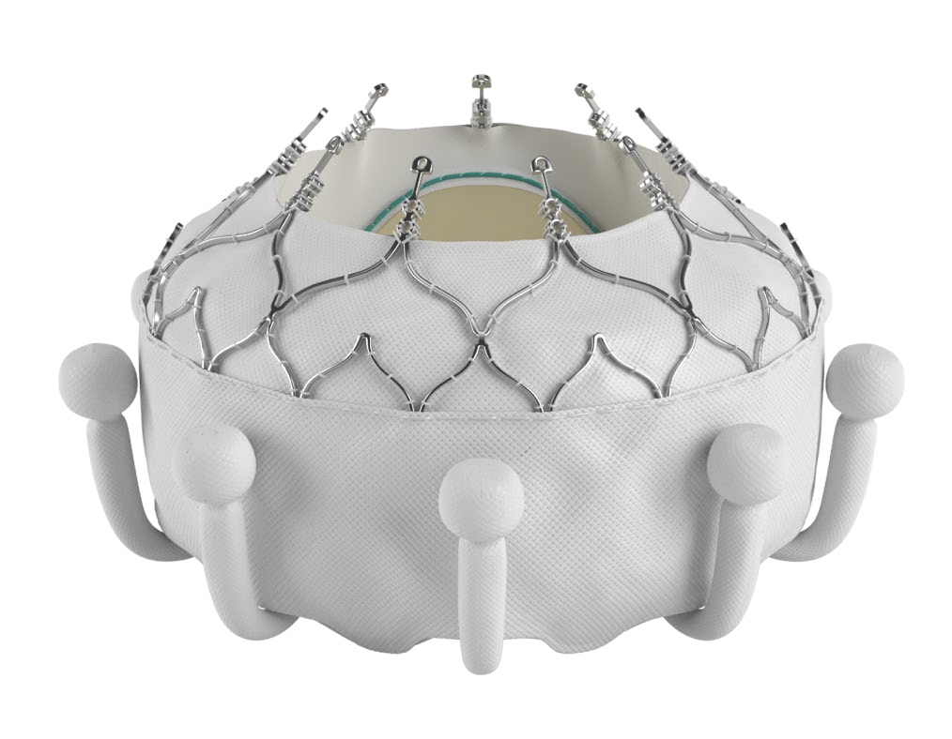
EVOQUE Tricuspid Valve Replacement System
Unique valve design engages leaflets, chords, and annulus to achieve secure placement
Atraumatic anchors compatible with pre-existing leads and respect the native anatomy Conforming frame designed to achieve optimal retention force
Multiple sizes offer treatment for a broad range of tricuspid pathologies and anatomies (44, 48 and 52 mm)
28F transfemoral delivery system with multiple planes of flexion and depth control
CAUTION: Investigational device. Limited by Federal (or United States) law to investigational use.

Slide 8
Fully transfemoral venous system (with pacing leads)

Slide 9
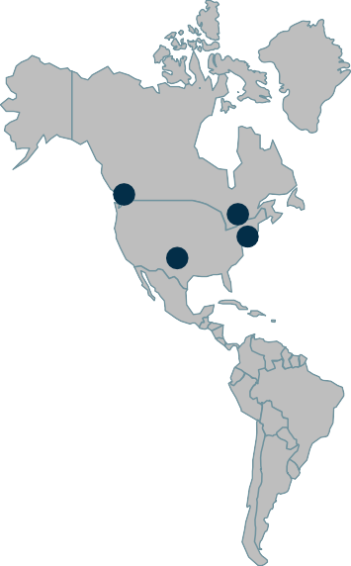
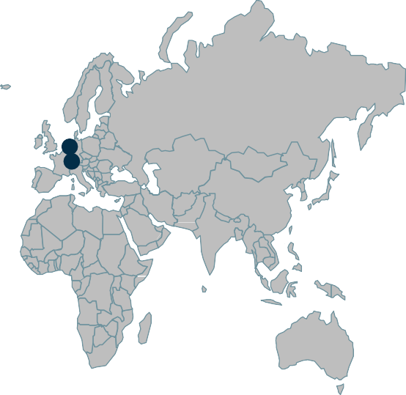
Compassionate use experience
EVOQUE CU
Early compassionate use; Mar 2019 – July 2020
7 institutions
27 consecutive patients with symptomatic severe+ TR, high surgical risk
Institutions
St. Michael’s Hospital, Toronto, Canada
St. Paul’s Hospital, Vancouver, Canada
Cedars-Sinai Medical Center, New York
Columbia University Medical Center, New York
Universitaetsklinikum Mainz, Germany
Ludwig-Maximilians-Universität München, Munich, Germany
The Heart Hospital Plano, Plano, Texas
Fam NP, Webb JG et al. Transfemoral Transcatheter Tricuspid Valve Replacement With the EVOQUE System: A Multicenter, Observational, First-in-Human Experience. JACC Cardiovasc Interv. 2021 Mar 8;14(5):501-511.

Slide 10
EVOQUE CU
Baseline characteristic
Baseline characteristics | N=27 % (n) or Mean ± SD
Age, years | 76 ± 3
Female | 24 (89%)
NYHA functional class III or IV | 24 (89%)
STS PROM | 8.6% ± 5.5%
Previous valve intervention | 12 (44%)
Etiology
Functional | 19 (70%)
Degenerative | 2 (11%)
Mixed | 5 (19%)
TR severity ≥3+ | 27 (100%)
Atrial fibrillation | 23 (85%)
TAPSE (mm) | 16 ± 2
Renal impairment (eGFR < 60) | 20 (74%)
PPM leads | 9 (33%)
eGFR = estimated glomerular filtration rate; NYHA = New York Heart Association; PPM = permanent pacemaker; RA = right atrial; RV = right ventricular; TAPSE = tricuspid annular plane systolic excursion; TR = tricuspid regurgitation.

Slide 11
EVOQUE CU
Clinical outcomes
30-day | N (%) or Mean ± SD
Procedural success¹ | 25 (93%)
Procedural time (skin-skin) (mins, mean/min/max) | 68 (37, 101)
Mortality | 0 (0%)
Stroke | 0 (0%)
Reintervention | 0 (0%)
HF hospitalization | 0 (0%)
Dialysis requirement | 1 (4%)
Anticoagulation | 25 (93%)
New PPM | 2 (8%)
¹Defined as ability to deliver and deploy the valve to the intended location with the absence of major device or procedural related serious adverse events Fam NP, Webb JG et al. Transfemoral Transcatheter Tricuspid Valve Replacement With the EVOQUE System: A Multicenter, Observational, First-in-Human Experience. JACC Cardiovasc Interv. 2021 Mar 8;14(5):501-511.

Slide 12
EVOQUE CU
Clinical outcomes
30 day | N (%) or Mean ± SD
Procedural success¹ | 25 (93%)
Procedural time (skin-skin) (mins, mean/min/max) | 68 (37, 101)
Mortality | 0 (0%)
Stroke | 0 (0%)
Reintervention | 0 (0%)
HF hospitalization | 0 (0%)
Dialysis requirement | 1 (4%)
Anticoagulation | 25 (93%)
New PPM | 2 (8%)
30 day to 1 year | N (%) or Mean ± SD
Mortality | 2 (7%)
Valve-related mortality | 0 (0%)
Stroke | 0 (0%)
Re-intervention | 0 (0%)
HF Hospitalization | 2 (7%)
Dialysis requirement | 0 (0%)
New PPM | 1 (4%)
HALT | 3 (12%)
¹Defined as ability to deliver and deploy the valve to the intended location with the absence of major device or procedural related serious adverse events Fam NP, Webb JG et al. Transfemoral Transcatheter Tricuspid Valve Replacement With the EVOQUE System: A Multicenter, Observational, First-in-Human Experience. JACC Cardiovasc Interv. 2021 Mar 8;14(5):501-511.

Slide 13
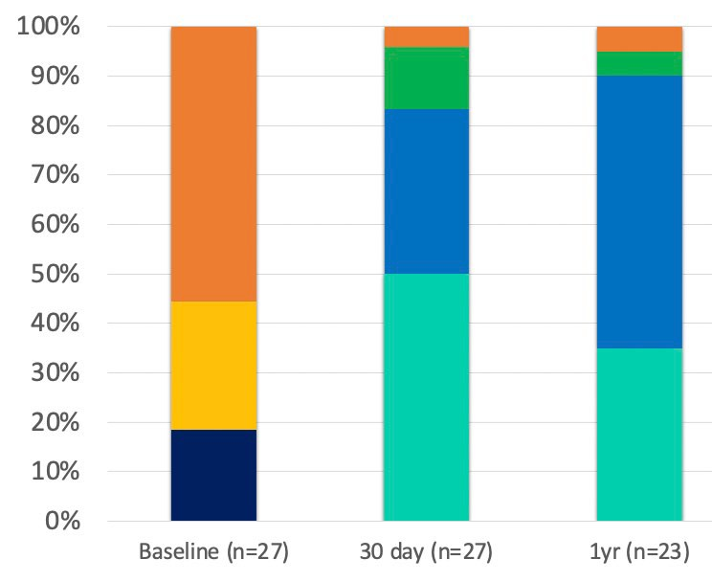
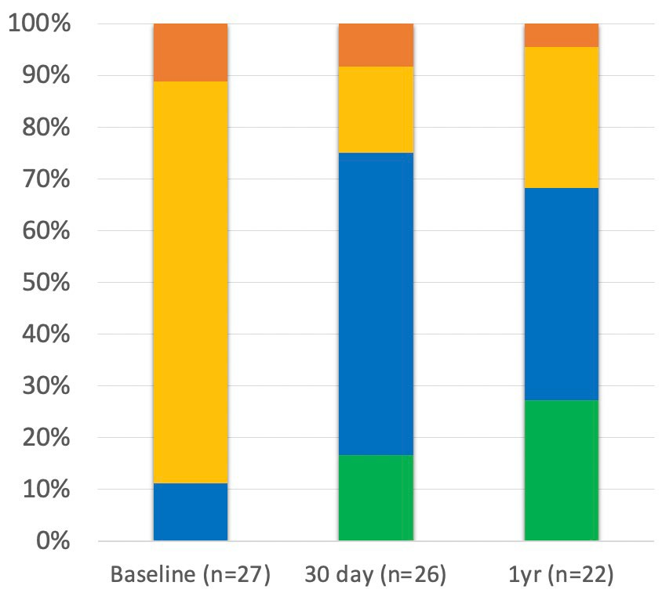
Echocardiographic and clinical outcomes
EVOQUE CU
TR Severity
NYHA Functional Class
4%
4%
4%
5%
27%
41%
27%
No valve implanted
Torrential
11%
7%
11%
IV
Massive
15%
55%
III
30%
Severe
All patients with implanted valve has TR
≤ moderate.
88% mild or trace
48%
44%
II
Moderate
81%
52%
I
Mild
26%
Trace
55%
19%
15%
7%

Slide 14
Echocardiographic and clinical outcomes
EVOQUE CU
TR Severity
NYHA Functional Class
4%
4%
4%
5%
No valve implanted
11%
7%
11%
IV
15%
27%
55%
III
30%
48%
All patients with implanted valve has TR
≤ moderate.
92% mild or trace
II
81%
52%
41%
I
26%
55%
44%
19%
27%
7%
15%

Slide 15
Echocardiographic and clinical outcomes
EVOQUE CU
TR Severity
NYHA Functional Class
4%
4%
4%
5%
No valve implanted
11%
7%
11%
15%
27% 68% of
patients had NYHA ≤ 2
55%
30%
48%
All patients with implanted valve has TR
≤ moderate.
92% mild or trace.
81%
52%
41%
26%
55%
44%
19%
27%
7%
15%

Slide 16
Conclusions
EVOQUE CU
Early experience demonstrates EVOQUE tricuspid valve replacement system has durable efficacy, low rates of mortality and acceptable morbidity in high surgical risk patients at 1 year
All treated patients achieved TR reduction to ≤moderate (92% achieved trace or mild TR) and persistent significant improvement in NYHA functional class at 1 year
Further studies underway to validate its long-term efficacy: TRISCEND
(NCT04221490) and TRISCEND II (NCT04482062)

Slide 17
7
7

