Slide 1
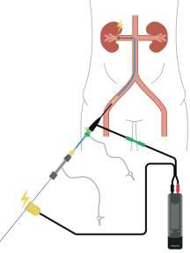
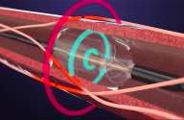
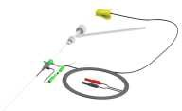
Safety and efficacy of renal stimulation with direct wire pacing during renal denervation procedure: RNS-DWP First-In-Human study
Romain Boulestreau; Nicolas Delarche, Atul Pathak, Alexander Persu, David Kandzari, Felix Mafhoud, MC Morice, Benjamin Faurie
Background - Aim
Wire
Wire
Highfrequency transvascular renal nerves stimulation (RNS) predicts RDN response¹⁻⁴ :
1°-RNS identifies good responders for RDN 2°-RNS maps target area for RDN
3°-RNS assesses the completeness of RDN
Loop shaped BMW®
P. Gal et al. J Hum Hypertens. 2015;05.
M. De Jong & al. Hypertension. 2016;07.
KP. Tsioufis & al. Eurointervention. 2018;12
HC Huang & al. Circintervention. 2023;02
Clamp
2° Us-RDN
Clamp
1° Pre-RDN Renal Nerves Stimulation
3° Post-RDN Renal Nerves Stimulation
4° 3-months ABPM
Unmet clinical need
Conclusion
ΔSBP ≥ 10 mmHg: good response
ΔSBP < 10 mmHg: low/bad response
I- In-hospital safety endpoint reached
RNS performed with bipolar probes or complex and expensive catheters and algorithms in EP laboratories.
This study aims at showing feasibility, safety and efficacy of RNS using Direct Wire Pacing (DWP) technique.
II- Efficacy endpoint reached :
Perspectives:
RDN WORKS BUT PATIENT SELECTION IS A WEAKNESS
RNS APPEAR TO PREDICT RDN EFFICACY BUT TOO COMPLEX TODAY
Conclusion:
RNS-DWP COULD PROVIDE A SIMPLE, RAPID, INEXPENSIVE AND UNIVERSAL METHOD FOR GUIDING THE RDN PROCEDURE AND PREDICTING ITS EFFICACY AND COMPLETENESS.
Future:
Electroducer Sleeve will become the reference introducer for RDN
Mean BPs change during RNS-DWP
25
20
15
10
5
0
Before RDN After RDN
Pau Hospital Centre:
Investigator initiated study
Methods
We used a BMW guidewire as a cathode to provide pacing with a subcatneous needle as an anode and a simple pacing algorithm provided by a standard external PM: 800/mn at 20mA during 1 min prior and after a RDN procedure.
12 patients with resistant HTN elligible for an usRDN with Recor Paradise system.
CERIC:
Study promotion and management Data Management
Electroducer: Financing Monitoring

