Slide 1



The PARTNER 3 Bicuspid Registry for SAPIEN 3 TAVR in Low-risk Patients
Mathew R. Williams, MD & John G. Webb, MD
on behalf of the PARTNER 3 Trial Investigators

Slide 2
Disclosures – Mathew Williams, MD
TVT: July 20-22, 2021
Within the past 36 months, I or my spouse/partner have had a financial interest/arrangement or affiliation with the organization(s) listed below:
Financial Relationship | Company
Research Support | Edwards, Medtronic, HLT, BSC
Other | Thubrikar, MID

Slide 3
Background
Bicuspid aortic valve (BAV) morphology is a common congenital cardiac abnormality, affecting about 1% of Americans
Aortic stenosis (AS) is a frequent complication of bicuspid anatomy
Patients with bicuspid AS have historically been excluded from TAVR studies, however recent reports suggest that the use of SAPIEN 3 (S3) in high-risk patients is safe and effective
TAVR data for BAV patients at low surgical risk are limited

Slide 4
Purpose
To prospectively study the 1-year safety and efficacy of the SAPIEN 3 TAVR system in selected patients with severe symptomatic AS and bicuspid anatomy who are at low surgical risk
To compare results to a clinically similar cohort of patients with tricuspid anatomy treated with SAPIEN 3 TAVR in PARTNER 3

Slide 5












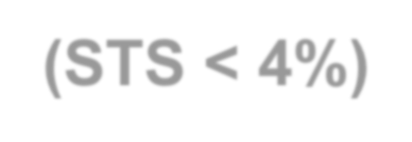


































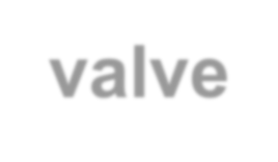





PARTNER 3 Study Design
Symptomatic Severe AS
P3 TAVR Bicuspid Registry
Low Risk/TF Assessment by Heart Team
(STS < 4%)
P3 Bicuspid CAP TVT-Registry
Continued Access Protocol (CAP) for S3 TAVR
Managed by TVT registry
In addition to meeting all P3 Bicuspid eligibility criteria, patients had to be covered by Medicare
1:1 Randomization
1000 Patients
TAVR
(SAPIEN 3 THV)
TAVR
(SAPIEN 3 THV)
Surgery
(bioprosthetic valve)
TAVR
(SAPIEN 3 THV)
Follow-up: 30 days, 6 months, and annually through 10 years
Follow-up: 30 days and 1 year
PRIMARY ENDPOINT:
Composite of all-cause death, stroke, or CV rehospitalization at 1 year post-procedure
All-cause death, stroke, valve-related rehospitalization,
and new PPMI

Slide 6
Study Leadership
National Principal Investigators
Mathew R. Williams, MD, NYU Langone Medical Center, New York, NY
John G. Webb, MD, St. Paul’s Hospital, Vancouver, BC, Canada
Steering Committee
Howard Herrmann, Samir Kapadia, Susheel Kodali, Martin B. Leon, Michael J. Mack, Raj Makkar, Craig R. Smith (chair), Wilson Szeto, Vinod Thourani, John G. Webb
Data & Safety Monitoring Board
Cardiovascular Research Foundation, New York, NY; Joseph Carrozza, Jr., MD, chair
Clinical Events Committee
Cardiovascular Research Foundation, New York, NY; Ziad A. Ali, M.D., chair; Steven Marx, M.D., co-chair
CT Core Laboratory
The University of British Columbia; Jonathon Leipsic, MD, chair; Philipp Blanke, MD, chair
Echocardiographic Core Laboratory
Quebec Heart & Lung Institute (Laval University); Philippe Pibarot, DVM PhD, chair
Cardiovascular Research Foundation, New York, NY; Rebecca Hahn, MD, chair
Sponsor
Edwards Lifesciences, Irvine, CA

Slide 7

Key Inclusion Criteria
Severe Calcific AS
AVA ≤ 1.0 cm² or AVA index ≤ 0.6 cm²/m²
Jet velocity ≥ 4.0 m/s or mean gradient ≥ 40 mmHg, AND
  NYHA Functional Class ≥ 2, OR
  Abnormal exercise test with severe SOB, abnormal BP response, or arrhythmia, OR
  Asymptomatic with LVEF < 50%
Low Surgical Risk
STS < 4% or judgement of local heart team and national case review
board
Adjudicated by case review board
Bicuspid Aortic Valve Anatomy
Bicuspid valve as determined by the CT core lab

Slide 8
Key Exclusion Criteria
Anatomic:
Aortic annulus diameter < 16 mm or > 28 mm (3D imaging)
Severe AR (> 3+) or MR (> 3+)
Severe LV dysfunction (LVEF < 30%)
Severe calcification of aortic valvar complex (esp. LVOT or raphe)
Vascular anatomy not suitable for safe femoral access
Complex CAD: ULM, Syntax score > 32, or not amenable for PCI
Low coronary takeoff (high risk for obstruction)
Clinical:
Acute MI within 1 month
Stroke or TIA within 90 days
Renal insufficiency (eGFR < 30 ml/min) and/or renal replacement Rx
Hemodynamic or respiratory instability
Frailty (objective assessment; > 2/4+ metrics)

Slide 9
Study Methodology
Each patient reviewed (including imaging studies) by multidisciplinary heart team AND case review board
Baseline and 30-day neuro assessment in all patients; serial neurologist examinations and neuro-imaging for suspected neuro events
Baseline 3D cardiac imaging by CT or TEE
  Bicuspid anatomy determined by the CT core lab
100% adjudication of all major endpoint events (VARC-2 definitions when applicable)
  CEC for Bicuspid Registry and Tricuspid TAVR arm
  Independent medical reviewer for Bicuspid CAP

Slide 10
Primary Endpoint
Composite endpoint of all-cause death, all stroke, and CV rehospitalization*
at 1 year post-TAVR
*Valve- or procedure-related and including HF

Slide 11
Statistical Methods
Patients from both registries were pooled to form one BAV TAVR group
Propensity-matched analysis was used to compare the BAV TAVR group to the tricuspid TAVR arm of the PARTNER 3 trial
Descriptive statistics were presented as follows:
  Continuous variables summarized by mean ± SD
  Categorical variables summarized by count and percent
  Event variables summarized by Kaplan-Meier event rates and number of subjects with the event

Slide 12
Covariates for Propensity Matching
Age
Renal disease
Sex
Atrial fibrillation
NYHA class
Prior cerebrovascular accident
Body mass index
Prior PCI
STS score
Aortic valve mean gradient
Diabetes mellitus
Effective orifice area
Peripheral vascular disease
Mitral insufficiency
Carotid disease
KCCQ score
Hypertension

Slide 13



























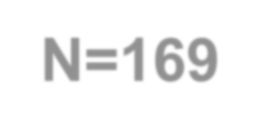
Patient Disposition
P3 Bicuspid Registry N=133
P3 Bicuspid CAP N=187
Not implanted (62):
Anatomical exclusion (43)
Enrollment closed (8)
Procedure not started (4)
Withdrew consent (3)
Not specified (2)
Medical exclusion (2)
Not implanted (89):
Anatomical exclusion (56)
Received commercial treatment (2)
Other (31)
Valve Implanted
N=71
N=98
Before Propensity Matching
Total P3 Bicuspid N=169
P3 Tricuspid N=496
After Propensity Matching
148 Matched Pairs

Slide 14
Anatomical Exclusions
Reason(s) n (%) | Bicuspid Registry (N=43) | Bicuspid CAP (N=56)
Severe calcification of aortic valvar complex | 5 (11.6) | 31 (55.4)
Tricuspid aortic valve | 15 (34.9) | 0.0
Annulus size and/or ascending aorta diameter too large | 11 (25.6) | 14 (25.0)
AND severe calcification AND aortic stenosis not calcific AND risk of coronary obstruction | 3 (7.0) 1 (2.3) 1 (2.3) | 7 (12.5) 0.0 0.0
Risk of coronary obstruction | 1 (2.3) | 3 (5.4)
Other | 6 (14.0) | 1 (1.8)

Slide 15
Baseline Patient Characteristics
Matched
Variable (median or %) | Bicuspid (N=148) | Tricuspid (N=148) | Variable (median or %) | Bicuspid (N=148) | Tricuspid (N=148)
Age, years | 71.0 | 72.0 | Diabetes | 17.7% | 18.2%
Male | 58.1% | 60.1% | Mean gradient, mmHg | 49.0 | 50.1
BMI, kg/m² | 28.0 | 27.6 | Aortic valve area, cm² | 0.7 | 0.7
STS Score, % | 1.4 | 1.5 | MR ≥moderate | 3.5% | 2.7%
NYHA class III or IV | 29.7% | 26.4% | TR ≥moderate | 2.1% | 0.7%
KCCQ-OS | 72.7 | 72.9 | History of AFib | 4.7% | 1.4%
No significant differences among any variables.

Slide 16
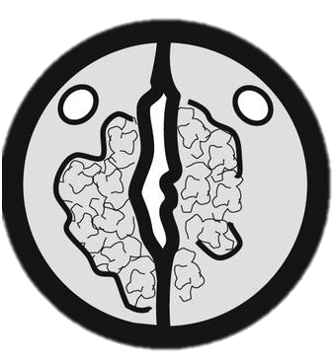
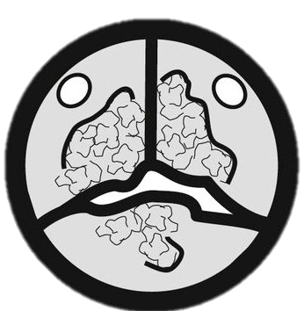
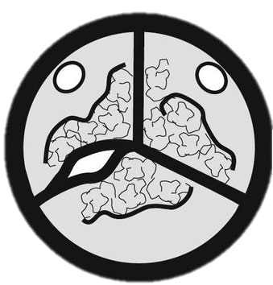
Baseline Morphology
% of patients
Bicuspid Sievers Classification
 | Type 0 (No raphe) | Type 1 (1 raphe) | Type 2 (2 raphae)
Registry (N=71) CAP (N=98) | 14.1% 13.3% | 84.5% 86.7% | 1.4% 0%
Figures adapted from Mylotte D et al. J Am Coll Cardiol. 2014 Dec, 64 (22) 2330-2339.

Slide 17
Procedural Outcomes
Matched
mean ± SD, median (IQR), or %
Outcome | Bicuspid (N=148) | Tricuspid (N=148) | p value
Conscious sedation | 68.9% | 62.2% | 0.27
Procedure duration (min) | 64.0 (46.0, 89.5) | 50.0 (36.0, 65.0) | <0.01
Fluoroscopy duration (min) | 13.3 (10.0, 19.8) | 12.0 (9.0, 16.0) | <0.01
Annulus area (mm²) | 486.0 (406.2, 541.6) | 457.1 (390.3, 516.3) | 0.01
Implanted valve size |  |  | 0.19
20 or 23 mm | 33.1% | 41.2%
26 or 29 mm | 66.9% | 58.8%
Oversizing (%) | 5.7±8.37 (N=147) | 8.0±8.82 (N=144) | 0.02
Procedure aborted | 0.0% | 0.0% | NA
Conversion to SAVR | 0.0% | 0.7% | >0.99
Procedural success | 100.0% | 99.3% | >0.99

Slide 18
Primary Endpoint
Matched
Death, Stroke, or Rehosp (%)
20
Tricuspid Bicuspid
Log Rank P = 0.80
10.9%
10.2%
10
0
0
3
6
Months After Procedure
9
12
Number at risk:
Tricuspid 148
Bicuspid 148
127
122

Slide 19
Clinical Outcomes
Matched
Outcome (KM estimate as %) |  | 30 Days |  |  | 1 Year
 | Bicuspid N=148 | Tricuspid N=148 | p value | Bicuspid N=148 | Tricuspid N=148 | p value
Death, Stroke, or Rehospitalization | 6.8% | 4.7% | 0.44 | 10.9% | 10.2% | 0.80
Death | 0.0% | 0.0% | NA | 0.7% | 1.4% | 0.58
Stroke | 1.4% | 1.4% | 0.99 | 2.1% | 2.0% | 0.99
Rehospitalization | 5.4% | 4.1% | 0.58 | 9.6% | 9.5% | 0.96
New pacemaker | 6.1% | 6.8% | 0.81 | 6.8% | 7.4% | 0.82

Slide 20


Echocardiographic Findings
Unmatched
60
2
Effective Orifice Area (cm²)
Mean Gradient (mmHg)
1.5
40
Bicuspid CAP (site-reported) Bicuspid Registry (core lab-reported) Tricuspid (core lab-reported)
1
20
0.5
0
0
No. of echos (MG|EOA):
Bicuspid CAP Bicuspid Registry Tricuspid
Baseline
30 Days
1 Year
97|NA
71|65
484|459
95|NA
70|61
491|471
74|NA
68|65
470|447

Slide 21











Paravalvular Regurgitation
Unmatched
2.3
1.4
0.8
3.1
0.6
100
≥Moderate Mild None/Trace
27.9
24.3
28.7
18.8
26.9
29.3
80
% of Patients
60
40
74.3
78.1
73.1
69.8
70.5
70.0
20
0
Bicuspid CAP N=70
Bicuspid Registry N=86
30 Days
Tricuspid Registry N=488
Bicuspid CAP N=67
Bicuspid Registry N=64
1 Year
Tricuspid Registry N=467
Numbers reflect all available echos

Slide 22






Paravalvular Regurgitation
Matched
p = 0.119 p = >0.999
1.7 1.7
2.6
0.7
100
≥Moderate Mild None/Trace
25.9
20.7
30.9
80
26.9
35.4
30.7
% of Patients
60
40
77.6
70.5
72.4
69.1
68.6
64.6
20
0
Bicuspid CAP N=78
Bicuspid Registry N=58
30 Days
Tricuspid Registry N=147
Bicuspid CAP N=58
Bicuspid Registry N=55
1 Year
Tricuspid Registry N=140
Numbers reflect all available echos

Slide 23





NYHA Class III/IV
Matched
40
P = 0.60
29.7
26.4
Tricuspid Bicuspid
30
% of Patients
20
10
P = 0.50
P > 0.99
0.8 0.7
0
1.4
0
Baseline
N=148 N=148
30 Days N=148 N=144
1 Year N=144 N=129

Slide 24

KCCQ Overall Summary Score
Matched
100
91.4
92.3
91.6
P = 0.50
90
KCCQ OS Score
88.4
P = 0.02
80
Tricuspid Bicuspid
70
69.5
68.0
P = 0.54
60
50
1 Year
N=144 N=126
Baseline 30 Days
Bicuspid Tricuspid
N=147 N=148
N=148 N=145

Slide 25


Study Limitations
Results reflect only 1-year outcomes; longer-term data for P3
CAP are not available
Results apply only to the enrolled population of highly selected
bicuspid patients
Conclusions from this limited sample size may not be generalizable to all bicuspid morphologies
P3 CAP 30-day and 1-year echo data were site reported

Slide 26
Conclusions
Patients with severe, symptomatic aortic stenosis, low surgical risk, and favorable bicuspid anatomy who underwent TAVR demonstrated:
Hemodynamic outcomes and adverse events that were comparable to a similar group of patients with tricuspid anatomy
Significant quality of life and symptomatic improvement
Longer-term follow up is necessary to confirm these results

Slide 27
Thank You

Slide 28
Back-up / Alternate Slides

Slide 29
All-Cause Mortality
Matched
10
Tricuspid Bicuspid
Log Rank P = 0.58
1.4%
0.7%
All-Cause Mortality (%)
5
0
0
3
6 9 12
Months After Procedure
Number at risk:
Tricuspid 148
Bicuspid 148
140
135

Slide 30
All Stroke
Matched
10
Tricuspid Bicuspid
Log Rank P = 0.99
All Stroke (%)
5
2.1%
2.0%
0
0
3
6
Months After Procedure
9
12
Number at risk:
Tricuspid 148
Bicuspid 148
139
133

Slide 31
Rehospitalization
Matched
20
Tricuspid Bicuspid
Log Rank P = 0.96
9.6%
9.5%
Rehospitalization (%)
10
0
0
3
6
Months After Procedure
9
12
Number at risk:
Tricuspid 148
Bicuspid 148
127
123

Slide 32
New Permanent Pacemaker
Matched
20
Tricuspid Bicuspid
Log Rank P = 0.82
7.4%
6.8%
New PPM (%)
10
0
0
3
6
Months After Procedure
9
12
Number at risk:
Tricuspid 148
Bicuspid 148
130
126

