Slide 1
Vein Of Marshall Ethanol Infusion For Persistent Atrial Fibrillation:
The Venus Trial
Miguel Valderrábano, Leif E. Peterson, Vijay Swarup, Paul Schurmann, Rahul Doshi, David DeLurgio, Charles Athill, Kenneth Ellenbogen, Andrea Natale, Irakli Giorgberidze, Amish Dave, Raquel Bunge, Michelle L. Guthrie, Neal Kleiman
Division of Cardiac Electrophysiology, Department of Cardiology, Methodist DeBakey Heart and Vascular Center, Houston Methodist Hospital, Houston, TX
Funded by NIH/NHLBI R01HL115003

Slide 2
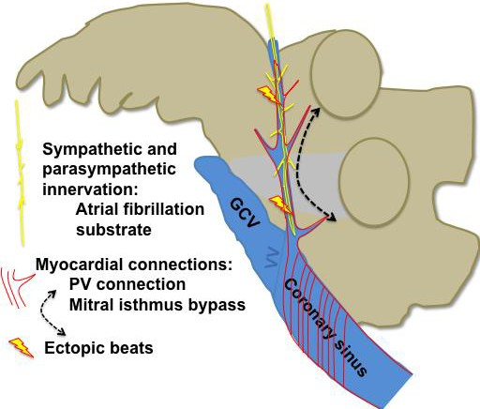
Persistent AF: A Challenge
Catheter ablation of persistent atrial fibrillation (AF) has suboptimal outcomes, with low single-procedure success and frequent need for repeat procedures.
The vein of Marshall (VOM) is an attractive target to improve
ablation results, since it contains:
Heart Rhythm. 2018 Jan;15(1):25-27
Pro-fibrillatory innervation
AF triggers
Sits in the mitral isthmus, critical for perimitral flutter
All of these mechanisms are ablated by VOM ethanol infusion

Slide 3
Hypothesis
Adding VOM ethanol infusion to de novo catheter ablation of persistent AF increases the chances of maintaining normal rhythm.

Slide 4
VENUS Clinical Trial Endpoints
Primary end-point:
Freedom from AF or atrial tachycardia (AT) of greater than 30s duration, after a single procedure, without the use of antiarrhythmic medications and occurring after 3-month blanking period*
Secondary end-points:
Freedom from AF/AT after >1 procedure, or on antiarrhythmic drug treatment
AF burden (% time) on continuous monitoring
Procedural parameters: total procedure, fluoroscopy, and total extent of tissue ablated
Need for and number of repeat procedures
Recurrence as AF vs AT
* Deaths and missing data considered as failures

Slide 5
VENUS Trial
Inclusion criteria:
Patients between 18 and 85 years of age
Symptomatic persistent AF (sustained, lasting > 7 days)
Refractory to at least one antiarrhythmic agent
Key exclusion criteria:
Previous AF ablation attempts
Left atrial diameter or volume exceeding 65 mm or 200 mL
Ejection fraction <30%
Patients and EKG core lab were blinded to randomization outcome
Funded by NIH/NHLBI R01HL115003. No industry funding.

Slide 6
VENUS Clinical Trial Design
RANDOMIZATION
1:1.15
Catheter Ablation N=156¹
Catheter AbIation plus VOM ethanol, N=180¹
VOM ethanol not doable
(15%): intention to treat
VOM ethanol completed
(85%): per treatment
1 month:
EKG, visit
3 months:
EKG, visit, cardioversion if AF, stop
antiarrhythmic drug
CLINICAL RECURRENCE
(Symptomatic AT/AF²)
6 months: EKG, visit
1-month monitor
MONITORING RECURRENCE (AT/AF ≥ 30s)
9 months: EKG, visit
12 months: EKG, visit
1-month monitor
¹Power of 91% power to detect a difference of 18% between groups using a two-tailed Z-Test at the 0.05 significance level (alpha)
²Repeat catheter ablation allowed per clinician’s discretion.

Slide 7
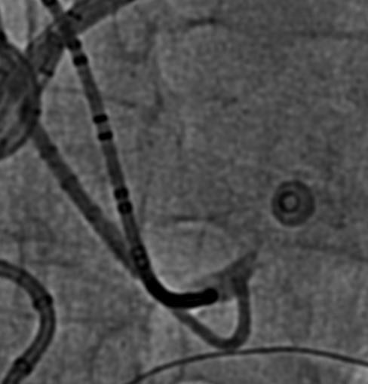
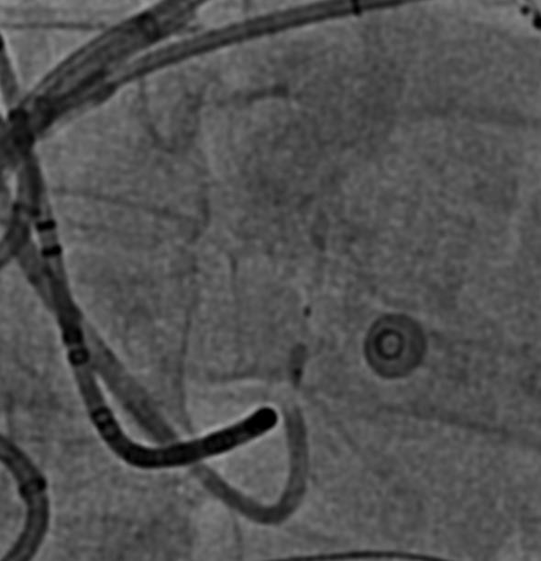
VENUS Trial Procedures
VOM-randomized patients, prior to catheter ablation:
Coronary sinus cannulation, VOM venogram, angioplasty wire and balloon cannulation.
Up to four injections of 1 cc ethanol, from distal VOM to
proximal
Left atrial voltage maps before and after ethanol
VOM
Catheter ablation
Pulmonary vein isolation
Per the operators’ discretion:
Posterior wall isolation
Mitral isthmus ablation
Ablation of complex and fractionated electrograms
VOM
All patients underwent a final left atrial voltage map
Scar (bipolar voltage <0.1 mV) quantified
balloon

Slide 8
VENUS clinical trial conduct
VOM procedure
350 patients screened in 12 US
centers
7 did not meet inclusion/exclusion criteria
343 Randomized
158 patients randomized to Catheter
Ablation only
185 patients randomized to Vein-of- Marshall Ethanol Infusion plus Catheter Ablation
30 unsuccessful Vein-of-Marshall ethanol infusion
155 patients received to Vein-of- Marshall Ethanol Infusion plus Catheter Ablation
2 died
14 missing follow-up/monitoring data
4 died
13 missing follow-up/monitoring data
3 died
10 missing follow-up/monitoring data
142 included in primary analysis
168 included in Intention-to-treat analysis
142 included in Per treatment analysis

Slide 9
Baseline patient characteristics
Catheter Ablation |  | VOM+Catheter Ablation | P value
 | N=158 | N=185
Age (years) | 66.4±9.9 | 66.6±9.6 | 0.83
Male sex - no. (%) | 124 (78%) | 137 (74%) | 0.34
White race- no. (%) | 150 (95%) | 169 (91%) | 0.194
Ejection fraction (%) | 53.4±9.4 | 52.1±10.1 | 0.26
Left atrial diameter (mm) | 47.0±7.5 | 44.8.1±7.9 | 0.01
Left atrial volume (ml) | 113.9±46.3 | 110.9.2±46.8 | 0.56
Left atrial volume index (ml/m²) | 52.8±24.5 | 52.9±21.1 | 0.93
Left atrial volume index category (ml/m²)
<75 | 131 (83%) | 155 (84%) | 0.97
76-89 | 15 (9%) | 17 (19%)
>90 | 12 (8%) | 13 (7%)
Body mass Index (kg/m²) | 31.9±6.5 | 31.2±6.6 | 0.3
Medical history - no. (%)
Hypertension | 104 (66%) | 144 (77%) | 0.025
Diabetes | 31 (20%) | 52 (28%) | 0.07
Coronary disease | 41 (26%) | 52 (28%) | 0.61
Stroke-TIA | 19 (12%) | 19 (10%) | 0.96
Heart failure | 42 (27%) | 48 (26%) | 0.66
CHADS-VASC Score | 2.6±1.6 | 2.9±1.6 | 0.23
Time from first AF diagnosis
<6 months- no. (%) | 10 (6%) | 15 (8%) | 0.81
6 months to 2 years - no. (%) | 65 (41%) | 76 (41)
>2 years- no. (%) | 83 (52%) | 94 (51%)
Longstanding Persistent atrial fibrillation - no. (%) | 82 (52%) | 99 (54%) | 0.75

Slide 10
Procedural parameters
 |  | Catheter Ablation | VOM+Catheter Ablation | P value
 |  | N=158 | N=185
 | Procedure Times
 | Fluoroscopy time of catheter ablation (min) | 11.9 ± 21.2 | 10.9 ± 19.5 | 0.6531
 | Procedure time of catheter ablation (min) | 190.2 ± 63.5 | 166.6 ± 74.5 | 0.002
 | Total fluoroscopy time (VOM ethanol plus catheter ablation, min) | 11.9 ± 21.2 | 23.0 ± 23.7 | <0.0001
 | Total procedure time (VOM ethanol plus catheter ablation, min) | 190.3 ± 63.5 | 215.9 ± 77.7 | 0.0011
 | LA instrumentation time (min) | 149.6 ± 48.8 | 193.0 ± 60.8 | 0.0007
 | Radiofrequency ablation time (min) | 79.8 37.7 | 65.9 ± 29.8 | 0.0002
 | Total ablated area (cm²) | 62.0±50.27 | 62.6±50.6 | 0.91
 | Mitral isthmus ablation performed- no. (%) | 114 (72.2) | 158 (85.4) | 0.0025
 | Mitral Isthmus ablation time (min) | 12.7 ± 15.5 | 8.1 ± 9.1 | 0.0028
 | Peri-mitral block- no. (%)
 | Bidirectional block | 81 (51.3) | 137 (74.0) | <0.0001
 | Failed | 33 (20.9) | 21 (11.4) | 0.0157
 | Not attempted | 44 (27.8) | 27 (14.6) | 0.0025
 | Requiring coronary sinus ablation | 74 (46.8) | 55 (29.7) | 0.0011
 | Other ablation sites- no. (%)
 | Any lesion beyond PVAI | 151 (95.6) | 177 (95.7) | 0.9618
 | LA posterior wall isolation | 118 (74.7) | 123 (66.5) | 0.0978
 | LAA isolation (%) | 16 (10.1) | 14 (7.6) | 0.4031
 | Ablation of complex potentials- no. (%) | 151 (95.6) | 167 (90.3) | 0.0598
 | LA roof | 134 (84.8) | 146 (78.9) | 0.1602
 | Mitral annulus | 37 (23.4) | 35 (18.9) | 0.3078
 | Septum | 62 (39.2) | 61 (33) | 0.1848
 | RA/SVC | 93 (58.9) | 83 (44.9) | 0.0097

Slide 11
Primary end-point
Ablation success: Freedom from AF/AT ≥ 30 seconds
after 3-months, a single procedure, off antiarrhythmics.*
 | INTENTION-TO-TREAT |  |  | PER TREATMENT
Catheter Ablation N=158 | VOM-Catheter Ablation N=185 |  |  | VOM-Catheter Ablation N=155
N (%) | N (%) | Odds Ratio (95% CI) | P-value | N (%) | Odds Ratio (95% CI) | P-value
60 (38) | 91 (49.2) | 0.63 (0.41-0.97) | 0.037 | 80 (51.6) | 0.57 (0.37-0.90) | 0.015
* Deaths and missing data considered as failures

Slide 12
Primary end-point components
INTENTION-TO-TREAT |  |  |  | PER TREATMENT
Catheter Ablation N=158 |  | VOM-Catheter Ablation N=185 |  | VOM-Catheter Ablation N=155
N (%) |  | N (%) | P value | N (%) | P value
AF/AT recurrence (excluding deaths and missing data) | 82 (51.9) | 77 (41.6) | 0.028 | 62 (40) | 0.018
Clinical AF/AT recurrence | 59 (37.3) | 58 (31.3) | 0.243 | 45 (29) | 0.119
Monitoring AF/AT recurrence (≥ 30sec) | 23 (14.6) | 19 (10.3) | 0.227 | 17 (11) | 0.342

Slide 13
Time-to-Recurrence
Freedom from atrial fibrillation or tachycardia after single procedure – Per treatment
Freedom from atrial fibrillation or tachycardia after single procedure – Intention to treat
1
0.9
0.8
0.7
0.6
0.5
0.4
0.3
0.2
0.1
0
1
0.9
0.8
0.7
0.6
0.5
0.4
0.3
0.2
0.1
0
Probability of success
Probability of success
Log-rank p=0.017 HR=0.669 CI=0.48-0.94
Log-rank p=0.0487 HR=0.733 CI=0.54-0.999
CA VOM-PT
CA VOM-ITT
 | 0 | 100 |  | 200 |  |  | 300 | 400 |  |  |  | 0 | 100 |  | 200 |  |  | 300 | 400
No. at Risk |  |  |  | Days since ablation |  |  |  |  |  |  | No. at Risk |  |  |  | Days since ablation
VOM-PT 155 |  | 151 | 145 | 129 | 111 | 100 | 95 | 77 | 58 | VOM-ITT 185 |  |  | 180 | 174 | 153 | 129 | 116 | 108 89 68
CA 158 |  | 157 | 148 | 132 | 110 | 95 | 86 | 69 | 54 | CA 158 |  |  | 157 | 148 | 132 | 110 | 95 | 86 69 54

Slide 14
Secondary Endpoints
 | Catheter Ablation N=158 | VOM-Catheter Ablation Intention-to-treat N=185 |  | VOM-Catheter Ablation Per Treatment N=155
 | N (%) | N (%) | P value | N (%) | P value
Freedom from AF/AT ≥ 30sec after 90-days (including repeat procedures) | 84 (53.8) | 115 (62.2) | 0.092 | 101 (65.2) | 0.031
Zero AF/AT on 6 and 12-month monitoring* | 184/271 (67.8) | 235/309 (76.1) | 0.029 | 206/263 (78.3) | 0.008
Recurrence as atrial fibrillation | 50 (31.6) | 47 (25.4) | 0.18 | 35 (22.6) | 0.071
Recurrence as atrial tachycardia | 32 (20.3) | 30 (16.2) | 0.31 | 27 (17.4) | 0.522
Repeat ablation(s) needed | 40 (25.3) | 32 (17.3) | 0.0443 | 27 (17.4) | 0.055
*per monitoring session (continuous 1-month at 6- and 12-months)

Slide 15
Atrial fibrillation/tachycardia burden
Atrial fibrillation Burden (%) 6- and 12- month monitoring
P=0.011
90
80
78.3%
Percentage of patients
70
67.9%
60
Catheter ablation
VOM-Catheter ablation
50
40
30
20.3%
20
11.8% _{10.3%}
11.4%
10
0
Zero
> 0 to 5%
> 5%

Slide 16
Adverse events
 | Catheter Ablation N=158 | VOM-Catheter Ablation N=185 | P-value
Intraprocedural pericardial effusion | 1 | 2 | 1.000
Subacute pericardial effusion requiring drainage | 2 | 2 | 1.000
Subacute pericardial effusion/pericarditis not requiring drainage | 6 | 11 | 0.456
Vascular access complications
Hematoma | 6 | 3 | 0.315
Pseudoaneurysm | 2 | 0 | 0.219
Stroke | 2 | 1 | 0.602
Transient ischemic attack | 2 | 2 | 1.000
Fluid overload | 2 | 14 | 0.004
Pneumonia | 4 | 3 | 0.710
Atrio-esophageal fistula | 0 | 0 | 1.000
Death | ₂1 | ₄2 | 0.689
Esophageal cancer (n=1), pneumonia (n=1)
Pancreatic cancer (n=1), lung transplant failure (n=1), hypokalemic cardiac arrest (n=1), unknown (n=1, VOM not done)

Slide 17
Conclusions
In persistent AF, vein of Marshall ethanol added to catheter ablation:
Reduces recurrence of AF/AT
Reduces AF burden
May reduce need for repeat procedures
Limitations:
VOM ethanol infusion completed in 83.8% of patients
VOM ethanol infusion increased the risk of fluid overload

