Slide 1
HALO: Results From a Phase 2, Double- Blind, Placebo-Controlled Trial Evaluating the Efficacy and Safety of Baxdrostat in Patients With Uncontrolled Hypertension
DEEPAK L. BHATT, MD, MPH, YUAN-DI HALVORSEN, PHD, WILLIAM MARSHALL, MD, DANIEL LADER, BRIAN SHEN, MACKENZIE PATER, PHD, AJAY SRIVASTAVA, MD, MORRIS J. BROWN, MD, MASON W. FREEMAN, MD

Slide 2
Author Disclosures
Deepak L. Bhatt, MD, MPH, receives research funding from CinCor Pharma, Inc. and AstraZeneca
Yuan-Di Halvorsen, PhD, is an employee of CinCor Pharma Inc. and receives stock-based compensation
William Marshall, MD, is an employee of CinCor Pharma, Inc. and receives stock-based compensation
Brian Shen is a contractor of CinCor Pharma, Inc.
Daniel Lader is an employee of CinCor Pharma, Inc. and receives stock-based compensation
Mackenzie Pater, PhD, is an employee of and has equity in CinRx Pharma, LLC, which has an equity stake in CinCor Pharma, Inc.
Ajay Srivastava, MD is an employee of Medpace, Inc.
Morris J. Brown, MD, is a member of CinCor Pharma, Inc.’s scientific advisory board and receives stock- based compensation, and receives research grants from National Institutes of Health Research, Medical Research Council, British Heart Foundation, and Barts Charity to study primary aldosteronism
Mason W. Freeman, MD, is an employee of CinCor Pharma, Inc. and receives stock-based compensation

Slide 3
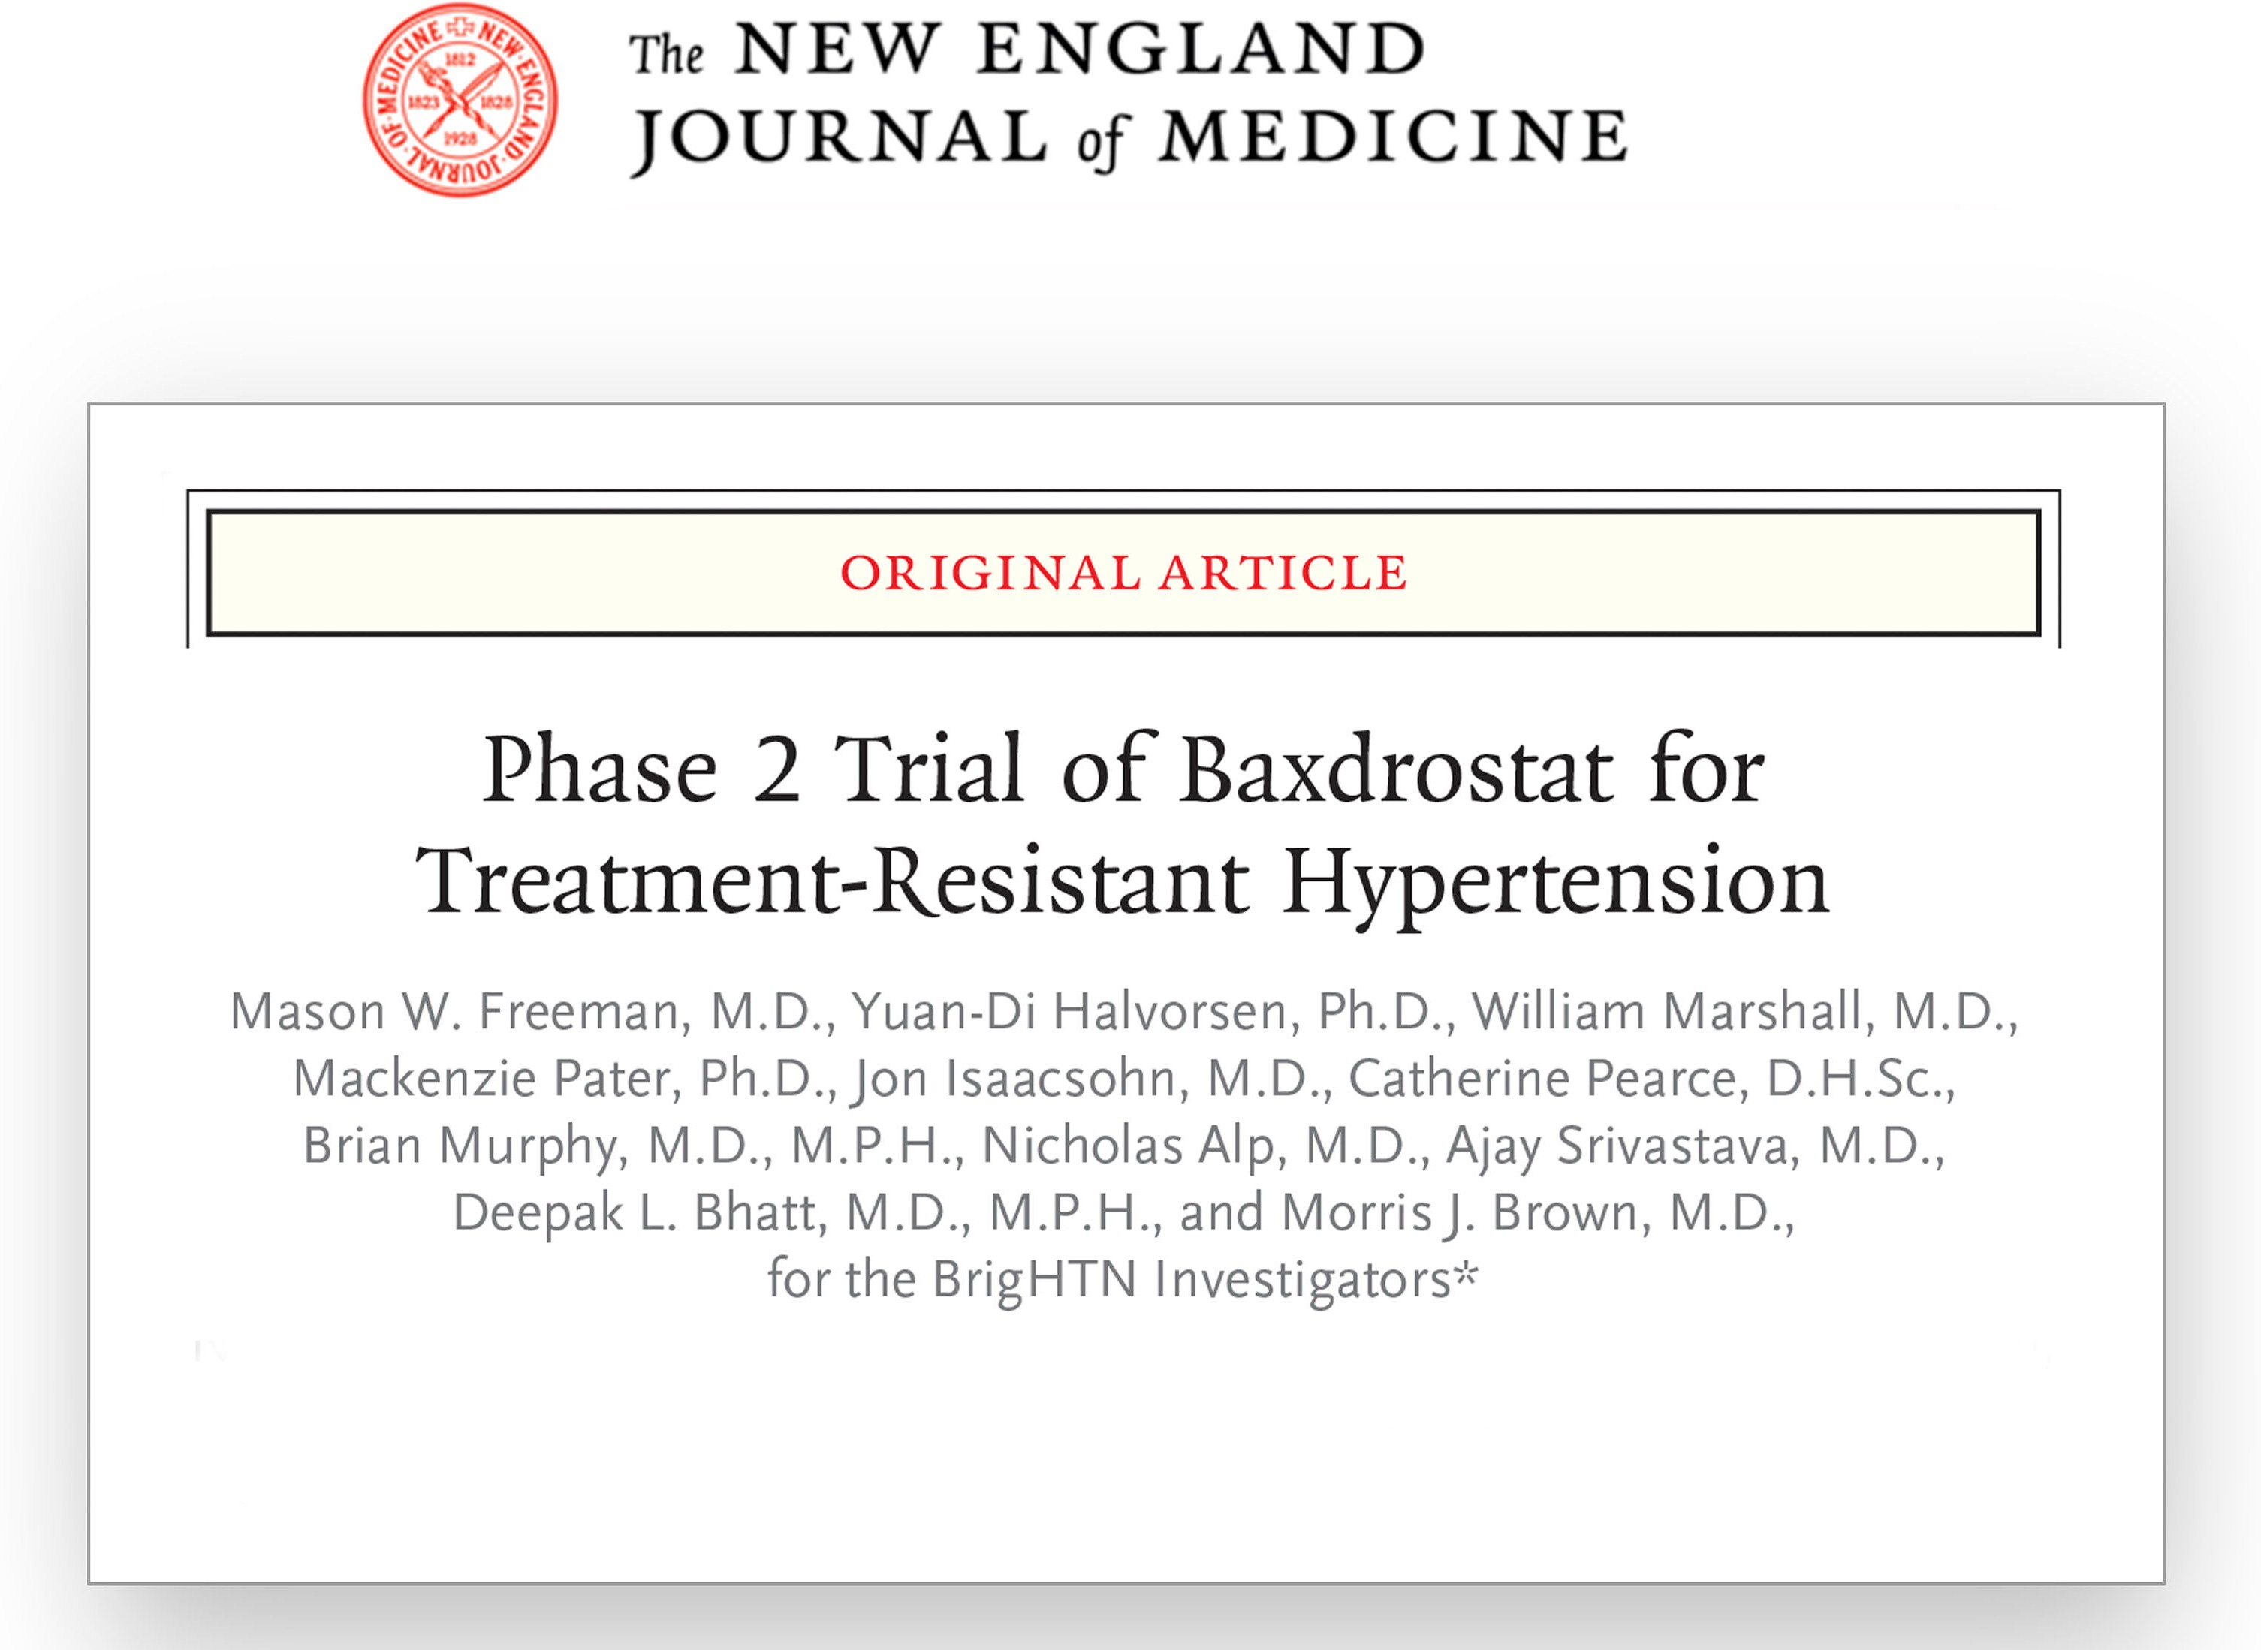
Introduction
Baxdrostat is a highly selective aldosterone synthase inhibitor
Phase 1 studies
Baxdrostat caused a sustained, dose-dependent reduction of plasma aldosterone by >70%
without reducing cortisol
Phase 2 studies
BrigHTN
̶ Baxdrostat reduced systolic blood pressure (SBP)
11 mmHg more than placebo in patients with treatment-resistant hypertension
HALO
̶ The objective of this study was to evaluate the efficacy and safety of baxdrostat in patients with uncontrolled hypertension
Abbreviation: SBP, systolic blood pressure.

Slide 4
Study Design
Randomized, double-blind, placebo-controlled, multi-center phase 2 trial
Key Inclusion Criteria
On a stable regimen of an ACEi or ARB, an ACEi/ARB plus a thiazide diuretic, or an ACEi/ARB plus a calcium channel blocker
Mean seated SBP ≥140 mmHg
Key Exclusion Criteria
Mean seated SBP ≥180 mmHg
Body mass index >50 kg/m²
Estimated glomerular filtration rate <30 mL/min/1.73 m²
Primary Endpoint
Change from baseline in mean seated SBP after 8 weeks of treatment
Secondary Endpoints
Change from baseline in mean seated DBP after 8 weeks of treatment
Change from baseline in 24-hour urine aldosterone and renin and serum aldosterone and renin levels
The percentage of patients achieving a mean seated SBP
<130 mmHg
1:1:1:1 Randomization
 | 2-4-weeks | 8-weeks
Screening | Run-In | QD Double-Blind Treatment
Stable medication regimen | Single-blind run-in to assess adherence | Baxdrostat 0.5 mg (n=64)
 |  | Baxdrostat 1 mg (n=63)
 |  | Baxdrostat 2 mg (n=62)
 |  | Placebo (n=60)
 | Remain on background antihypertensive medication(s)
Week 1
Visit 2
Week 2
Visit 3
Week 4
Visit 4
Week 6
Visit 5
Week 8
Visit 6
Abbreviations: ACEi, angiotensin-converting enzyme inhibitor; ARB,
angiotensin receptor blocker; DBP, diastolic blood pressure; SBP, systolic blood pressure.

Slide 5
Patient Demographics
Well-balanced across all cohorts
Demographic ^{Placebo} | 0.5 mg baxdrostat | 1 mg baxdrostat | 2 mg baxdrostat
(n=64) | (n=63) | (n=62) | (n=60)
Age, mean (SD), y 60.5±10.6 59.9±10.9 61.2±10.7 59.2±11.9
<65 yr, n (%) 40 (62.5) 37 (58.7) 37 (59.7) 41 (68.3)
≥65 yr, n (%) 24 (37.5) 26 (41.3) 25 (40.3) 19 (31.7)
Sex, n (%)
Male 37 (57.8) 28 (44.4) 37 (59.7) 30 (50.0)
Female 27 (42.2) 35 (55.6) 25 (40.3) 30 (50.0)
Race, n (%)
White 46 (71.9) 48 (76.2) 43 (69.4) 44 (73.3)
Black or African American 17 (26.6) 14 (22.2) 15 (24.2) 14 (23.3)
Asian 1 (1.6) 1 (1.6) 2 (3.2) 2 (3.3)
Other 0 (0) 0 (0) 2 (3.2) 0 (0)
Ethnicity, n (%)
Hispanic or Latino | 31 (48.4) | 39 (61.9) | 28 (45.2) | 35 (58.3)
Not Hispanic or Latino | 33 (51.6) | 24 (38.1) | 34 (54.8) | 25 (41.7)

Slide 6
Baseline Characteristics
Well-balanced across all cohorts
Placebo (n=64)
0.5 mg baxdrostat (n=63)
1 mg baxdrostat (n=62)
2 mg baxdrostat (n=60)
Characteristic
BMI, mean (SD), kg/m² 32.0±5.1 32.3±4.5 31.7±4.9 32.5±6.0
Seated SBP, mean (SD), mmHg 147.9±9.3 146.3±8.6 147.0±9.1 146.3±7.8
Seated DBP, mean (SD), mmHg 84.3±9.2 82.7±10.3 82.3±12.0 81.8±9.9
Estimated GFR, mean (SD), mL/min/1.73m² 89.0±19.0 88.2±15.6 88.9±17.3 86.9±21.7
Diabetes on entry, n (%) 29 (45.3) 21 (33.3) 29 (46.8) 24 (40.0)
Background antihypertensive regimen, n (%)
ACEi/ARB 27 (42.2) 27 (42.9) 26 (41.9) 24 (40.0)
ACEi/ARB and calcium channel blocker 15 (23.4) 16 (25.4) 13 (21.0) 13 (21.7)
ACEi/ARB and thiazide diuretic 20 (31.3) 20 (31.7) 22 (35.5) 19 (31.7)
Calcium channel blocker 0 (0) 0 (0) 1 (1.6) 2 (3.3)
Thiazide diuretic 2 (3.1) 0 (0) 0 (0) 2 (3.3)
Abbreviations: ACEi, angiotensin-converting enzyme inhibitor; ARB, angiotensin receptor blocker; BMI, body mass index; DBP, diastolic blood pressure; GFR, glomerular filtration rate; SBP, systolic blood pressure.

Slide 7
HALO Patient Disposition
227 PATIENTS COMPLETED THE HALO TRIAL
631 Assessed for eligibility
249 Randomized
64 Randomized to receive placebo
63 Randomized to receive
0.5 mg baxdrostat
62 Randomized to receive 1 mg baxdrostat
60 Randomized to receive 2 mg baxdrostat
4 Withdrew
1 Lost to follow-up
3 Withdrawal by patient
8 Withdrew
1 Lost to follow-up
3 Withdrawal by patient
3 Physician decision
1 Adverse event
4 Withdrew
6 Withdrew
4 Withdrawal by patient
1 Adverse event
1 Prohibited concomitant medication required
2 Lost to follow-up
2 Withdrawal by patient
60 Included in primary analysis
55 Included in primary analysis
58 Included in primary analysis
54 Included in primary analysis

Slide 8
Primary Endpoint
placebo-corrected change from baseline in mean seated SBP at 8 weeks
The primary endpoint of placebo-corrected systolic blood pressure change was not met at any baxdrostat dose
BAXDROSTAT
1 MG
LSM CHANGE FROM BASELINE (MMHG)
PLACEBO
0.5 MG
2 MG
0.6
-0.5
p=0.83
p=0.79
-3.2
p=0.15
There was a large decrease in SBP noted in the placebo group
-16.6
-17.0
-16.0
-19.8
Placebo Absolute Change Placebo-Corrected Change
Data are LSM ± SE. The significance of changes from baseline comparing the treatment groups to the placebo group was estimated by an MMRM model. Abbreviations: LSM, least squares mean; SBP, systolic blood pressure.

Slide 9
Secondary Endpoint
placebo-corrected change from baseline in mean seated DBP at 8 weeks
There was no significant difference in placebo-corrected diastolic blood pressure change
BAXDROSTAT
1 MG
LSM CHANGE FROM BASELINE (MMHG)
PLACEBO
0.5 MG
2 MG
1.0
0.5
0.1
There was a large decrease in DBP noted in the placebo group
p=0.55
p=0.75
p=0.95
-5.0
-5.4
-5.9
-5.8
Placebo Absolute Change Placebo-Corrected Change
Data are LSM ± SE.
Abbreviations: DBP, diastolic blood pressure; LSM, least squares mean. The significance of changes from baseline comparing the treatment groups to the placebo group was estimated by an MMRM model.

Slide 10
Secondary Endpoint
Percent of patients achieving a seated SBP response <130 mmHg at 8 weeks
BAXDROSTAT
PLACEBO
0.5 MG
1 MG
2 MG
 | Odds ratio 0.97 | Odds ratio 0.85 | Odds ratio 1.88
 | p=0.92 | p=0.65 | p=0.10
 |  |  | 71.7
56.3 | 57.1 | 53.2
PERCENT OF PATIENTS
Abbreviations: SBP, systolic blood pressure.

Slide 11
Changes in Hormone Levels
Baxdrostat decreased serum aldosterone and increased plasma renin activity
1.5
1
0.5
0
-0.5
-1
-1.5
-2
-2.5
-3
-3.5
-4
Serum Aldosterone 10 Plasma Renin Activity
CHANGE IN PLASMA RENIN ACTIVITY (ΜG/L/HR)
8
CHANGE IN ALDOSTERONE (NG/DL)
6
p=0.013
4
p=0.112
2
p=0.763
0.5 mg p=0.002
1 mg p=0.001
2 mg p=0.001
0
-2
-4
0
2
4
TRIAL WEEK
6
8
0
2
4
TRIAL WEEK
6
8
Mean (±SD) baseline serum aldosterone level (ng/dL) | Placebo | 0.5 mg | 1 mg | 2 mg
 | 6.55±5.44 | 6.84±4.43 | 7.03±6.79 | 7.33±5.85
Mean (±SD) baseline plasma renin activity (mg/L/hr) | Placebo | 0.5 mg | 1 mg | 2 mg
 | 5.50±8.69 | 8.00±13.61 | 4.46±6.05 | 5.64±9.47
Placebo 0.5 mg baxdrostat
Data are least squares means ± SE. p-values are for placebo-corrected change from baseline.
1 mg baxdrostat
2 mg baxdrostat

Slide 12
Safety Profile
Baxdrostat was well tolerated
Event No. of patients (%) | Placebo (n=64) | 0.5 mg baxdrostat (n=63) | 1 mg baxdrostat (n=62) | 2 mg baxdrostat (n=60)
Any serious adverse event* | 0 (0) | 0 (0) | 1 (1.6) | 1 (1.7)
Any adverse event | 14 (21.9) | 18 (28.6) | 19 (30.6) | 14 (23.3)
Drug-related | 4 (6.3) | 4 (6.3) | 6 (9.7) | 6 (10.0)
Leading to dosing discontinuation | 1 (1.6) | 1 (1.6) | 2 (3.2) | 2 (3.3)
Leading to study discontinuation | 1 (1.6) | 1 (1.6) | 0 (0) | 1 (1.7)
Leading to death | 0 (0) | 0 (0) | 0 (0) | 1 (1.7)*
Adverse event of special interest** | 1 (1.6) | 1 (1.6) | 1 (1.6) | 4 (6.7)
Hyperkalemia/Potassium increased | 1 (1.6) | 0 (0) | 1 (1.6) | 3 (5.0)
Hyponatremia | 0 (0) | 0 (0) | 0 (0) | 1 (1.7)
Hypotension | 0 (0) | 1 (1.6) | 0 (0) | 0 (0)
* One patient died from an unrelated serious adverse event of acute respiratory failure following a diagnosis of COVID-19 30 days after the last dose of baxdrostat.
** Adverse events of special interest included hypotension, elevated potassium levels > 5.5 mEq/L, and abnormal sodium levels < 130 mEq/L that required clinical intervention. In the 6 patients receiving baxdrostat, all patients recovered from their adverse events of special interest after drug was interrupted (in 4 cases) or withdrawn (in 2 patients).

Slide 13
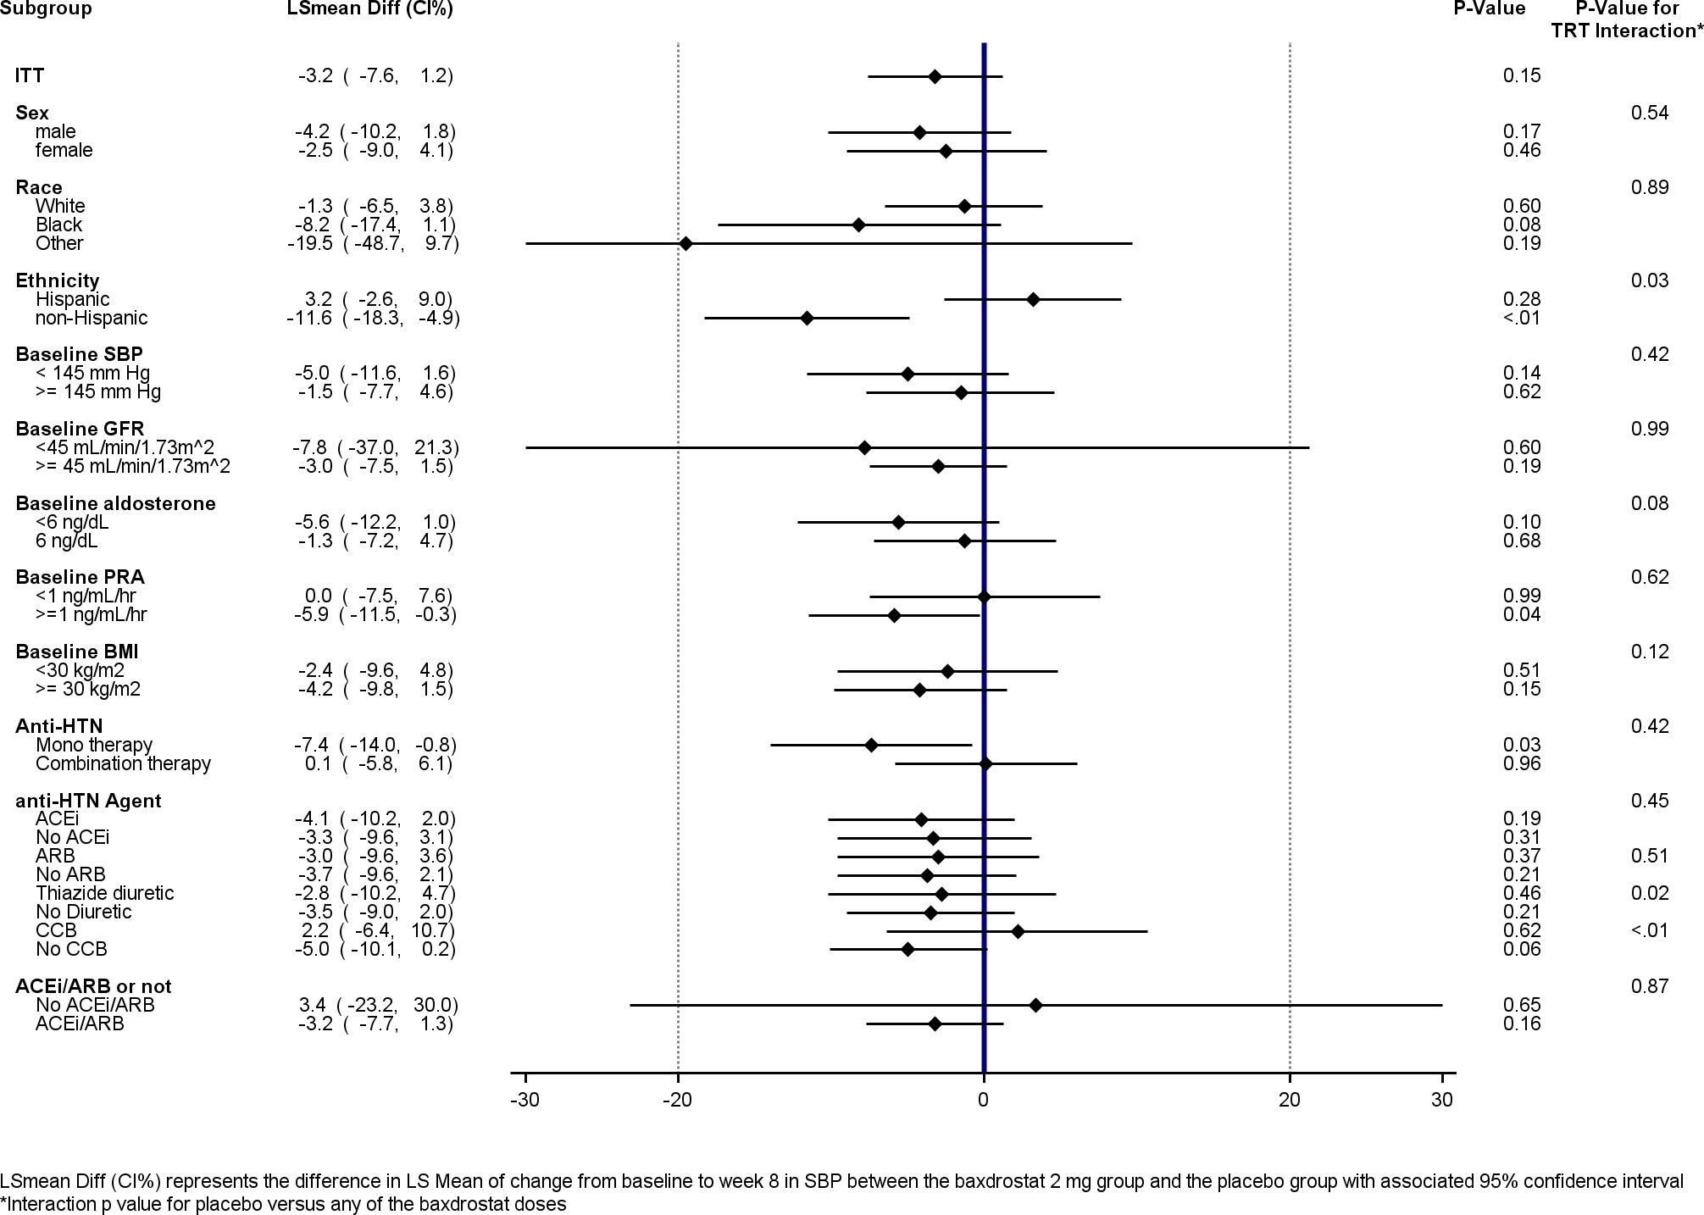
Prespecified Subgroups
non-Hispanic Subgroup P value and Ethnicity Interaction p value both <0.05 (unadjusted)

Slide 14
Post Hoc Subgroup Analysis
In adherent patients, SBP appeared reduced in the 2mg dose group
Baxdrostat levels in plasma at week 8 were measured
20 patients (36% of 54 who completed the 8-week treatment) in the 2 mg arm had baxdrostat levels
<0.2 ng/mL, indicating non-adherence (<1% of expected level)
Non-adherence was discordant to dosing records by pill-count, which showed >95% adherence in all groups
A post hoc analysis of adherent patients (defined as baxdrostat ≥ 0.2 ng/mL at week 8) demonstrated a SBP reduction in the 2 mg group
BAXDROSTAT
1 MG n=47
0.4
LSM CHANGE FROM BASELINE (MMHG)
PLACEBO n=64
0.5 MG n=41
2 MG n=34
-0.2
p=0.94
p=0.88
-7.9
P<0.01
-16.4
-16.6
-16.1
-24.3
Placebo
Absolute Change
Placebo-Corrected Change
Data are LSM ± SE. *The significance of the change from baseline in each group was estimated by a T-test. The significance of changes from baseline comparing the treatment groups to the placebo group is estimated by an MMRM model. Abbreviations: LSM, least squares mean; SBP, systolic blood pressure.

Slide 15
Limitations
HALO was a Phase 2 trial that was modest in size
The primary endpoint was assessed at 8 weeks (BrigHTN was 12 weeks)
Only US patients were enrolled
Adherence in patients, clustered at a few sites, was suboptimal as assessed by measured drug levels less than 1% of expected

Slide 16
Conclusions
HALO did not achieve its primary endpoint of statistically significant change from baseline in mean seated SBP versus placebo
Baxdrostat appeared to have a generally favorable safety profile and was well tolerated
Baxdrostat substantially reduced aldosterone levels and increased plasma renin activity (though less than in BrigHTN, suggesting worse adherence in HALO)
A large placebo effect was observed in this study
In a post hoc analysis, a placebo-corrected reduction in SBP (-7.9 mmHg) was suggested in patients adherent to the highest dose (2 mg) of baxdrostat, which will need to be confirmed in future trials

Slide 17
Thank You!
Deepak L. Bhatt, MD, MPH, FACC, FAHA, FESC, MSCAI
Director, Mount Sinai Heart
Dr. Valentin Fuster Professor of Cardiovascular Medicine Email: dlbhattmd@post.harvard.edu
Webpage: alum.mit.edu/www/dlbhattmd Twitter: @DLBhattMD

