Slide 1
Renal denervation prevents atrial fibrillation
and reduce cardiovascular death in patients with hypertensive heart disease
Marshall Heradien ^{1,3,5}, Felix Mahfoud ², Christeman Greyling ^{1,3}, Jan Andre Saaiman^{3;} Douglas Hettrick ⁴, Warren Stillwaney ¹, Siyolise Sibeko¹, Rene Jansen van Rensburg¹, Dale Peterson¹, Bonke Khwinani³, Althea Goosen^{1,3}, Christian Ukena², Michael Böhm², Paul Brink ^{1,3}
Author affiliations:
Department of Medicine, Stellenbosch University, Tygerberg, South Africa.
Department of Internal Medicine III, Cardiology, Angiology, Intensive Care Medicine; Saarland University Hospital, Homburg/Saar, Germany
SA Endovascular; Netcare Kuilsriver Hospital; Cape Town, South Africa
Renal Denervation Unit; Medtronic; Santa Rosa, United States of America
Hamilton Naki Trust Awardee

Slide 2
Potential conflicts of interest (1)
Speaker's name : Marshall Heradien
☑ I have the following potential conflicts of interest to declare:
Receipt of grants / research support: Medtronic

Slide 3
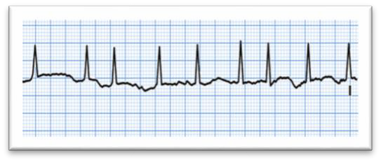

Background: non-valvular AF pathogenesis
Left Atrial dilatation and increased intra atrial pressure
Stretch of pulmonary veins
Atrial fibrillation
Hypertensive heart disease
Increased sympathetic tone
Adrenergic Surges*
*Precipitants:
Acute Hypoxia
Hypoglycemia
Acute myocardial ischemia
Metabolic syndrome Obesity
Diabetes mellitus Obstructive sleep apnea Emotional/work stress Chronic anxiety

Slide 4
Background
Renal denervation (RD) reduces brain-kidney sympathetic cross-talk
RD reduces LV mass, LA size and atrial ectopic burden
Several studies support the hypothesis that RD may have an anti-
arrhythmic effect
Hypothesis: Upstream RD treatment can reduce AF in patients with HTHD

Slide 5
METHODS: Inclusion/Exclusion criteria
Inclusion criteria:
Age ≥55 years
Sinus rhythm at randomisation
≥3 Antihypertensive drugs, including a diuretic
Hypertensive Heart Disease (HTHD) (LVH and/or left atrial dilation on echocardiogram)
Suspected coronary artery disease (previous MI, angina or positive exercise stress test)
Exclusion criteria:
eGFR <45ml/min/1,73m²
Significant valvular heart disease (e.g. mitral regurgitation/stenosis or AS)
Untreated thyroid disease

Slide 6
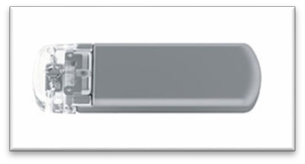
METHODS: Study Design
Randomised sham-controlled trial (NCT 01990911)
Similar design to SYMPLICITY HTN-3
80 patients randomised
42: RD (10 Flex catheter; 32 Spyral catheter)
38: sham-RD
Primary endpoint, first event of subclinical AF lasting at least 6 minutes on implantable loop recorder (ILR)
ILR scanned at six-month intervals

Slide 7
RESULTS: Baseline characteristics
 | RD (N=42) | Sham-RD (N=38)
Age- yr | 65.2 ± 7.0 | 66.0 ± 8.2
Male sex-no. (%) | 29 (69) | 30 (79)
Abdominal girth (cm) | 115 ± 11 | 116 ± 13
Body mass index (kg/m²) | 34.7 ± 6.2 | 33.3 ± 6.3
M e d i c a l h i s t o r y - n o . ( % ) :
Previous atrial fibrillation | 13 (31) | 9 (24)
Obstructive sleep apnea | 24 (57) | 21 (55)
Stroke | 2 (5) | 3 (8)
Transient ischemic attack | 4 (10) | 4 (10)
Peripheral arterial disease | 6 (14) | 3 (9)
Coronary artery disease | 28 (67) | 26 (68)
Previous myocardial infarction | 12 (29) | 9 (24)
Diabetes Type 2 | 25 (60) | 18 (47)
Hyperlipidemia-no. (%) | 36 (86) | 34 (89)
Current smoker-no. (%) | 4 (10) | 6 (16)

Slide 8
RESULTS: Baseline characteristics
 | RD (N=42) | Sham-RD (N=38)
No. of antihypertensive medications | 3.6±0.9 | 3.9±1.1
T y p e o f a n t i h y p e r t e n s i v e m e d i c a t i o n - n o . ( % ) :
ACE-inhibitor | 27 (64) | 24 (63)
Angiotensin-receptor blocker | 15 (36) | 14 (37)
Aldosterone antagonist (AA)/Spironolactone | 10 (24) | 11 (29)
Direct acting vasodilator (alpha-blocker) | 5 (12) | 10 (26)
Beta-blocker | 34 (81) | 29 (76)
Calcium channel blocker | 19 (45) | 23 (61)
Diuretic, other than AA | 39 (93) | 36 (95)
T r a n s t h o r a c i c e c h o c a r d i o g r a m :
Left ventricular ejection fraction | 63.4±8.0% | 64.7±8.9%
Left atrial dimension (mm) | 46.0±4.6 | 46.0±4.4
E/e’ ratio | 11.5±4.2 | 12.9±6.8
Left ventricular mass (grams)* | 247.9±65.7 | 278.3±71.2

Slide 9
RESULTS: Procedural statistics
 | RD (n=42) | Sham-RD (n=38)
Coronary stents (patients) | 3 | 3
Fluoroscopy time (minutes) | 25:42 | 7:57
Contrast used (ml) | 206 | 135
Renal artery ablations/patient | 24,4 | 0

Slide 10
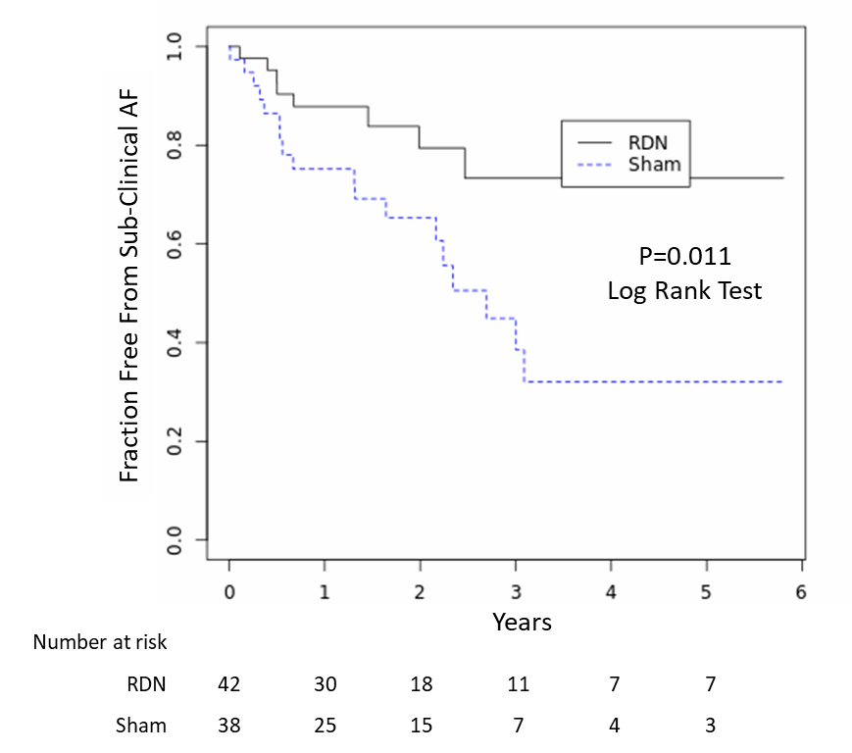
RESULTS: Primary Endpoint: Subclinical AF*
Cumulative incidence of primary endpoint after average 3 years follow up:
RD: 8 of 42 (19%)
Sham RD: 18 of 38 (47%)
RR: 0,4 (95% CI: 0,22-0,73)
RRR= 60%
NNT: 3,5 to prevent one event
*identified via ILR

Slide 11
RESULTS: Subclinical AF characteristics
 | RD (n=42) | Sham RD (n=38) | p-value
Age at presentation (yr.) | 66.0±5.4 | 70.3±9.2 | 0.23
Median ventricular rate of first subclinical AF episode (bpm) | 97.3±38.5 | 123.5±56.6 | 0.25
Fast AF (Ventricular rate ≥100bpm ) -no. (%) | 2 (5) | 12 (32) | 0.002**

Slide 12
RESULTS: Office blood pressure at 6 months follow up
Delta SBP difference:
-5,2mmHg; p=0,33
155
0,00
-2,00
-4,00
-6,00
-8,00
-10,00
-12,00
-14,00
Systolic blood pressure (mmHg)
delta change in blood pressure at
six months
150
145
140
135
-7,90
130
RD baseline (n=42)
RD 6MFU (n=42)
sham-RD baseline (n=38)
sham RD 6MFU (n=35)
-13,10
P=0,003*
P=0,06

Slide 13
RESULTS: Secondary Endpoint: CV death
Cardiovascular Death
18
P=0.04 RR: 0,15 (0,03-0,84) RRR: 85% NNT: 7,4
Proportion (%)
Follow up duration (median [IQR])
RDN: 2.2 years [0.5 to 5.8]
Sham: 2.0 years [0.7 to 5.8]
12
6
0
RDN (1/42)
Sham (6/38)

Slide 14
Study Limitations
Single center trial
Drug adherence not tested
Hawthorne effect
Small sample to comment on mortality benefits
Catheter type may have confounded blood pressure results

Slide 15
Conclusions
Single centre, RCT of patients with HTHD, upstream-treatment with RD reduced:
subclinical and fast AF
cardiovascular death in patients with HTHD
Observed effects are likely mediated by reducing sympathetic tone
Superiority BP lowering criteria (>5mmHg) were met
Office SBP reduction did not differ significantly between groups at 6MFU

Slide 16
m By and Foe you
PCRonline.com

