Slide 1


First-in-man Experience of the Transcatheter FORMA Repair System for Treating Severe Tricuspid Regurgitation
Francisco Campelo-Parada, MD

Slide 2
Disclosure Statement of Financial Interest
I, Francisco Campelo-Parada, DO NOT have a financial interest/arrangement or affiliation with one or more organizations that could be perceived as a real or apparent conflict of interest in the context of the subject of this presentation.

Slide 3
FORMA centers
Quebec Heart & Lung Institute, Quebec City
  Josep Rodés-Cabau, Francisco Campelo-Parada, François Philippon, Elisabeth Bédard, Omar Abdul- Jawad, María del Trigo
St.Paul’s Hospital, Vancouver
  John Webb, Gidon Perlman, Chris Thompson, Jonathon
Leipsic, Philipp Blanke, Danny Dvir, JianYe
Bern University Hospital, Bern, Swizterland
  Stephan Windecker, Fabien Praz, David Reineke, Thierry
Carrel, Aris Moschovitis

Slide 4
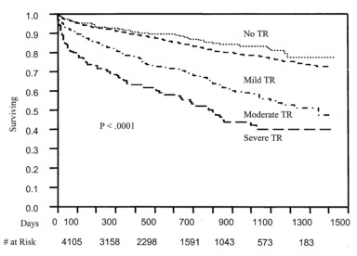
Tricuspid regurgitation
Moderate to severe TR is an under-treated condition
Degree of TR is associated with worse survival
(independent of LVEF or PAP)
Stuge and Liddicoat. J Thorac Cardiovasc Surg. 2006;132:1258-61 Nath et al. J Am Coll Cardiol. 2004;43:405–9

Slide 5
Surgical TR repair outcomes
Isolated tricuspid surgery is associated with a high in-hospital mortality, especially in patients with prior aortic or mitral surgery.
Recently, novel transcatheter treatment options were developed for treating patients with symptomatic severe TR and prohibitive surgical risk.
Kim et al. Circulation. 2009;120:1672-78

Slide 6
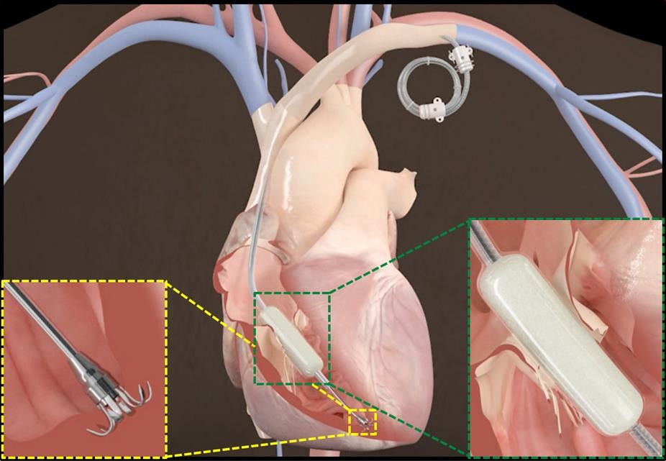
Edwards FORMA Repair System
Designed to improve leaflet coaptation
in functional TR

Slide 7
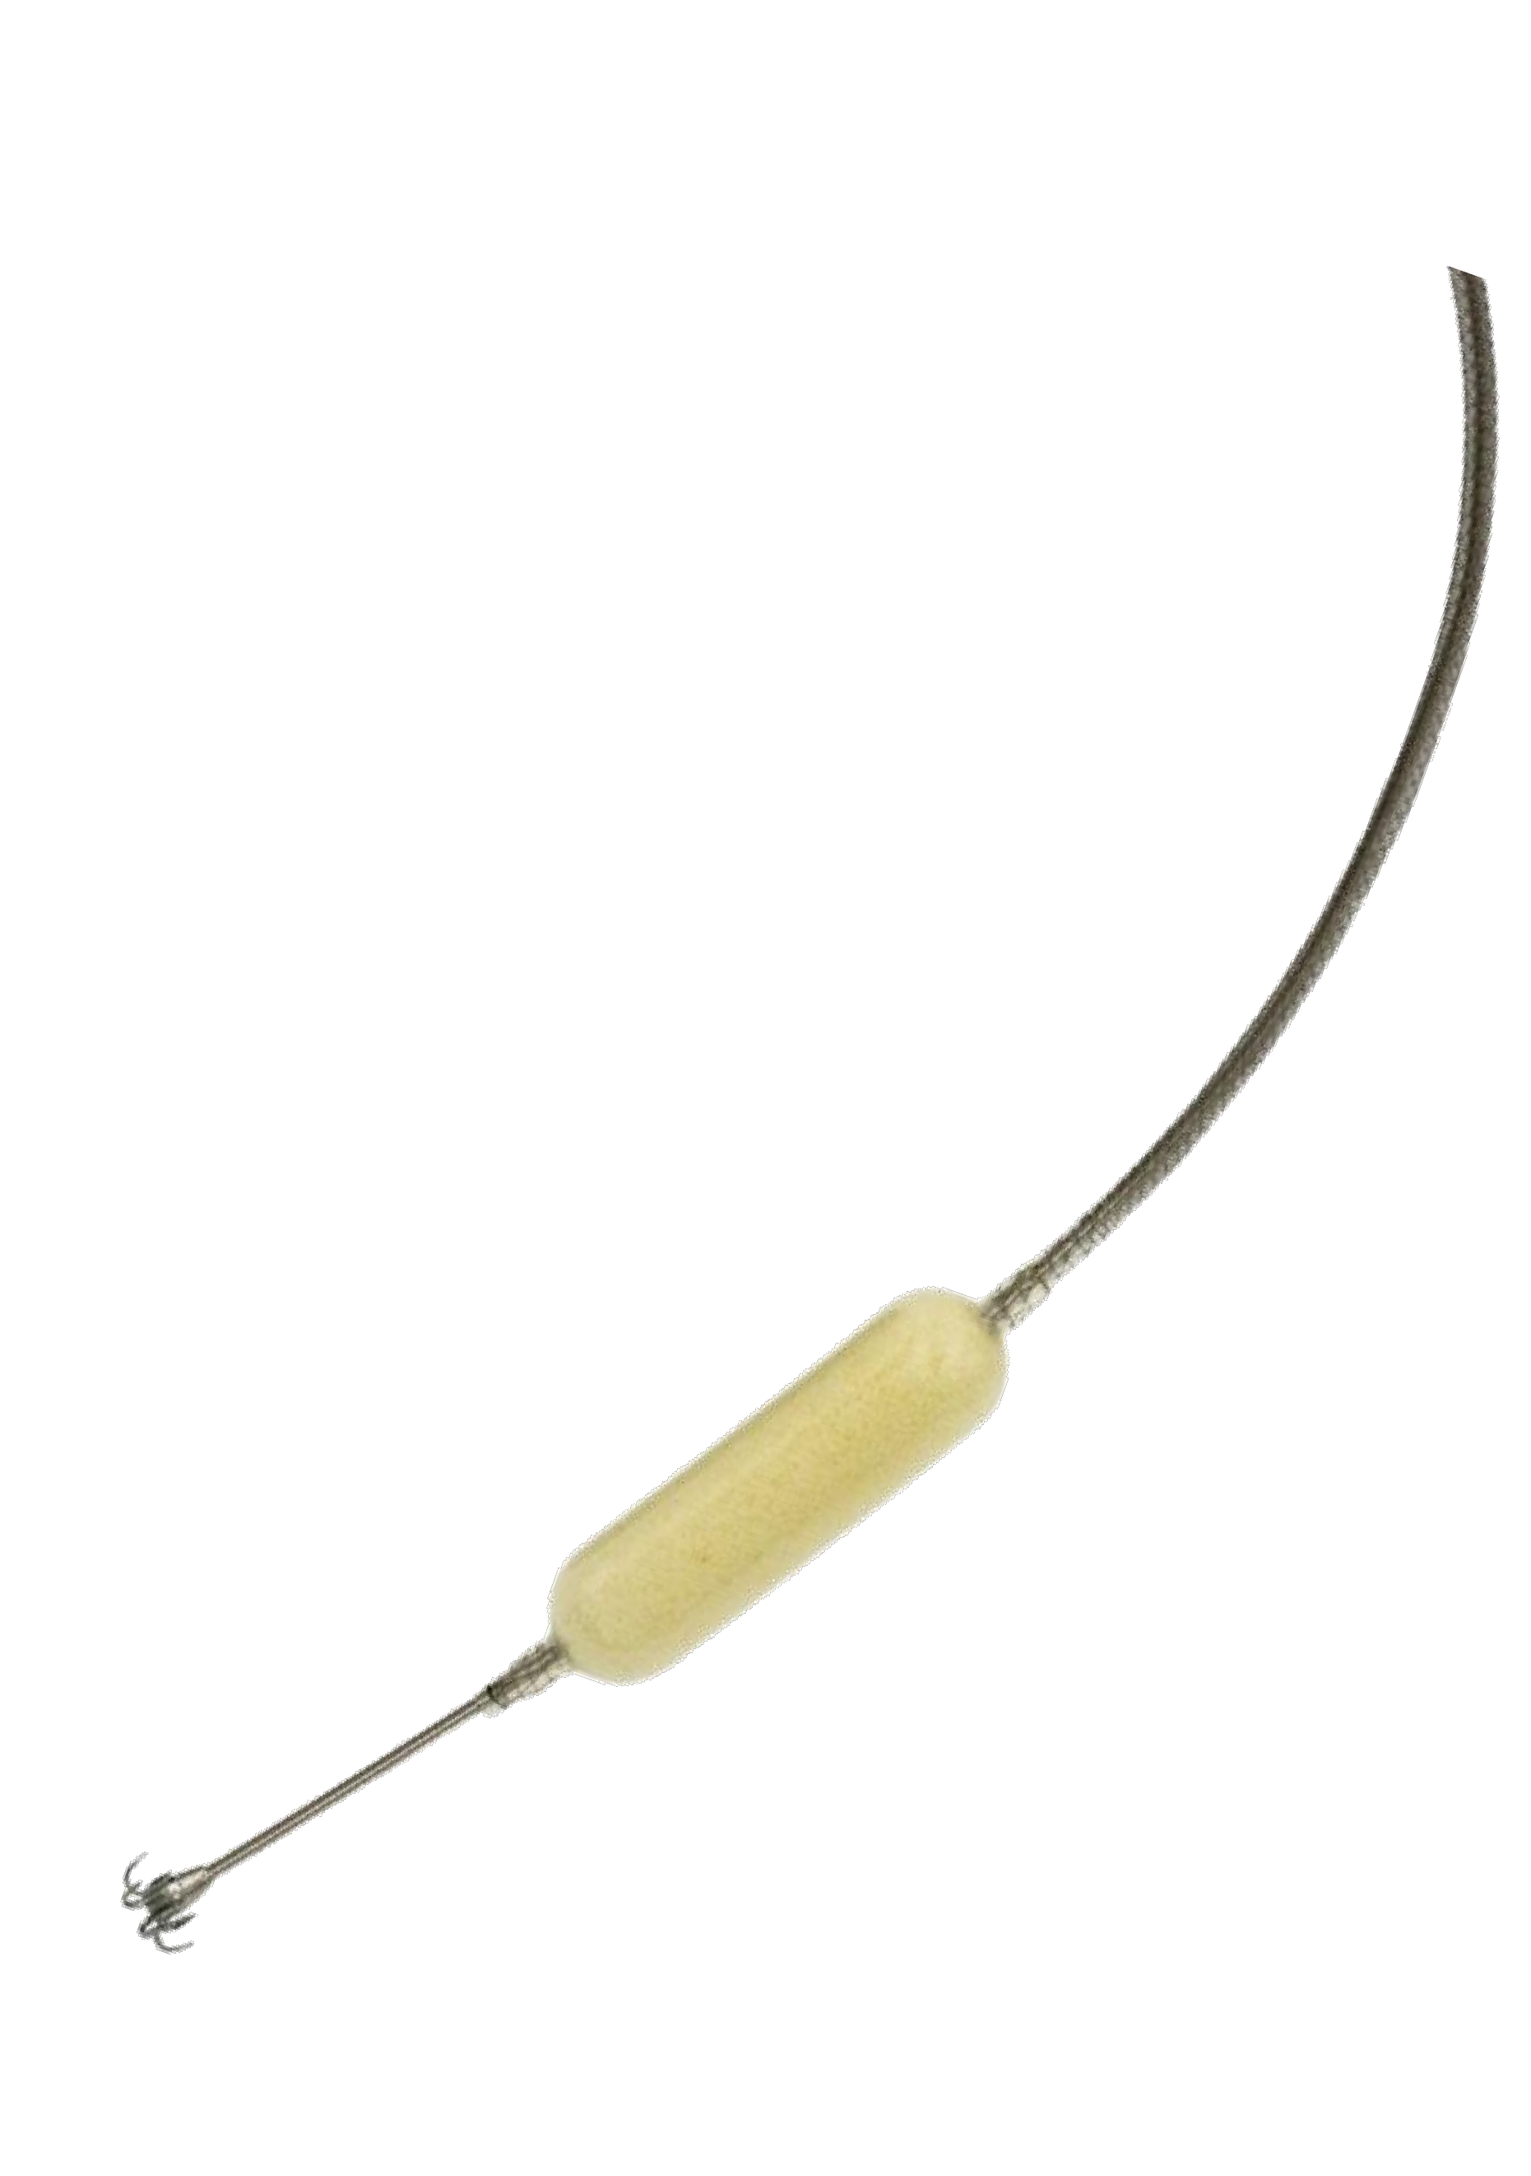
FORMA Repair System
Designed to restore leaflet coaptation
FORMA System consists of:
Spacer
  Positioned into the regurgitant orifice
  Platform for native leaflet coaptation
Rail
  Tracks spacer into position
  Distally and proximally anchored

Slide 8
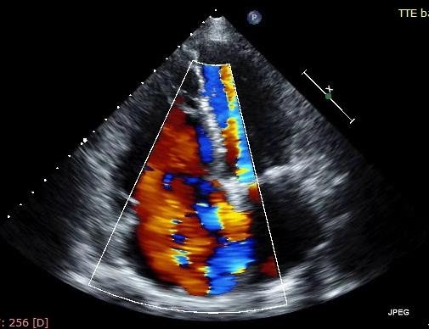
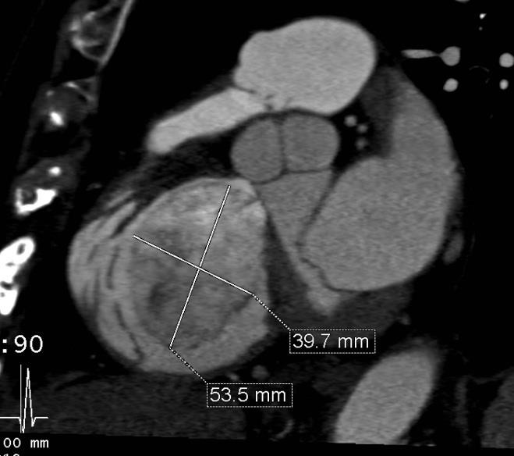
Screening
Severe symptomatic functional TR
No pacemaker lead or prior tricuspid surgery
Heart Team:
Very high/prohibitive surgical risk
Pre-procedural work-up: Clinical evaluation, TTE, Cardiac CT
Health Canada Special Access program

Slide 9
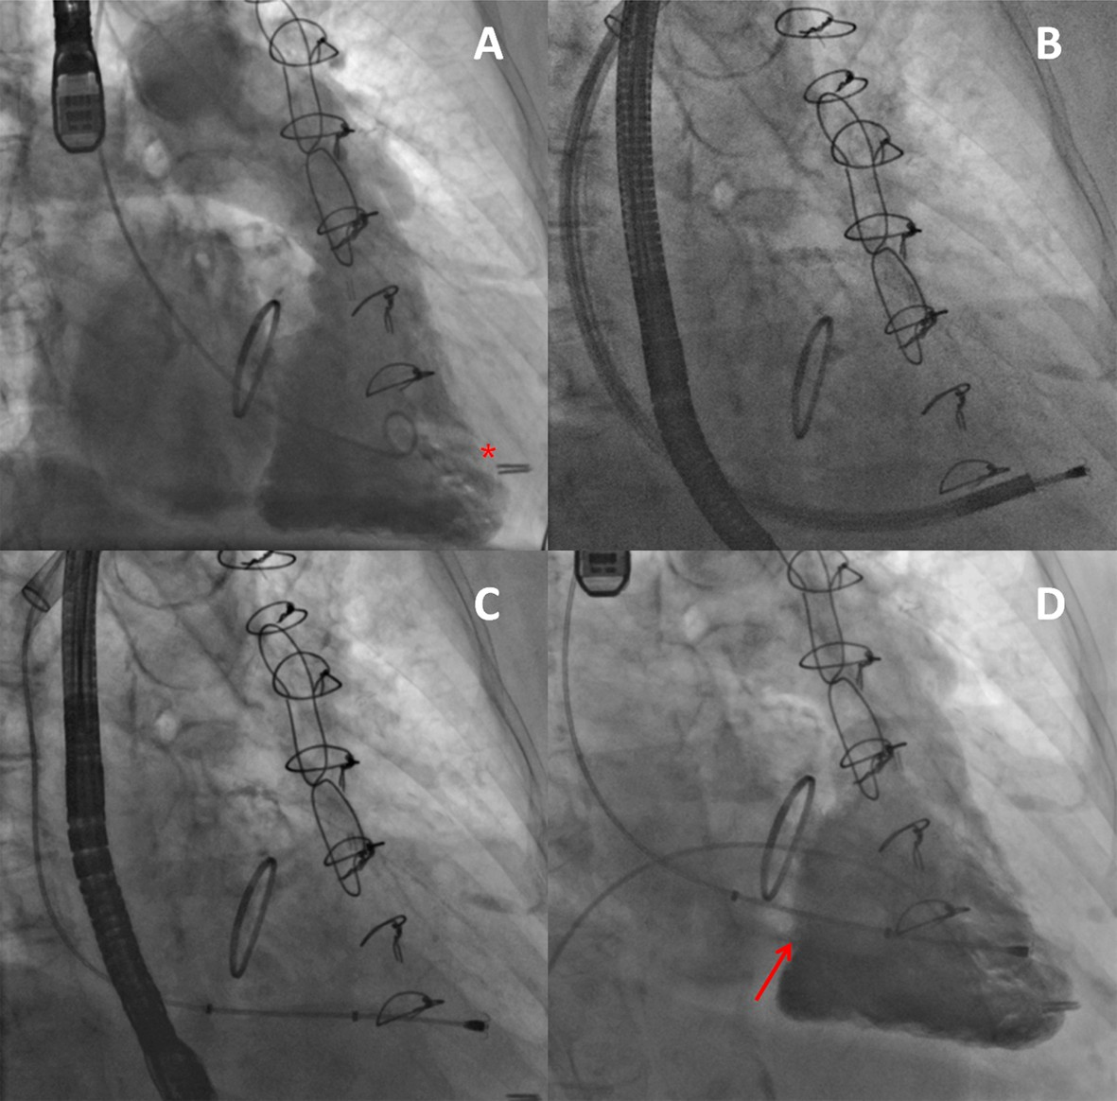
Procedural Steps

Slide 10
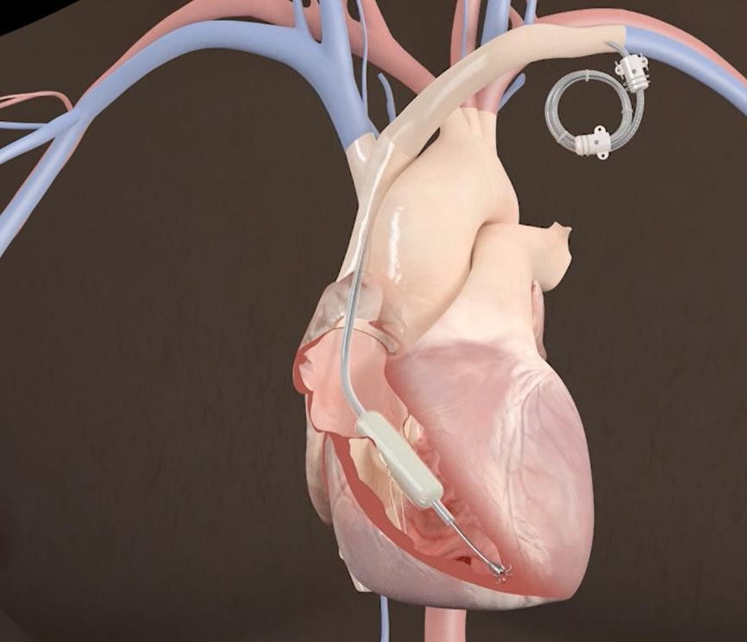
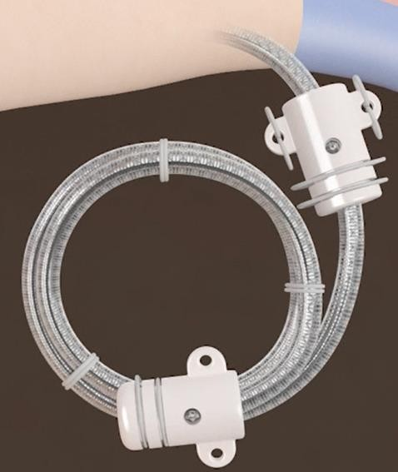
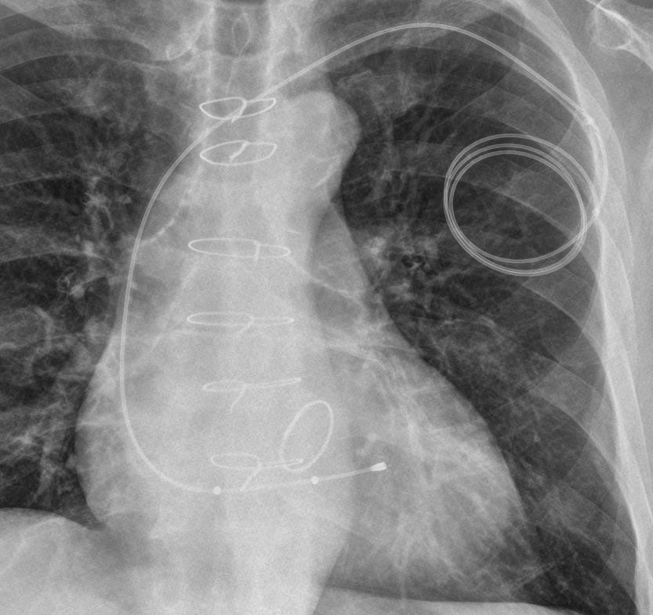
Procedural Steps: Locking System

Slide 11


Baseline Characteristics
 |  | N=7
Age (years) |  | 76 ±13
Sex (male) |  | 4 (57)
NYHA Class Š III |  | 6 (86)
Coronary artery disease |  | 6 (86)
Previous CABG |  | 5 (71)
Previous valve surgery |  | 4 (57)
Mitral |  | 2 (29)
Aortic |  | 2 (29)
COPD |  | 1 (14)
Permanent atrial fibrillation |  | 5 (71)
Pulmonary Hypertension |  | 5 (71)
Clearance of creatinine <60 mL/min | (eGFR) | 6 (86)
Hemodialysis Log. EuroSCORE (%) |  | 1 (14) 25.7±17.4
Daily Furosemide dose (mg) |  | 80 ±61
6 minute walk test (meters) |  | 297 ± 66
Kansas City Cardiomyopathy Questionnaire
Baseline Echocardiogram
LVEF (%)
PAPs (mmHg)
MR grade (Mild or Moderate)
Severe TR grade Vena contracta (mm) RV diameter (mm) TAPSE (mm)
59.6 ± 14.1
56 ± 5
69.7 ± 6.0
7 (100)
7 (100)
15.50± 5.14
47± 7
16.5± 4.2
Values are expressed as n (%) or mean (±SD)

Slide 12



Procedural results
N=7
Successful device implantation Conversion to open heart surgery Device retrieval
Cardiac tamponade
Acces site complication (hematoma)
7 (100)
0 (0)
1 (14)
0 (0)
1 (14)
Procedure time (skin-to-skin, min) Procedure time (device implant, min)
122 ± 34
71±17
Venous closure
Suture Percutaneous
5 (71)
2 (29)
Contrast volume (mL)
70.5± 31.6
Intraprocedural TEE TR reduction Š 1 grade
7 (100)
Values are expressed as n (%) or mean (±SD)

Slide 13
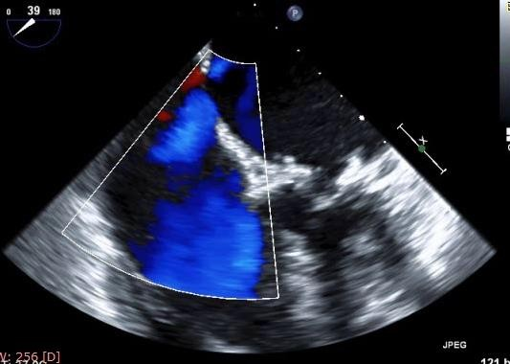
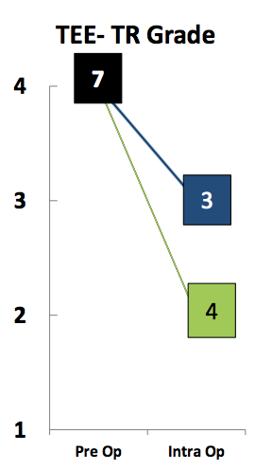
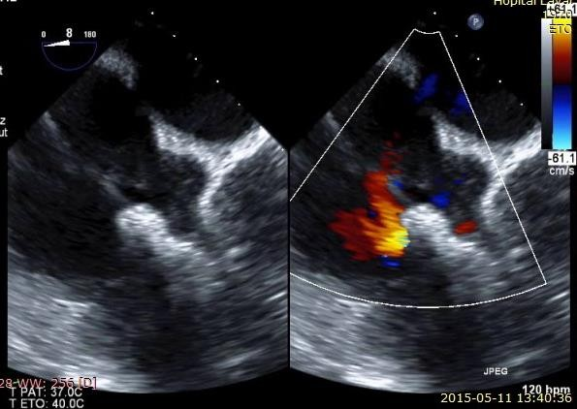
Intra-procedural TEE Assessment

Slide 14
Hospital outcomes
Death
Renal failure
Conduction disturbance/Arrhythmia
Bleeding (VARC-2 criteria) Minor
Major
0 (0)
1 (14)
2 (29)
1 (14)
0 (0)
Vascular or access site complication
Minor (hematoma)
Major
1 (14)
0 (0)
Pneumonia Pulmonary embolism
Hospitalization length (days), median (IQR)
1 (14)
0 (0)
4 (3-6)
Values are expressed as n (%) or mean (±SD)

Slide 15
30-day outcomes
Death
NYHA Class
II
ŠIII
0 (0)
7 (100)
0 (0)
Peripheral edema reduction Furosemide dose reduction Access site complication
6 minute walk test (meters)
Kansas City Cardiomyopathy Questionnaire Re-Hospitalization
7 (100)
2 (29)
0 (0)
326± 74
86.2± 5.4
0 (0)
Echocardiography data
LVEF (%)
TR grade
Mild Moderate Severe
TAPSE (mm)
Trans triscupid gradient (mmHg) RV diameter (mm)
57 ± 4
0 (0)
7 (100)
0 (0)
18.5± 5.3
1.2 ± 0.3
46.5 ± 8
Values are expressed as n (%) or mean (±SD)

Slide 16
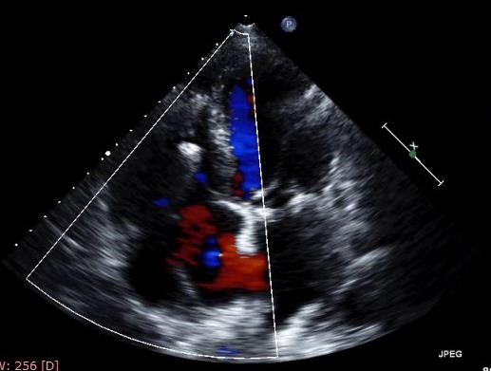
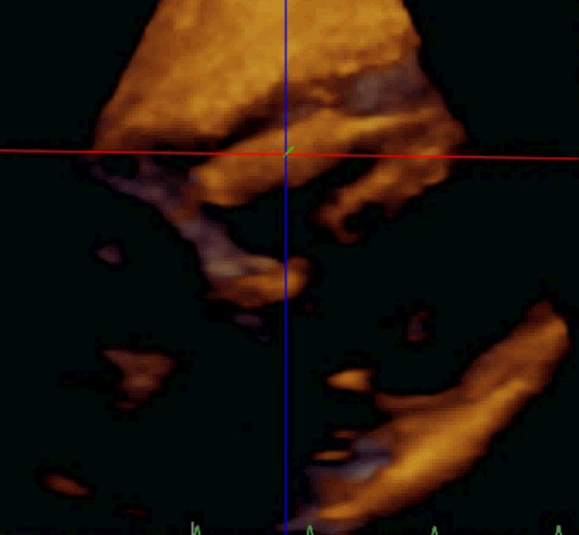
Pre and Post-procedural TTE
Pre-procedure
Post-procedure

Slide 17
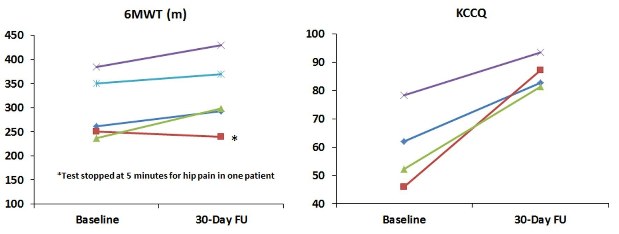
Exercise capacity and quality of life
before and after device implantation
6MWT: Six minute walk test
KCCQ: Kansas City Cardiomyopathy Questionnaire

Slide 19


Total FORMA System Experience
Centers Compassionate Case Performed
Initial Experience
Reported in JACC
Additional
Implants
Quebec Vancouver
4
3
2
2
Canada
Bern
2
EU
13 total compassionate cases performed
All alive
1 patient has completed 6 month follow-up visit

Slide 20

FIH Acute results (Present day)
Procedural outcomes Successful device implantation Conversion to open heart surgery Cardiac tamponade
Arrhythmia, ventricular Device retrieval Anchor dislocation Venous closure
Suture Percutaneous
Intraprocedural TEE TR reduction Š 1 grade
12 (92)
0 (0)
0 (0)
1 (8)
1 (8)
1 (8)
9 (69)
4 (31)
13 (100)
Hospitalization outcomes
Death
Renal failure Conduction disturbance
New Permanent Pacemakers
Access site complication
Minor Major
Pulmonary embolism Pneumonia
Hospitalization length (days),median (range)
0 (0)
1 (8)
3 (23)
0 (0)
3 (23)
0 (0)
0 (0)
1 (8)
4 (1-20)
Values are expressed as n (%) or mean (±SD)

Slide 21
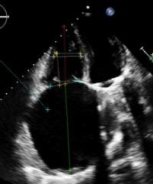
Patient Case Learning
1st experience with enlarged RA (10 cm) and RV (9 cm)
Unique introducer sheath positioning
  Resulting in challenging anchor delivery
  Arrhythmias induced dependent on system positioning
Acute anchor dislodgement; Spacer out of the
valve plane
No clinical sequelae; patient alive and stable

Slide 22
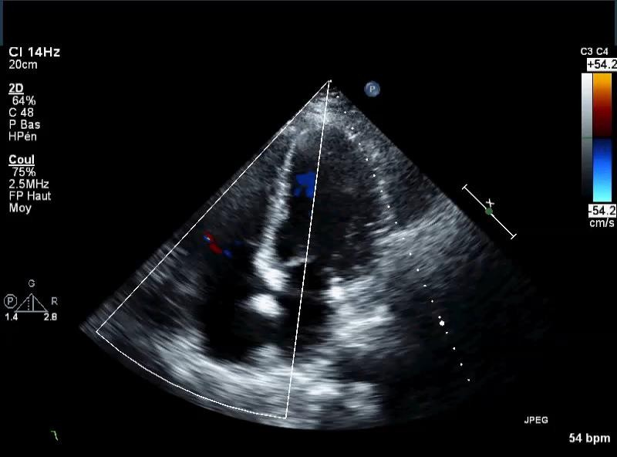
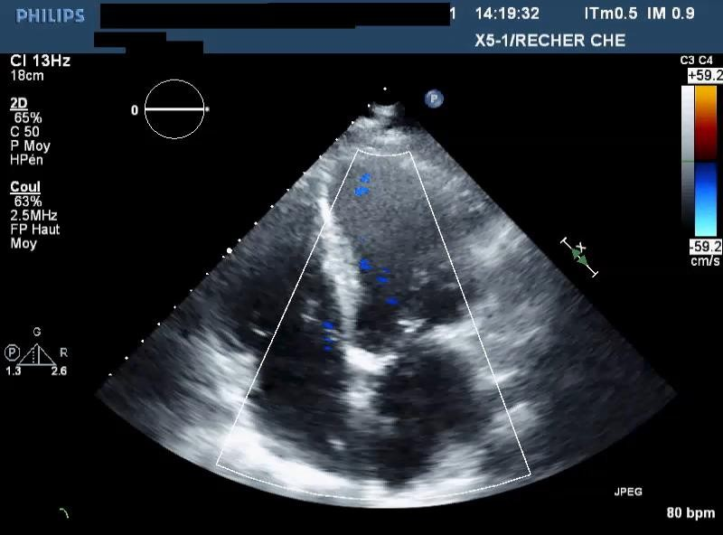
First Patient Now at 6 Months
Pre FORMA Implant
6 Month Follow Up
TR reduction from Severe to Moderate
NYHA Class reduced from III to II
47.5% improvement in 6 MWT
Edema reduced

Slide 23
FORMA Repair System
Conclusions
Transcatheter reduction of functional TR appears safe and feasible with the FORMA Repair System.
TR reduction was observed in all successfully implanted patients, along with improvements in peripheral edema and functional status.
Longer-term follow up and larger studies are
required to confirm these preliminary results.

Slide 24
Next Step:
Continue early clinical experience
Clinical study planning underway:
  Early Feasibility Study, US
  Multi-center EU/Canada Study

