Slide 1
Ischemia and Viability Imaging in Heart Failure: The Alternative Imaging Modalities in Ischemic Heart Failure Trial (AIMI-HF)
IMAGE-HF Project 1A
LM Mielniczuk, MD, FRCPC, FCCS E O’Meara, MD, FRCPC, C Wiefels,MD, MSc, L Chen, MSc, L Garrard, RN, BScN, J White, MD, FRCP(C), RA deKemp, BASc, MSc, PhD, PEng, PPhys, MF Di Carli, MD,FACC, E Larose, DVM, MD, FRCPC, FAHA, D. I Paterson, MD, FRCPC, J Ezekowitz, MB, BCH, MSc, FRCPC, FACC, FAHA, FESC, RM Kandolin, MD, G Wright, M.A.Sc., PhD, R Campisi, MD, FASNC, MK Laine, MD Ph.D., EMBA, K
Connelly, MBBS PhD FSCMR FCCS, M Rajda, MD, FRCPC, JV Vitola, MD, PhD, MASNC, S Lepage, MD, FRCPC, CSPQ, J Hartikainen, MD, B Chow
MD, FRCPC, FACC, FASNC, FSCCT, J Knuuti, MD, PhD GA Wells, MSc, PhD RSB Beanlands MD, FRCPC, FACC, FAHA, MASNC
and the IMAGE HF Investigators
Late Breaking Trials: Clinical Research I American College of Cardiology
March 4, 2023
Lisa M Mielniczuk MD FRCPC FCCS
Professor of Medicine, University of Ottawa Heart Institute
Director, Advanced Heart Disease Program
Vice Chair, Quality and Clinical Care, Department of Medicine, University of Ottawa
Tier 1 Research Chair, University of Ottawa

Slide 2
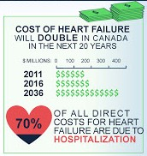
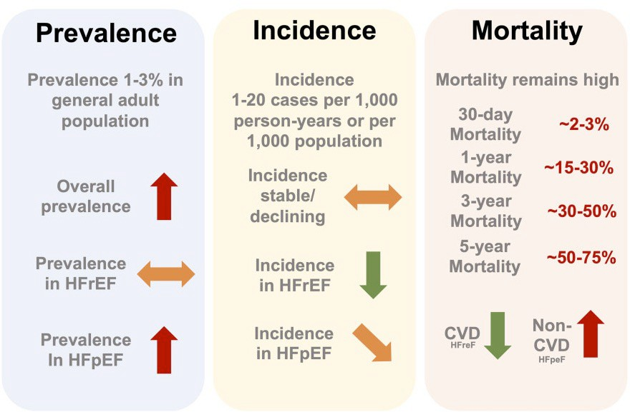
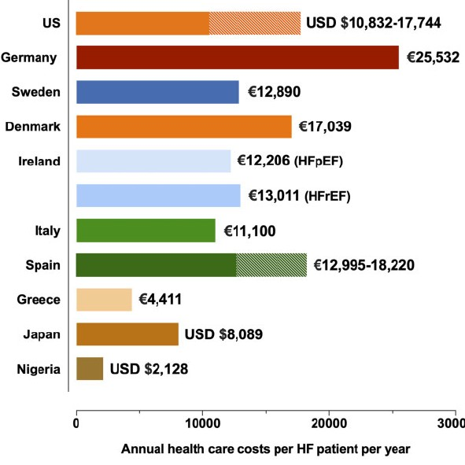
The Global Burden of Heart Failure
Savarese G et al. ESC CV Res 2022, 118. 3272-87.

Slide 3
The Role of Revascularization and Cardiac Imaging in Ischemic Heart Failure
Advances in drug therapy and devices
Advances in options for intervention
Differences in cardiac imaging modalities
STICH Viability Study
Original STICH Study
REVIVED-BCIS 2
STICH Extension Study
PARR 2
ISCHEMIA sub study of HF patients
Panza JA, N Engl J Med. 2019;381(8):739–48; Bonow RO, N Engl J Med. 2011;364(17):1617–25. Divaka Perera, N Engl J Med. 2022;387:1352–60. Velazquez EJ, N Engl J Med. 2016;374(16):1511–20. Petrie MC, Circulation. 2016;134(18):1314-1324.
Lopes RD, Circulation. 2020;142(18):1725–35. Beanlands RSB J Am Coll Cardiol. 2007;50(20):2002–12.

Slide 4
IMAGE–HF Program
IMAGE–HF Program
IMAGE-1A
Alternative Imaging Modalities in Ischemia and Viability Imaging in HF
IMAGE-1B
Routine vs. Selective CMR Imaging for patients with NICM
IMAGE-1C
Cardiac CT vs. conventional angiography for CAD detection in ischemic heart failure
Paterson DI etal., Circulation 2020;141:818-27; Chow BJW et al. Eur Heart J CV Imaging. 2021;22:1083-90

Slide 5
Overall Study Objectives and Design
To Determine the impact of advanced imaging modalities with PET or CMR compared to SPECT on a CV composite in patients who required further definition of ischemia or viability
What is the burden of ischemia?
OR
Is there evidence of myocardial viability?
Randomized Arm
Registry Arm

Slide 6
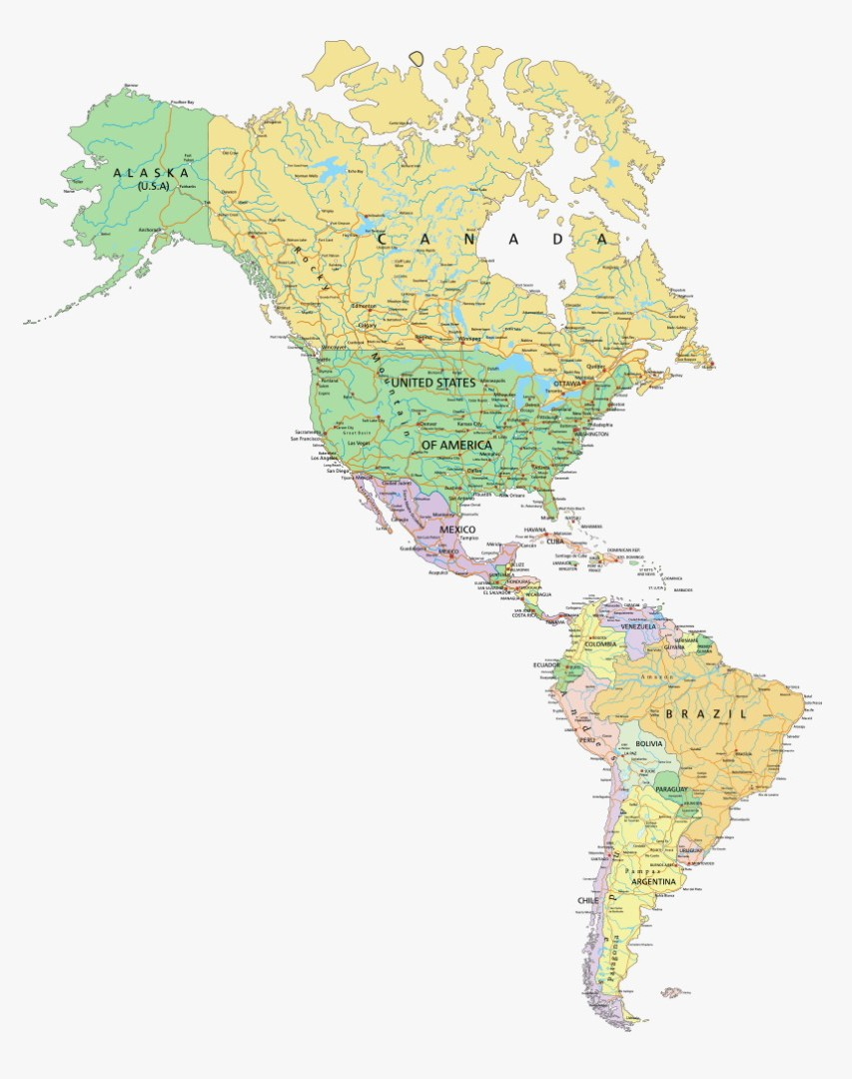
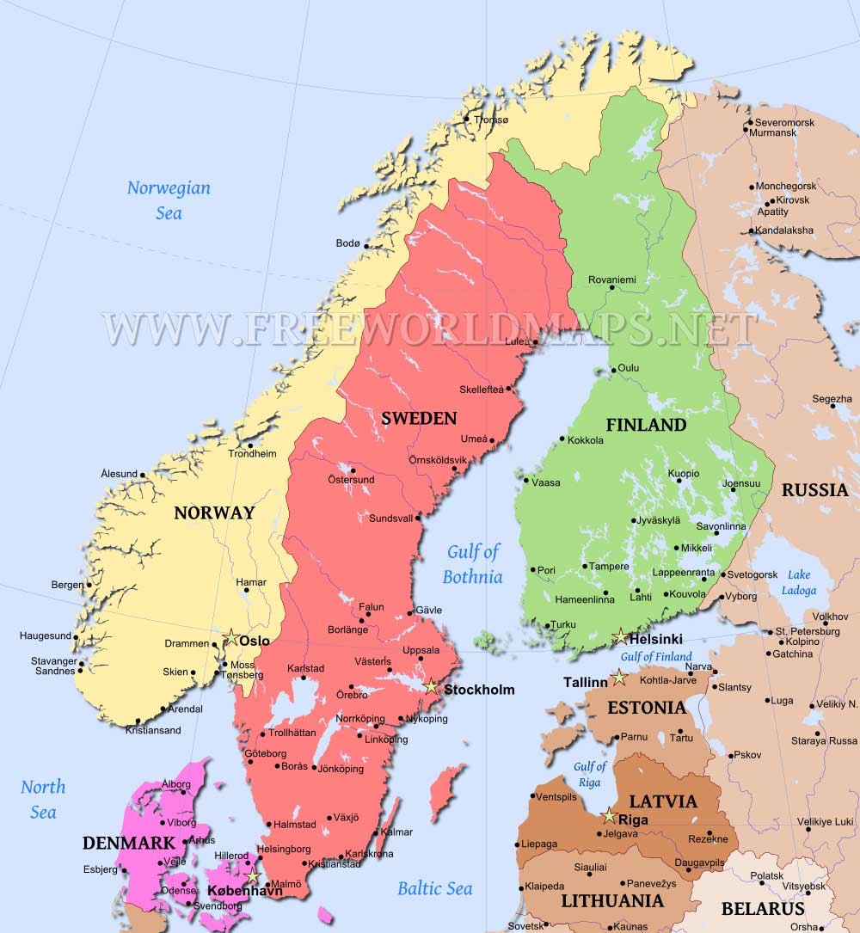
Participating Sites
15 Participating Sites Canada
Ottawa, Montreal, Quebec City, Calgary, Toronto (2 sites), Edmonton, Sherbrooke, Halifax
Finland
Turku, Helsinki, Kuopio
United States
Boston
South America
Curitiba Buenos Aires

Slide 7
Patient Inclusion/Exclusion Criteria
Age > 18 years with known or highly suspect CAD documented by coronary angiography, previous MI or moderate ischemia or scar
Exclusion Criteria
Severe medical conditions that would preclude revascularization
ACS< 4 weeks from enrolment
Emergency surgery or concomitant valve surgery indicated
NYHA functional class II-IV
+ EF<45%
NYHA functional class I
+ EF<30%

Slide 8
Clinical Outcome Measures
Primary Outcome:
Time to cardiac composite event
Cardiac death
MI
Resuscitated cardiac arrest
Cardiac hospitalization (worsening HF, ACS, arrhythmia)
Secondary Outcomes:
Each individual component
Event rates of composite and each component
All cause death
Effect of imaging strategy on incidence of revascularization
Interaction of imaging and revascularization on primary outcome and CV death
Outcomes in ischemia and viability cohorts

Slide 9
Methods
Target sample size: 1511 patient
Propensity score matching used to adjust for differences:
All baseline characteristics
Location of study site
Status of randomization vs. registry
Competing risk analysis for primary outcome
Cumulative incidence function used to estimate probability of endpoints
Intention to treat analysis

Slide 10
Study Enrollment
Total enrolled (n=1390)
Median follow up:
24.1 months (IQR 11.4, 26.8)
Randomized
Registry
Total eligible (n=1382)
Excluded (n=8)*
N= 271
N= 1110
Ischemia as Primary Clinical Question
(n= 672)
Viability as Primary Clinical Question
(n = 709)
(n=1381)
Excluded n=1 ^{ϕ}
Advanced Imaging (n = 400)
SPECT imaging (n=272)
Advanced Imaging (n=669)
SPECT Imaging (n = 40)
CMR (n=19)
PET (n=381)
CMR (n=306 )
PET (n=363)
* Inappropriate randomizations, patients
did not meet inclusion/exclusion criteria ^{ϕ} Administrative withdrawal – patient refused to continue post consent, with limited data

Slide 11
Baseline Characteristics
Variables | Advanced n=1069 | SPECT n=312 | Unadjusted Standard Difference | Adjusted Standard Difference
Age | 66.4±9.8 | 68.0±10.2 | 0.167 | 0.013
Male | 914 (85.5%) | 271 (86.9%) | 0.045 | 0.040
Hx-CAD | 1051 (98.3%) | 307 (98.4%) | 0.004 | 0.017
CHF | 962 (90.0%) | 278 (89.0%) | 0.035 | 0.041
pre-MI | 677 (63.3%) | 208 (66.7%) | 0.067 | 0.041
pre-PCI | 388 (36.2%) | 145 (46.5%) | 0.216 | 0.119
pre-CABG | 217 (20.3%) | 119 (38.0%) | 0.394 | 0.129
Atrial Arrhy | 271 (25.4%) | 112 (35.9%) | 0.215 | 0.064
Ventricular Arrhy | 124 (11.6%) | 66 (21.4%) | 0.268 | 0.071
Arrest | 58 (5.4%) | 23 (7.5%) | 0.084 | 0.047
Pacemaker | 47 (4.4%) | 53 (16.9%) | 0.410 | 0.089
ICD | 138 (12.9%) | 90 (29.2%) | 0.410 | 0.126
CRT | 33 (3.1%) | 25 (8.1%) | 0.221 | 0.072
Smoker | 726 (67.7%) | 198 (64.3%) | 0.071 | 0.020
Diabetes | 508(47.5%) | 148(47.4%) | 0.019 | 0.038
% Patients by NYHA Class
60
40
20
0
Advanced SPECT NYHA I NYHA II NYHA III NYHA IV
% Patients by CCS Class
80
60
40
20
0
Advanced
CCS 0 CCS III
SPECT
CCS I CCS II CCS IV

Slide 12
Baseline Characteristics
Variables | Advanced n=1069 | SPECT n=312 | Unadjusted Standard Difference | Adjusted Standard Difference
HTN | 744 (69.6%) | 236 (75.9%) | 0.151 | 0.085
Dyslipidemia | 788 (73.7%) | 242 (77.6%) | 0.100 | 0.112
Chronic Kidney Disease | 237 (22.2%) | 103 (33.0%) | 0.269 | 0.087
Dialysis | 21 (2.0%) | 9 (2.9%) | 0.036 | 0.003
PVD | 145 (13.6%) | 63 (20.2%) | 0.175 | 0.023
Pulmonary disease | 291 (27.2%) | 89 (28.5%) | 0.021 | 0.019
Cerebrovascular disease | 116 (10.9%) | 42 (13.5%) | 0.074 | 0.016
BMI (calculated) | 28.8±6.0 | 28.9±5.4 | 0.013 | 0.009
BP sys (mmHg) | 121.1±19.8 | 122.1±20.5 | 0.047 | 0.023
BP dia (mmHg) | 71.5±12.3 | 71.4±12.3 | 0.003 | 0.024
HR (BPM) | 75.3±16.5 | 73.2±15.7 | 0.134 | 0.026
Creatinine (umol/L) | 117.6±88.9 | 130.7 ±98.9 | 0.122 | 0.010
Qualifing_EF (%) | 28.1±8.3 | 30.8 ±8.0 | 0.325 | 0.075
Baseline Medications
100
90
80
70
60
50
40
30
20
10
0
% patients
Beta ACEI/ARB MRA
Blocker
Advanced
Diuretics
SPECT

Slide 13
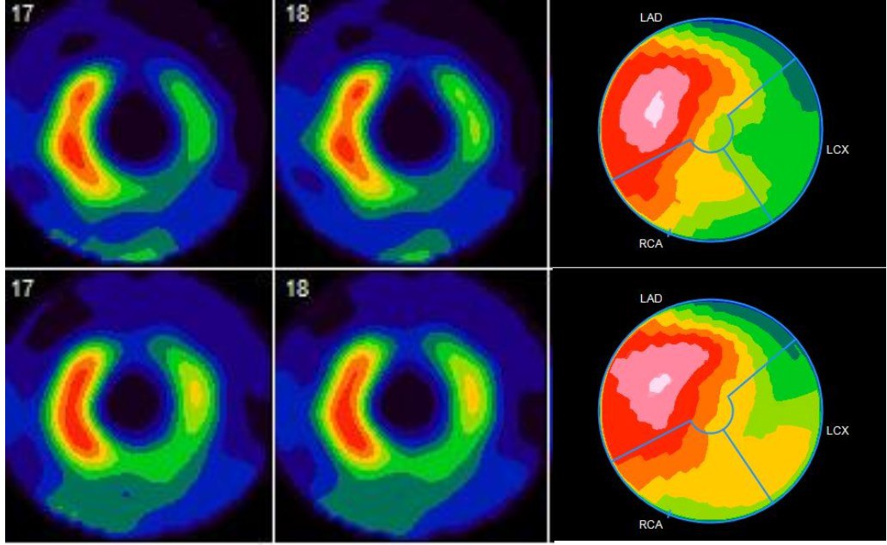
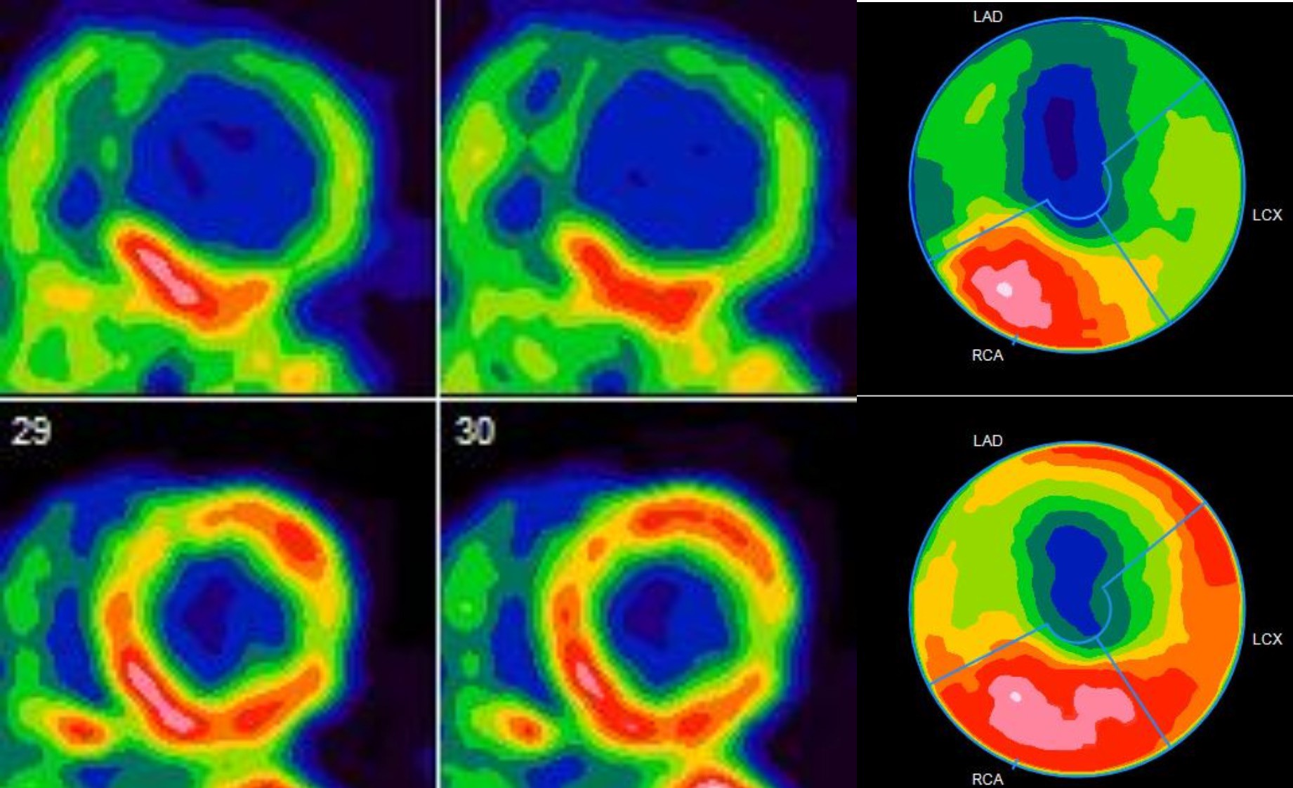
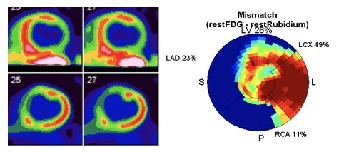
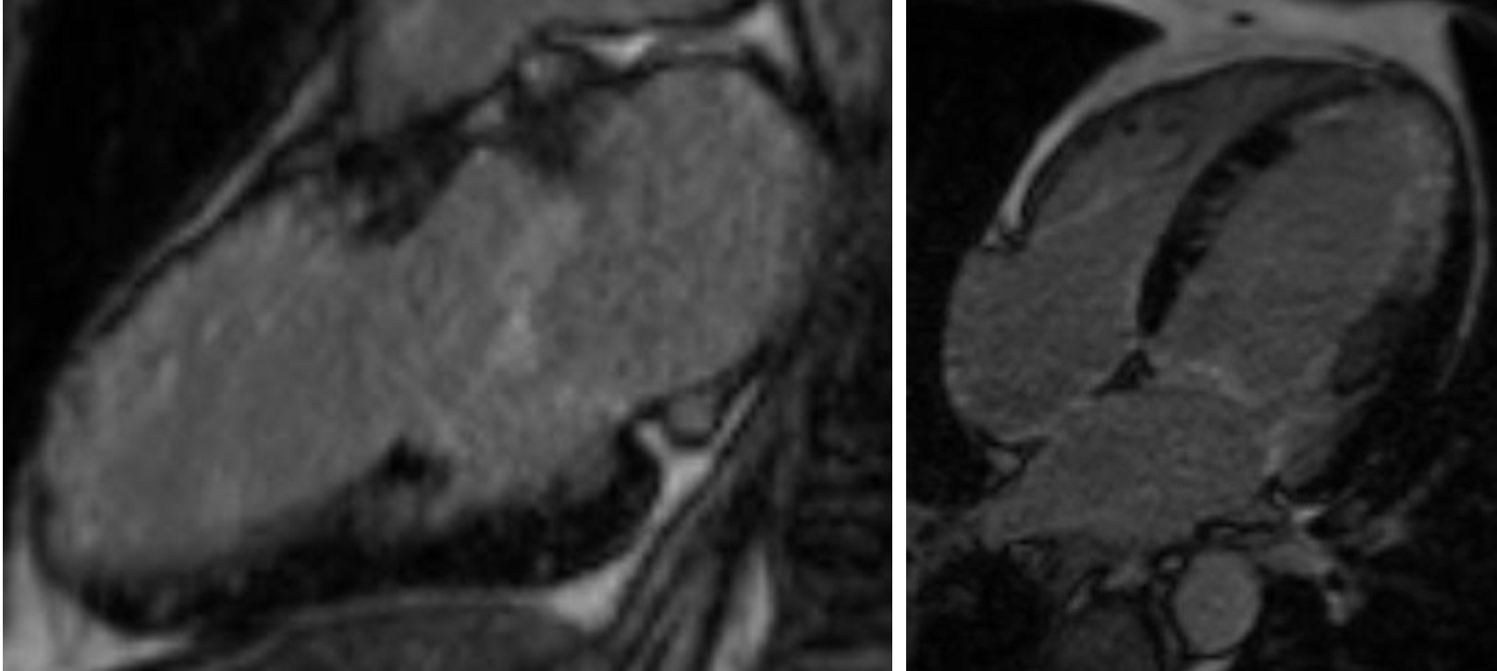
Case Examples
SPECT PERFUSION showing ischemia and scar
PET PERFUSION showing ischemia and scar
LV Ischemia 11%
LV Scar 26.4%
LV Ischemia 22%
LV Scar 31%
FDG PET Viability showing large region of hibernation
Cardiac MRI LGE showing large area of scar in the LAD
Mismatch Pattern in LCx Territory
LV Hibernating Myocardium 26%
LGE>50% Mid
and Apical Anterior & Apical
Lateral wall
LGE<50% Apical Septal segment

Slide 14
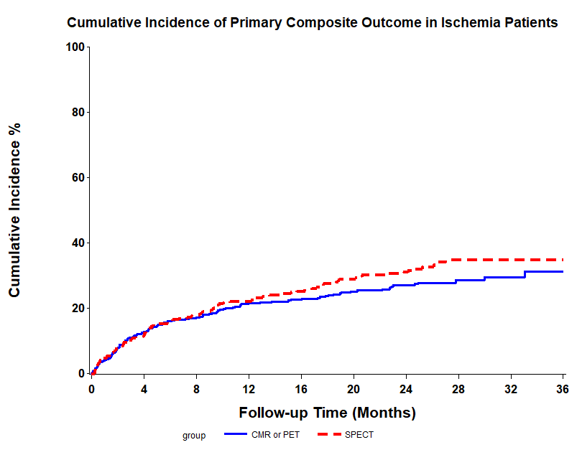
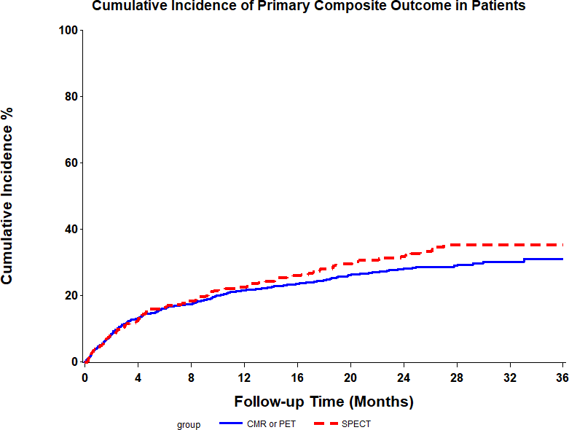
Primary Composite Outcome
TOTAL STUDY POPULATION
ISCHEMIA COHORT
HR 0.86, 95% CI 0.61-1.21, p=0.388
HR 0.95, 95% CI 0.71-1.25, p=0.696
Months | 0 | 4 | 8 | 12 | 16 | 20 | 24 | 28 | 32 | 36
CMR or PET | 1069 | 916 | 862 | 791 | 734 | 681 | 570 | 200 | 96 | 61
SPECT | 312 | 270 | 250 | 228 | 204 | 188 | 158 | 66 | 38 | 28
Months | 0 | 4 | 8 | 12 | 16 | 20 | 24 | 28 | 32 | 36
CMR or PET | 400 | 346 | 325 | 296 | 277 | 248 | 205 | 92 | 43 | 29
SPECT | 272 | 238 | 219 | 201 | 180 | 165 | 142 | 62 | 35 | 26

Slide 15
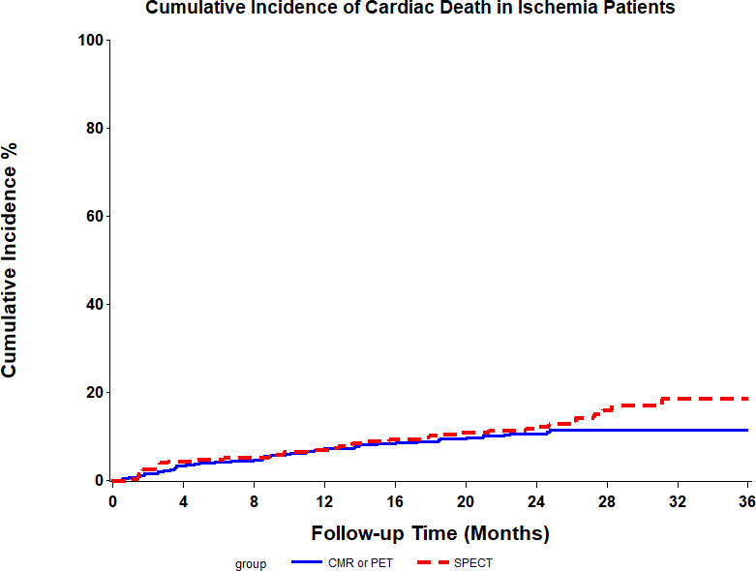
Ischemia Cohort: Cardiac Death
HR 0.61, 95% CI 0.38-1.00, p=0.049
Months | 0 | 4 | 8 | 12 | 16 | 20 | 24 | 28 | 32 | 36
CMR or PET | 400 | 381 | 373 | 349 | 326 | 299 | 246 | 112 | 52 | 34
SPECT | 272 | 256 | 252 | 239 | 219 | 208 | 184 | 82 | 43 | 30

Slide 16
Randomization Arm
3 Years |  | Advanced N=190 | SPECT N=81 | HR (95% CI) | P value
Primary outcome | N (%) | 53 (27.9%) | 24 (29.6%)
 | CIR (%) | 30.4% | 32.8% | 0.88 (0.55,1.43) | 0.615
Cardiac Death | N (%) | 26 (13.7%) | 16 (19.8%)
 | CIR (%) | 14.7% | 25.5% | 0.63 (0.34,1.18) | 0.152

Slide 17
Revascularization
40
Type of Revascularization
2%
37%
61%
35
30
35
P<0.0001
25
P<0.0001
30
CABG
PCI
Both
% revascularized
% Revascularized
25
20
20
15
15
10
10
5
5
0
Advanced
SPECT
0
Viability Ischemia
Advanced vs. SPECT Groups
Viability vs. Ischemia Cohorts

Slide 18
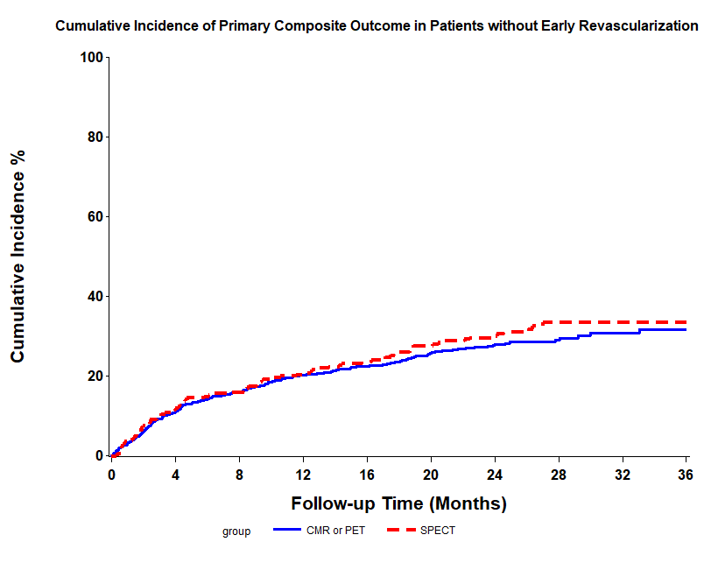
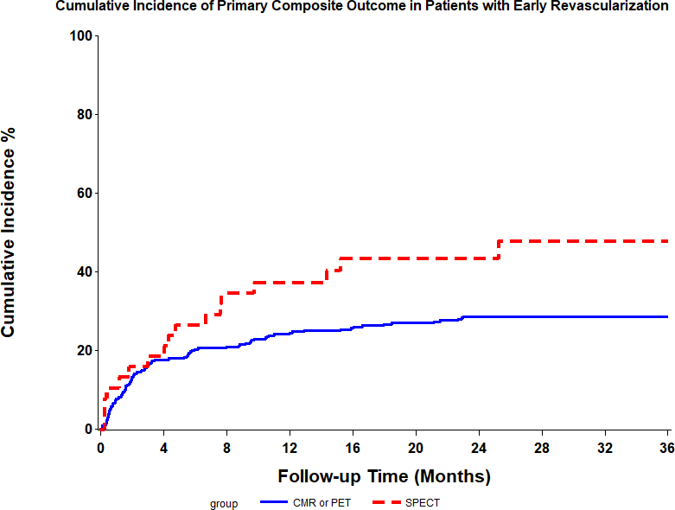
Effect of Early Revascularization on Incidence of Primary Outcome
TOTAL STUDY POPULATION
HR 0.71, 95% CI 0.37-1.38, p=0.317
HR 0.97, 95% CI 0.71-1.32, p=0.852
With Early Revascularization
Without Early Revascularization

Slide 19
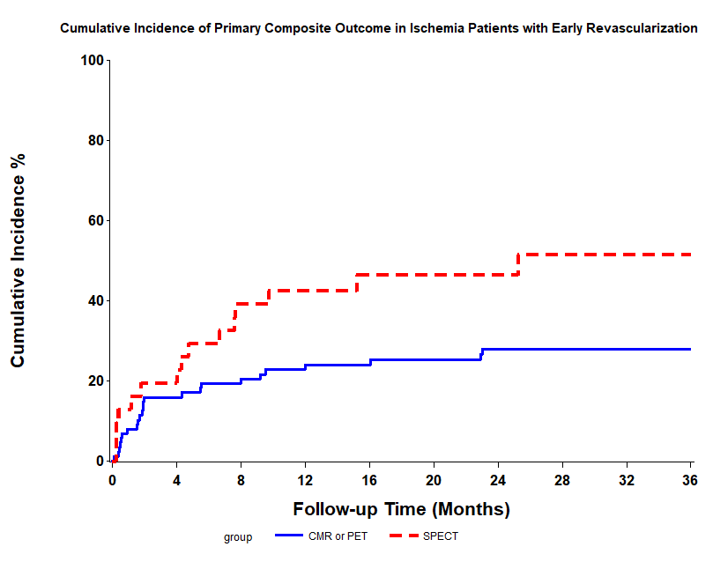
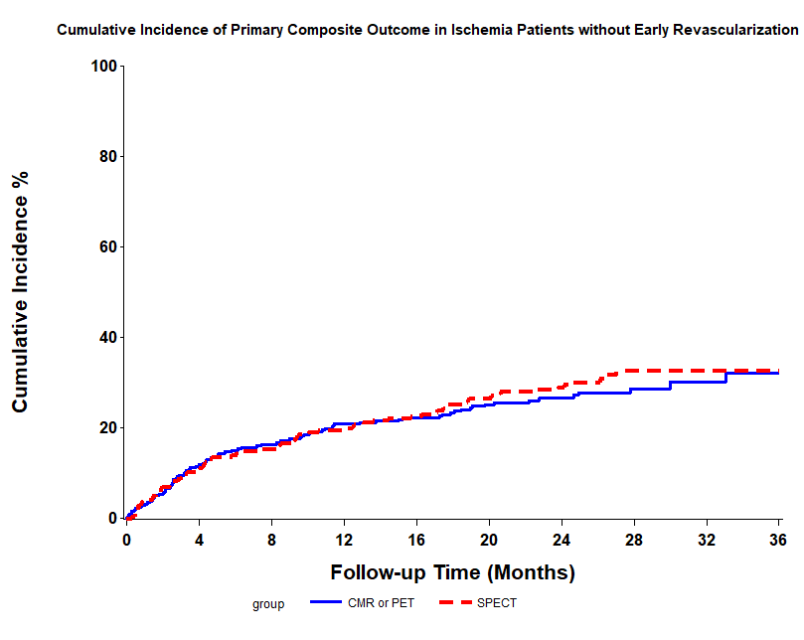
Effect of Early Revascularization on Incidence of Primary Outcome
ISCHEMIA COHORT
HR 0.52, 95% CI 0.23-1.15, p=0.107
HR 0.93, 95% CI 0.64-
1.36, p=0.722
With Early Revascularization
Without Early Revascularization

Slide 20
Conclusions
No significant differences in primary endpoint between ADVANCED vs. SPECT groups
Total study population
Randomized cohort
Revascularization occurred more frequently in patients with advanced imaging
Ischemia Cohort
Reduction in cardiac death in the ADVANCED imaging group
Patients with advanced imaging who underwent revascularization had trend for outcome benefit

Slide 21
Limitations
Total study enrollment short of anticipated sample size
– RCT arm underpowered
Propensity score can not account for uncontrolled confounders
Small fraction of SPECT imaging for viability limits Advanced vs SPECT viability comparisons
Medical therapy not representative of current practice

Slide 22
Implications
Event rates remain high for patients with ischemic HF
Choice of imaging test not associated with difference in overall outcomes
In a subgroup of patients being evaluated for ischemia, an advanced imaging strategy may be associated with a reduction in CV death

Slide 23
Acknowledgements
Participating Sites/Principal Investigators
University of Ottawa Heart Institute: L. Mielniczuk, R. Beanlands Montreal Heart Institute: E. O’Meara
Laval University: E. LaRose University of Calgary : J. White
Sunnybrook and Women’s Hospital: G. Wright Mazankowski Heart Institute: D.I. Paterson
St. Michael’s Hospital: K. Connelly Dalhousie University: M. Rajda Université de Sherbrook: S. Lepage University of Turku: J. Knuuti University Central Hospital: M. Laine University of Kuopio: J. Hartikainen
Brigham and Women’s Hospital: M. DiCarli Quanta Diagnostico e Terapia: J. Vitola
Diagnostico Maipú and Instituto Argentino de Diagnóstico y Tratamiento: R. Campisi
IMAGE-HF Project Management
L. Garrard
Cardiac Imaging Fellows
C. Wiefels, R. Kandolin, A. Tavoosi
Cardiovascular Research and Methods Centre University of Ottawa Heart Institute
G. Wells, L. Chen, M. Tran, A. Guo
Event Adjudication Committee
E.Stadnick (Committee Chair), R.Kandolin, D. Messika-Zeitoun,
F. Erthal, K.Boczar, S.Chih, C.McGuinty, M.Lamacie, N.Ghosh,
P.Joseph, L.Sanna Maria, C.Tinoco Mesquita, G.Small, J.Russo, L.Sun
Special thanks are extended to the clinical research staff and imaging technicians from all participating sites for their dedication and commitment to patient enrolment, follow up and imaging procedures.

