Slide 1

Clopidogrel versus Aspirin Monotherapy in Patients with High Ischemic Risk after PCI
: SMART-CHOICE 3 Trial
Joo-Yong Hahn, MD/PhD
Samsung Medical Center, Seoul, Korea On behalf of SMART-CHOICE 3 Investigators

Slide 2
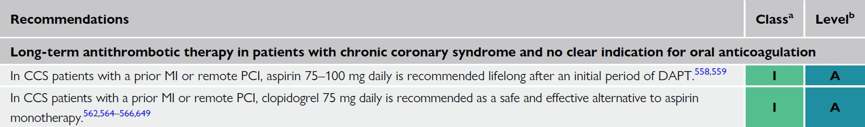
Background (I)
Standard practice has been to recommend indefinite aspirin monotherapy following dual antiplatelet therapy (DAPT) for the prevention of subsequent cardiovascular events among patients undergoing percutaneous coronary intervention (PCI ).
However, data supporting the use of aspirin as a single antiplatelet therapy after DAPT have been debated, and clopidogrel has been proposed as a possibly superior alternative to aspirin.
2024 ESC Guidelines for the management of chronic coronary syndromes

Slide 3
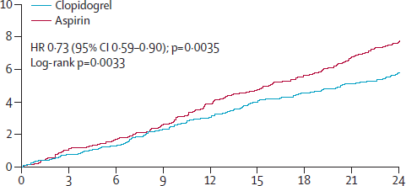
Background (II)
HOST-EXAM Trial
Lancet 2021; 397: 2487–96
Primary endpoint: all-cause mortality, MI, stroke, readmission due to ACS, major bleeding
A trial with an adequate sample size comparing clopidogrel with aspirin, focusing solely on a strict endpoint of hard events, is needed.
Moreover, targeting patients with a higher risk profile than those enrolled in the previous trial may provide more robust evidence for the superiority of clopidogrel over aspirin and help identify the patients who would benefit the most.

Slide 4
Study Objective
To ascertain the efficacy and safety of clopidogrel monotherapy compared with aspirin monotherapy beyond the standard duration of DAPT after PCI in patients at high risk of recurrent ischemic events
Working Hypothesis
Clopidogrel monotherapy would be superior to aspirin monotherapy as a long-term maintenance treatment after PCI in preventing recurrent ischemic events.

Slide 5
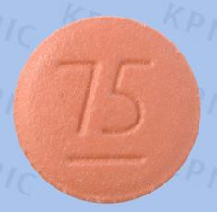
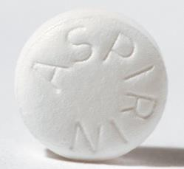
Study Design
SMART-CHOICE 3 (ClinicalTrials.gov, NCT04418479)
An investigator-initiated, randomized, open-label, multicenter trial at 26 sites in South Korea
5,000 Patients Being Treated with Standard Duration of DAPT at High Risk* of Recurrent Ischemic Events After PCI with DES
*Previous MI, medication-treated diabetes, complex PCI
Randomization (1:1)
Treatment Strategy of Antiplatelet Monotherapy
Stratified by clinical presentation at the index PCI and participating center
Clopidogrel Monotherapy
N = 2,500
Aspirin Monotherapy
N = 2,500

Slide 6
Enrollment Criteria
INCLUSION
KEY EXCLUSION
Patients were aged 19 years or older.
Patients who had undergone successful PCI with DESs
Patients who had received a standard duration of DAPT
  ≥12 months for MI and ≥6 months for any other indication
Patients who had no cardiovascular events after the index PCI
Patients who at least clinical characteristic (previous MI or
medication-treated diabetes) or one complex coronary artery lesion characteristic
  True bifurcation lesion (Medina 1,1,1/1,0,1/0,1,1) with side branch ≥2.5mm
  Chronic total occlusion (≥3 months) as target lesion
  Unprotected LM disease PCI (LM ostium, body, distal LM bifurcation including non-true bifurcation)
  Long coronary lesions (implanted stent ≥38 mm in length)
  Multi-vessel PCI (≥2 vessels treated at one PCI session)
  Multiple stents needed (≥3 more stent per patient)
  In-stent restenosis lesion as target lesion
  Severely calcified lesion (encircling calcium in angiography)
  Ostial coronary lesion (LAD, LCX, RCA)
Ongoing long-term treatment with oral anticoagulants;
Need of DAPT for any reason other than coronary artery disease;
Use of single antiplatelet therapy at screening
Contraindications to aspirin or clopidogrel
Pregnancy or breast feeding
Non-cardiac co-morbid conditions are present with life expectancy <2 year or that may result in protocol non- compliance (per site investigator’s medical judgment)

Slide 7

Study Organization
Principal Investigator | Joo-Yong Hahn
Steering Committee | Joo-Yong Hahn, Young Bin Song, Kyeong Ho Yun, Jang-Whan Bae, Cheol Whan Lee, Kiyuk Chang, Hyun-Jong Lee, Jin-Ok Jeong
Data Safety and Monitoring Board | Jun-Hee Lee, Sun Woo Kim, So Ree Kim
Clinical Event Adjudication Committee | Sang-Ho Jo, Woo Jin Jang, Hyun Sung Joh
Data Coordination and Management | Clinical Research Institute, Academic-Clinical Research Operation Team, Samsung Medical Center
Sponsor | Dong-A ST

Slide 8

Study Endpoints
Primary Endpoint
Major adverse cardiac and cerebrovascular events (MACCE)
  A composite of death from any cause, myocardial infarction, or stroke
Secondary Endpoints
Death from any cause
Myocardial infarction (4th Universal Definition)
Stroke
Definite or probable stent thrombosis (ARC criteria)
Death from cardiovascular cause
Death from cardiovascular cause, MI, or stroke
Bleeding (BARC type 2, 3, or 5)
Major bleeding (BARC type 3 or 5)
Upper gastrointestinal clinical event
Gastrointestinal ulcer or bleeding*
Net adverse clinical events (MACCE + major bleeding)
Any revascularization
*Composite of overt bleeding of gastroduodenal origin, overt upper gastrointestinal bleeding of unknown origin, occult gastrointestinal bleeding with a documented decrease in hemoglobin concentration of at least 2 g/dL, symptomatic gastroduodenal ulcer or at least five erosions, symptomatic gastro-esophageal reflux disease, upper gastrointestinal obstruction, or perforation

Slide 9
Sample Size Calculation and Statistical Analyses
Expected annual event rate of the primary end point
  4.0% in the aspirin group
  3.0% in the clopidogrel group (25% relative risk reduction)
Accrual time – 3 years
Additional follow-up time – 1 year after last patient enrollment
1:1 randomization
A total of 5,000 patients would provide a statistical power of 82% with significance level of 0.05 (2-
sided).
When the original target sample size of 5000 patients was reached ahead of the planned accrual period, we decided to continue enrolling patients until the end of the planned recruitment period (ie, a 3-year accrual period).

Slide 10

Study Flow
5542 Patients were assessed for eligibility
(From Aug 2020 to July 2023)
36 Were not enrolled
18 declined to consent
12 did not meet enrolment criteria 6 duplicates already enrolled
5506 Underwent randomization
2752 assigned to clopidogrel monotherapy
2722 assigned to aspirin monotherapy
30 did not complete 1 year of follow-up 18 withdrew consent
12 lost to follow-up
32 did not complete 1 year of follow-up 11 withdrew consent
21 lost to follow-up
2752 included intention-to-treat analysis
2626 included in per-protocol analysis
2754 included in intention-to-treat analysis
2594 included in per-protocol analysis

Slide 11
Protocol Deviations
 | Patients (%)
Clopidogrel Monotherapy | N=2752
No protocol violation | 2626 (95·4%)
Patient wanted | 7 (0·3%)
Judgement by the clinician | 32 (1·2%)
Prescription error | 0 (0%)
Received other devices (not drug-eluting stent) | 87 (3·1%)
Aspirin Monotherapy | N=2754
No protocol violation | 2594 (94·2%)
Patient wanted | 7 (0·3%)
Judgement by the clinician | 64 (2·3%)
Prescription error | 4 (0·1%)
Received other devices (not drug-eluting stent) | 85 (3·1%)

Slide 12
Baseline Patient Characteristics (I)
 | Clopidogrel group (n=2752) | Aspirin group (n=2754)
Age, years | 66·0 (58·0–73·0) | 65·0 (58·0–73·0)
Women | 512 (18·6%) | 490 (17·8%)
Enrolment criteria
Previous myocardial infarction | 1283 (46·6%) | 1269 (46·1%)
Medication-treated diabetes | 1039 (37·8%) | 1050 (38·1%)
Complex PCI | 2113 (76·8%) | 2072 (75·2%)
BMI, kg/m² | 24·9 (23·0–27·0) | 24·8 (23·1–26·9)
Hypertension | 1756 (63·8%) | 1690 (61·4%)
Dyslipidaemia | 1626 (59·1%) | 1604 (58·2%)
Current smoking | 448 (16·3%) | 488 (17·7%)
Chronic kidney disease | 242 (8·8%) | 260 (9·4%)
Previous stroke | 76 (2·8%) | 66 (2·4%)
Peripheral vascular disease | 23 (0·8%) | 22 (0·8%)
Previous history of major bleeding | 15 (0·5%) | 21 (0·8%)
Left ventricular ejection fraction, % | 60·0% (55·0–65·0) | 60·0% (55·0–65·0)

Slide 13
Baseline Patient Characteristics (II)
 | Clopidogrel group (n=2752) | Aspirin group (n=2754)
High bleeding risk defined by ARC | 427 (15·5%) | 448 (16·3%)
Time from PCI to randomisation, months | 17·3 (12·7–36·1) | 17·7 (12·6–36·2)
DAPT regimen before randomisation
Aspirin plus clopidogrel | 1702 (61·8%) | 1729 (62·8%)
Aspirin plus prasugrel | 304 (11·0%) | 341 (12·4%)
Aspirin plus ticagrelor | 746 (27·1%) | 684 (24·8%)
Medications at randomisation
Statin | 2708 (98·4%) | 2714 (98·5%)
Ezetimibe | 1717 (62·4%) | 1730 (62·8%)
β blocker | 1524 (55·4%) | 1565 (56·8%)
ACEI or ARB | 1755 (63·8%) | 1762 (64·0%)
Gastrointestinal protection medication | 792 (28·8%) | 844 (30·6%)
Proton-pump inhibitor | 545 (19·8%) | 589 (21·4%)
Potassium-competitive acid blocker | 100 (3·6%) | 115 (4·2%)
Histamine-2 receptor blocker or others | 153 (5·6%) | 150 (5·4%)

Slide 14
Primary Endpoint: MACCE
100
Clopidogrel Aspirin
90
10
80
HR 0.71 (95% CI 0.54–0.93); P=0.013
70
7.5
6.6%
Cumulative Incidence (%)
60
5
4.4%
50
40
2.5
Absolute risk reduction of 2.2 percentage points NNT to prevent one event 45 patients
30
20
0
0
1
2
3
10
Number at Risk
(number censored)
0 ₀
3
1
Follow-up (Years)
2
Aspirin | 2754 | 2642 | 1573 | 597
Clopidogrel | 2752 | 2662 | 1583 | 602

Slide 15

Myocardial Infarction
100
90
10
Clopidogrel Aspirin
80
7·5
HR 0.54 (95% CI 0.33–0.90)
Cumulative Incidence (%)
70
60
5
50
40
2·5
2.2%
1.0%
30
20
0
0
1
2
3
10
0
0
1
2
3
Number at Risk (number censored) |  |  | Follow-up (Years)
Aspirin | 2754 | 2656 |  | 1585 | 601
Clopidogrel | 2752 | 2668 |  | 1593 | 607

Slide 16

Bleeding
100
10
Clopidogrel Aspirin
90
80
7·5
HR 0.97 (95% CI 0.67–1.42)
70
Cumulative Incidence (%)
60
5
50
3.0%
3.0%
40
2·5
30
20
0
0
1
2
3
10
0
0
3
Number at Risk
(number censored)
1
2
Follow-up (Years)
Aspirin | 2754 | 2660 | 1580 | 597
Clopidogrel | 2752 | 2660 | 1577 | 599

Slide 17

Secondary End Points
 | Clopidogrel group (n=2752) | Aspirin group (n=2754) | Hazard ratio (95% CI)
Death from any cause | 50 (2·4% [1·6–3·1]) | 70 (4·0% [2·9–5·0]) | 0·71 (0·49–1·02)
Death from cardiovascular cause | 33 (1·4% [0·9–2·0]) | 42 (2·1% [1·4–2·8]) | 0·79 (0·50–1·24)
Death from non-cardiovascular cause | 17 (1·0% [0·4–1·5]) | 28 (1·9% [1·1–2·6]) | 0·60 (0·33–1·10)
Stroke | 23 (1·3% [0·7–2·0]) | 29 (1·3% [0·8–1·7]) | 0·79 (0·46–1·36)
Stent thrombosis | 1 (0% [0·0–0·0]) | 5 (0·2% [0·0–0·4]) | 0·20 (0·02–1·68)
Death from any cause or MI | 71 (3·2% [2·4–4·1]) | 109 (5·9% [4·7–7·1]) | 0·65 (0·48–0·87)
Death from cardiovascular cause or MI | 54 (2·3% [1·6–3·0]) | 81 (4·1% [3·1–5·1]) | 0·66 (0·47–0·94)
Death from cardiovascular cause, MI, or stroke | 76 (3·6% [2·7–4·5]) | 103 (4·9% [3·9–6·0]) | 0·73 (0·54–0·98)
Major bleeding (BARC type 3 or 5) | 26 (1·6% [0·9–2·3]) | 26 (1·3% [0·8–1·8]) | 1·00 (0·58–1·73)
Upper gastrointestinal clinical event | 58 (2·8% [2·0–3·6]) | 90 (4·9% [3·7–6·0]) | 0·65 (0·47–0·90)
Gastrointestinal ulcer or bleeding | 24 (1·3% [0·7–1·8]) | 32 (1·6% [1·0–2·1]) | 0·76 (0·45–1·29)
Gastrointestinal ulcer | 8 (0·6% [0·0–1·1]) | 15 (0·7% [0·0–1·1]) | 0·54 (0·23–1·28)
Gastrointestinal bleeding | 21 (1·1% [0·6–1·6]) | 25 (1·4% [0·8–2·0]) | 0·85 (0·48–1·52)
Net adverse clinical event | 111 (5·4% [4·2–6·5]) | 142 (7·3% [6·0–8·6]) | 0·78 (0·61–0·99)
Median follow-up period: 2.3 years (IQR 1·6–3·0)

Slide 18

Sensitivity Analysis (Per Protocol Population)
100
Clopidogrel Aspirin
10
90
80
7.5
HR 0.70 (95% CI 0.54–0.92)
70
6.8%
Cumulative Incidence (%)
60
5
4.5%
50
40
2.5
30
20
0
0
1
2
3
10
0
0
1
2
3
No.at Risk
Follow-up (Years)
Aspirin Clopidogrel
2594
2626
2487
2540
1483
1500
569
568

Slide 19
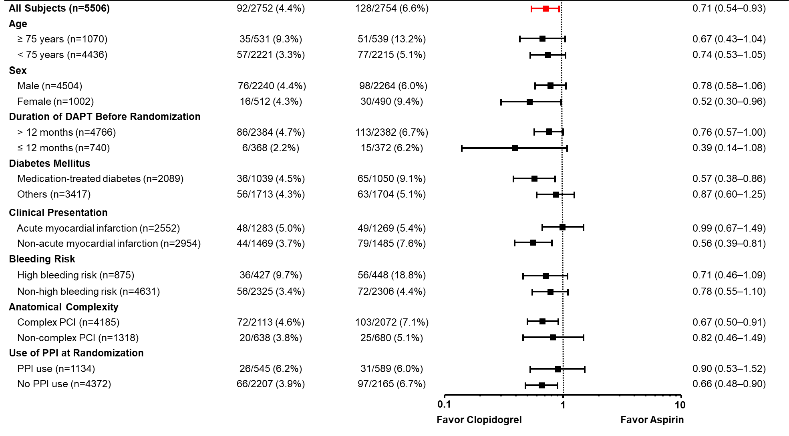
Prespecified Subgroup Analysis

Slide 20

Limitations
The trial had an open-label design, and the allocated group were not masked by the physician. However, we minimized the risk of bias by using an end-point analysis with precisely defined criteria, and by having clinical events adjudicated by a committee.
The actual event rate was lower than expected, resulting in substantially fewer number of expected
events, even though the final sample size was increased by 10% from the original sample size.
This study exclusively enrolled Korean patients; therefore, the results should be applied with caution to other populations. However, given the high prevalence of intermediate or poor clopidogrel metabolism in the Korean population, clopidogrel might in fact be more effective in populations where reduced-function CYP2C19 alleles are less common.

Slide 21

Conclusion
Among patients who were at high risk of recurrent ischemic events and completed the standard duration of DAPT following PCI, clopidogrel monotherapy resulted in a lower risk of a composite of death from any cause, myocardial infarction, or stroke than aspirin monotherapy, without increase in bleeding.
The SMART-CHOICE 3 trial was the first to demonstrate the benefits of clopidogrel monotherapy compared with aspirin monotherapy on a composite of hard endpoints in patients at a high risk of recurrent ischemic events after PCI.

Slide 22

Thank You Very Much!
I would like to thank patients enrolled, research nurses, study coordinators, and participating investigators.
SMART-CHOICE 3 Investigators
Name | Center | No. of patients enrolled
Joo-Yong Hahn | Samsung Medical Center | 1573
Ki Hong Choi
Hyeon-Cheol Gwon
Seung-Hyuk Choi
Young Bin Song
Jeong Hoon Yang
Taek Kyu Park
Joo Myung Lee
Yong Hwan Park | Samsung Changwon Hospital | 608
Jong-Young Lee | Kangbuk Samsung Hospital | 544
Jin-Ok Jeong | Chungnam National University Hospital | 258
Chan Joon Kim | Catholic University of Korea Uijeongbu St. Mary's Hospital | 237
Kyeong Ho Yun | Wonkwang University Hospital | 234
Han Cheol Lee | Pusan National University Hospital | 234
Kiyuk Chang | Catholic University of Koea Seoul St. Mary's Hospital | 198
Mahn-Won Park | Catholic University of Korea Daejeon St. Mary's Hospital | 150
Name | Center | No. of patients enrolled
Jang-Whan Bae | Chungbuk National University Hospital | 139
Joon-Hyung Doh | Inje University Ilsan Paik Hospital | 135
Byung Ryul Cho | Kangwon National University Hospital | 131
Hee-Yeol Kim | Catholic University of Korea Bucheon St. Mary's Hospital | 119
Weon Kim | Kyung Hee University Hospital | 118
Ung Kim | Yeungnam University Medical Center | 106
Seung-Woon Rha | Korea University Guro Hospital | 100
Young Joon Hong | Chonnam National University Hospital | 98
Hyun-Jong Lee | Bucheon Sejong Hospital | 90
Sung Gyun Ahn | Wonju Severance Christian Hospital | 82
Doo Il Kim | Inje University Haeundae Paik Hospital | 81
Jang Hyun Cho | St Carollo Hospital | 76
Sung Ho Her | Catholic University of Korea St. Vincent’s Hospital | 65
Doo Soo Jeon | Catholic University of Korea Incheon St. Mary's Hospital | 51
Seung Hwan Han | Gachon University Gil Medical Center | 37
Jin-Bae Lee | Daegu Catholic University Medical Center | 22
Cheol Whan Lee | Asan Medical Center | 20

